Slide 1
Kentucky Community and Technical College System
Budget Review Subcommittee on Postsecondary Education
February 20, 2025

Slide 2
The KCTCS IMPACT
KCTCS is made up of 16 colleges and 70+ campuses across the Commonwealth.
KCTCS is the largest provider of postsecondary education in the state, with an annual enrollment of over 107,000 students and 45% of the state’s public higher education undergraduate students.
Since its creation, KCTCS has bettered the lives of over 1.2 million Kentuckians, awarded over 650,000 credentials, and graduated over 250,000 students.
KCTCS educates 68% of Kentucky high school students who enroll in dual credit.
KCTCS is #8 in the nation in credentials awarded by public, two-year institutions and #1 in the nation in credentials awarded per capita by public, two-year institutions.
60% of graduates from low-income households at Kentucky’s public institutions receive their credentials from KCTCS.
KCTCS facilitated the award of 4,460 GEDs to incarcerated individuals from 2020 to 2024.
KCTCS is the #1provider of workforce training in Kentucky.

Slide 3
HB6 – Efficient operations and innovation plan
KCTCS was tasked with developing priorities and an implementation plan in response to SJR179 in order to unlock funds for capital construction set aside in HB6.
Throughout 2024, 5 internal work teams committed more than 7,000 hours to the requested internal review.
In December 2024, KCTCS presented recommendations to address each of the 11 questions raised by SJR 179 to the Interim Joint Education Committee, meeting the directive of the legislature and requirements to release contingent funds in HB6 for capital construction.

Slide 4
Capital investment
Somerset Community College – $27 million
Consolidate Laurel North and South campuses by building a replacement advanced technical building at the Laurel North Campus.
Jefferson Community and Technical College – $35.7 million
Phase II replacement of Hartford Hall at the downtown JCTC campus, which is no longer compliant with building codes and cannot offer modern science instruction.
Southcentral Kentucky Community and Technical College – $27.3 million
Phase I construction of a new consolidated campus in Glasgow replacing a severely outdated health campus in response to the high demand allied health career field across Kentucky and demographic changes to the region resulting from new electric vehicle battery plants in Glendale and Bowling Green.

Slide 5
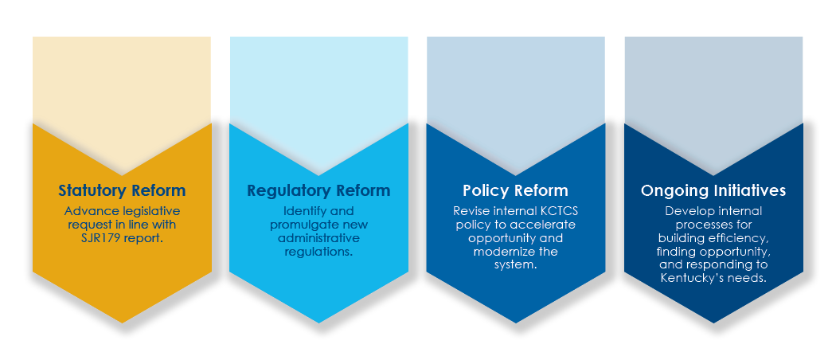
Next Steps
KCTCS is reviewing, integrating and developing action steps based on the multiple recommendations from SJR 179, the Huron Report, and various audits as part of our long-term strategic planning process. Our goal is to elevate and accelerate our role as Kentucky’s entry point for higher education and the Commonwealth’s essential industry and workforce partner.

