Slide 1
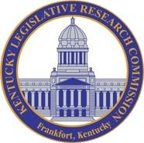
Presented by: H.H. Barlow, Executive Director
Joint Legislative Committee on Agriculture
September 9, 2019
Kentucky’s Dairy Industry
State of the Industry 2019

Slide 2
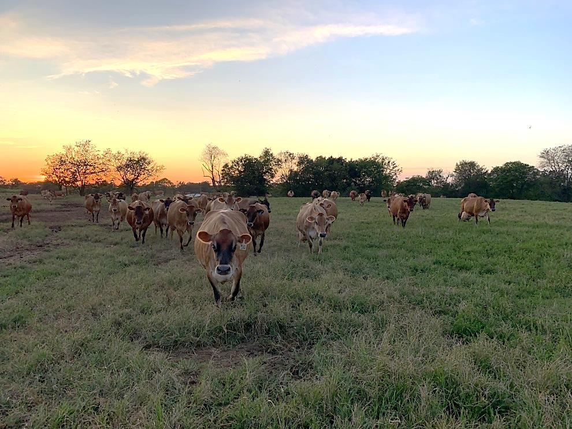
Our agenda today
Brief Background
National Snapshot
Today’s Kentucky Dairy Industry
Challenges
Opportunities
Strategy
KDDC’s role

Slide 3
A little about my background...
Biography
Father started dairy in 1929 – 90 years ago
Born 1950 and raised on home dairy
Very active in 4-H as youngster
Graduated UK College of Ag 1972
Married, four children, farmed full time 11 yrs
1984 - Entered feed industry - 30+ years as commissioned sales representative
Continuously operated and maintained the family dairy operation.
2004 1st dairyman appointed to KY Ag Development Board
2007 appointed to federal Board for International Food and Agricutural Development
KDDC formed and funded during my service on KADB.
2019 - still operating our dairy, presently 250 cows and heifers on the farm, and in May, accepted the position of KDDC Executive Director.
“A lifetime in the industry has strengthened my passion for dairying. I love the dairy cow. In many ways, I owe my life to the dairy cow. “
Previous Board Experience
Lone Star Milk Producers
Southeast United Dairy Industry Association
Federal Land Bank Association
Dairymen, Inc. - Nashville Division

Slide 4
Kentucky’s Dairy Industry State of the Industry 2019
Now … let’s dive in

Slide 5
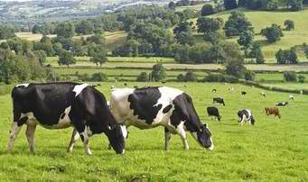
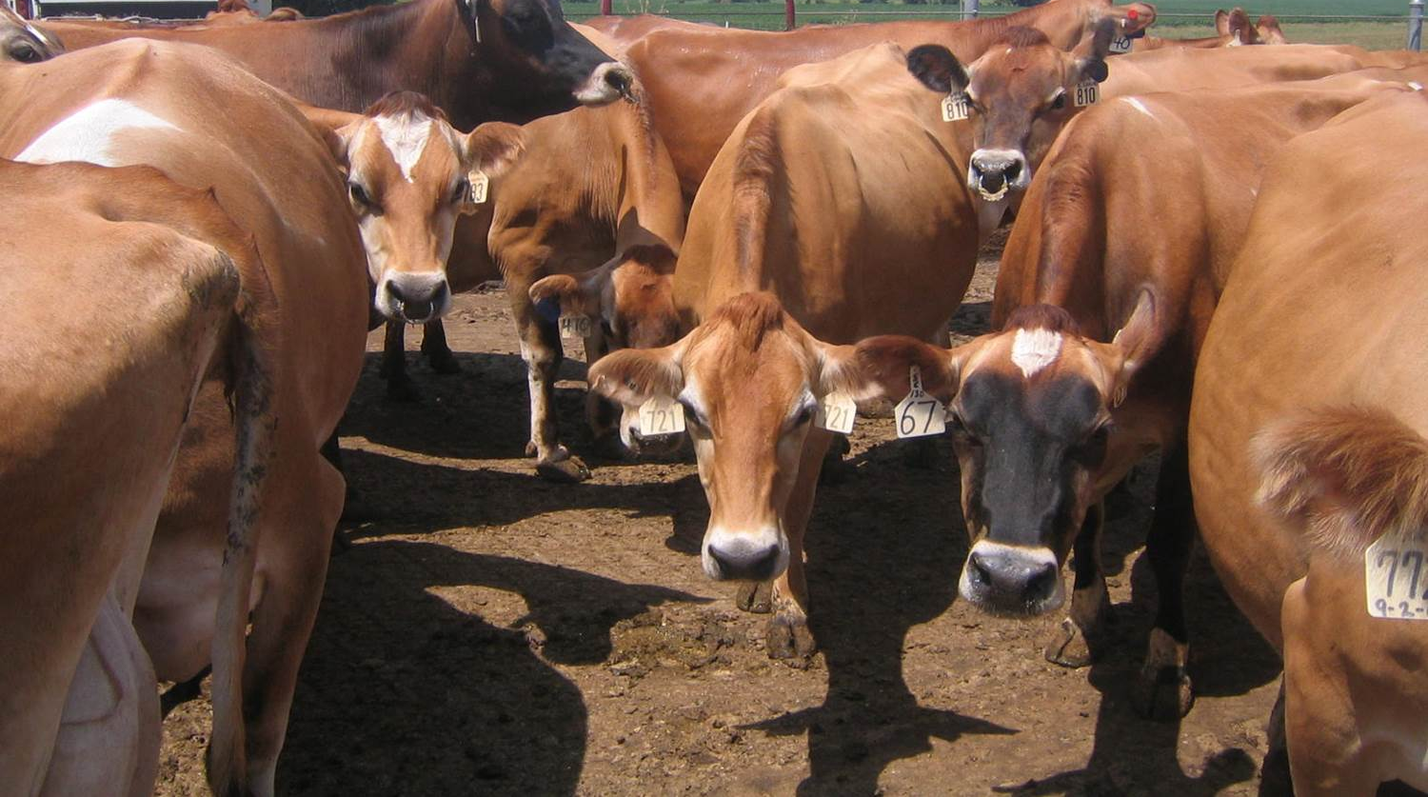
A National Snapshot: Then and Now
1997
2017
168 Billion Pounds
23%
218 Billion Pounds
Testament to improved production and efficiency, but…
110,000 Dairy Farmers
64%
40,000 Dairy Farmers

Slide 6
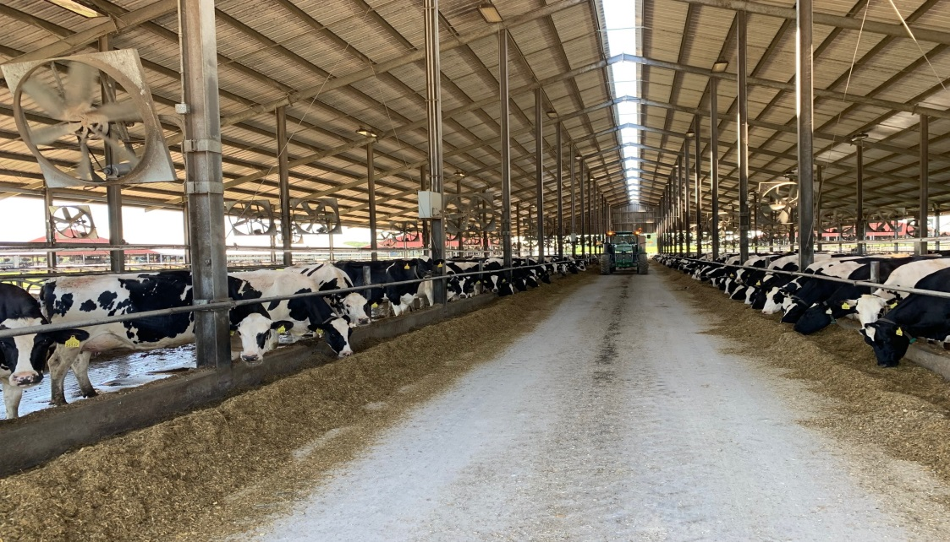
The Commonwealth: A Similar Story
2005
2018
43%
12,427 avg lbs. per cow
17,710 avg lbs. per cow
Even bigger increase than the national in improved production and efficiency, but…
1500 Dairy Farmers
66%
500 Dairy Farmers

Slide 7
Improved Efficiency & Production
What was the impact?
Excess of Milk Supply
19 KY Dairy Farms Forced to Shut Down
The consolidation and liquidation of our nation’s dairy farms is truly a tragic and difficult reality.
Skyrocketing supply due to increased milk production per cow across the state and nation.
Long Lasting Depressed Price
Starting in 2014 through 2018.
Closing of the Dean’s Milk Plant
2018 closing of the Dean’s Milk Plant in Louisville KY. WalMart’s 1st processing plant started production in northern Indiana.
66

Slide 8
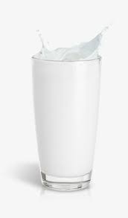
Additional Noteworthy Facts
Milk is a perishable product.
Supply is not easily manipulated because you cannot stop a cow from producing. This creates an inelastic supply demand relationship.
Thus, any fluctuation in supply or demand can cause significant implications including sale of product and price of milk.
Historically, KY milk has mostly been sold into fluid consumption.
Nationally, consumption of milk products has continued to grow, but the product mix has changed.
Fluid milk is only 40% of consumption now. Cheese is actually the star today.
Therefore, change of the product mix has created smaller demand for fluid consumption.
26

Slide 9
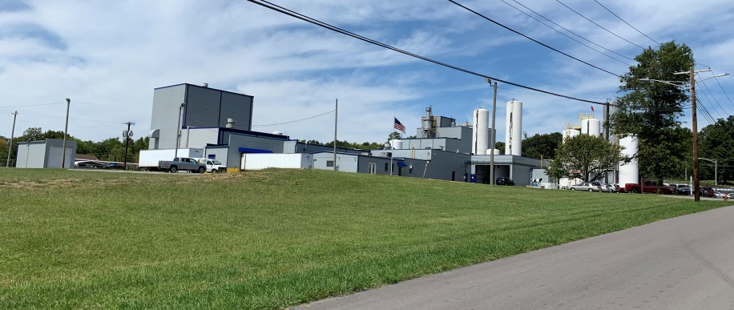
Ky’s Dairy Processing and Co-op Industry
It’s a synergistic relationship:
PROCESSORS NEED MILK DAIRY FARMERS NEED MARKET
TODAY’S KENTUCKY PROCESSORS:
3 Fluid Processors
Winchester Farms, Winchester
Borden Dairy, London
Prairie Farms, Somerset
4 Product Processors
Bluegrass Dairy & Food, Glasgow and Springfield
Bel Kaukauna (Bel Cheese), Leitchfield
Saputo Dairy, Murray
Dippin Dots, Paducah
4 Cooperatives - DFA, Prairie Farms, Select Milk, and Maryland-Virginia

Slide 10
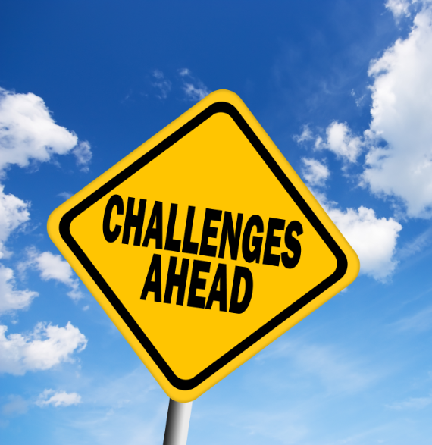
Challenges for Kentucky’s Dairy Industry
These are the obstacles we have faced; some we still face today.
Liquidation of Dairies
Diminishing Profitability
Loss of Infrastructure
Lack of Markets
Loss of Fluid Milk Consumption
Loss of Dairy Farm Equity
6

Slide 11
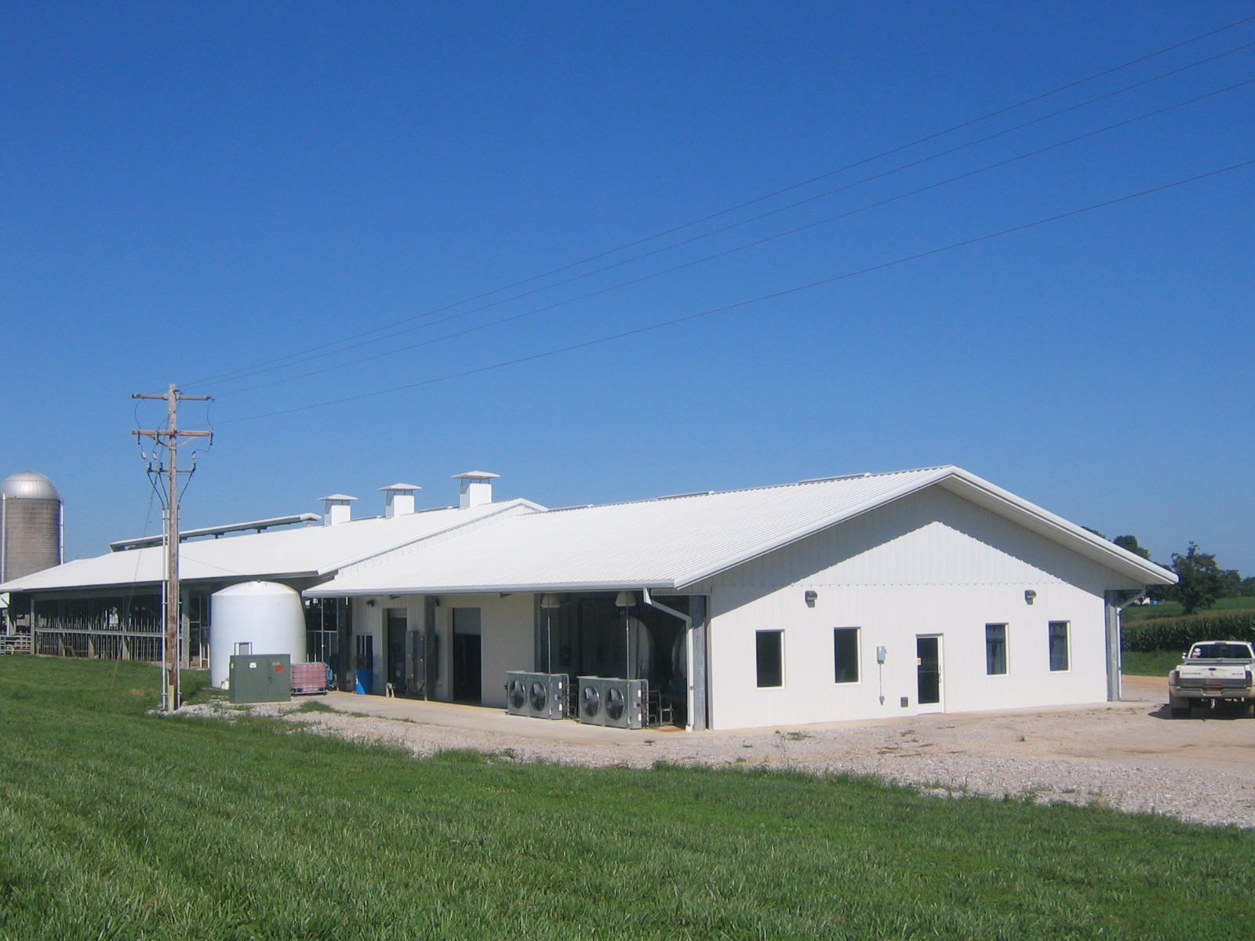
Opportunities Before Us
Market conditions have changed:
Growth of milk supply has slowed to a trickle.
New plant built in Michigan will result in less milk transported to KY dairy processors.
With these market changes comes opportunity:
Replace out of state milk with local milk
New product development – cheese powders, specialty products, protein drinks, or… Can we find a way to marry milk and bourbon?
Value added on-farm milk processing – Chaney’s Dairy, Kenny’s Cheese
Work with co-ops to place more value on KY milk
Product Name
Specification

Slide 12
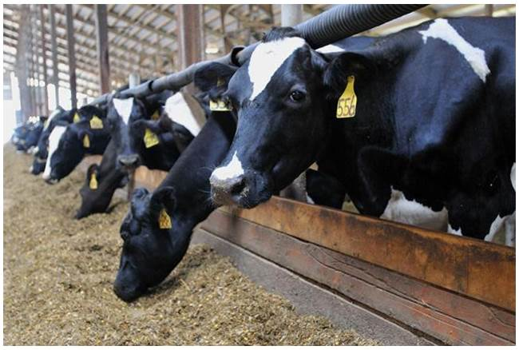
Dairy has Great Potential!!
Abundant natural resources
Ideal environmental conditions for dairy animals
Strong market potential - presently producing only 1/2 of KY capacity
Strong economic engine for rural KY communities (dairy vs. factory)

Slide 13
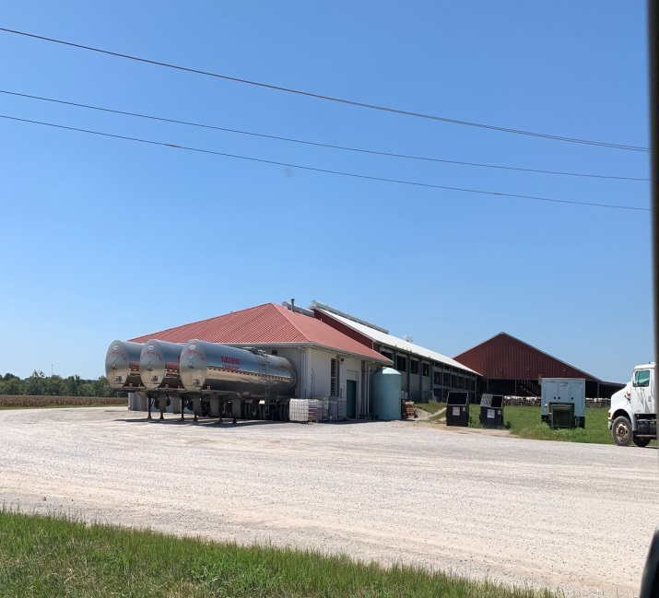
The Economic Engine
Wisconsin study determined each cow contributes over $14K to local economy!
Retail Sales
Feed Sales
Community Taxes
A.I. Sales
Community Services
Community Impact
From a Dairy
Custom Harvesting
Concrete Supplier
Milk Truck Driver
Milk Inspector
Equipment Service
Veterinarian
Feed Equipment
Fertilizer Sales
Vehicle Sales
Fuel Sales
Service Industry
Equipment Sales
Health Services
Equipment Parts

Slide 14
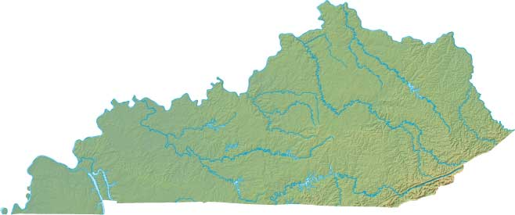
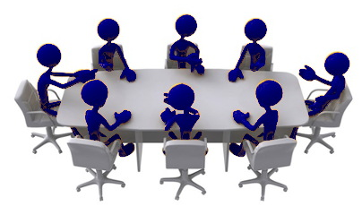
KDDC – Ky’s Strongest Tool for Reaching Potential
Kentucky Dairy Development Council
Founded 2005
Appointed to Agricultural Development Board
Goal - Utilize KADF funds for dairy growth
Initiated dairy summit and forums
Developed concept of statewide dairy organization
Every dairy farmer in the state is an automatic member
20 directors form governing board
12 districts across the state with dairy farmer representative
8 allied industry representatives, i.e. feed, dairy supply, veterinary, etc.
Only organization in state focused solely on the diary industry
Variety of programs strategically built around a singular vision

Slide 15
Mission & Vision
Kentucky Dairy Development Council
Mission
To educate, promote and represent dairy farmers and foster an environment of growth for the KY dairy industry.
Vision
The accomplishment of our mission will solidify and maintain the position of the dairy industry in Kentucky as a leading agricultural economic engine for our rural Kentucky communities.

Slide 16
KDDC Programs
Strategically designed to align with our mission and vision
MILK Program
Milk Counts
Dairy Margin Coverage Insurance Incentive Program Cost Share
University of Kentucky Collaborative
Young Dairy Producer Initiative
Ag Water Quality Plans
Consultant Visit Program

Slide 17
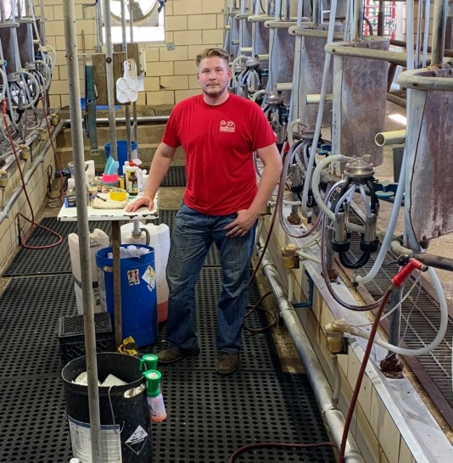
Young Dairy Farmer Initiative
The FUTURE of our industry!
Annual Young Dairymen Conference
World Dairy Expo Tour Sponsor
150-200 attendees, networking with peers, plus session topics ranging from production issues to financial planning for sustainability and success
Annually held in Madison, WI; KDDC helps sponsor 40-50 young dairymen.
Spring and Summer Dairy Events
Young Dairymen Peer Groups
Include but not limited to workshops in dairy production, dairy farm tours, and financial education.
Planned for 2020

Slide 18
UK Collaborative
Partnering with Kentucky’s premier land grant institution to build a sustainable future!
Quality
Production
Stewardship
Support
Milk quality and management programs
Animal Care offerings and Barn meetings, including COW SIGNALS
Conservation and water quality meetings and programs
Annual dairy conference for producers and young dairyman

Slide 19
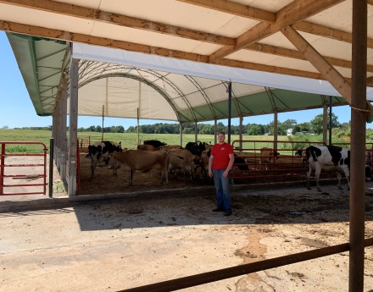
Our 4 Dairy Consultants
Greatest strength in KDDC
4 full time consultants
3 of the 4 consultants have owned and operated dairy farms, and the 4th worked in dairy processing for more than 30 years.
Daily work personally one on one on the farms with our dairy farmers
Assisted in obtaining over $1 million in energy grants from Ag Development Fund
Complete and administer water quality plans, nutrient management plans, and no discharge permits
Facilitate hands-on farm training of dairyman by taking them to other farms to see evidence- based standard practices
Dave Roberts
Jennifer Hickerson
Beth Cox
Meredith Scales

Slide 20
MILK Program
Milk Incentive Leadership Kentucky
1
Over 8 million dollars paid directly to producers through the MILK program
2
Must see production increase, quality improve, & participation in official record keeping to track performance
350 million additional pounds from starting point in first three years
Additional $67 million dollars in farm gate receipts along with the $8 million in premiums
3
Cost Share - ½ ag development funds; ½ processing industry;
Now KY ranks in 30’s in production per cow – formerly at bottom
Highest increase in production per cow in 2017 of all states
4

Slide 21
All KDDC programs lead back to our Mission
Kentucky Dairy Development Council
Mission
To educate, promote and represent dairy farmers and foster an environment of growth for the KY dairy industry.
And success of our mission leads to…
Success
Success for the dairy industry in Kentucky, success for the vitality of our rural Kentucky economies, and success for our dairy farmers across this great Commonwealth.

Slide 22
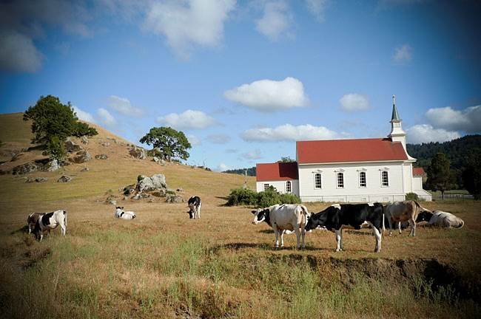
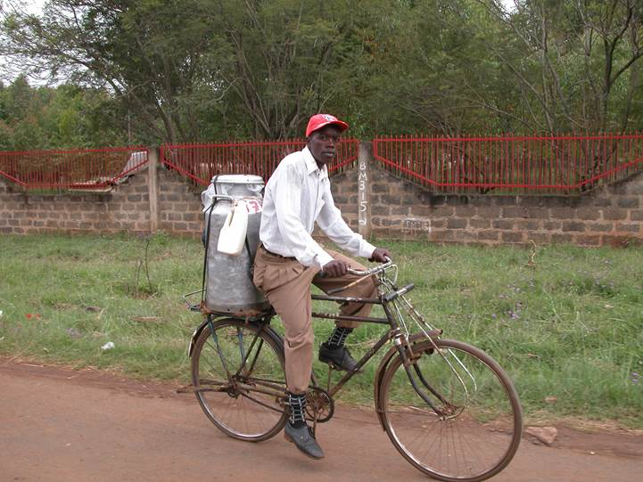
Final Thoughts...
Much work ahead
Blessed to be a dairy farmer
Our responsibility is to be a good steward of those blessings
Maintain a positive outlook
Let’s do this!

Slide 23
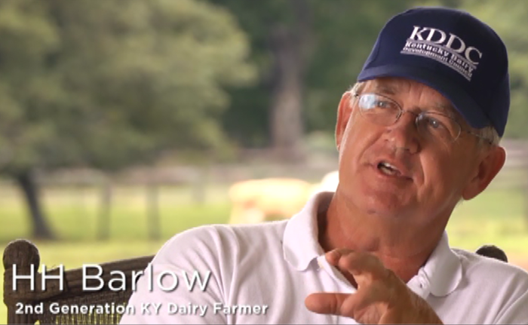
QUESTIONS
Get in Touch
176 Pasadena Drive
Lexington, KY 40503
859.516.1129
270.404.8003
kddc@kydairy.org
Thank you for supporting Kentucky’s dairy industry!

