Slide 1
Interim Joint Committee on Agriculture
Dr. Ryan F. Quarles, Agriculture Commissioner
October 7, 2019

Slide 2
Topics
Drought / Weather
Hemp
Food Safety Modernization Act (FSMA)
2020 Budget

Slide 3
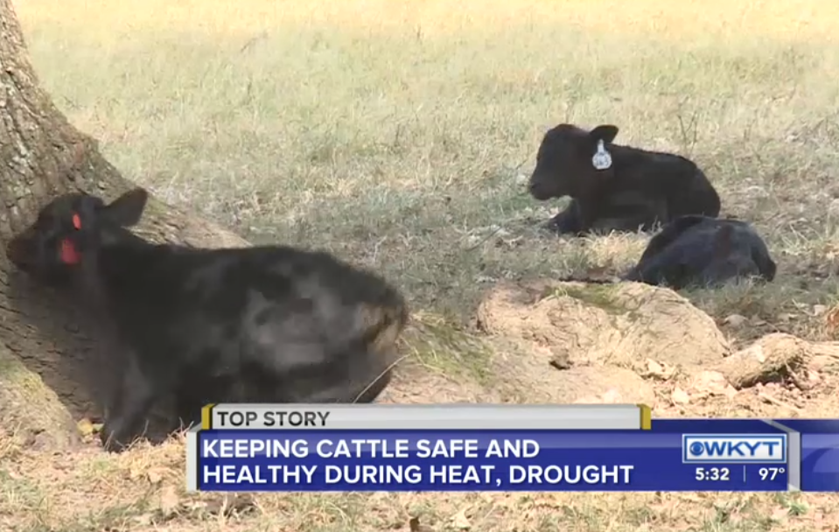
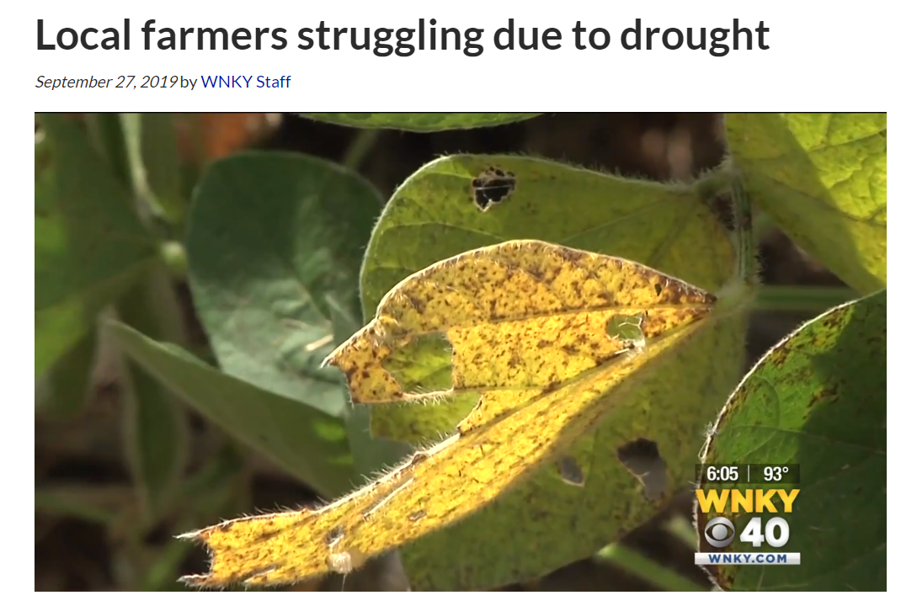
Drought

Slide 4
Hemp

Slide 5
Hemp By the Numbers
978 growers
202 processors
6 universities
Record production year – 26,000 acres planted

Slide 6
Hemp
Applications for 2020 growing open Nov. 15
Online mapping feature
Continue to educate about this new industry and the risk
Whole Farm Crop Insurance
Uncertainty (FDA, CBD, Lending)
Potential legislation – pending USDA guidelines

Slide 7
Food Safety Modernization Act (FSMA)
Passed by Congress in 2011
KDA + Food Safety Branch + UK
Reasoning: Let’s keep FDA off the farm
Produce Safety Rule
Voluntary On Farm Readiness Reviews
Education Effort

Slide 8
Budget
Doing more with less
Quarles Admin has implemented 6 budget cuts
Historically low staff – 196 employees
Retention is hard

Slide 9
Questions?

