Slide 1
Kentucky Cattlemen’s Association
legislative issues for the 2020 Regular Session

Slide 2
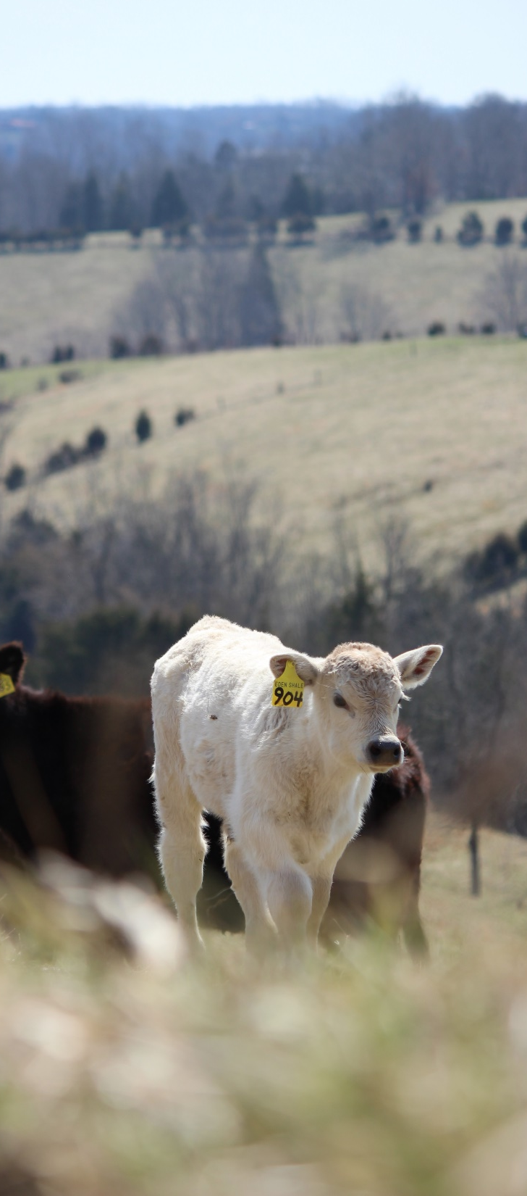
Kentucky Cattlemen’s Association
Long Range Strategic Plan
2020-2025
Cultivate value-added marketing opportunities
Strengthen research, demonstration and outreach
Improve KCA engagement, collaboration and advocacy
Develop and leverage organizational infrastructure and capabilities

Slide 3
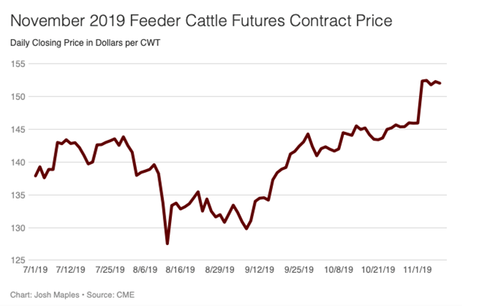
Cattle Market
Cattle Prices
Cattle Numbers

Slide 4
Cattle Market

Slide 5
Kentucky is a
strong
cattle state

Slide 6
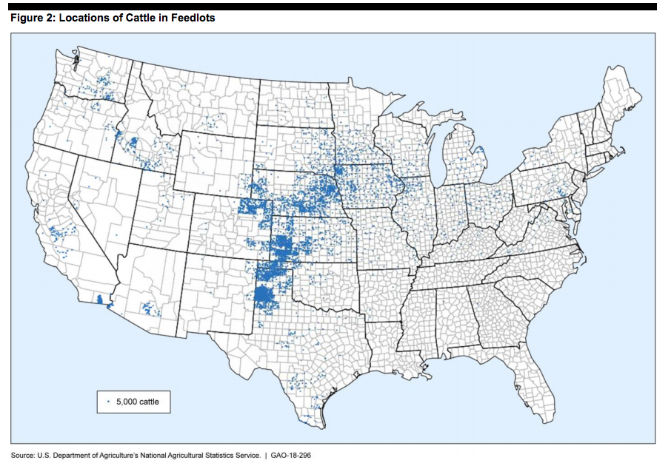
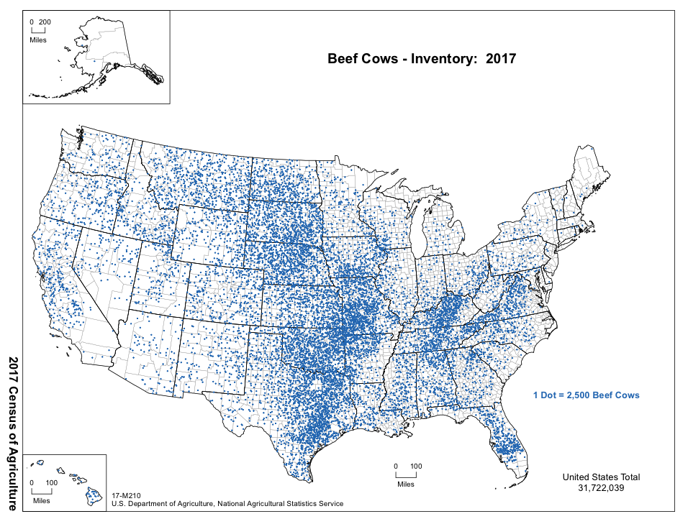
Beef Cow Inventory/Cattle in Feedlots
THE PROBLEM
Shortage of Truck Drivers
ELD or DOT Restrictions on Driving Time
Antibiotic Use Regulations
Consumers Demand Traceability
Food Miles
$
Lexington, KY Ulysses, KS
(Red River Feeding Company):
Approx. 1000 miles
15 hours

Slide 7
Top Beef Packing Plants in the U.S.
JBS
National Beef
Tyson

Slide 8
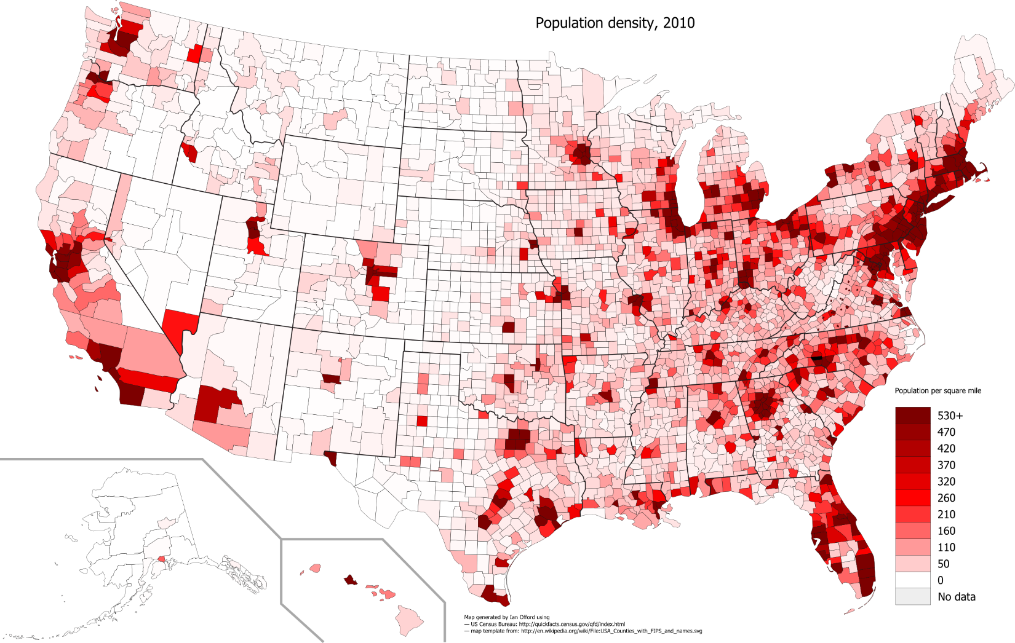
2010 U.S. Population Density

Slide 9
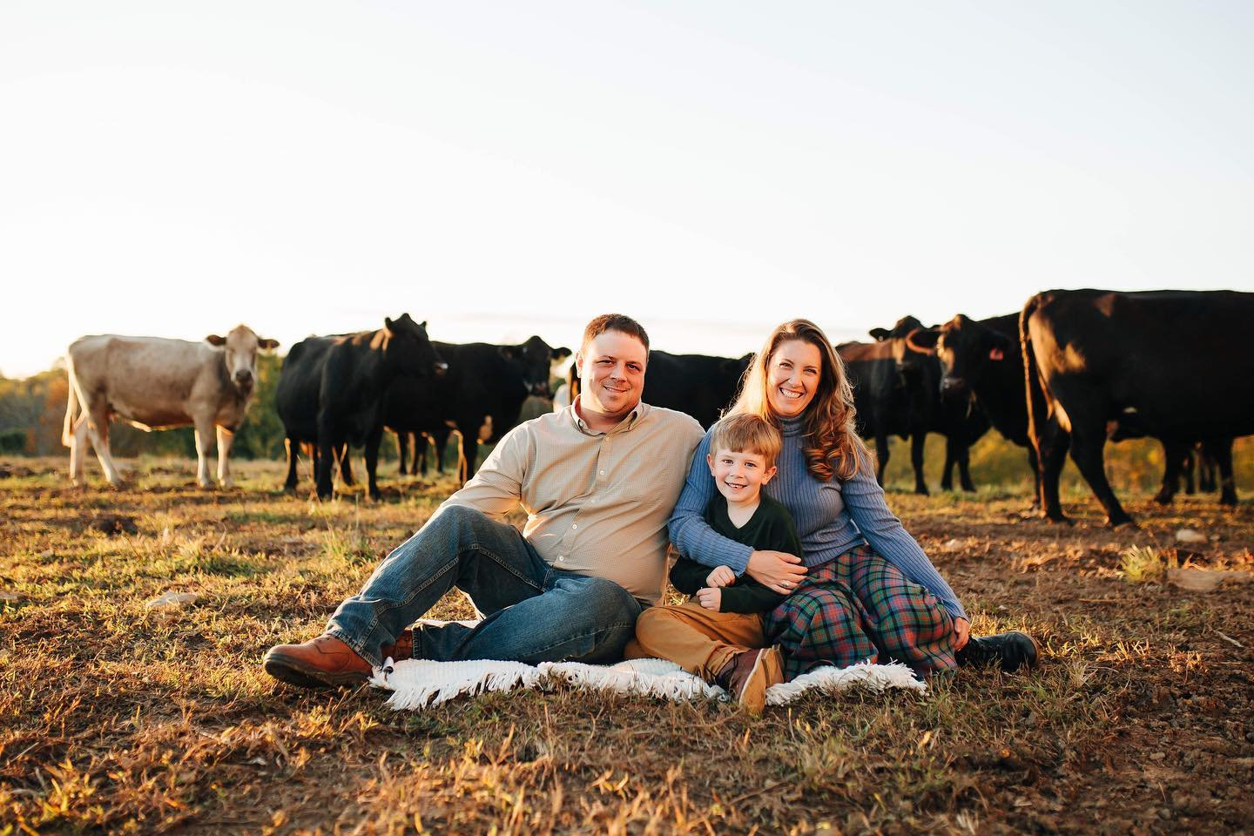
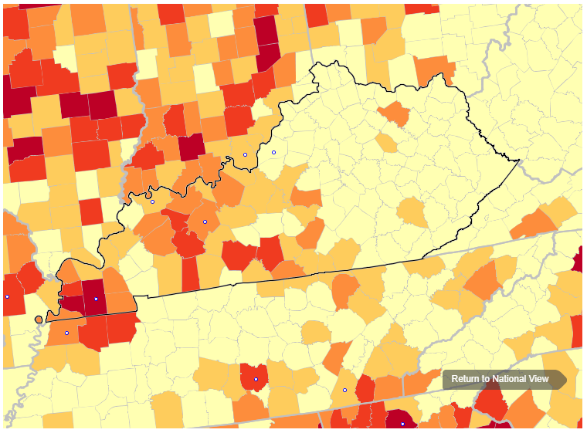
Who We Are & What We Do
Agriculture is Under Fire Fake Meat, Meatless Diets, Greenhouse Gases, Concentration, Regulations, Tariffs, Labeling, Animal Activists
“We have an obligation to listen; we need to hear what producers need from us. And, we have an amazing beef story to tell.”
Sarah Metzler, Cattlemen’s Beef Board

Slide 10
Moving Forward
Cultivate value-added marketing opportunities
Beef Solutions – Kentucky Cattlemen’s Ground Beef
Expanded marketing opportunities – Working with KDA and EDC
KADB
Traceability
Strengthen research, demonstration and outreach
Beef Innovation Center – University of Kentucky
Antibiotics
Veterinarians
Improve KCA engagement, collaboration and advocacy
Electronic Logging Devices (ELD)
USMCA
Taxes on Animal Health
Mental Health
Develop and leverage organizational infrastructure and capabilities

