Slide 1
HEALTHY FARMS & FOODS “Kentucky grown for Kentucky homes.”
Kimmie Ishmael and Martin Richards
Notes:
Introductions and thanks.

Slide 2
HUNGER IN KENTUCKY
HUNGER IN COUNTIES
In Kentucky, the number of SNAP recipients increased by 30% between February and December of 2020.
75% of Kentucky’s public school children participate the free or reduced priced meals at school and 22% of Kentucky’s children live below the poverty threshold
Carroll County: 2018 to 2020 child food insecurity percentage went up 15%
6 Kentucky counties have a food insecurity rate of 24% or higher
Sources: 1. https://www.statista.com/statistics/196114/top-10-us-states-by-number-of-farms/ 2. Lee-Kwan SH, Moore LV, Blanck HM, Harris DM, Galuska D. Disparities in State-Specific Adult Fruit and Vegetable Consumption — United States, 2015. MMWR Morb Mortal Wkly Rep 2017;66:1241–1247. DOI: http://dx.doi.org/10.15585/mmwr.mm6645a1 3. https://kyyouth.org/kentucky-kids-count/data/
Notes:
Despite Kentucky being a top agriculture state, a staggering number of Kentuckians are food insecure. For example, 1 in 7 Kentuckians and 1 in 5 children struggles with hunger.
And looking at data from the Brighton Center in Florence, Kentucky shows that in rural parts of the state, like Carroll County, from 2018 to 2020 child food insecurity percentage went up 15%. In Owen County over 13% of the county were using SNAP benefits in 2020. And data from Feeding KY’s Map the Meal Gap 2020 showed us that 6 KY counties have a food insecurity percentage of 24% or higher. This included Harlan, Bell, Maggofin, Breathitt, Clay, and Wolfe counties. And it also shows us that in Western KY many counties are over 17%, the highests being Metcalf, Grayson, and Fulton Counties.
Especially with the pandemic Kentuckians and Kentucky families have been struggling even more. Pre-pandemic data reflects national food insecurity rates the lowest they have been in more than 20 years, but with the current crisis has reversed any improvements, with millions of people newly experiencing food insecurity.
Kentucky farmers have stepped up in this trying time to try and help feed those in their communities, but many are still struggling.

Slide 3
KENTUCKY HEALTH OUTCOMES
Kentucky ranks
48th for cardiovascular disease
44th for diabetes
45th for obesity
43rd for diet related health outcomes
Sources: America’s Health Rankings Annual Report: Overall Health (2021). https://www.americashealthrankings.org/explore/annual/measure/Overalla/state/KY America’s Health Rankings Annual Report: Physical Health. (2021). https://www.americashealthrankings.org/explore/annual/measure/physical_health/state/KY
Notes:
And our farmers are producing healthy foods, Kentucky ranks 50th in consumption of fruits and vegetables. Not only that but Kentucky consistently ranks in the bottom ten nationally for diet-related health outcomes, coming in at 43rd in 2020.
A big factor in this is affordability and accessibility.

Slide 4
SOME PROGRAMS TO HELP ADDRESS THE ISSUE
Kentucky Double Dollars incentivizes the purchase of Kentucky produced fruits and vegetables, meat, eggs, and dairy by SNAP, WIC, and SFMNP participants.
Fresh Rx for MOMs is a fruit and vegetable prescription (FV Rx)program for Mothers on Medicaid
Farm to Food Banks help cover farmers’ costs to harvest, package and transport donated agricultural products to food banks or food pantries.
Berea Kids Eat prepare breakfast and lunch to youth (ages 18 and under) during the summer months.
Notes:
With seeing and acknowledging the problems, organizations like Feeding Kentucky and have stepped to the plate to help shorten the line at food banks by developing different programs to try and address hunger and health outcome issues.

Slide 5
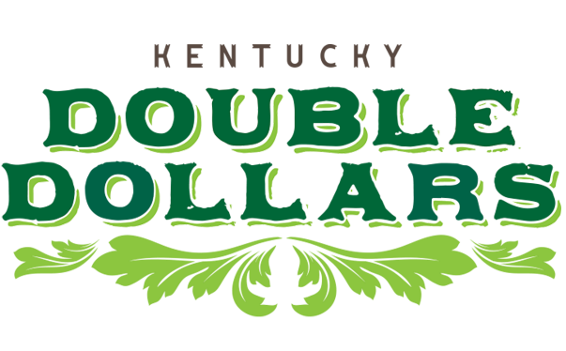
Over the four year period there is a over a 94% redemption rate across all the incentives
Notes:
With the start of the Kentucky Double Dollars Program, those utilizing SNAP, WIC, or senior citizens can double their money on locally grown fruits and vegetables. Expanding on that over the last year to also include Kentucky meat, eggs, and dairy products. The Kentucky Double Dollars Program is now in almost 50 farmers markets, 19 fresh stops, and 5 retail stores. Over the four year period there is a over a 94% redemption rate across all the incentives.
Actually four programs

Slide 6
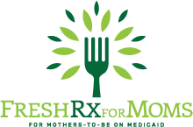
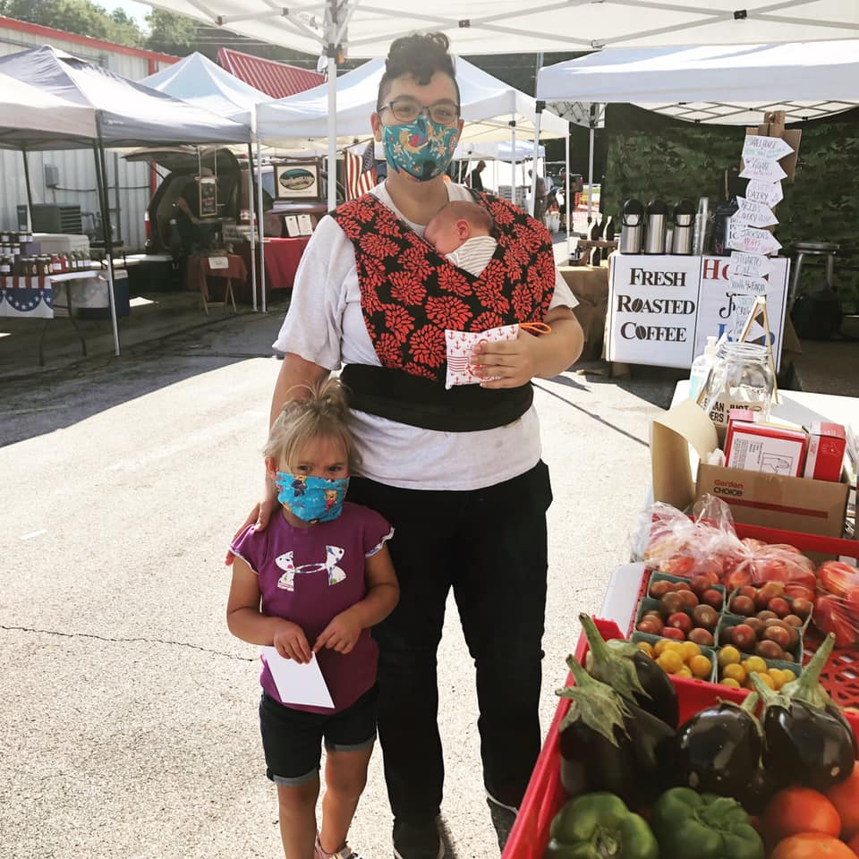
2022 Plans
Community Farmers Market
61 participants
Lexington Farmers Market
70 participants
Franklin Co. Farmers Market
50 participants
Perry Co. Farmers Market
25 participants
Up to 7 additional Markets
310 participants
Notes:
And a newer program, FreshRx for MOMs has plenty of room to grow. This program provides 21-or 40-week prescriptions for fresh fruits and vegetables for expectant mothers enrolled in Medicaid. Participants receive $20 in fresh fruit and vegetable tokens each week for up to 40 weeks and have regular access to nutrition education and consultation with a dietitian. In 2020, over $7,000 was redeemed.

Slide 7
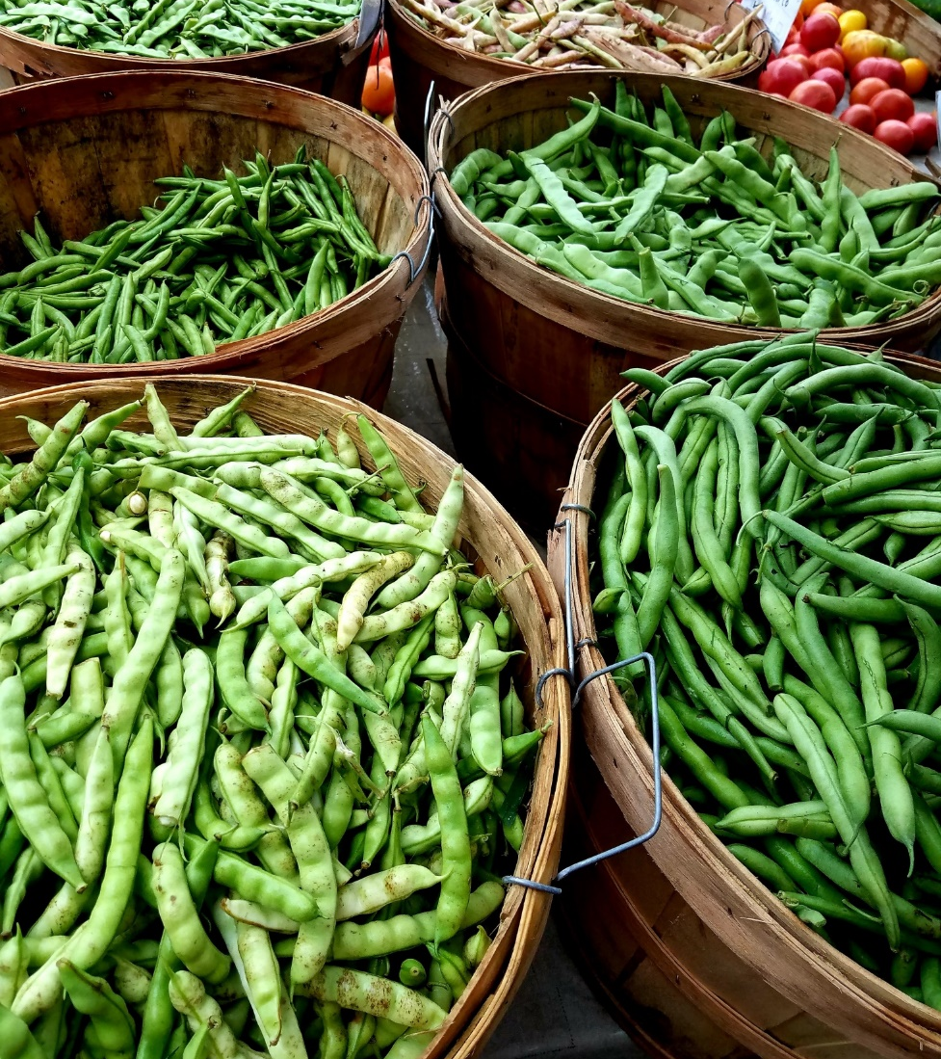
THE HEALTHY FARM & FOOD FUND
Challenges for Healthy Food Access Programs
Sustainability
Growth
Match requirements
How do we address those issues to help these programs?
Notes:
With programs like KDD and Fresh RX for MOMs there are also many challenges. The biggest 3 are sustainability, growth, and meeting match requirements. How do we address these challenges and what is the best route to ensure these programs continue to feed hungry Kentuckians and put money back into the pockets of farmers?

Slide 8
THE HEALTHY FARM & FOOD FUND
Tobacco Master Settlement Funds
Agriculture
Public Health
Set aside 1.5% of the total pool of Tobacco Master Settlement funds to leverage additional federal dollars to benefit farmers and public health outcomes.
GOAL
Notes:
Luckily, in 2000, the Kentucky legislature had the foresight to devote Tobacco Master Settlement (TMS) funds to support agriculture and improve public health. Right now it is the ag side supporting tthese programs that have Whereas other states have set aside General Funds to bolster healthy food access, the TMS gives Kentucky a unique opportunity to provide food and farm security.
A Healthy Farm & Food Fund would set aside 1.5% of the total pool of Tobacco Master Settlement funds to leverage these additional federal dollars. This would significantly increase the amount of funding available to support successful programs which ensure that low-income Kentuckians have access to affordable, healthy, locally-grown food.
Even though healthy food access impacts both sectors, currently only the agriculture portion of the fund is supporting programs like Kentucky Double Dollars and Farms to Food Banks. This creates instability and jeopardizes sustainable funding for Kentucky’s direct farm impact healthy food access programs.
The good news is that the US Department of Agriculture has millions of dollars available for healthy food access – but the USDA requires an equal match, which is a huge challenge for these programs. This is money that could help stimulate our economy, our farmers, and our communities.

Slide 9
THE HEALTHY FARM & FOOD FUND IMPACT
FARMERS
FAMILIES
ECONOMY
Notes:
More importantly, this would have a great impact on not only positive health outcomes, but would help farmers and stimulate the economy. Farmers have the opportunity to grow their business and increase their sales from customers who otherwise could not be able to afford locally grown food.
And by increasing accessibility the Healthy Farm and Food fund will lower household food insecurity while also improving health outcomes of Kentucky children and their families.
Of course adding the benefits to our economy, adding to families grocery budgets to be spent on Kentucky grown foods, putting dollars back into the pockets of farmers and keeping dollars local. Economists even estimate that for every $1 a household redeems through SNAP generates about $1.70 in economic activity.
This model is what we call a win-win-win. Farmers increase sales, families affording local food to become healthier, all while stimulating our economy.
Story form Ted

Slide 10
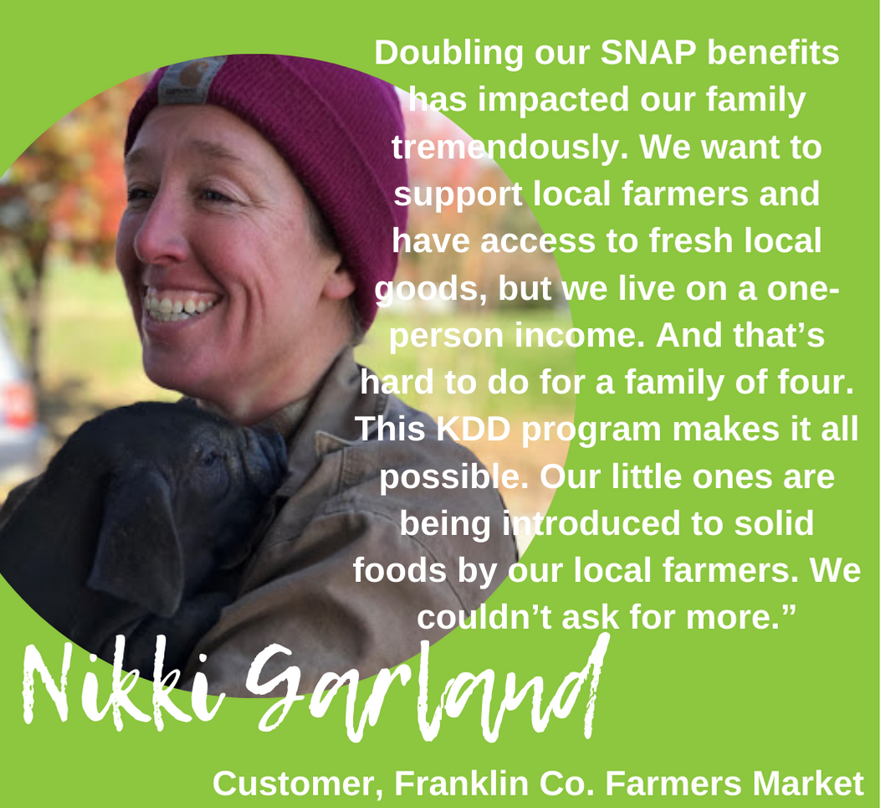
THE HEALTHY FARM & FOOD FUND

Slide 11
THANK YOU
Community Farm Alliance
Notes:
As much as I’d like to dive into all the specifics of this legislation, there’s not enough minutes in the day. And we will be presenting at the IJC Budget Review Sub Committee on Human Resources in November. But I will end saying, introducing and passing this Healthy Farm & Food Fund legislation, that has already gained support, will build upon Kentucky’s current momentum, creating stability and opportunities for direct farm impact food access programs and pave the way for additional new efforts that support the vitality of Kentucky agriculture and the health of Kentuckians.

