Slide 1
Thank You!

Slide 2
Beef Industry Structure
RETAIL GROCERY
FOOD SERVICE
EXPORT
FURTHER PROCESSING
WHOLESALE
PACKER
LARGE SCALE
COST EFFICIENCIES
FEEDLOT
STOCKER
COW-CALF

Slide 3
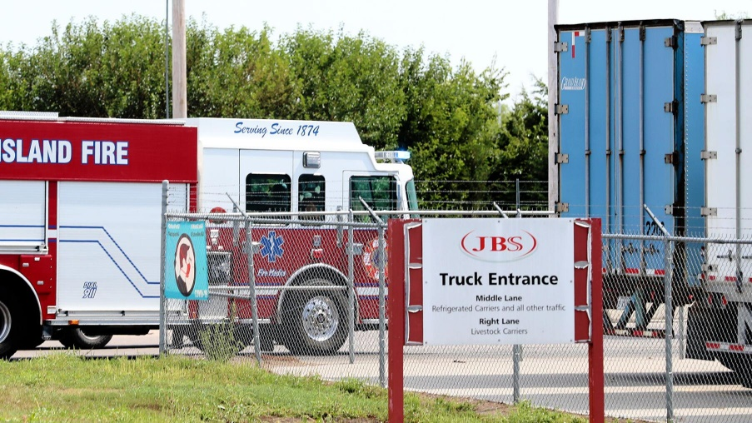
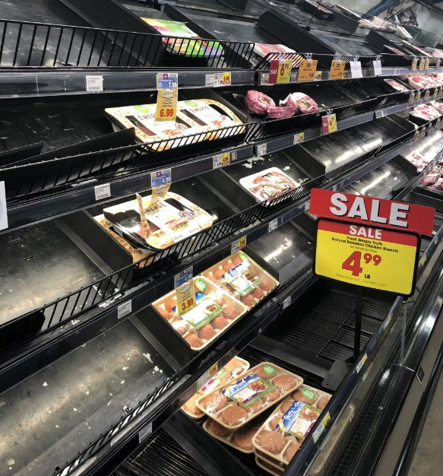
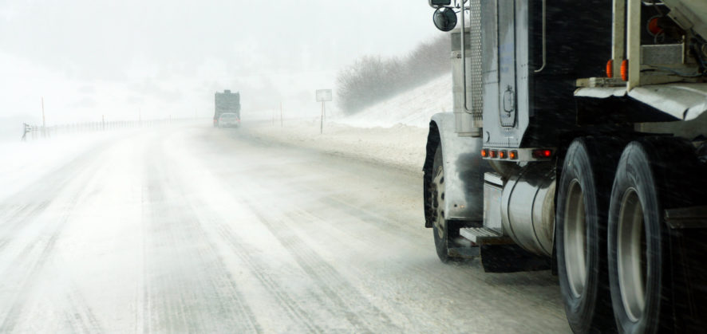
National Supply Chain Disruptors
Beef’s Big Four: JBS, Tyson, Cargill, National Beef
Black Swan Events
Packing Plant Fires
Cyber Attack
Weather
Global Pandemic
Transportation
Labor

Slide 4
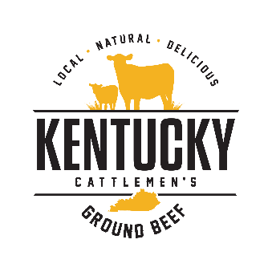
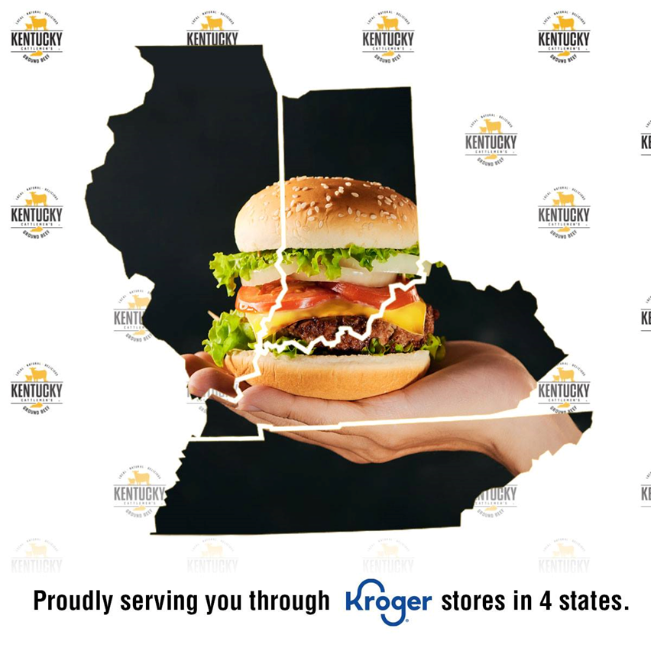
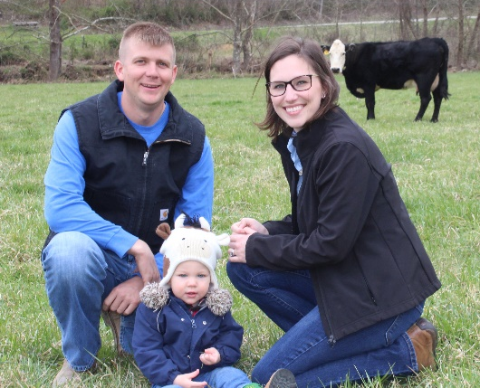
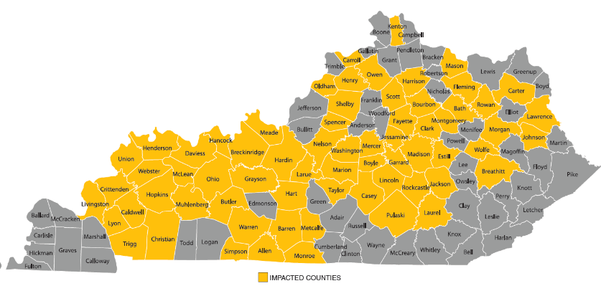
Kentucky Cattlemen’s Ground Beef
Local Demand, Local Impact
3,422 Cows Purchased
$2,773,700.50 Farm Gate Sales
242 Kentucky Farm Families
159 Kroger Locations & 3 Large Event Venues
Notes:
.

Slide 5
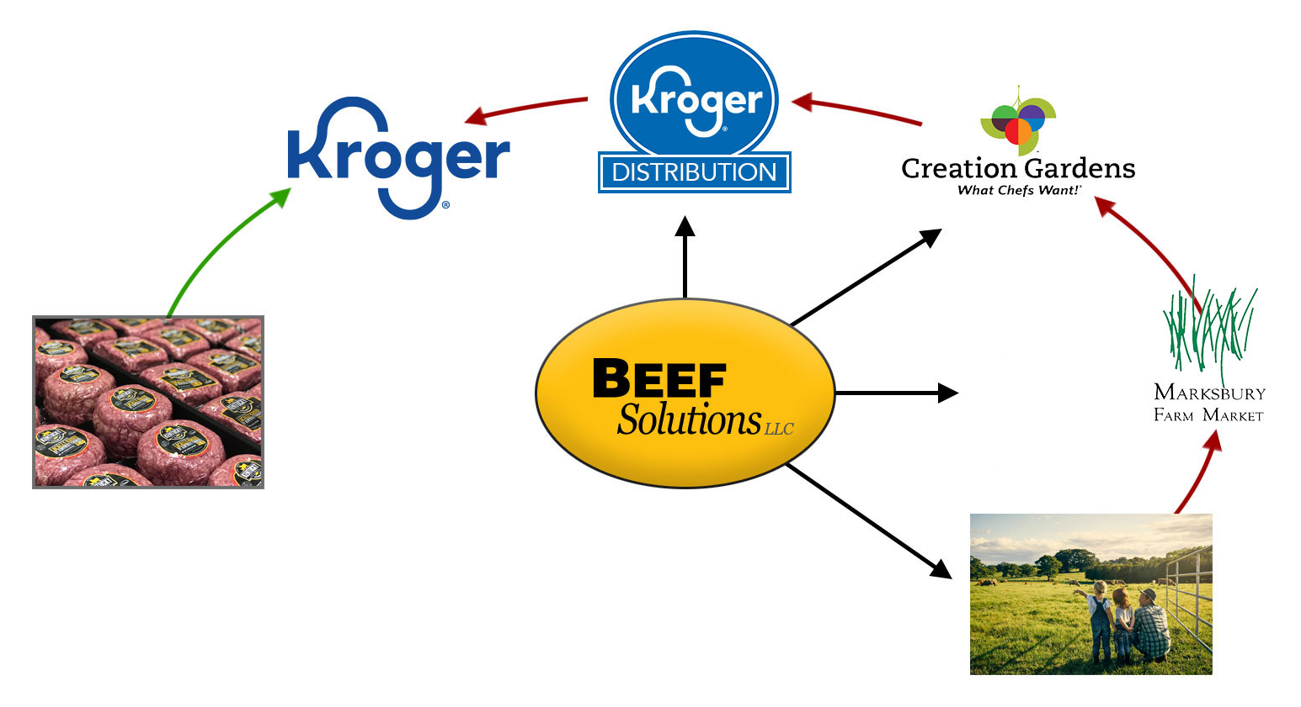
Local Supply Chain Disruptors
National Supply Chain Expectations on a Local Level
Production Inefficiencies
Food Safety
Weather Conditions
Labor Shortage
Notes:
.

Slide 6
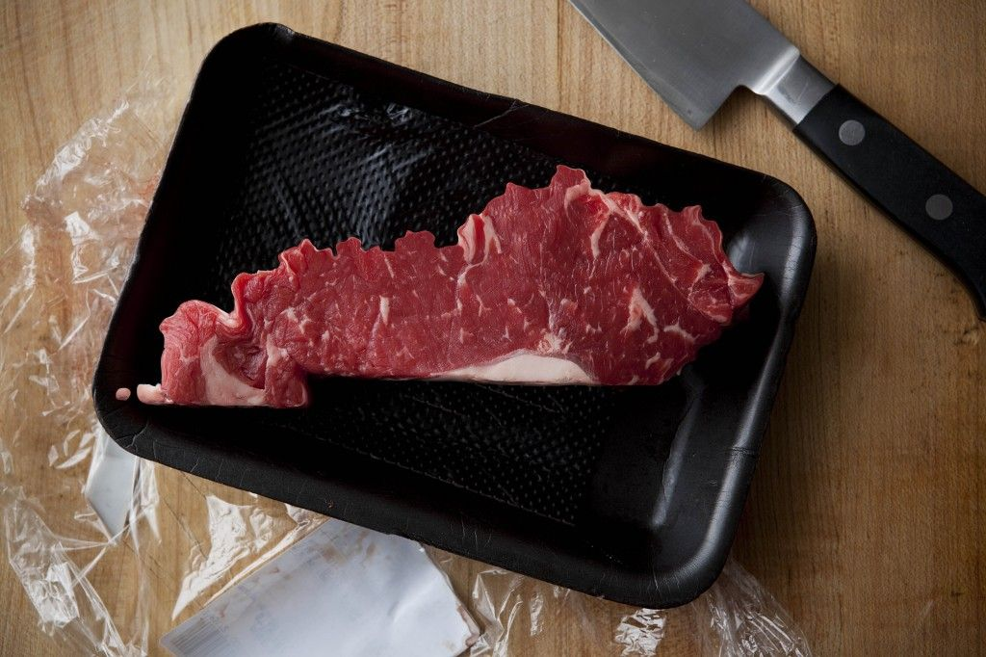
Moving Kentucky’s Meat Industry Forward
Third Party Industry Insight
Industry & Professional Development
University of Kentucky Meat Laboratory & Training Center
Current Economic Expansion Opportunity

Slide 7
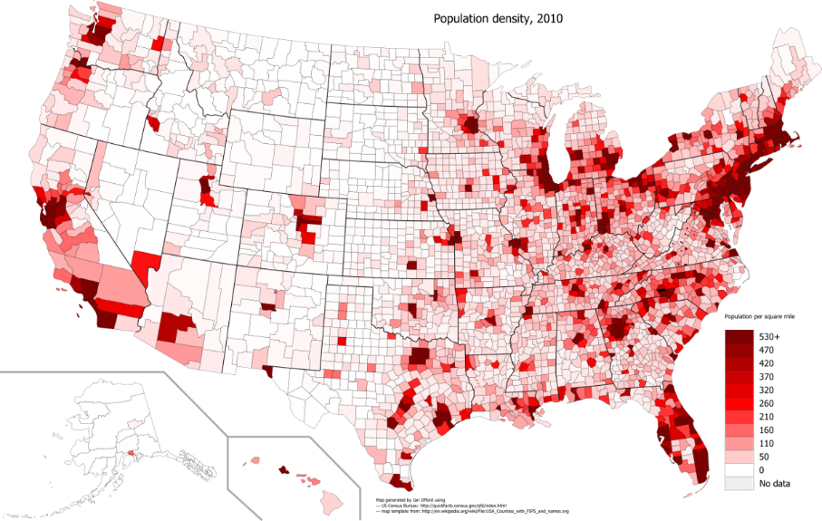
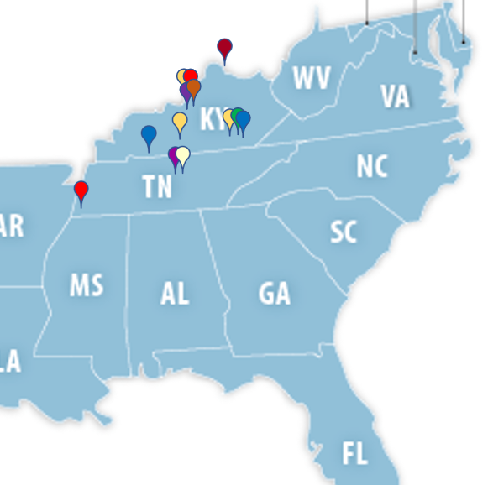
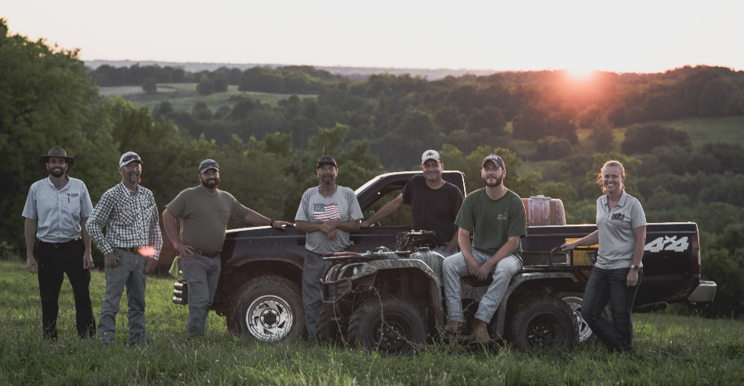
Why Kentucky
Geographic Location of Kentucky
Infrastructure of Interstates, Railways, and Water Systems
Robust Agricultural Industry
Constant Commitment to Growing Marketing Opportunities
Strong Communities Built on Farm Family Values
Regional Food Distribution Centers

