Slide 1
Kentucky Electric Generation and Transmission Siting Board
Presentation to the Joint Meeting of Natural Resources and Energy and Agriculture Interim Joint Committees
September 15, 2021
Any views expressed in this presentation are those of the presenter and do not reflect official positions of the PSC.

Slide 2
PSC Regulated Entities
1,100 jurisdictional utilities:
Water and sewer utilities (small systems comprise the bulk of regulated utilities)
Natural gas distribution systems and intrastate pipelines
Electric utilities (investor-owned and jurisdictional cooperatives)
Telecommunications
Do not include municipal utilities except for gas pipeline safety.
Do not include cooperatives served by TVA.
The mission of the Kentucky Public Service Commission is to foster the provision of safe and reliable service at a reasonable price to the customers of jurisdictional utilities while providing for the financial stability of those utilities by setting fair and just rates, and supporting their operational competence by overseeing regulated activities.

Slide 3
Today’s Key Terms
MW= Megawatt
How much electricity can be produced by a facility
1 Megawatt can power about 750 homes
Merchant Generator= generation facility not owned by a utility
IRB= Industrial Revenue Bonds
Decommissioning= Returning land back to its original condition, regardless of depth, except for major moved earth and roads
Kentucky State Board on Electric Generation and Transmission Siting= Siting Board

Slide 4
Renewable Energy in the Commonwealth

Slide 5
Merchant Solar Facilities—the Siting Board
Created in 2002 with very few changes since
Reviews applications and grants certificates if approved for the construction of electric generating facilities (i.e., merchant generators) greater than 10 MW and transmission lines from entities not regulated by the PSC.
Review focuses on such factors as noise and visual impacts; economic impacts; and potential impact on transmission lines within the state.
Attached to the PSC and staffed by PSC staff
Operations are funded through fees paid by applicants

Slide 6
Siting Board Members
Three members of the PSC
Secretary of the Energy and Environment Cabinet or a designee/proxy
Secretary of the Cabinet for Econ. Development or a designee/proxy
Two local members, with one appointed by the Governor to serve for a specific case
Ordinarily Judge/Executive or chair of P & Z is one member

Slide 7
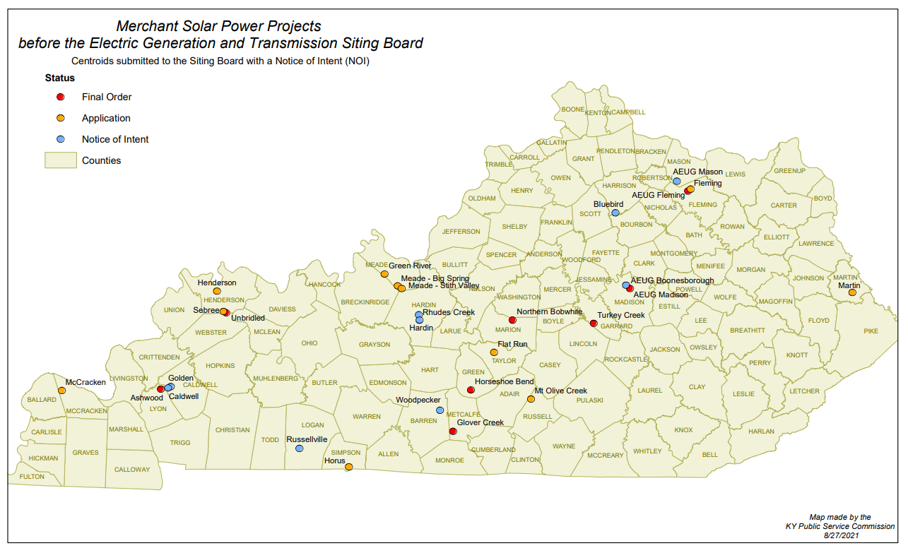
Current & Approved Solar Projects as of August ‘21

Slide 8
Solar Generation
Can be used to serve Ky. entities or out of state entities/markets
For out of state, the facilities can serve specific customers or specific utilities, or no one in particular
Kentucky has multiple markets/grids
KU/LG&E (including municipalities)
TVA (to the South)
PJM (to the North and East)
MISO(to the West)

Slide 9
Siting Board Process- Before filing application
90 days before application is filed, applicant must conduct local public meeting
Public notice 2 weeks before local public meeting, at a minimum, must be provided to:
General public via newspaper
Bordering landowners by mail
Additional public involvement program activities via other media coverage, direct mailing, fliers, newsletter, additional public meeting, etc. can be conducted
At least 30 days before application, applicant must file notice with PSC/Siting Board with pertinent information, such as the location and whether P&Z applies
30 days before application, applicant must provide public notice of the location and a general description of the project to:
General public (in newspaper)
Bordering landowners

Slide 10
Siting Board Process- After filing application
Ad hoc members are placed on the Siting Board for that project
Local member appointed by Governor
Statutory member (planning and zoning chair, Judge/Executive, mayor, etc.) provided notice by Siting Board staff
Application fee filed ($1,000 per megawatt, with min. $40,000 and maximum $200,000)
Procedural schedule entered allowing for:
Deadline for motions to intervene
Two rounds of discovery
Date for the Siting Board consultant’s report to be filed
Applicant's response to consultant’s report
Evidentiary Hearing
By statute, Siting Board has 120 days to render a final order, or 180 days after application is filed if an evidentiary hearing is held.

Slide 11
Siting Board Considerations- Site Assessment Report
Per KRS 278.708, the applicant completes a Site Assessment Report that is to include:
A description of the proposed facility, which is to include a proposed site development plan that describes:
Surrounding land uses for residential, commercial, agricultural, and recreational purposes;
The legal boundaries of the proposed site;
Proposed access control to the site;
The location of the facility, buildings, transmission lines, and other structures;
Location and use of access ways, internal roads, and railways;
Existing or proposed utilities to service the facility;
Compliance with applicable setback requirements as provided under KRS 278.704(2), (3), (4), or (5); and
Evaluation of the noise levels expected to be produced by the facility.

Slide 12
Siting Board Considerations- Site Assessment Report (continued)
The Site Assessment Report also must include:
An evaluation of the compatibility of the facility with scenic surroundings;
The potential changes in property values and land use resulting from the siting, construction, and operation of the proposed facility for property owners adjacent to the facility;
Evaluation of anticipated peak and average noise levels associated with the facility’s construction and operation at the property boundary; and
The impact of the facility’s operation on road and rail traffic to and within the facility, including anticipated levels of fugitive dust created by the traffic and any anticipated degradation of roads and lands in the vicinity of the facility.

Slide 13
Issues In Recent Cases
Statutory Set back
Without P & Z, current 2000 foot setback from neighborhood, school, hospital or nursing home and facilities used for generating electricity
Siting Boards have granted reasonable deviations
Tax Revenue/Economic Impact
Industrial Revenue Bonds
School Taxes
Property taxes
Noise- abatement methods at construction and operation
Viewshed- mitigation for benefit of surrounding properties
Impact on PSC
Decommissioning
Plans and bonding

Slide 14
Best Practices
Decommissioning
Bonding
Set Backs to neighborhoods, hospitals, etc.
Distance to homes and neighboring property of non-participating and participating individuals
Viewshed mitigation
IRBs
Ordinance and Conditional Use Permits
Henderson and Madison County

