Slide 1
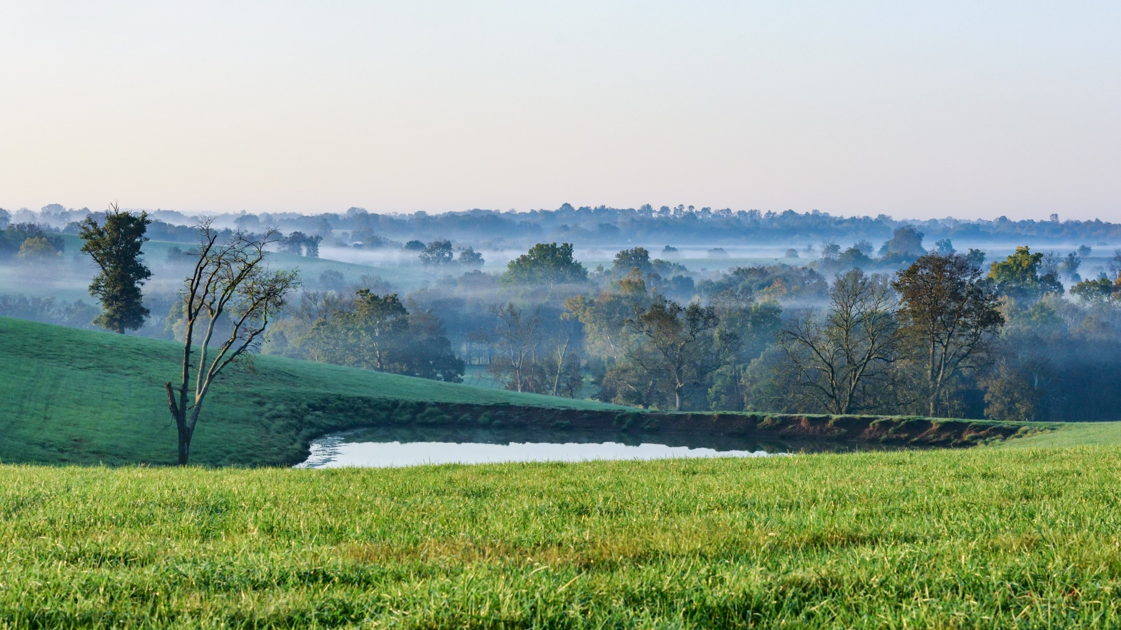
Clark Coalition
Raising Awareness of Industrial-Scale Solar Development
On Kentucky’s Agricultural Land
Interim Joint Committee on Agriculture and Natural Resources & Energy
September 15, 2021

Slide 2
A Statewide Issue
Currently, Over 100 Proposed Industrial-Scale Solar Developments in Kentucky
– Totaling 10,991 Megawatts, ~110,000 Acres
– In 47 Counties, and Growing
– Consisting of 25-60 million+ solar panels
*As of 8/31/2021, Source: PJM New Services Queue, MISO Interconnection Queue
Notes:
Clark Coalition is recognized – both among other Inner Bluegrass Region counties and across the state – for its leadership on the issue of industrial-scale solar. We were the first land-use organization in the state to organize around the issue. We are also active in the regional discussions taking place on solar, and have provided information to other community groups

Slide 3
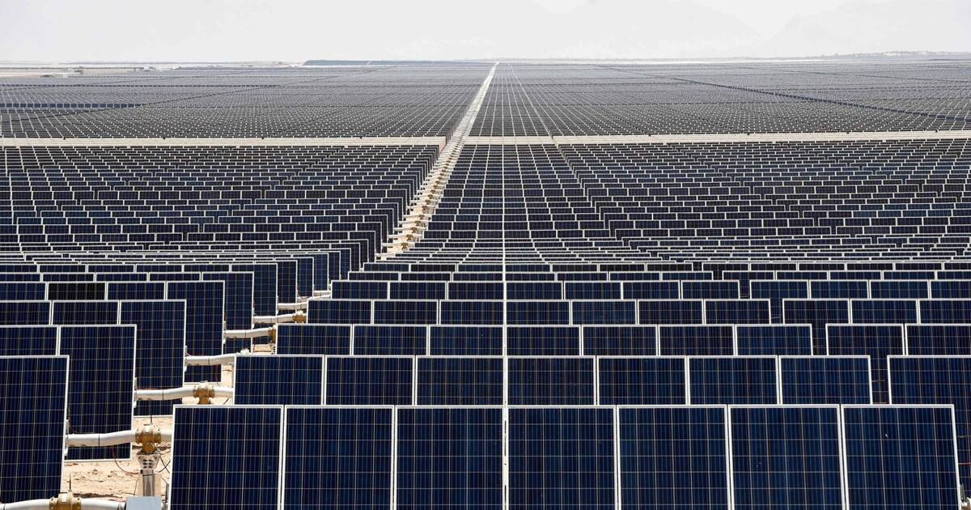
Current Status of Industrial Solar in KY
Significant lack of understanding of the issues
Coupled with federal tax policy and a regulatory framework that disadvantages local communities and transparent decision-making
Aggressive out-of-state and foreign developers
– changing our laws and ordinances with
very little public awareness
Result: majority of benefits accrue to developers & outside interests while the costs are borne by Kentuckians
What’s needed?
– Balance short and long-term impacts

Slide 4
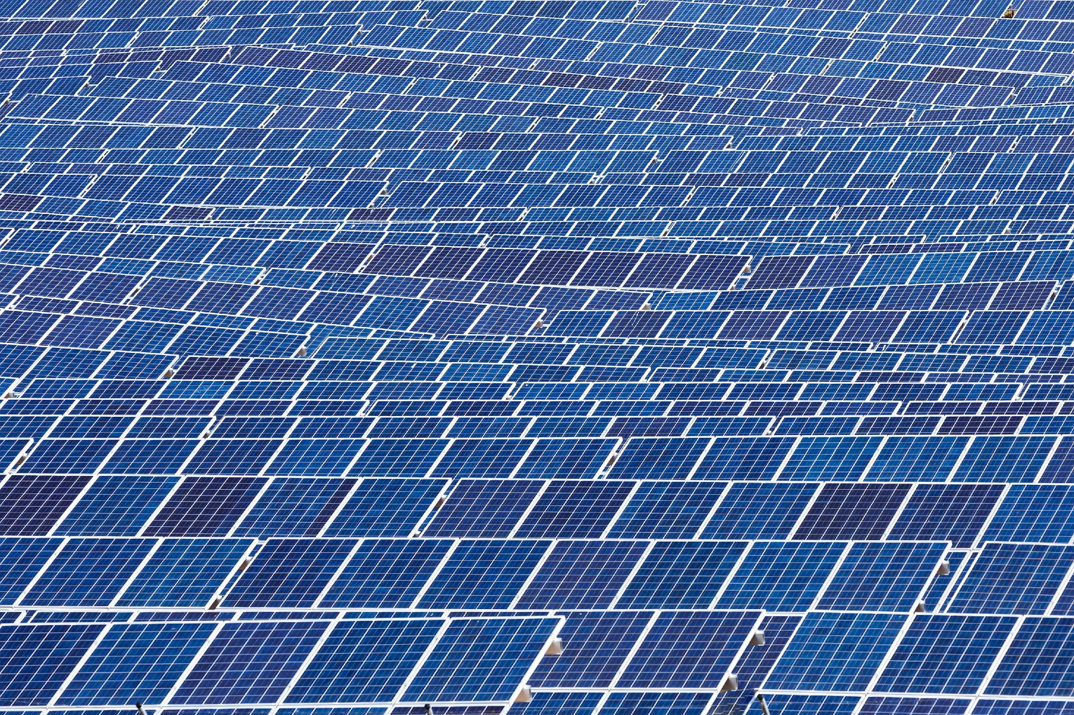
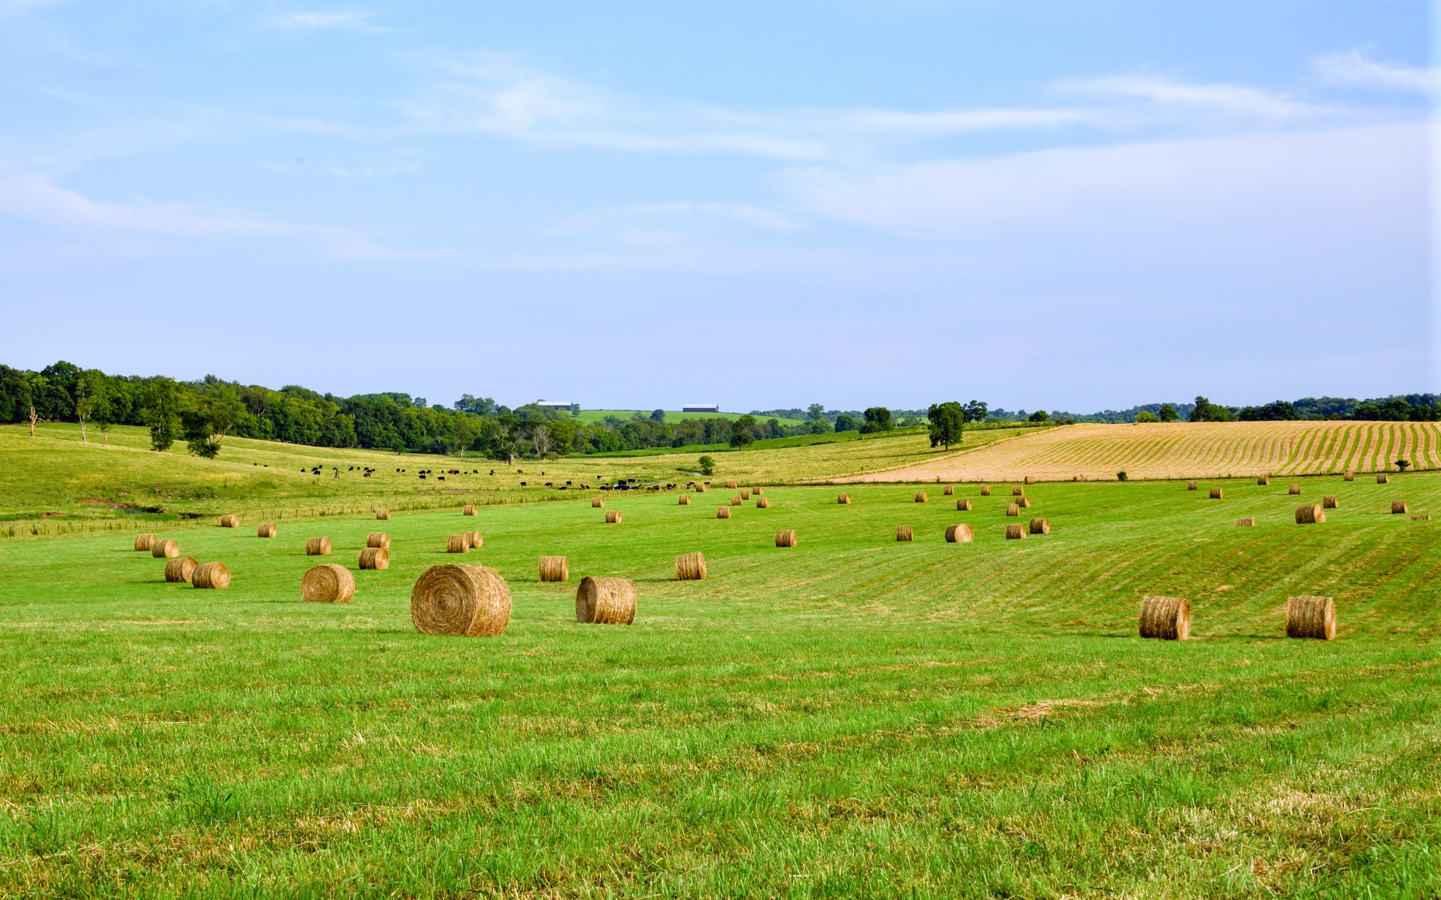
Industrial Solar on Farmland
Complex Issue
– Environmental, Economic, Fiscal, Property Value
& Quality of Life Considerations
Local Differences
– What is appropriate in one county, may not work
in another
Possible Outcomes
– If handled smartly, Industrial Solar presents an
opportunity
– If not, it is a significant threat to existing
industries, property owners and local and state
governments

Slide 5
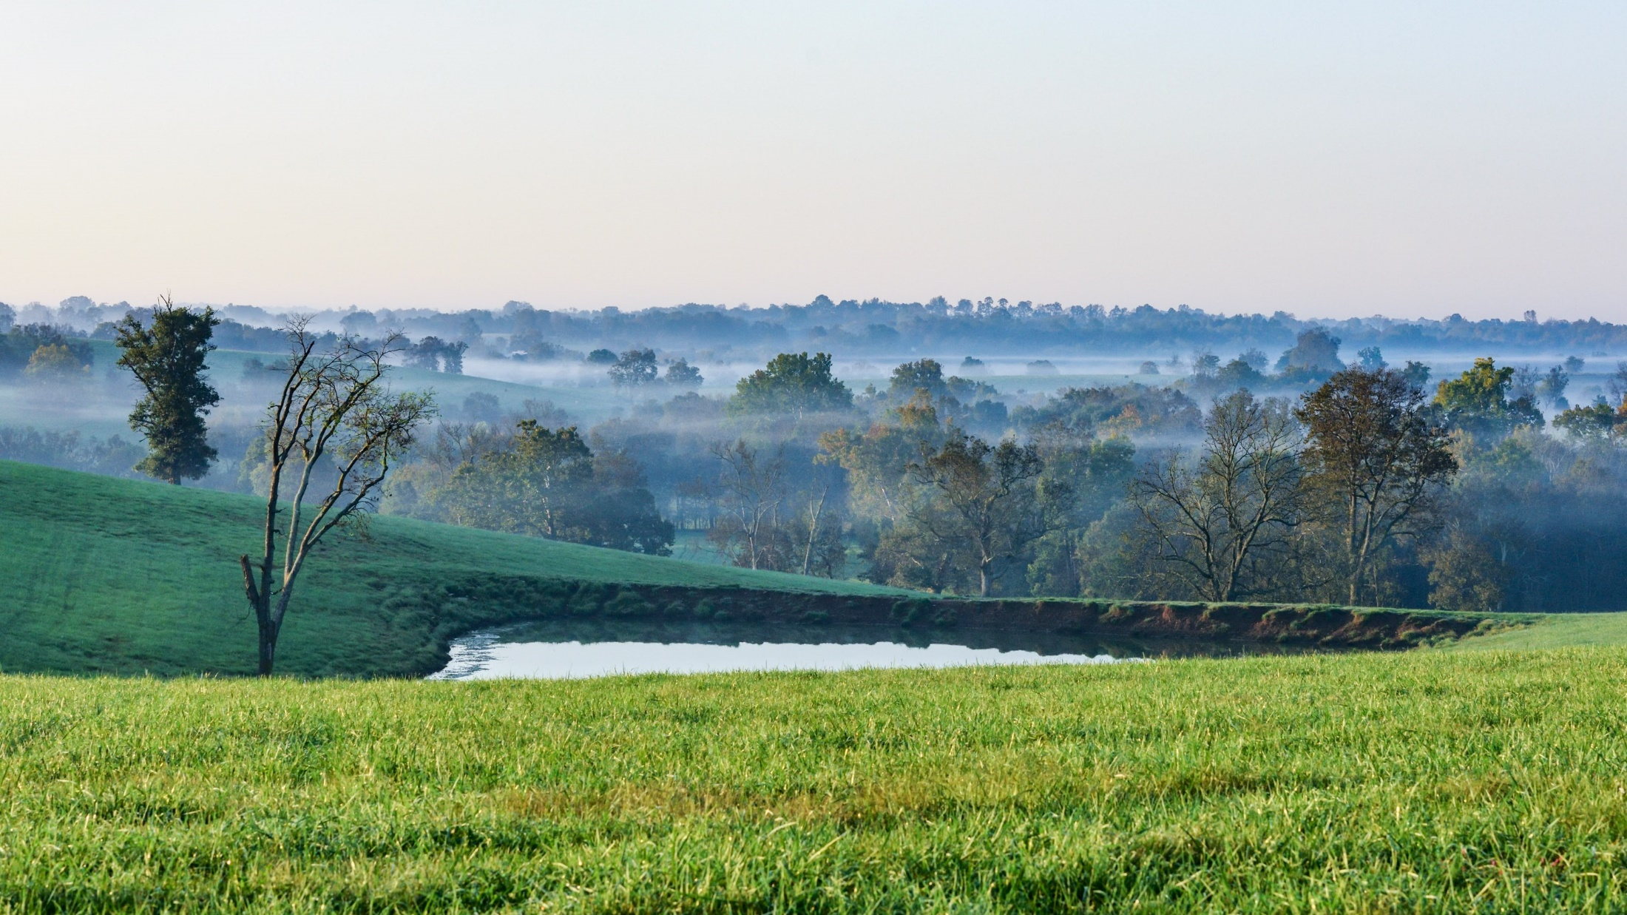
Notes:
Kentucky Agricultural Land: An economic engine AND a tool in the fight against climate change
Our farmland plays an important role in combating climate change, It is the largest carbon sink that we have - sequestering carbon, feeding our population and shortening supply chains of the current national system. Energy production is important, but so is food production. We must use our most productive farmland for its highest and best use. Pushing food production to less productive areas/soils results in a number of negative consequences: lower yields, more erosion, greater need for exogenous fertilizer, etc.
In many communities the agricultural landscape is important to its ability to attract residents and businesses. It is a critical component of citizens’ quality of life.

Slide 6
The State’s Role
Regulate Decommissioning & Reclamation
Ensure Adequate Bonding Requirements
Provide for Sufficient Code Enforcement & Environmental Regulation

Slide 7
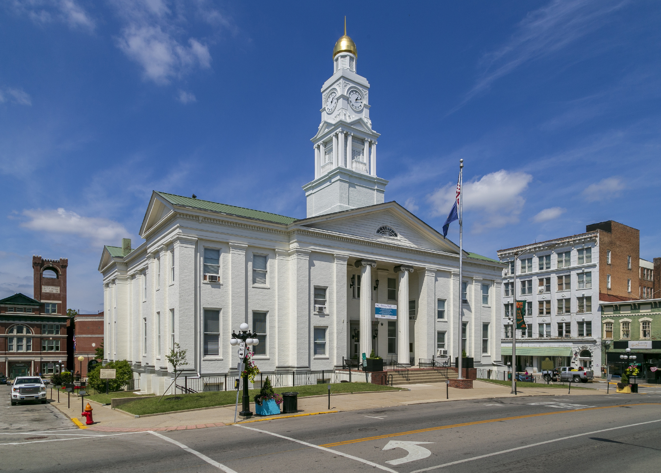
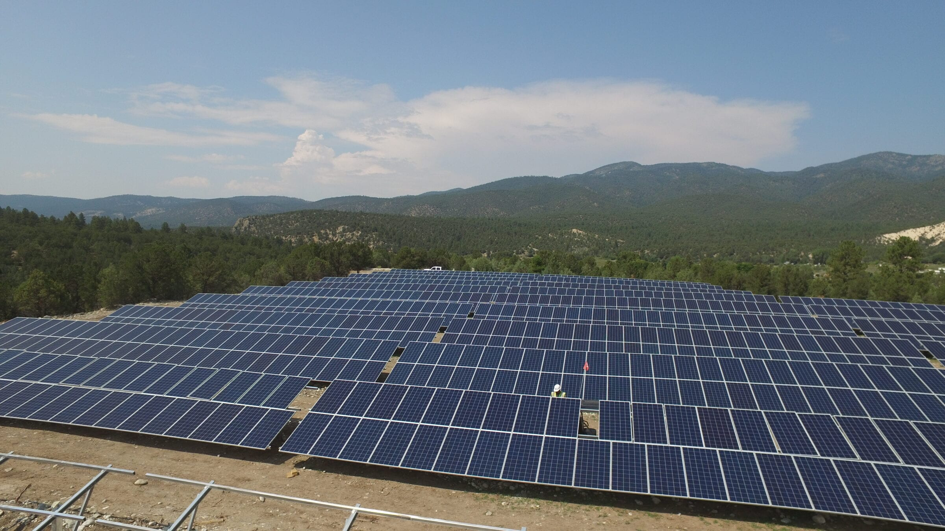
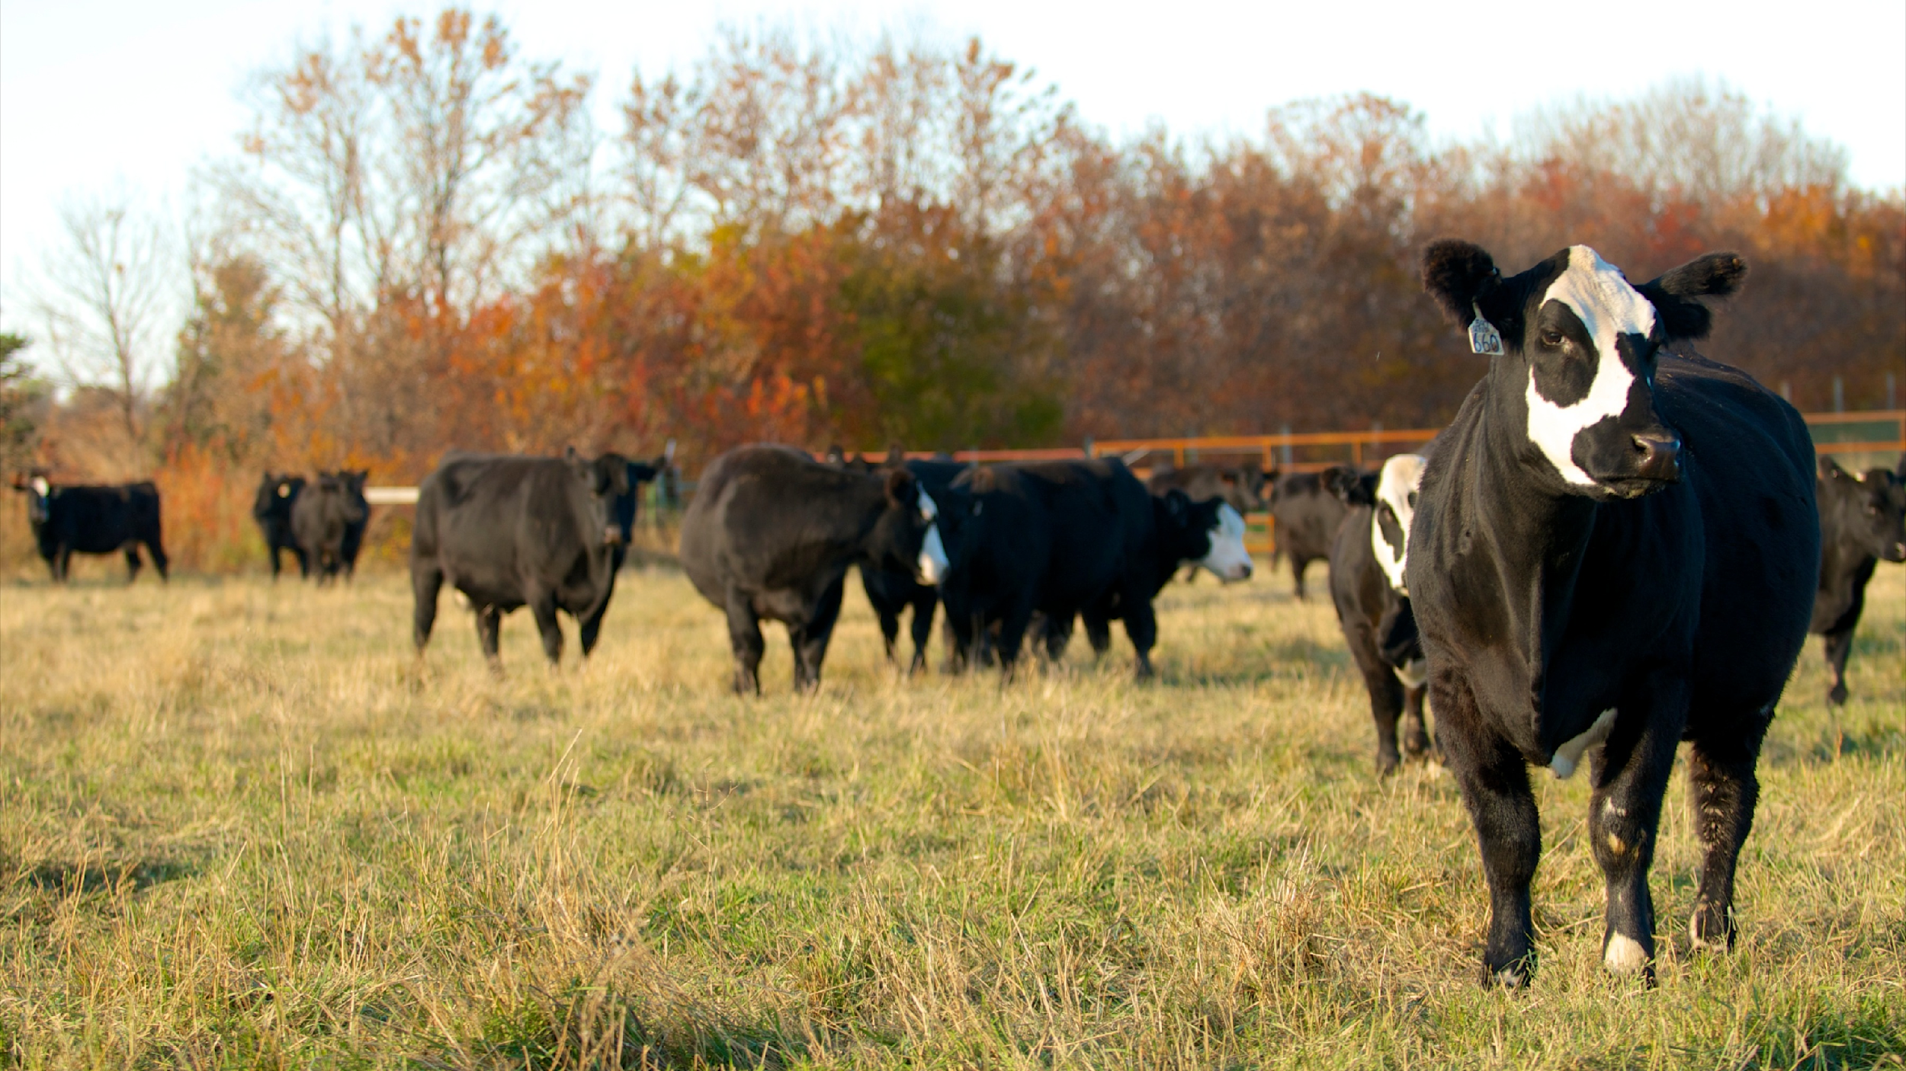
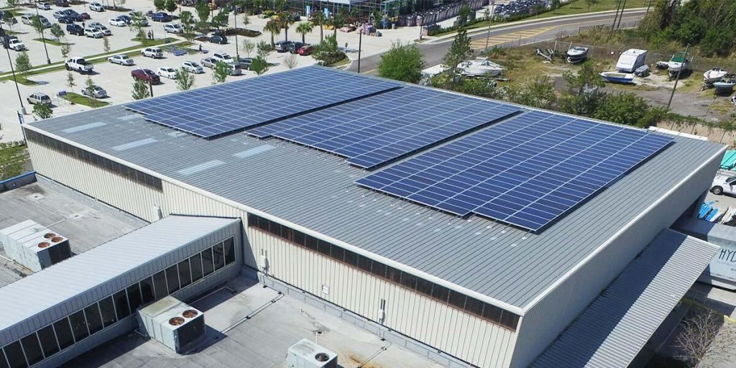
A Path Forward
Maintain local control of siting decisions
– Local communities are best-suited to address
unique land-use issues
– Encourage comprehensive planning to weigh
costs and benefits; short and long-term impacts
Incentivize Industrial Solar development in economically-depressed areas
Preserve our economic engines of High Value Farmland
Promote distributed solar (i.e. rooftops) for enhanced grid reliability
Recognize the role of agriculture as a solution to the climate issue

Slide 8
Questions? Contact:
Will Mayer
Executive Director, Clark Coalition Inc.
will@clarkcoalition.com
(859) 556-0680

Slide 9
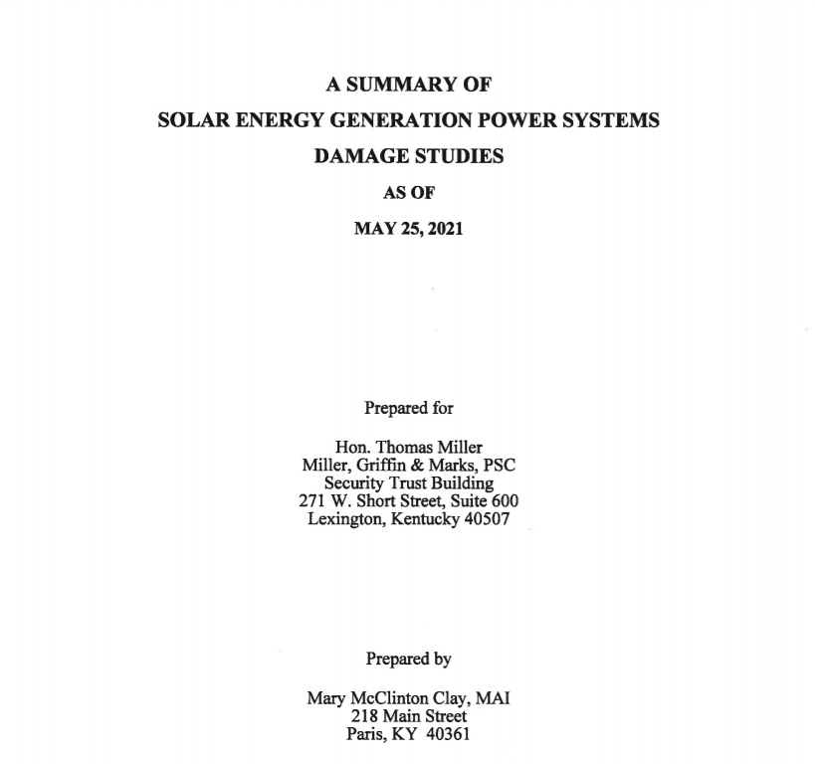
Addendum: Diminution of Property Values
*For a rural home appraised at $350,000,
this equals a $52,500 to $98,000 loss in value
**For a 400 acre farm, worth $5,000/acre ($2,000,000)
this equals a $300,000 to $560,000 loss in value
Notes:
The most comprehensive examination of impact of solar on property values anywhere in the country.
Where communities have made the decision to permit rural home development – those property owners should be protected. Homes = their 401k

Slide 10
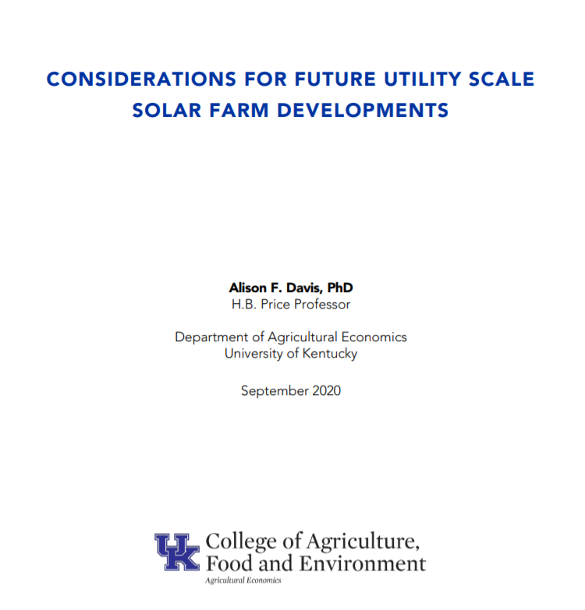
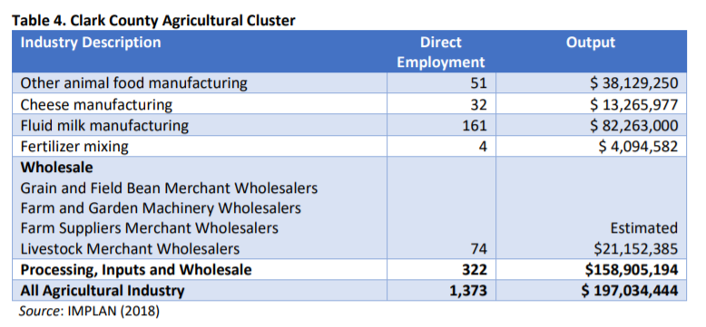
Addendum: Clark County’s Agricultural Economy

