Slide 1
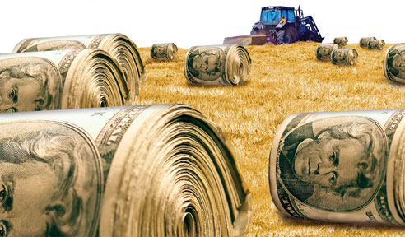
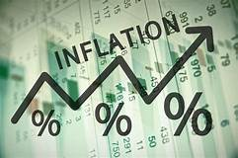
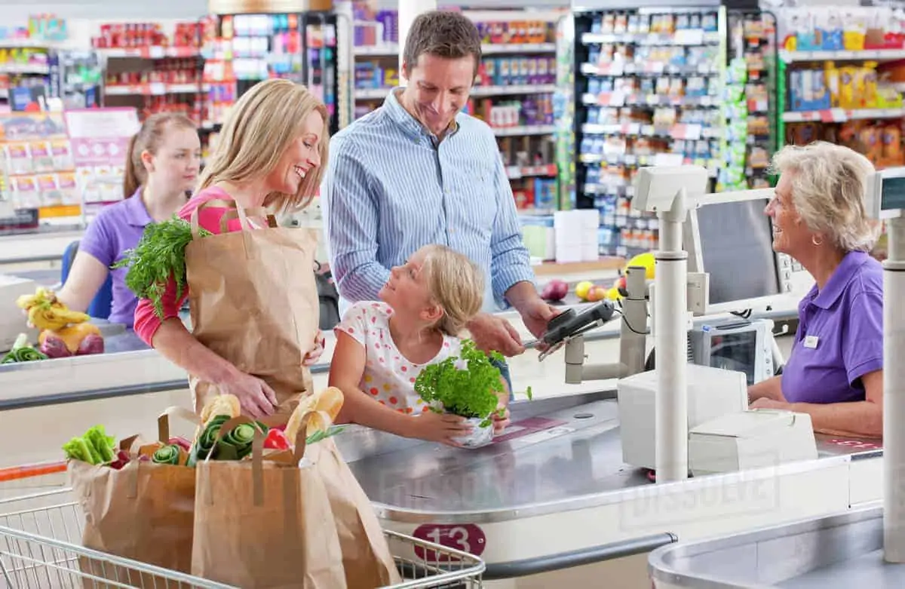
Observations and Implications of Inflation on Ky Agriculture
Will Snell
Ag Economist
University of Kentucky, College of Agriculture Food and Environment

Slide 2
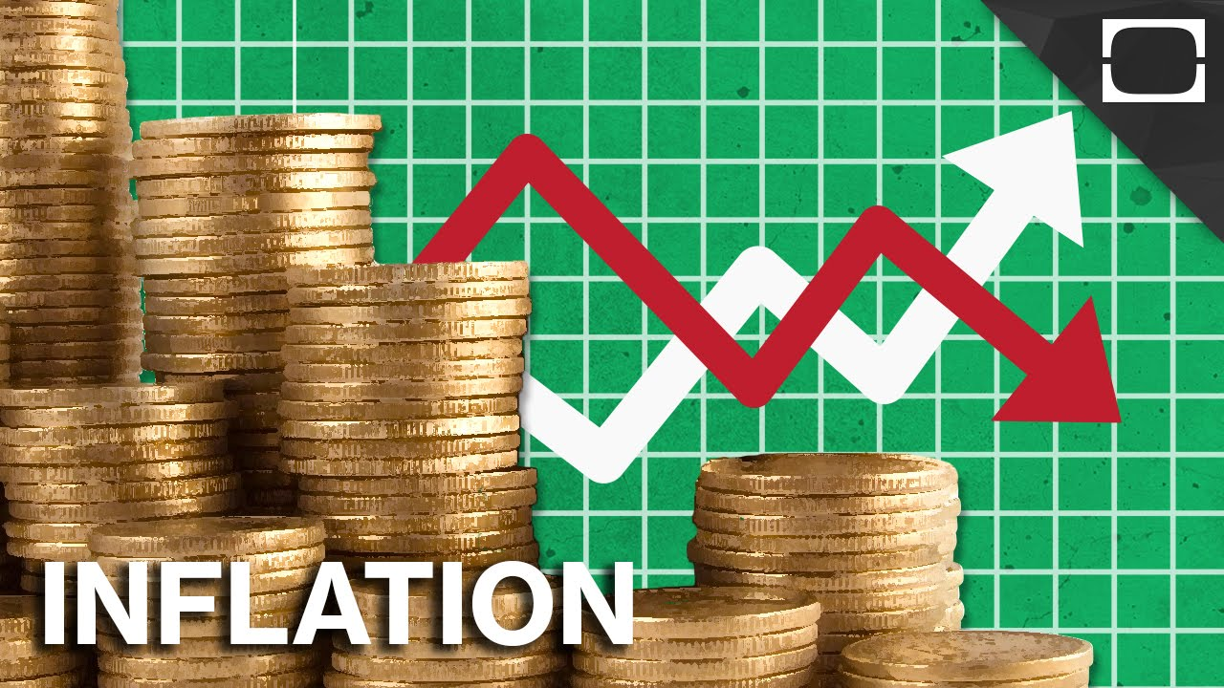
From An Economist’s Perspective ….What is Inflation?
  a general rise in prices for a selected basket of goods and services
  too much demand chasing too few goods and services

Slide 3
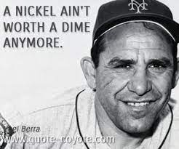
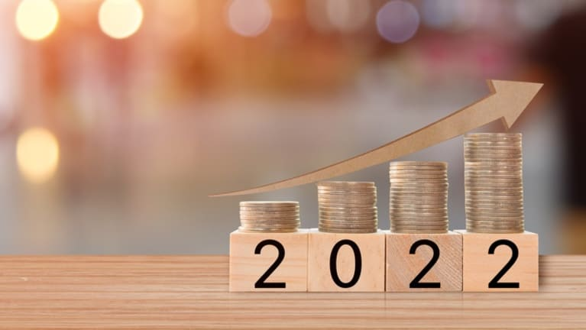
In reality ….
Inflation
  Inflation reflects a decline of purchasing power for consumers and producers

Slide 4

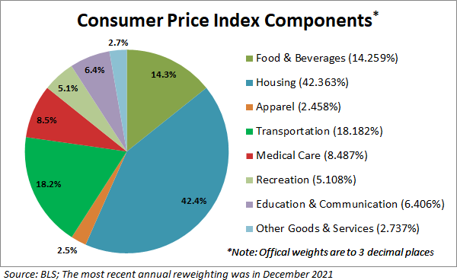
Consumer Price Index (CPI)
-- General Measure of Inflation
CPI tracks changes in monthly prices of approximately 80,000 goods and services in 75 urban areas and 23,000 retail establishments

Slide 5
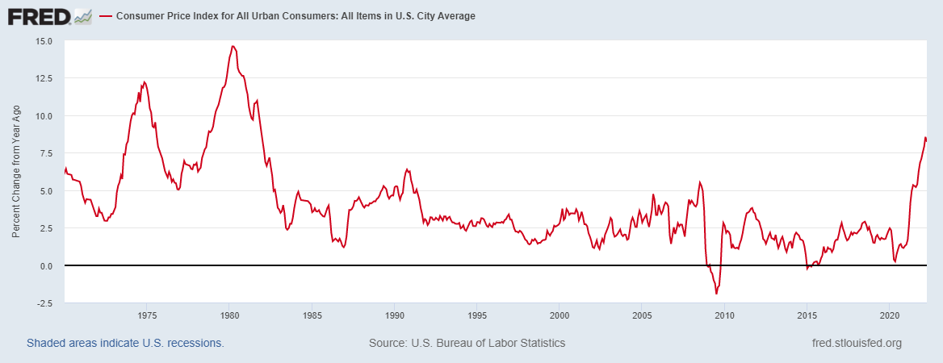
Inflation Over the Past 50 Years
April 2022: +8.3%

Slide 6
What Has Caused the Recent Run-up in Inflation?
Government Spending
Monetary Policy
Supply Chain Disruptions
Weather /Disease Events
Labor Supply Issues
War in Ukraine

Slide 7
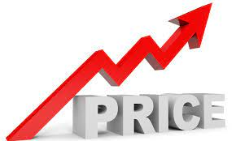
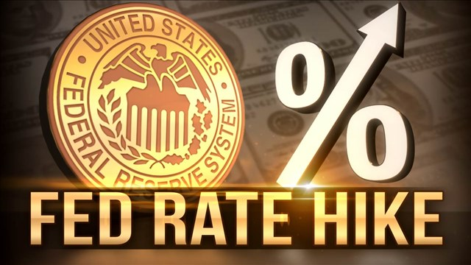
Within Agriculture, Inflation Affects ….
Farm Inputs Prices
(Including Interest Rates)
Farm Commodity Prices
Higher Farm Commodity Prices Leads to:
Increased Demand for Farm Inputs Globally
Sustained “Unacceptable” Levels of Inflation Leads to Actions by the Fed to Raise Interest Rates

Slide 8
Farm Production Input Costs Up 24% (vs 12% for all goods and services)
since January 2020
Source: NASS/USDA – April 2022 vs January 2020

Slide 9
But Commodity Prices Have Risen As Well Since 2020
$/BU
$/LB
SOYBEANS (+79%)
CALVES (+11%)
WHEAT
(+110%)
BROILERS (+112%)
HOGS
(+ 59%)
CORN
(+87%)
MILK (+39%)
----------------- 2020 ------------------
---------------- 2021 -----------------
-- 2022 --
----------------- 2020 ------------------
---------------- 2021 -----------------
-- 2022 --
Source: NASS/USDA

Slide 10
Index of Farm Prices Received vs Farm Prices Paid vs CPI
Source: NASS/USDA, April 2022 data

Slide 11
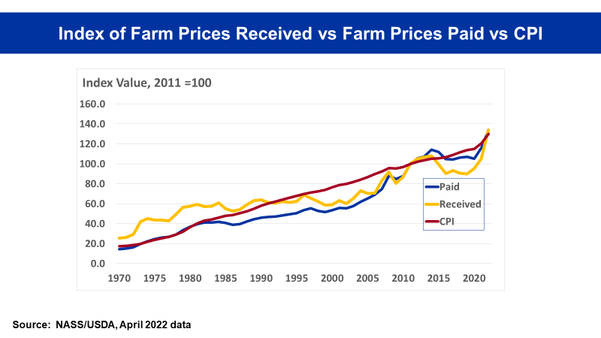
What about the Simple Correlation Between:
Farm Prices Paid and Inflation?
Farm Prices Received and Inflation?
Correlation Between 2 Economic Variables
Correlation is a numerical measure of some type statistical relationship between two variables.
Ranges from -1 to +1
  (-1) … perfect negative relationship between the two variables
  (+1) … perfect positive relationship between the two variables
  ( 0) … no relationship between the two variables
Correlation Does Not Imply Causality!
Correlation Between Prices Paid and CPI: (+0.95)
Correlation Between Prices Received and CPI: (+0.92)

Slide 12
Over the past 50 Years, Which Has Increased At a Faster Pace:
Farm Prices Received or Farm Prices Paid?
How Does that Compare to Overall Inflation?
CPI – Averaged (+3.9%/year)
Farm Prices Received – Averaged (+3.2%/year)
Farm Prices Paid – Averaged (+4.3%/year)

Slide 13
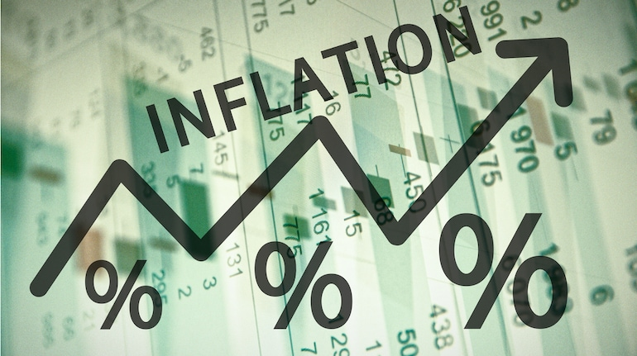
Over the past 50 years ….
During periods of higher ag commodity prices, farm input prices rose at a faster pace
During periods of lower ag commodity prices, farm input prices didn’t fall as fast

Slide 14
Inflation Affects ….
Farm Commodity Prices
Farm Inputs Prices
(Including Interest Rates)
Farm Income

Slide 15
Net Farm Income vs Changes in Inflation
Correlation Between NFI and Changes in CPI Since 1970
(-0.50)
Source: NASS/USDA and Federal Reserve Bank data

Slide 16
Inflation Affects ….
Farm Commodity Prices
Farm Inputs Prices
(Including Interest Rates)
Farm Income
Land Values
Farm Living Expenses
(Including Food Prices)
Exchange Rates/Trade
Overall Purchasing Power of Farm Resources

Slide 17
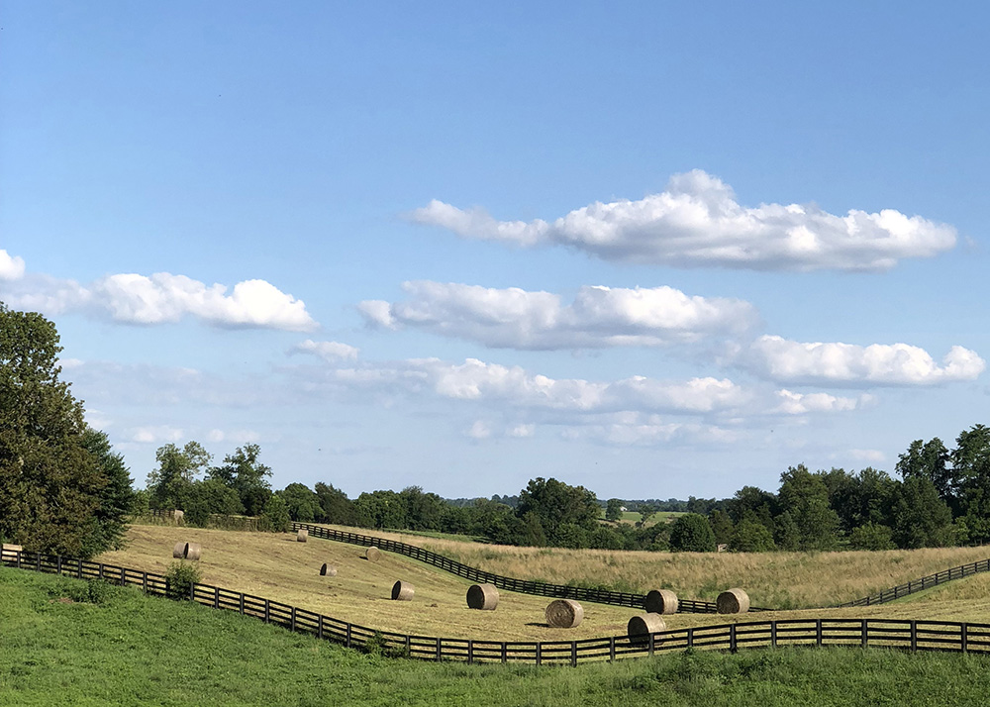
What about Farmland Values?
A good estimate of the current value of an asset
R
V
=
I
Where
V is the current (or present) value of a unit of land
R is the expected return per unit of land in each future time period
I is the discount (or interest) rate
Assume:
-- $250 annual expected return on land/acre
-- 5% interest rate
$250
= $5000/acre
.05
Assume:
-- $250 annual expected return on land/acre
-- 7% interest rate
$250
= $3571/acre
.07

Slide 18
KY “Average” Land Values vs
Interest Rates (10 Year Treasury)
Source: ERS/USDA

Slide 19
Annual Percentage Change in KY Land Values vs Inflation
Average Annual Change in Land Values (+4.6%)
Average Change in Inflation (+2.8%)
Source: ERS/USDA

Slide 20
KY “Average” Land Values Adjusted for Inflation
(Measured in 2021 Dollars)
Source: ERS/USDA

Slide 21

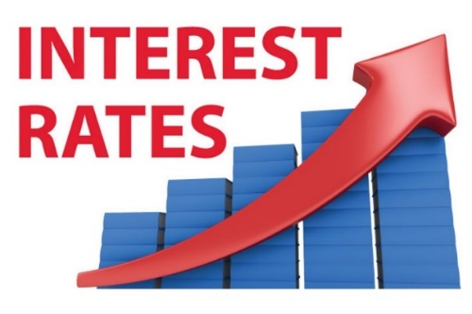
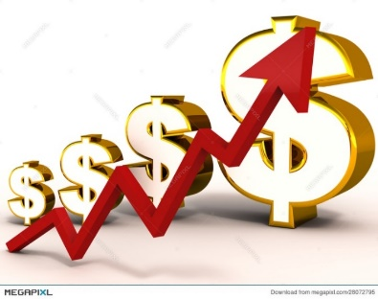

How Does Inflation Impact Exchange Rates?
Sustained and “Unacceptable Levels” of Inflation
Action by the Fed to
raise U.S. interest rates
Increases the demand for U.S. dollar denominated financial assets
Increase in the value of the U.S. dollar ….
reducing the demand for U.S./KY Ag exports

Slide 22
U.S. Ag Exports vs U.S. Trade Weighted Exchange Rate
Source: FAS/USDA

Slide 23
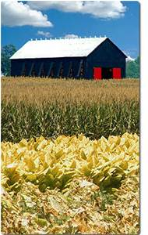
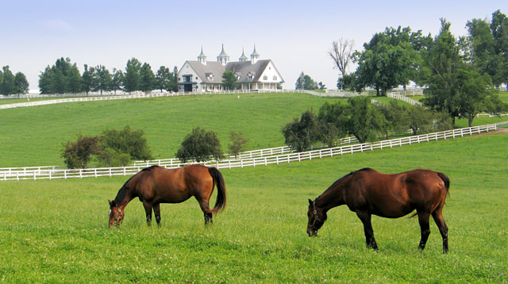
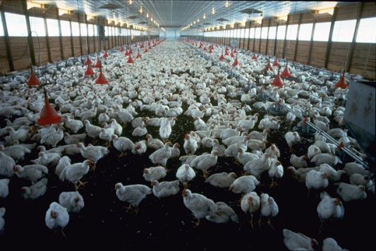
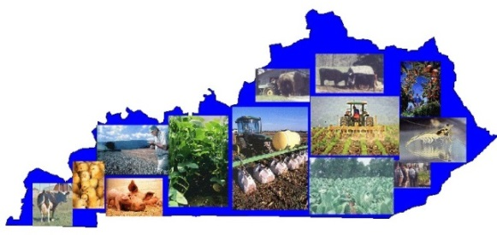
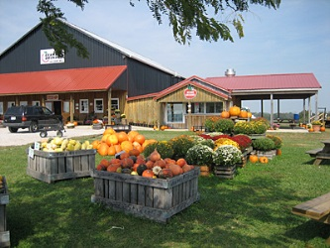
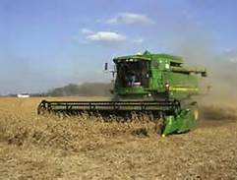
Observations of the Impact on Inflation on the 2022 Kentucky Farm Economy?

Slide 24
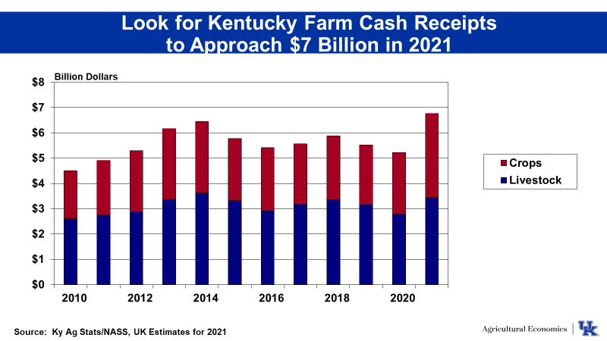
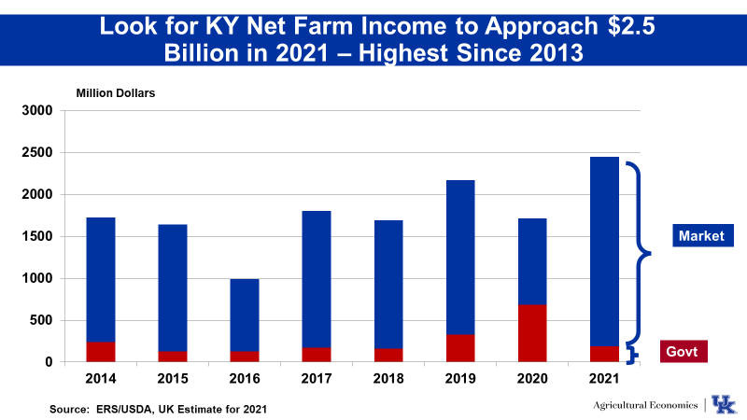
UK Ag Econ Dept Estimates From Dec 2021

Slide 25
KY Grain Profitability
2022 vs 2020
Source: UK Dept of Ag Economics – Greg Halich

Slide 26
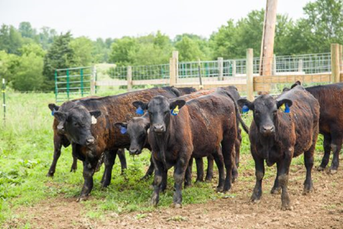
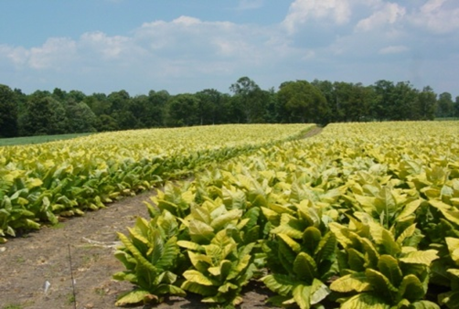
KY Cattle and Tobacco
Cattle (Kenny Burdine)
Input costs up 20-30% in 2022
Higher fall calf prices (+0.20/lb) may offset higher input costs for cow/calf operations
Anticipated fall stocker prices may more than offset higher input costs
Tobacco
Companies boosted contract prices 7-12%
Input costs up 10-20%

Slide 27
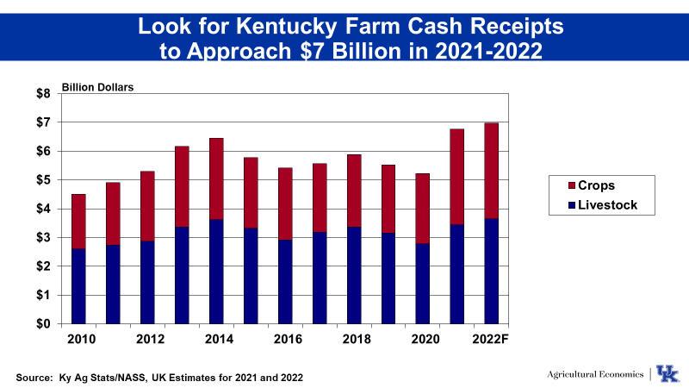
KY Ag Outlook for 2022
Exceed $7 Billion in 2022
Higher Cash Receipts Could Offset Higher Cash Costs, But Limited Govt Payments Will Constrain Growth in Net Farm Income
Despite Inflation – 2022 Has Potential of Being a “Good” Year for KY Ag ….
2023 Raises a lot of Concerns if Inflation Doesn’t Subside

Slide 28
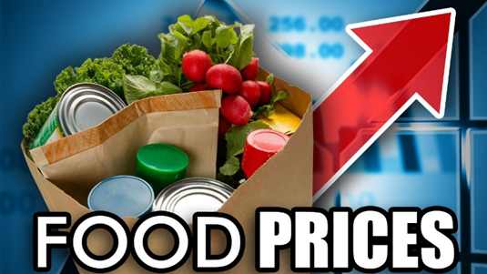
What about Food Price Inflation?
Over the past 12 months (+9.4%) …
Eggs +23%
Poultry +15%
Beef +14%
Pork +14%
Milk +9%
Fruits +8%
Vegetables +6%

Slide 29

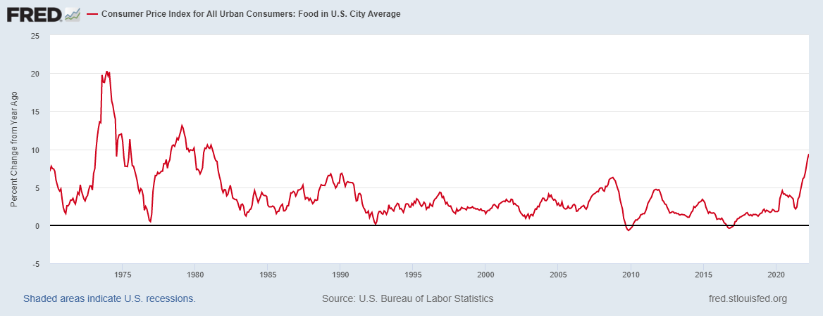
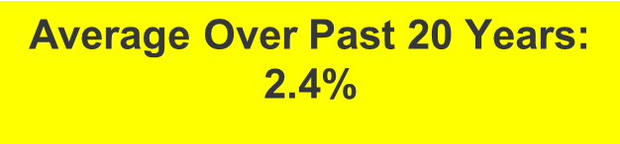
U.S. Food Price Inflation
(1970-2022)
+9.4%
Source Federal Reserve Economic Data (FRED).
1/ Note: Data reflects changes in monthly prices over the past 12 months

Slide 30
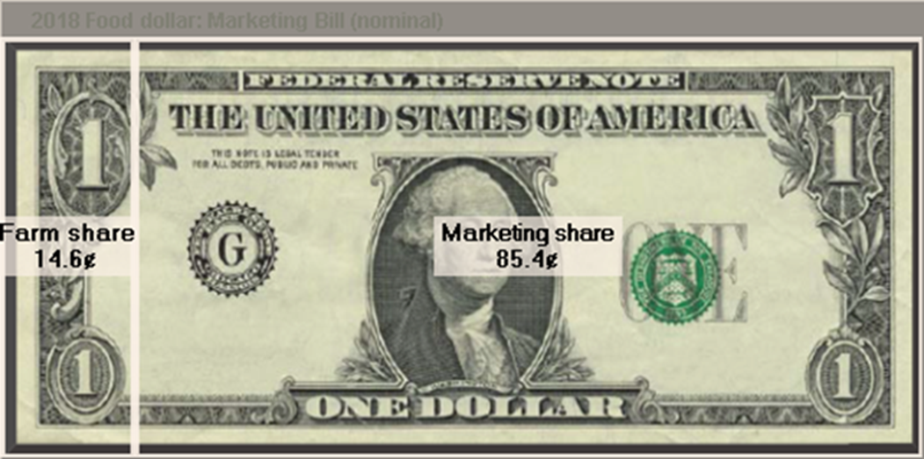
What’s Driving Food Price Inflation?
Higher Commodity Prices --- YES … but not the only factor and somewhat a delayed impact
Higher Fuels Prices
Higher Labor Cost
Supply Chain Disruptions
Higher Packaging Costs
Increased Consumer Demand
Increased US Food Exports

Slide 31
Food Price Volatility: U.S. vs Global
(1990-2022)
Annual Change in Food Prices
U.S. Food Price Volatility
Source Federal Reserve Economic Data (FRED), and Food and Agriculture Organization (FAO) Food Price Index
Note 2022 data based on March 2021 – March 2022 period.

Slide 32
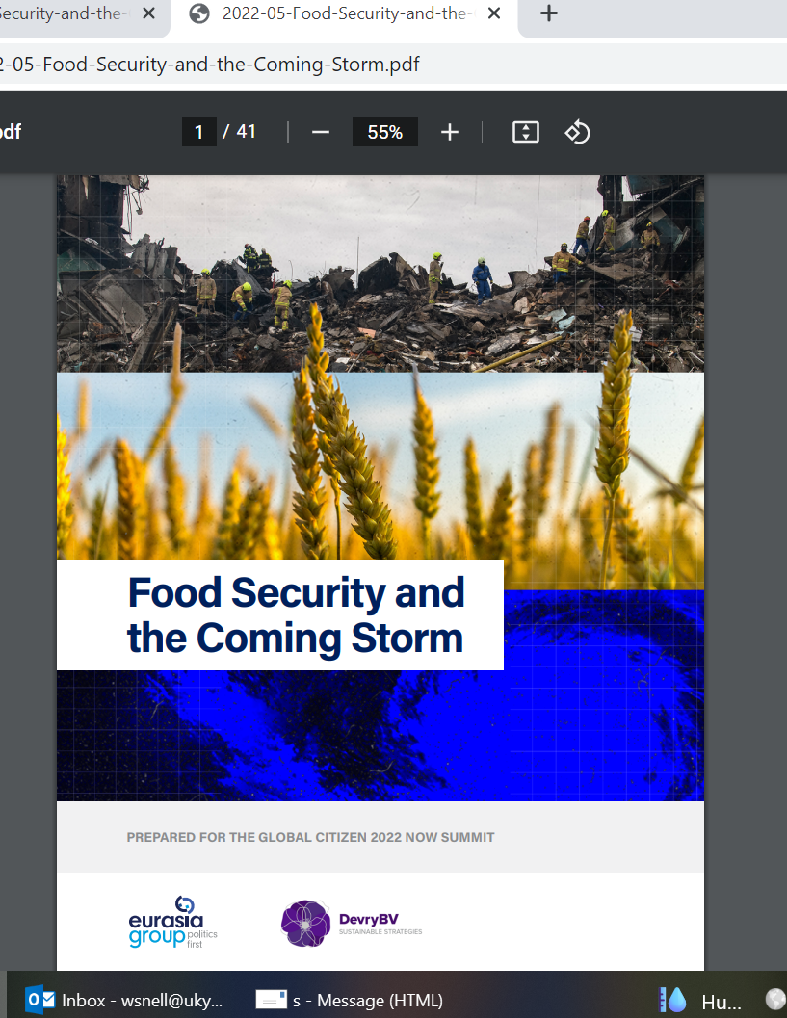
Russia-Ukraine War – Already Contributing to Global Food Inflation/Food Insecurity …. and will get much worse if the war lingers
Russia and Ukraine account for:
29% of global wheat exports
17% of global corn exports
14% of global barley exports
80% of global sunflower oil exports
Approximately 12% of global calories
2022-23 Outlook – War may cause 30-50% reduction in production/exports
“The numbers surrounding global food insecurity are alarming: In the next six months the world could see as many as 240 million more people become food insecure, between 3.5 million and 7 million more wavering on the edge of famine, and an additional 200 million living in extreme poverty,”
Michael Sheldrick, co-founder and chief policy, impact, and government relations officer, Global Citizen.
https://www.agri-pulse.com/ext/resources/2022/2022-05-Food-Security-and-the-Coming-Storm.pdf

Slide 33
Final Observations: Inflation “Good” or “Bad” for Ag Producers and Consumers?
For Consumers … Pretty easy answer
For Producers …During periods of relatively high/sustained inflation …
  Commodity prices tend to increase, but so do farm input prices which over the past several decades have increased more than farm prices and tend to come down slower when commodity prices start falling
  Inflation tends to boost land values, but is tampered by eventually higher interest rates
  Higher U.S. interest rates put upward pressure on the value of the U.S. dollar, hurting U.S. ag exports, holding all other factors constant
  Bottom line --- Uncertain impact… Depends on severity and length of “excessive” inflation (short run vs long run) and one’s position in the ag/food chain (farmland investor, owner or renter, plus one’s dependence on borrowed funds and/or international markets).

