Slide 2
Industry Supporters
Kentucky Association of Meat Processors

Slide 3
Industry Priorities
Strengthen Kentucky’s processing industry
Workforce development: Management, technical assistance, research in food safety
Collaborate efforts in advocating Kentucky agriculture assets
Support value–added product development and marketing
Assist producers in developing marketing opportunities to make them more economically sustainable
Provide technology transfer opportunities to improve in aspects of the production, food, and consumer industries
Promote foods impact on human health
Immersive education models
Regional universities and technical schools
Develop programs to overlap departments/focus areas
Facilitate internships and apprenticeships

Slide 4
“Centers” – Public Private Partnership
Service to the food-processing industry.
Research for solving problems and creating new products for the food-processing industry.
Education focused on technology transfer for the food-processing industry.
326+ Million Sales Revenue
1,150+ Jobs Created

Slide 5
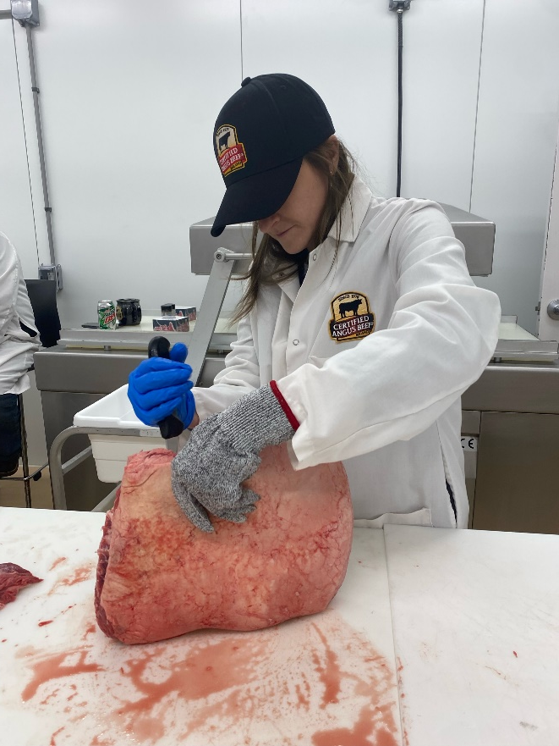
“Centers” – Public Private Partnership
Site Visits:
Meat Science and Muscle Biology Laboratory – Mississippi State University
Global Food Innovation Center – Colorado State University
Meat Science Laboratory – Purdue University
Certified Angus Beef Culinary Center
Commitment from UK
Memorandum of Understanding – Signed Oct 2021

Slide 6
Industry Priorities
An education center that would serve as a key resource for industry through continuing education and training.
A food processing center that would provide innovative and modern approaches to education, research, and workforce development in the processing industry.

Slide 7
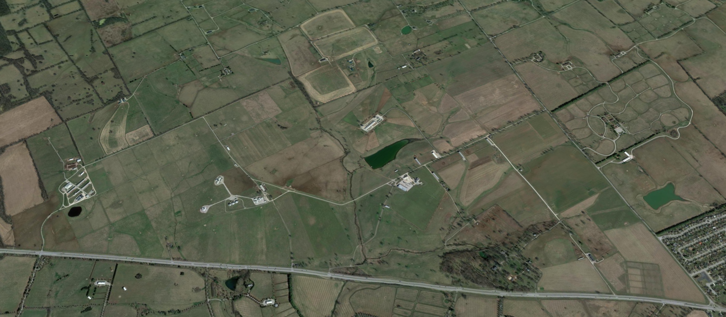
“ a central focus”
Sheep Unit
Future ARS Animal Lab
Future ARS Dairy Calf/Heifer Lab
AFS Dairy Research Lab
Poultry Unit
Swine Unit
Beef Unit
Meats and Foods Development Center
Ag Education Center

Slide 8
Woodford County Farm - Timeline
1990 – Funds were provided by the General Assembly for the purchase of the former Pin Oak Farm.
1996 – General Assembly provided $12.4M for Phase I.
Beef, Swine, Sheep Unit
1998 – Dean Little Proposal for Phase II = $19.2M
Dairy, Nutrition, and Learning Center
“The development of new technologies and methodologies for the sake of their development alone is of little benefit to anyone. The true merit lies in the timely and accurate dissemination of that technology in a manner such that it reaches the maximum number of potential clientele.” – Dean C. Oran Little

Slide 9
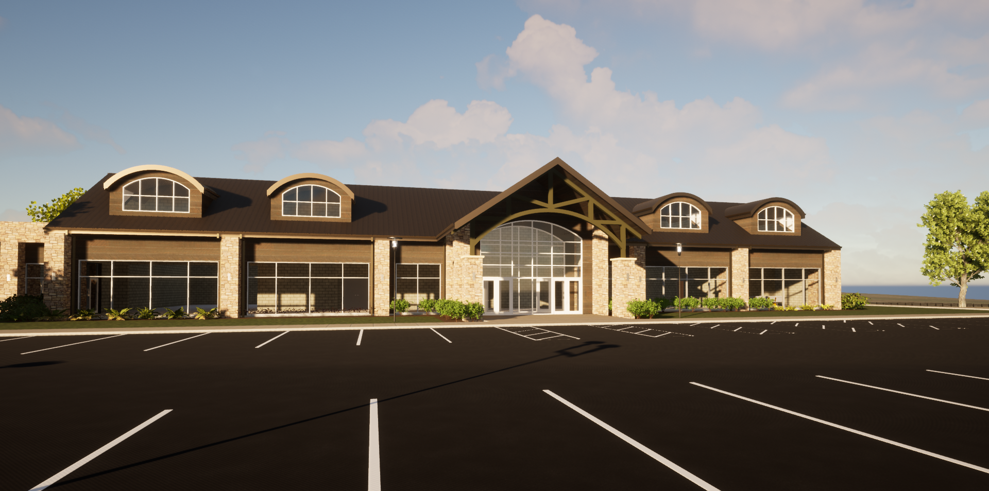
Agriculture Education Center

Slide 10
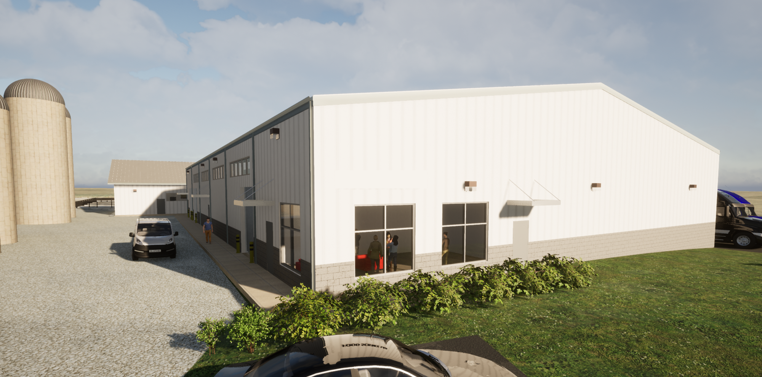
Kentucky Value-added Meats and Foods Workforce Development Center

Slide 11
Workforce Development
Provide individual consultations and technical assistance in food safety and processing
HACCP (Hazard Analysis and Critical Control Points
Third Party Good Agricultural Practices (GAP) & Good Handling Practices (GHP) Audit Training
GFSI (Global Food Safety Initiative)
Provide Human Resources Training Workshop
Employee recruiting, training, and retention, background checks, payroll, benefits; and assistance for software technology designed for small business
Occupational Health and Safety, and Ergonomics Training Program
Assist the food processing industry in meeting their occupational health and safety requirements
Environment and Water Quality Control
Understanding water and wastewater flow is absolutely essential to any processor

Slide 12
Value Added Food Systems
Produce Best Practices
157 home-based processors & 1463 home-based microprocessors either sell on-farm, at roadside stands, and/or in farmers' markets.
Value-added Dairy Processing
Establish a pilot program to identify aging rooms/caves that could provide Kentucky cheese producers a unique recipe development
Value-added Red Meat and Poultry Processing
Kentucky has 85 local, family-owned red meat processors (42 USDA-FSIS inspected) and 5 poultry processors (2 USDA-FSIS inspected, 1 Kentucky Cabinet for Public Health inspected).
Develop The Meat Processor Certificate Program & Processed Meats Clinic
Retail & Food Service Culinary Kitchen
Grocery store, restaurant, cafeteria, and consumer education
Foster innovation in food marketing, packaging, and preparation

Slide 13
Producer Profitability
Help agricultural producers participate in value-added activities to generate new products, create and expand marketing opportunities, and increase income
Develop practices that enable farmers to align with consumer preferences for agricultural or food products
Demonstrate best management practices for a direct return on investment
Apply research to practical solutions
Gain access to new markets
Capitalize on Kentucky’s agriculture assets and tradition

Slide 14
Student Enrichment & Development
Collaborate Departments
Animal and Food Science
Biosystems & Agricultural Engineering
Community & Leadership Development
Entomology
Family Sciences
Forestry & Natural Resources
Horticulture
Landscape Architecture
Plant & Soil Sciences
Plant Pathology
Retailing and Tourism Management
Veterinary Science
Dietetics & Human Nutrition
Create a pipeline among junior, state, and regional colleges and universities
Provide better exposure of different careers available within the animal and food processor industries
Develop vocational programs
Expand dietetics and human nutrition to focus on foods impact on human health

Slide 15
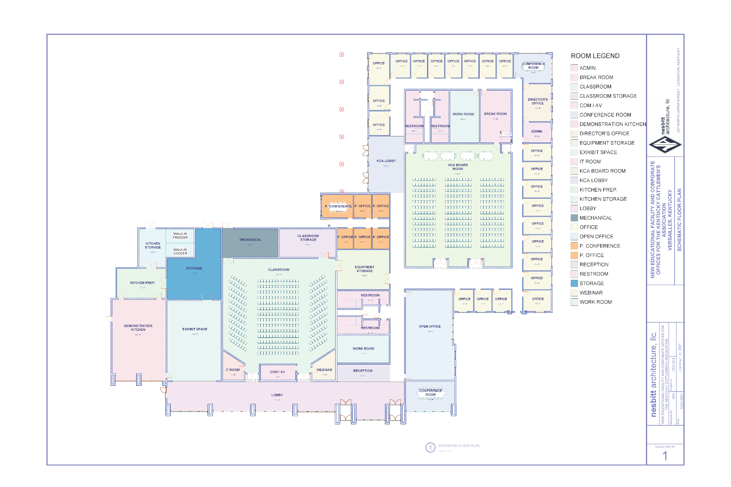

Slide 16
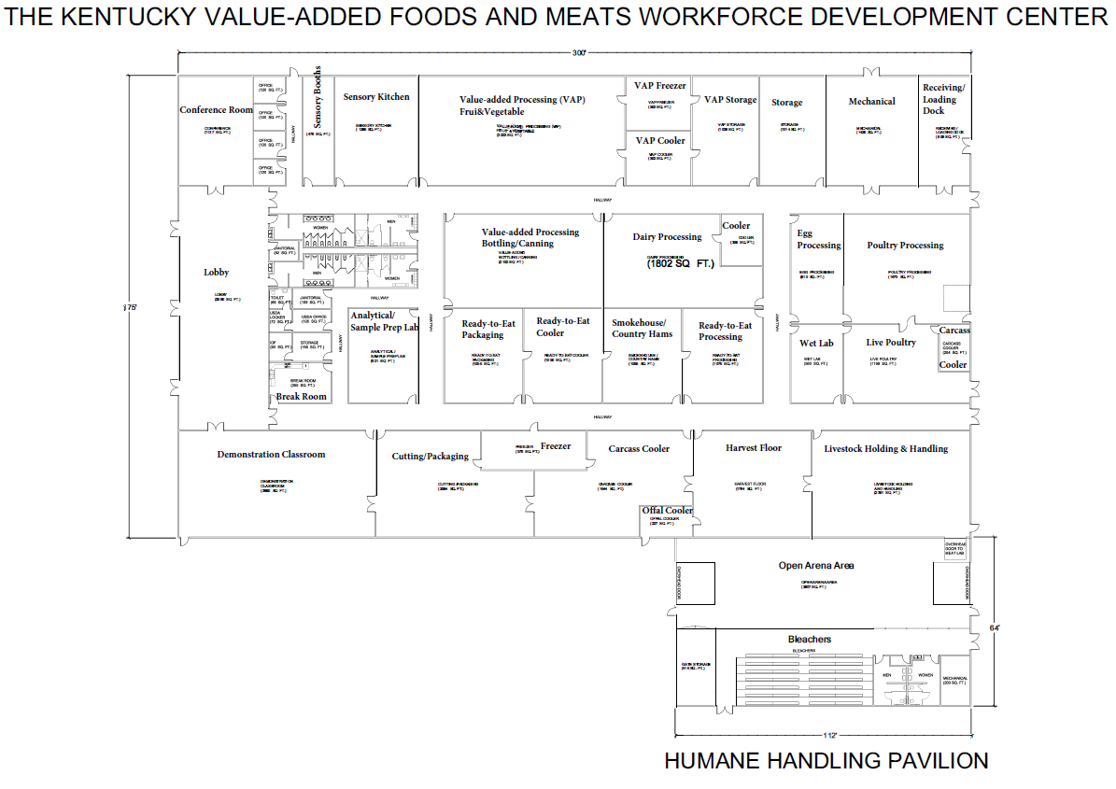

Slide 17
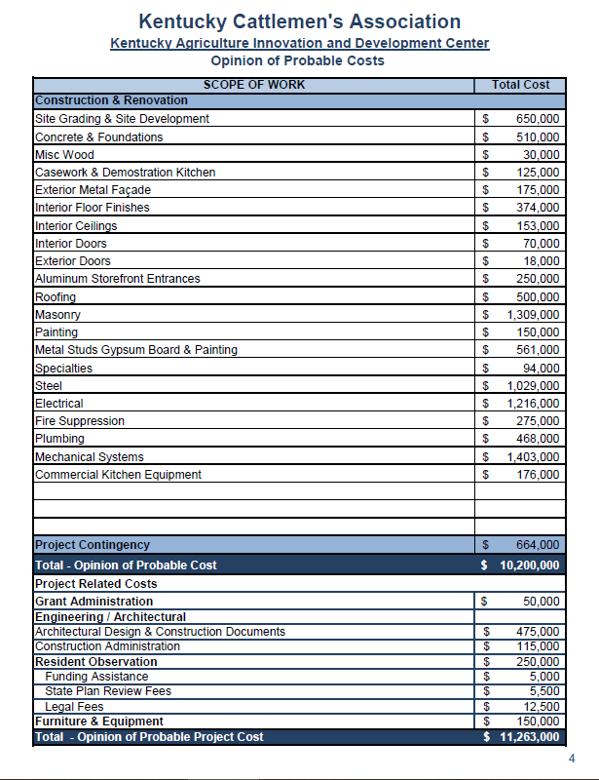
Agriculture Education Center
$11.3 Million Construction +Land & Road Improvements
$15 Million – Total Project
Meats and Foods Development Center
$52.7 Million Construction (est @ $900/sqft) +$2.8 Million Equipment +Land & Road Improvements
$60 Million – Total Project
Sustainability
Federal grants
Cost-effective workshops, trainings, and commercial processing consultations service fees
Shared use agreements and rentals with industry partners
Industry investment

Slide 18
Industry Outcomes
Capitalize on a public-private model
Create a proactive industry committee
Enhance research and development
Increase employment opportunities
Celebrate Kentucky’s agriculture heritage
Be the leader in the Southeast

