Slide 2
Office of State Veterinarian Impacts of Veterinary and Staff Shortage
Dr. Katie Flynn
State Veterinarian
Office of State Veterinarian
Kentucky Department of Agriculture

Slide 3
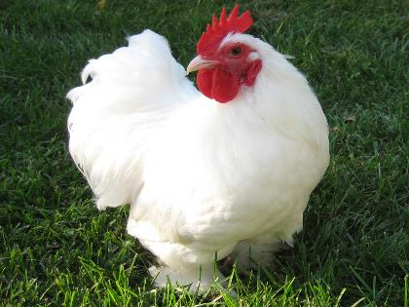
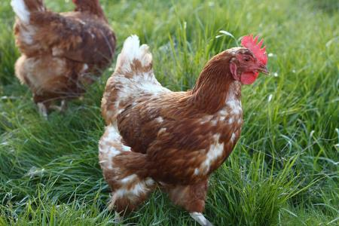
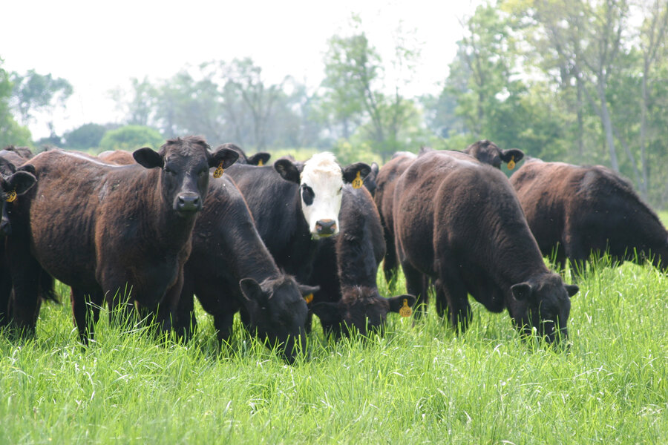
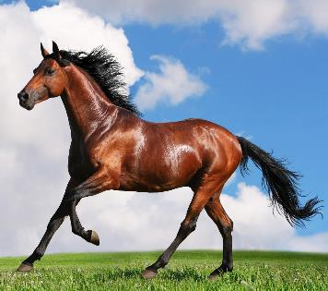
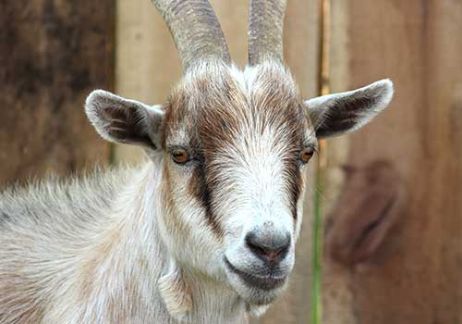
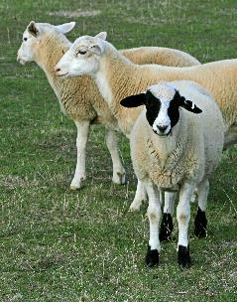
Office of State Veterinarian Mission: To Protect Kentucky’s Animal Agriculture
Almost 1 million head
289 million broilers
5 million layers
1.3 billion eggs
~400,000
(Market Hogs)
65,000
43,000
~300,000

Slide 4
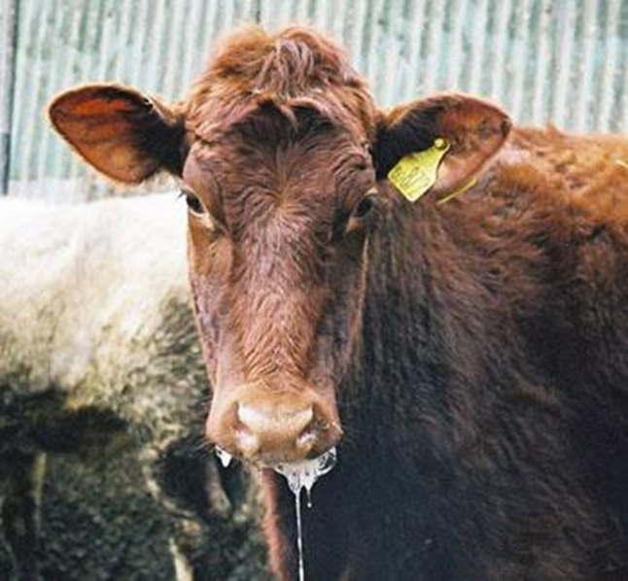
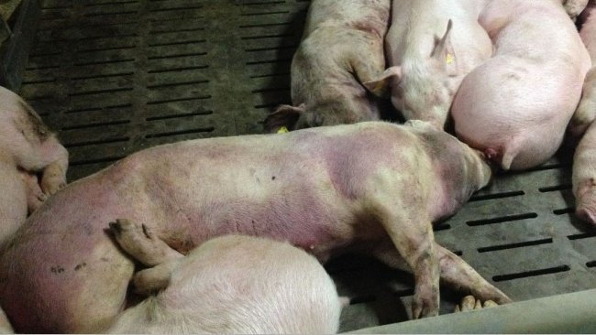
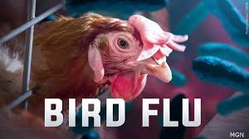
Critical Role In Protecting the Food Supply
African Swine Fever
Foot and Mouth Disease

Slide 5
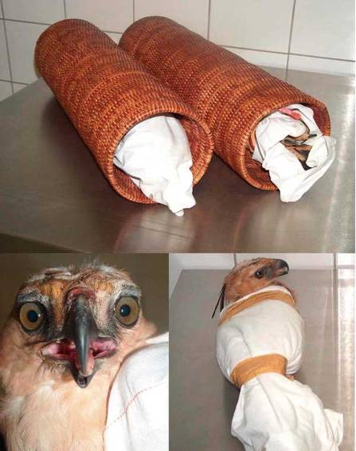
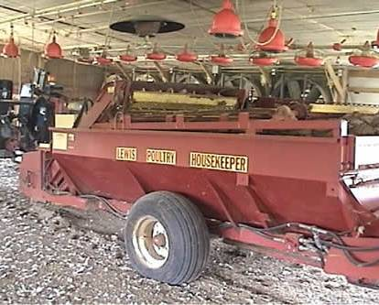
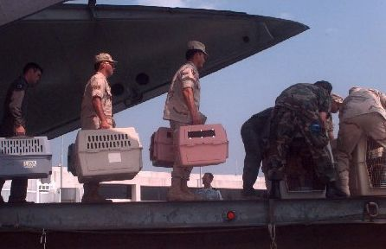
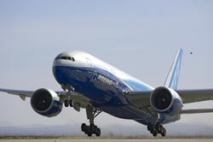
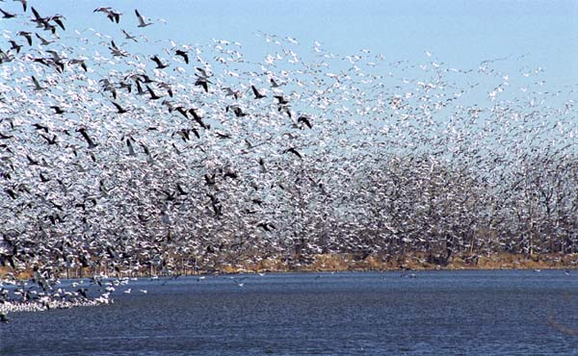
Is Kentucky Safe From A Foreign Animal Disease Agent Entry?

Slide 6
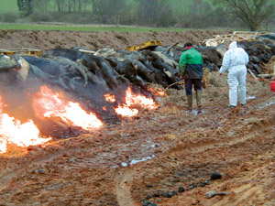
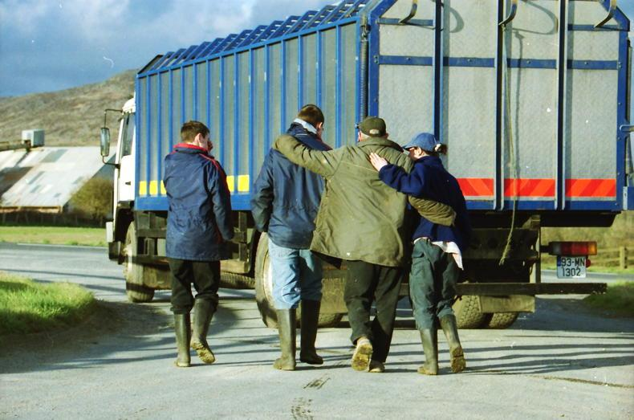
Consequences of Foreign Animal Diseases
Animal morbidity or mortality
Human morbidity or mortality (Zoonosis)
Economic Impacts
Local producer
Local economy
National Economy
International trade
Social Impacts

Slide 7
Foreign Animal Disease Hits KY in 2022 Highly Pathogenic Avian Influenza
4:50pm Friday February 11, 2022 - Veterinarian Call from Fulton Co. Broiler Premises
Increased mortality, significant decrease in water consumption, respiratory signs
Approx. 240,000 birds (46 day old) in 12 broiler houses on the premises
11:58pm on Friday- Presumptive positive on Matrix and H5
Saturday morning- Sample hand carried by federal personnel to National Veterinary Services Laboratory (NVSL) in Ames, Iowa
NVSL Confirmation of H5N1 Eurasian Strain at 9pm Saturday February 12th
Saturday evening February 12th- Call from Turkey Manager at a Webster Co facility
Increased mortality (9,31,184) and decreased water consumption (1716, 1224, 600) in only one house
Approximately 54,000 turkeys (117 days of age) in 6 barns
Sunday AM- Presumptive positive, Confirmed by NVSL
Detection February 12 to Freedom from Diseases May 15,2022
Trade Implications

Slide 8
Kentucky Ranks
7th
in US Broiler Production

Slide 9
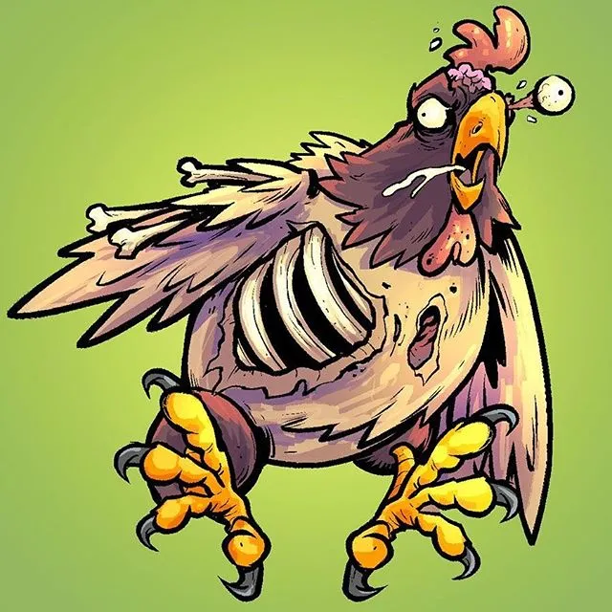
February 2022 HPAI Incident Summary
Fulton County
1 affected premises- 231,398 birds depopulated
940 Door to Door Contacts--- 57 Backyard Quarantines Issued (37 in TN)
6 commercial premises quarantines issued within control zone
Webster County
1 affected premises ---53,286 birds depopulated
1163 Door to Door contacts--- 31 backyard quarantines issued within control zone
13 commercial premises quarantines issued within control zone
Permitting
71 Permits and 337 movements
318 feed movements, 12 egg movements- 10 to hatchery and 1 to farm, 6 live bird movement to Slaughter, 1 live birds to farm
Time Frame
February 12, 2022- May 15, 2022 (regained OIE free status)
https://www.flylanddesigns.com/zombie-chicken/

Slide 10
OSV Staffing and Workload Impacts
OSV Field Response Staffing | # Staff | Total Hrs on HPAI | OT Hrs on HPAI | State Vet Hours
Week 1 (2/12-19) | 22 | 822 | 148 | 108.5
Week 2 (2/20-26) | 20 | 754 | 181 | 77.5
Week 3 (2/27- 3/5) | 7 | 347 | 72 | 68
Week 4 (3/6-12) | 10 | 180.5 | 21 | 65
Week 5 (3/13-19) | 9 | 207 | 25 | 64
Week 6 (3/20-26) | 4 | 190.5 | 46 | 56
TOTALS |  | 2113.5 | 447 | 439
First Week Deployments
22 OSV staff assigned
822 hours record on HPAI (148 OT hours)
Emergency Cooperative Agreement Awarded- Staff OT, Per Diem, Travel, Supplies
Balancing “Clean” and “Dirty” Personnel
Only clean personnel could respond to sick calls and then were on hold for at least a day until the test results came back. If negative considered clean but limited exposure to other poultry.
Those on infected premises are considered dirty until 5 days after last visit to premises
Work Not Completed
100% of NPIP inspections with inspection dates of Jan- now 2022 (24)
73% of the annual CWD inspections not completed (91/124)
67% of rendering first quarter inspections not completed (22/33)
35% of Stockyard sale days missed (43/135)

Slide 11
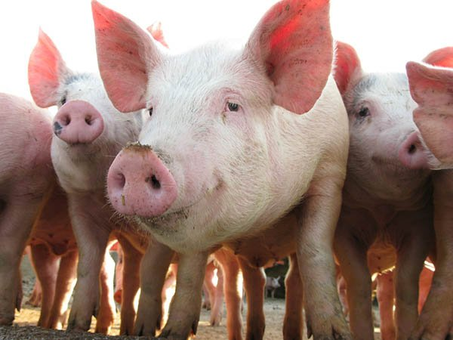
Kentucky and Pork
Ranks 17th in Pork Production
1,805 swine farms in Kentucky (Production commercial, backyard, show swine)
More than 860,000 swine produced annually in Kentucky
Sale of market hogs and pigs - $170,2 million in 2021 (up 33% from previous year)
8,882 jobs supported by KY Pork Industry
Over $459.7 Million in personal income
Large Sow Slaughter Plant in Louisville
Sources 70% product from KY and TN farmers
Growing Industry with new herds entering Kentucky
Since 2017 the number of swine operations has increased by 500

Slide 12
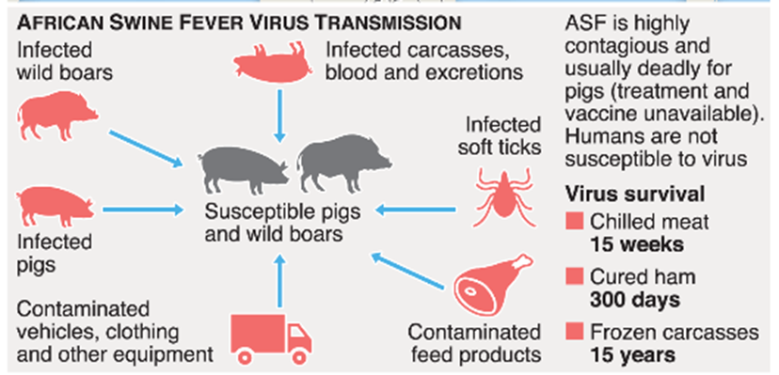
Now What if African Swine Fever Hit Kentucky at the Same Time as HPAI? Is it Possible?

Slide 13
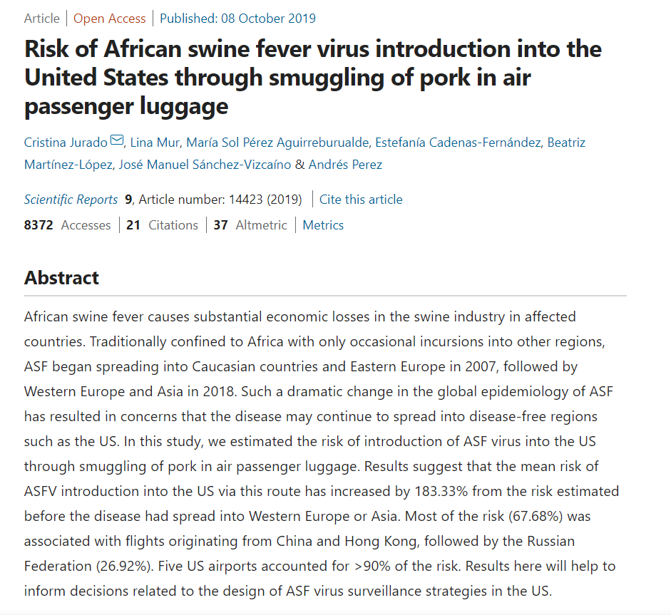
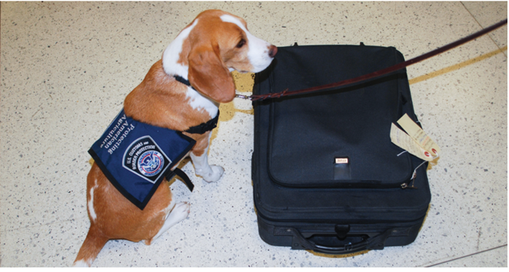
Risk for Entry to the United States
A modeling project published in 2019 estimated the risk of ASF virus introduction into the U.S. via international air travel has increased more than 180% since 2018
China, Hong Kong, Russia and Poland account for 97% of the risk, with all other countries contributing less than 1% of the risk.
https://cahfs.umn.edu/news/risk-asf-virus-introduction-us-air-passengers

Slide 14
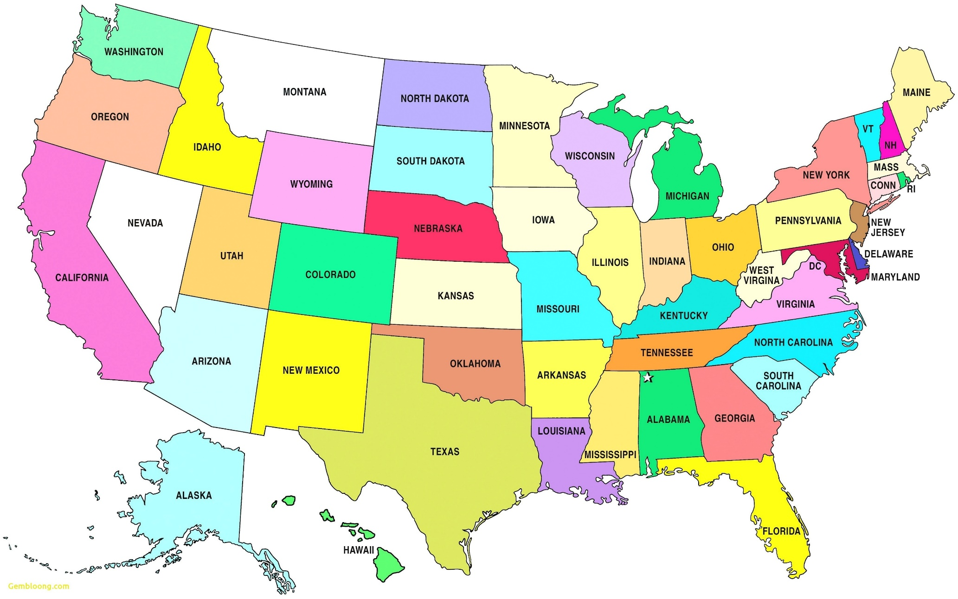
Swine Imports to the Expo Center
Date Range: January 1st,2021 - December 30th, 2021
Total Number of States: 38 States

Slide 15
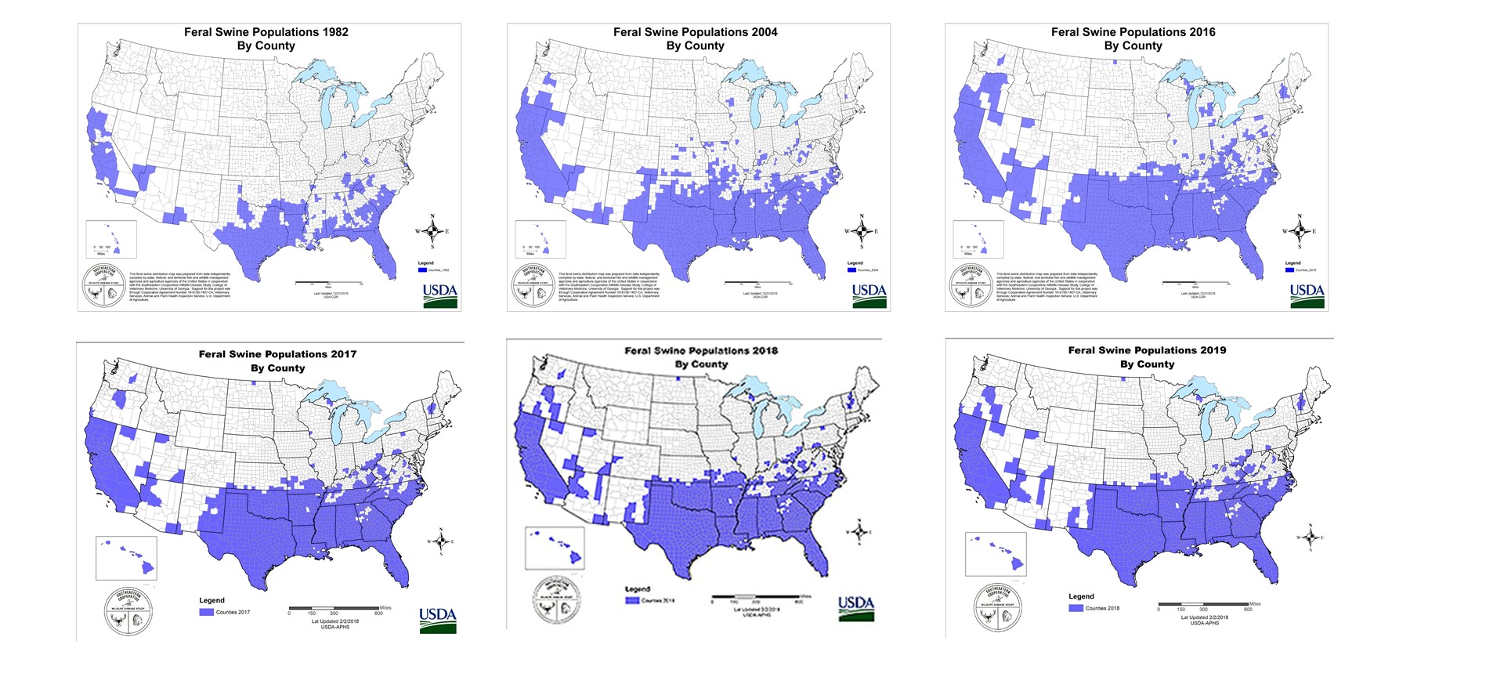

Slide 16
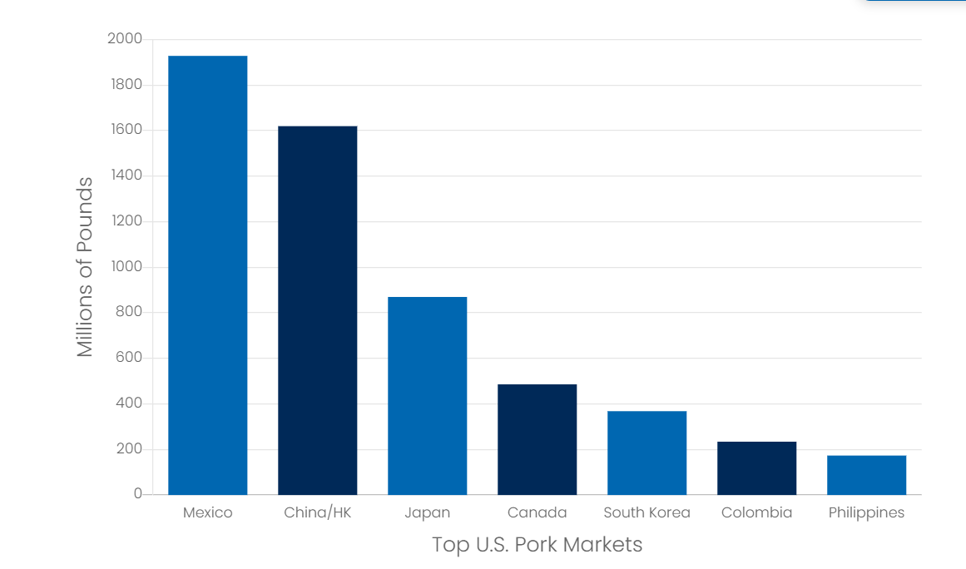
Potential Impacts of ASF Incursion
Export Markets Close
US produces 12% of world’s pork
Export Market $8.1 billion in value
6.4 billion pounds of pork exported
~30% of total pork production is exported
40-50% reduction in US Live Hog Prices
To sell the surplus of pork intended for Export
Economic Impact
Revenue Loses -$15 billion in losses
National Job loss – Potentially up to 140,000 jobs
All Hog Movement Stops Initially for 72 hours
Resumption of Movement only if disease risk assessment deems low risk

Slide 17
Does the United States have an adequate staffed and trained veterinary field force for Foreign Animal Disease Incursion and Natural Disaster? Does Kentucky and the Office of State Veterinarian?

Slide 18
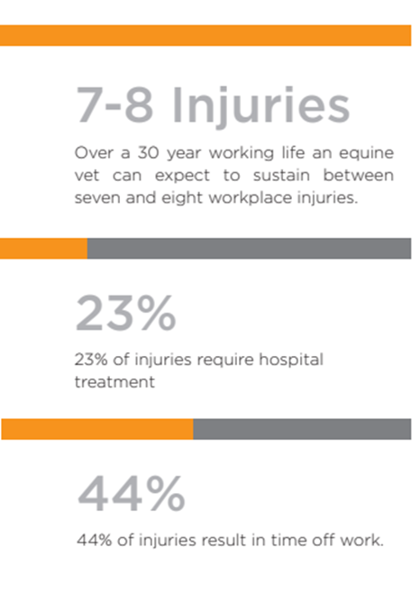
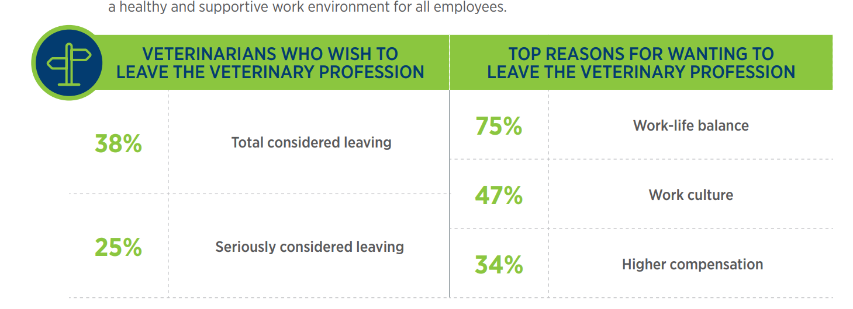
Where are the Large Animal Veterinarians? Why are Veterinarians Leaving or Not Entering Large Animal Practice?
Salary- Small Animal higher paid
Hours– On call Schedule, longer hours
Dangers of the job
Emotionally Draining/ Compassion Fatigue
Unrealistic Client Expectations
Source: BEVA 2014 Study

Slide 19
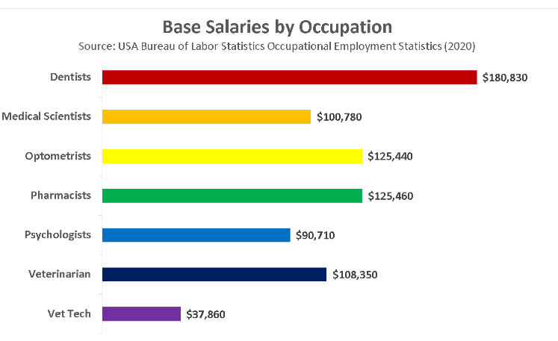
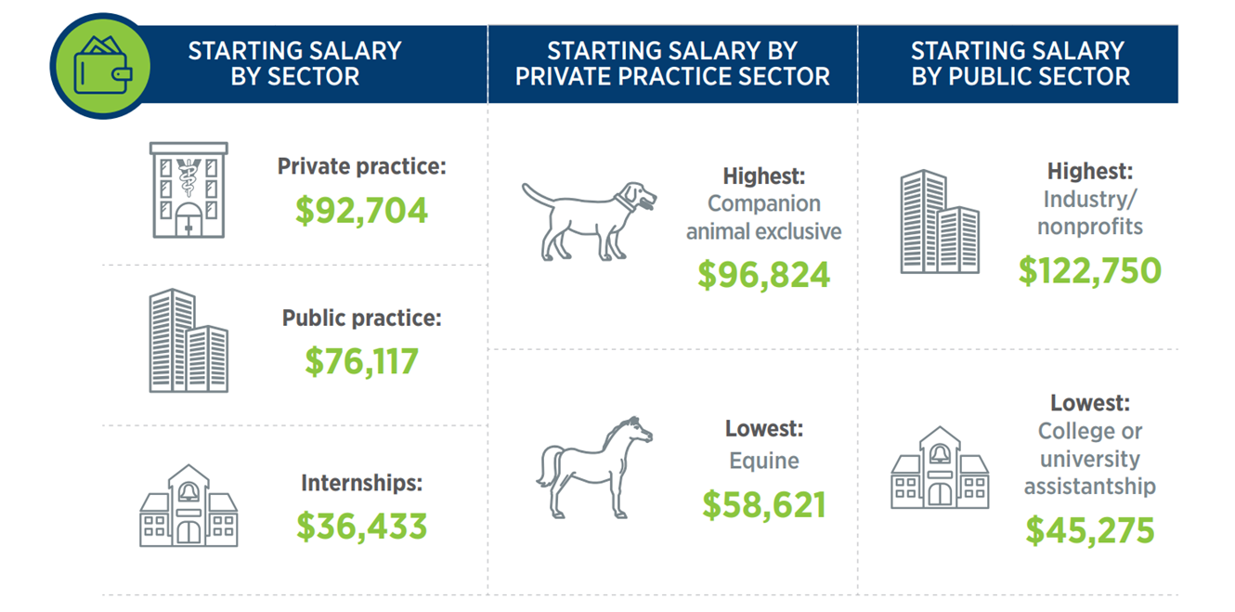
Veterinarian Salaries and Debt Load
Notes:
https://www.careerwatch.co/blog/veterinarian

Slide 20
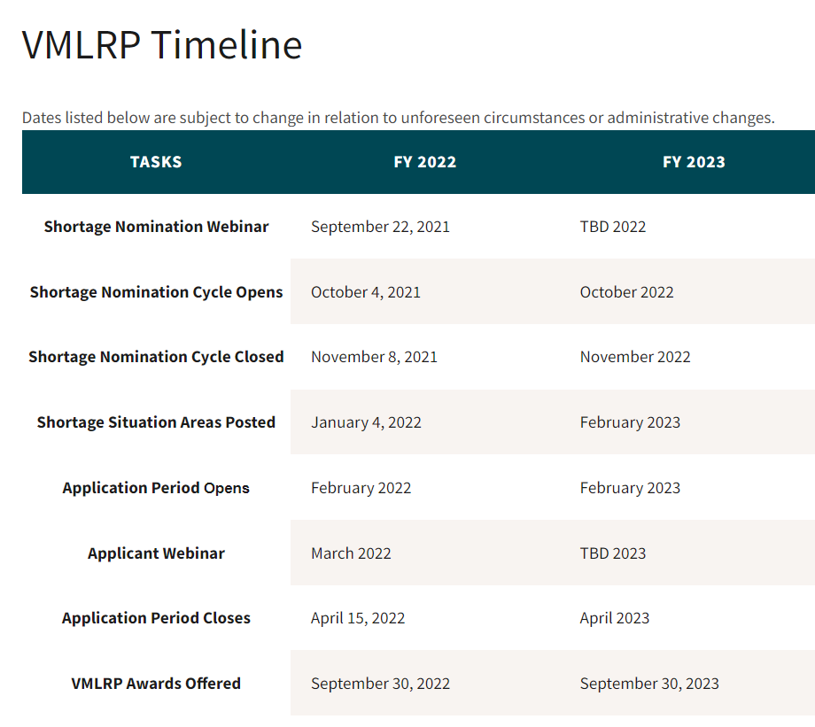
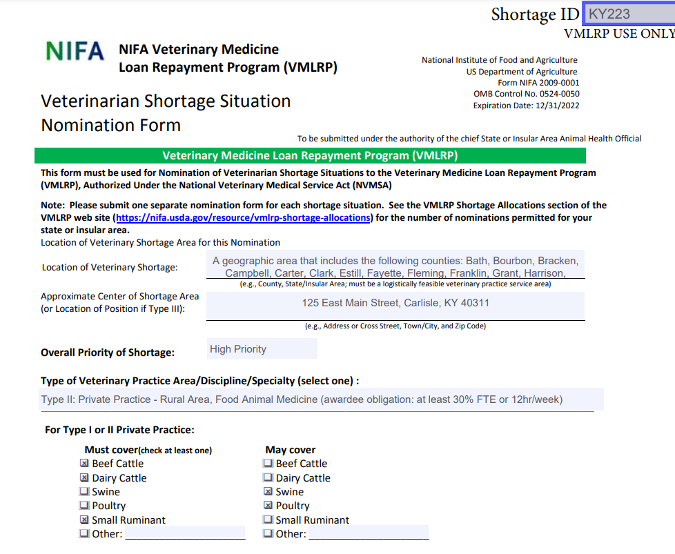
Veterinary Medicine Loan Repayment Program
Year | Awards | Nominations
2021 | 3 | 5
2020 | 2 | 5
2019 | 2 | 5
2018 | 2 | 5
 | 9 | 20

Slide 21
KDA’s Current Authority and Budget
has created and funded 4 full-time positions and one temporary/part-time contractor
Executive Staff Advisor
To serve as Emergency Coordinator
To be housed in the Office of State Veterinarian
Hired and started November 1st
1
Special Assistant
To serve as fourth veterinarian
Will work in the field
Three candidates interviewed, one declined offer
2
Agriculture Regulatory Specialist I
To be additional support to current field staff
Recently posted
Will be based in Area 4
3

Slide 22
KDA’s Current Authority and Budget
has created and funded 4 full-time positions and one temporary/part-time contractor
Branch Manager
To serve as manager and supervisor over the current four investigators
Position is in the process of being created with the Personnel Cabinet
Will increase total investigators to five
4
Temporary/part-time contractor
Will work to develop Food Safety and Emergency Preparedness Plans
Individual has been selected, hired through a temporary employment agency, and will start November 7th
Work will take approximately six months and be paid for with USDA Cooperative Agreement Funds
5

Slide 23
Request to the General Assembly:
- SUMMARY -
To create a new Division within the Office of State Veterinarian titled Division of Emergency Preparedness and Response
To rename current two Divisions:
Division of Animal Health → Division of Regulatory Field Services
Division of Producer Services → Division of Animal Health Programs
- PURPOSE -
To address the top three deficiencies identifies during the past year, which include Emergency Programs, Policy and Regulations, and Outreach and Education

Slide 24
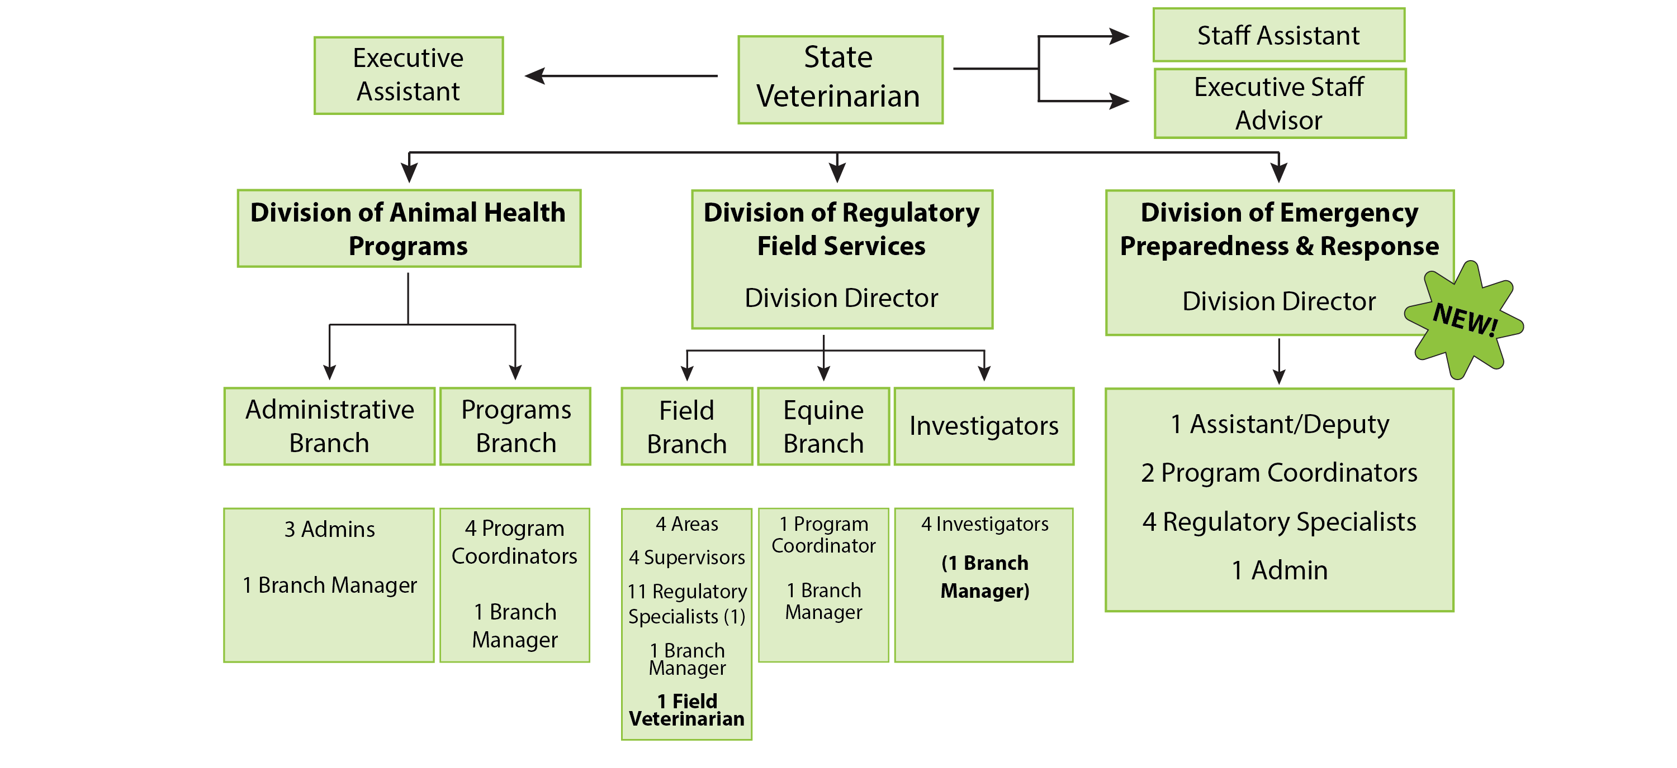
The new Division would include the following positions:
Division Director
- Non-merit, executive management
Assistant Director
- Merit staff
Program Coordinator
- Focused on emergency programs
Program Coordinator
- Focused on outreach and education
4 Agriculture Regulatory Specialist
- One for each 4 areas
Administrative Assistant II
- Office based to support division

Slide 25
Questions?
Commissioner Ryan Quarles
Dr. Katie Flynn
(502)782-5920
Katie.Flynn@ky.gov
www.kyagr.com/statevet
statevet@ky.gov
Keith Rogers
(502)782-9255
KeithL.Rogers@ky.gov
www.kyagr.com

