Slide 1
Presented by H.H. Barlow, Executive Director
Kentucky Dairy Development Council
November 3, 2022
Kentucky’s Dairy Industry
2022 and Beyond – Paving New Roads in a New Era
Notes:
Need date of presentation, check the subtitle?

Slide 2
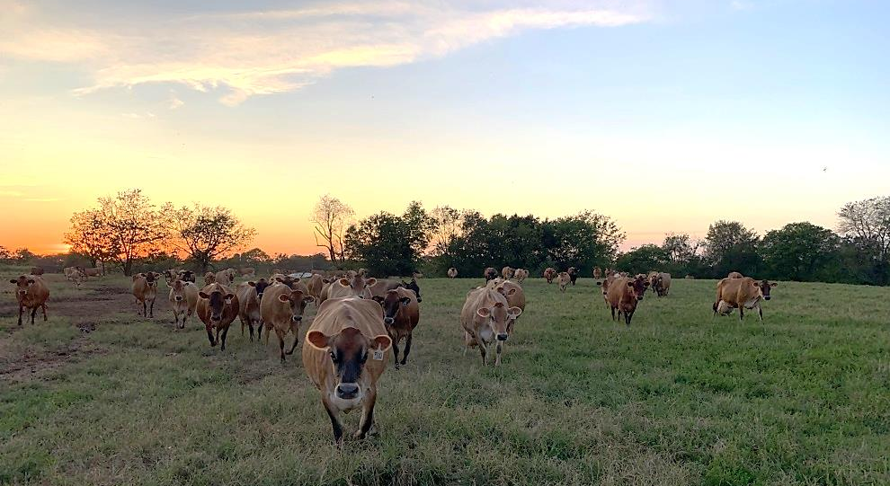
Our agenda today
Welcome
Introduction
History of Kentucky Dairy and KDDC
Industry Status
Need For Growth
KDDC Programs
Kentucky Poised for Influx
Recruitment Momentum
Closing

Slide 3
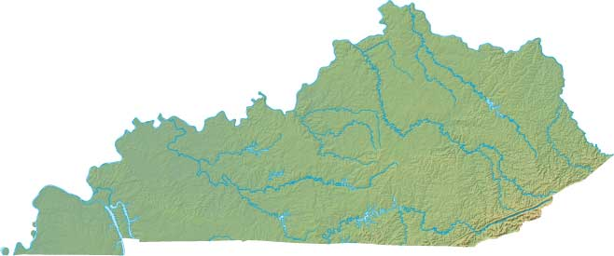
First, let’s travel back in time
2005 – KDDC formed, organizing Kentucky’s dairy industry
Tobacco buyout paved the road for diversifying agriculture
Kentucky’s dairy heritage was smaller but strong, primed and ready for new growth and opportunity
Through funding and support from Kentucky Ag Development Board (KADF)
3 main goals –
1. improve farmer profitability by increasing production
2. improve quality of milk produced
3. engage farmers to adopt and implement latest technology through education and involvement opportunities

Slide 4
By the numbers
The status of Kentucky Dairy - then and now
2011
2021
900 dairy farms
76,000 cows
Statewide Total Production:
1.09 Billion Lbs.
Per Cow Production:
14,300 lbs./year
420 dairy farms
46,000 cows
Statewide Total Production:
907 Million Lbs.
Per Cow Production:
19,740 lbs./year

Slide 5
What revelations must we glean from these statistics?
Key takeaways from this trend
SHARP Reductions in total numbers:
- total herds down 53% - total cows down 40%
- total production down 17%
Yet, SHARP increase in productivity:
- per cow production up 38%
…In just 10 years, we are MUCH smaller, but we are MUCH BETTER!
BUT… what good is it to be better if we become obsolete?
Must act to revitalize now!
Increase herds, cows, & overall production

Slide 6
How do we make that happen?
Parallel efforts to accomplish growth strategy
Grow our existing dairy farms
Recruit new dairies into Kentucky
Grow our existing dairy farms
Previously, markets disallowed more milk due to surplus. (still in central/northern KY but will be short lived – high transportation costs necessitate processors seeking local milk)
Worldwide production is down & US exports are up – all time high of 19% in June/July
Southern KY has open door now for more milk, seeking new supply
How do we get that supply from existing KY dairies?
1. grow cow numbers
2. improve production per cow
3. improve facilities
4. improve genetics
5. improve management and nutrition
KDDC programs and personnel play a major role in accomplishing these 5 goals and helping our
dairy farmers grow

Slide 7
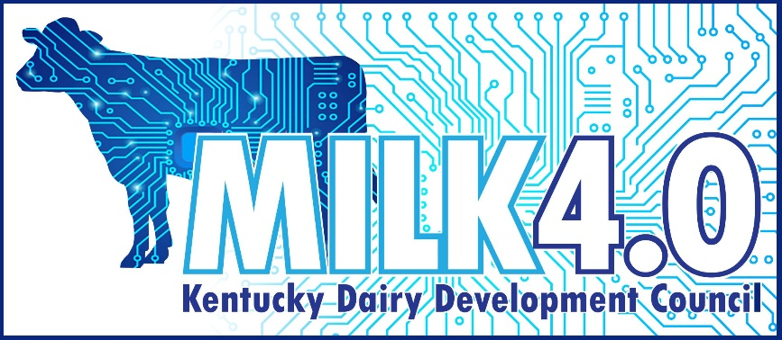
KDDC’S new MILK 4.0 Program
Programs strengthening our existing dairy farms
Using evidenced-based best practices from across US to drive success at home in KY!
1
Surveyed our greatest areas of need
2
Researched best practice farms ranking highest across the US
3
Consulted with nationally recognized dairy consultant specialists
4
5 major factors identified through this analysis effort:
a. Genetics b. Reproduction c. Quality d. Financial Analysis e. Beef on Dairy
5
For the genetics portion, we formed partnership with national genetic leader Zoetis to provide farmers with 50% discounts on genetics testing.
6
DHIA records utilized to evaluate reproductive performance and milk quality. Incentives are paid if/when goals are met.
7
Financial Analysis in cooperation with two entities:
a. University of Tennessee – Dairy Gauge
b. Rockingham Cooperative
Adoption of this robust program provides the latest in technology and practices bringing our dairy men and women into the 21st century!

Slide 8
Producers benefit from national initiatives supported by KDDC
Two additional value propositions…
Small Dairy Value-Added Program
Partnering with UT and NC State
3-year $6 million grant
Help new start-ups or existing dairies with establishing on-farm processing ventures
10 operations currently, several more in planning phase
Chaney’s Dairy Barn and Kenny’s Cheese - both tenured and successful examples
This year, my neighbor, the Jones family, started processing and selling their own milk as Legacy Dairy
Beef on Dairy
Gaining steam nationwide
Advent of sexed semen (predetermined gender of calf) resulted in too many dairy heifers thus flooded market
Genomics and record keeping allows easy identification of top 50% of your herd for raising milk cow replacements
Bottom 50% milk producing cows in herd can be bred to genetically superior beef bulls
Creates a cross-bred calf with premium carcass and cut quality over dairy bull calf
Adds at least $150 value to these calves over purely dairy bred
New cost-share semen & bull program for approved sires

Slide 9
Recruitment strategy for bringing new dairies into KY
KY – the future premier dairy state of the Southeast
Sounds nice but what is the real potential?
This opportunity is not only real, but very possible:
Southeast - fastest growing consumer base in the US
5 of the 11 states have fewer than 50 dairy herds:
Arkansas
Louisiana
Alabama
Mississippi
South Carolina
Two have less than 140 herds:
North Carolina
Tennessee
We rank 3rd in Southeast:
Georgia only has 110
Florida only 75
Extremely large farms that are not positioned for growth
That leaves only Kentucky… with 7 plants, where less than 50% of the milk processed comes from local KY farms – a need we can meet!!

Slide 10
The dawn of a new day in America’s dairy industry means positive change ahead for Kentucky dairy producers
The new era of dairy…
Jack Britt
Scarcity of resources
Jack Britt - nationally renowned dairy scientist at NC State; born and raised in KY, brother started the embryo transfer movement
Published a major publication predicting that 42% of dairy cows in the US today are living in severely water stressed areas.
Population exploding
Dairy – a complete food
California lacks water
Britt also explains that worldwide milk consumption will increase by 37% over next two decades due to sizeable increases in Asian and African population.
“Hungry people need dairy foods” and “indispensable amino acids are complete only in meat, milk and eggs!”, says Britt.
Dairy powder exports will rise over 20 years.
Texas, New Mexico, Oklahoma and Kansas have sparse resources as well. Human needs take precedence of course.
Scarcity of resources and increasing needs point the way eastward

Slide 11
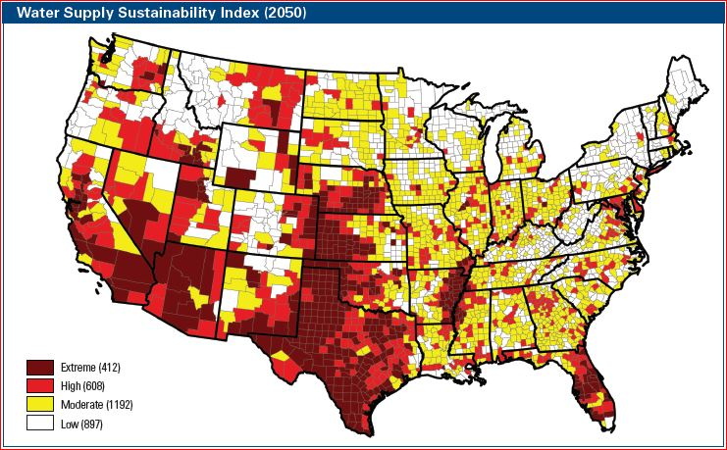
Visually speaking…
Lack of water will drive dairy eastward and northward
Updated 10/25/2021 from: Britt et al 2018 J. Dairy Sci. 101 (5): 3722-3741
Mo
Longer Growing Seasons & More Rain
2.3%
1.8%
18.5
2.2%
3.7%
6.6%
Dairies will shift from six states that produce 35.1% of milk today.
Darker shades have more severe water shortages.
Climate Change, Water, and Risk: Current Water Demands Are Not Sustainable www.nrdc.org/globalWarming/watersustainability
Announced in July that 46% of dairy cows in the US are in significant drought areas
Notes:
The map is projected for 2050, so by 2067 the differences may be more severe. Darker shades have more severe water shortages. Projections of movement of dairies are forecast by the author and some colleagues.

Slide 12
And there’s more…
Added factors demanding the move from the west
In addition to lack of water, water, water
Urban pressures (in California)
Environmental regulations
Transportation cost
High percentage of consumers live east of Mississippi River
Scarce resources and increased demand - basically dictates that there will be a major move of milk production to east of the Mississippi over the next 20 years

Slide 13
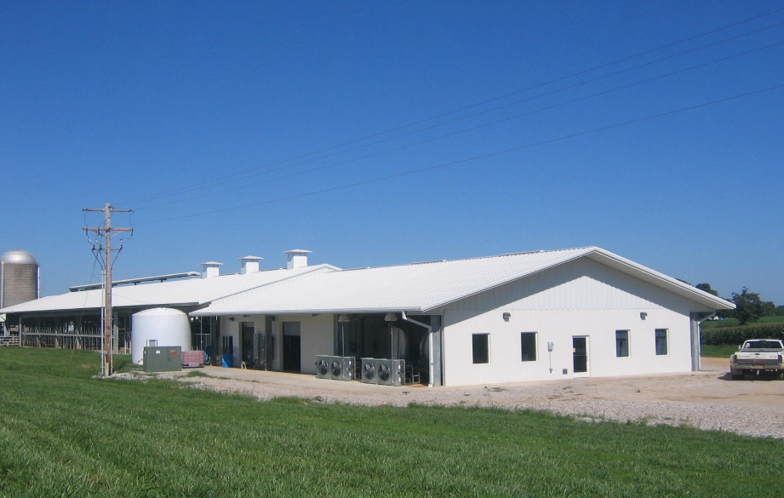
Where do we fit in?
Kentucky poised to attract development
Water water water
Dairy-friendly environment
Temperate climate
Cheap energy
Abundant feed supply
Rural KY prime for new investment
Proximity to consumers
KDDC statewide organization
The past 12 months of recruitment experience with California dairy farmers has proven that all of these factors are in fact real reasons for their selection of Kentucky

Slide 14
What does a large dairy look like?
A deeper dive:
Each cow produces a minimum of $5000 farm gate sales annually
These numbers contribute to an appealing ROI for owners/producers looking to relocate or start new
1000 cows = $5 million annually
5000 cows = $25 million annually
To produce the revenue, input costs are between 80-90% of gross
These input costs represent feed costs, equipment cost, service cost, labor cost, utility cost, etc.
Job creation - minimum of 10 people per 1000 cows
These numbers are projections provided by California dairy
The infrastructure investment up front (bricks, mortar and equipment, not including land) runs $8000-10,000 per cow.
Now, let’s dive deeper into the economic impact outside of the dairy farm’s borders
High land values in California and other western states adds to the appeal of a move east of the Mississippi

Slide 15
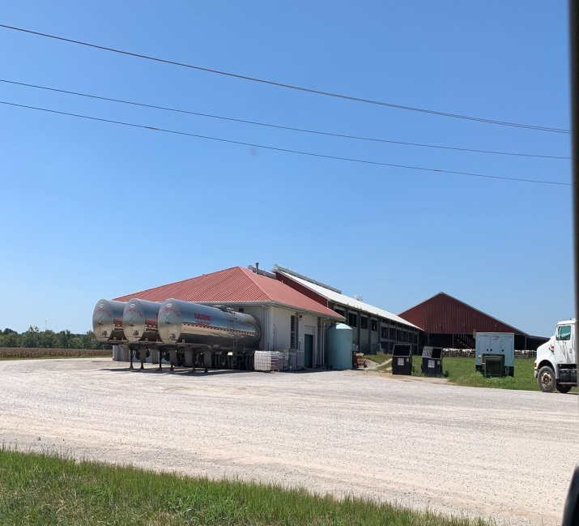
Ponder the impact on a local rural Kentucky community with a large dairy
An Economic Engine
Retail Sales
Lending Institutions
Dairy Farm Labor
Custom Harvesting
Feed Sales
Vehicle Sales
A.I. Breeding Sales
Utilities
Community Impact
From a Dairy
Milk Truck Driver
Concrete Supplier
Milk Inspector
Equipment Service
Veterinarian
Feed Equipment
Fertilizer Sales
Service Industry
Fuel Sales
Health Services
Equipment Sales
Insurance Sales
Equipment Parts
Community Tax Base
State Taxes

Slide 16
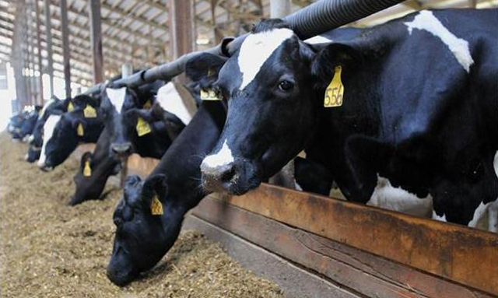
Reaching beyond the borders of the farm
Various satellite industries will generate additional growth
Feed productions
Waste utilization
Market for distillers by products
Feeding replacement animals
Offsite beef on dairy feeding and processing
Contract harvesting and manure removal
Energy production – methane digesters

Slide 17
How will these opportunities solidify KY’s present dairy industry?
One more question…
An energizing bolster to benefit all!
Solidify and expand infrastructure such as satellite industries that serve dairy farms locally
Large influx of milk will expand and create new processing opportunities.
Will force current milk marketers to take note and engage with local producers
Just this week, conversations with a leading cooperative serving the Kentucky dairy industry reiterated the importance of and their desire for locally produced milk.

Slide 18
Dreams to reality…
Converting ideas into tangible actions
Recruiting in past 12 mos:
6,000 cow dairy from CA
Option on land in Fulton Co.
$2.5 mil grant from Economic Development
New business with 50 new jobs
Low interest participation loan with ADB
$50 mil into KY not including cows
8-10 truck loads per day
Recent developments:
2 more California dairies seriously investigating coming to KY
Discussions that production could double in KY in 5-10 years
Would create need for another processor
Would result in 100’s of jobs
And more investment into KY dairy
Now … let’s dive in

Slide 19
Remember this…
Concluding thoughts for a bright future
We have:
Present and increasing demand
Water/feed and other resources
Advantage over competing states
We need:
Continued commitment
Consistent hard work
Continuing promotion of what we have to offer
Will we continue to take advantage of these opportunities or will we let Pennsylvania, Indiana, Kansas, Texas and Michigan produce the milk and send it here in packaged form?

Slide 20
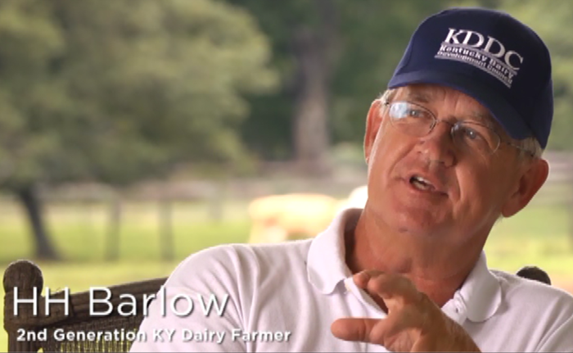
QUESTIONS
Get in Touch
176 Pasadena Drive
Lexington, KY 40503
859.516.1129
270.404.8003
kddc@kydairy.org
Thank you for supporting Kentucky’s dairy industry!

