Slide 1


Kentucky USDA-NRCS Assisted Watershed Project Dams Overview
Natural Resources Conservation Service
Interim Joint Committee on Agriculture Meeting
June 8, 2023

Slide 2
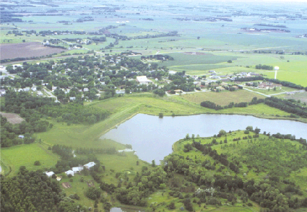
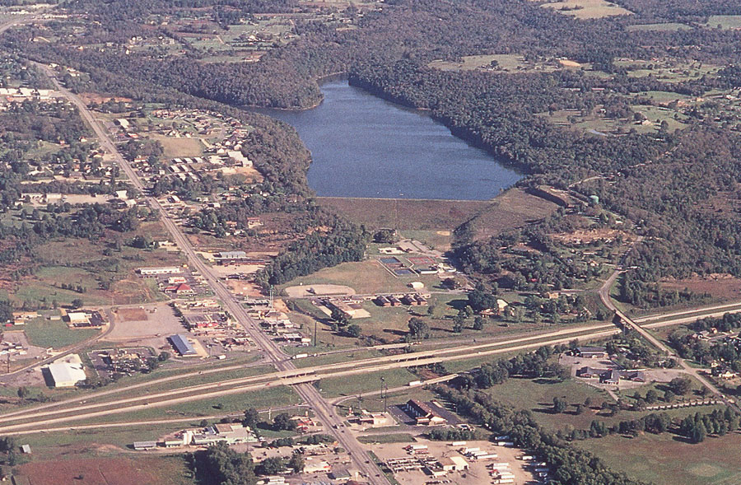
U.S. Dams
    93,000+ in NID Nationwide
      29,500 Dams assisted by NRCS
        11,845 NRCS Watershed Program Dams
          (Source: 2020 National Inventory of Dams)

Slide 3
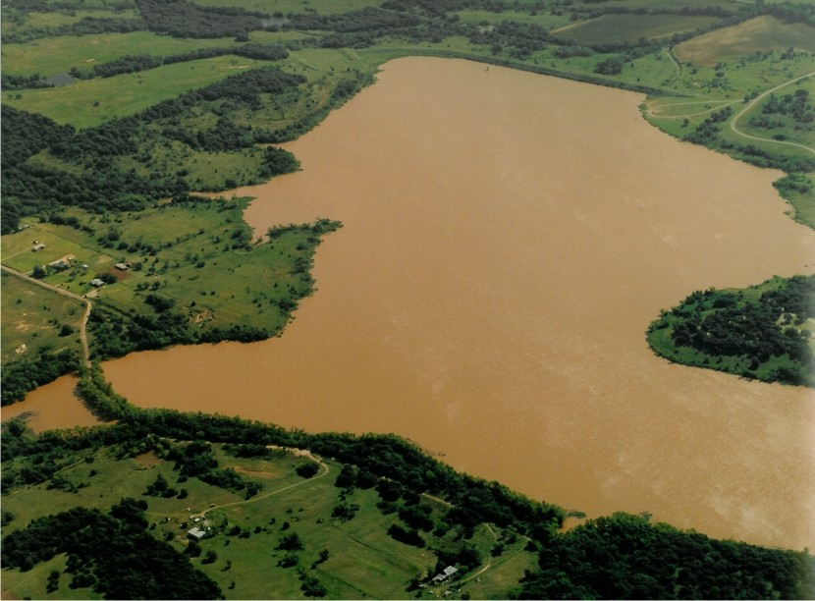
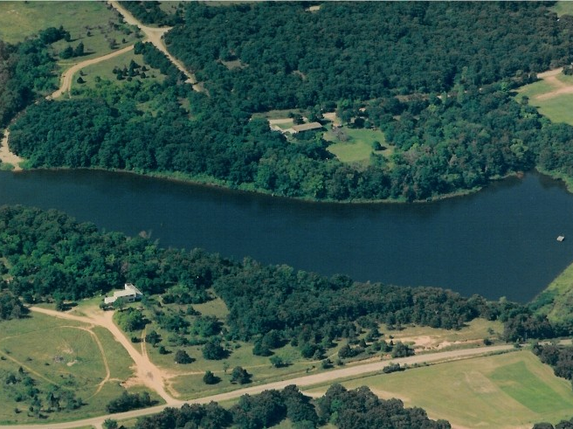
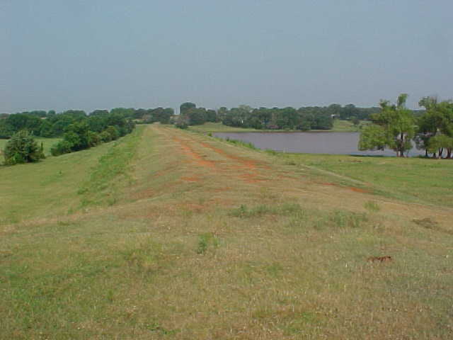
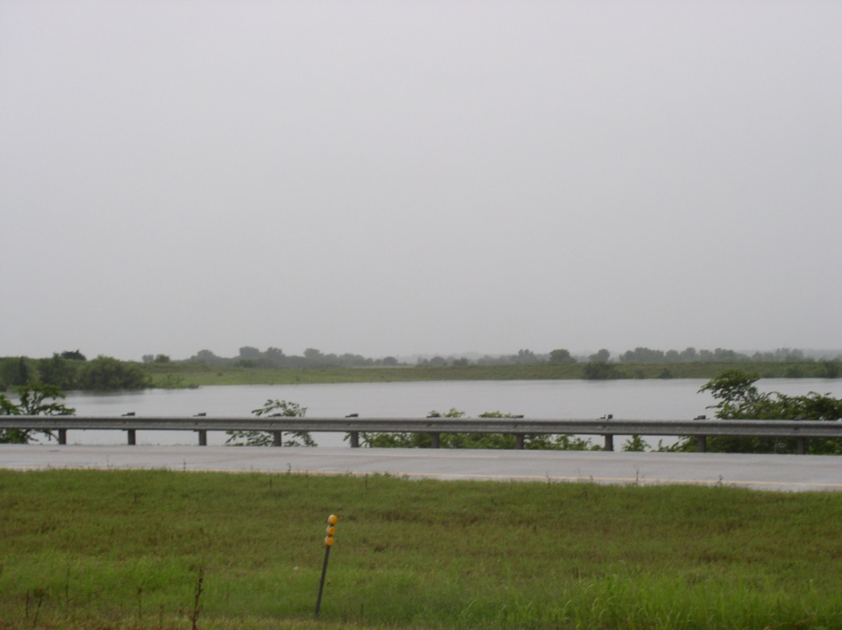
Watershed dams come in all shapes and sizes

Slide 4
USDA - NRCS Watershed Program Authorizations
Flood Control Act of 1944 (PL-534)
11 projects in 12 states (3,421 dams)
Pilot Watershed Program (1953 - 54)
62 projects in 35 states (472 dams)
Watershed Protection and Flood Prevention Act (PL-566)
Enacted August 4, 1954 (7,669 dams)
Resource Conservation & Development (225 dams)

Slide 5
The NRCS Watershed Program is the best example of a federal, state, local, private partnership
Federal (NRCS):
Technical Assistance (planning, design, construction, O&M)
Financial Assistance (construction)
Local Project Sponsors (Conservation Districts)
Land rights (easements)
Operation and Maintenance
State
Funding Assistance / Technical Support
Private
Donated Easements

Slide 6
The NRCS Watershed Program
NRCS has assisted communities build almost 11,845 dams in 1,271 Watershed Projects in 47 States since 1948

Slide 7
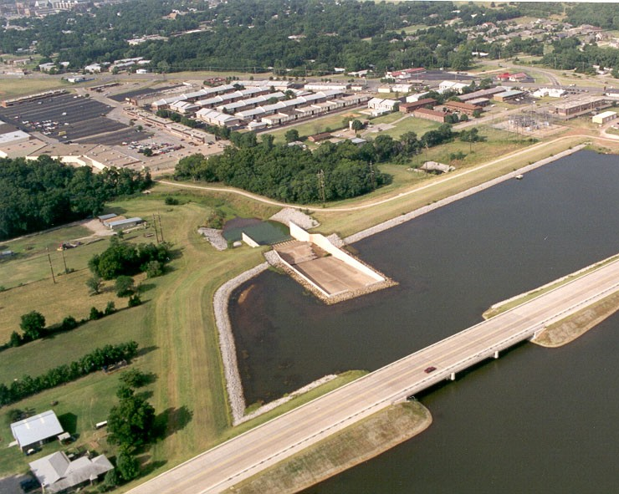
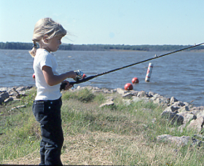
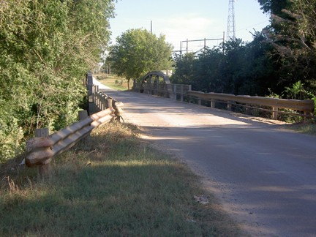
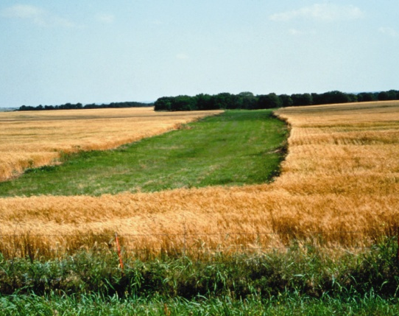
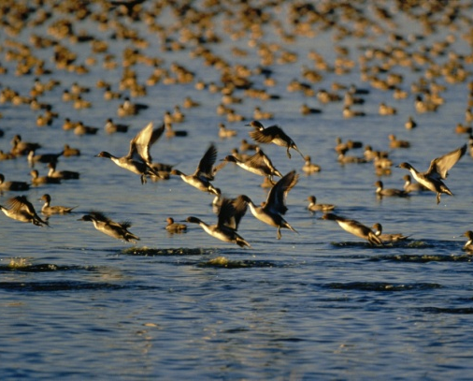
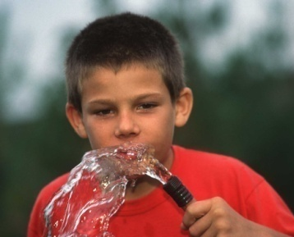
Nationwide Watershed Projects are an Integral Part of
Rural Communities
Watershed projects provide over $2.4 billion in average benefits each year:
  Flood control
  Water Supply
  Erosion Control
  Recreation
  Wetland Restoration
  Wildlife Habitat

Slide 8
Nationwide NRCS Watershed Dams Constructed by Fiscal Year
Notes:
The first project dam was constructed in 1948 and the last project dam was constructed in 2015.
The majority of project dams were constructed in the 1960s.

Slide 9
Nationwide NRCS Watershed Dam Design Life
2020
In 2020, 6,574 dams (53%) will reach their design life
2021
In 2021, 6,778 dams (57%) will reach their design life
2022
In 2022, 6,973 dams (58%) will reach their design life
Notes:
Dams were constructed with a design life of 50 or 100 years.
The number of dams exceeding their design life increases each year.
204 increase from 2020 to 2021
195 increase from 2021 to 2022

Slide 10
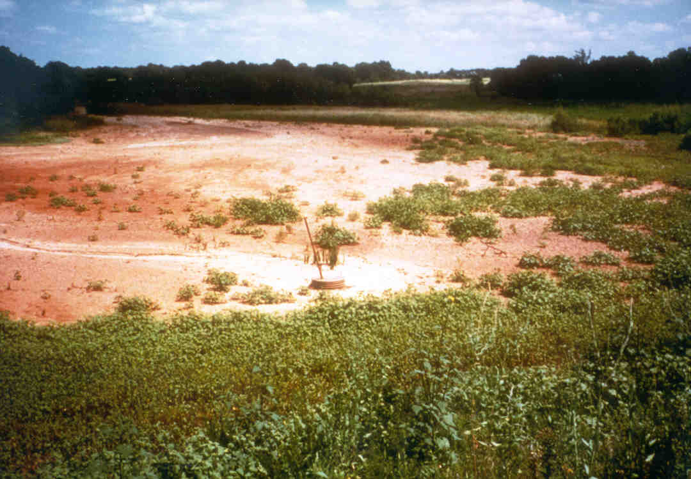
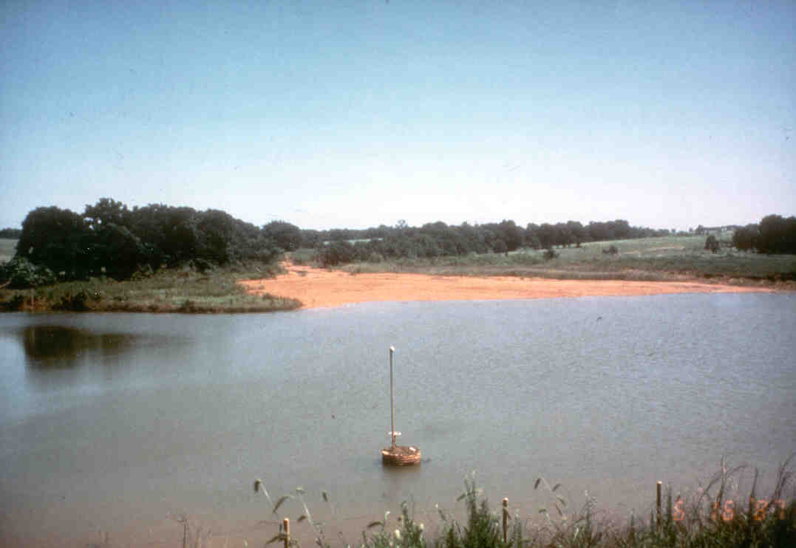
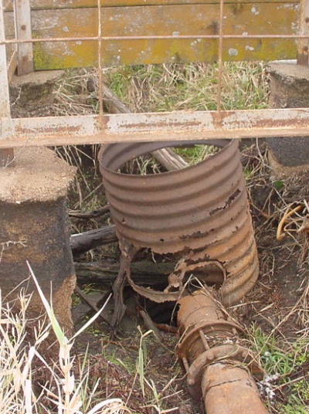
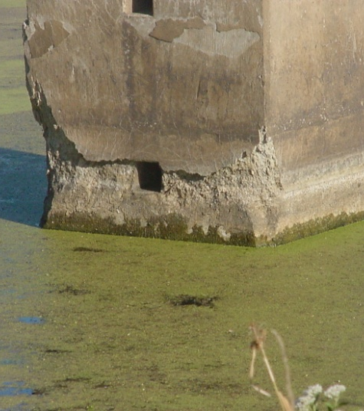
Aging Dams Need Attention!
Many watershed dams are at or nearing the end of their 50-year designed life span
Time has taken it’s toll on many of the dams; some pose a threat to life, health, property, & the environment

Slide 11
Sediment Accumulation:
Reservoir filling with Sediment – 1982….
Notes:
One of the most visible signs of aging dams is sedimentation
Most people don’t realize that all dams have a finite life span; their reservoirs will all eventually fill up with sediment.

Slide 12
Sediment Accumulation:
Same Reservoir – 1995….
Notes:
Same location 13 years later. Completely filled with sediment! Loss of sediment storage does not mean a loss in flood control.

Slide 13
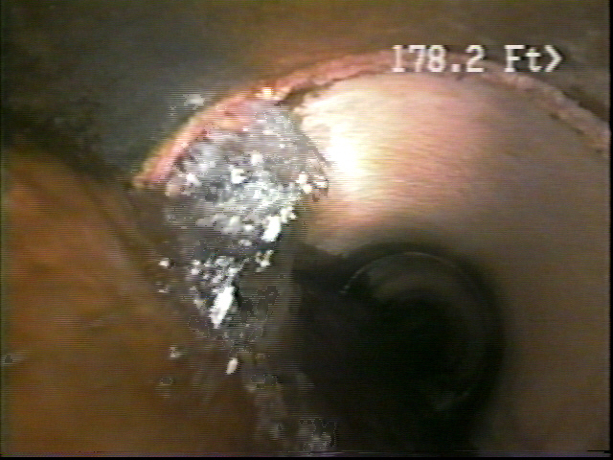
Pipe Joints Leaking
Notes:
Many of the pipes had anti-seep collars to stop leaking pipe joints, however, even these appurtenances will deteriorate over time. What we have discovered in Oklahoma is that most dams with anti-seep collars resulted in cracked pipes near the collars.

Slide 14
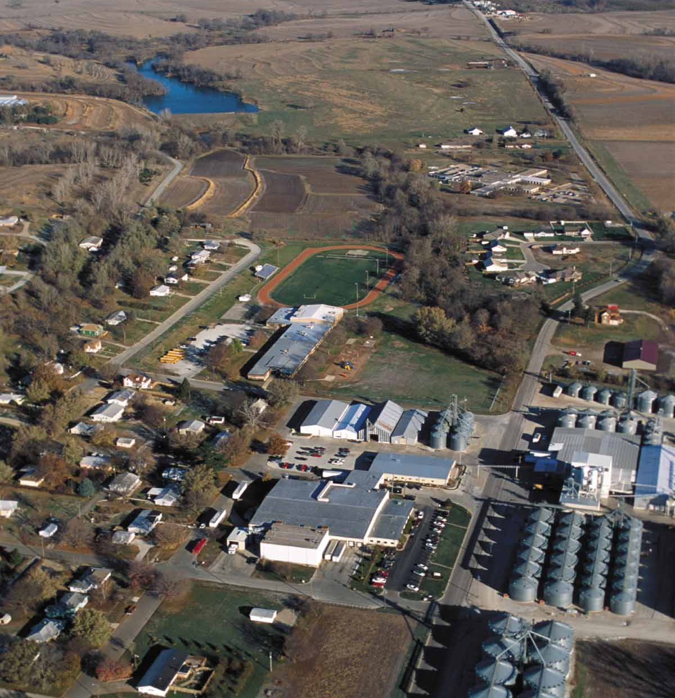
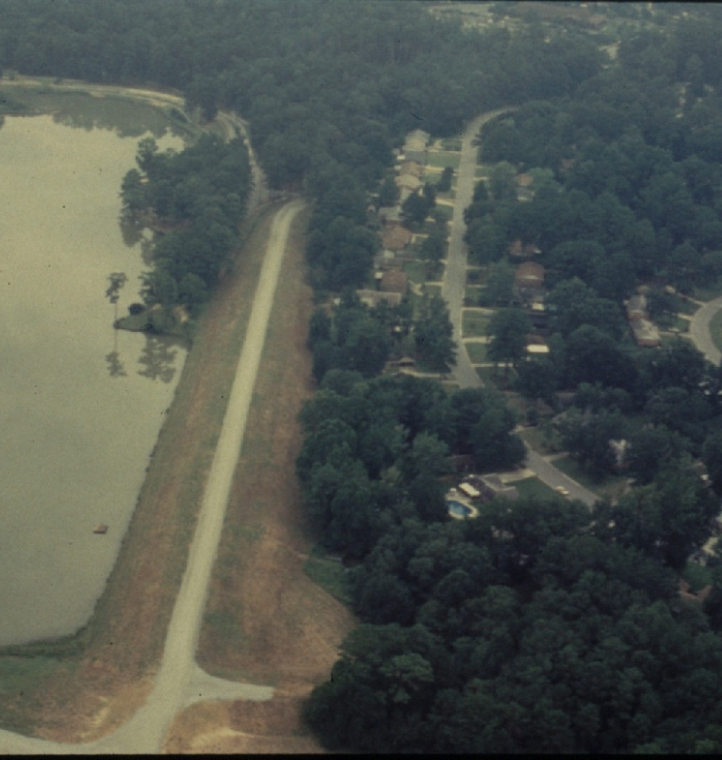
Public Health & Safety Concerns
Downstream development can put people in harms way

Slide 15
“Big Picture” Kentucky
Watershed Stats (08/2021)
Number of Watershed Projects:
4 pilot (3 with dams)
1 RC&D (with 1 dam)
44 PL-566 (including 29 with dams)
49 (including 33 that include dams)
200 dams that control 743 sq miles of drainage area:
182 PL-566, 17 pilot, 1 RC&D
48 high, 17 significant, 135 low
131 beyond 50 years old
Average Annual Benefits:
$5.436 mil flood
$6.745 mil non-flood
$12.180 mil total
Funded Rehab Projects:
1 completed – Plum Creek 18 in 2007
3 in Design Phase – Red Lick 1, Red Lick 12, and East Fork Clarks River 32

Slide 16
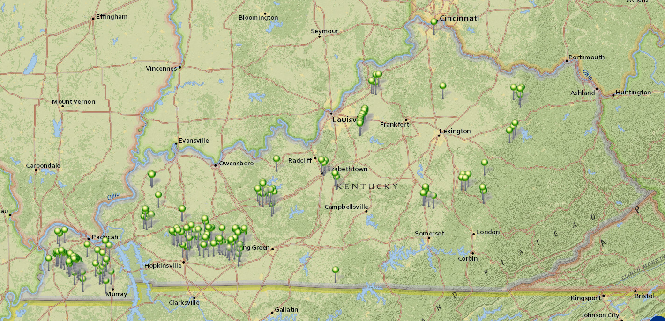
Kentucky Watershed Dams
200 Total

Slide 17
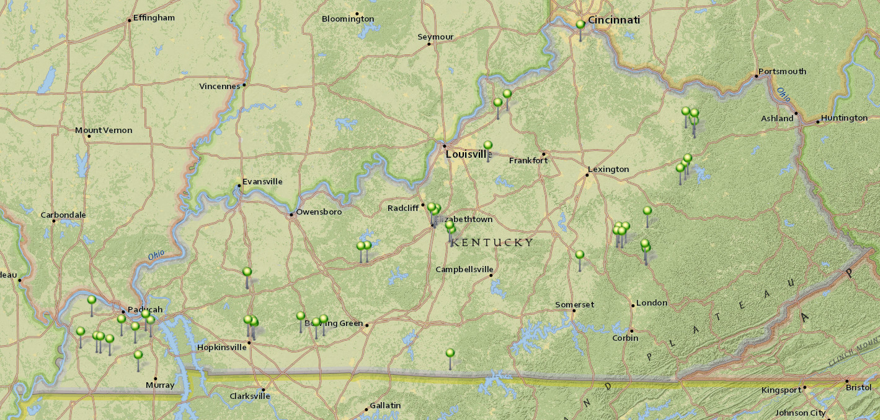
Kentucky Watershed Dams
48 High Hazard Potential Classification

Slide 18
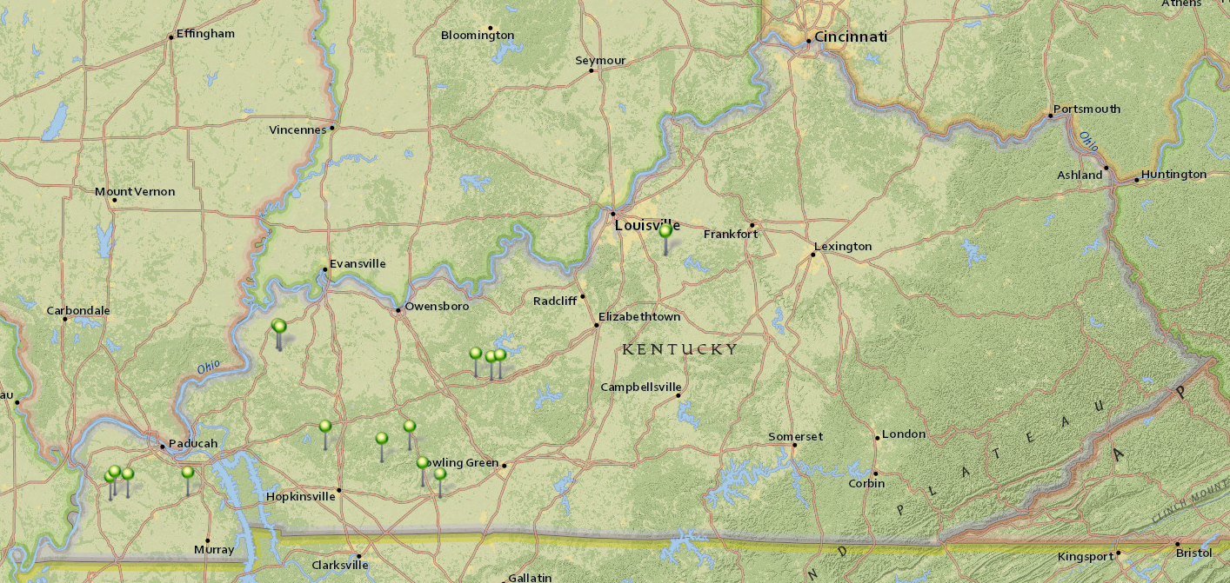
Kentucky Watershed Dams
17 Significant Hazard Potential Classification

Slide 19
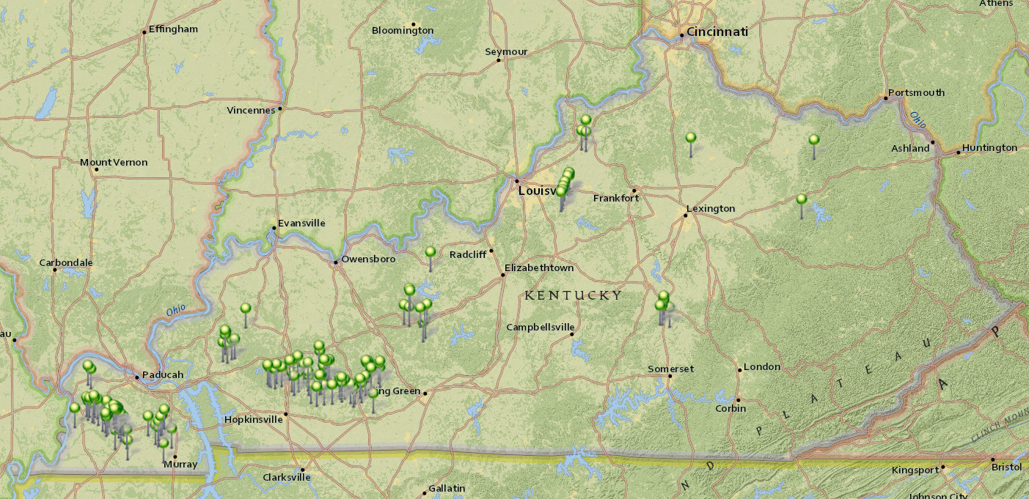
Kentucky Watershed Dams
135 Low Hazard Potential Classification

Slide 20
Downstream Development Hazard
Of the 48 high hazard potential classification watershed dams in Kentucky, only 24 were originally designed as a high hazard potential dam.
Downstream development changed the hazard potential classification for the other 24 dams after construction.
With essentially no authorities for control of downstream development, the number of high hazard potential classification dams will continue to increase.
To date, 1 high hazard potential classification dam has been rehabilitated.
Only 47 more high hazard potential classification dams to rehabilitate to current safety standards (plus additional dams that will be reclassified to high hazard potential in the future!).

Slide 21
Watershed Rehabilitation Program
(Authorized by PL-83-566 Section 14, the Watershed Protection and Flood Prevention Act)
Authorizes NRCS to provide sponsors technical & financial assistance to rehabilitate their aging watershed dams
  Local Sponsor requests NRCS assistance
  Dam assessment
  Planning Phase
  Design Phase
  Construction Phase
Rehabilitation is defined as all work necessary to extend the service life of a dam and to meet applicable safety and performance standards.
KY Funded rehab projects:
  1 completed – Plum Creek 18 in 2007
  3 in Design Phase – Red Lick 1, Red Lick 12, and East Fork Clarks River 32

Slide 22
Watershed Dam Rehabilitation
Program – Eligibility
Originally constructed through a NRCS Watershed Program
  PL 83-566 (182 dams in KY)
  PL 78-534 (No dams in KY)
  Pilot Watershed Program (17 dams in KY)
  RC&D (1 dam in KY)
Priority given to high-risk dams
NRCS provides assessment, planning, design, and implementation financial assistance
  65% total rehabilitation cost
  Not to exceed 100% construction costs
Notes:
It is primarily up to the State watershed rehabilitation program manager to ensure the 65 to 35 percent cost-share provisions are being met. There are several components included in the total cost that NRCS Management Services Division (MSD) or Financial Management would not have access to, but would qualify as sponsor in-kind credit. These items include land rights cost, minor implementation costs beyond construction, contract administration expenses, attorney fees, financial costs, etc. MSD would generally only have the construction contract information, and that would only be for Federal contracts. The sponsor must provide supporting documentation for in-kind credit. An example “Cost Computation for Rehabilitation Project Spreadsheet” is provided in section 606.71 of this handbook.

Slide 23
What Triggers the Need for Rehabilitation?
Age of the Dam
Structural Problems
Sediment Accumulation
Damaging Flows over Auxiliary Spillway
Development Downstream of Dam Causes Hazard Potential Classification Change
Notes:
There are several things that trigger the need for rehabilitation including the age of the dam, structural problems, sediment accumulation, damages from erosion, but the main one that the Agency focuses on is the Hazard Potential Classification.

Slide 24
Funds Allocated By Fiscal Year Across the Nation
Notes:
In FY 2014 and 2015 NRCS received the largest allocation. Allocated does not meet the potential needs of rehabilitating aging dams.

Slide 25
Funds Allocated in 2022 Across the Nation
$112,356,285 Allocated
  118 dam assessments
  23 existing supplemental watershed plans
  52 new supplemental watershed plans
  50 designs
  19 construction projects
Notes:
Summary of funding allocated and project funded

Slide 26
How to Apply
Sponsor submits letter of request or SF-424 to the NRCS State Office.
  Applicant contact information
  Program
  Project description
  Estimated funding
  Document ability to meet program eligibility
NRCS works with Sponsors to develop REHAB funding request.
Request are submitted to NRCS National Office for National ranking and funding.

Slide 27
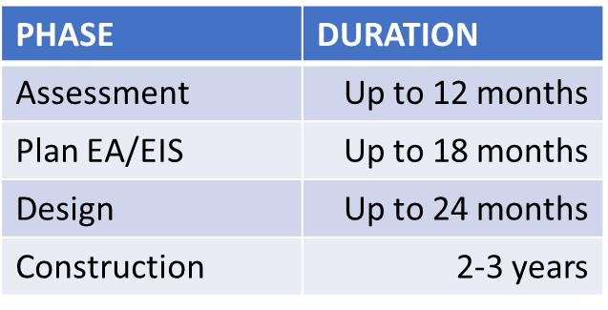
Implementation
Once a project is selected for funding, funds are allocated to the NRCS State Office. (One phase funded at a time)
NRCS then enters into an agreement with the sponsor to complete the funded phase of the work (PIFR, planning, design, or construction)
Technical work may be completed by the Sponsor or NRCS.
NRCS reviews & approves technical work completed at stages
Ideal project timeframes are:
Notes:
NHQ wants to be able to Rehabilitate a dam within 5 years, from the planning start to construction completion… On our best projects we can make it in 7 years

Slide 28
Budgeting
Sponsors must show evidence of commitment for funding, installing, operating, and maintaining the project.
The Sponsor may either perform all contracting for construction or request that NRCS perform contracting.
Sponsors provide funds upfront and are reimbursed for the federal share of the project cost.
For every $1.00 the sponsors contributes to construction, $1.86 will be contributed from the Federal Government toward the project construction (35% / 65% cost-share).
Sponsors are not reimbursed for
  Acquiring needed permits and licenses
  Operation and Maintenance
  Technical services to implement M&I water supply

Slide 29
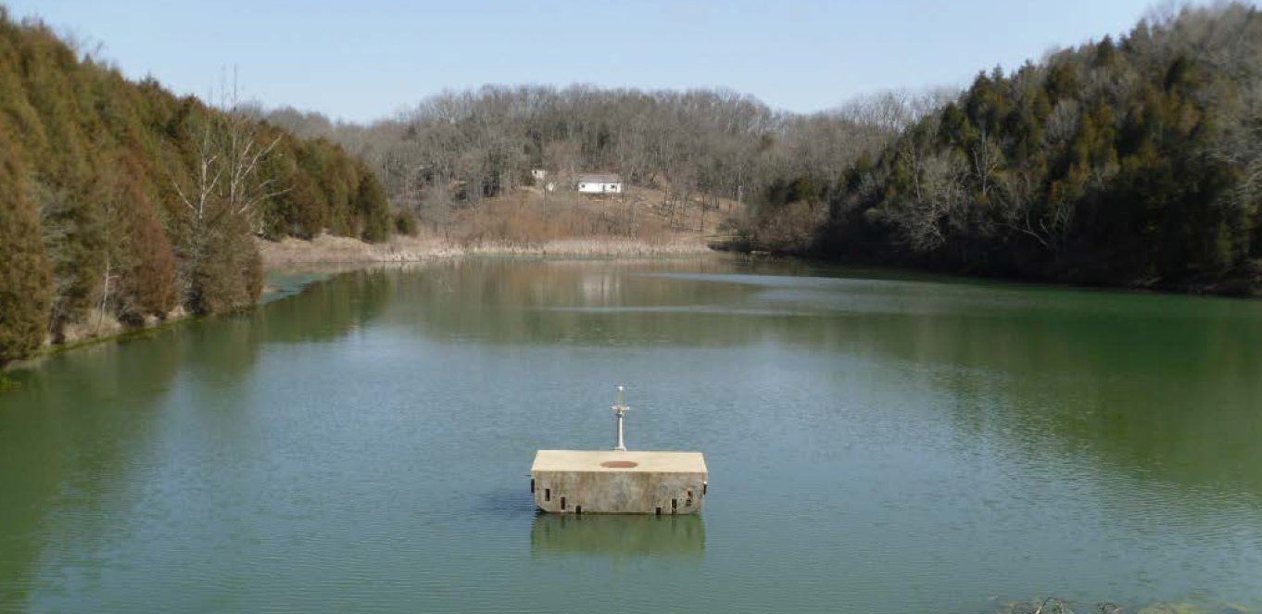
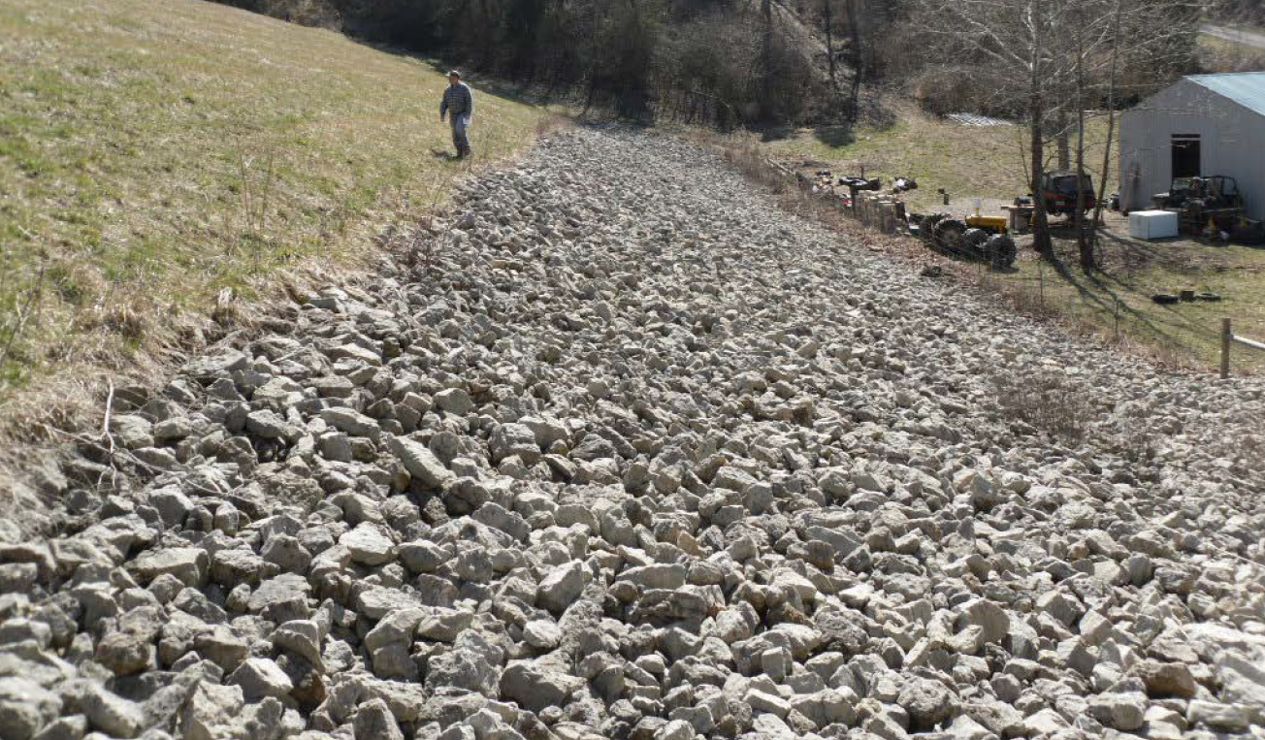
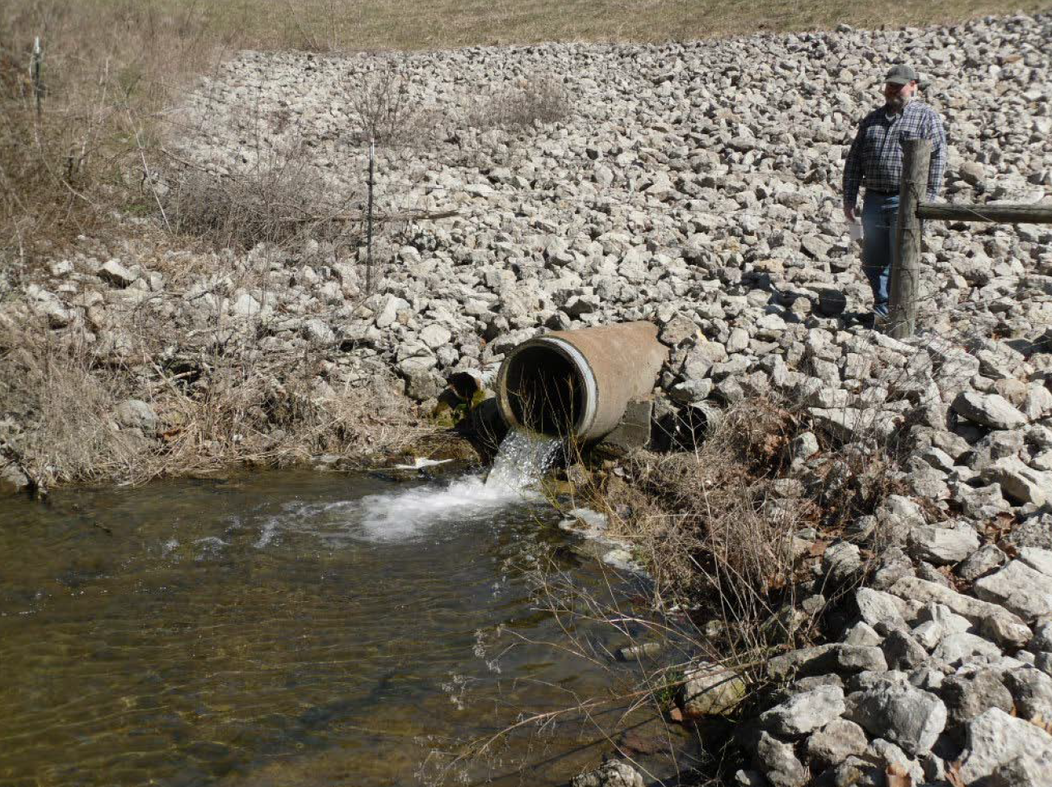
Kentucky Rehab - SUCCESS STORY
Plum Creek 18, Kentucky 2007
Location: Nearest Town – Waterford, KY in Spencer County
Sponsor: Plum Creek Conservancy District
Issue: 1 House and Featherbed Hollow Road downstream would be affected by a dam breach.
Measures: Replace principal spillway riser, Install downstream slope riprap toe drain, House elevated to flood proof
Total Project Cost - $245,892
NRCS Costs - $143,845
Final Construction Costs - $221,392
Notes:
Very inexpensive rehab project example. The typical cost of a rehab project is $2-4 Million.

Slide 30
Questions?

Slide 31
Natural Resources Conservation Service
In accordance with Federal civil rights law and U.S. Department of Agriculture (USDA) civil rights regulations and policies, the USDA, its Agencies, offices, and employees, and institutions participating in or administering USDA programs are prohibited from discriminating based on race, color, national origin, religion, sex, gender identity (including gender expression), sexual orientation, disability, age, marital status, family/parental status, income derived from a public assistance program, political beliefs, or reprisal or retaliation for prior civil rights activity, in any program or activity conducted or funded by USDA (not all bases apply to all programs). Remedies and complaint filing deadlines vary by program or incident.
Persons with disabilities who require alternative means of communication for program information (e.g., Braille, large print, audiotape, American Sign Language, etc.) should contact the responsible Agency or USDA's TARGET Center at (202) 720-2600 (voice and TTY) or contact USDA through the Federal Relay Service at (800) 877-8339. Additionally, program information may be made available in languages other than English.
To file a program discrimination complaint, complete the USDA Program Discrimination Complaint Form, AD-3027, found online at How to File a Program Discrimination Complaint and at any USDA office or write a letter addressed to USDA and provide in the letter all of the information requested in the form. To request a copy of the complaint form, call (866) 632-9992. Submit your completed form or letter to USDA by: (1) mail: U.S. Department of Agriculture, Office of the Assistant Secretary for Civil Rights, 1400 Independence Avenue, SW, Washington, D.C. 20250-9410; (2) fax: (202) 690-7442; or (3) email: program.intake@usda.gov.
USDA is an equal opportunity provider, employer, and lender.

