Slide 1
House Bill 9 Kentucky GRANT Program
Interim Joint Committee on Agriculture
July 20, 2023

Slide 2
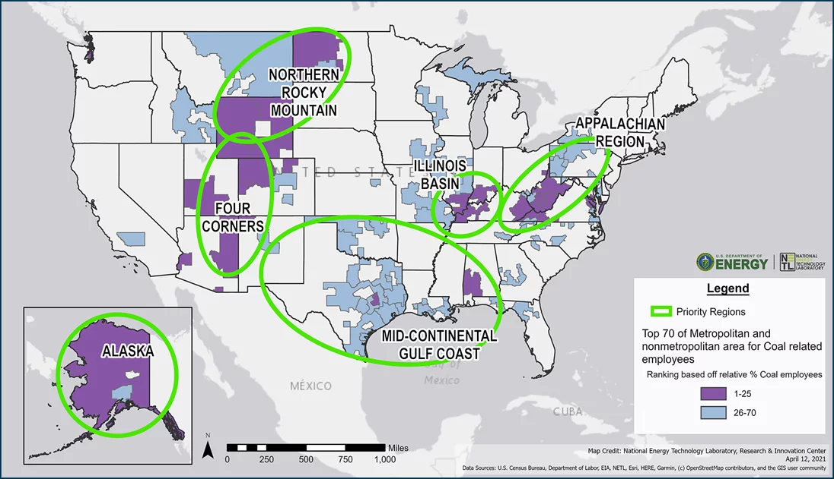
*U.S. Energy Communities as defined by The Interagency Working Group on Coal and Power Plant Communities and Economic Revitalization

Slide 3
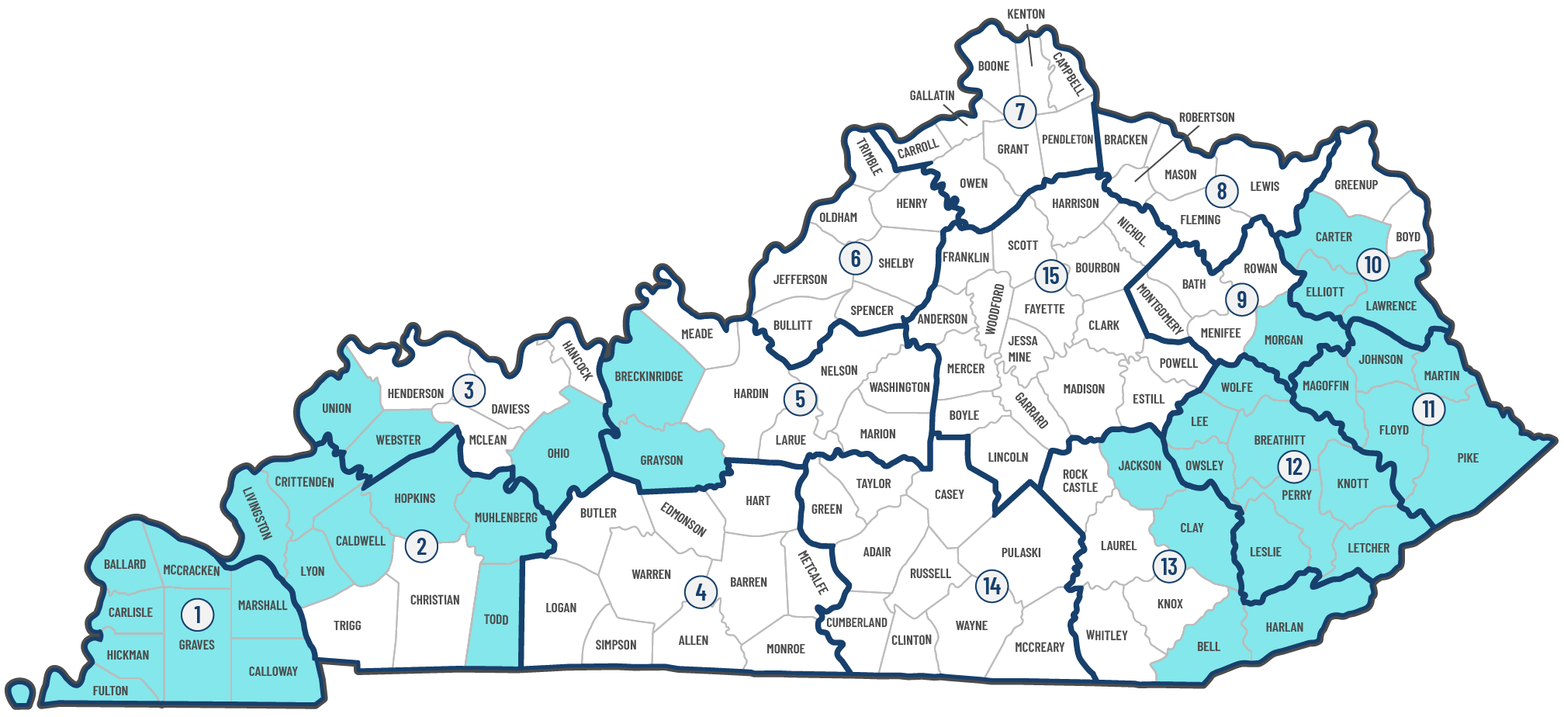
Kentucky GRANT Program

Slide 4
For More Information:
energycommunities.gov
grantreadykentucky.org

