Slide 1
Farm Stress and Rural Mental Health
Programming
Laura Weddle
Extension Specialist
Farm Stress and Rural Mental Health

Slide 2
Informing to Transform
What modes are being used to be impactful?
Publications
Trainings
Media
Programs

Slide 3
Informing to Transform
Research-based informational publications for agent and public use:
Understanding and Coping with Farm Stress
Rural Mental Health Challenges
Understanding Suicide
Anxiety
Depression
Farmer Suicide
Recognizing and Responding to Trauma
Self-Care and Coping
Stress
Increase the reader’s knowledge of specific and applicable rural mental health topics.
Equip agents with research-based and peer-reviewed content to share as a resource and utilize for programming purposes.

Slide 4
Informing to Transform
Trainings for healthcare providers, mental health professionals, ag-centric professionals, social service providers, and business providers:
Working with Rural and Farm Populations: A CE for Kentucky Advanced Nurse Practitioners
Understanding Rural and Farm Stress and the Neurological Impact of Stress
Farm Stress and QPR for Suicide Prevention: A Webinar for Veterinarians
Characteristics and Social Determinants of Rural Mental Health Challenges and Farm Family Stress
Mental Health First Aid
QPR for Suicide Prevention
Increase provider knowledge of rural mental health challenges for a more informed response in clinical, business, and professional scenarios.

Slide 5
Informing to Transform
Trainings for Extension Professionals and Community Members:
Managing Stress when Working with Farmers: A Kentucky Farm Business Management Specialist Training
Rural Mental Health Challenges and Farm Stress
Identifying and Preventing Farm Stress and Suicide
Working with Rural Farm Families
Managing Farm Stress: A Workshop for Kentucky’s New and Beginning Farmers
An Agent’s Guide to Rural Mental Health
Impact of Mental Health and Farming for Women in Agriculture
Mental Health First Aid
QPR for Suicide Prevention
Increase participant knowledge of rural mental health challenges to better respond in family and community-based settings.

Slide 6
Informing to Transform
Podcasts and Television Segments:
Your Brain on Stress: A Three-Part Podcast
Preventing Suicide through Social Connections
Reaching Farm Families with Mental Health Messages
Recognizing and Responding to Trauma after a Natural Disaster
Information release library for agent use in community media outlets (newspaper, newsletter, radio, and television)
Provide information for wider/broadcast distribution within communities.

Slide 7
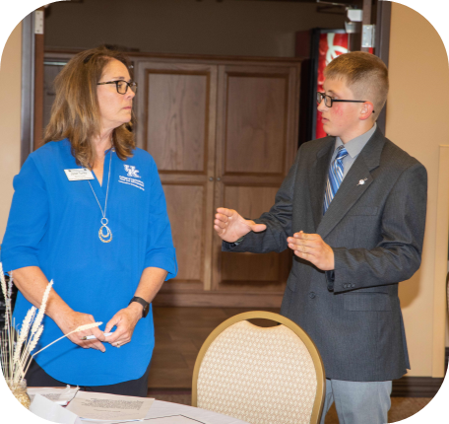
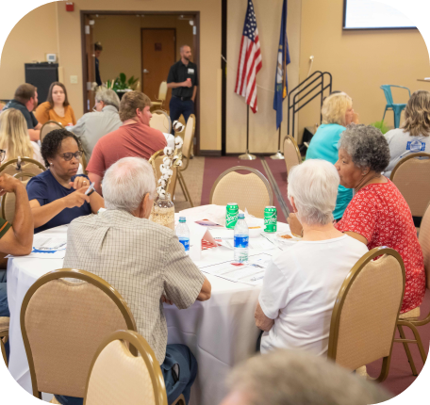
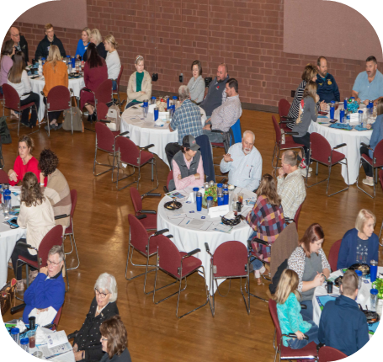
Informing to Transform
Curricula and Toolkits for Agent Use in the Community:
BARN: Farm Dinner Theater
Kentucky Farm Family Well-Being: A Youth Program (in collaboration with 4-H and Raising Hope)
Inform and provide mental health resources using programs that have a multi-generational impact.
Create a safe space for community conversations to reduce stigma and identify access points for professional care.
Instruct appropriate response techniques for rural mental health challenges.

