Slide 1
HUTSON SCHOOL OF AGRICULTURE UPDATES
Fall 2023
Presented By : Dr. Brian Parr, Dean and Dr. Shea Porr, Associate Dean

Slide 2
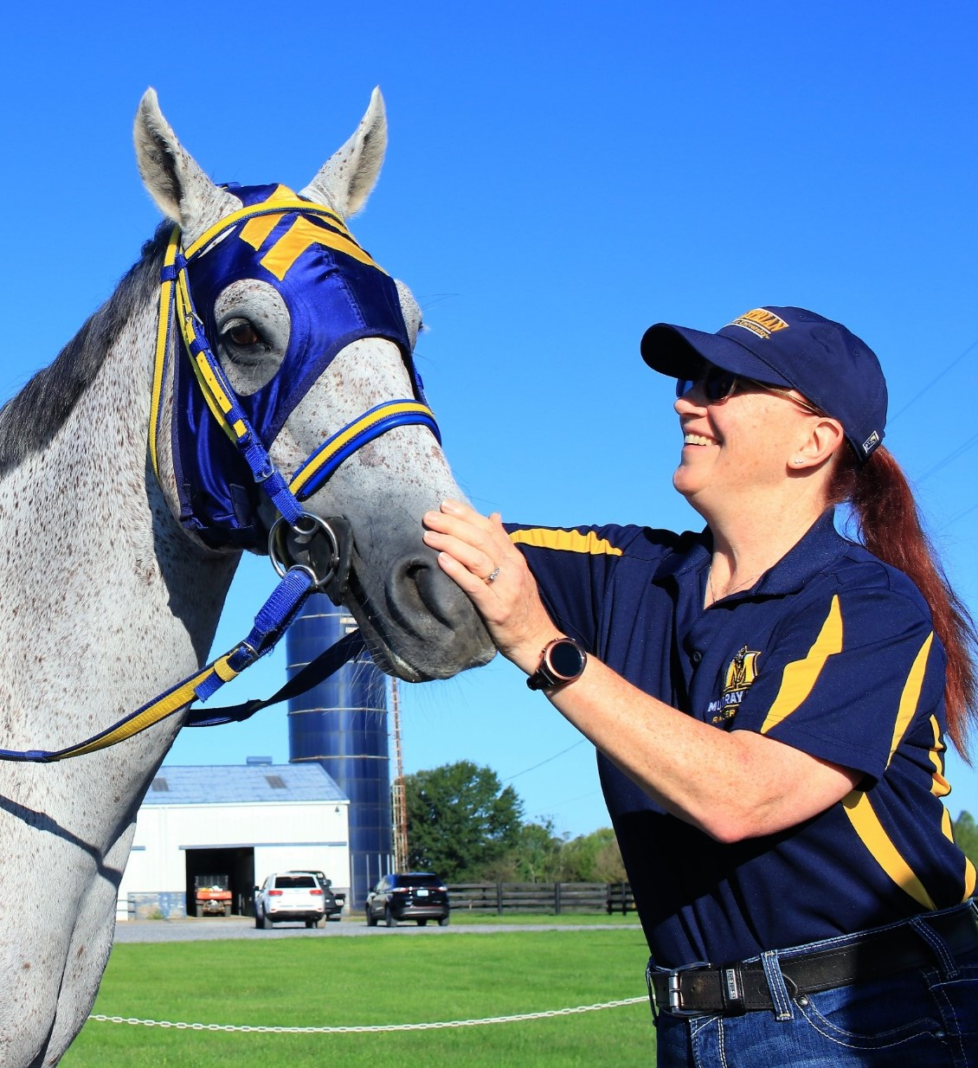
ASSOCIATE DEAN
Dr. Shea Porr
Associate Dean
AES Department Head

Slide 3
High school visits, state, and national FFA convention, NFMS, TN FFA Convention
Hosting ~ 2,000 high school students per year on campus
Enrollment for Fall 2023 over 1,300 students
RNO Number: 294 students
RECRUITMENT EFFORTS

Slide 4
Enrollment: Over 200 students
Masters
Specialist (EdS)
Doctorate (EdD)
Online Options
GRADUATE PROGRAMS

Slide 5
New Partnerships within Industry for Research & Education
Bayer
BASF
Stine
AGRICULTURE SCIENCE

Slide 6
NEW PROPERTY

Slide 7
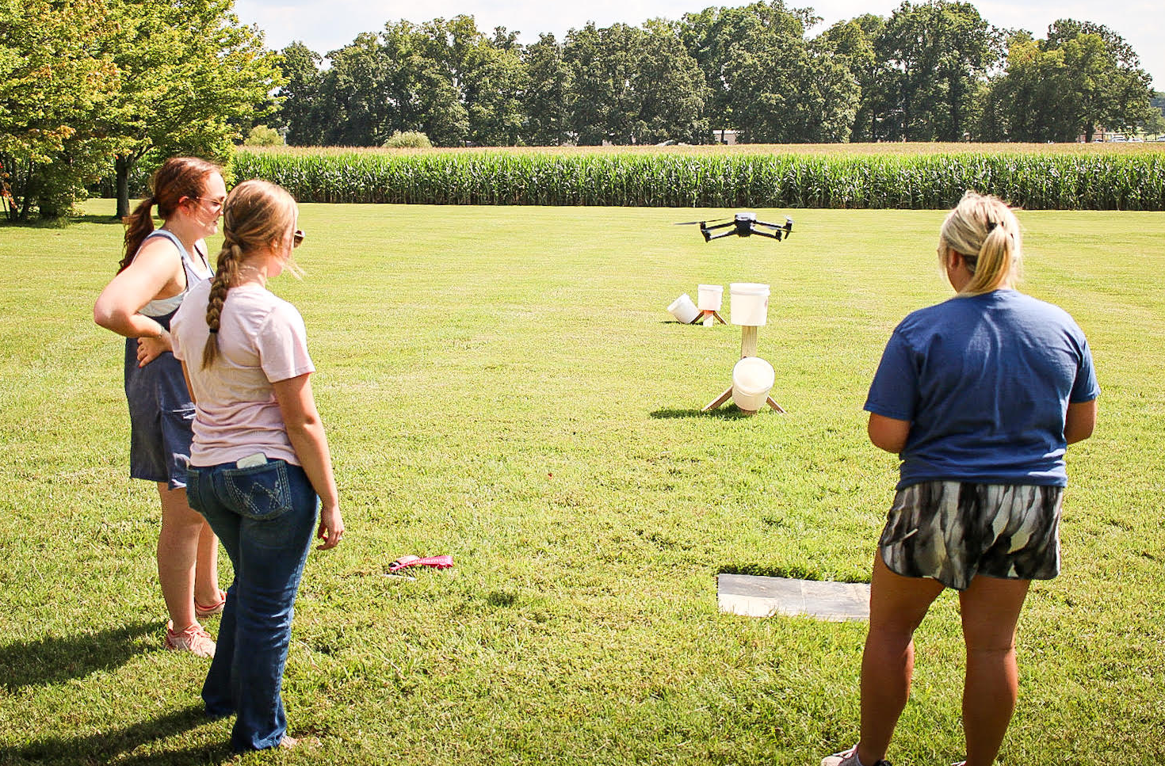
Selected for FAA Unmanned Aircraft Systems-Collegiate Training Initiative
UAS Minor and Certificate
Flight practice, drone maintenance, safety and federal policies
UNMANNED AERIAL SYSTEMS
Notes:
Minor 21 hours, certificate 15 hours
85 students – ag, engineering, journalism, construction and architecture, cyber security, and more
--Beginners to advanced
Large number of graduats, many of whom already work in the industry in KY

Slide 8
New focus on poultry & meat science
New articulation agreements for equine chiropractic schools
New livestock judging team
Hosting 2024 American Collegiate Horseman's Association National Convention
ANIMAL/EQUINE SCIENCE

Slide 9
RODEO TEAM
Tate Papszycki:
Currently leads the Lone Star Rodeo Circuit by nearly 1,000 points!
#5 in world standings as a rookie in the IPRA
Finished 2nd IFYR
Finished 11th in average at NHSRA
Reserve National Champion Little Britches National Rodeo Association
RODEO TEAM
Tate Papszycki

Slide 10
New Department Head, Dr. Laura Ken Hoffman
New state-of-the-art radiology equipment
New, innovative approaches to education
Large enrollment – 434 students total
PRE-VET/VET TECH

Slide 11
BVC has the only Biological Safety Level 3 lab space dedicated to veterinary diagnostics in Kentucky
BVC) is an AAVLD accredited laboratory in Hopkinsville and a critical piece of Kentucky infrastructure
BVC has veterinary pathologists,
microbiologists, toxicologists and other laboratory professionals on staff
BREATHITT VETERINARY CENTER

Slide 12
DORAN ARBORETUM
Notes:
Announced in Sept 2023, w/establishment of Doran Arboretum Fund for Excellence to support capital improvements and maintenance of the Arboretum
Arboretum offers green space, walking trails, native and introduced horticultural gardens, play areas, a scenic hill and pond, hands on learning space for students and youth, and space for community activities and events
Complements gift from Ms. Pullen, who gifted the Pullen Farm, where the Arboretum is housed

Slide 13
EAGLE REST
FARM
Collaboration with Ballard County FFA for sheep and hay production
Crop land improvements
Home improvements
Notes:
534 acres, Ballard County, ~60 mi NW campus

Slide 14
Achieve College Status
Oakley Applied Science Building Renovations
Eagle Rest
Vet School Proposal/Feasibility Study
VISION FOR THE FUTURE

