Slide 1
Who we are
Purpose
To provide leadership to support and improve the Kentucky beef industry
Mission
To provide a strong proactive voice for all of Kentucky’s beef farm families, serve as a resource for information and education for producers, consumers and the industry and be a catalyst for enhancing producer sustainability.
Est. 1973

Slide 2
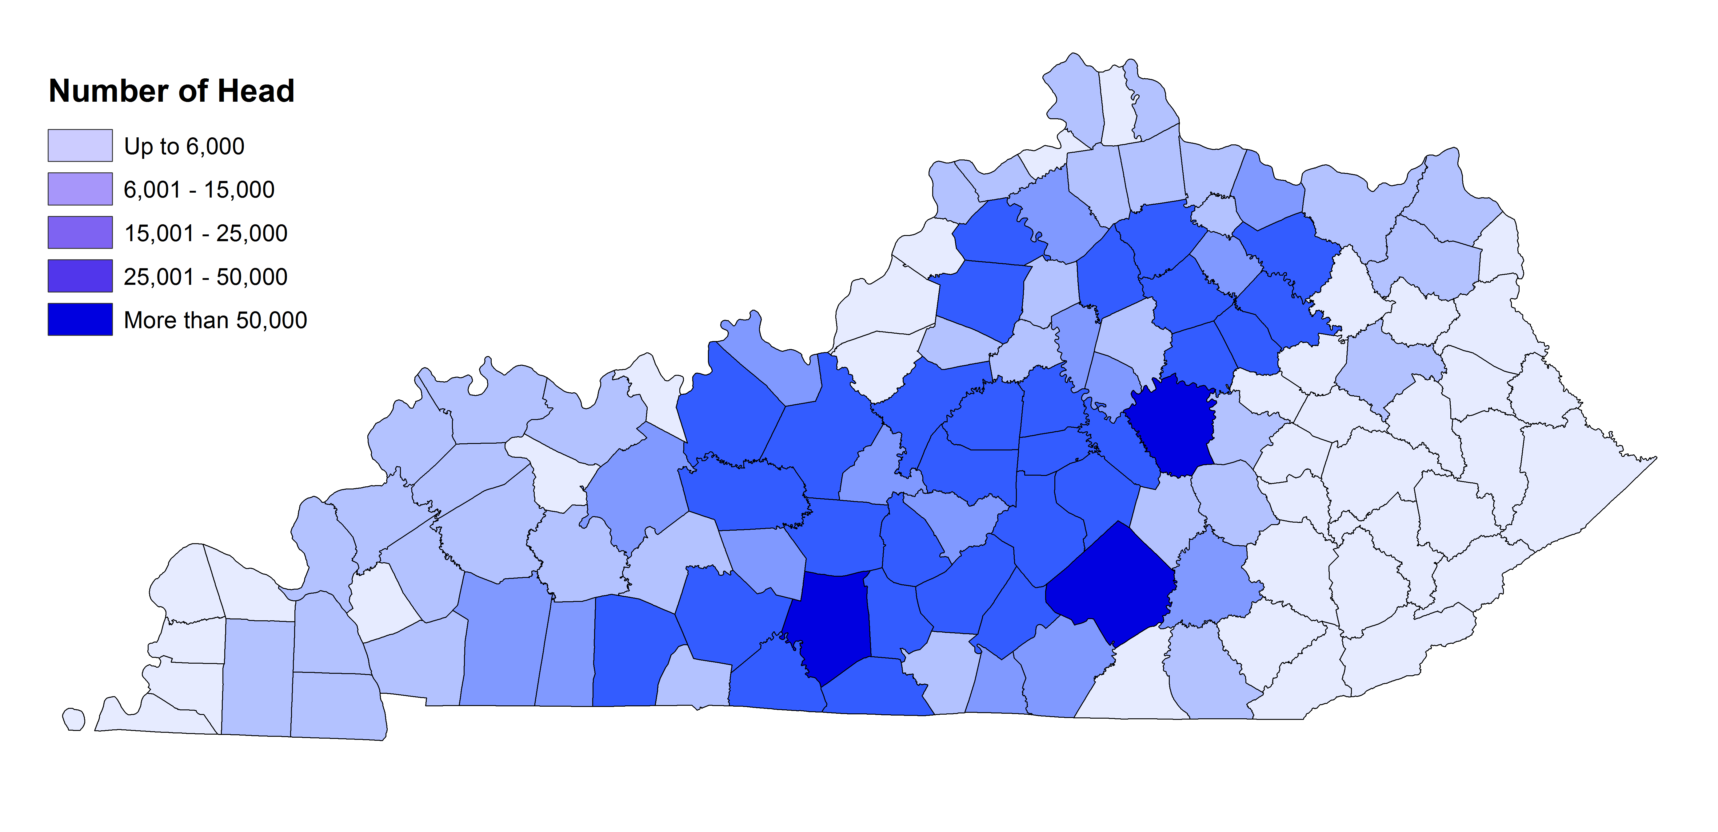
Snapshot of Kentucky’s Beef Industry
32,000
Beef Farm Families
1.9 Million
Cattle, Incl Calves
$1.10 Billion
Cash Receipts
28 Head
Average Herd Size
63%
Work off the Farm
23%
Total Farmland in KY is Pastureland

Slide 3
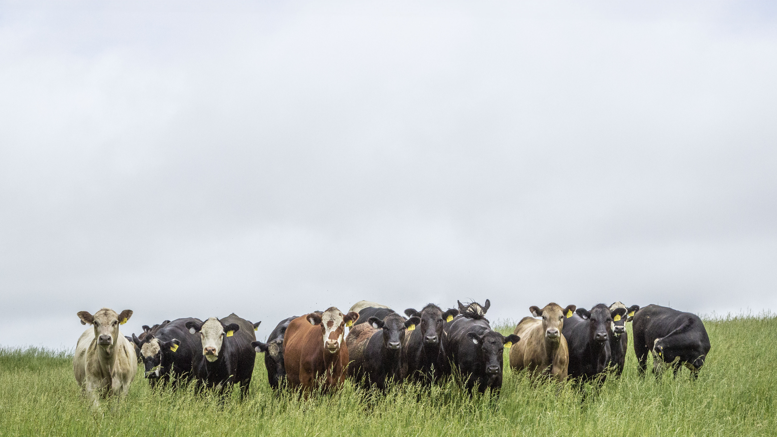
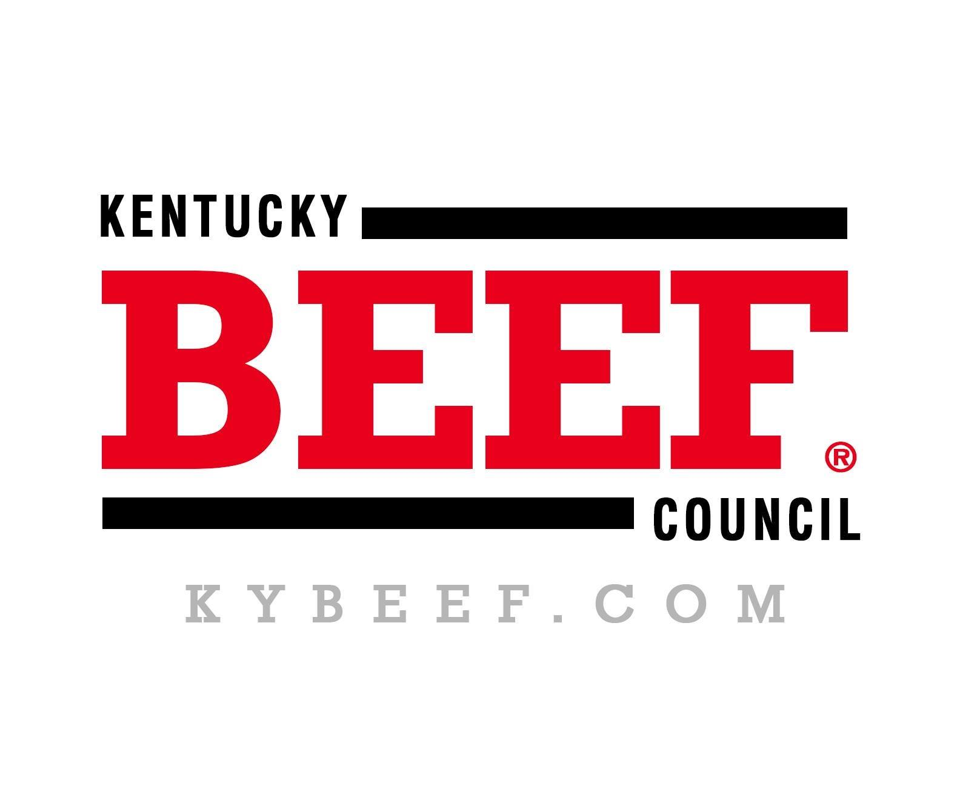
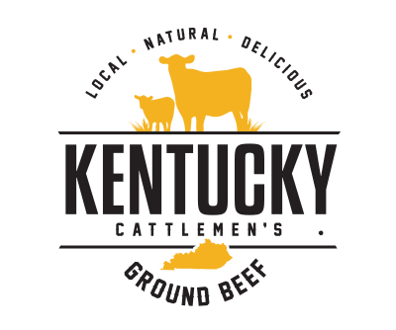
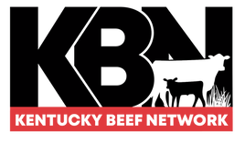
Snapshot of Kentucky Cattlemen’s
State & Federal Checkoff
$6 Million Farm Gate Sales
KY Ag Development Funds
11,000+ Members
Provides services to 18 state Cattlemen Associations, 2 breed associations, and 1 private industry
Consumer demand for beef remains strong overall, despite higher prices
Provides a pathway for Kentucky’s cattle farmers to enter the market for locally produced and marketed ground beef
Helps Kentucky farmers increase revenue on their farms through new management practices and concepts.

Slide 4
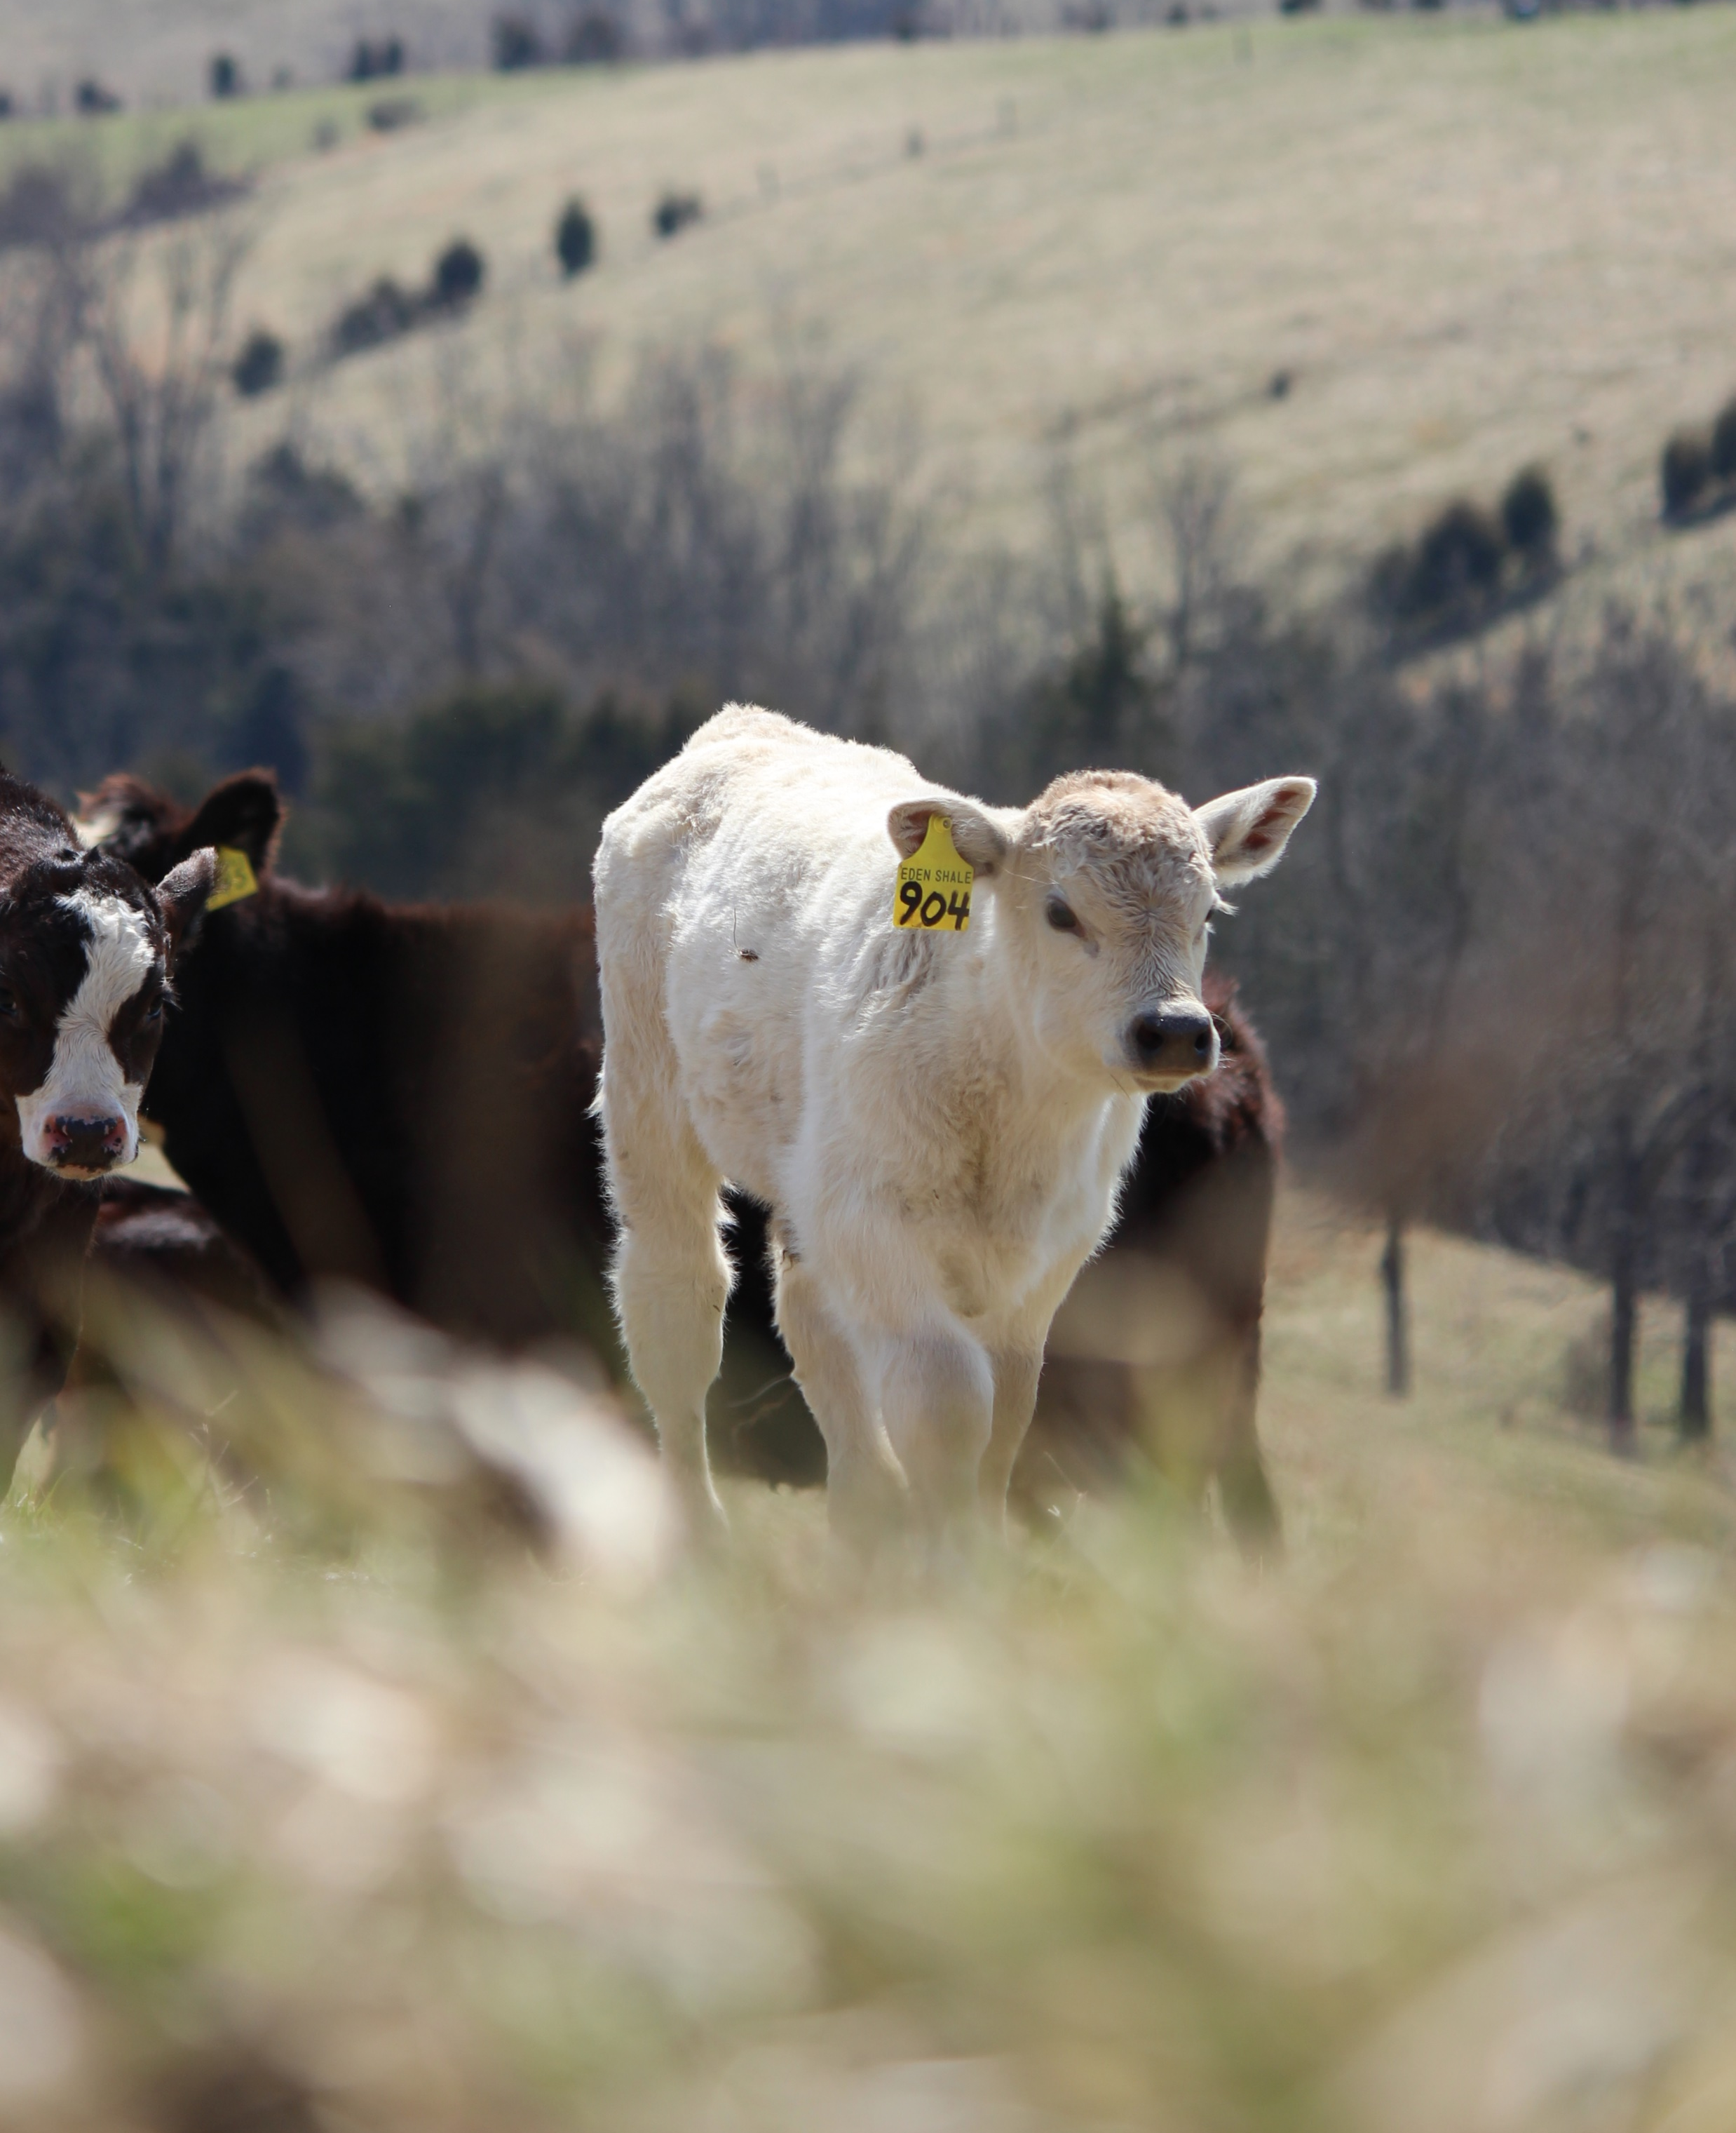
Kentucky Cattlemen’s Association
Long Range Strategic Plan
2020-2025
Cultivate value-added marketing opportunities
Strengthen research, demonstration and outreach
Improve KCA engagement, collaboration and advocacy
Develop and leverage organizational infrastructure and capabilities

Slide 5
“Production efficiency is the key issue driving structural change” John Nalivka – Sterling Marketing Inc
The U.S. cattle herd peaked at 132 million in 1975 and produced 24 billion pounds of beef.
Our herd is now one-third smaller, and will produce 27 billion pounds, or 15% MORE than 1975.

Slide 6
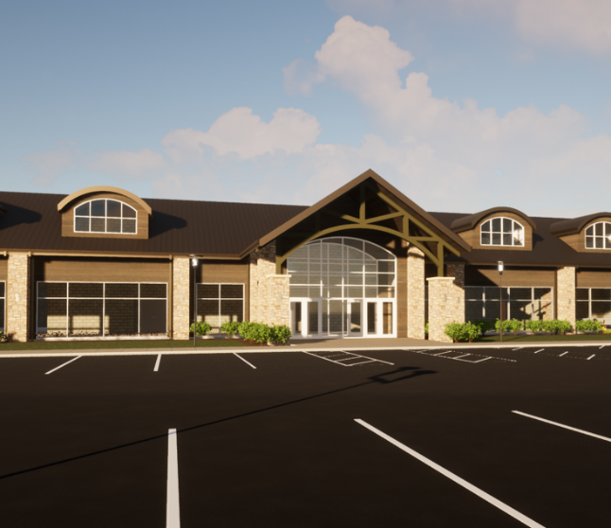
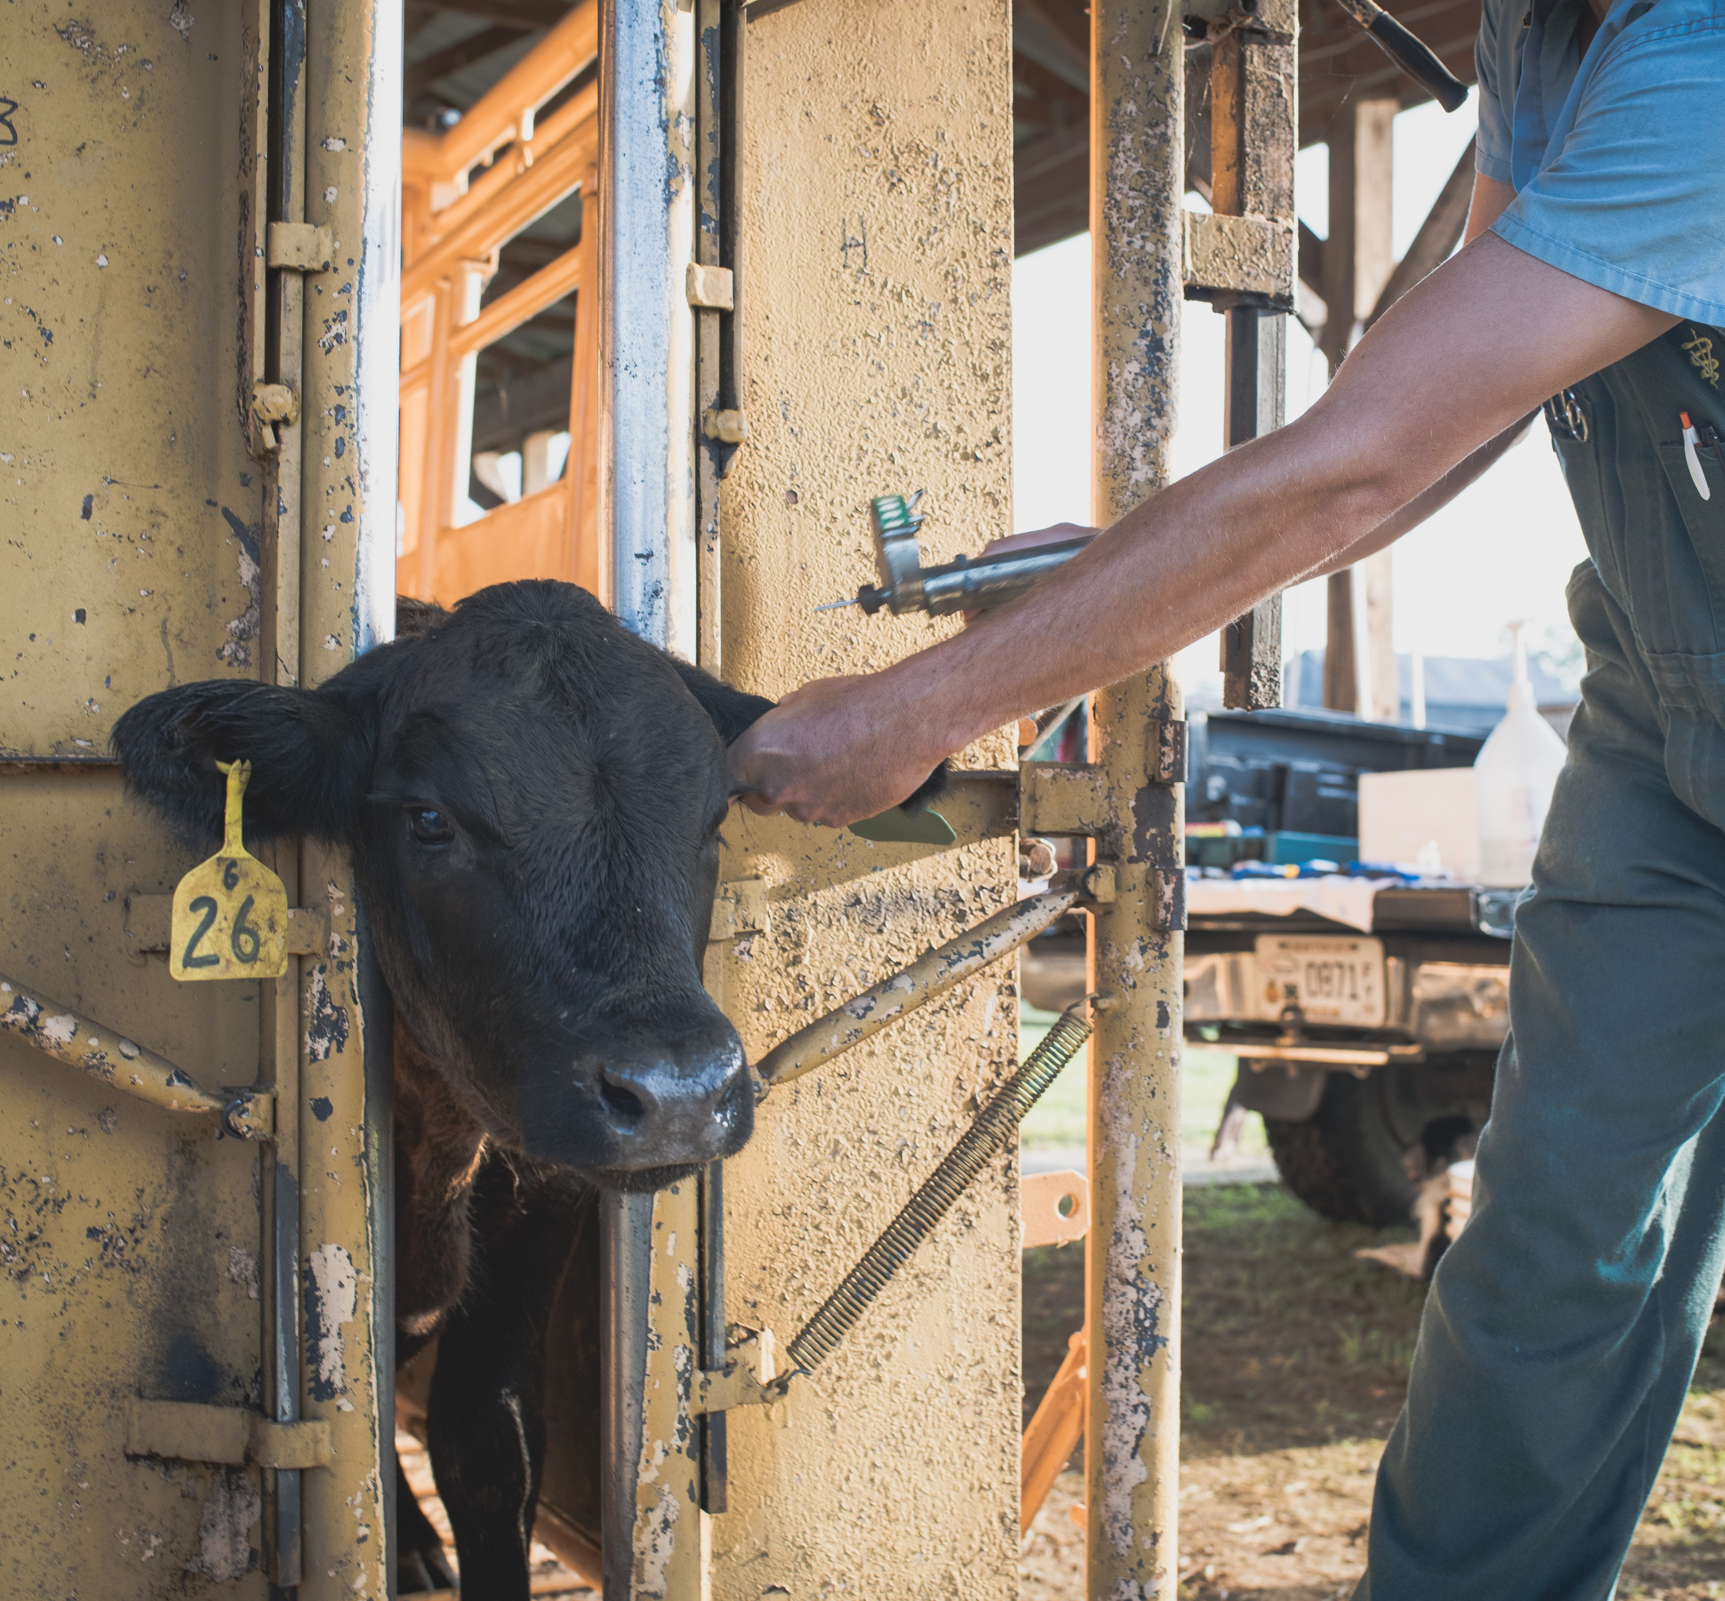
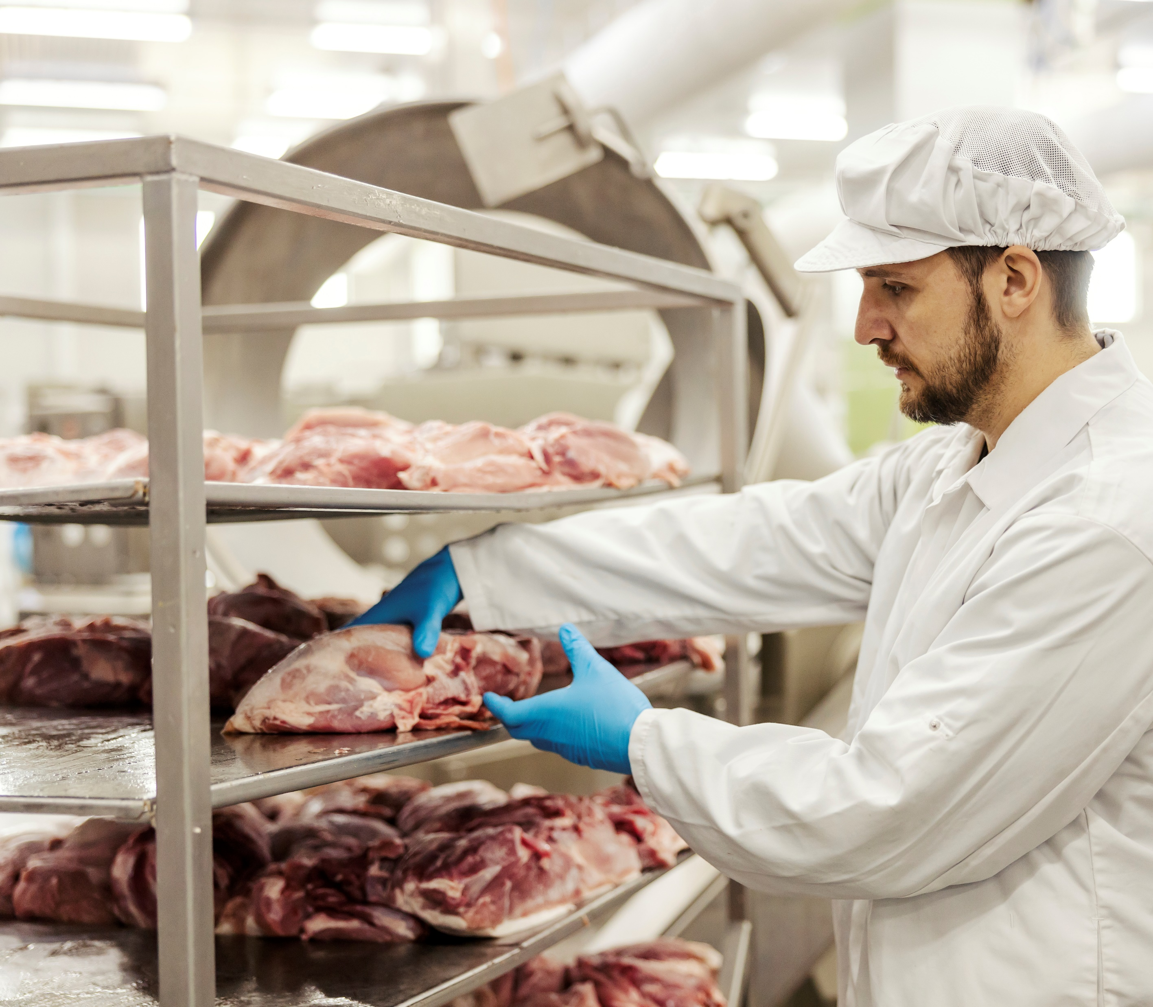
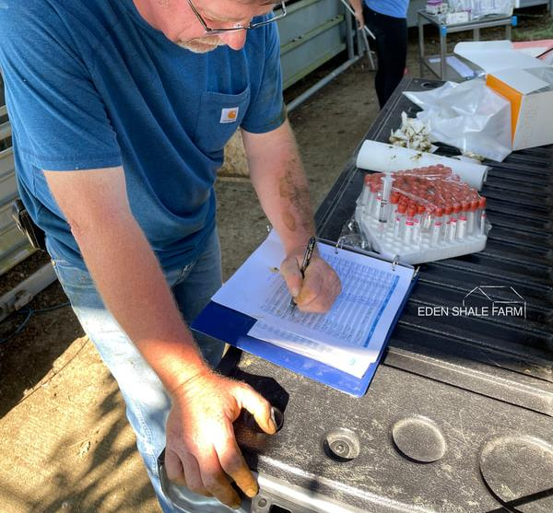
Legislative Priorities
KY Livestock Innovation Center
Support the Kentucky Cattlemen’s Foundation for their one-time state budget funding request to establish a Kentucky Livestock Innovation Center
Large Animal Veterinarians
Adopt the political and economic reforms to better support, recruit, and retain food animal veterinarians; make a priority of addressing any shortage of food animal veterinary practitioners, especially in the rural areas of Kentucky; and develop “common sense” solutions for a more robust large animal veterinary workforce.
Food Safety
Increase the demand for beef by supporting a multidisciplinary approach to identify and develop interventions along the entire food chain.
Research
Support adequate funding for research which will protect the profitability, and long-term viability of Kentucky’s cattle and beef supply.

