Slide 1
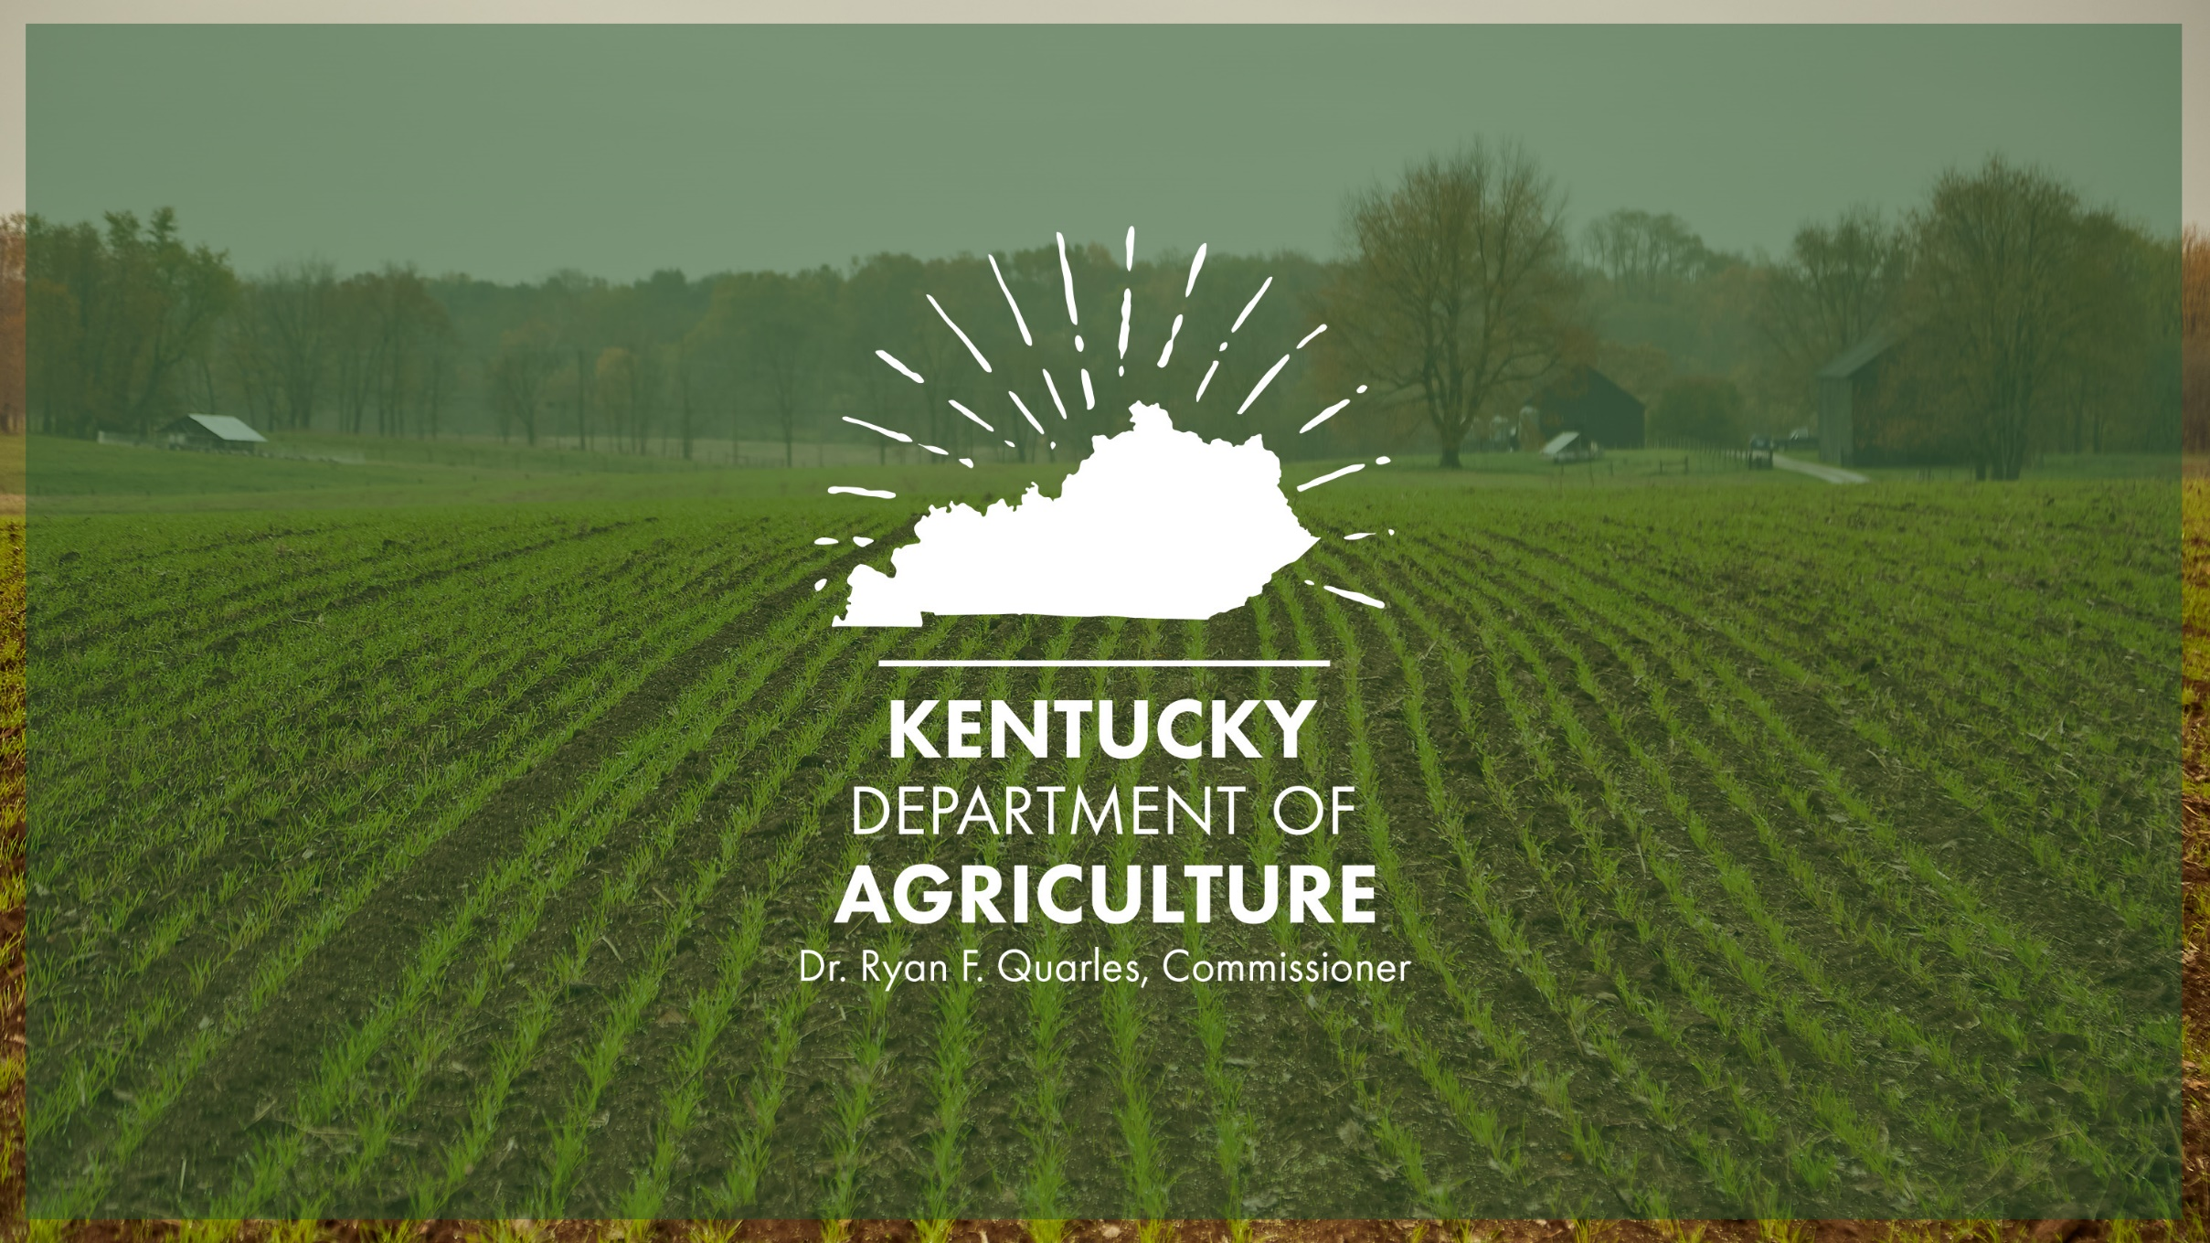

Slide 2
The Office of State Veterinarian Workload and staffing challenges has changed drastically over the past 10 years
A snapshot:
Since 2002, Office of State Veterinarian staff has been reduced from 69 to a low of 36 in 2021; in Commissioner Quarles effort’s to re-build OSV, today it has 40 staff members
Meanwhile, since 2015, workload has increased drastically:
Population of farmed cervids from 1,422 to 3,565
# of Backyard Poultry flocks enrolled in National Poultry Improvement Program from 63 to 158
# of Import Certificate Inspections from 3,915 to 23,711
# of Export Certificate Inspections from 10,993 to 41,893
The deployment of personnel and resources brought to light the critical staff shortage as OSV staff took on emergency response roles with the December 2021 & January 2022 tornado disasters, flooding in eastern KY in July 2022, and multiple High Path Avian Influenza outbreaks in addition to their day-to-day tasks.

Slide 9
The Kentucky Department of Agriculture requests funding in the 2024 – 2026 Biennial Budget
The request will provide 4 positions in the new Emergency Division and 11 in the Field Division (6 in FY 25 & 5 in FY 26):
 | 4th Q FY 2024 | FY 2025 | FY 2026
Emergency Division
Personnel | $96,200 | $361,100 | $361,100
Operations | $57,700 | $82,800 | $82,800
Field Division
Personnel |  | $396,900 | $725,600
Operations |  | $156,800 | $261,500
TOTAL | $153,900 | $997,600 | $1,431,000

Slide 10
KDA Update Veterinary Shortage Activity
Two Stakeholder’s Dialogues on the Status of Large Animal Veterinarians – June and November of 2022
Commissioner appointed Veterinary Shortage Working Group (VSWG) in February 2023
22 members representing all segments of animal agriculture, the veterinary industry, and higher educational institutional leaders
Three VSWG meetings plus numerous committee meetings
Four committees and focuses:
1) Developing a strong pipeline of Kentucky Students to veterinary school
2) Opportunities in veterinary school, what should Kentucky focus on to assist
3) From veterinary school to rural and large animal practice, what can this Working Group do
4) Keeping Veterinarians in rural and large animal practice, what can this Working Group do
VSWG will meet on November 28, to finalize and approve their report

Slide 11
KDA Update Veterinary Shortage Activity
KDA accomplished to date:
KAFC: Large/Food Animal Veterinary Loan Program
KADB: Large/Food Animal Veterinary Incentives Program
During 2023, KDA partnered on the national level with Farm Journal Foundation (FJF) and NASDA
FJF Study: Addressing the Persistent Shortage of Food Animal Veterinarians and Its Impact on Rural Communities
Member of the FJF Rural Veterinary Mapping Group
Washington D.C.
U.S. Senate established the Veterinary Medicine Caucus to focus on increasing awareness, advancing legislation on veterinary-related issues
The Rural Veterinary Workforce Act (S. 2829) introduced in September to address the critical shortage of Veterinarians practicing in rural areas
Commissioner Quarles participated in countless media interviews to raise awareness to the issue

Slide 12
Questions?
Commissioner Dr. Ryan F. Quarles
Keith L. Rogers
Chief of Staff
(502) 234-8022 (cell)
KeithL.Rogers@ky.gov
www.kyagr.com
Dr. Steve Velasco III
State Veterinarian
(502)782-5920
Steve.Velasco@ky.gov
www.kyagr.com/statevet

