Slide 1
SREB Contract for Veterinary Education Kentucky and Auburn University
Calvin M. Johnson, Dean
Melinda S. Camus, Associate Dean for Academic Affairs

Slide 2
SREB Contract
Continuous since 1951 (72 years)​
152 students attend Auburn University’s College of Veterinary Medicine (AU CVM) – 38 per class in a four-year program​
68% of employed graduates immediately return to Kentucky​
1,900 DVM graduates of the AU CVM have benefitted from the SREB contract ​
57% of Kentucky Veterinary Medical Association members graduated from the AU CVM

Slide 3
Financial Impact of SREB Seats at Auburn
Kentucky will pay the SREB $5,244,760 in FY 2023-24 for 152 seats at Auburn​
The AU CVM invoices the SREB each semester for each verified Kentucky resident at the contract rate​
Kentucky residents pay in-state tuition and fees to Auburn University​
Four-year tuition savings to Kentucky students for an AU DVM degree: $127,500

Slide 4
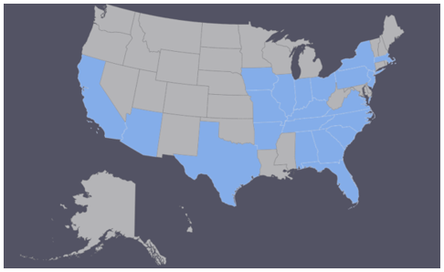
AU CVM Class of 2027 (Current 1st Year Class)​
136 applicants for 38 Kentucky seats​
184 applicants for 41 Alabama seats​
897 applicants for 51 at-large seats ​
27/130 (21%) male students​
15/130 (12%) URM students​
5 Hispanic​
5 Black​
3 Asian​
2 Native American

Slide 5
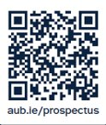
Class of 2027 Statistics for All Students
Overall GPA = 3.70 (Kentucky = 3.41)​​
Science GPA = 3.66 (Kentucky = 3.32)​​
Organic/Physics GPA = 3.50 (Kentucky = 2.97)​
Trend GPA = 3.71 (Kentucky = 3.43)​
Hours of Veterinary Experience = 2,820 (Kentucky= 3,575)

Slide 6
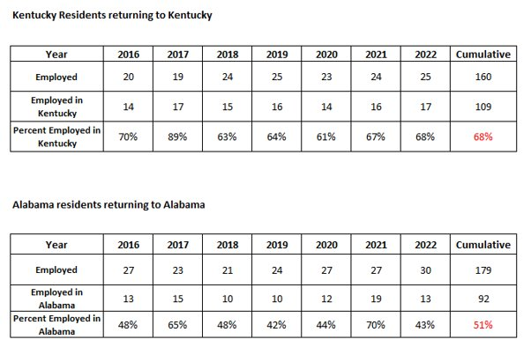
Return to Kentucky After Graduation​

Slide 7
Initiatives to Address the Rural Shortage​ (Kentucky-Focused Projects Conducted by the AU CVM)
USDA-NIFA Veterinary Services Grant Program (VSGP) grants​
September 2017-August 2022 ($246,495)​
September 2023-August 2026 ($230,323)​
Kentucky Agricultural Development Fund (KADF) Contract​
August 2023-August 2025 ($128,365)​
Jointly funded by the AU CVM, KADF, and Kentucky Veterinary Medical Association​

Slide 8
Initiatives to Address the Rural Shortage​ (Kentucky-Focused Projects Conducted by the AU CVM)
​
Recruitment efforts, practice management rotations, externships, and preceptorships in federally identified rural shortage areas
Camus et al., Community of origin, preferred community, and gender are predictors for veterinary graduates from Auburn University choosing rural food animal employment, Journal of the American Veterinary Medical Association, Sept. 6, 2023

Slide 9
USDA-NIFA Veterinary Services Grant 1:​ Recruitment and Support of Veterinarians in Underserved Rural Areas of Kentucky (2018-2022)​
​Key Outcomes:
20 senior students conducted 8-week capstone training experiences in rural Kentucky practices​
19 (95%) became licensed and accepted jobs in rural practice​
15 (75%) became licensed and accepted jobs in rural Kentucky
Two are now practice owners

Slide 10
USDA-NIFA Veterinary Services Grant 2:​ A bookend approach to recruit students and retain food animal veterinary practitioners in Veterinary Shortage Situations in Kentucky (2023-2026)​​
​Key Outcomes to Date:
10 high school students were selected with the assistance of the Kentucky Junior Cattlemen’s Association to engage in a mentoring experience with AU CVM students
The first mentoring session was held successfully at the Kentucky Veterinary Medical Association meeting from September 22-23, 2023 in Louisville
​Sites for upcoming mentoring sessions: AU CVM campus, Kentucky Cattlemen’s Association Meeting, AU CVM’s two-week Beef Stocker Rotation in Kentucky
Eden Shale, Owen County and Fountain Run, Allen County

Slide 11
Kentucky Agricultural Development Fund Contract:​ Recruitment and Support of Veterinarians in Underserved Rural Areas of Kentucky (2023-2025)​
​Objectives:
To continue the successful USDA-NIFA Veterinary Services Grant project for 2 additional years​
Cultivate a partnership between Auburn University, KADF, the Kentucky Veterinary Medical Association, the Kentucky State Veterinarian, and veterinary practitioners in rural Kentucky​

Slide 12
