Slide 1
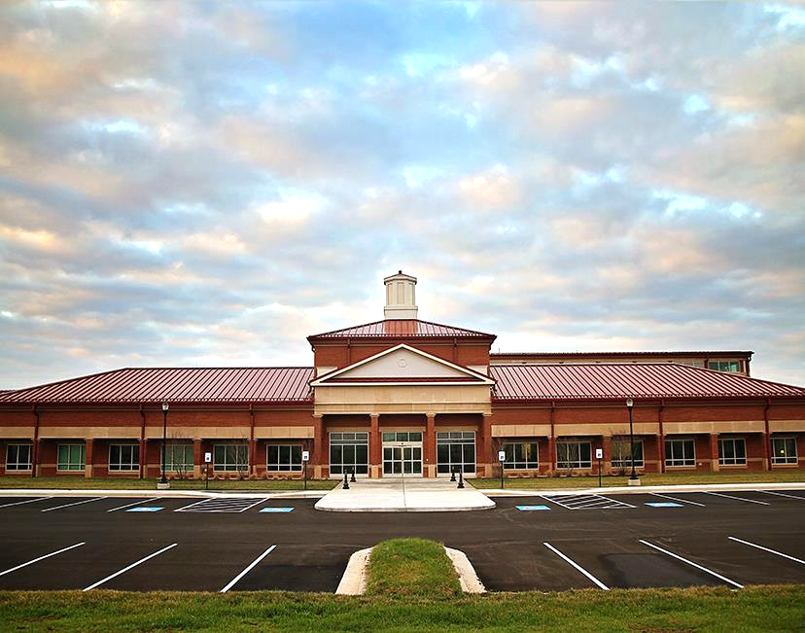
Murray State School of Veterinary Medicine
Brian Parr- Dean of the Hutson School of Agriculture
Jordan Smith- Director of Governmental Affairs
Jason Peake- Peake and Associates LLC
10/19/2023
Joint Agriculture Committee

Slide 2
Feasibility Study- Peake et al.
Murray State University’s Hutson School of Agriculture is perfectly positioned to address the growing need for rural veterinarians in Kentucky.
Kentucky has a need for rural and large animal veterinarians that has not been met by the current approach to training Kentucky students.

Slide 3
Existing Support Structure
Rudolph Equine Education Center and Eldon Heathcott Rodeo Facility located on the West Farm complex
West Farm Complex, which houses the university’s certified Angus herd
North Farm Complex, which houses the university’s swine unit
Breathitt Veterinary Center, a veterinary diagnostic laboratory
Eagle Rest Farm, a 534-acre farm and historic cattle ranch in Ballard County, located about 60 miles northwest of campus
Hopkinsville Regional Campus Facilities
Carman Pavilion Pre-Vet/Vet Tech Teaching Facility

Slide 4
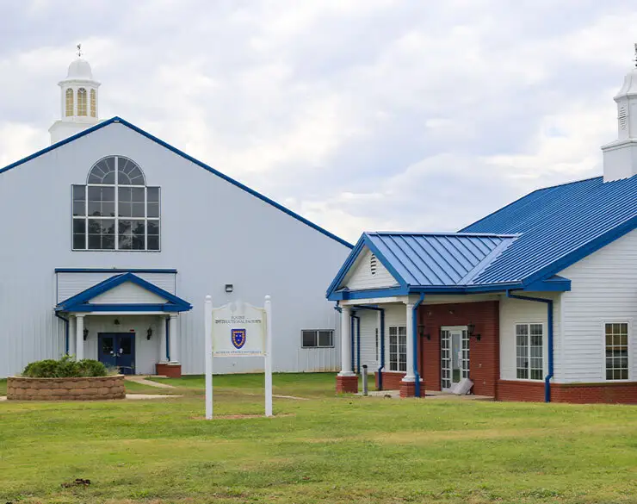
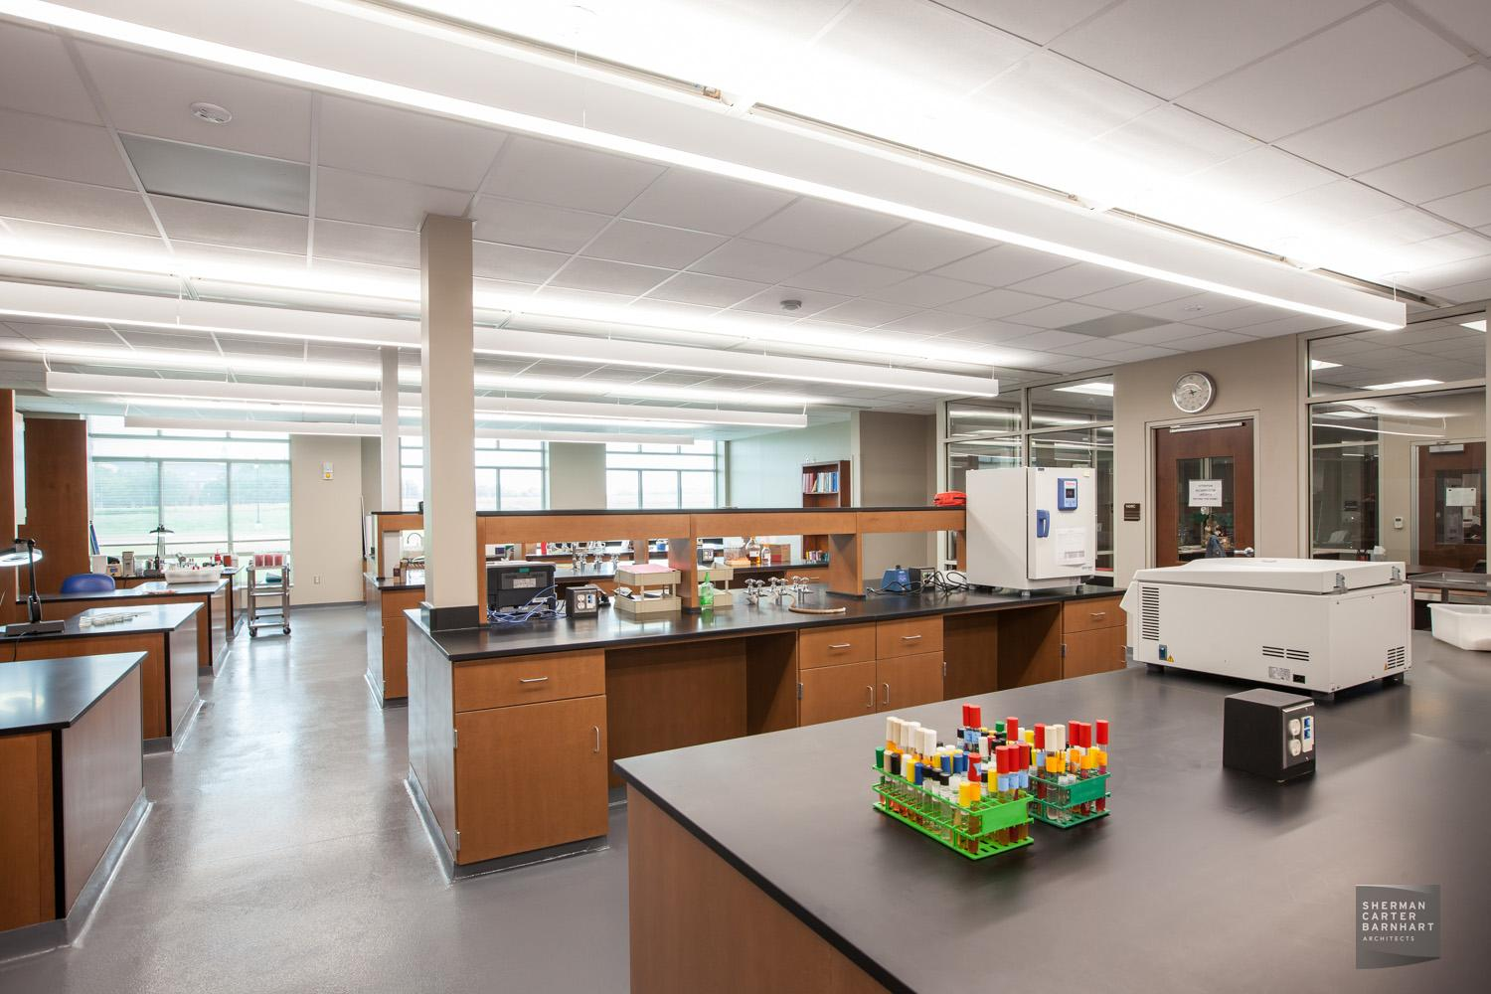
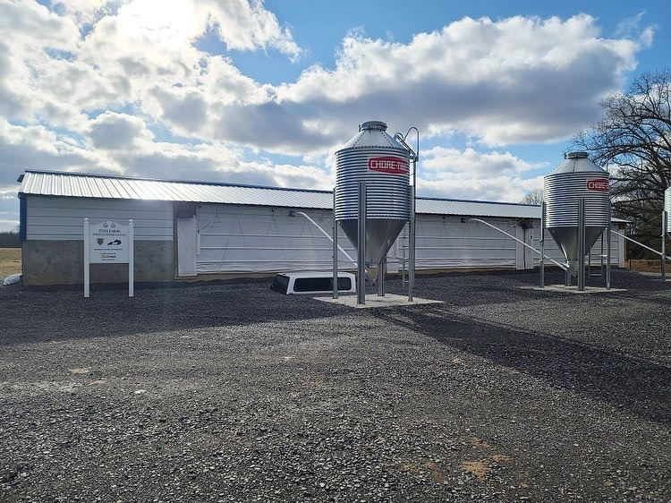
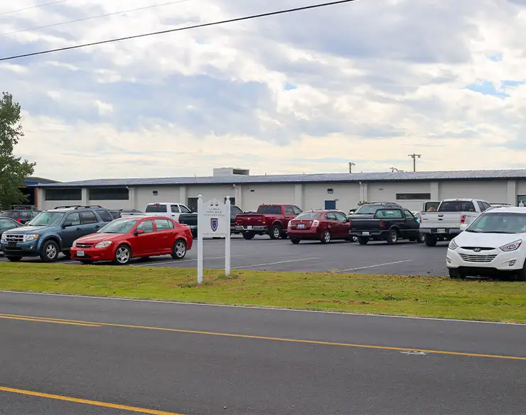
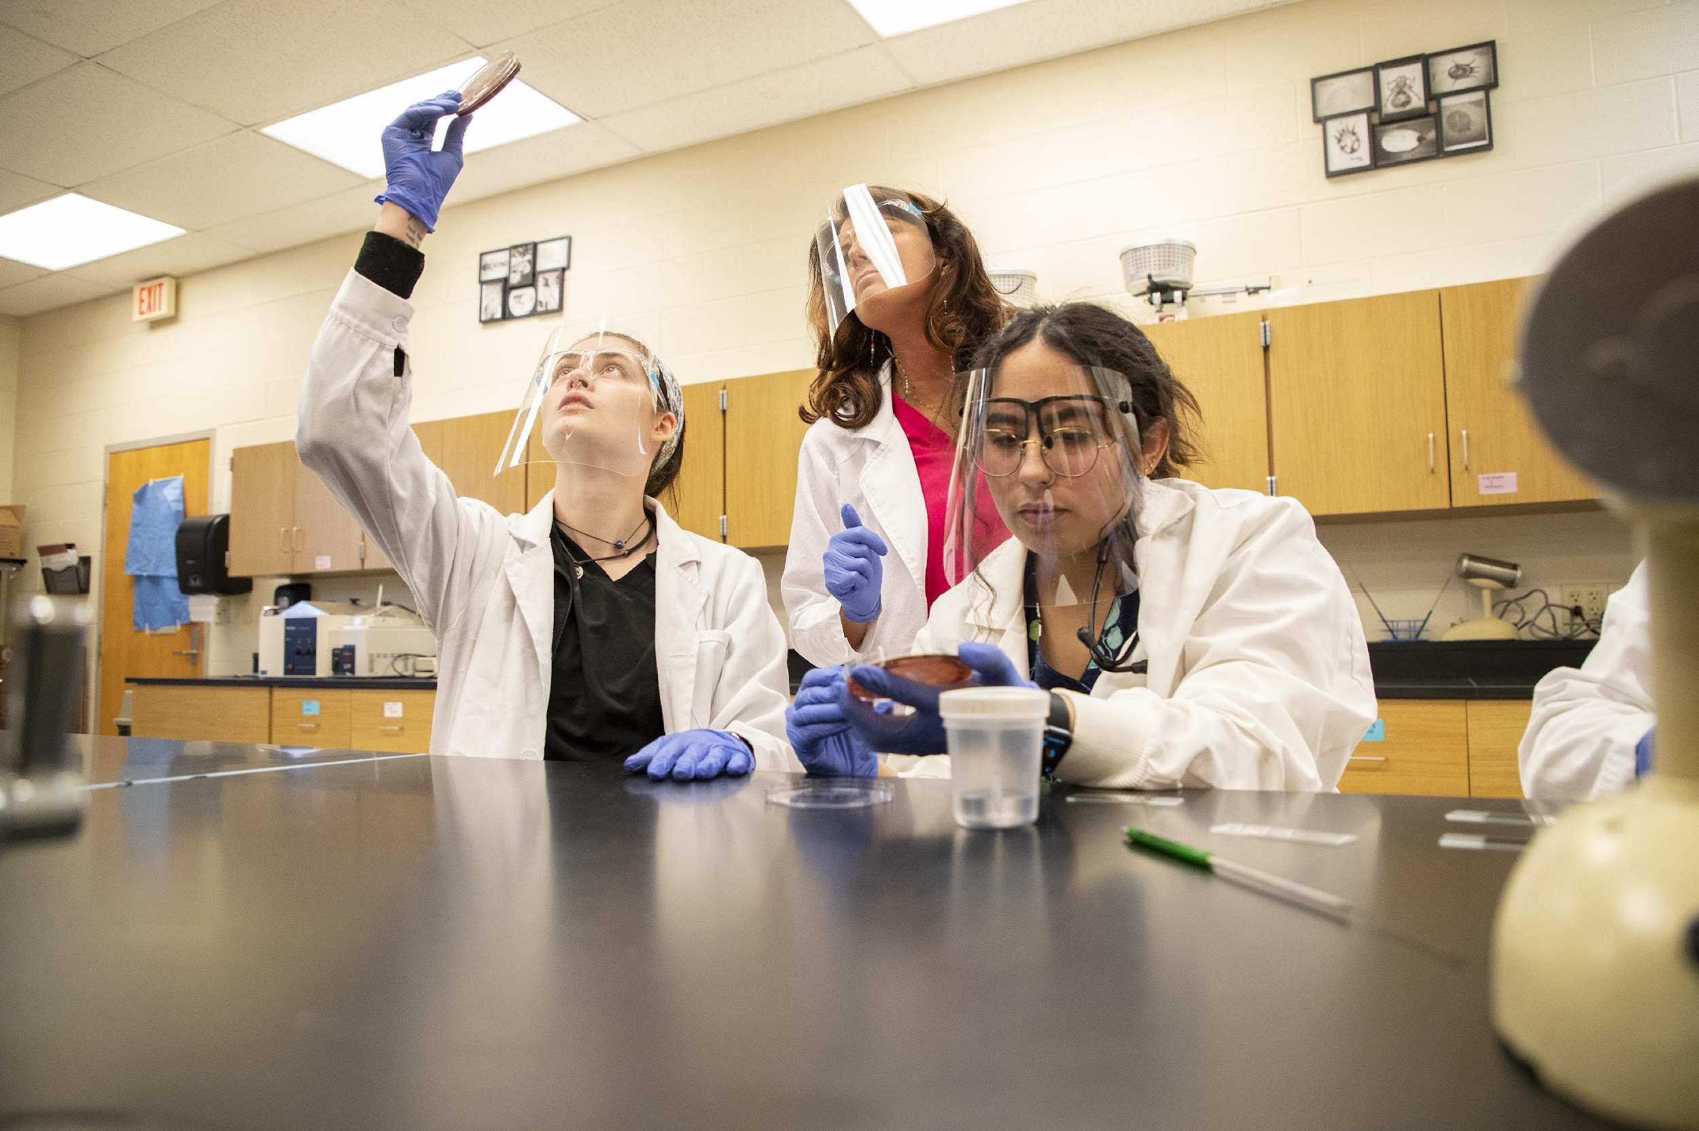
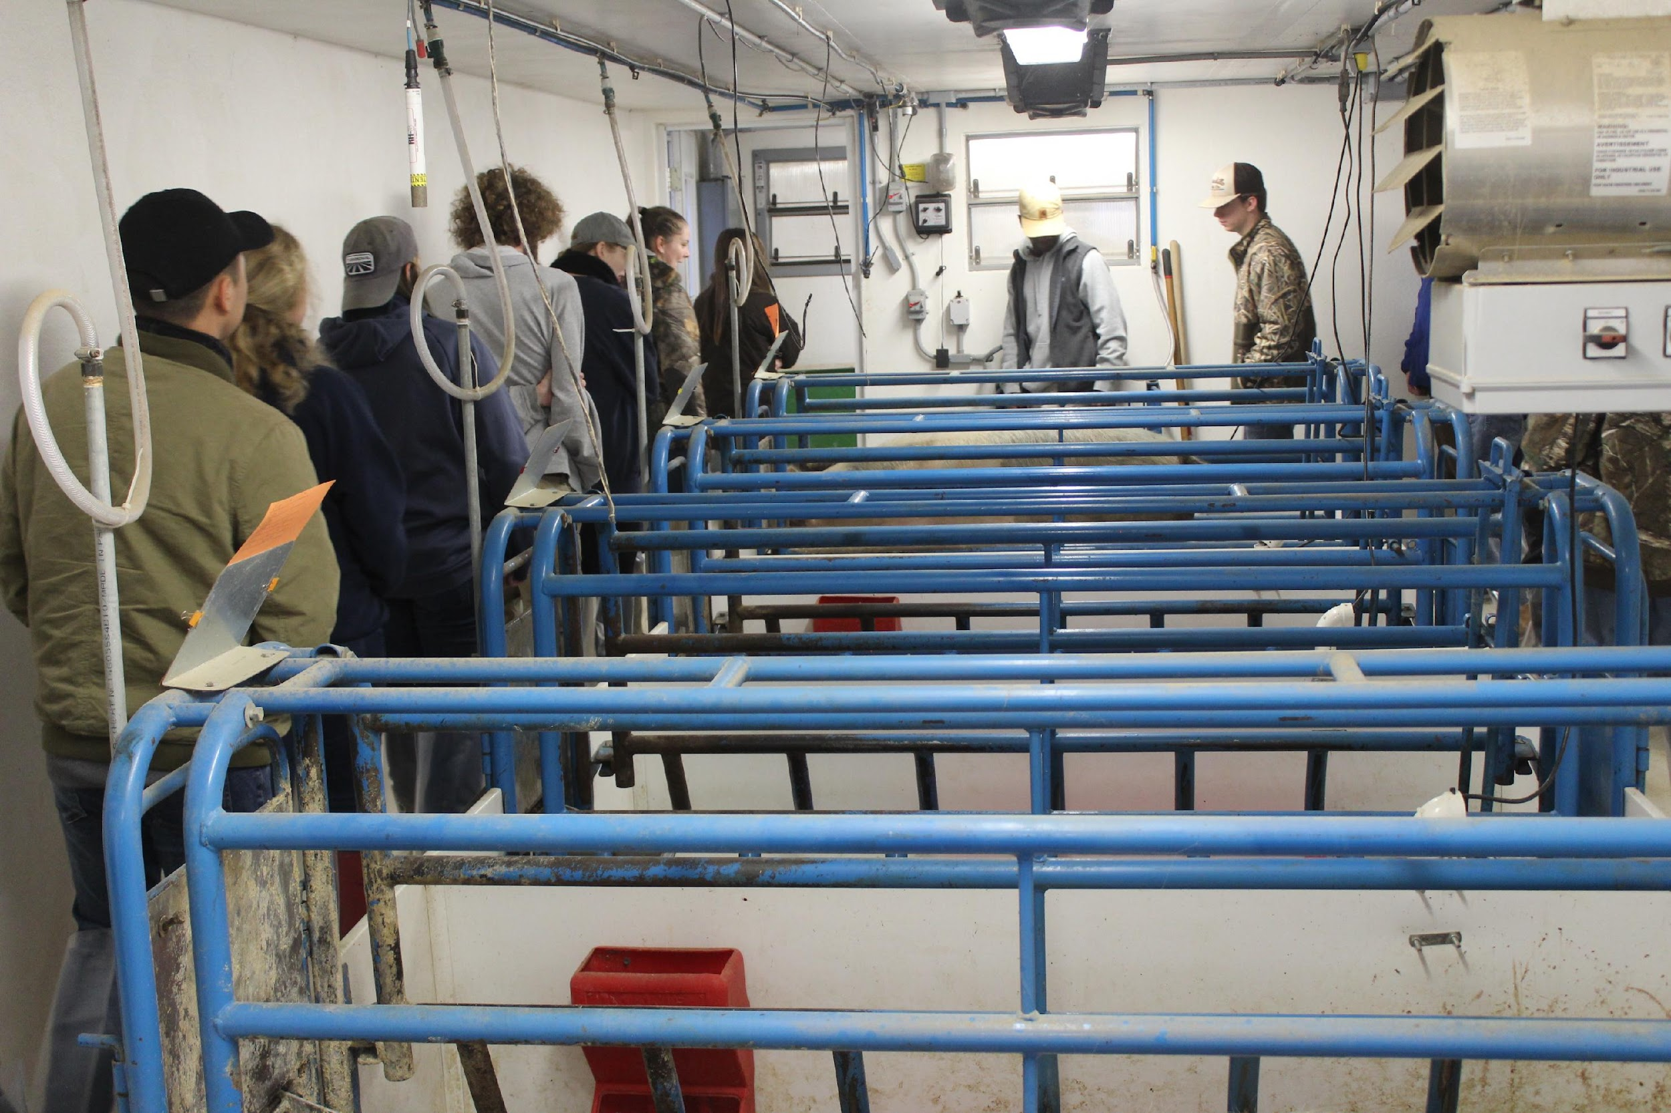

Slide 5
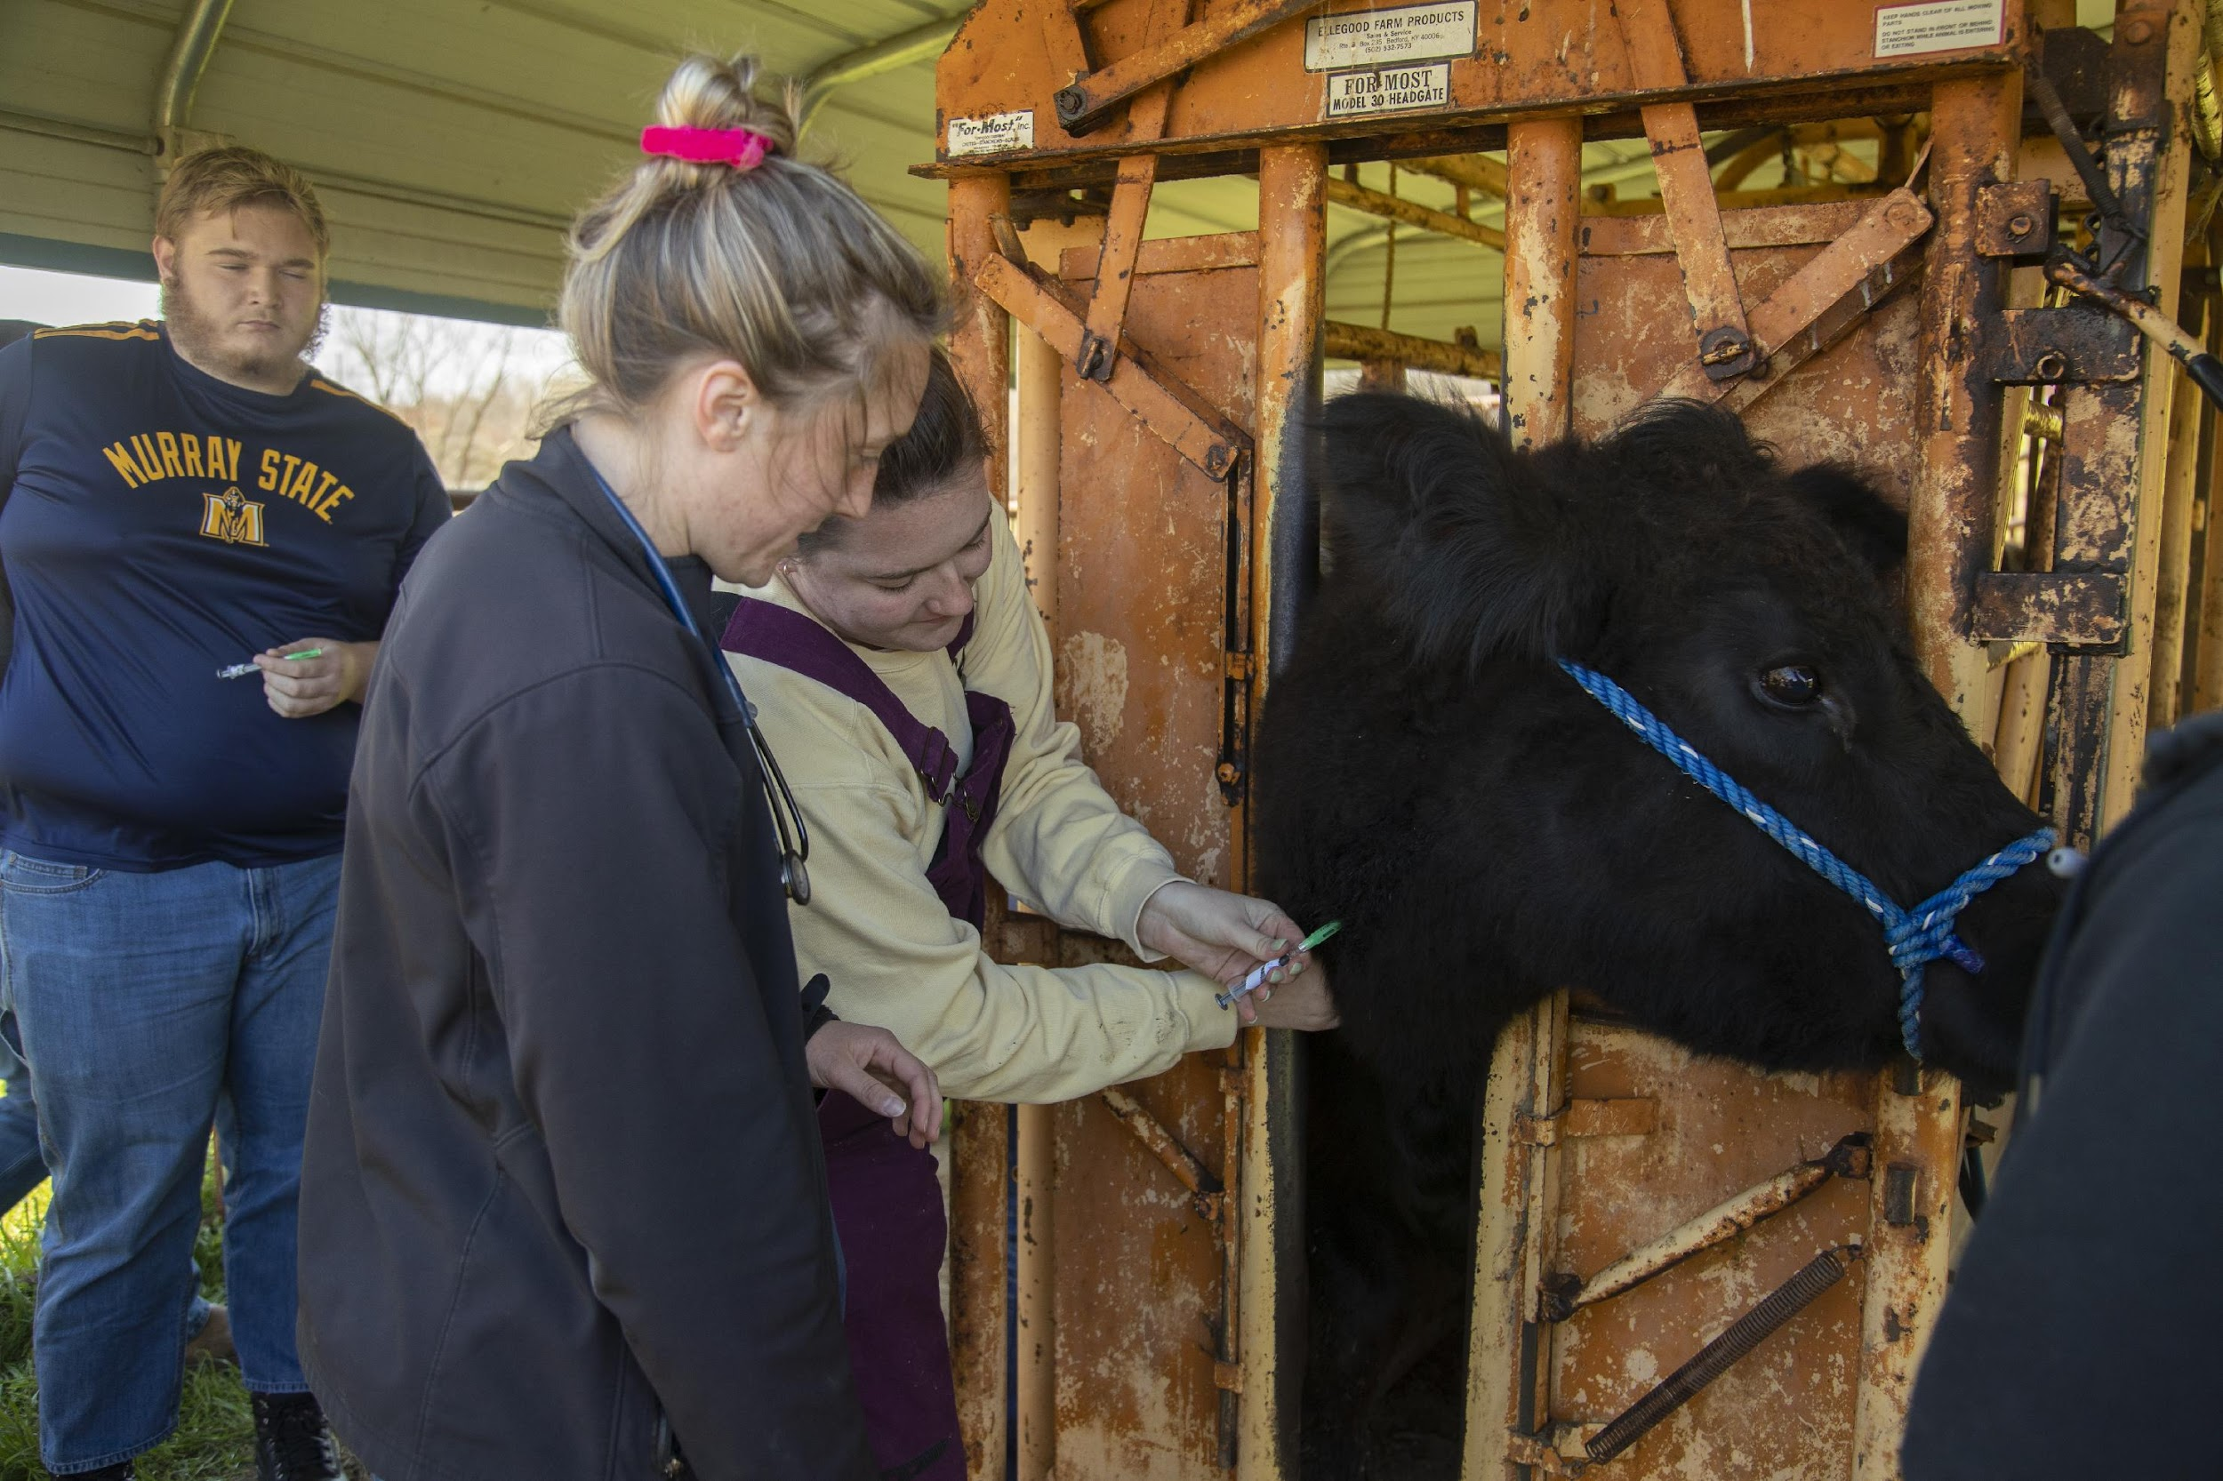
Kentucky Livestock Industry
Kentucky’s livestock industry is well known. Kentucky consistently ranks in the top 10 in domestic cattle production and has a world renowned horse industry.
There are a combined 2,304,500 head of livestock in Kentucky.
Given that there are 54 sole large animal practice veterinarians covering the state and 2.3 million large animals.
This works out to 42,676 large animals per large animal veterinarian.

Slide 6
Current Status of Veterinary Medicine
Currently there is a national need (unmet by existing veterinary college/school graduates).
This number is compounded by the fact that an increase of younger veterinarians are not seeking 40hr/week positions, so 5,000 individuals are needed to meet FTE demand between 3,000 – 4,000.

Slide 7
Kentucky Veterinarian Status
Data from the Board of Veterinary Examiners identify 1,564 practicing veterinarians with addresses in Kentucky and 2,613 licensed veterinarians in total.
The largest concentration are practicing in urban counties near Louisville and Lexington.
Just over half of Kentuckians who benefit from the veterinary contract spaces program at that institution return to Kentucky to practice after graduation.

Slide 8
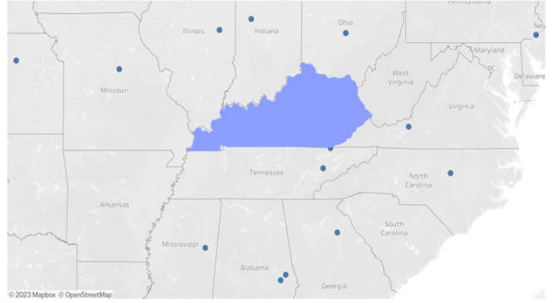

Slide 9
Future Veterinarian Needs Data Sources: AVMA 2023 State of the Profession
Veterinary positions will grow by 19.3% between 2016 and 2026, with 704 total openings during that time.
Veterinary Medicine is a “fast growing” occupation in Kentucky.
The shortage of rural food animal veterinarians available for herd health visits/consultations, surgery and emergency after hour visits is putting Kentucky producer’s herds and flocks at risk.
In the absence of veterinary consultation, producers may use veterinary pharmaceuticals inappropriately, putting a potentially dangerous product into the food chain. (USDA NIFA, 2023,paragraph 10).

Slide 10
Large Animal Veterinarians And Student Loans
Food animal exclusive and food animal predominant practice together attracted 2.7% of all graduates.
Full-time positions in equine practice were accepted by 1.4% of all graduates.
To combat the problem of recent graduates choosing areas of focus other than large animal, prioritize placements at large animal veterinary clinics and increase training large animal vets.
Other colleges of veterinary medicine are diversified, but largely focused on pets. MSU has an opportunity to establish itself as the leading large animal school of veterinary medicine.
New endowment to support rural students studying veterinary medicine- $4.2 million
Existing Public Service Loan Forgiveness Program.
Existing Veterinary Medicine Loan Repayment Program.

Slide 11
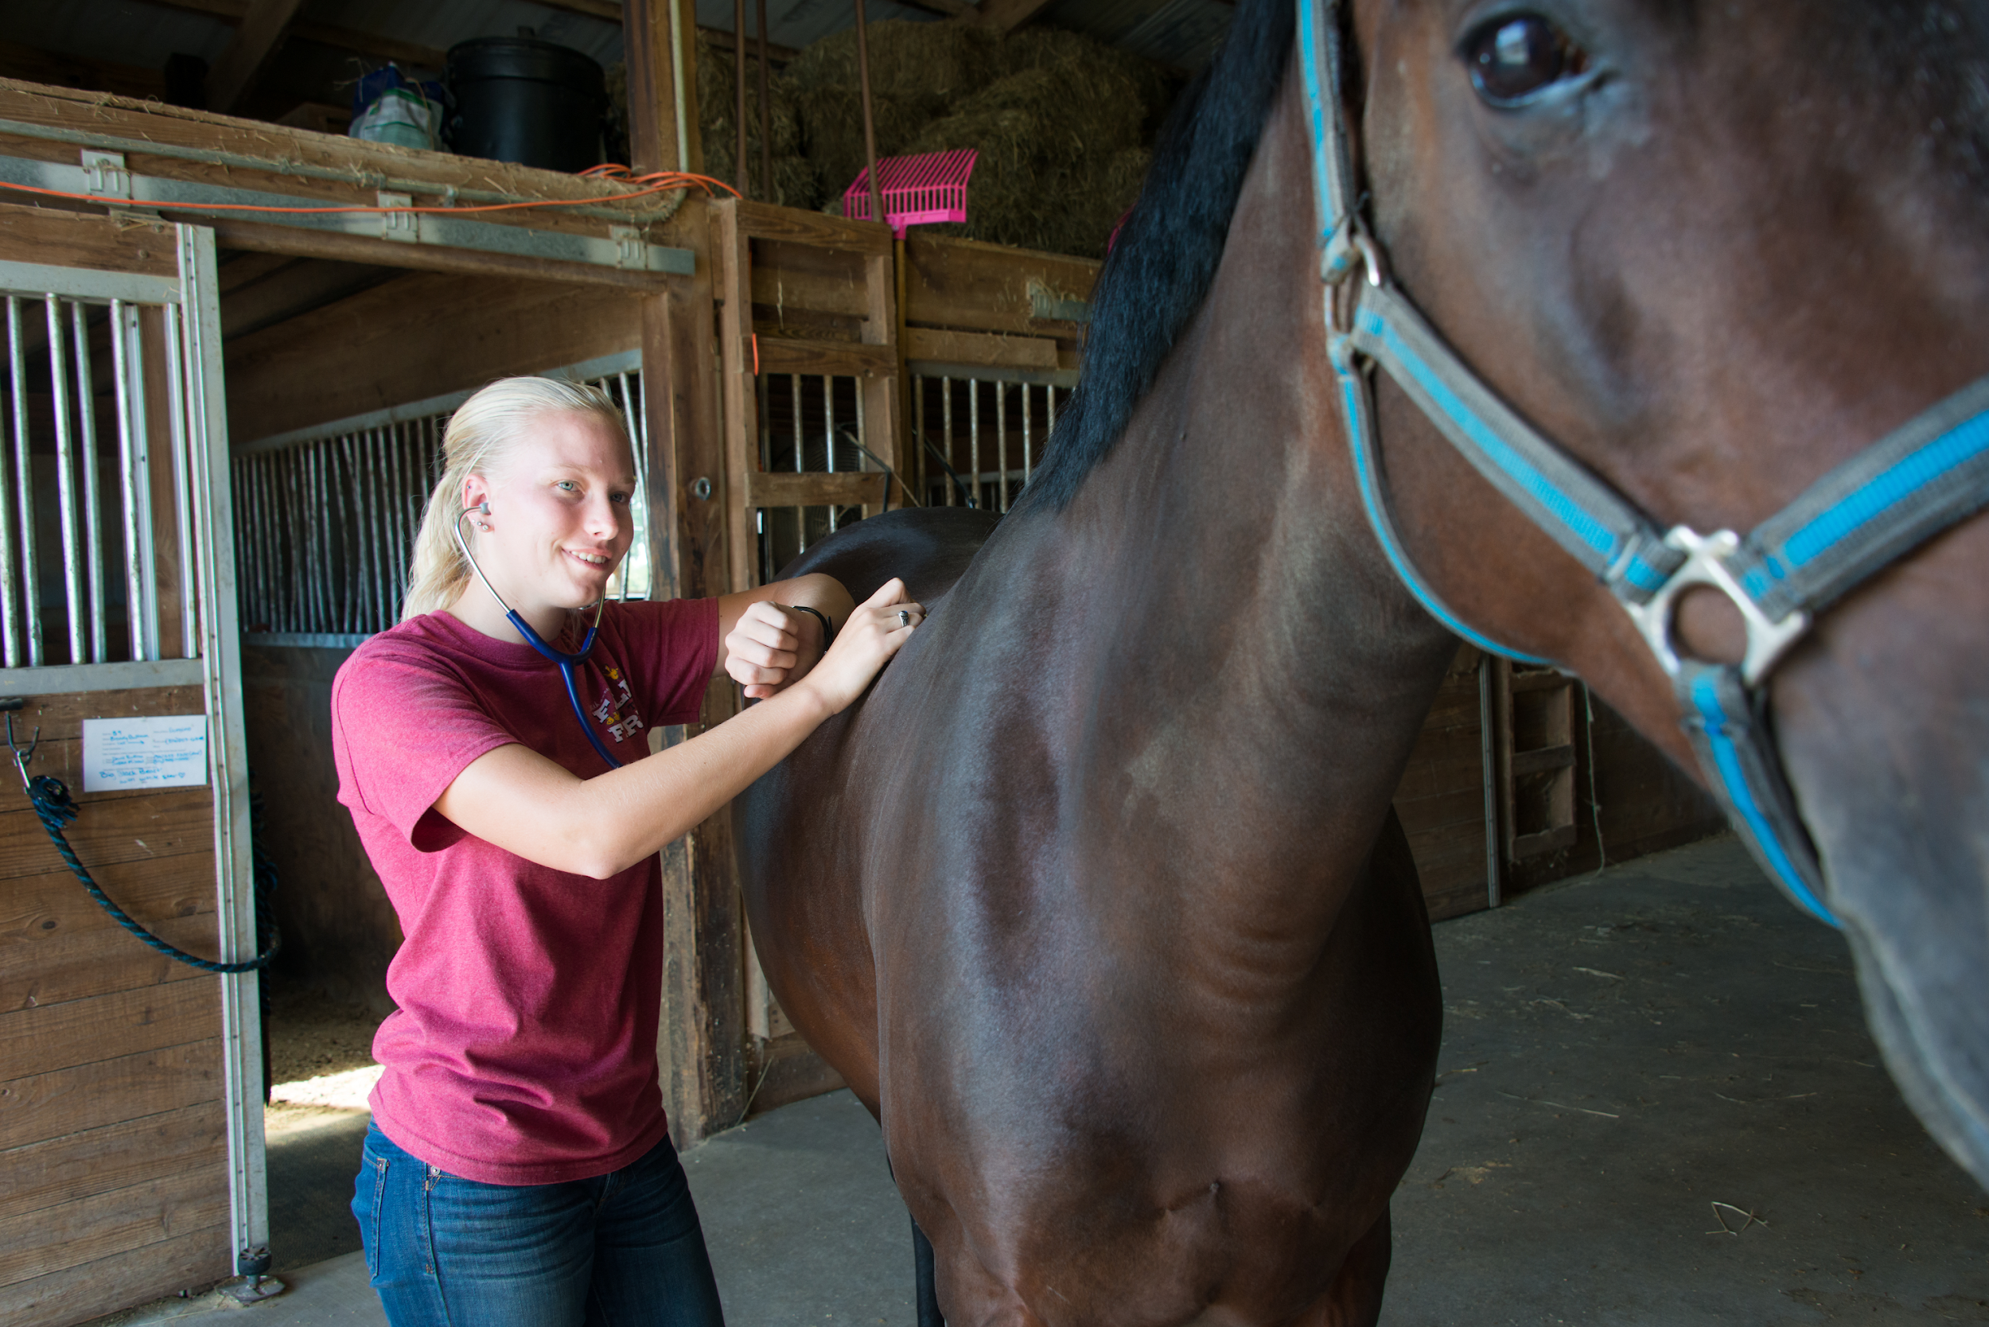
There are currently 33 Colleges of Veterinary Medicine in the United States.
21 States do not have veterinary schools and each year there is a shortage of seats for students interested in studying veterinary medicine.

Slide 12
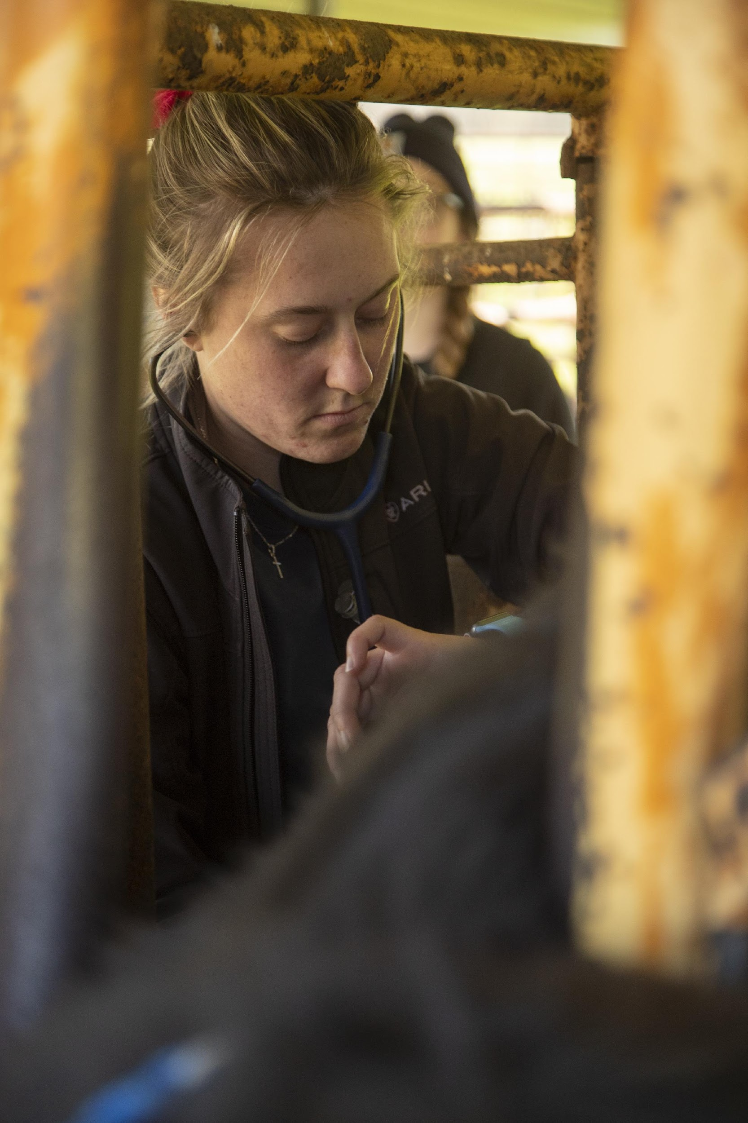
Potential Impact
Job Creation: The new school will address the shortage of veterinarians in Kentucky.
An estimated 50–70 veterinarians graduate each year with an increased likelihood to remain in Kentucky.
Emergency veterinary care facility
Bolster potential veterinarians from rural areas

Slide 13
A few words From Pre-Vet Students...
“It isn't just a passion, it is a dream for most of us. Going through your undergrad and spending all the time taking the hard classes just to not get accepted into a Veterinary School is very discouraging. Everyone always says, "follow your dreams," however that is not possible unless you get accepted.”
“Murray State has been a great pre-vet program and I could only imagine how great of a vet school they could have here!”
“Murray State's Pre-Veterinary undergraduate path leads students in the right direction with an enormous amount of knowledge before ever stepping foot into veterinary school.”

Slide 14
The Clinical/Distributed Model
Distributed learning is an instructional model that allows instructor, students, and content to be located in different, non-centralized locations so that instruction and learning can occur independent of time and place.
Real world immersion
Networking & job offers
Tailor student clinical year focus
Student creates their own geography
Industry standard equipment exposure
Clinical partners screen and hire top students
Increased stakeholder engagement in training students
Reduced construction cost (approximately $150 million)

Slide 15
VISION OF MSU SCHOOL OF VETERINARY MEDICINE
Curriculum: 3-year, 9-semester, year-round Clinical/Distributed Model of Veterinary education program; years 1 & 2 – preclinical training at the new Murray facility, year 3 – clinical partnership training with existing practices, non-profits, and industries
Class Size: up to 70/class for a maximum total of 140 veterinary students on campus (year 1 & 2 students)
Facility: Focused on lecture halls, skills labs, research labs, and student amenity and support spaces and emergency care facility
Location: university-owned land west of the A. Carman Health Technology Center (home of the Veterinary Technology/Pre-Veterinary Medicine Program) on the West Farm in coordination with:
Rudolph Equine Education Center, Eldon Heathcott Rodeo Facility, West Farm Beef Center, North Farm Complex, Breathitt Veterinary Center, Eagle Rest Farm, and the Hopkinsville Regional Campus facilities

Slide 16
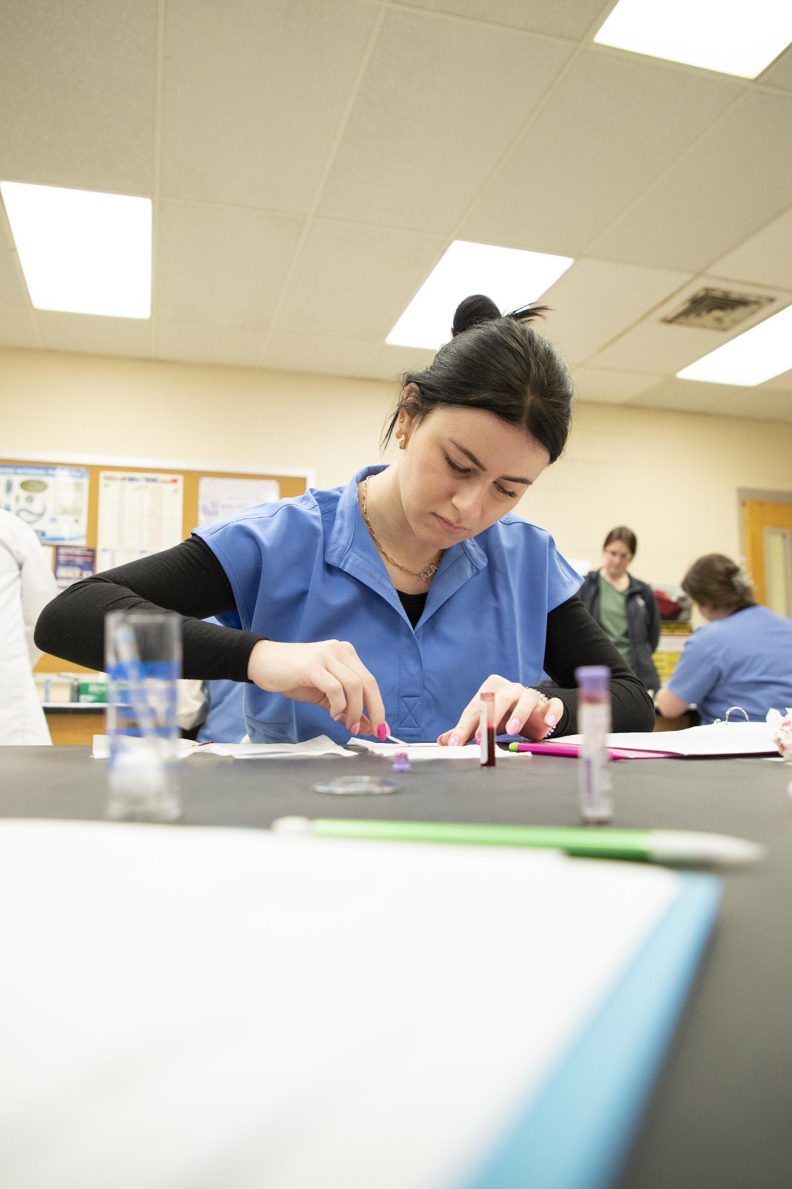
Estimated Timeline and Cost of Construction:
Planning – Fall 2023
Design – Summer 2024- Spring 2025
Begin Construction – Summer 2025
Occupancy – Fall 2027
Construction- ~$89 million

Slide 17
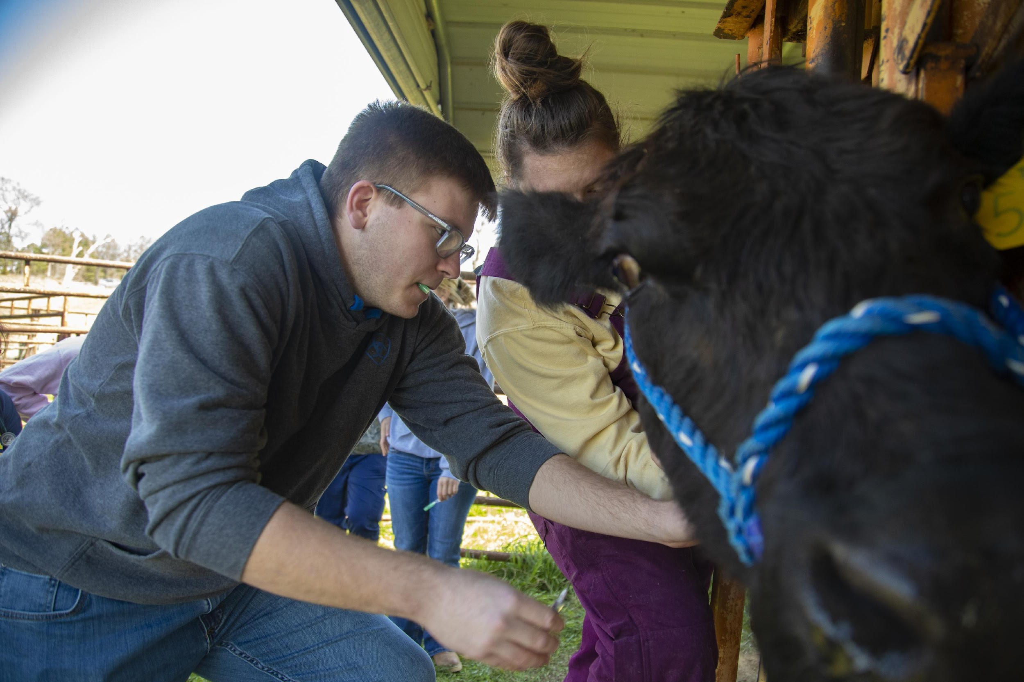
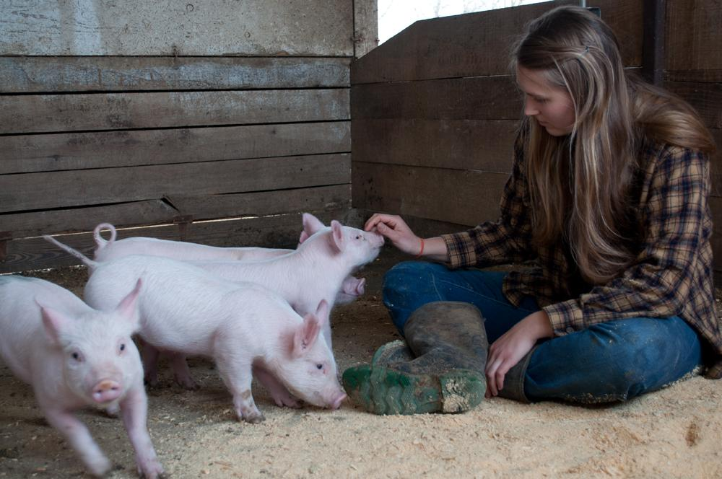
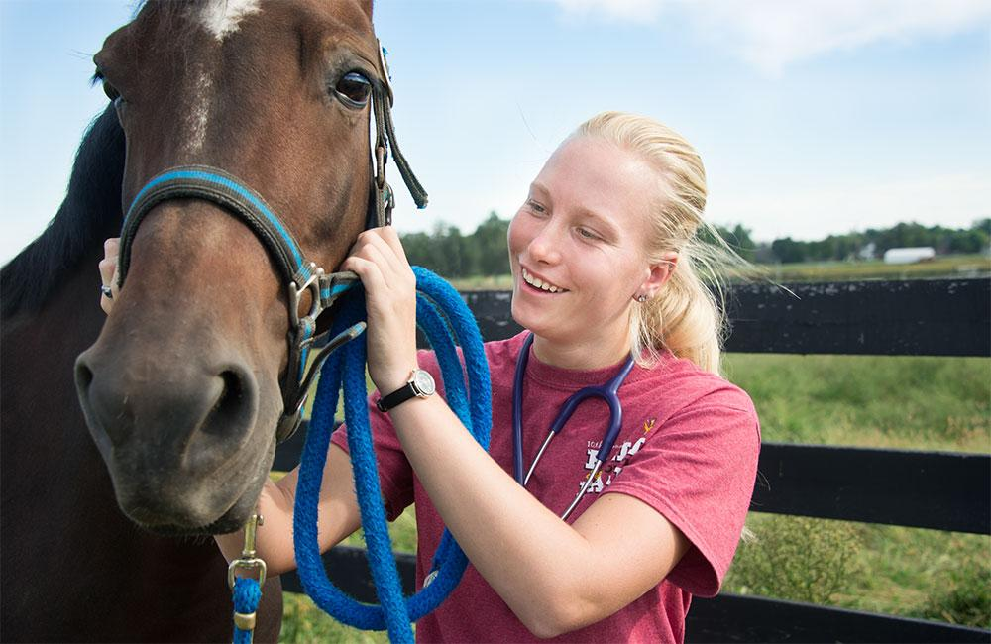
Discussion

