Slide 1
AGRICULTURE IJC
KENTUCKY PORK PRODUCERS
NOVEMBER 2024

Slide 2
Fighting for reasonable public policy defending our freedom to operate and expanding access to global markets.
Build Trust and Add Value

Slide 5
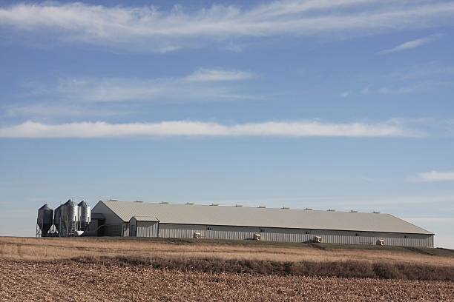
SPRINKLERS
(Fire suppression)
(NFPA 150)
Extremist led:
It is important to note that this was pushed through this committee by the Animal Welfare Institute, whose interests are to put farmers out of business.
This was noted in the appeals process (which failed), and the organization has since changed the wording of its website mission.
This was the second attempt to pass this. The first failed in 2012 when the Humane Society of the United States introduced it.
What happened?
National Fire Protection Association Standards Council adopted into their code:
3.5.1 Automatic Fire Sprinklers.
3.5.1.1 Class A Facilities meeting or exceeding the US Environmental Protection Agency animal size threshold of a Medium Concentrated Animal Feeding Operation shall be provided with automatic fire sprinklers in accordance with Section 9.2, unless otherwise permitted by 17.3.5.1.2 .
3.5.1.2 Where approved by the AHJ, sprinkler protection required by 17.3.5.1 shall not be required where equivalent alternative active or passive protection, or a combination thereof, is provided.
Historically, Kentucky has NOT adopted the NFPA code but the International Fire Code.

Slide 6
SPRINKLERS
(Fire suppression)
(NFPA 150)
Significant impacts such as:
$9-15 per square foot
1750 square foot barn
=$26,000+ to install
Most producers have at least 2 barns this size.
A dedicated water source would also be needed until fire departments extinguish the fire.
Periodic inspections and significant inspections
Creating biosecurity risks.
NFPA research indicates that the operation of ventilation systems in conjunction with the sprinkler reduces functionality and will likely shut down ventilation systems for sprinklers to work properly, resulting in severe animal welfare concerns.
Excess water also creates problems for deep pit barns, possibly resulting in serious environmental situations with overflow waste.
Why it matters?
Without preemptive language to protect livestock producers such code in the future could force them to install fire sprinkler systems in new barns as well as those going through major retrofit.

Slide 7
SPRINKLERS
(Fire suppression)
(NFPA 150)
Kentucky Pork Producers ask:
Proactive language to protect livestock producers from possible future fire code adoption that could negatively impact their operations.
Animal care and protection of their animals is the top priority for pork producers. Pork producers, in conjunction with their insurers, already implement construction and designs- not needing a code to do this for them. A blanket sprinkler requirement for all livestock farms, without scientific basis and disregard to feasibility, is improper.

Slide 8
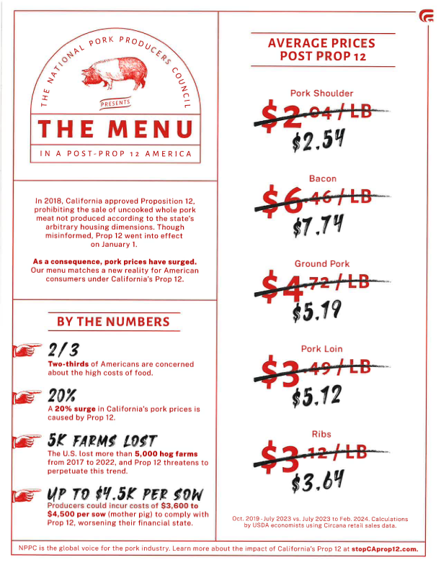
Food security is national security.
A reminder of what can happen when extremist groups work to push through policy.
Putting family farms out of business.
Adding to food cost.
Hindering food availability.
Threatening food security.

Slide 9
Thank you.
www.kypork.org
www.nppc.org

