Slide 1



Presented by H.H. Barlow, Executive Director
Joint Legislative Committee on Agriculture
November 7, 2024
Kentucky’s Dairy Industry
State of the Industry 2024

Slide 2
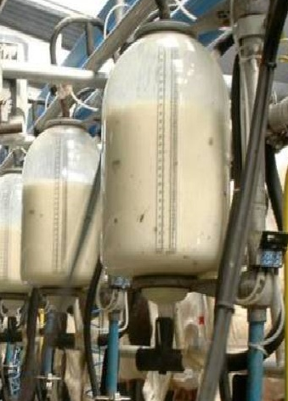
By the numbers
Kentucky’s Dairy Industry in 2023
Producers
Processors
340 dairy farms
45,000 cows
130 cows per farm
Production: 1,000,000,000 lbs. milk = 120 million gallons
Farm Receipts: approximately $220 million
4 Fluid Milk Dairy Processors
3 Dairy Product Processors
11 Value-added On-Farm Processors

Slide 3

Two primary ways to grow:
Opportunities ahead…
Increasing herd size of Kentucky’s existing dairy farms
+
Recruiting new dairy operations into Kentucky
=
ONE clear message…
6
Creating economic activity for rural Kentucky both ways!

Slide 4
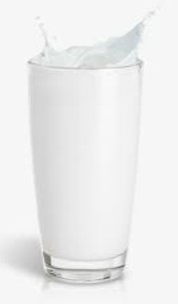
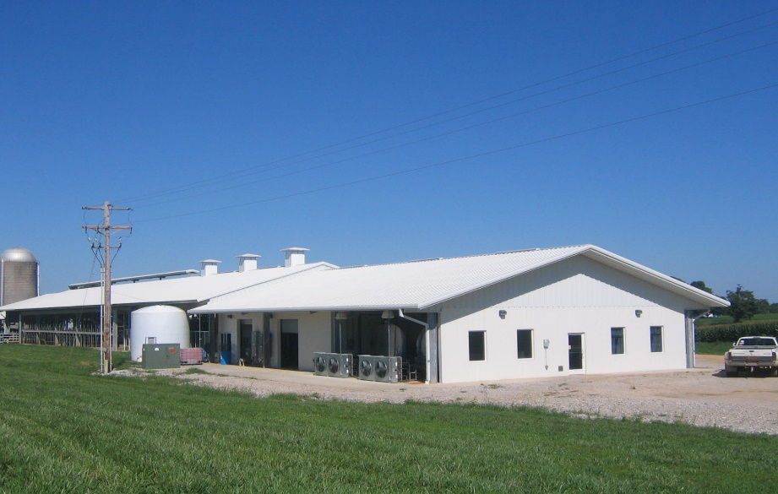
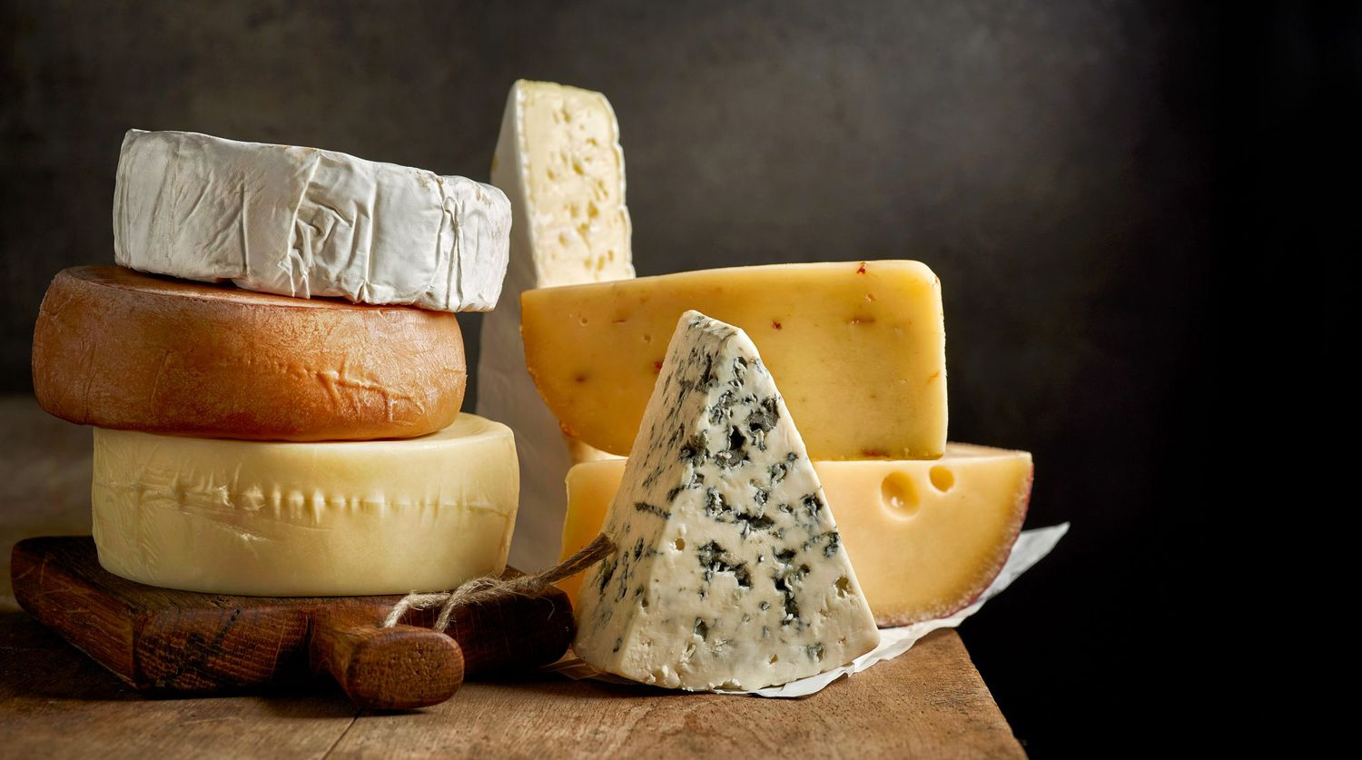
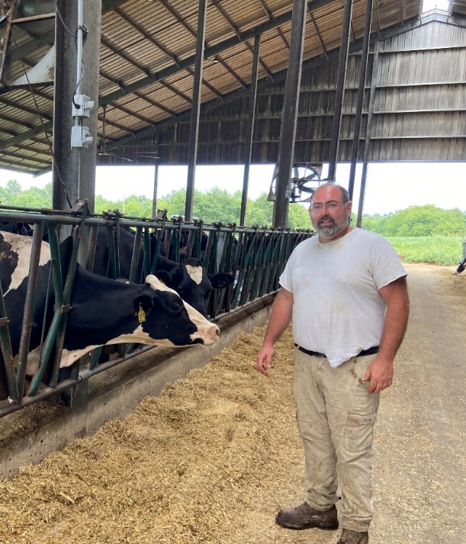
Tackling #1 – Growing our existing dairy operations
KDDC is the central part of this endeavor
Programs presently in place that improve milk quality, reproductive efficiency, and genetics.
Cost-share grant programs to improve dairy farm facilities
Consultants work continually assisting dairy producers to grow and improve. For example, energy grants, water quality and nutrient management plans.

Slide 5


Tackling #2 – Recruiting new dairies
Why Kentucky? We are poised to attract development
Water water water
Dairy-friendly environment
Temperate climate
Cheap energy
Abundant feed supply
Rural KY prime for new investment
Proximity to consumers
KDDC
Other Southeast states such as Tennessee are experiencing sharp declines in their dairy industry. Conversely, Kentucky has the most attractive infrastructure and advantages to attract those from the west looking for a new home.

Slide 6

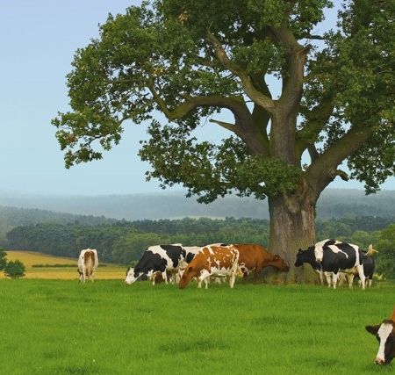
Let’s talk about the dollars for Kentucky…
A deeper dive:
5000 cow dairy = $60 million initial investment for infrastructure only - not counting land and cows
Each cow produces a minimum of $6500 farm gate sales annually
5000 cows = $32.5 - $40 million annual cash flow (includes dollars for beef sales)
Job creation - a 5000 cow dairy will employ 60 people not counting associated support industries
These dollars become an economic engine for any community where a dairy exists
A large dairy creates many satellite industries in the surrounding community – for example, raising heifers and custom harvesting

Slide 7
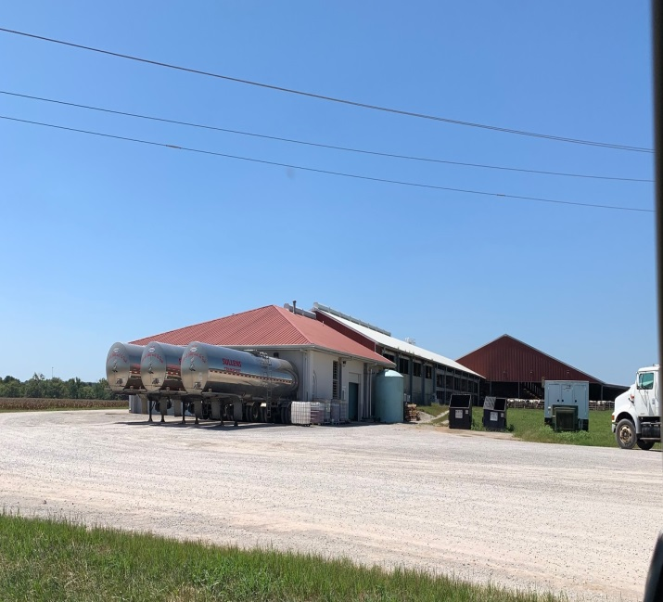
Let’s ponder the impact on any local rural Kentucky community with a large dairy
AN ECONOMIC ENGINE…
Retail Sales
Lending Institutions
Dairy Farm Labor
Custom Harvesting
Feed Sales
Vehicle Sales
A.I. Breeding Sales
Utilities
Community Impact
From a Dairy
Milk Truck Driver
Concrete Supplier
Milk Inspector
Equipment Service
Veterinarian
Feed Equipment
Fertilizer Sales
Service Industry
Fuel Sales
Health Services
Equipment Sales
Insurance Sales
Equipment Parts
Community Tax Base
State Taxes

Slide 8
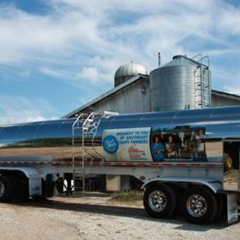
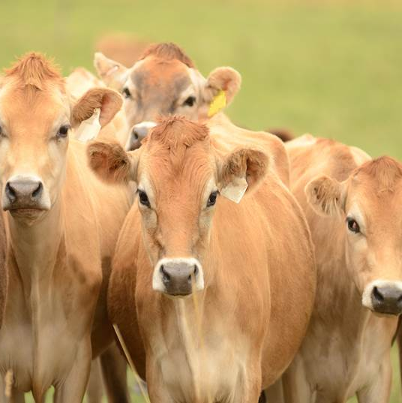
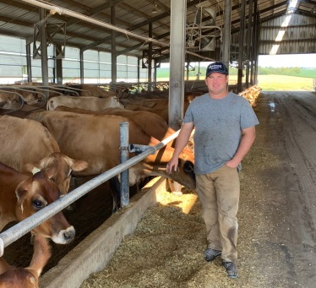
Dreams to Reality…
Converting opportunity into tangible actions
Three most important requirements:
Creating economic incentives
Streamlining the permitting process
Create cooperative environment with Cabinet for Economic Development, Ky Dept of Agriculture, Ky Ag Development Board, and Kentucky Dairy Development Council

Slide 9

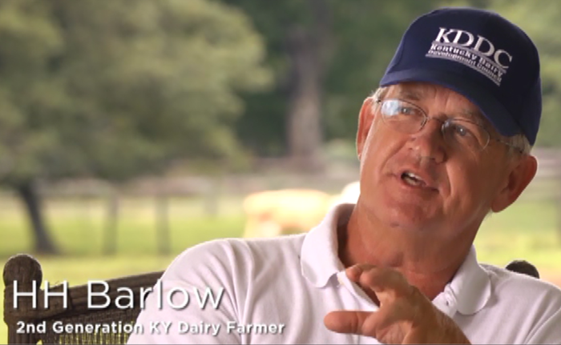
QUESTIONS
Get in Touch
500 Salem Church Road
Cave City, KY 42
270.404.8003
hhbarlowiii@yahoo.com
Thank you for supporting Kentucky’s dairy industry!

