Slide 1
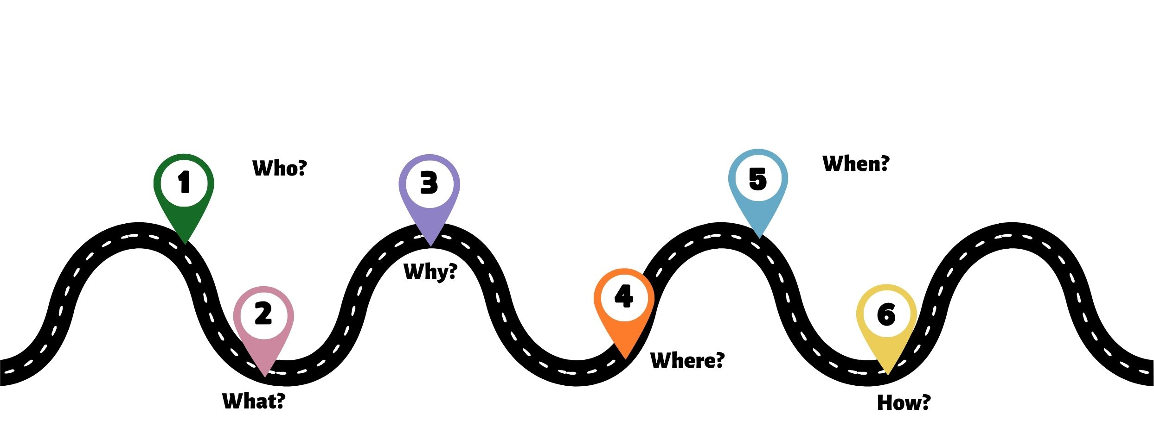
Kentucky Agriculture Strategic Roadmap
Joint Agriculture Committee Report

Slide 2
Presenting
Jennifer Elwell, Executive Secretary
KY Ag & Environment in the Classroom
Tod Griffin, Treasurer
AgriBusiness Assn of KY, KY Retail Federation
Michele Payn, Strategic Roadmap Facilitator
Cause Matters Corp.

Slide 3
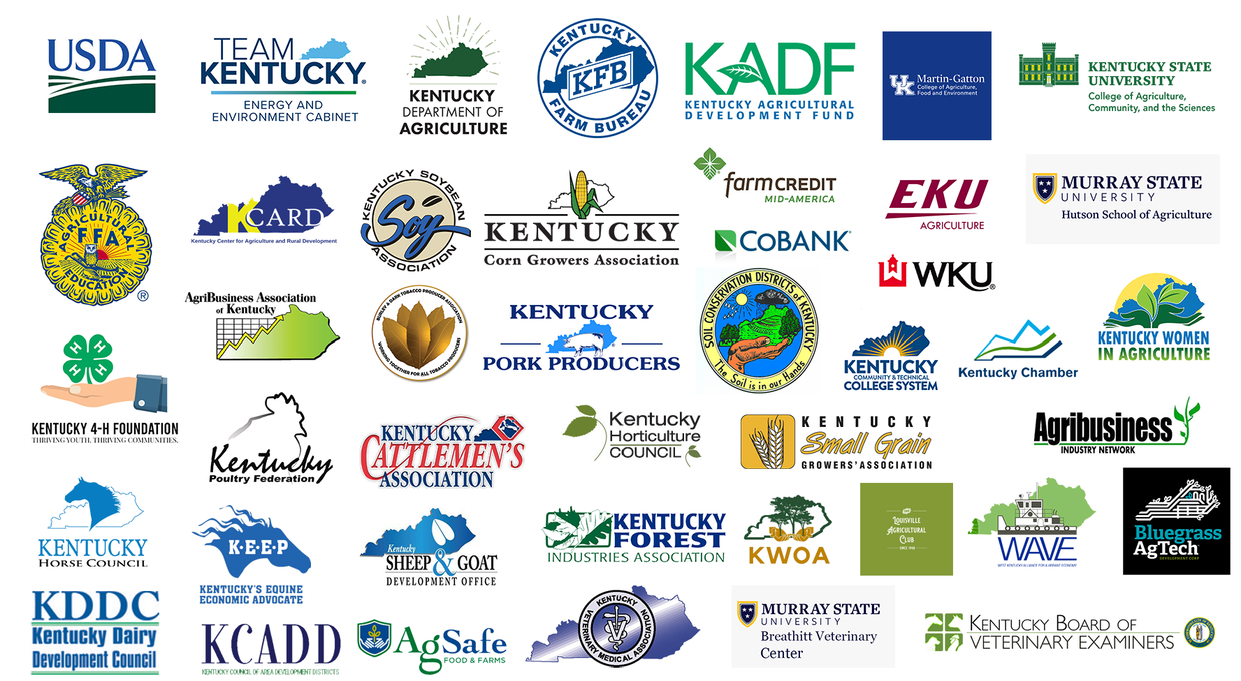
Our Members
More than 50 agricultural organizations, education institutions, and cooperatives.

Slide 4
Our Mission
Plan programs for its members and disseminate information that creates an understanding and appreciation of Kentucky agriculture.
Serve as liaison between private and public agricultural organizations, the Commissioner of Agriculture, the Governor, and the legislature to develop and effectively utilize our agricultural resources.

Slide 5
Our leadership

Slide 7
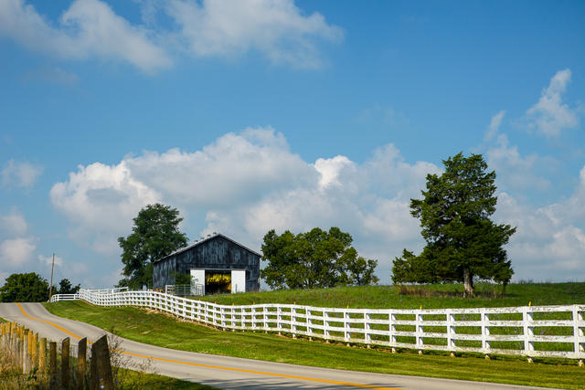
28 focus groups with 120⁺ Participants
Three sets of interactive focus groups on Zoom, mid-December to early February.
Membership organizations, farmers, agribusiness, check-off programs, academia, government officials, food advocates, Extension, educators, elected officials, et al from across the Commonwealth were involved, from young farmers to retirees.
All focus groups led by Michele Payn.

Slide 8
Bringing together diverse voices in kentucky agriculture
First group (34): Active leaders within KAC membership
Second group (48): KAC membership, plus people suggested by first focus group, and interested KALP alumni
Third group (39): new KDA staff, groups not historically involved with KAC, and recommendations of other focus group participants
Commodity farmers, organic growers, minorities, woodland owners, CSAs, veterinarians, federal/state/local government staff, executives, specialty/niche farmers, processors, funding institutions, educators, livestock & horse owners, and produce growers were involved

Slide 9
Six questions discussed in every focus group
What’s missing for Kentucky agriculture?
In 10 years, how is Kentucky agriculture going to stand out?
Why is there a gap of understanding between our urban neighbors and producers?
Who specifically needs to learn more about Kentucky agriculture?
Who do you need to work with that you’re not today?
What would make the Kentucky Agriculture Summit valuable to you?

Slide 10
help farm transitions & sustain Kentucky farmlands
Significant concern about how to transitioning assets from older to younger generation. People inheriting land who don’t want to farm.
“It is nearly impossible for a young farmer to start in the business today” was a common sentiment.
How are farmers who “look different” included in Kentucky agriculture?
“What is going to happen to our farmland with development and all of these people moving in?” was a common theme.
Breadth of resources available overwhelming; potential need for centralized database or mentoring.

Slide 11
Engage agriculture in economic development discussions
Communicate the economic impact agriculture makes at local, regional, and state level. Look at dollars contributed, rather than number of jobs.
Become involved in economic development boards to increase familiarity with farms and agribusiness as a major economic contributor.
“Economic development at all levels of government could benefit from better understanding of agriculture.”
Build relationships with local, regional, state staff and boards. Meet them where they are.
Change sentiment from “that’s undeveloped land” to understanding agriculture’s economic role across community.

Slide 12
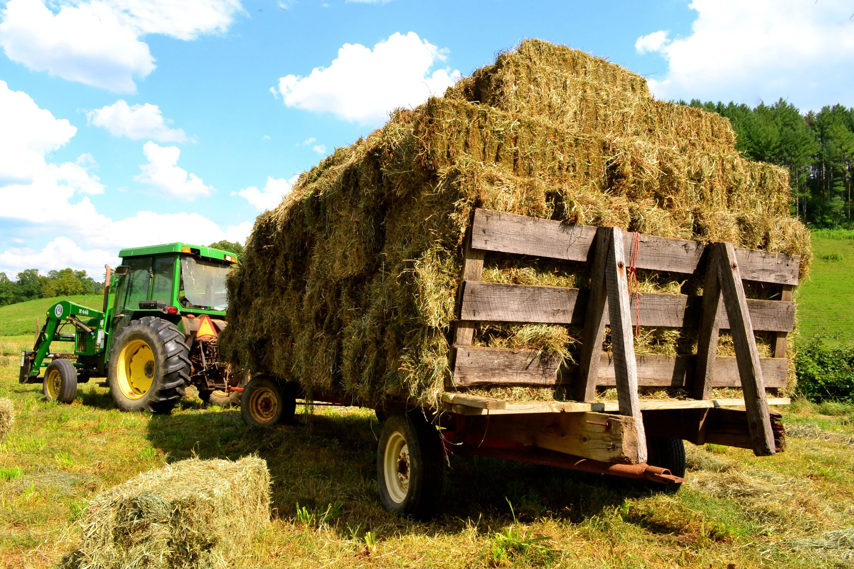
Prioritize workforce development
An adequate employee base for farms & agribusinesses, across entire state, is needed.
Many mentioned a need to broaden young people’s understanding of career opportunities beyond farming.
High school, community college, and university levels all mentioned, with a call for coordinated efforts for local education, certification, and higher level learning to meet needs.
“Our next generation of workers need to be a skilled workforce. Not a lot of students coming out of local ag program; we need to find the right people to give them the right training.”

Slide 13
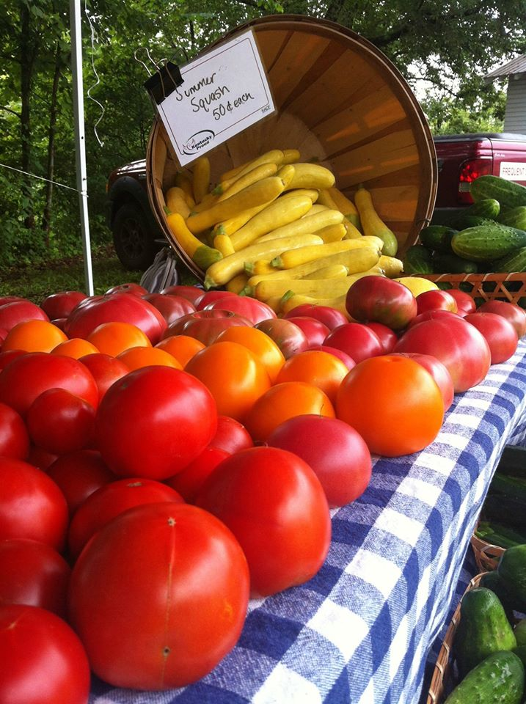
Foster more supply chain coordination to improve market access
Continued need for more processors e.g. large beef, small/mid-size dairy.
“We’re missing the middle of the value chain connection from small and mid-size farms to sell into markets.”
Need for product aggregation, coordinated distribution, or wholesaler to allow growing number of produce farms to tap into new markets.
“We are well situated with tourism, horses, bourbon, breweries, food. How can we make sure these are all Kentucky supply chains in a really explicit way?”
Desire to develop relationships with institutional and international buyers.

Slide 14
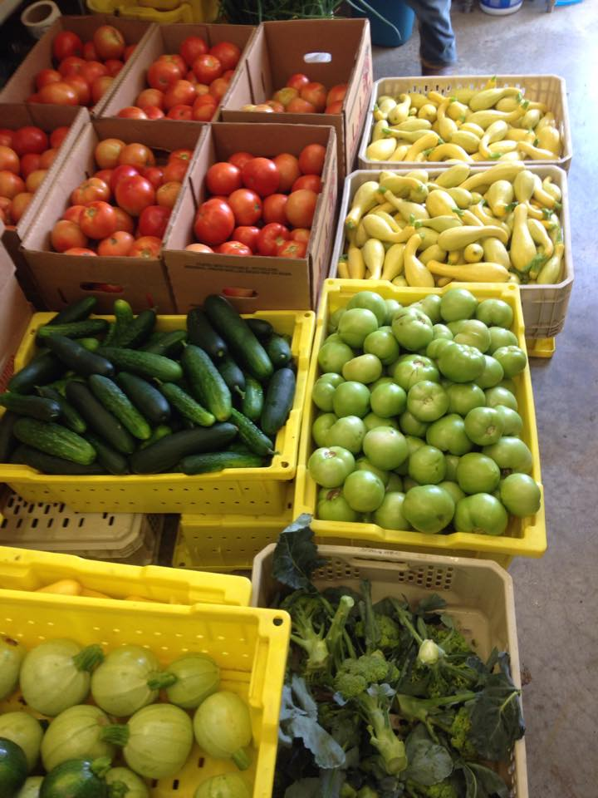
Continue diversification and innovation
Great interest in leveraging the diversity and historic innovation of KY agriculture into the future.
“Unless there is change, we’ll struggle in 10 years. Diversification allows us to stand out.”
Need more relationships between producers and processors for understanding both ways.
How can Kentucky leverage it’s conservation practices in carbon market and value chain's sustainability requirements?
Precision ag calls for more training in technology, new practices, AI, and automated systems.

Slide 15
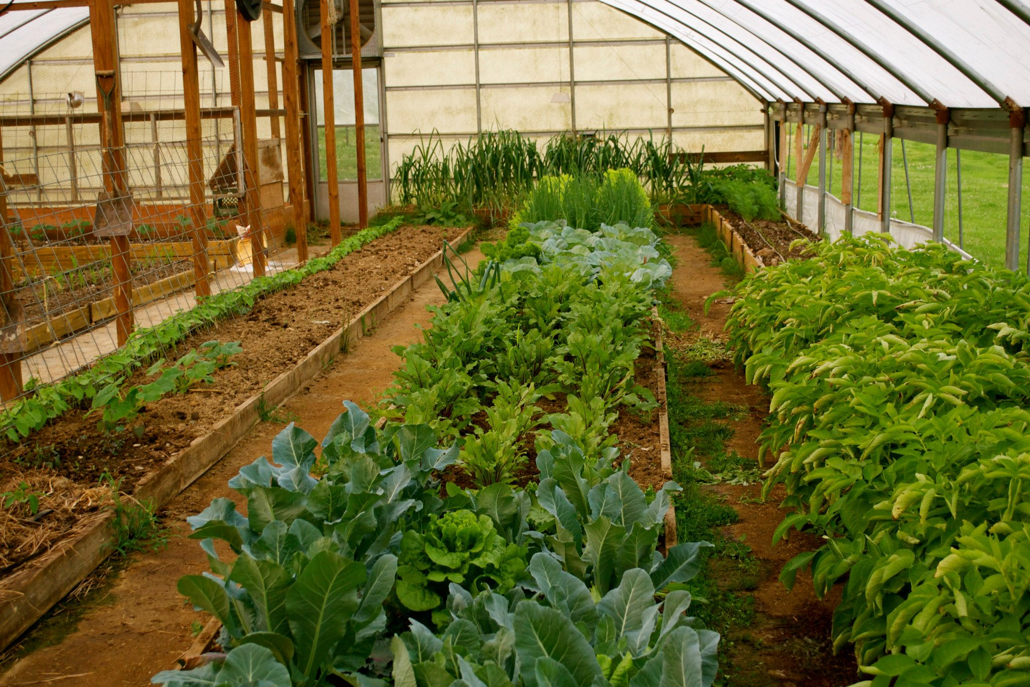
Create more value-added markets
Building awareness of certifications to put more KY products on shelves mentioned several times. Leverage “local” Kentucky brand to create market advantage.
“We are missing value-added end users compared to the national scene. We are not a mover of the market - we have to create our own market and be diligent in finding premium pay.”
Focus on and seek new product innovation with unique partners e.g. jet fuel and biodiesel.
Continue to grow farmer’s markets, agri tourism, urban ag, CSAs, etc.

Slide 16
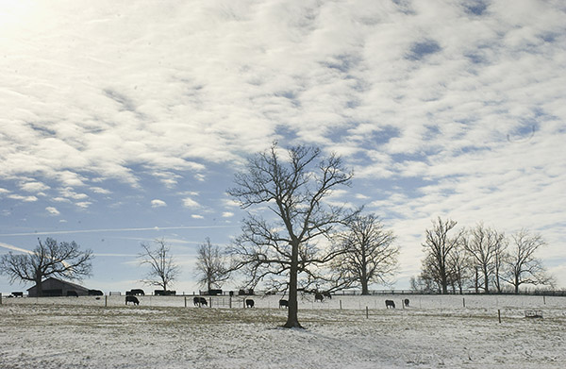
Develop ag’s partnerships in the food & health space
Work with health professionals, e.g. dietitians or hospital administrators.
Leverage ag’s role in the food is medicine movement.
Build relationships with processors, chefs, food banks, retailers, and food service.
“There is growing momentum to understand about where food comes from and how it is produced.”

Slide 17
Build understanding around farm and food
Prioritize K-5, middle school, and high school engagement (in that order).
Develop legislative relationships with some common messages (e.g. economic development, diversification, ag ed, development fund).
Involvement with business, chamber, and civic group presentations and leadership groups to increase reach. This will also foster mutual understanding.
“Lack of appreciation is a stressor to farmers - they feel devalued in their research. Help farmers share story.”

Slide 18
Grow collaboration, coordination, & communications within Kentucky ag
“Communications across the spectrum of ag is missing. What do others bring to the table and what’s their expertise?”
The need to coordinate and communicate with each other was a strong sentiment, especially from farmers.
“I don’t know what other organizations are doing, but we’re focused on…” How can we work toward common goals?
How can ag organizations leverage our strengths and synergize with schools, legislators, and regulators to go beyond choir?
“A lot of great stuff is happening, but it’s not always known. Need better communications platform to get ag to work together more, streamline some work, and not re-create the wheel.”

Slide 19
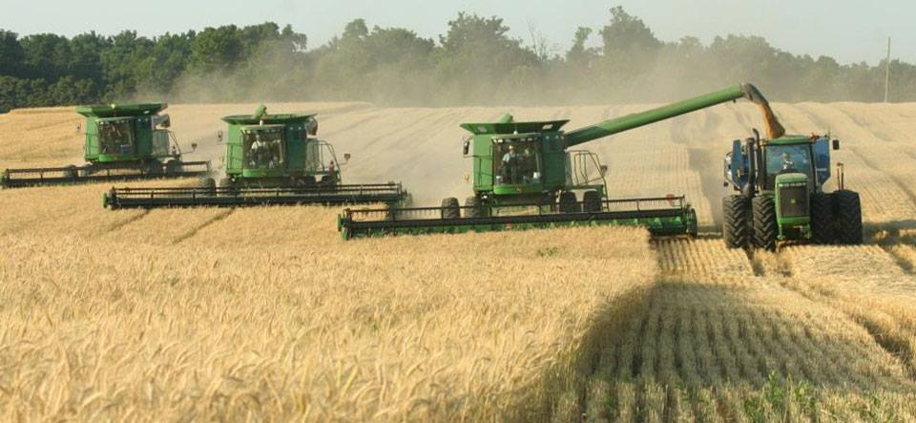
work on nine strategic roadmap themes
19 working group meetings on Zoom to refine and prioritize actionable tactics involved 200+ ag leaders, March-May, .
Two in-person interactive meetings created more feedback, initially prioritized themes, February and June.
KDA involvement: Meeting with Commissioner Jonathan Shell, Warren Beeler leading Economic Dev. working group, and other staff engaged.
Additional in-person work in August and at Kentucky’s Agriculture Summit in November.

Slide 20
Who was involved in the Working Groups?
Agribusiness Association of Kentucky
Agribusiness Industry Network, Inc.
AgSafe
Burley and Dark Fire Tobacco Producers
CoBank
Community Farm Alliance
Eastern Kentucky University
Farm Credit Services Mid-America
Feeding Kentucky
KY Ag and Environment in the Classroom
KY Community and Technical College System
Kentucky 4-H Foundation, Inc.
Kentucky Agricultural Development Board
Kentucky Agricultural Finance Corporation
Kentucky Agricultural Leadership Program
KY Association of Agricultural Educators
KY Association of Conservation Districts
Kentucky Board of Veterinary Examiners
Kentucky Cattlemen's Association
KY Center for Ag and Rural Development
Kentucky Chamber of Commerce
Kentucky Corn Growers Association
Kentucky Dairy Development Council
Kentucky Department of Agriculture
Kentucky Department of Economic Development
Kentucky Division of Conservation
Kentucky Division of Forestry
Kentucky Equine Education Project
Kentucky Farm Bureau Federation
Kentucky FFA Association & Foundation
Kentucky Horse Council
Kentucky Horticulture Council
Kentucky Office of Agricultural Policy
Kentucky Pork Producers Association
Kentucky Poultry Federation
Kentucky Sheep and Goat Development Office
Kentucky Soybean Association
Kentucky State Beekeepers Association
Kentucky State University
Kentucky Veterinary Medical Association
Kentucky Women in Agriculture
Kentucky Woodland Owners Association
Louisville Agricultural Club
Murray State University
Organic Association of Kentucky
University of Kentucky
USDA (Various Offices)
WAVE Ag Initiative
Western Kentucky University
WKDZ/Alan Watts

Slide 21
roadmap Strategies
Create more value-added markets across Commonwealth.
Develop agriculture’s partnerships in the food and health space.
Build understanding around farm and food amongst all Kentuckians.
Grow collaboration, coordination, and communications within Kentucky ag.
Help protect farm transitions and sustain Kentucky farmlands.
Engage agriculture in Kentucky’s economic development discussions.
Prioritize workforce development.
Foster more supply chain coordination to improve market access.
Continue diversification and innovation across farm, food, fuel and fiber.

Slide 22
1. Help protect farm transitions & sustain Kentucky farmlands.

Slide 23
2. Engage agriculture in Kentucky’s economic development discussions.

Slide 24
3. Prioritize workforce development to provide an adequate employee base and broaden young people’s understanding of career opportunities in agriculture.

Slide 25
4. Continue diversification and innovation across farm, food, fuel and fiber.

Slide 26
5. Foster more supply chain coordination to improve market access.

Slide 27
6. Develop agriculture’s partnerships in the food and health space.

Slide 28
7. Create more value-added markets across the Commonwealth.

Slide 29
8. Build understanding around farm and food amongst all Kentuckians.

Slide 30
9. Grow collaboration, coordination, and communications within Kentucky ag.

Slide 31
Kentucky Agriculture Strategic Roadmap
Jennifer Elwell, KAC Executive Secretary, Jennifer@teachkyag.org
Dr. Tony Brannon, KAC Chair, tbrannon@murraystate.edu
Tod Griffin, KAC Treasurer, tgriffin@kyretail.com
Michele Payn, Cause Matters Corp., Strategic Roadmap Consultant, mpayn@causematters.com

