Slide 1
Joint Committee on Agriculture

Slide 2
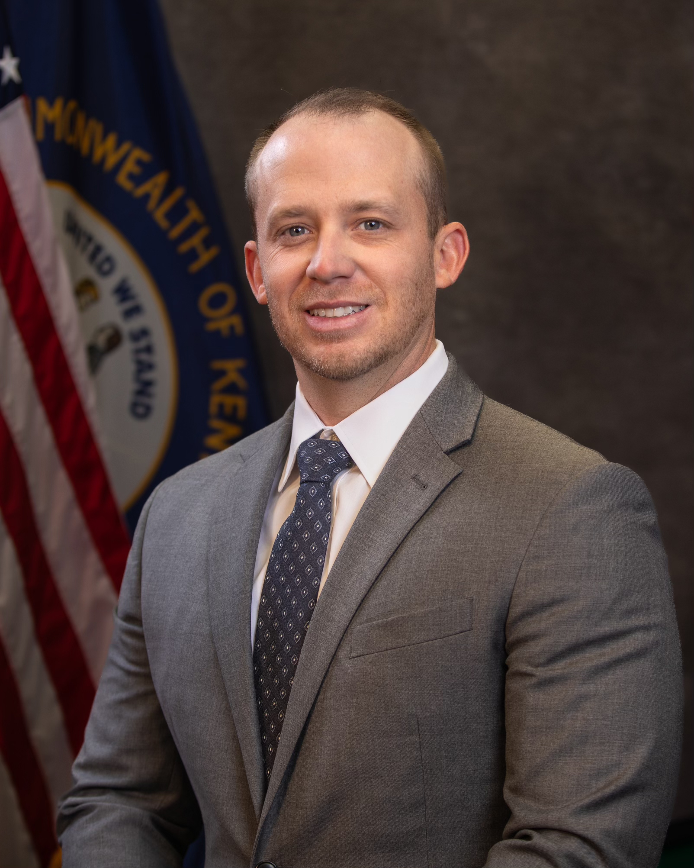
Commissioner Jonathan Shell

Slide 3
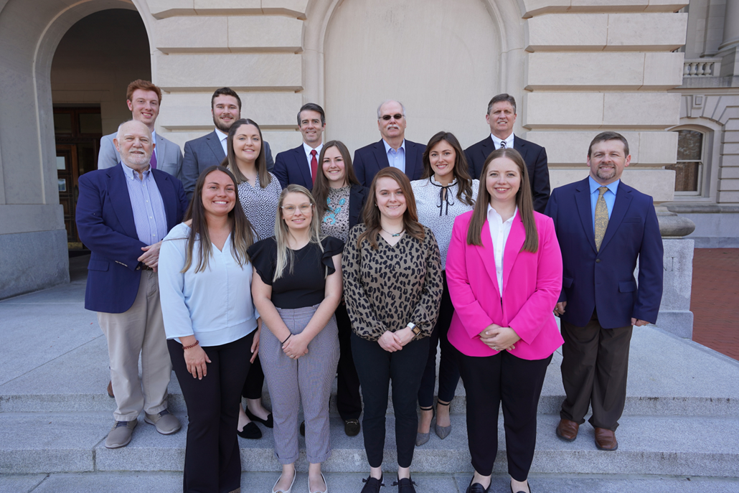
Brandon Reed
Executive Director Kentucky Office of Agricultural Policy
KOAP Staff
Brandon Reed
Executive Director
Bill McCloskey
Deputy Executive Director
Bill Hearn
Fiscal Officer
Brian Murphy
General Counsel
Chelsea Smither
KADF Project Manager
Hannah Sharp-Johnson
Boards & Special Events Manager
Hunter Jones
KADF Project Manager
Jesslyn Watson
KADF Project Manager
Olivia Randolph
KAFC Loan Programs Manager
Rebecca Besok
KADF Project Manager
Sarah Bryant
KADF Programs Manager
Savanna Hill
KADF Project Manager
Tera Roberts
KAFC Loan Programs Manager
Jeff Parman
KADF Program Compliance Manager

Slide 4
2024 Combined Board Approvals:
Jan. - June
KADB KAFC
$24.6 MM $20.5 MM

Slide 5
Lee McIntosh
Executive Director of Administrative Services
Division of Human Resources
Jennifer Wright - Director
Division of Information Technology
Kathy Harp - Director

Slide 6
Lee McIntosh
Executive Director of Administrative Services
The Office of Administrative Services provides support for 222 full-time employees and 11 interns.
Human Resources: recruitment, talent and performance management, payroll, salary & compensation, time & attendance, administering fringe benefits such as health & life insurance, training & staff development and ensuring employees’ legal rights are guaranteed and protected under statutory and regulatory authorities
Information Technology: provides the installation, configuration, testing and maintenance of all agency hardware and software including infrastructure, networking, security, technical services and support; develop, maintain and support 100+ KDA IT systems, websites, mobile applications, and databases
Biennial Budget Request
Fiscal Management: Procurement, inventory, accounts payable and accounts receivable

Slide 7
HB 6
Provides Farms to Food Banks funds
FY2025 - $850,000
FY2026 - $1,000,000
Provides County Fair Grants funds - $750,000 each fiscal year
Provides $1,000,000 funds to support the Kentucky Rural Mental Health, Suicide Prevention, and Farm Safety Program
Provides funds to support the Division of Emergency Preparedness and Response
FY2024 - $153,900
FY2025 and FY226 - $443,900
Provides funds to support the Division of Regulatory Field Services
FY2025 - $553,700
FY2026 - $987,100

Slide 8
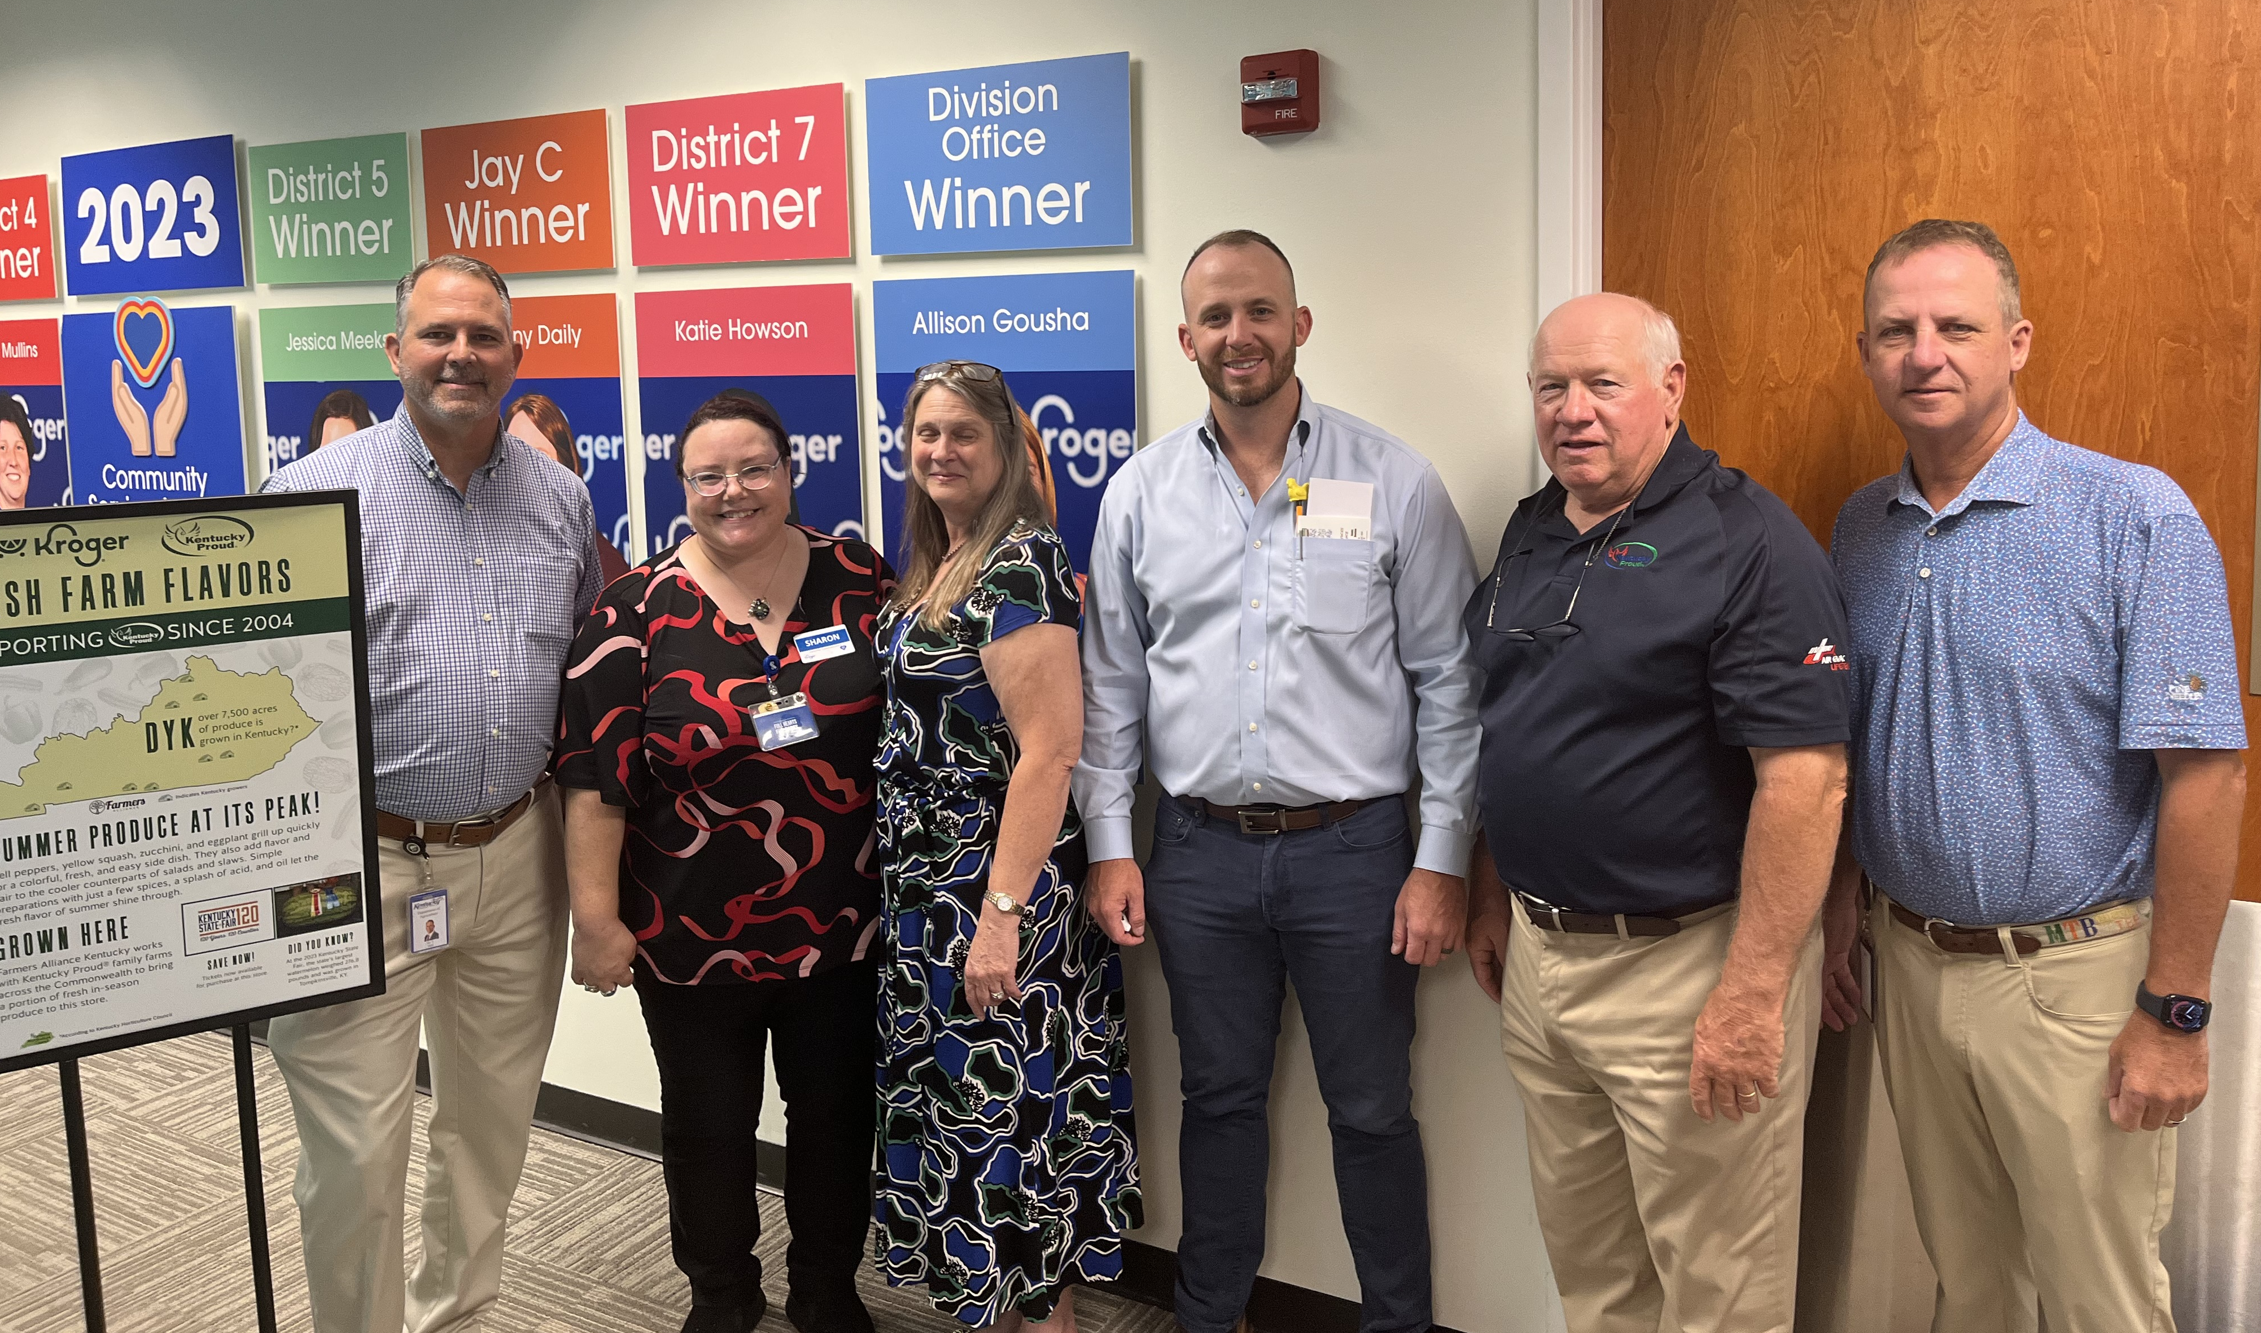
Jay Hall
Executive Director of Marketing
Kentucky Proud
The Kentucky Proud Brand was introduced in 2002 (It originally launched as Kentucky Fresh). In 2008 it was codified into law as Kentucky’s official agricultural marketing brand. The Kentucky Proud program is funded through the generosity of the Kentucky Agricultural Development Fund.
Retail
The Department recently participated in the Kroger Food Show. Over 60 Ky Proud vendors participated.

Slide 9
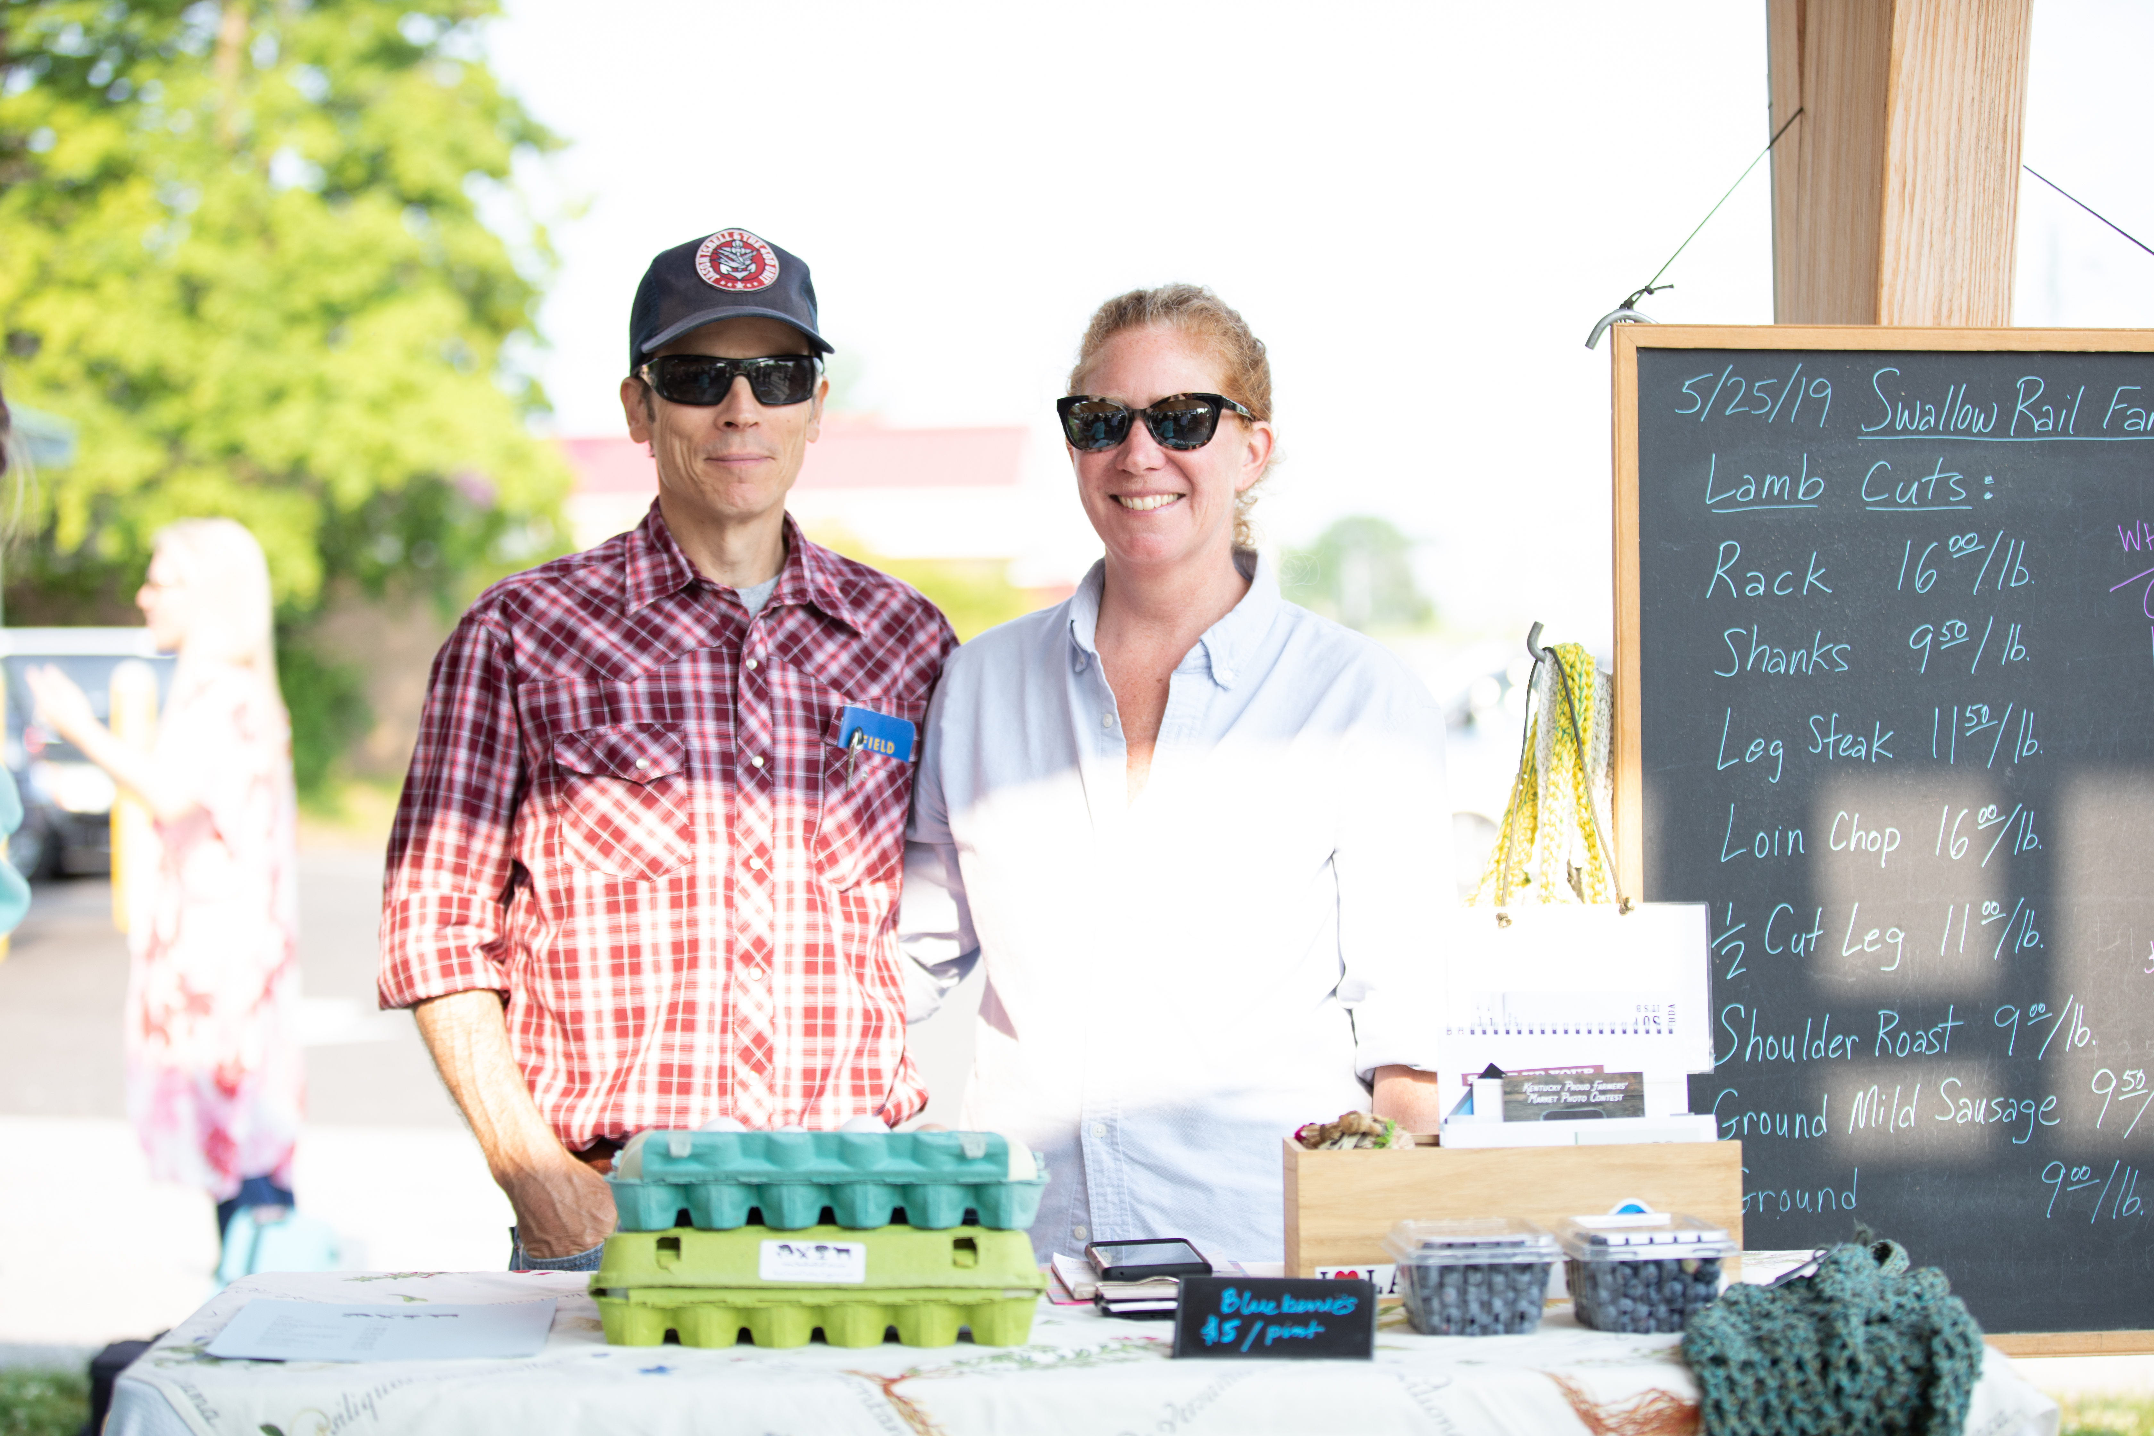
Farmer's Markets
There are now 178 successful and diverse farmers’ markets across the Commonwealth, spanning 114 counties and approximately 2,400 vendors.

Slide 10
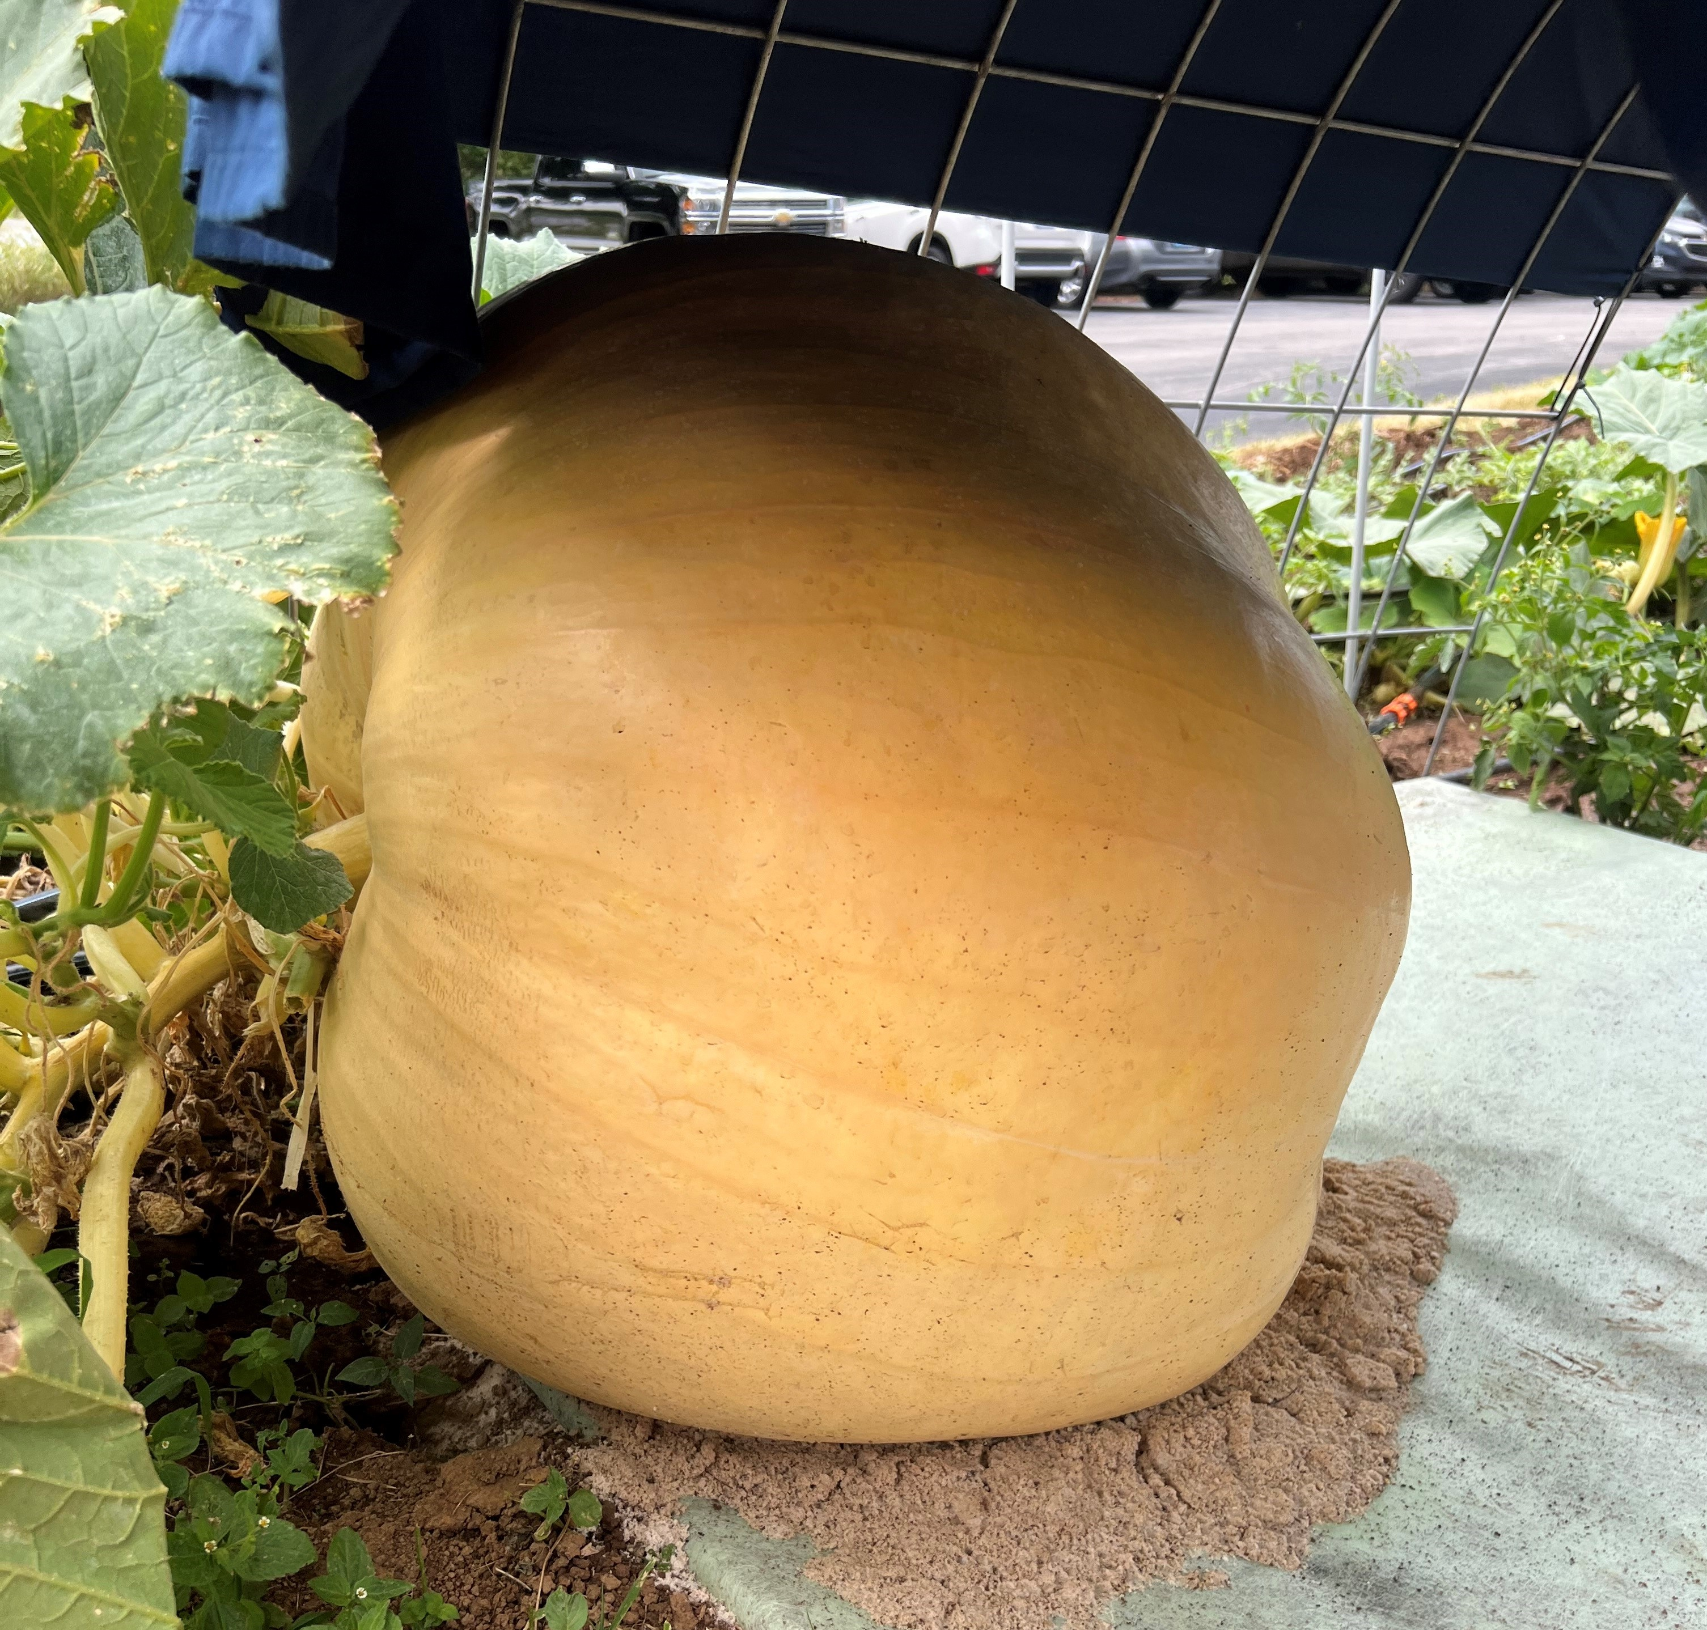
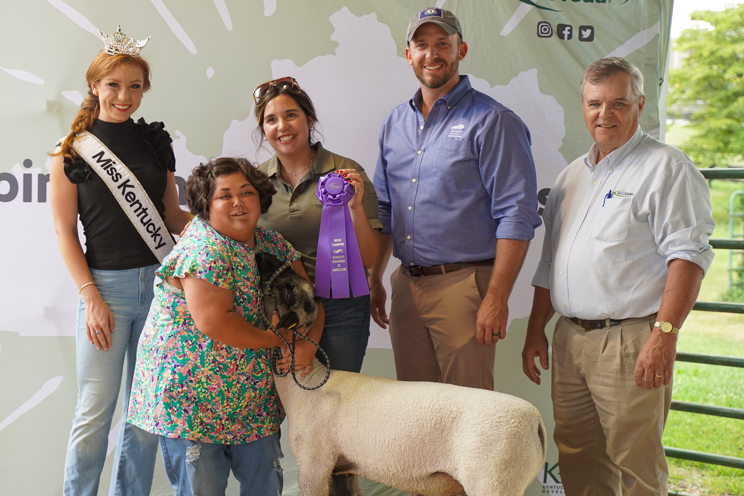
State Fair
Three exciting new events at the Kentucky State Fair this year
Ag Land Obstacle Course
Sunshine Class
Commissioner’s Pumpkin

Slide 11
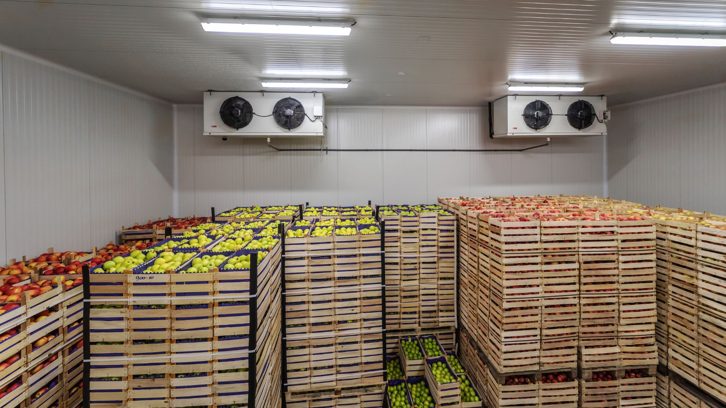
Resilient Food Systems Infrastructure Program (RFSI)
Launched in January of 2024, the RFSI program is funded by the USDA and administered by the Kentucky Department of Agriculture to address the middle-of-the-supply-chain infrastructure and equipment needs. With a little over $7M in grant funds to administer and almost $40M in applications, the program has already demonstrated the need for funding in Kentucky to address vital middle-of-the-supply-chain infrastructure needs.
The Department received:
96 Equipment Grant Applications totaling $7,362,374
42 Infrastructure Grant Applications totaling $32,404,258.22
Applications came from 57 different counties from all over the Commonwealth.

Slide 12
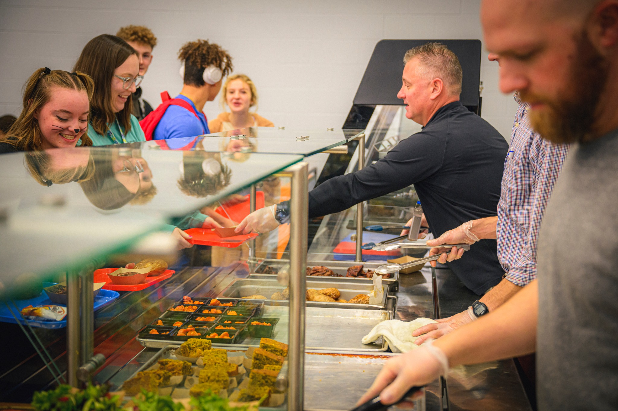
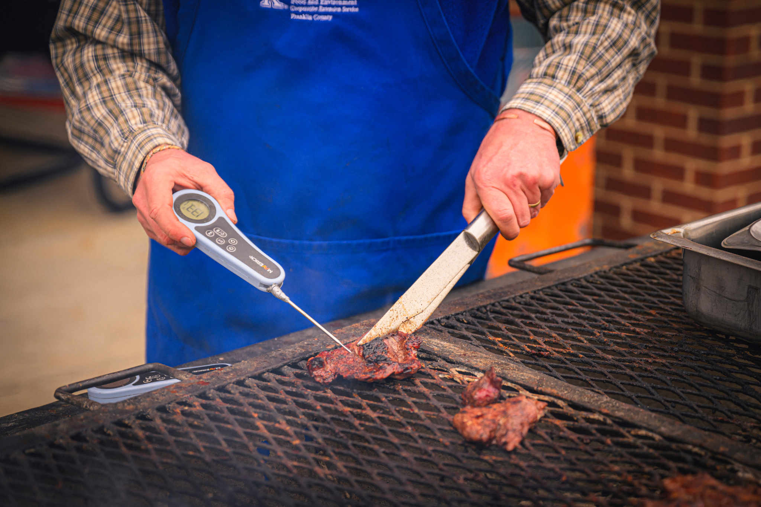
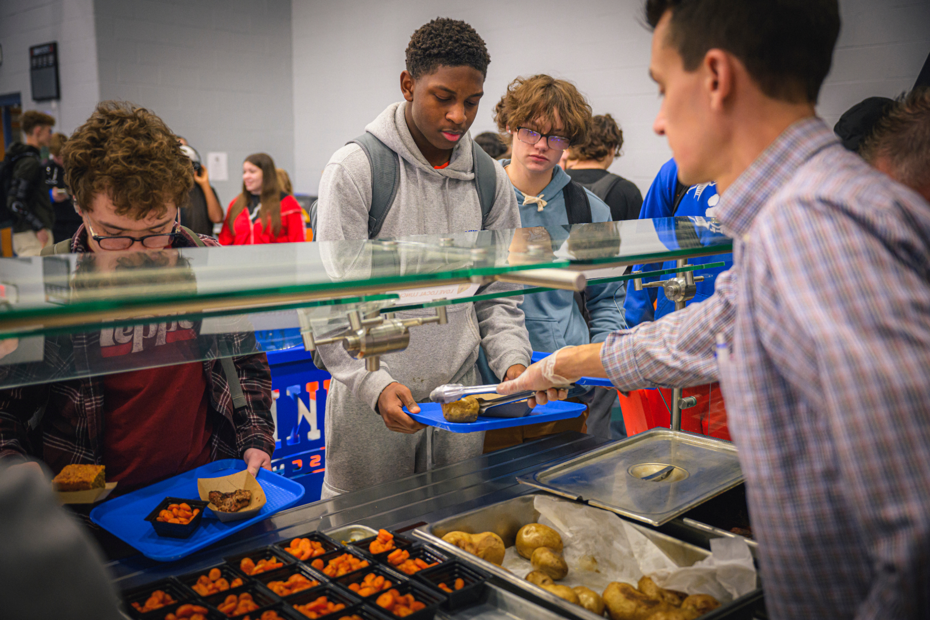
Dana Feldman
Executive Director of Consumer and Environmental Protection
Food Distribution Division
Local Food for Schools: $3.2 million grant; $2.1 million spent to date. 120 farmers participating
Local Food Purchase Assistance: $11 million grant; $4.5 million spent to date. 128 producers participating; 80% are socially disadvantaged

Slide 13
Dana Feldman
Executive Director of Consumer and Environmental Protection
Environmental Services Division
Online Pesticide Testing Program started April 1, 2024
496 online tests taken to date
About 4,000 tests annually

Slide 14
Regulation and Inspection Division
70,434 Gas Pump Inspections during 2023 (initial and rechecks)
2024 Percentage Complete

Slide 15
Steve Velasco
State Veterinarian
Mission:
• Protect the health and welfare of Kentucky's livestock, poultry, and agricultural industries
• Promote an environment which enhances the economic and recreational opportunities and prosperity of Kentucky agriculture

Slide 16
Steve Velasco
State Veterinarian
Regulatory Disease Monitoring
Foreign Animal Diseases
Certification Programs & ADT
Education & Outreach
Emergency Management

Slide 17
Steve Velasco
State Veterinarian
Emerging Disease- HPAI in Dairy Cattle
Emerging Disease Response – Kentucky Movement Requirements Intrastate
Dairy Cattle:
•Within Kentucky – Currently no restrictions on commercial movement
•Exhibition Movements – Supplemental Facility Requirements may be required
•Intrastate - (within Kentucky) – Currently no response related restrictions on movement, standard movement requirements.
•Interstate – (Normal Commerce) –
Out Bound - Check with destination State for requirements
In Bound - Must check w/ KDA/OSV for requirements (no additional incident related requirements at this time)
Lactating - Neg HPAI Test results within 7 days (USDA/FO)
EXCEPTION - if moving directly to slaughter from State of origin aggregation site or facility of origin

Slide 18
Greg Shanks
Director of Emergency Management
The Division of Emergency Preparedness and Response was established in 2023 (SB46) to lead the Office of State Veterinarian efforts in mitigating the effects of, plan and prepare for, respond to and recover from natural or man-made incidents affecting food and agriculture systems in Kentucky.
Currently hiring for three positions

Slide 19
Greg Shanks
Director of Emergency Management
Goals for year 2 of the division
Develop a framework that sets KDA on a path to build a comprehensive emergency management program.
Identify capability targets – address known gaps in training, planning, exercise, and equipment to respond to animal disease and natural / man-made incidents
Enhance response plans for high-consequence foreign animal diseases
Work with the Division of Emergency Management to enrich agriculture-related statewide disaster response plans.
Establish a state-led incident management team specializing in response to animal disease.
USDA National Animal Disease Preparedness and Response Program Grant
Outreach to farms, producers, and slaughter facilities
Biosecurity Plan – mitigation strategies to reduce the risk of disease transmission
Secure Food Supply Plan – Goal is to avoid interruption in animal movement to commercial processing from premises with no evidence of a Foreign Animal Disease. Maintain business continuity through response planning.

Slide 20
Legal Update
Advocating for Kentucky Agriculture
Commissioner Shell aggressively commented in opposition to proposed EPA action that would devastate meat processing in Kentucky and in opposition to proposed limitations on the use of acephate. Similarly, he’s repeatedly pointed out how the EPA’s sledgehammer approach to regulating agriculture is arbitrary, overbroad, and unnecessary.
Commissioner Shell has been actively engaging the EPA, Treasury Department, and several other federal agencies to provide guidance on existing tax credits relating to SAF production and consumption. Kentucky is uniquely poised to be a tremendous producer and consumer of sustainable aviation fuels, but the federal government can’t get out of its own way to provide commonsense guidelines and regulations to foster the necessary capital investment.
We’re ready to engage with the General Assembly in advance of the next session on Commissioner Shell’s signature initiative, Agriculture is Economic Development, and to secure the necessary closing fund appropriation to fully bring Agriculture to the table for future economic development projects.

Slide 21
Thank You

