Slide 1



Carbon Credits
Kentucky Interim Joint Committee on Agriculture
Alex McWard
Policy Specialist - Energy

Slide 2
Carbon Offsets and Markets
Carbon Offsets
Carbon Market
Offsets compensate for emissions by investing in projects that reduce or prevent emissions in the atmosphere
  Reforestation
  Carbon storing agriculture,
  Renewable energy
Offsets purchased for internal goals
Voluntary market
Third party verification
Cap-and-trade or cap-and-invest
Entities receive allowances that permit a certain amount of carbon emissions
Allowances can be traded between entities
The number of allowances declines over time
Compliance market

Slide 3
State Cap and Trade Programs
AK
WA
ID
MT
ME
OR
ND
MN
MI
WI
NY
RI
WY
SD
CA
CT
NV
IA
PA
VT
UT
NE
IL
OH
NH
CO
IN
WV
NJ
UT
KS
MO
VA
MA
KY
DE
MD
AZ
NM
NC
DC
OK
TN
TX
AR
SC
MS
AL
GA
HI
LA
State Carbon Market
FL
Pending Carbon Market
Regional Greenhouse Gas Initiative
AS
GU
MP
PR
VI

Slide 4
Carbon Market Legislation
Enacted
  Washington SB 6058 (Enacted, 2024) facilitates the linkage of Washington’s carbon market with the California-Quebec carbon market.
Introduced
  Oklahoma SB 1389 (Introduced, 2024) would have established the Greenhouse Gas Cap and Invest Program.
  New Jersey AB 4278 (Introduced, 2024) would establish a statewide cap and invest program for major greenhouse gas emitters.
  Florida SB 1470 (Introduced, 2023) would have established a carbon credit trading market for agricultural producers.

Slide 5
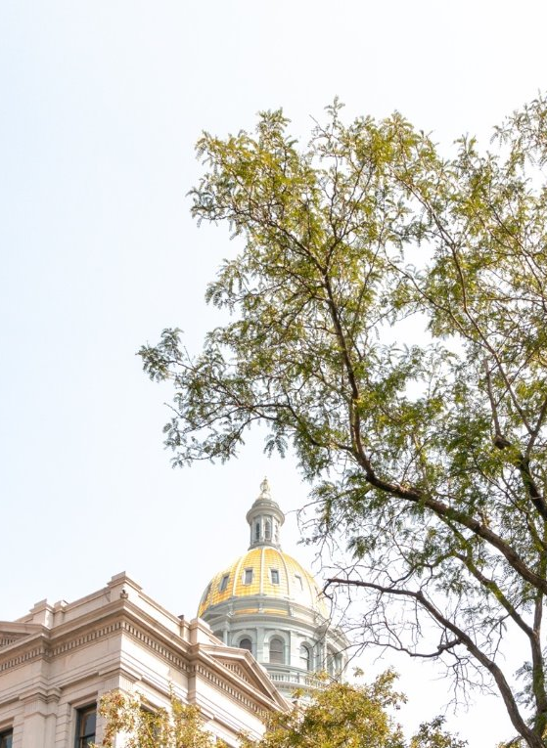
Enacted Carbon Offset Legislation
New Hampshire HB 1697 (Enacted, 2024) mandates a study on how forest lands enrolled in carbon credit offset programs impact timber tax revenue.
Oklahoma SB 1569 (Enacted, 2024) modifies statute to focus on terrestrial and agricultural carbon sequestration practices.
Alaska SB 48 (Enacted, 2023) established a carbon offset program for state land and authorized the sale of carbon offset credits.
California AB 1305 (Enacted, 2023) requires entities selling voluntary carbon offset credits to disclose specified information about the offset projects.
Hawaii SB 3325 (Enacted, 2022) promotes carbon sequestration through incentives for agriculture and forest preservation.

Slide 6


Introduced Carbon Offset Legislation
  Washington HB 2333 (Introduced, 2024) would mandate an assessment of the carbon sequestration potential of state-owned lands for the generation of carbon offset credits.
  Hawaii SB 421 (Introduced, 2023) would have established a process for assisting air travelers to Hawaii in voluntarily purchasing verified carbon offsets to compensate for travel emissions.
  Ohio SB 174 (Introduced, 2023) would have allowed natural gas service suppliers to offer carbon offsets to customers.
  Maine LD 11235 (Introduced, 2023) would have allowed forest land-owners to sell carbon credits for their property.

Slide 7

Introduced Carbon Offset Legislation
  California SB 1036 (Introduced, 2024) would require voluntary carbon offset credits to explicitly market that the offset is not physically equivalent to the climate impact of carbon dioxide.
  Massachusetts HB 895 (Introduced, 2023) would have presented carbon offsets sold to entities outside of MA from counting towards the state’s carbon reduction goals.
  West Virginia SB 595 (Introduced, 2023) would have set new registration requirements for carbon offset agreements.

