Slide 1
Carbon market update
Presented By: Jordan Shockley, Ph.D.
Associate Extension Professor
UK Agricultural Economics

Slide 2
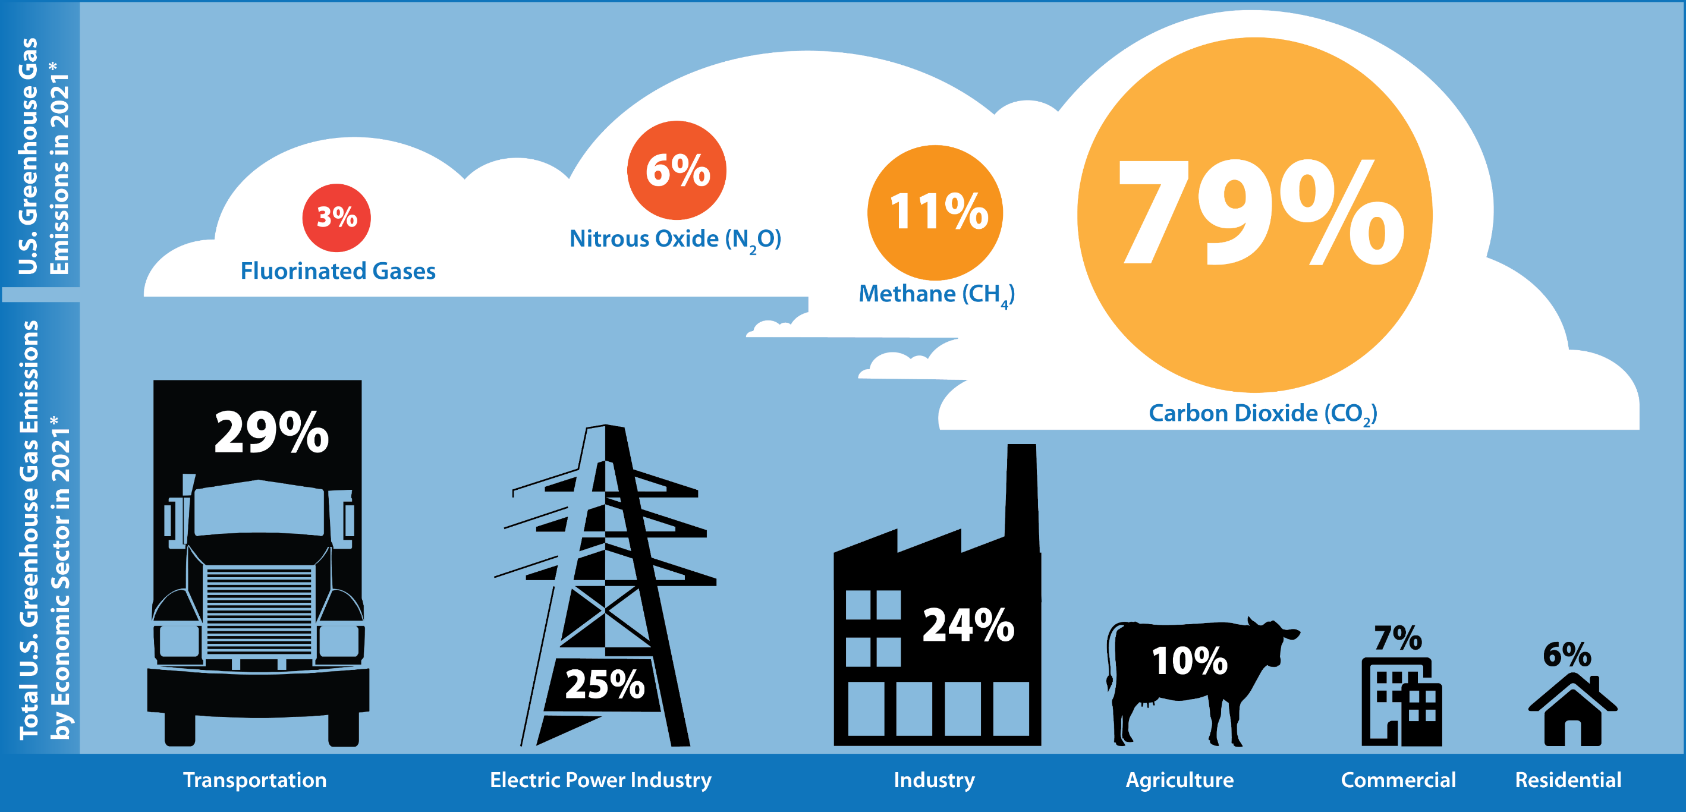
WHY CARBON?
Source: 2021 U.S. EPA Inventory of GHG Emissions

Slide 3
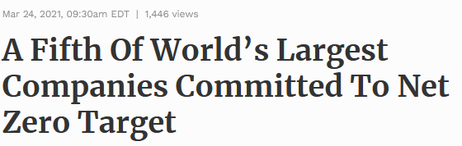
What is driving voluntary carbon markets?

Slide 4
Why this is important
How will companies meet these goals, especially those in the food supply chain?
Who is going to pay?
Consumers? Suppliers (farmers)? Everyone?
For farmers, will this be voluntary or voluntold?
Financial implications and risks
Opportunities for Kentucky farmers

Slide 5
What is driving carbon markets
Two broad categories driving carbon markets:
1.) State government’s GHG regulations – COMPLIANCE MARKETS
Example: California’s Cap and Trade Program

Slide 6
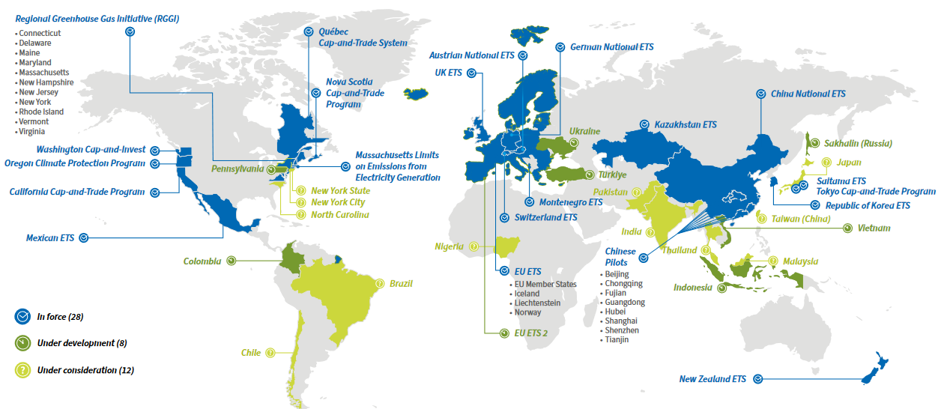
Compliance markets globally
Source: International Carbon Action Partnership, Emissions Trading Worldwide: Status Report 2023

Slide 7
What is driving carbon markets
Two broad categories driving carbon markets:
1.) State government’s GHG regulations – COMPLIANCE MARKETS
Example: California’s Cap and Trade Program
2.) Corporate Sustainability Reporting – VOLUNTARY MARKETS

Slide 8
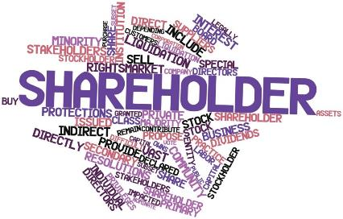
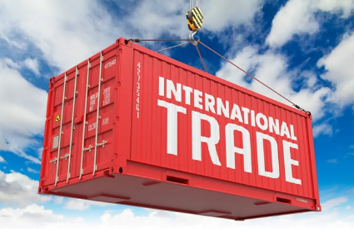
Why are companies making ghg pledges?

Slide 9
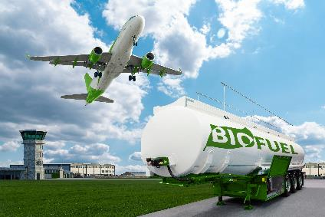
How do companies use carbon markets to reach their GHG Pledges?
OFFSET
INSET

Slide 10
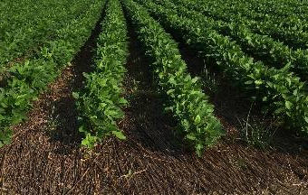
Structure of carbon offset markets in agriculture
Carbon Credit 1
Carbon Credit 2
Carbon Credit 3
Project Developer
Companies Pledging GHG Reductions
Seller
Buyer
Example: Shockley Farms
Example: Carbon Program X
Example: Fortune 500 Company

Slide 11
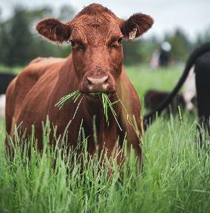
Structure of carbon inset markets in agriculture
Direct buyer in the supply chain
Seller
Buyer
Example: Shockley Farms
Example: McDonalds

Slide 12
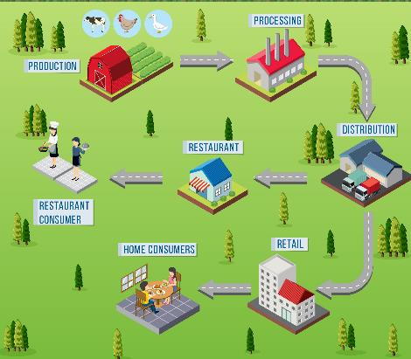
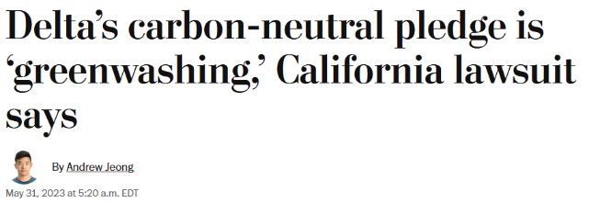
Why are companies pursuing carbon insets?
* Delta spent $137M to buy offsets to neutralize 27 million metric tons

Slide 13
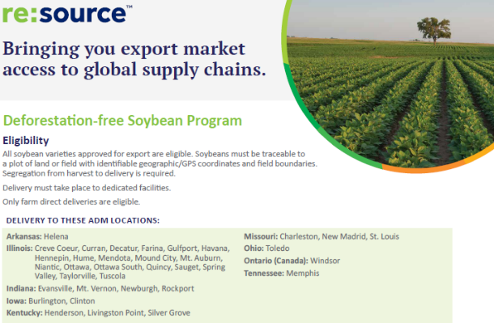
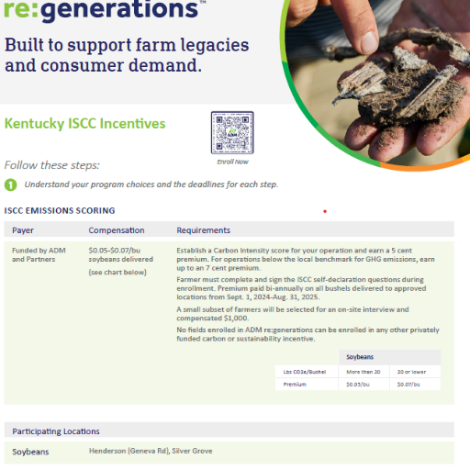
Voluntary and voluntold markets

Slide 14
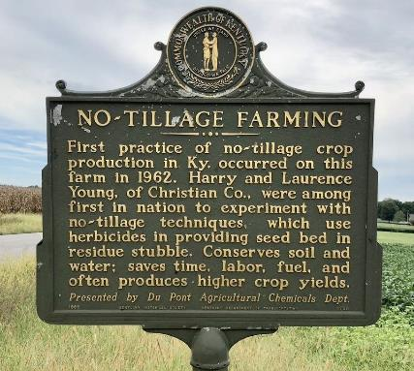
Economic risks vs opportunities facing agriculture in Kentucky
“Work only with growers that use sustainable practices by 2040” – Beam Suntory
Cut beef emissions from North American beef supply chain by 30% by 2030 - Cargill
But at what cost and risks to the farmer? Premiums?
Could Kentucky be the center for sourcing sustainable agricultural products?

Slide 15
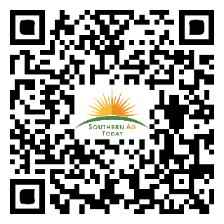
Thank You!
Jordan Shockley, Ph.D.
Phone: 859.218.4391
Email: jordan.shockley@uky.edu
http://agecon.ca.uky.edu/person/jordan-shockley
@Shock_N_AgMgmt
Dr. Jordan Shockley

Slide 16
Why agriculture?
Source: U.S. EPA Inventory of GHG Emissions

Slide 17
Carbon inset examples
COMPANY | GHG GOALS
ADM | 25% Scope 3 reduction by 2035 ---- supporting growers in adopting soil health practices
Bunge | 12% Scope 3 reduction by 2030
Cargill | Reduce emissions from the supply chain by 30% by 2030
Beam Suntory | Achieve net-zero GHG by 2040 --- “work only with growers that use sustainable practices by 2040”
Brown-Forman | By 2025, 100% engagement with our direct farmers on regenerative agriculture practices
Nestle | 50% of key ingredients sourced through regenerative agriculture methods by 2030
Coca-Cola | Advance sustainable sourcing of our agricultural ingredients at the farm level
Tyson | We partner with row crop farmers to continue to advance sustainable land stewardship

Slide 18
Carbon inset examples
COMPANY | GHG GOALS
Cargill | Cut beef emissions from North American beef supply chain by 30% by 2030
Tyson | Net-Zero emissions by 2050 -- Sustainable beef production on 5 million acres of cattle grazing land by 2025
JBS | Net-Zero emissions by 2040 -- Strengthen and scale regenerative farming practices
Wal-Mart | Net-Zero emissions by 2040 -- Sustainably source fresh beef by improving grain sourcing and grazing management practices
McDonald’s | Net-Zero emissions by 2050 -- Improve grazing techniques in the U.S.
YUM! Brands | Reduce emissions of beef, poultry, dairy, and packing 46% below 2019 levels
Restaurant Brands International (Burger King) | Advance beef sustainability…work with ranchers and producers in our supply chain to scale regenerative agriculture

Slide 19
Current Carbon programs For row crop producers
Bayer Carbon (ForGround)
CIBO
Ecosystem Services Market Consortium (ESMC)
Indigo
Gradable
Nori
Nutrien
AgriCapture
Locus AG CarbonNOW
Truterra
Soil and Water Outcomes Fund (SWOF)
Cargill RegenConnect
Corteva
Agoro
Farmers Edge
ARVA Intelligence Corp.
Kellogg’s InGrained
Perdue AgriBusiness
Siemer Milling STAR Rewards Program
ADM re:generations ISCC Incentives
= Kentucky producers are eligible to enroll in the carbon program

Slide 20
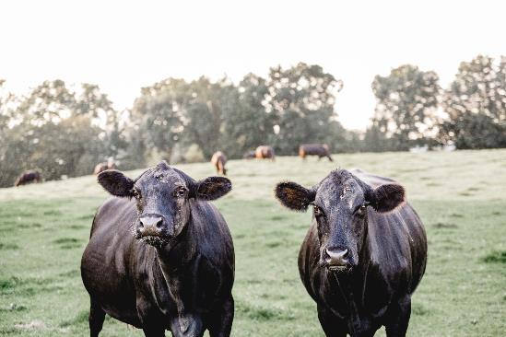
Current Carbon programs For Beef operations
Ecosystem Services Market Consortium
Grassroots Carbon
Regen Network
Soil & Water Outcomes Fund
Agoro
Native HelpBuildTM
Tyson Climate-Smart Beef (BrazenTM)
Source: Wright, L. and E. Harris. “Voluntary Carbon Markets Applicable to Grazing Operations: Review and Considerations for Farmers and Ranchers” Prepared for the National Cattlemen’s Beef Association (NCBA) August 2021
= Kentucky producers are eligible to enroll in the carbon program

Slide 21
Current Carbon Programs for Dairy Producers
Truterra Dairy Soils Program
Sustainable practices on crops used for feed – including silage and alfalfa

Slide 22
Current Practices eligible for carbon markets
Row Crops
Beef Operations
Cover Crops
No-Till or Strip-Till
Optimized Nitrogen Management
Rotational Grazing
Silvopasture
Waterway/Riparian Management
Payments range from $10 - $30 per mt CO₂eq
U.S. average estimates of 0.31 mt per year for no-till and 0.37 mt per year for cover crops (Thompson et al., 2021)

Slide 23
Current Carbon programs for Woodland owners
 | Forest Carbon Works | CORE Carbon | Family Forest Carbon
Minimum Land | 40 acres | 40 acres | 30 acres
Contract Length | 60 years | 40 years | 20 years
Payments | $10/ac with Revenue Share Option | Tied to carbon market price | $230/ac over contract period with 20% premium option
Allows for Harvest | Yes | Defer for 20 years | Sustainable harvesting allowed
Contract Ties | Land as easement | Land as easement | Land as easement
Forest Management Plan | Required | Required | Required
Enrollment Eligibility | All of U.S. | Southeast and Northeast | AL, GA, KY, MD, NC, SC, TN, VA, WV

