Slide 1


Agriculture Technology for Kentucky Classrooms

Slide 2

Farm-Ed Overview
Farm-Ed is a pioneering STEM technology platform that integrates AI-powered Grow Chambers with a dynamic curriculum designed to engage students in hands-on learning experiences related to agriculture, technology, and sustainability.
Check out our website!
In a Farm-Ed classroom, learners experience first-hand the freedom of exploration, experimentation, and applied data analytics.

Slide 3
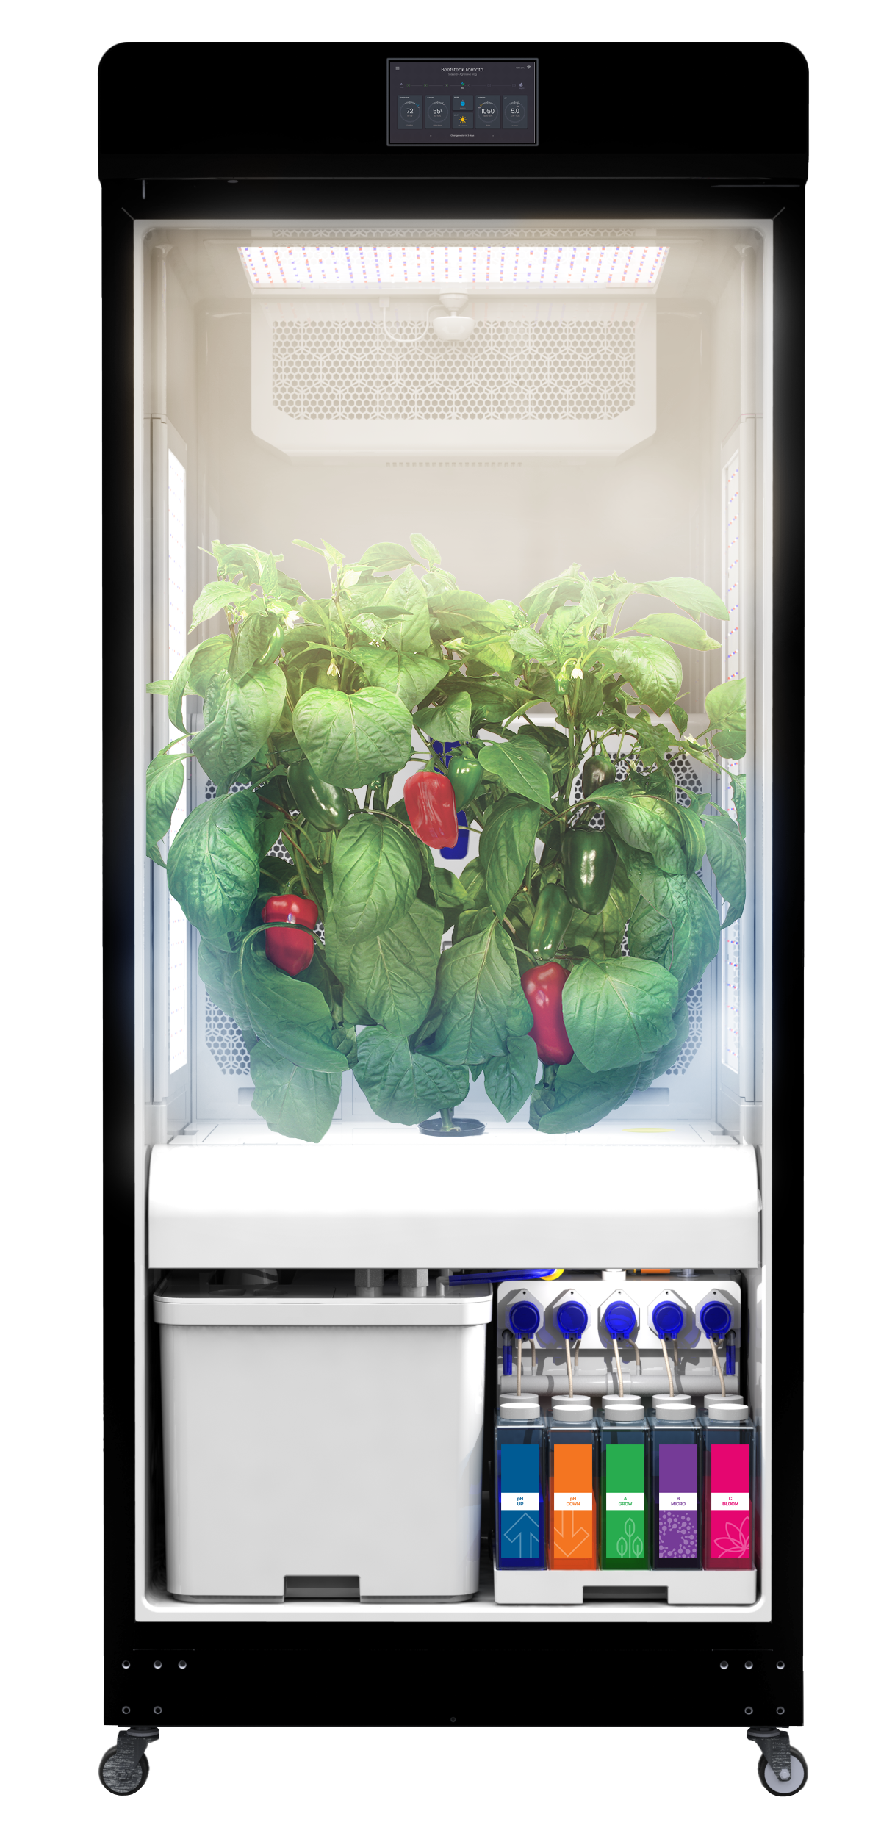
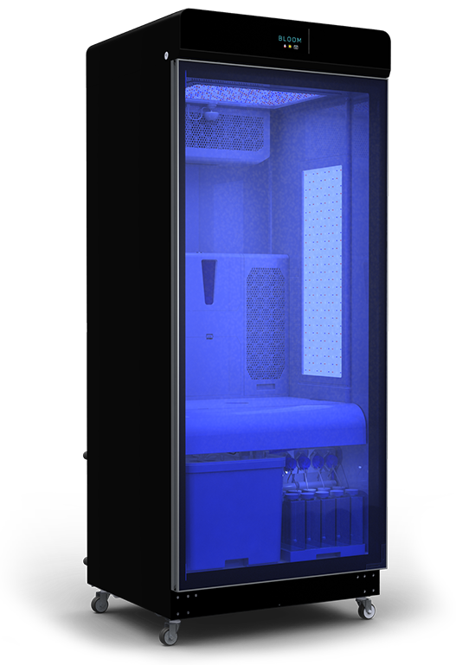
Smart Controlled Environment Grow Chamber
25” (63.5 cm)
28” (71.1 cm)
Farm-Ed’s Smart Grow Chamber is a complete ecosystem for plants
Exact Temperature (±1% precision)
Humidity Adjustments (± 5% precision)
Lab-grade pH and EC sensors work in conjunction with other components
Collection of 216k data points per day, per device, allowing real-time system adjustments
70” (177.8cm)

Slide 4
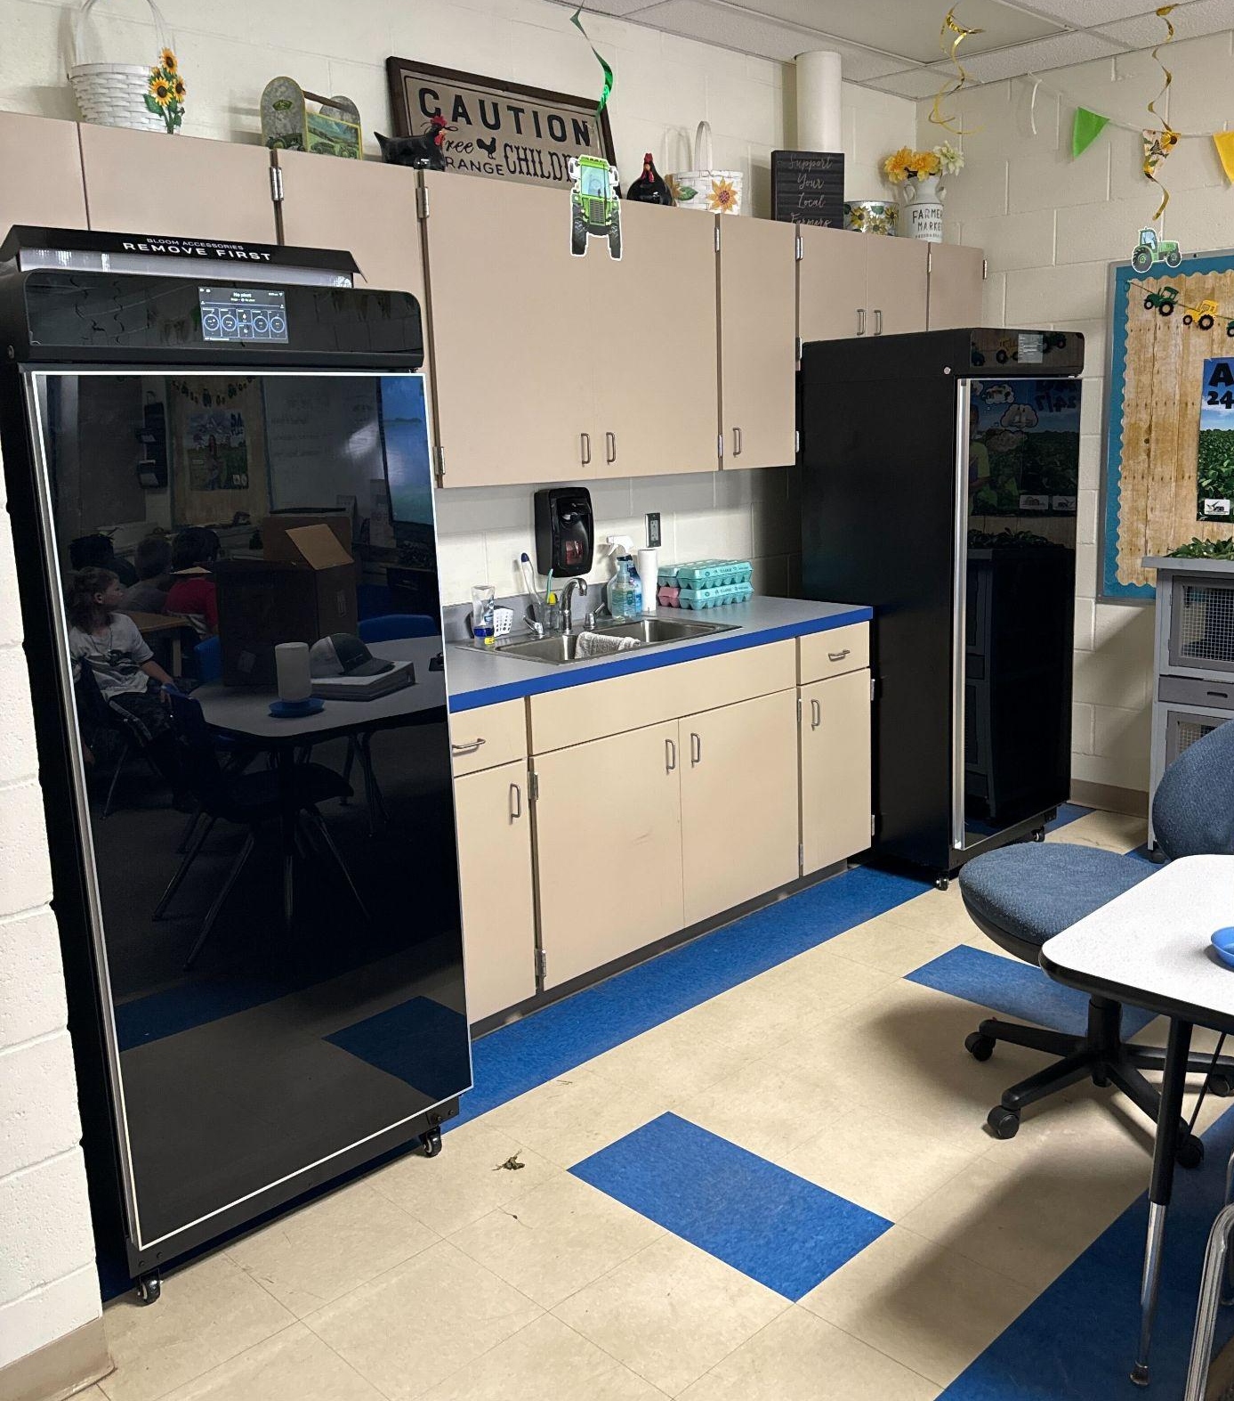
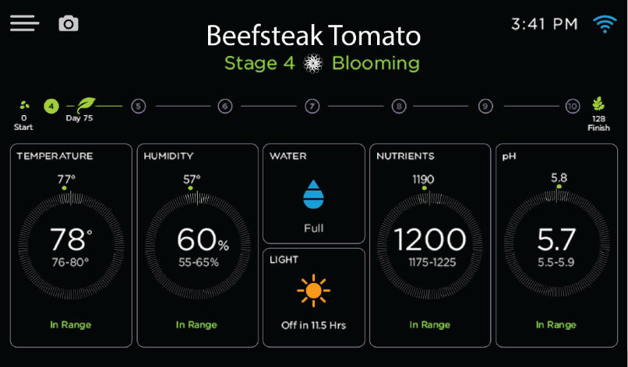
Grow Chambers in Classrooms
Our goal is to make Agriculture accessible to every K-12 classroom
Select your plant type and press GROW
AI monitoring & Push Notifications
Data from seedling to harvest

Slide 5

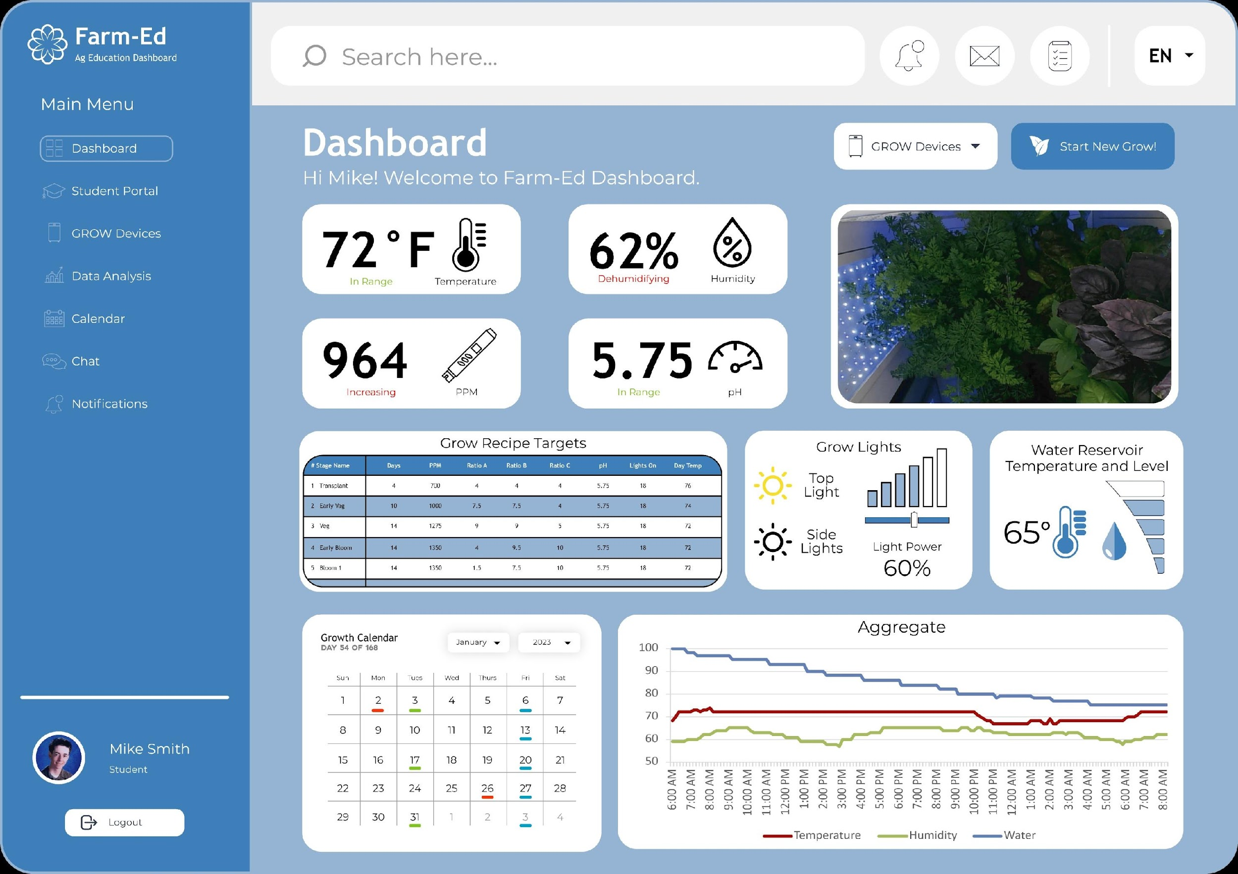
Data Dashboard
The Farm-Ed platform provides classrooms the tools to conduct long-term, data rich, and industry-standard experiments
Throughout the plant’s life, learners and teachers have access to over 216,000 data points daily from each grow chamber.
Learners interact with this data through user-friendly data dashboards to assist in the analysis and understanding of growth data.

Slide 6

Bringing our Program to Kentucky
Designed by industry experts, our program fits into any classroom, providing learners and teachers:
Grow Chamber and all supplies for each classroom
Weekly curriculum lesson to enrich course standards with inquiry-based and project-based learning experiences
Data Dashboard access correlated to their own classroom Grow Chamber
Professional development and collaboration with other program teachers

Slide 7
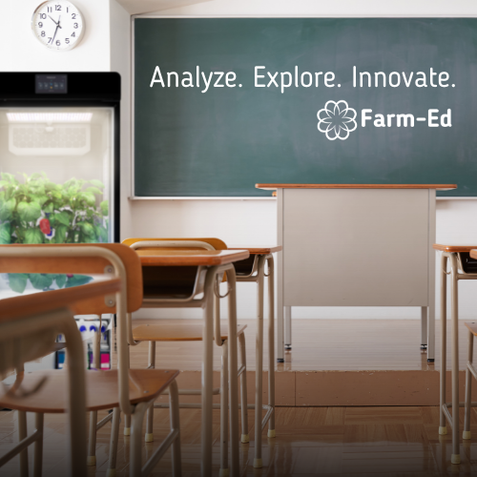
Benefits for Kentucky
Kentucky learners will master transferable skills necessary for their future
Learn firsthand about ongoing experimental modules, repeated trials, and research protocols
Program the AI-managed environment
Study data trends and interpret for insightful analysis
Build interest in exploring Agriculture fields of study and future careers

