Slide 2
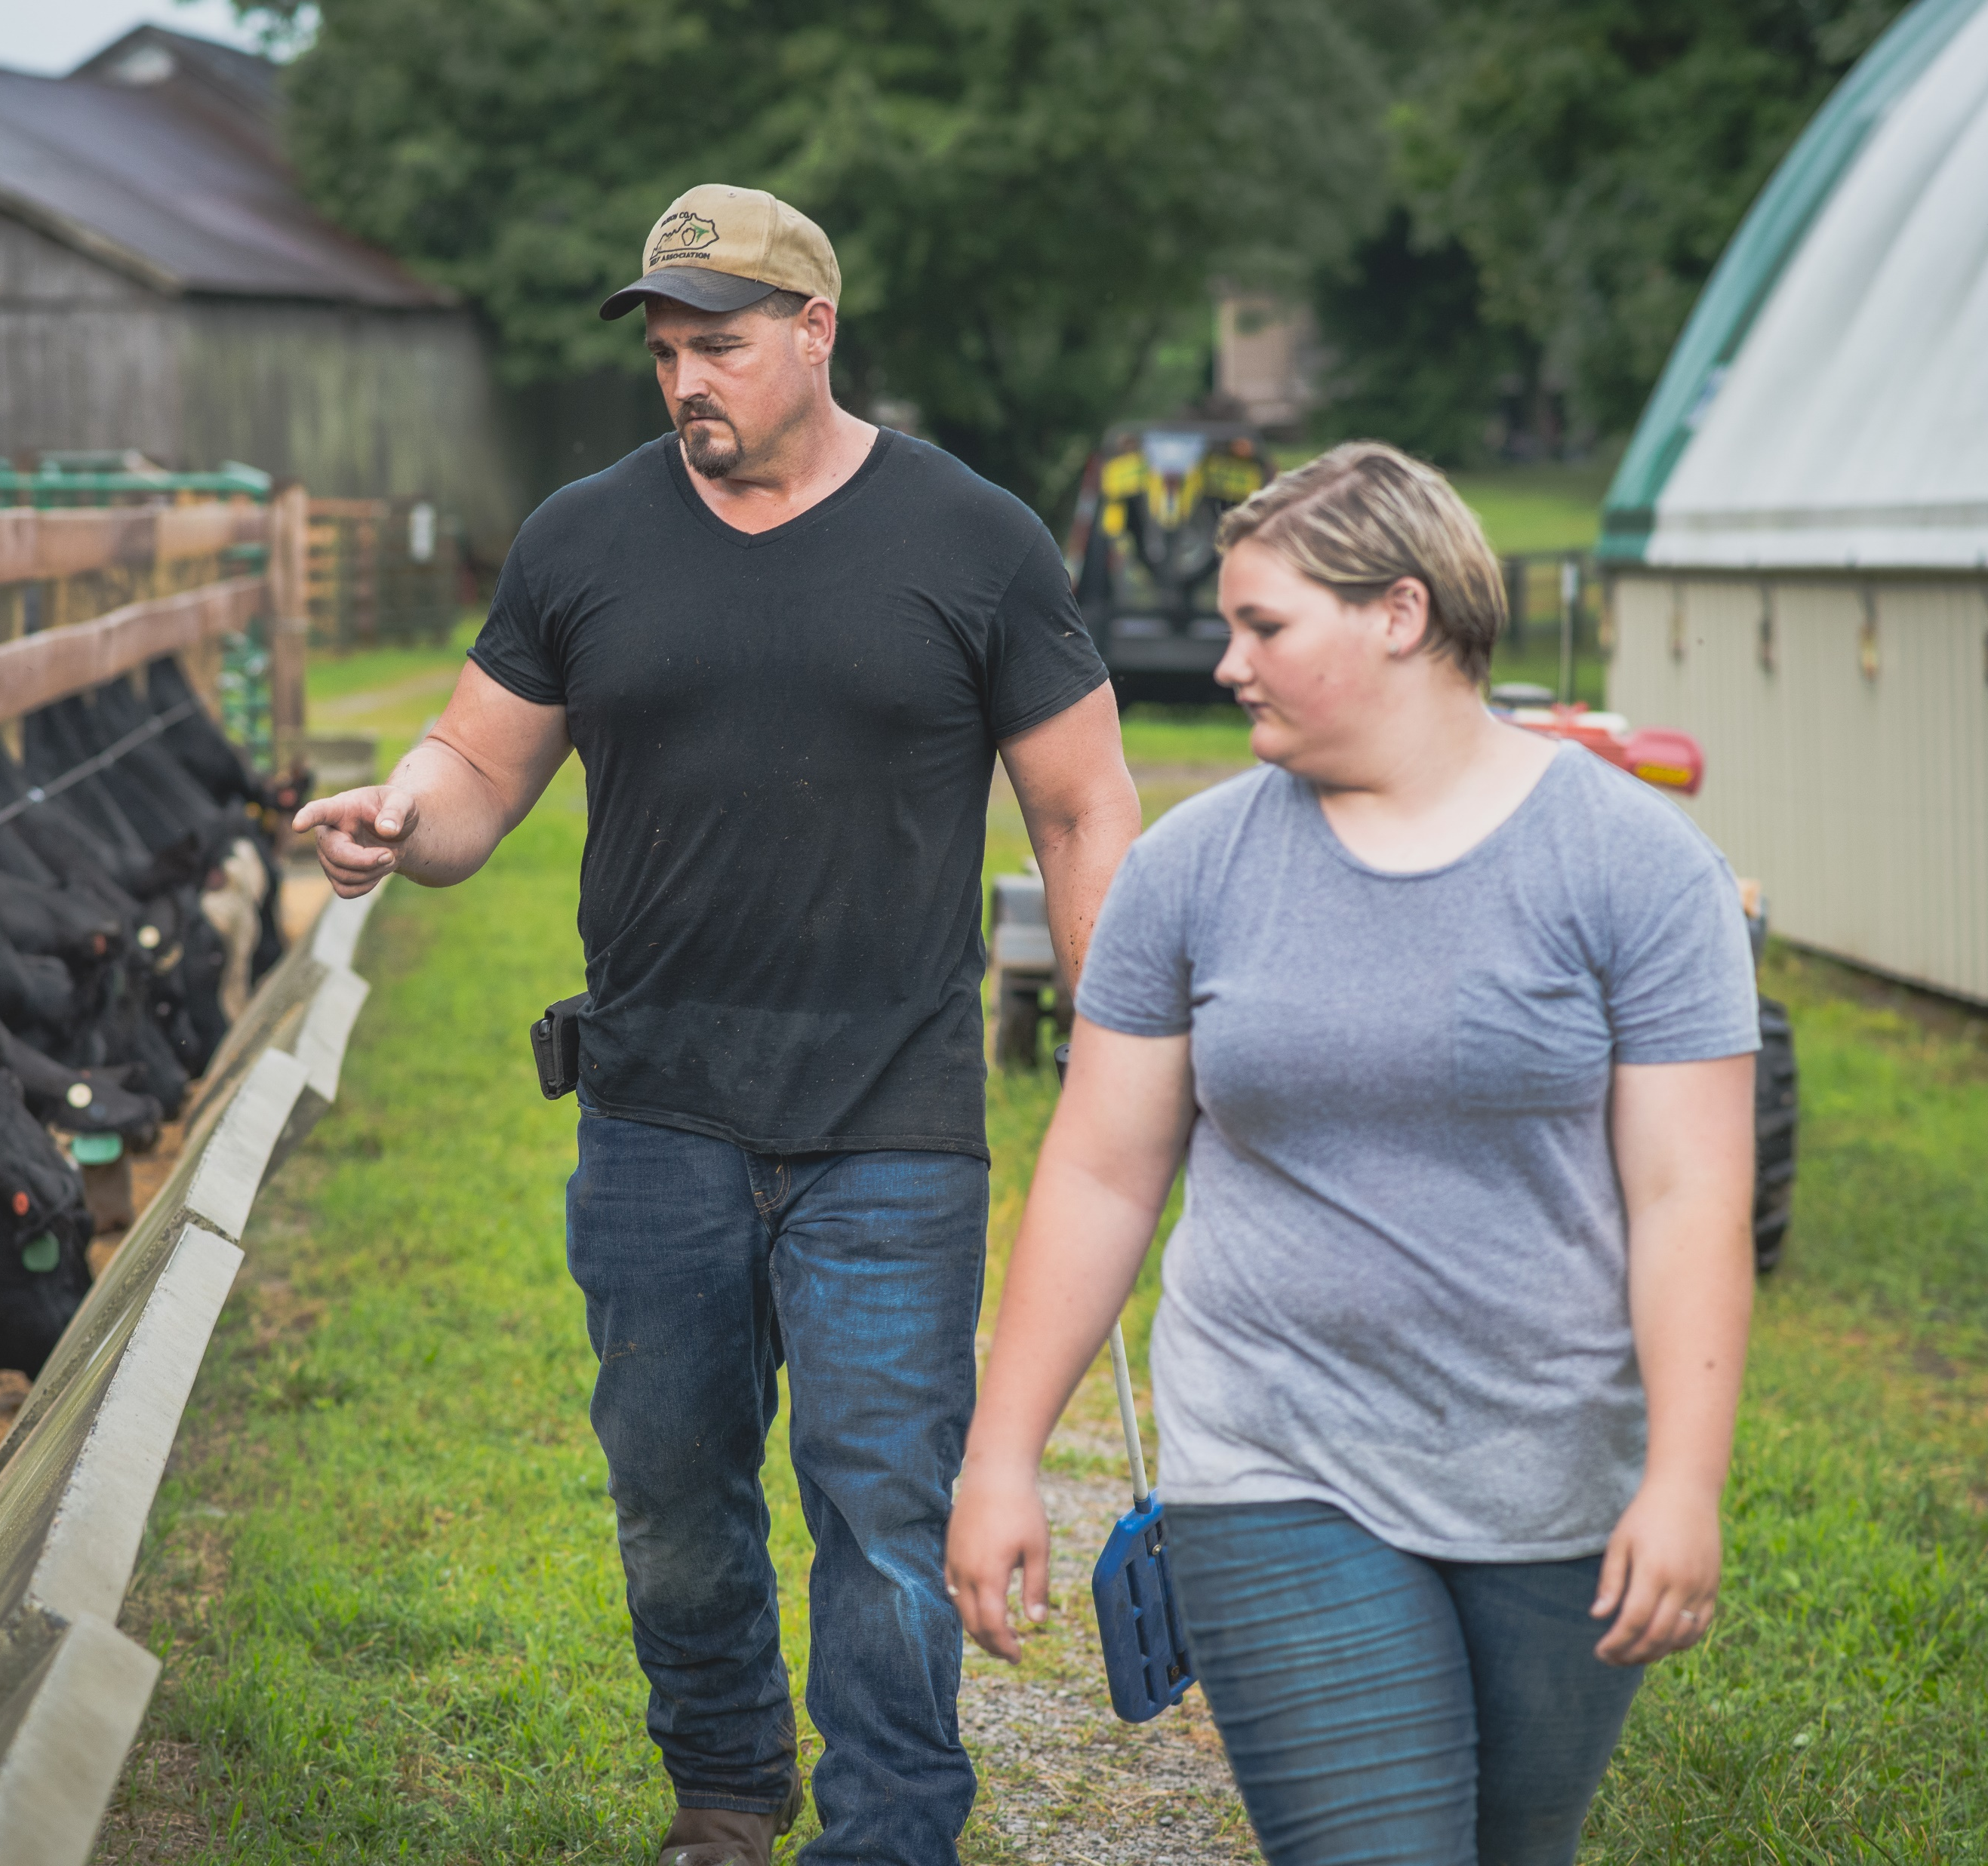
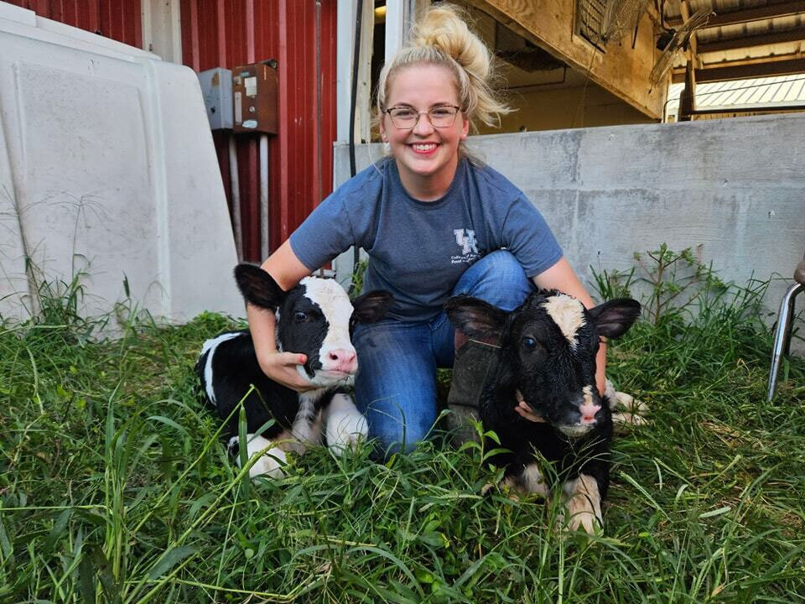
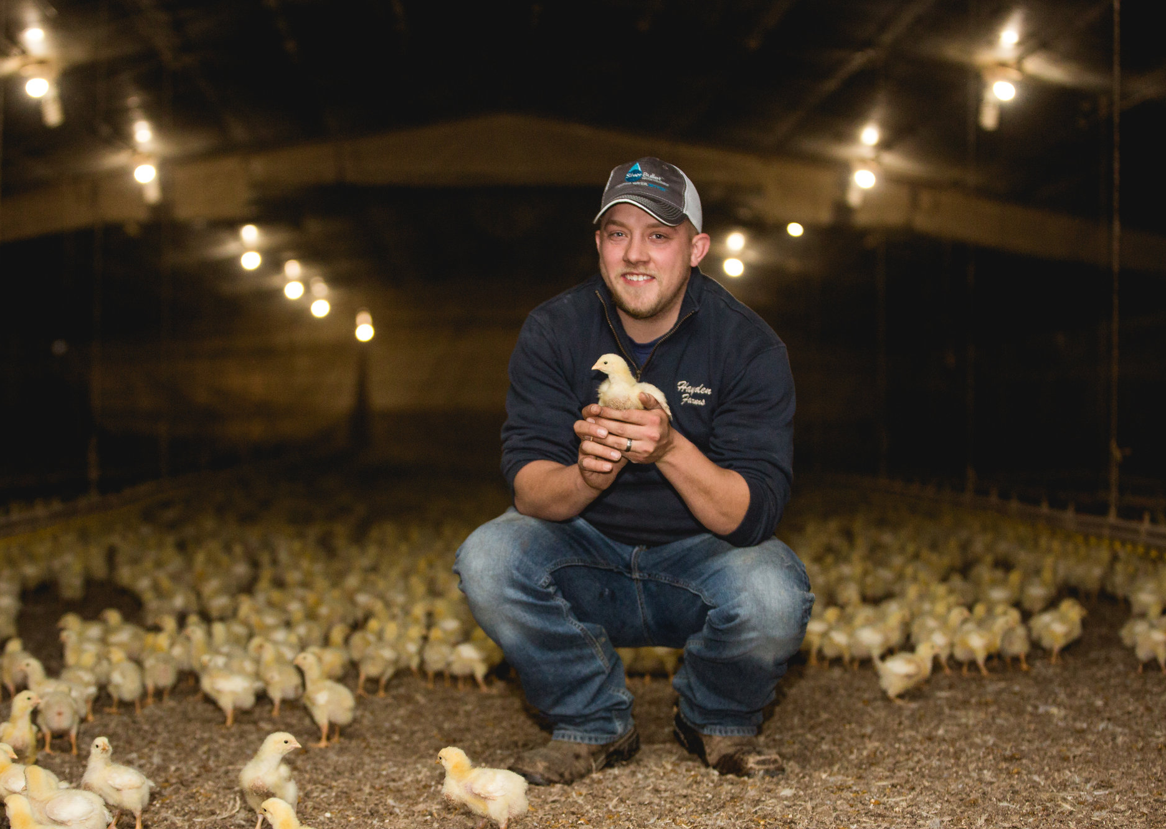
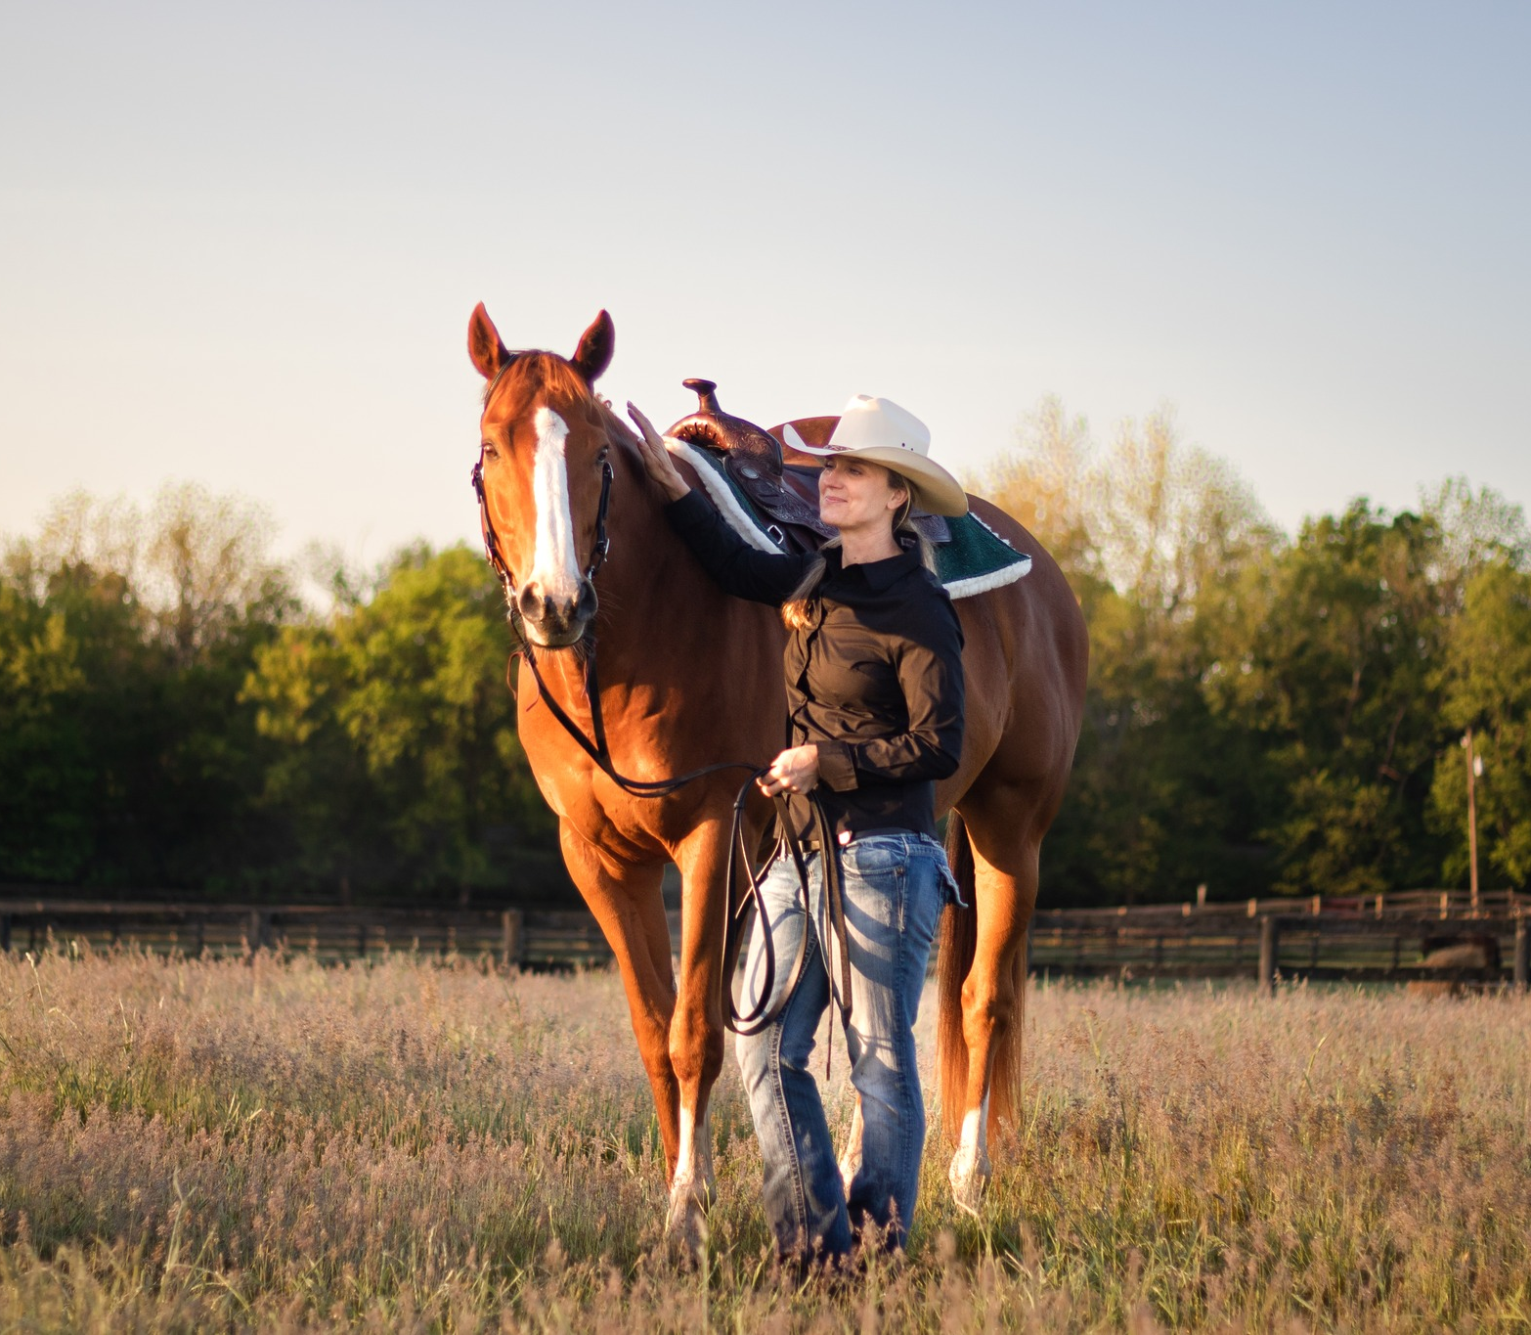
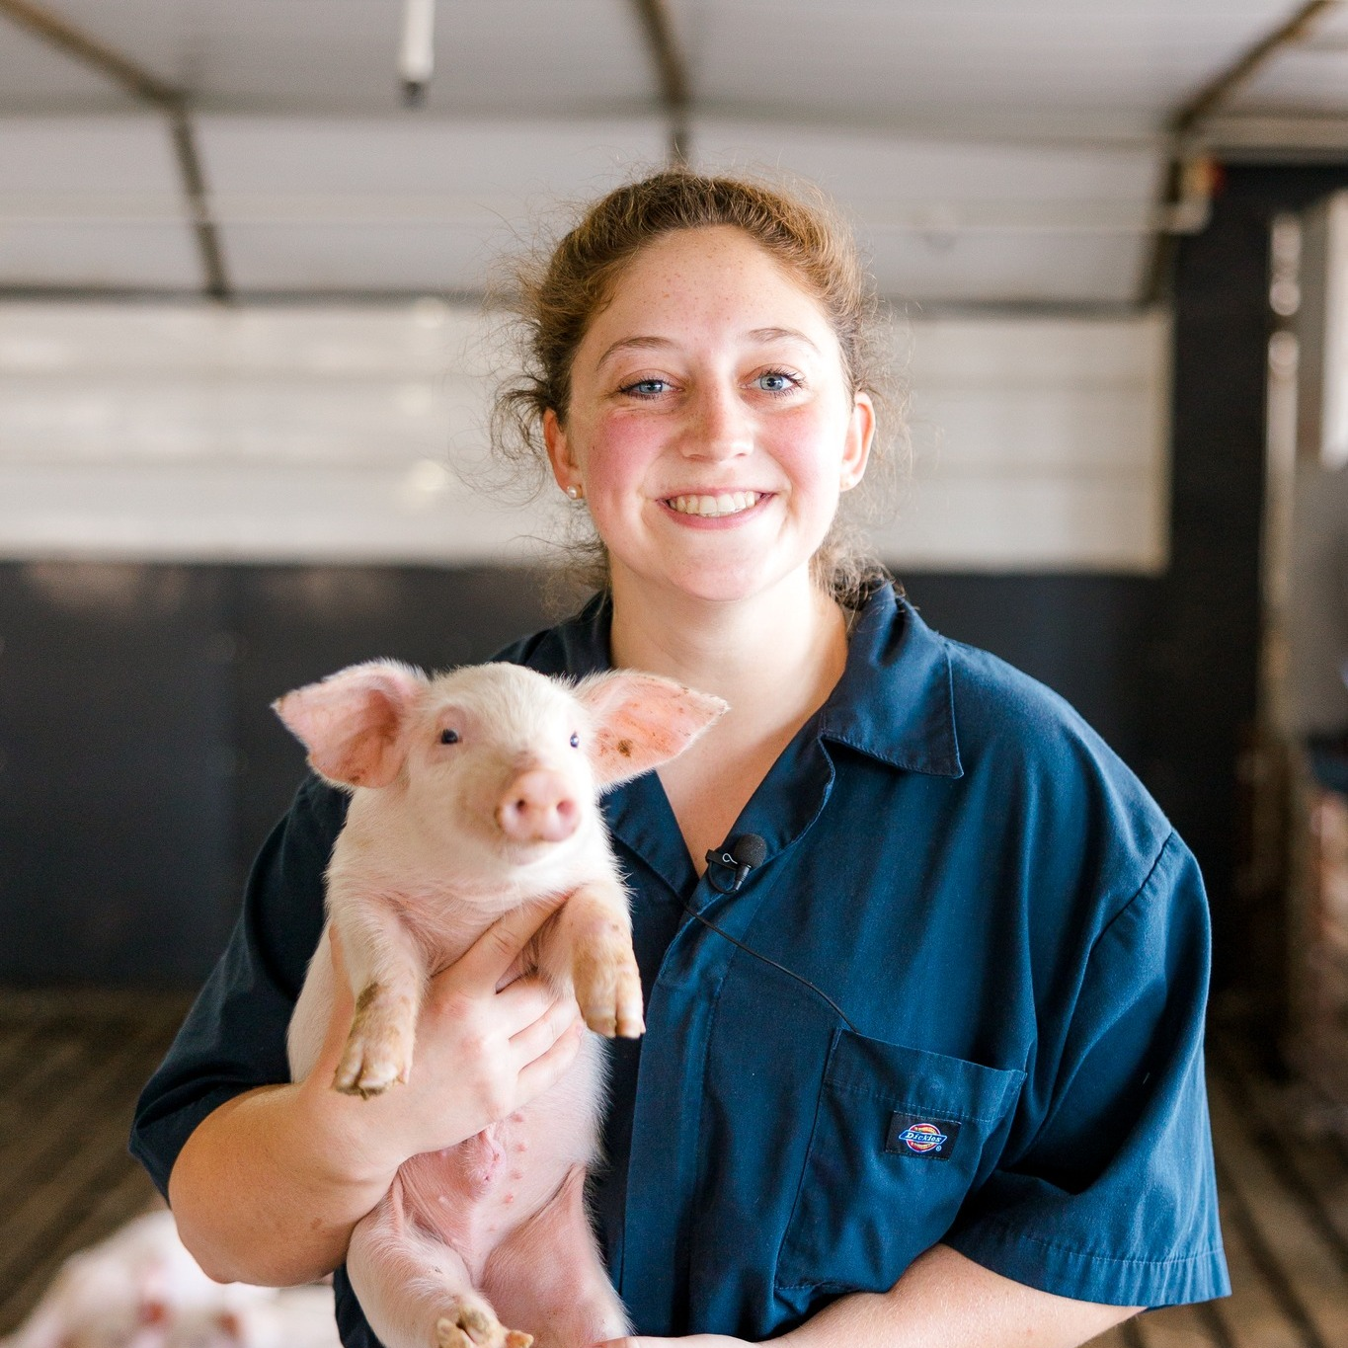
Notes:
Thank you for choosing to create a center to sustain and grow the livestock industry in Kentucky and in the region

Slide 3
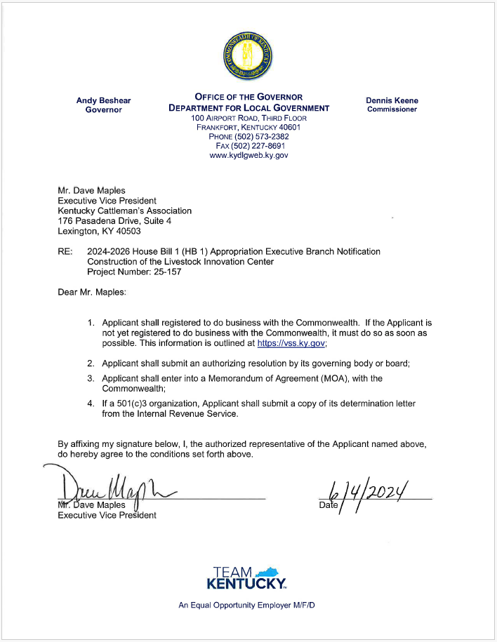
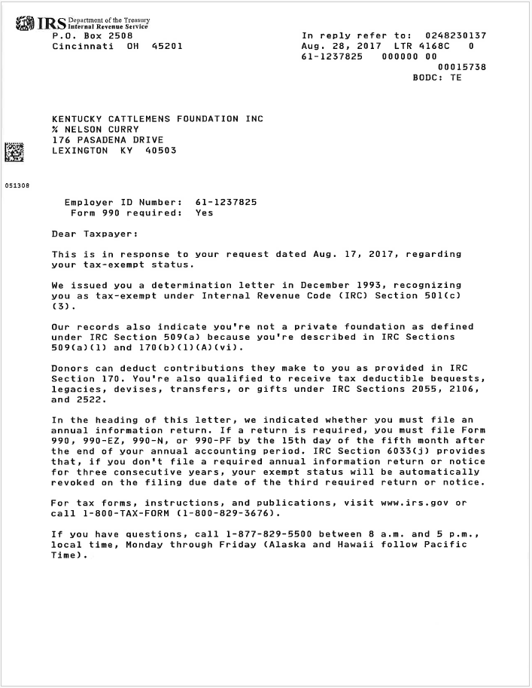
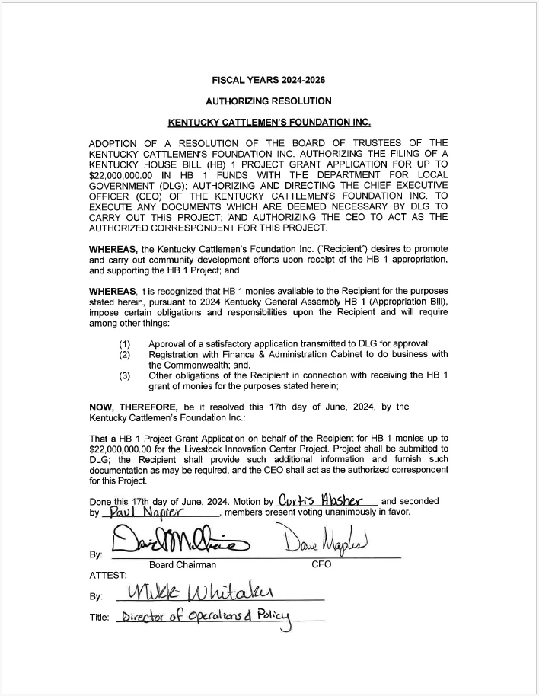
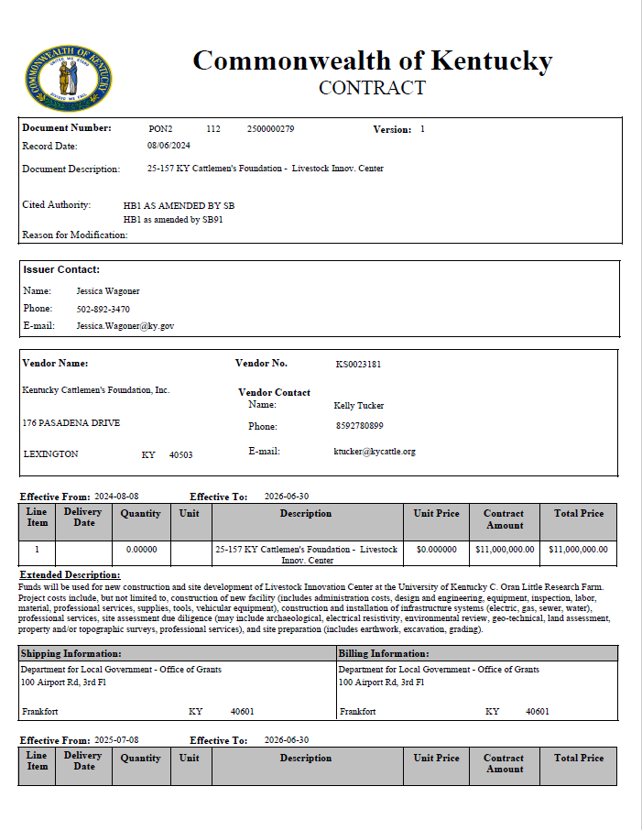
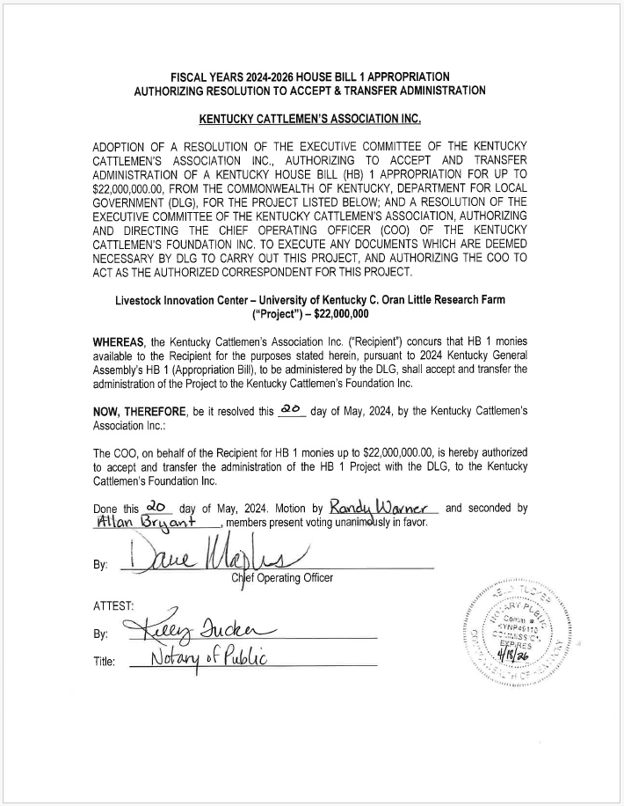
Recipient of House Bill 1
August 7
May 20
June 4
June 6
June 17

Slide 4
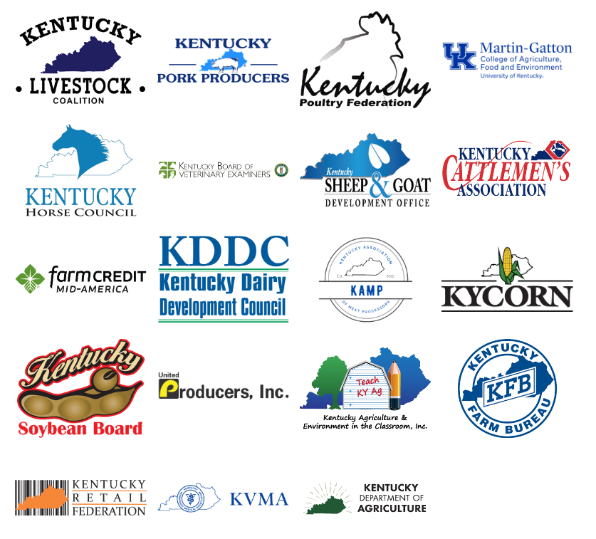
Background
The idea for an innovation center began with a strong statement of need from industry leaders.
Founded in 1993, the Kentucky Cattlemen’s Foundation is a 501(c)(3) nonprofit organization affiliated with the Kentucky Cattlemen's Association.
Members of the Kentucky Livestock Coalition, agriculture groups, and county cattlemen's chapters across the state had several meetings between 2019-2024 to develop a combined effort of support for a Kentucky Livestock Innovation Center.
2019
2024

Slide 5
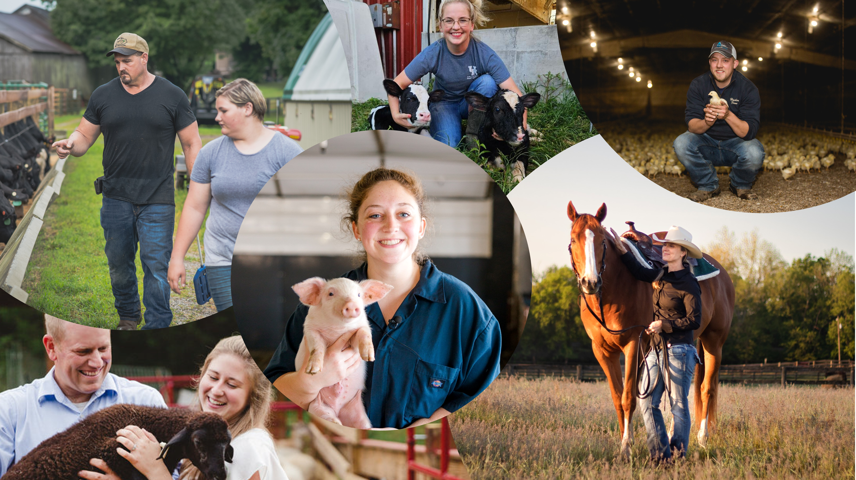
We are stronger
together

Slide 6
Industry Strategic Objectives
Workforce Development
Value Added Production
Education and Research
Producer Profitability
Consumer Information
Student Enrichment
Advancements in Agriculture
Stronger Food Systems

Slide 7
Mission and Purpose
Create a central coordinating location that will directly and indirectly serve as a tool and resource to advance the socioeconomic benefit of agriculture to the Commonwealth of Kentucky.
Direct Impact (Hands-On):
Field Demonstrations
Workshops and Training Sessions
Indirect Impact (Developmental):
Curriculum Development
Industry Collaboration

Slide 8
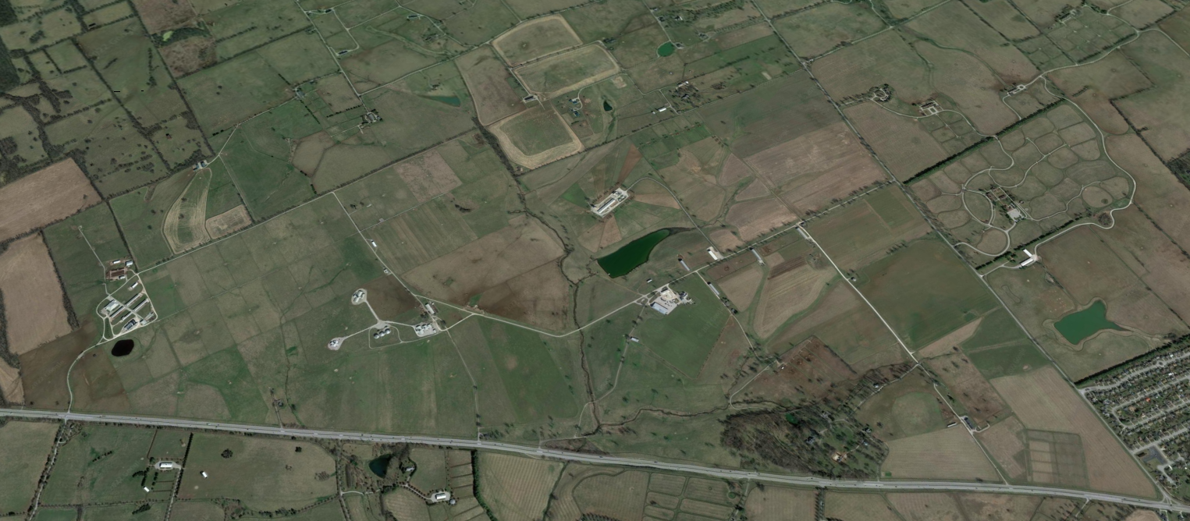
C. Oran Little Research Farm – Versailles, KY
Sheep Unit
Meats & Foods Development Center
Poultry Unit
Swine Unit
Beef Unit
Equine Unit
Livestock Innovation Center
Crop Research
OPENING THE DOOR TO OPPORTUNITIES

Slide 9
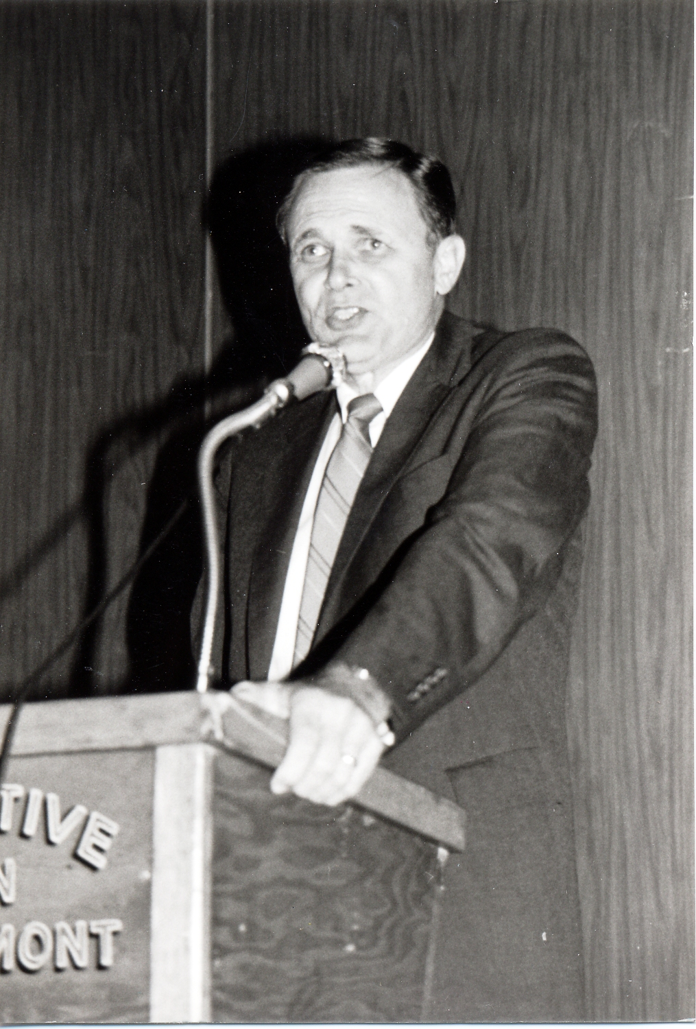
The development of new technologies and methodologies for the sake of their development alone is of little benefit to anyone. The true merit lies in the timely and accurate dissemination of that technology in a manner such that it reaches the maximum number of potential clientele.” – Dean C. Oran Little

Slide 10
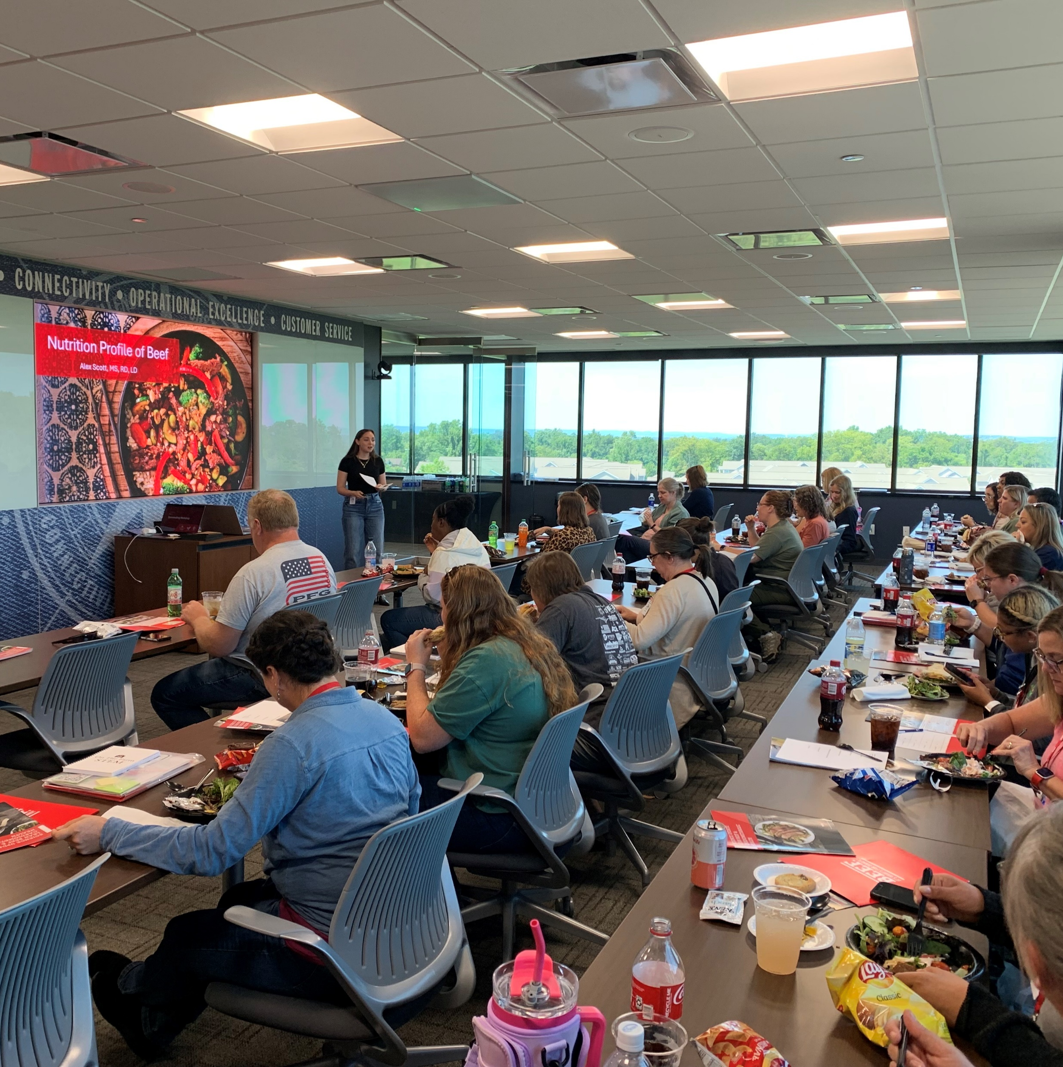
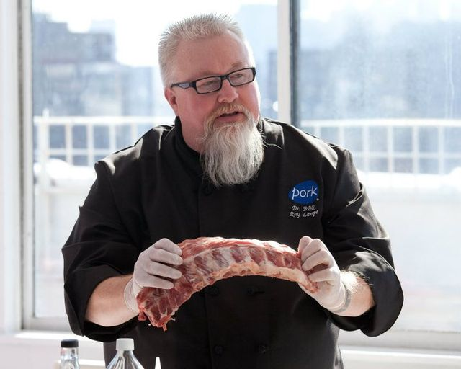
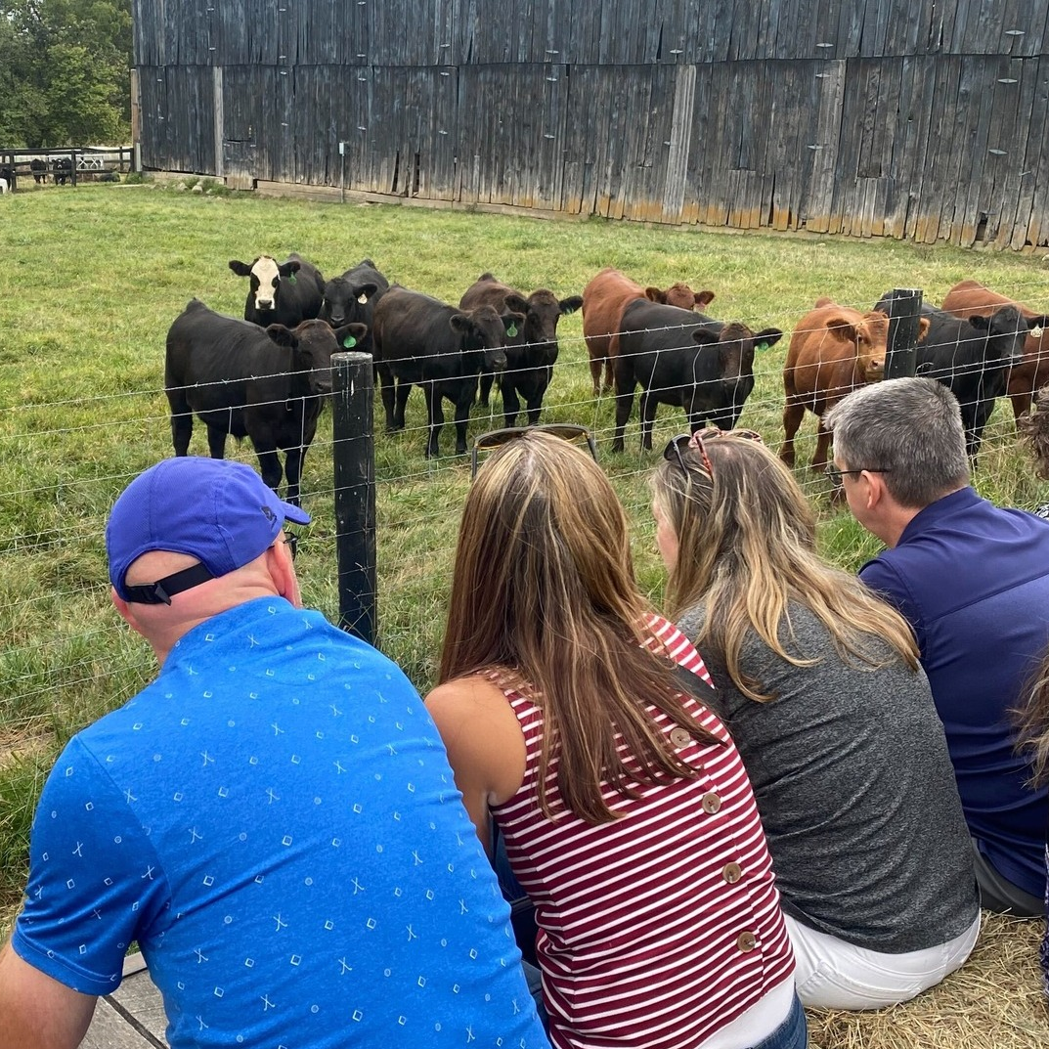
OPENING THE DOOR TO OPPORTUNITIES
Health Professionals
This collaborative approach not only enhances the understanding of food systems among health professionals but also empowers farmers to align their production with the nutritional needs of their communities

Slide 11
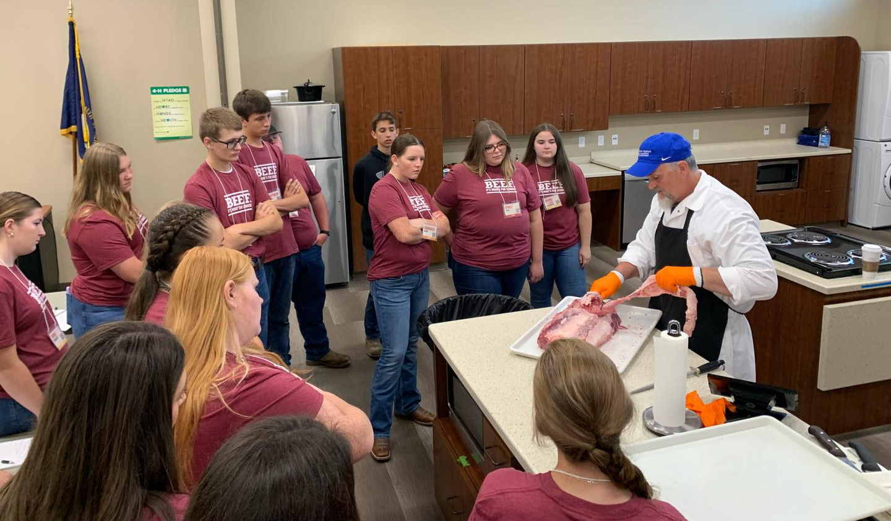
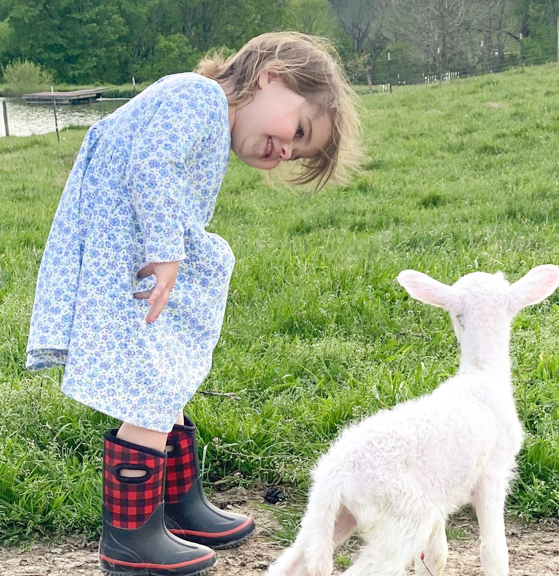
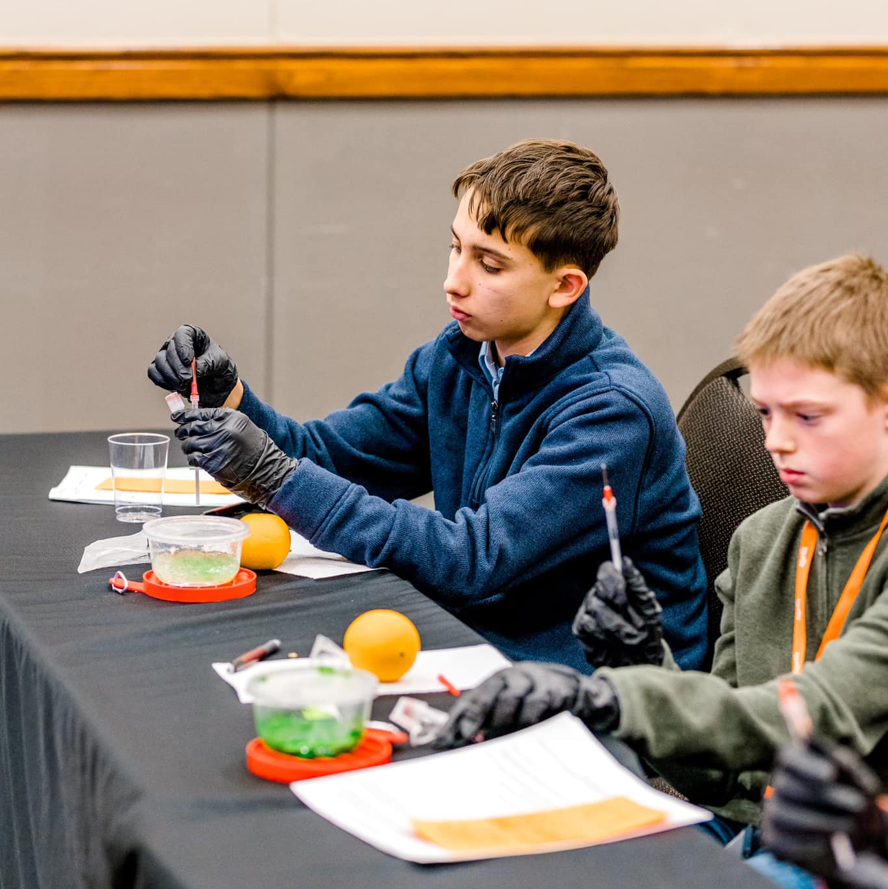
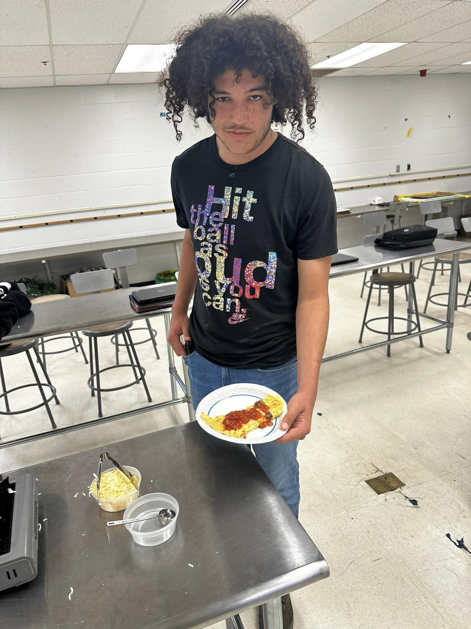
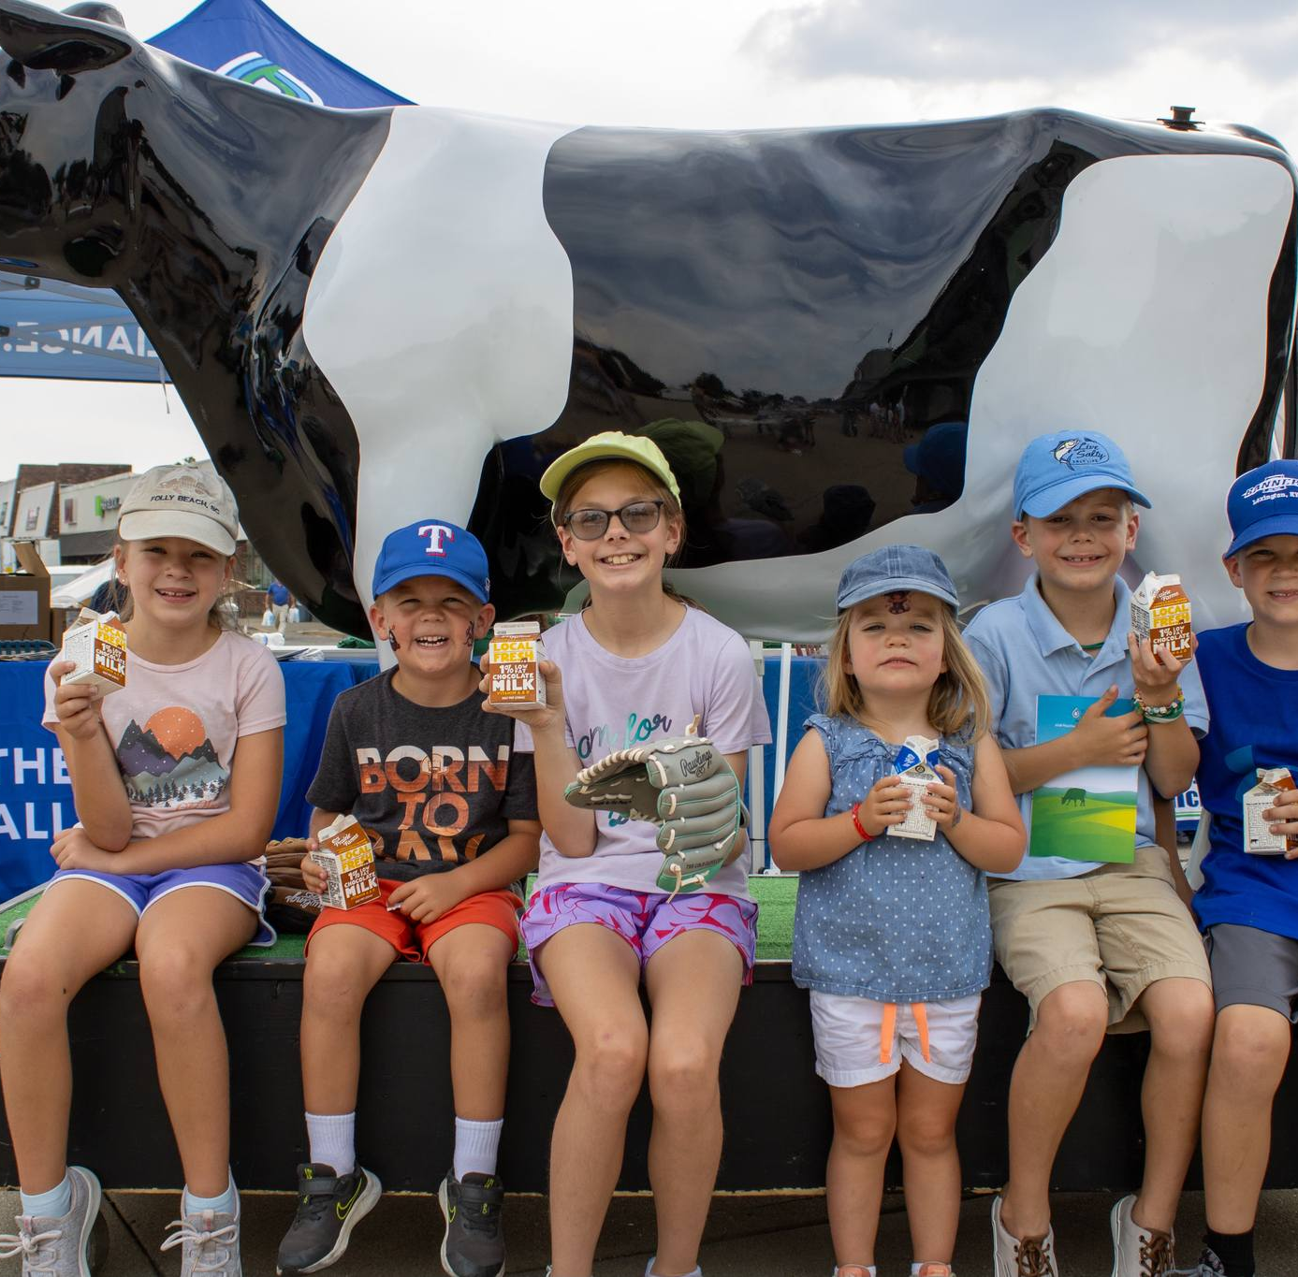
OPENING THE DOOR TO OPPORTUNITIES

Slide 12
Student Enrichment
Ag Student
Ag Classes
Ag Job
Non-Ag Student
Ag Classes
Ag Job
Non-Ag Student
Non-Ag Classes
Ag Job
Non-Ag Student
Non-Ag Classes
Non-Ag Job

Slide 13
Economic Development
OPENING THE DOOR TO OPPORTUNITIES
Increase packing capacity
Decrease food miles
Retain farmers
Grow more animals
Impact multipliers
Develop the region
Challenge
Decrease in farmers
Decrease in animals
Rising input costs
Rising age of farmer
Shift in business model

Slide 14
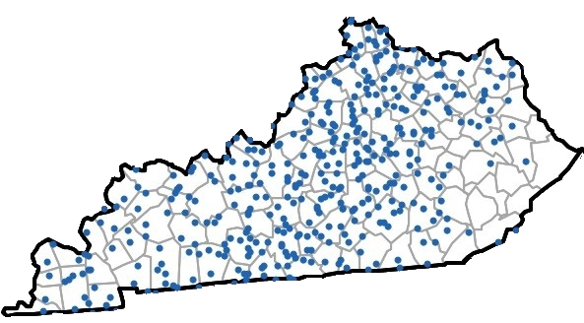
1 dot = 200 farms

Slide 15
“Don’t you have to actually- build the building?”
Soliciting Proposals
Construction Manager
Architect / Design
Oversight Committee
Partner Collaboration
Completion: Fall 2027

Slide 16
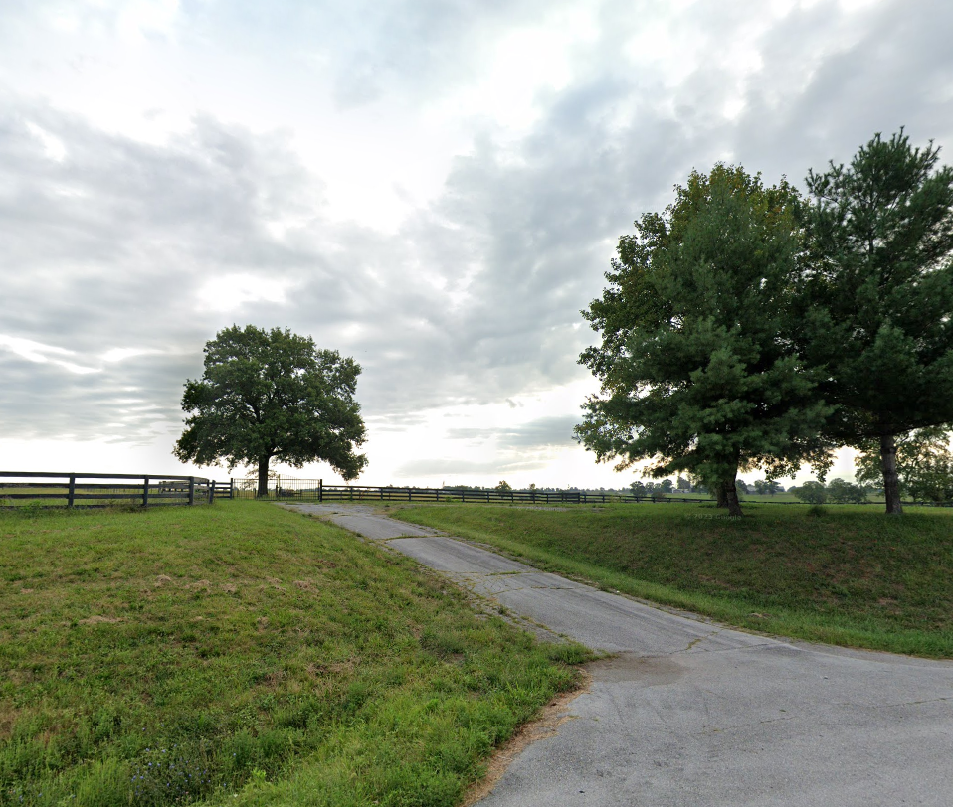

Slide 17
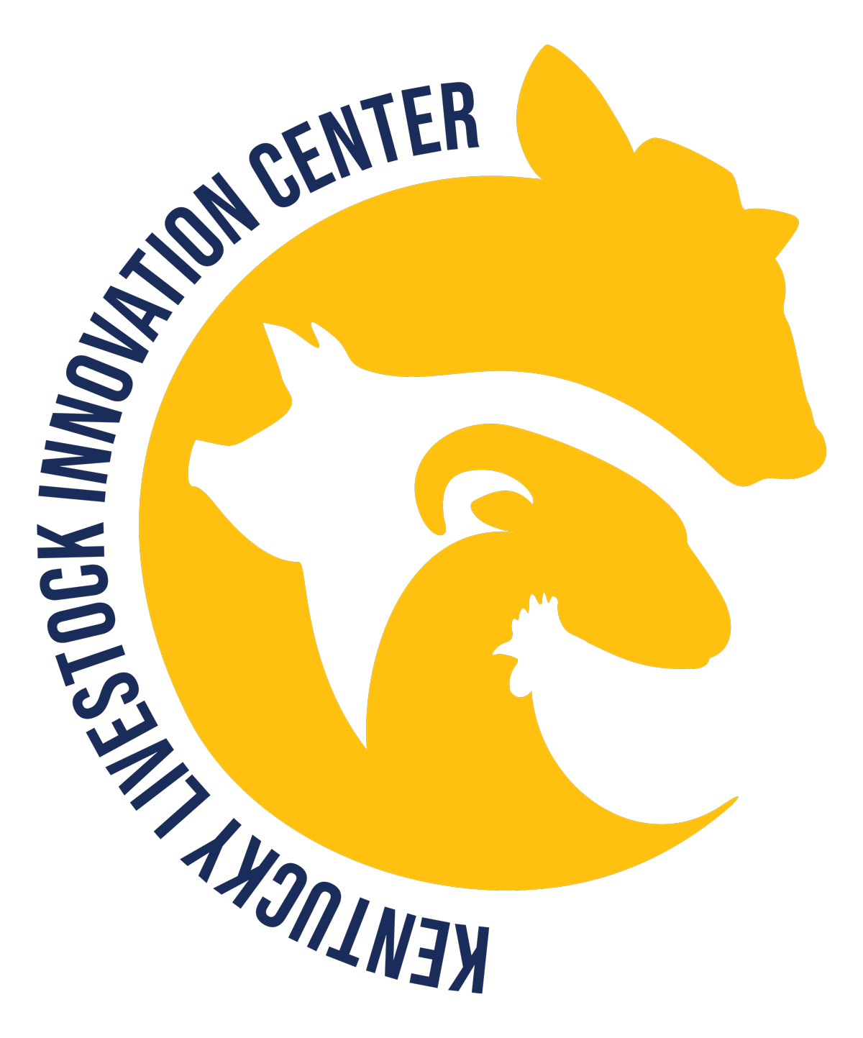
Kentucky Livestock Innovation Center www.livestockinnovationcenter.org

