Slide 1

HUTSON SCHOOL OF AGRICULTURE UPDATE
Fall 2024
Presented By : Dr. Brian Parr, Dean | 10/17/ 2024

Slide 2
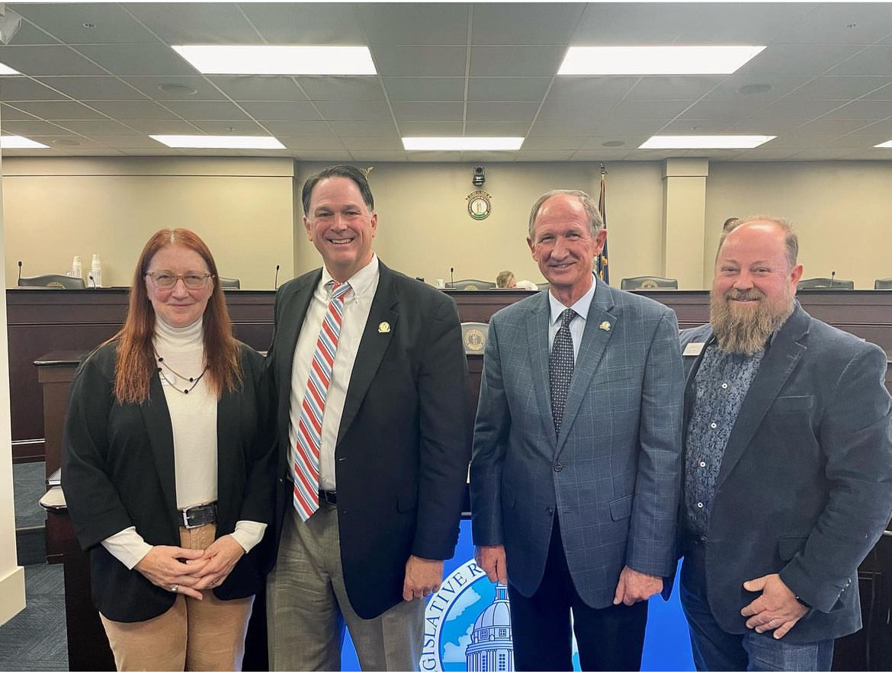
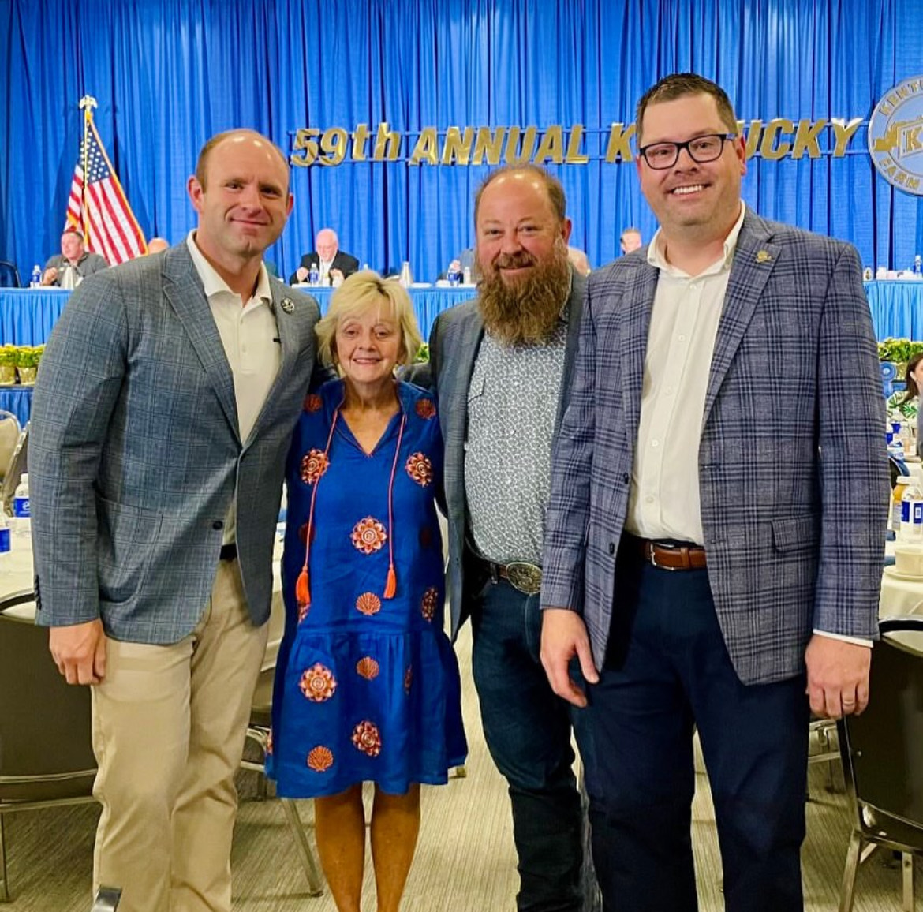
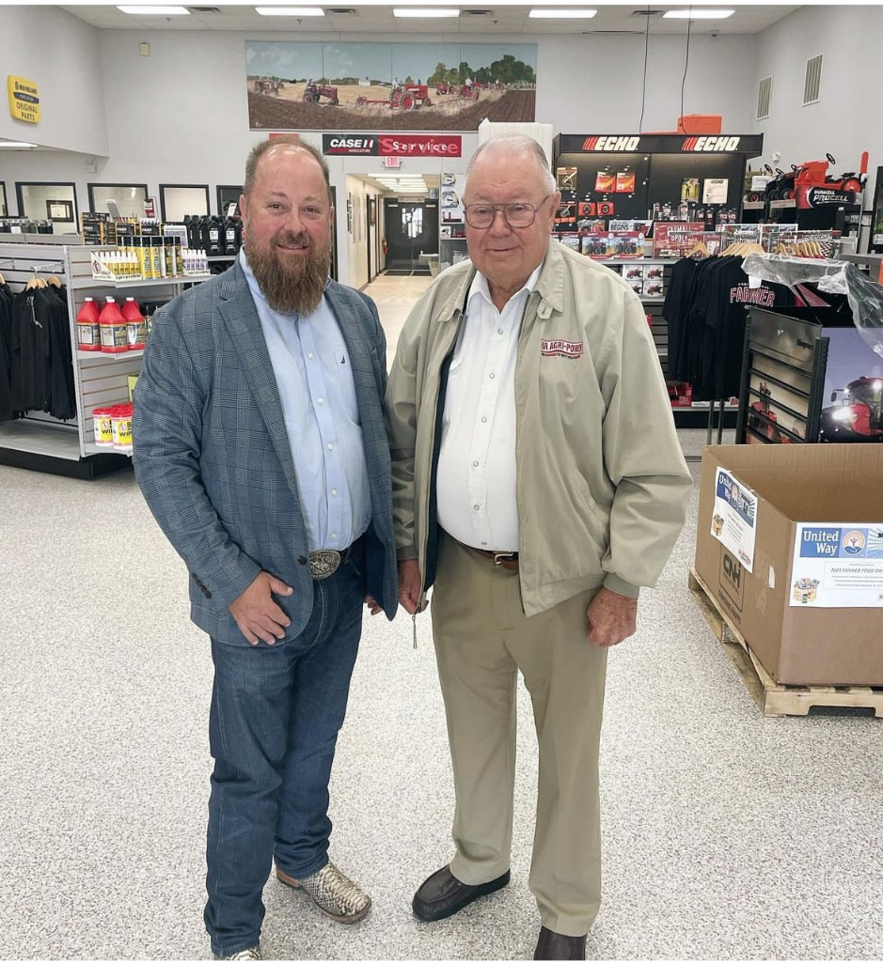
Thank You
First, thank you to the General Assembly for your continued support of the MSU HSOA
We cannot do our work without your support
Thank you also to our many HSOA alumni, friends and supporters throughout the state

Slide 3
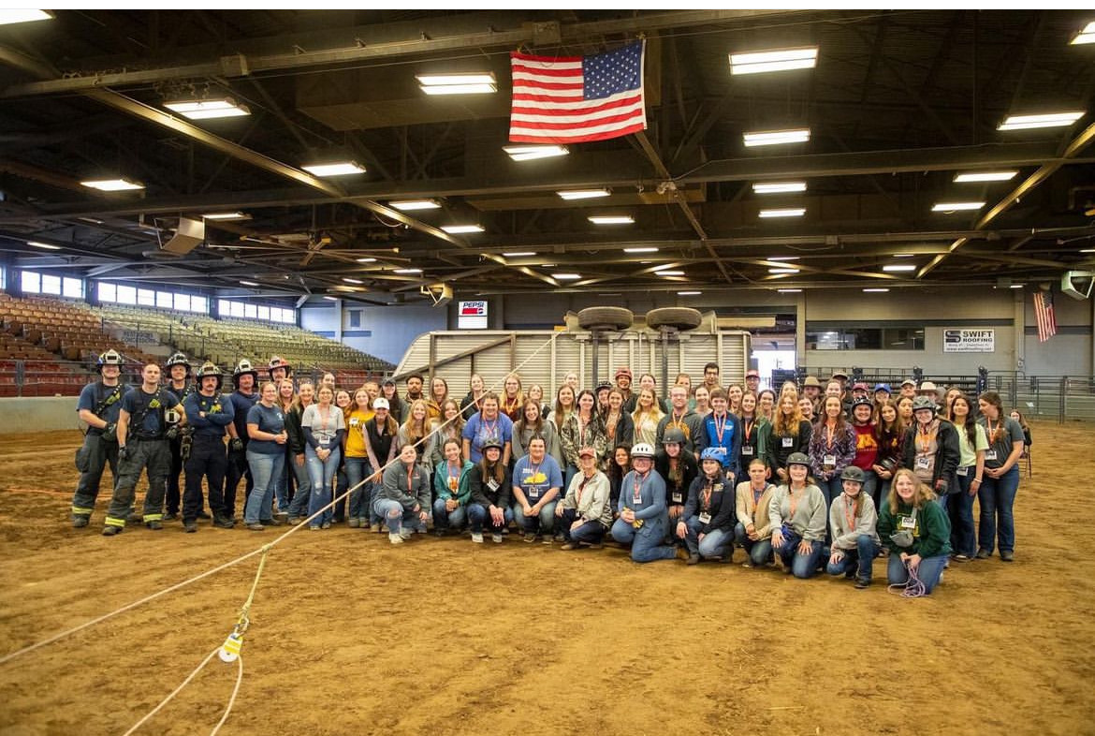
NEW FACULTY
Dr. Oliver Freeman- Assistant Professor
Agronomy
Dr. Lydia O’Sullivan- Assistant Professor
Animal Science
William B. Cherry Expo Center Director - Connie Gray

Slide 4
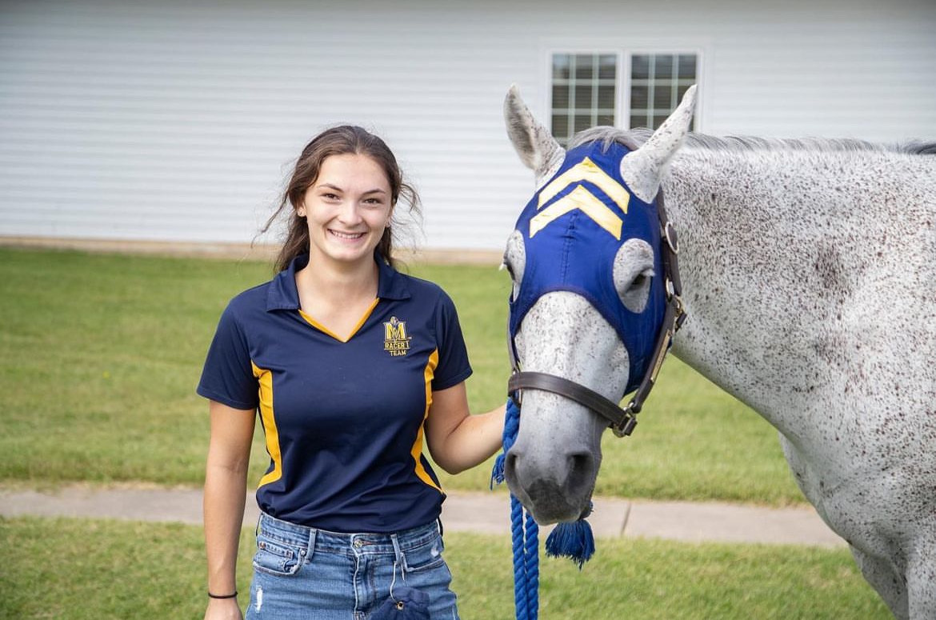
ENDOWED PROFESSORSHIPS/
Gifts
Hamm Endowed Professorship
Billie Garrett Endowed Professorship
Billie Garrett Endowment
Demp Alford Scholarship

Slide 5
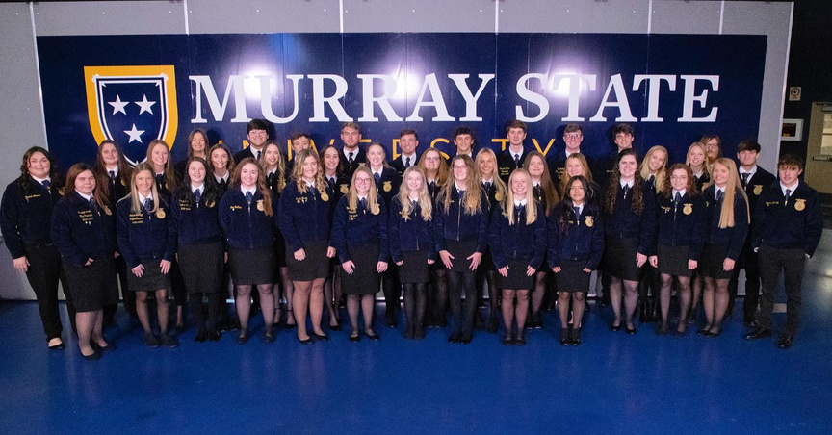
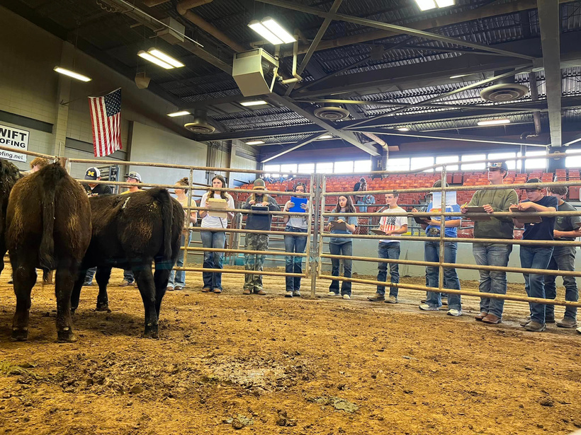
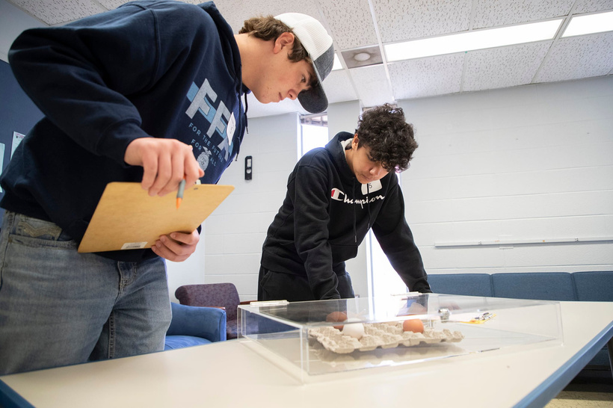
  High school visits, state, and national FFA convention, NFMS
  Hosting over 2,500 high school students per year on campus
  Enrollment for Fall 2024 over 1,300 students
  280 New Freshmen
RECRUITMENT EFFORTS

Slide 6
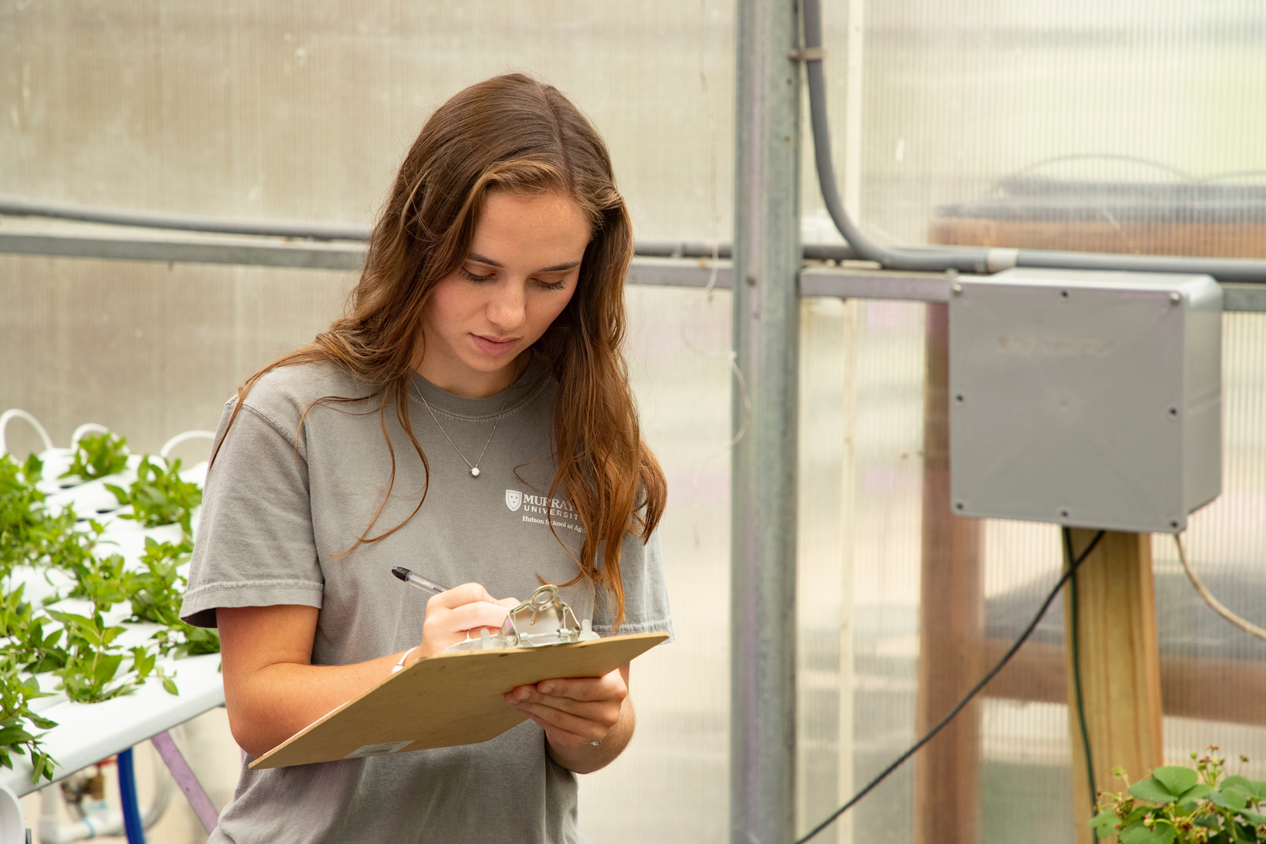
Graduate Enrollment: Over 240 students
  Masters
  Specialist (EdS)
  Doctorate (EdD)
  Online Options
GRADUATE PROGRAMS

Slide 7
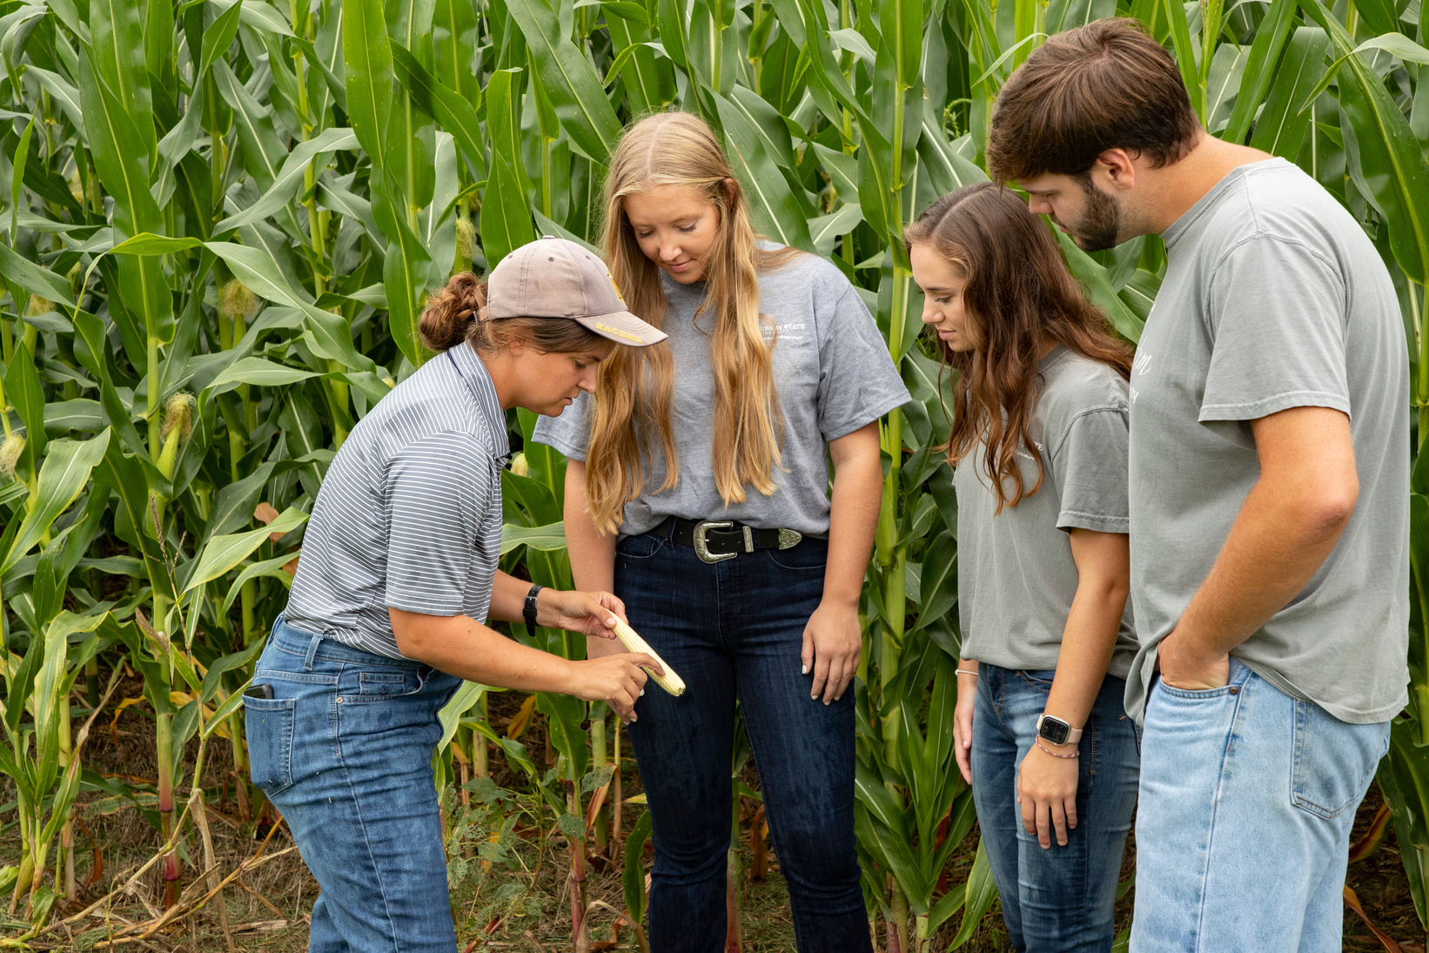
Partnerships with Industry/ Universities for Research & Education, AFA
  Bayer
  BASF
  Stine
  UK- Princeton
AGRICULTURE SCIENCE

Slide 8
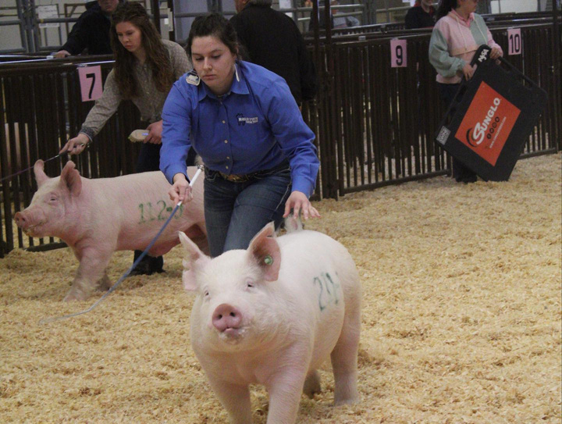
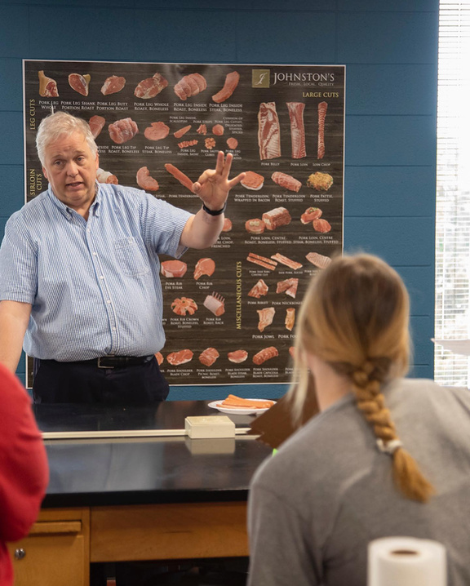
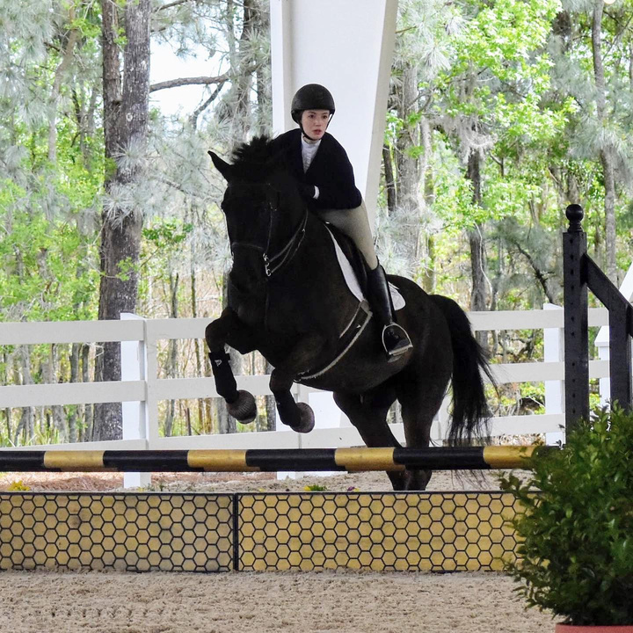
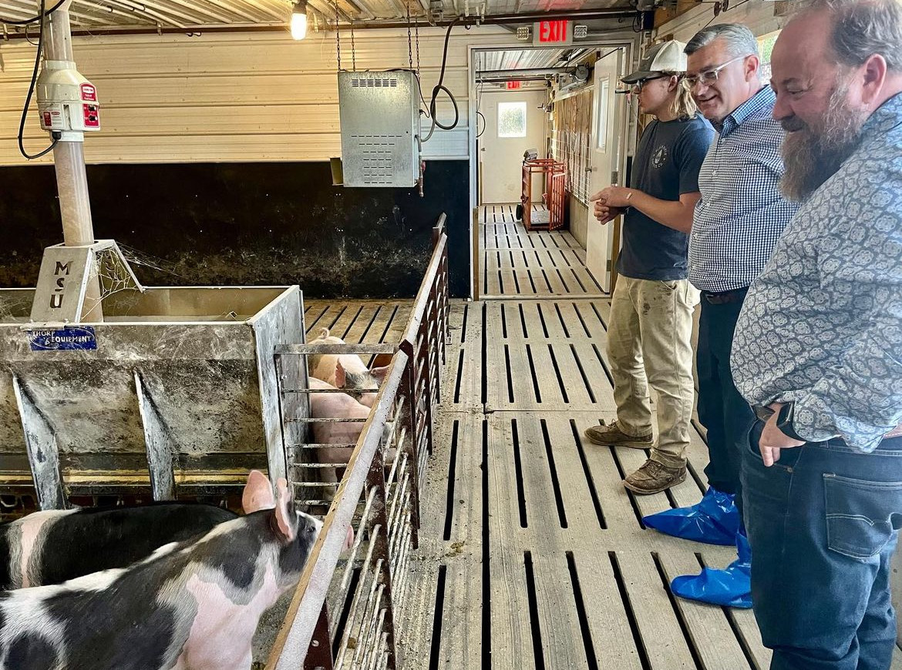
  Rodeo and Equine competitive success
  New articulation agreements for KCTCS
  Livestock judging team success
ANIMAL/EQUINE SCIENCE

Slide 9
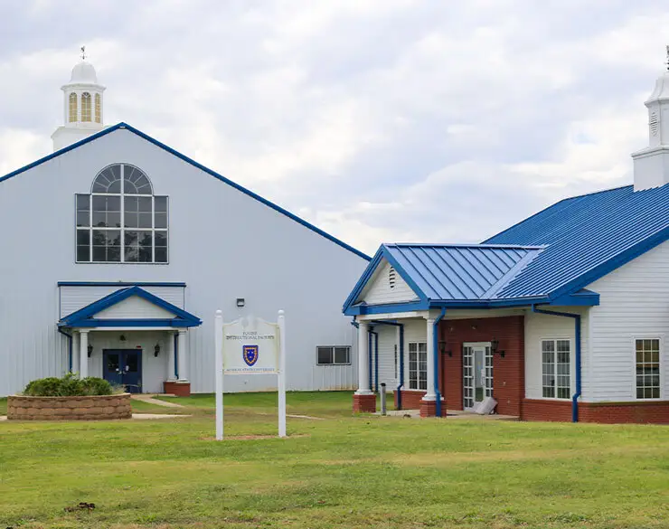
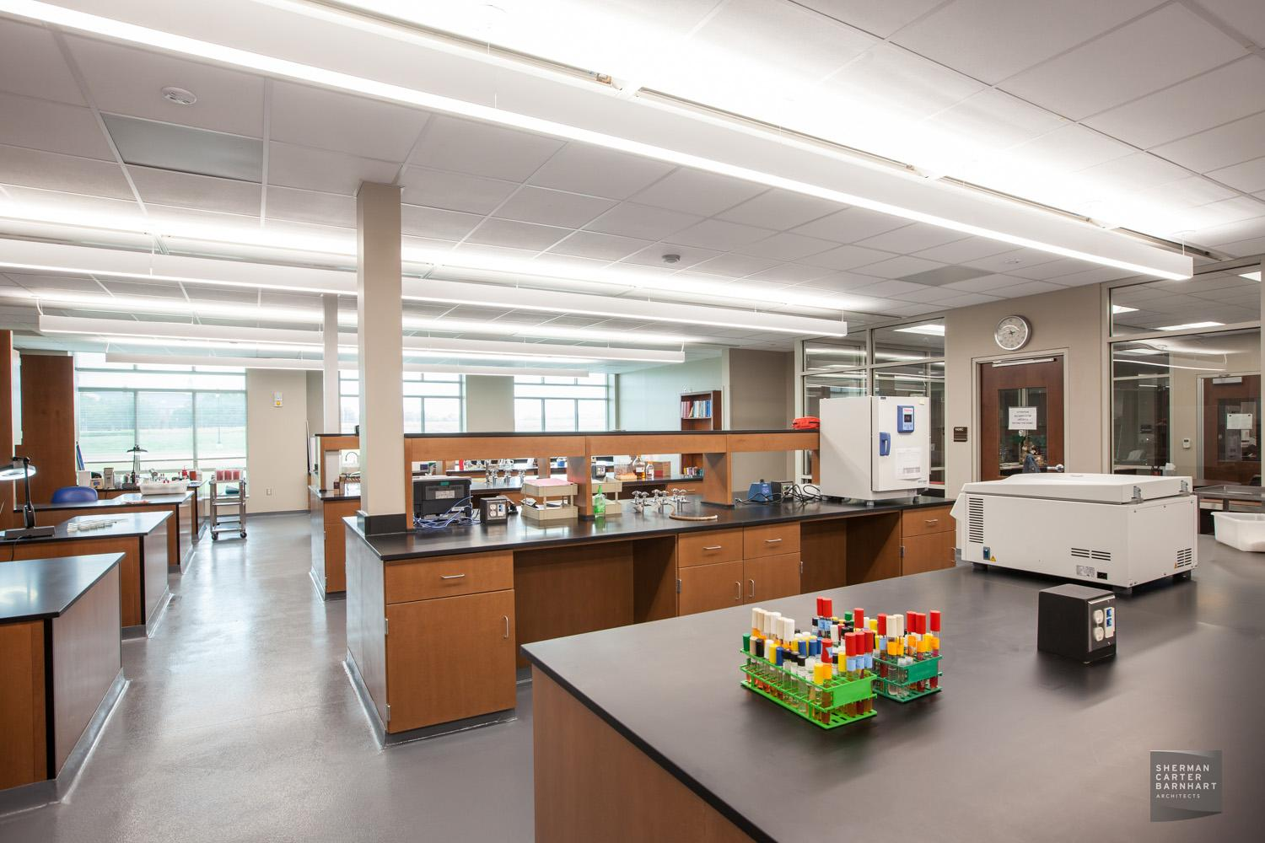
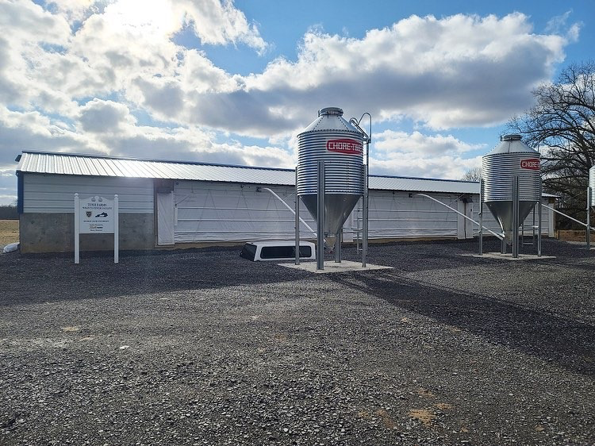
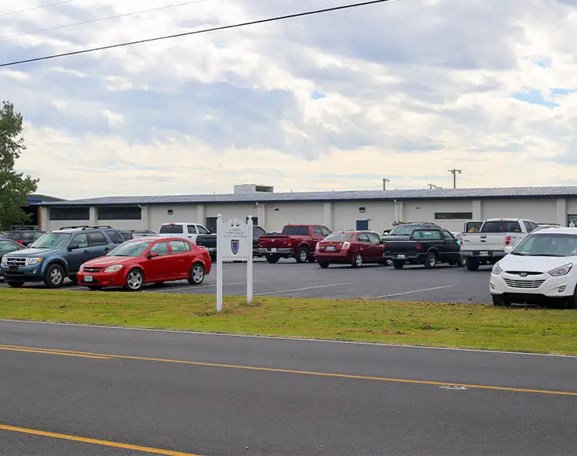
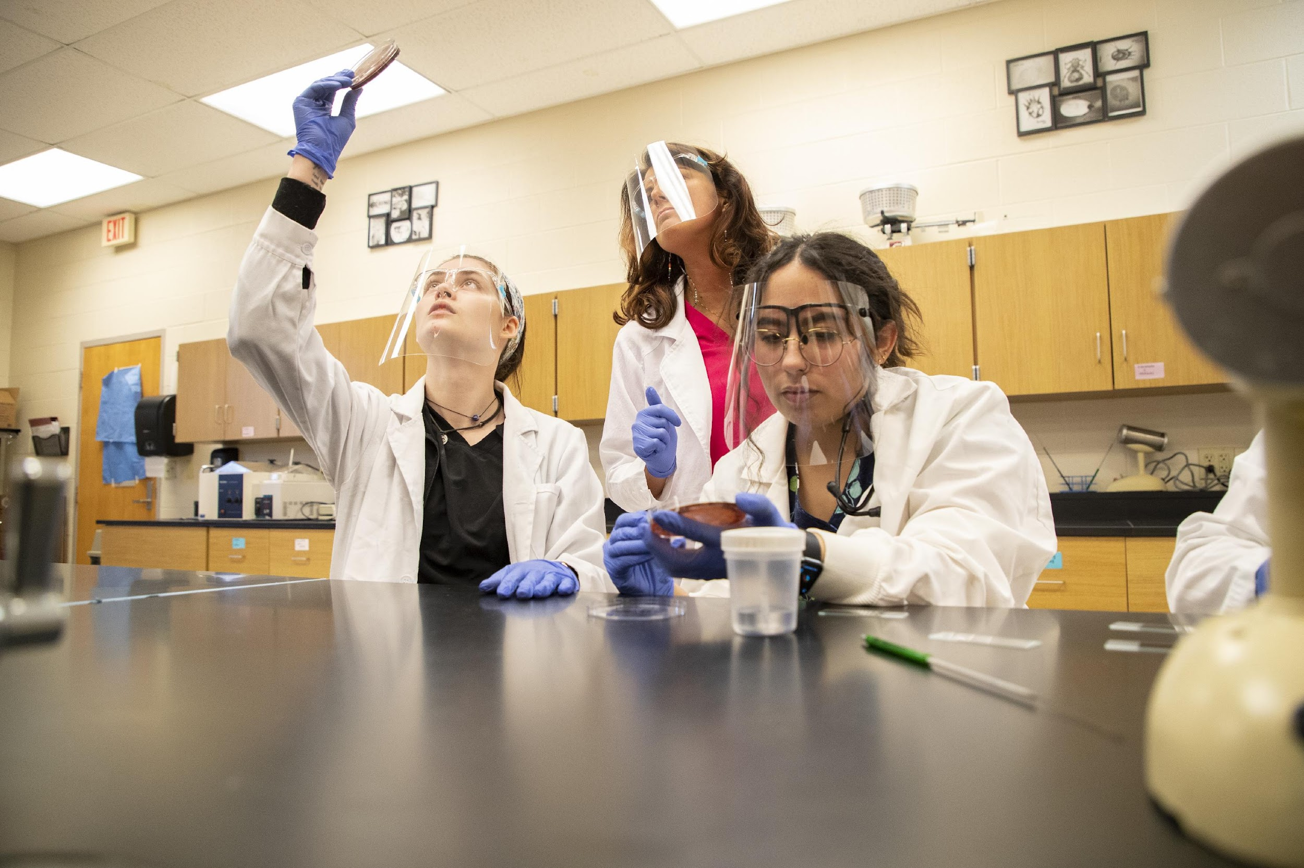
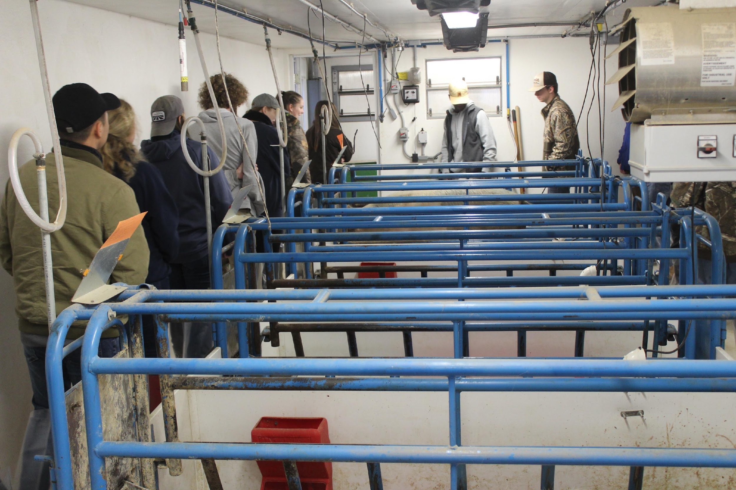

Slide 10
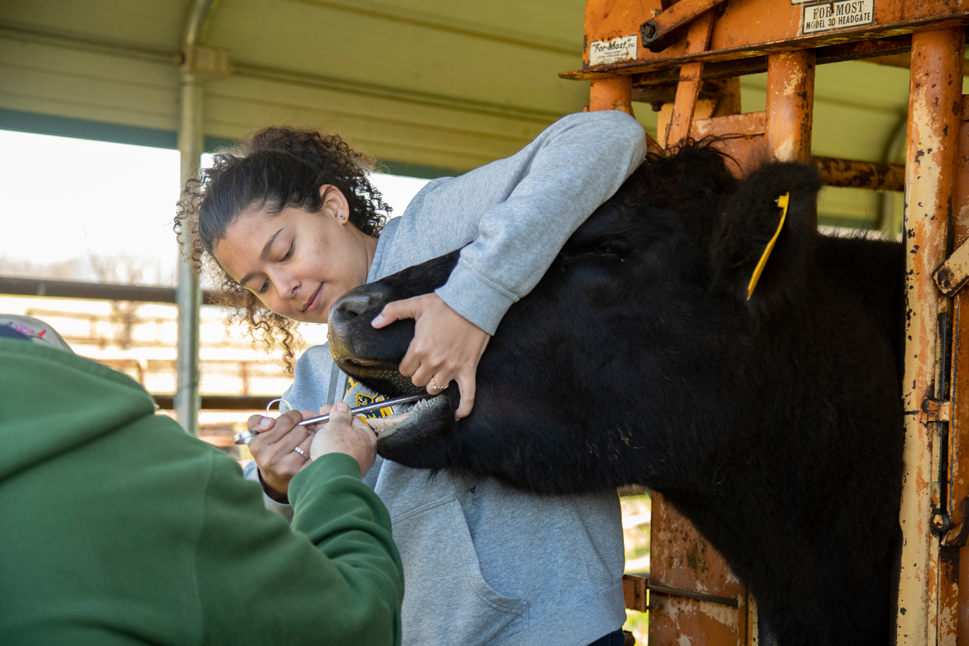
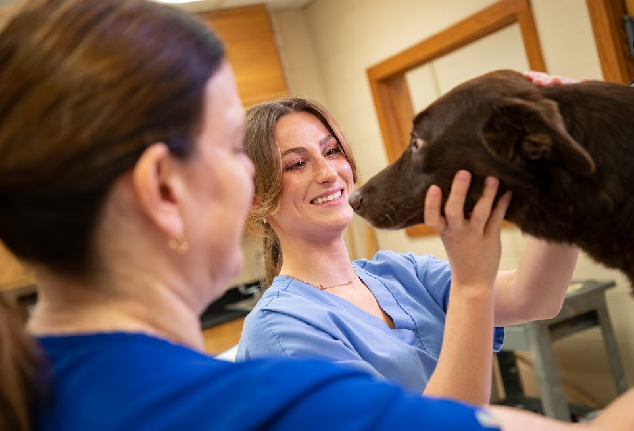
  New and innovative approaches to education
  Large enrollment for Fall : 463 students
  New facilities
  Hosted the 2024 American Collegiate Horsemen’s Association National Convention
PRE-VET/VET TECH

Slide 11
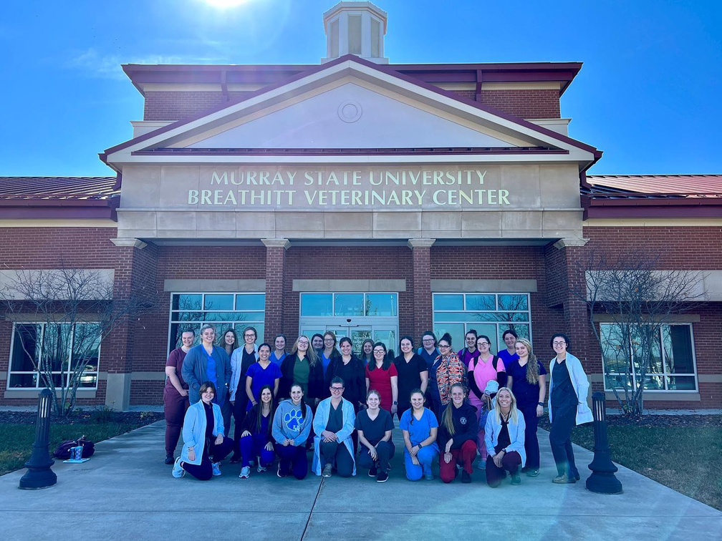
BREATHITT VETERINARY CENTER
  BVC has the only Biological Safety Level 3 lab space dedicated to veterinary diagnostics in Kentucky
  Fully incorporate BVC for all of our HSOA students

Slide 12
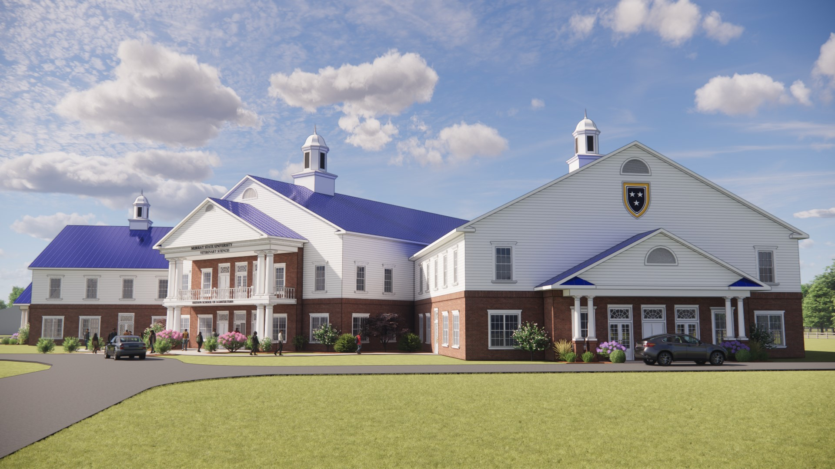
School of Veterinary Medicine Progress

Slide 13
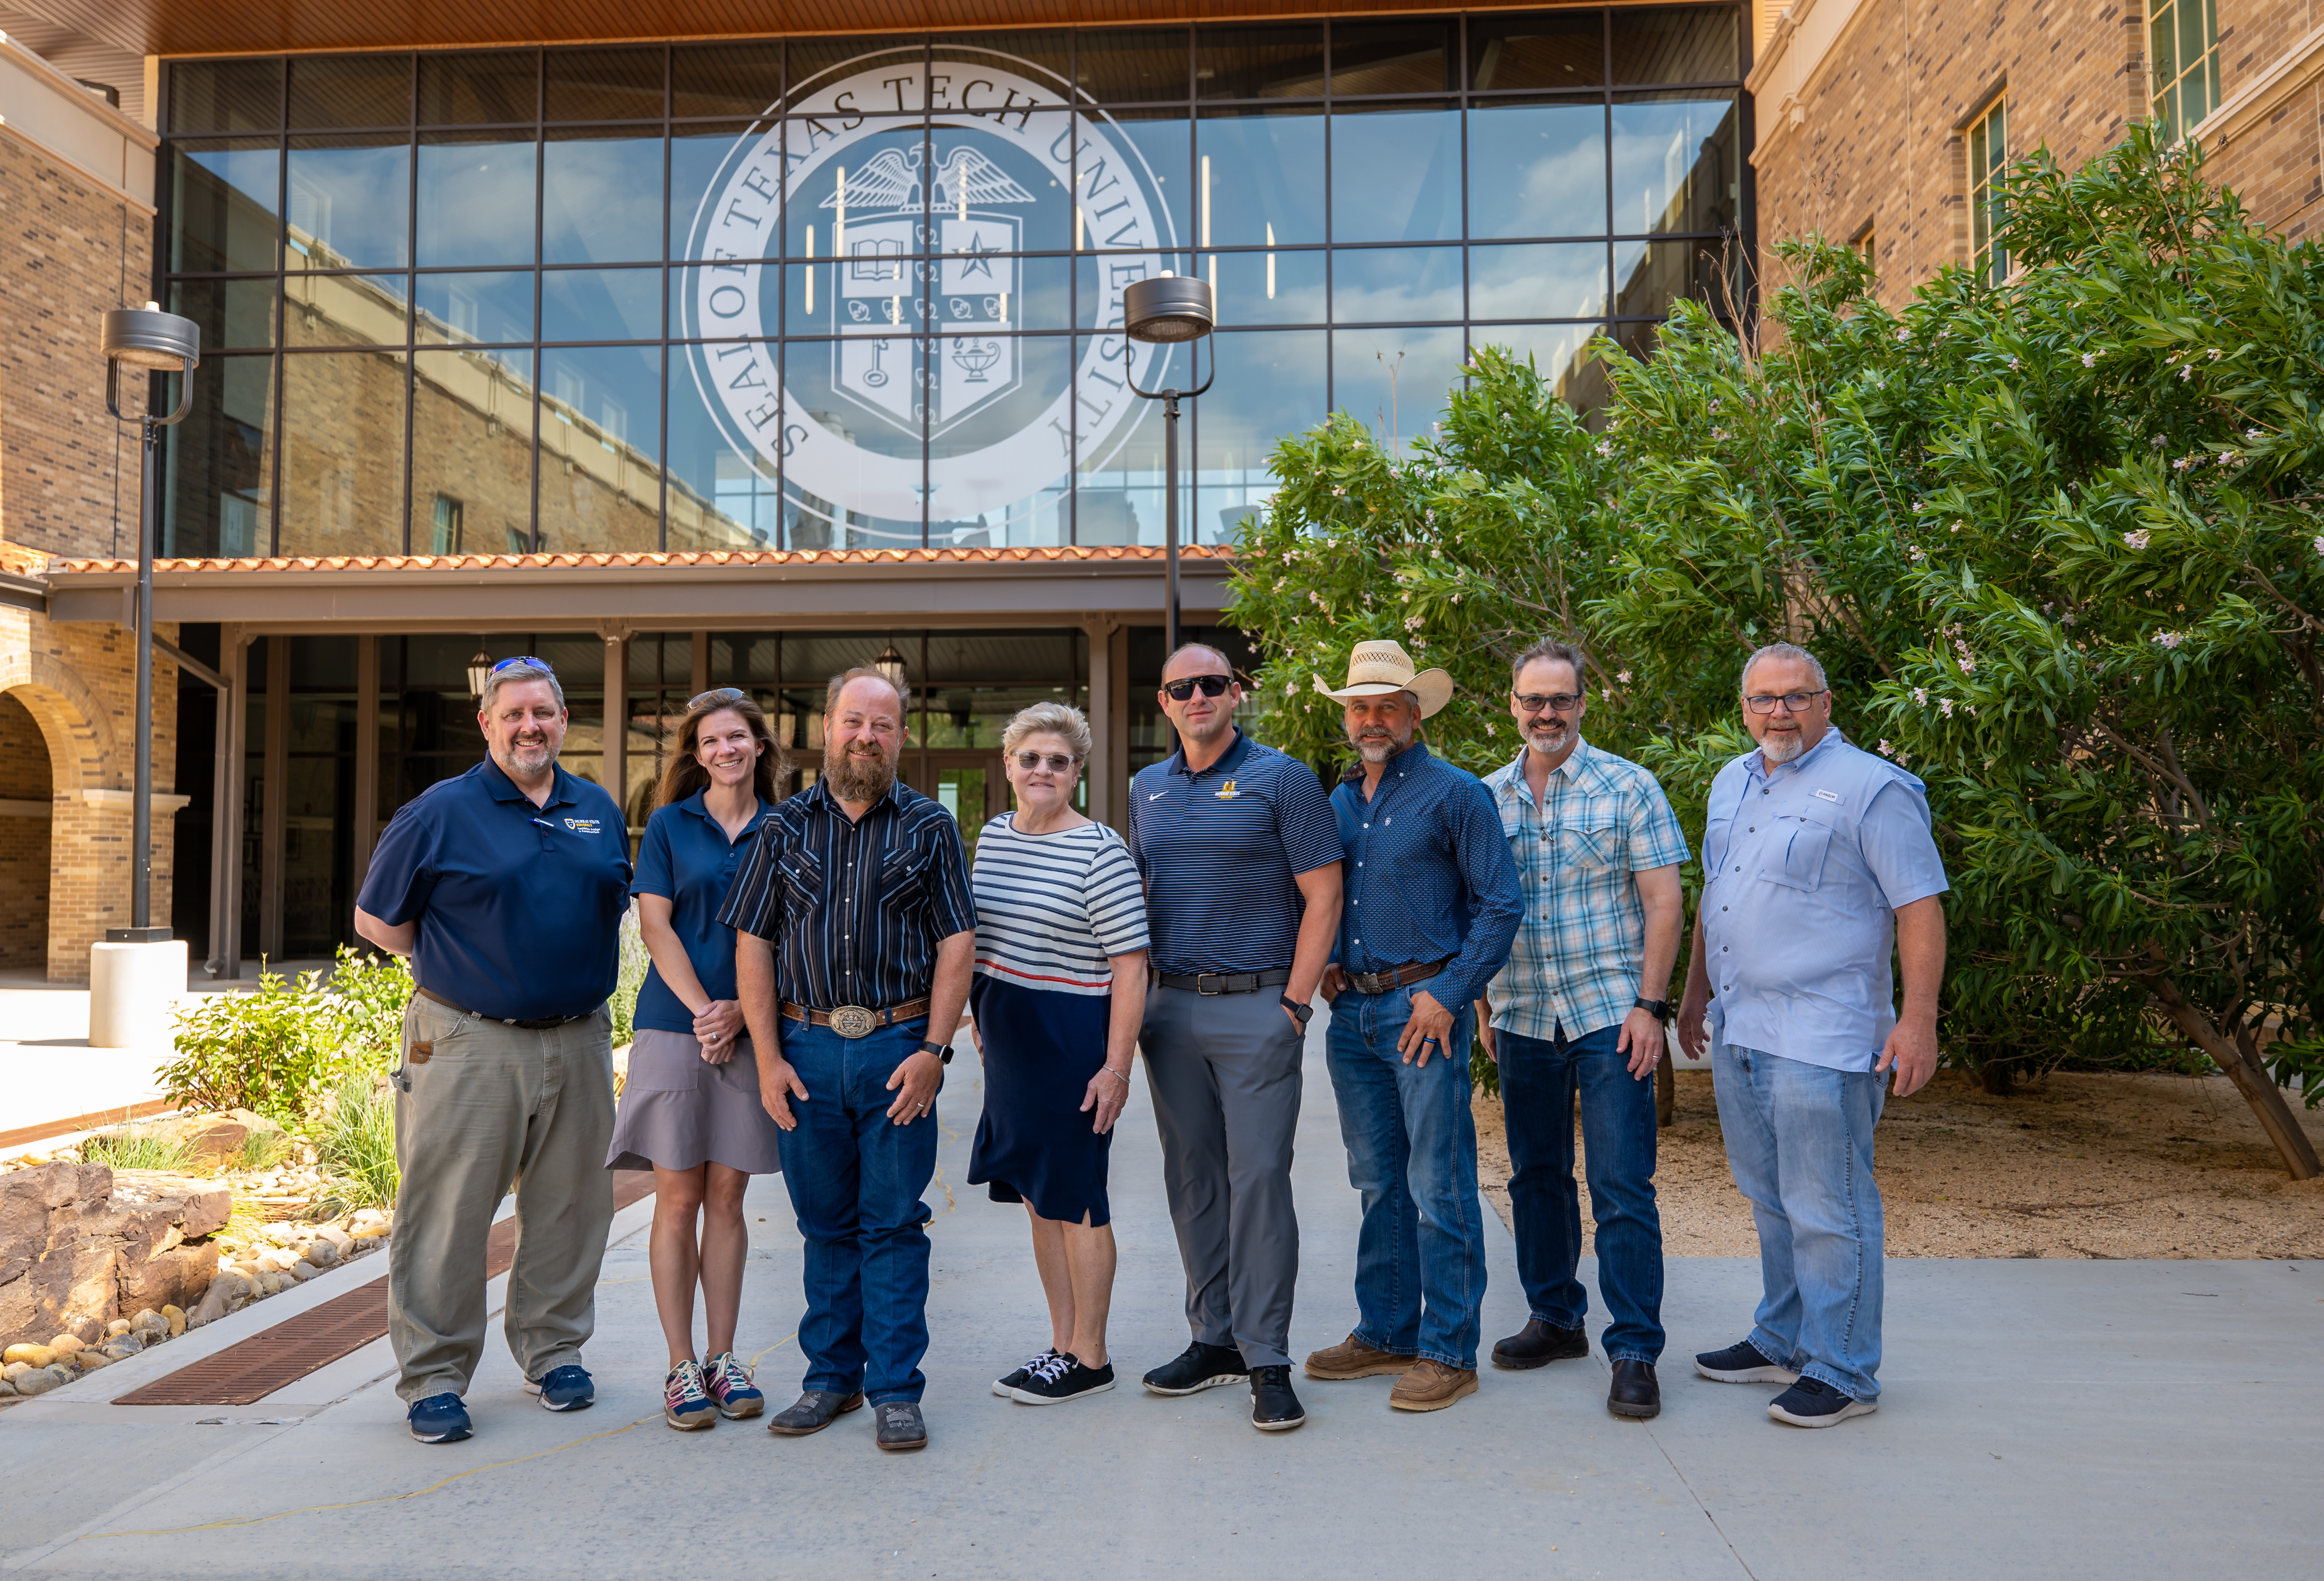
Veterinary Medicine Site Visits
  Long Island University
  Lincoln Memorial University
  Texas Tech University

Slide 14
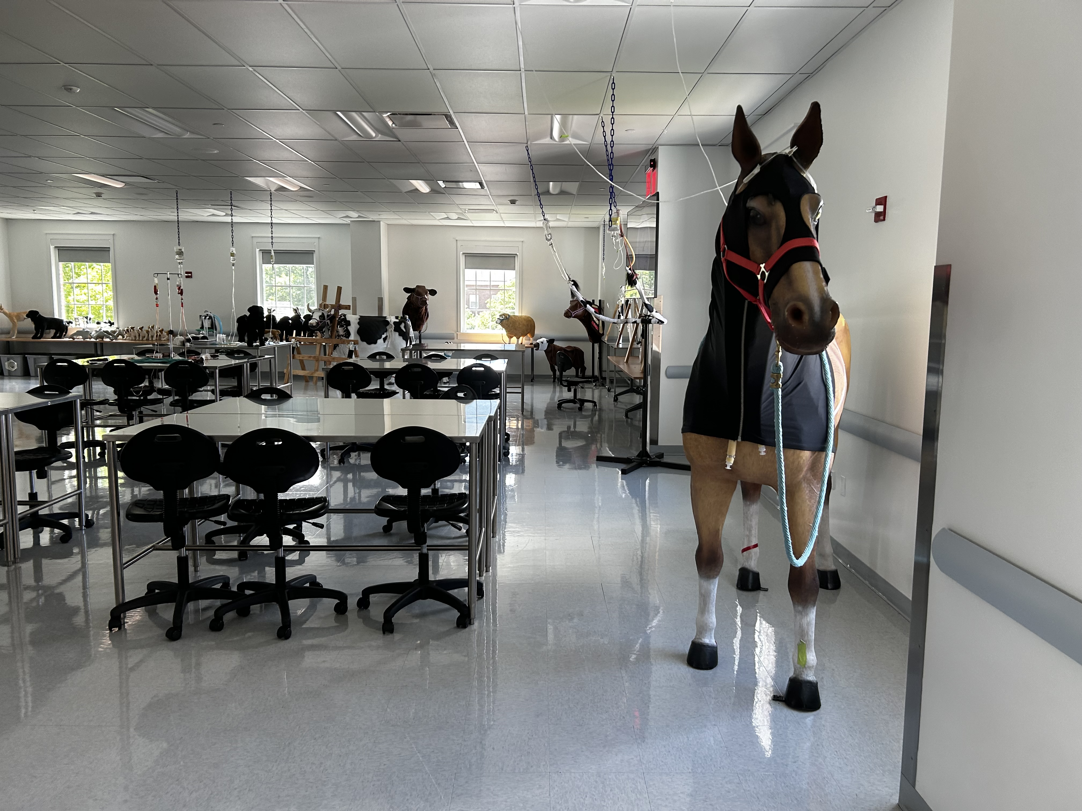
Long Island University

Slide 15
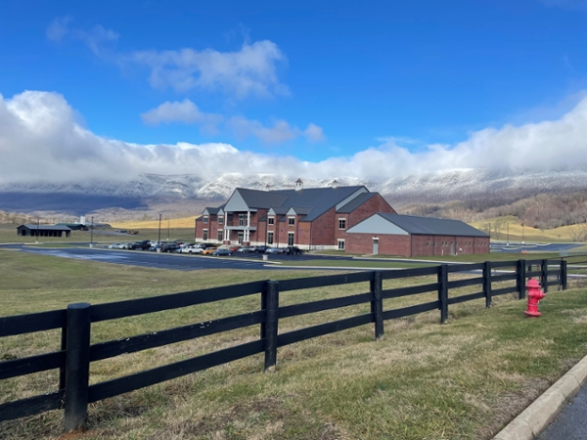
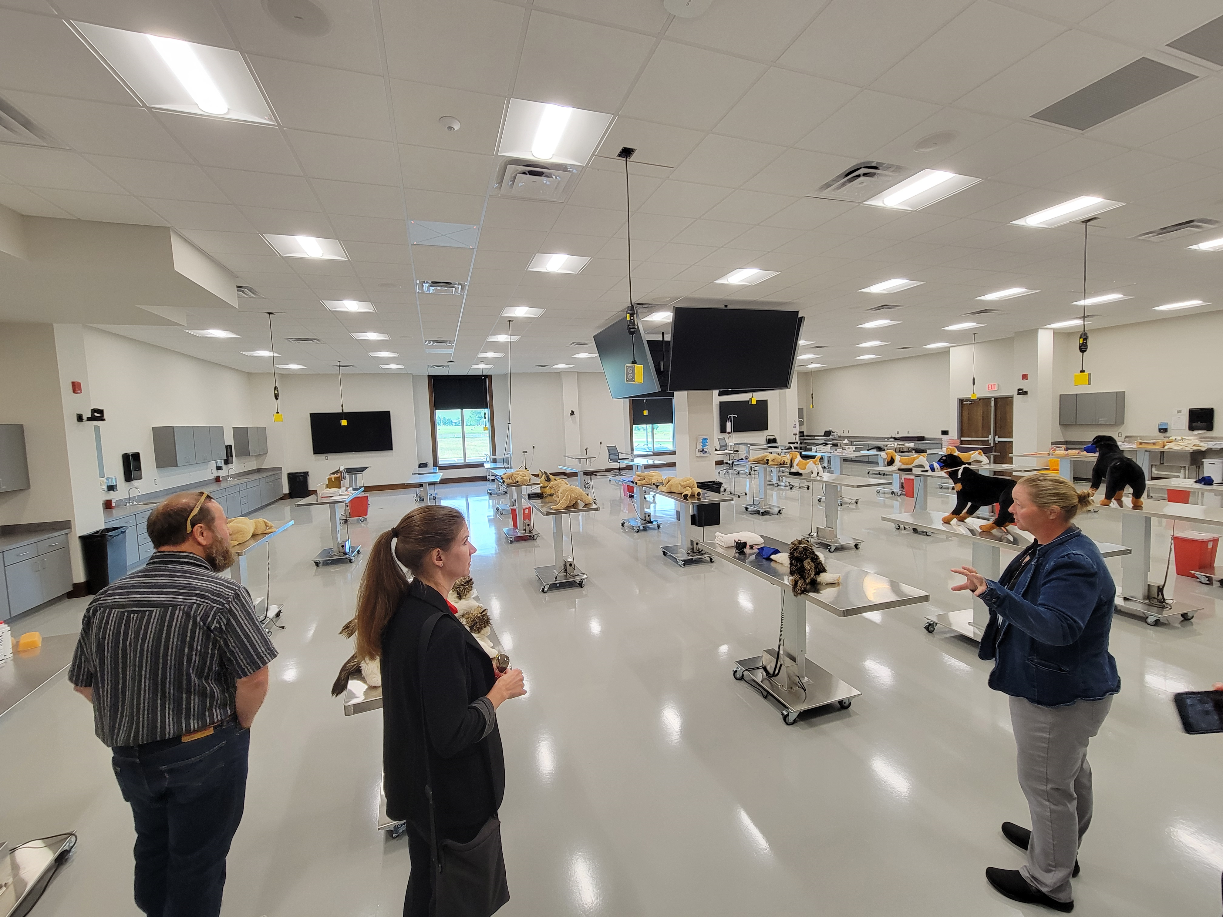
Lincoln Memorial University

Slide 16
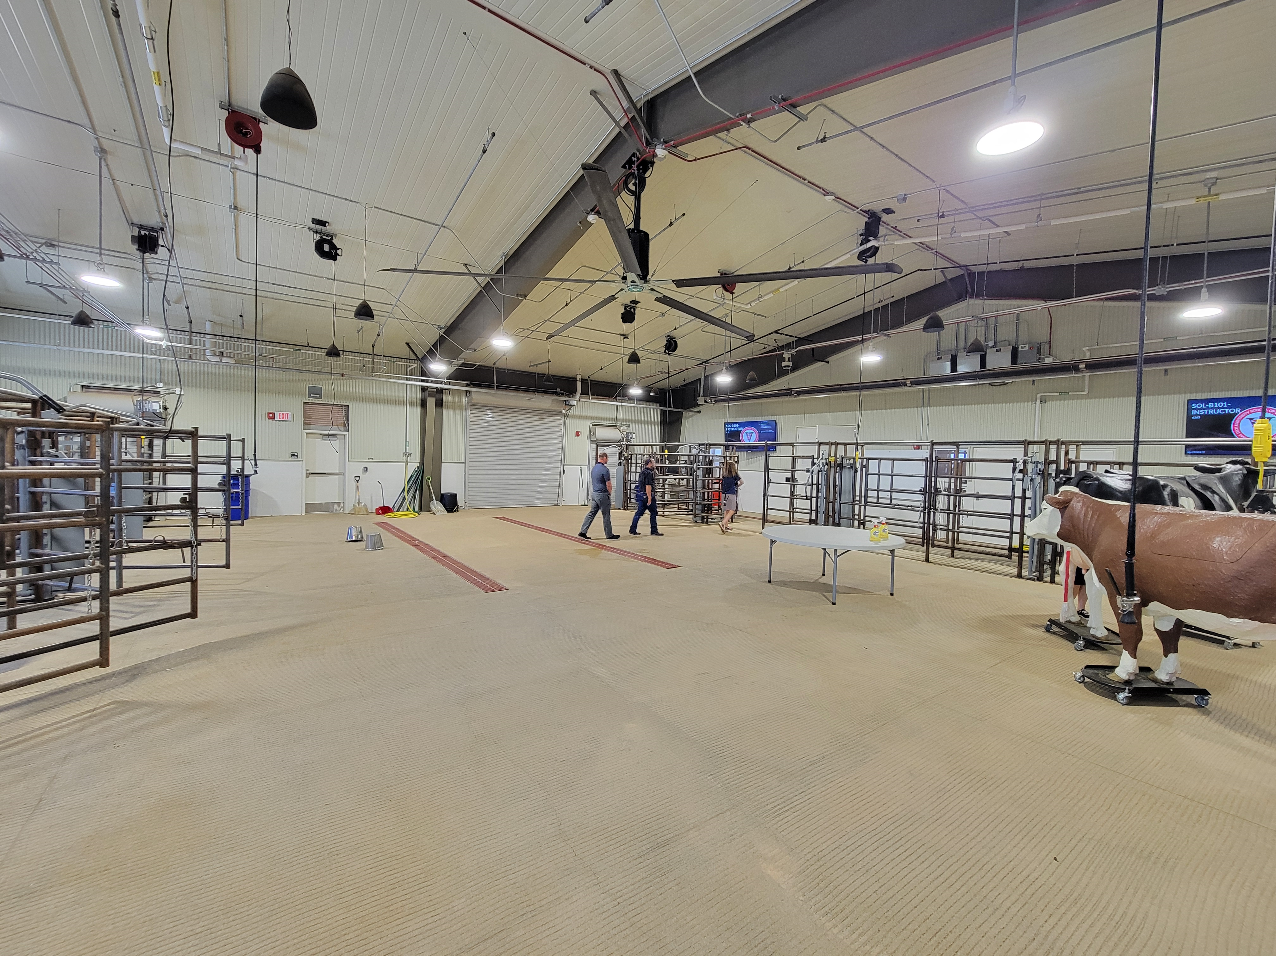
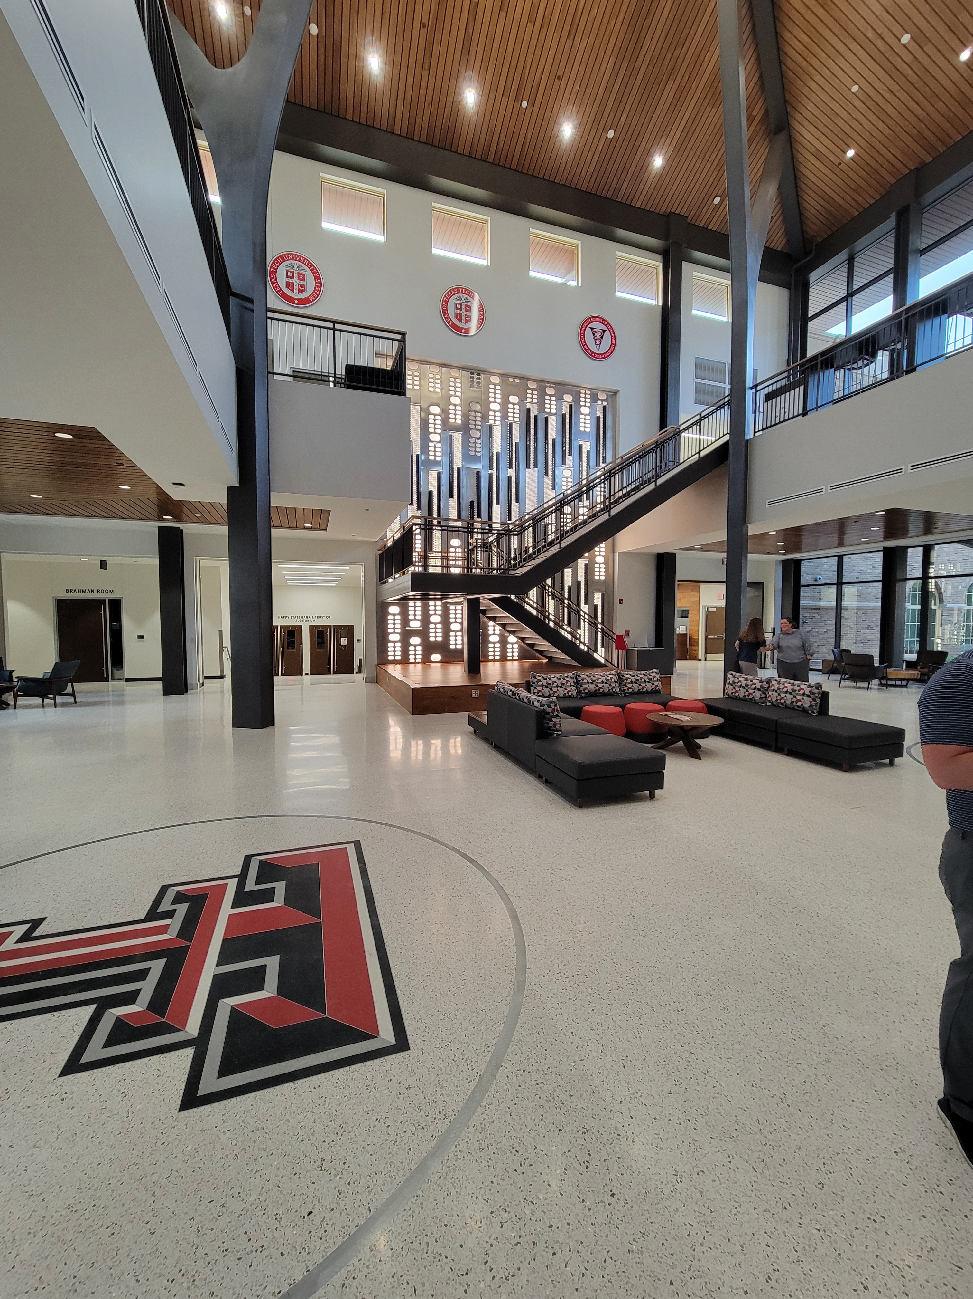
Texas Tech University

Slide 17
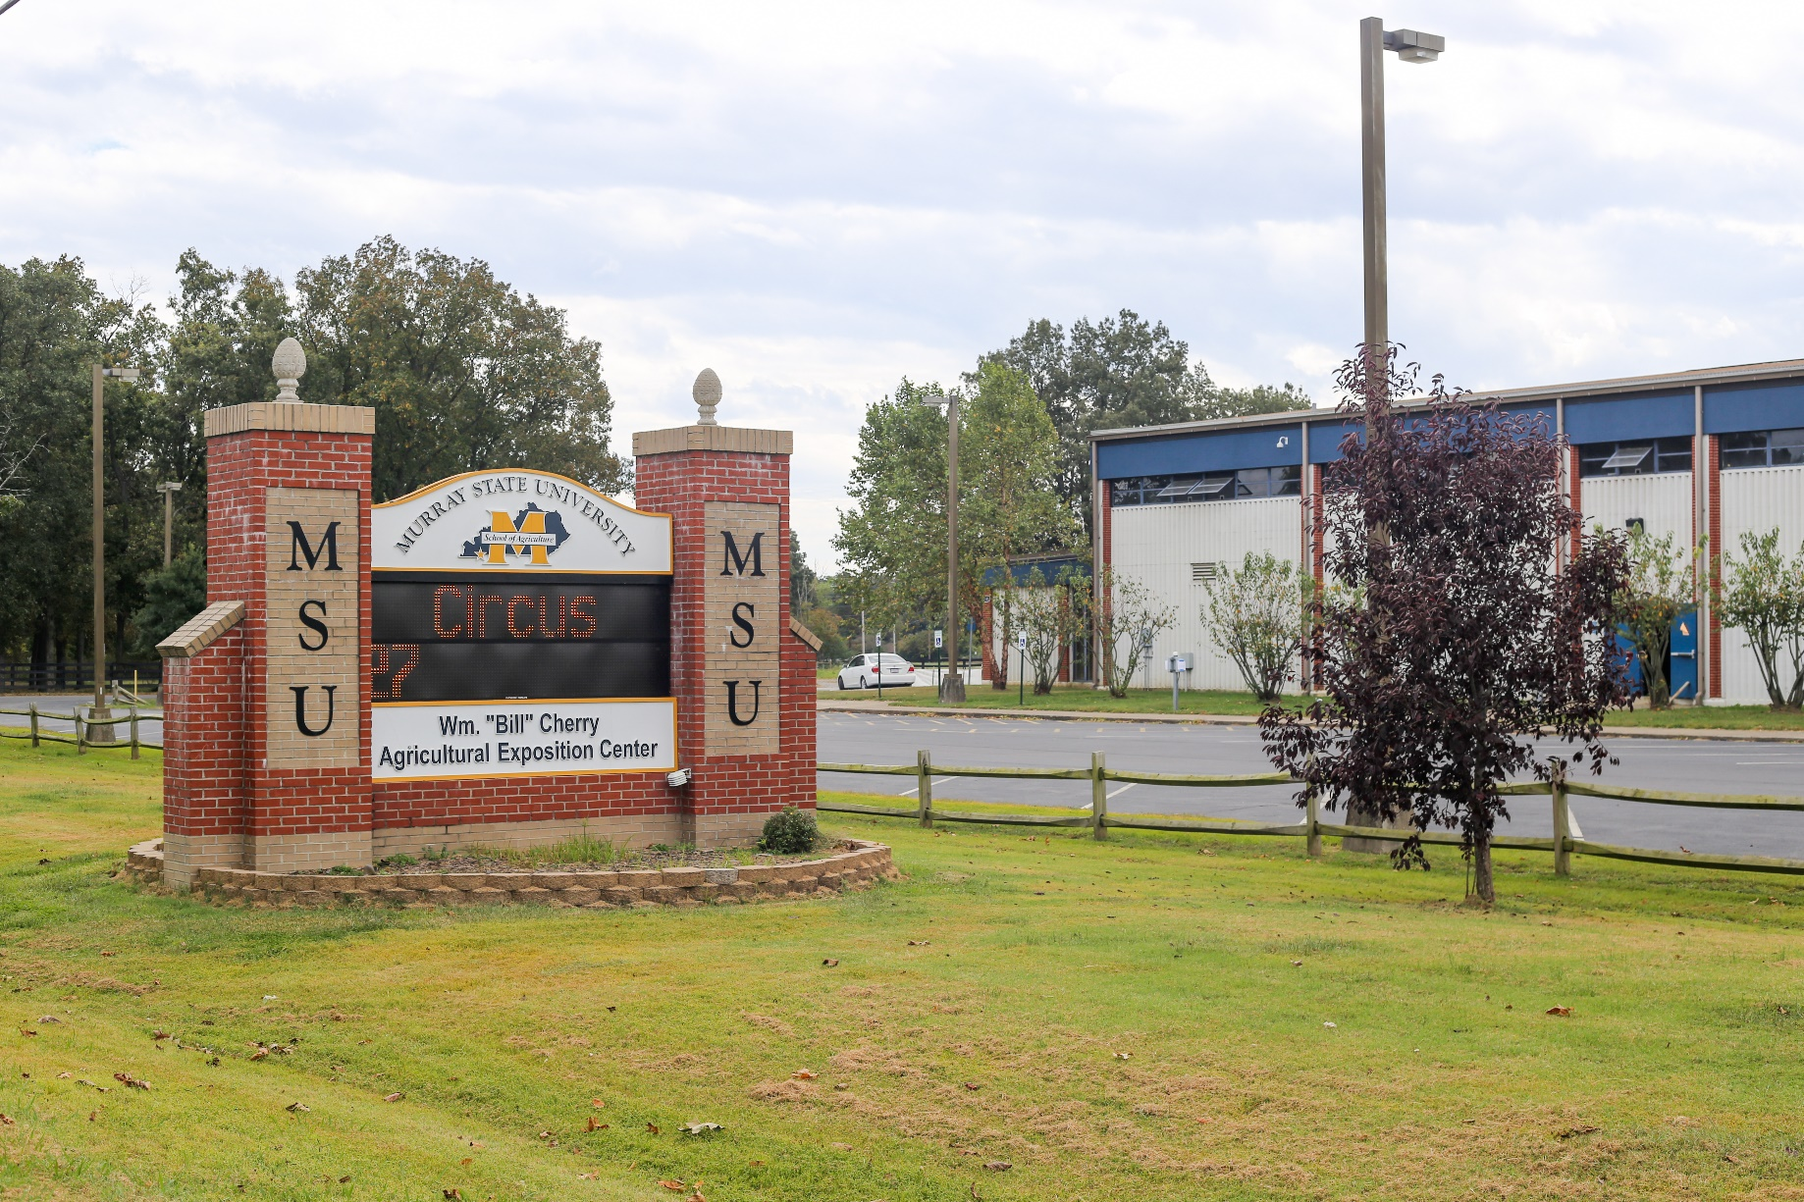
Senate Joint Resolution(SJR) 170
Per SJR 170, we are working closely with Deloitte, CPE and the General Assembly on the additional feasibility study
Site Visit - 10/2/2024

Slide 18
Continued work on the School of Veterinary Medicine Proposal
Parents, Students, Community Members Strong Support
4 Year vs. 3 year Model
Veterinarian Collaborators

Slide 19
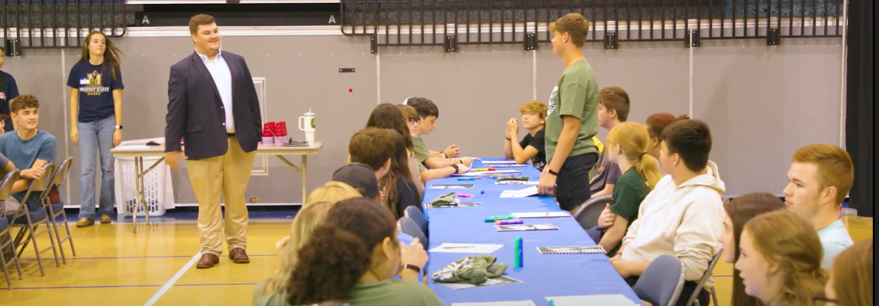
How Do We Get them to Stay in KY and Practice in Rural Areas- The Grassroots Approach
We must identify rural youth with desire and potential in 10th grade
Continue to deliver dual credit sciences and support to those students
Bolster the veterinary pipeline in Kentucky with capable Vet School applicants

Slide 20
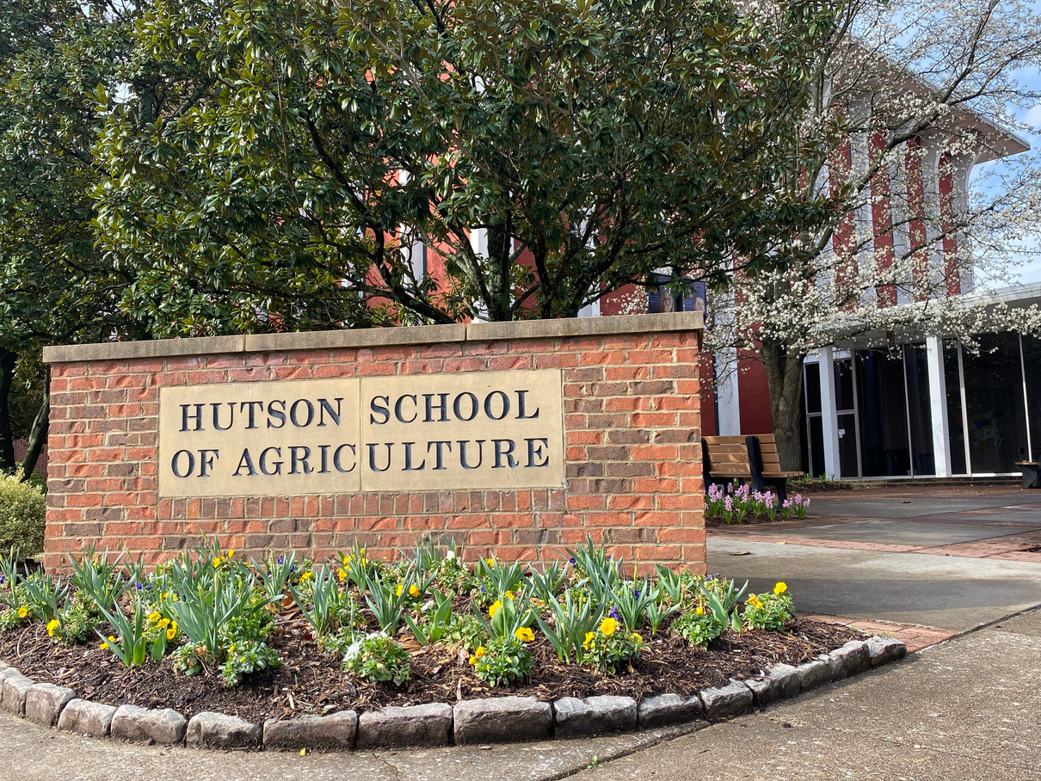
How Do We Get them to Stay in KY and Practice in Rural Areas- The Grassroots Approach
Admission to MSU Vet School criteria clearly defined and transparent
Reduce the debt burden
Tuition Model - lower tuition and fees than KY students currently pay to attend Auburn.
Considerably less than several private schools

Slide 21
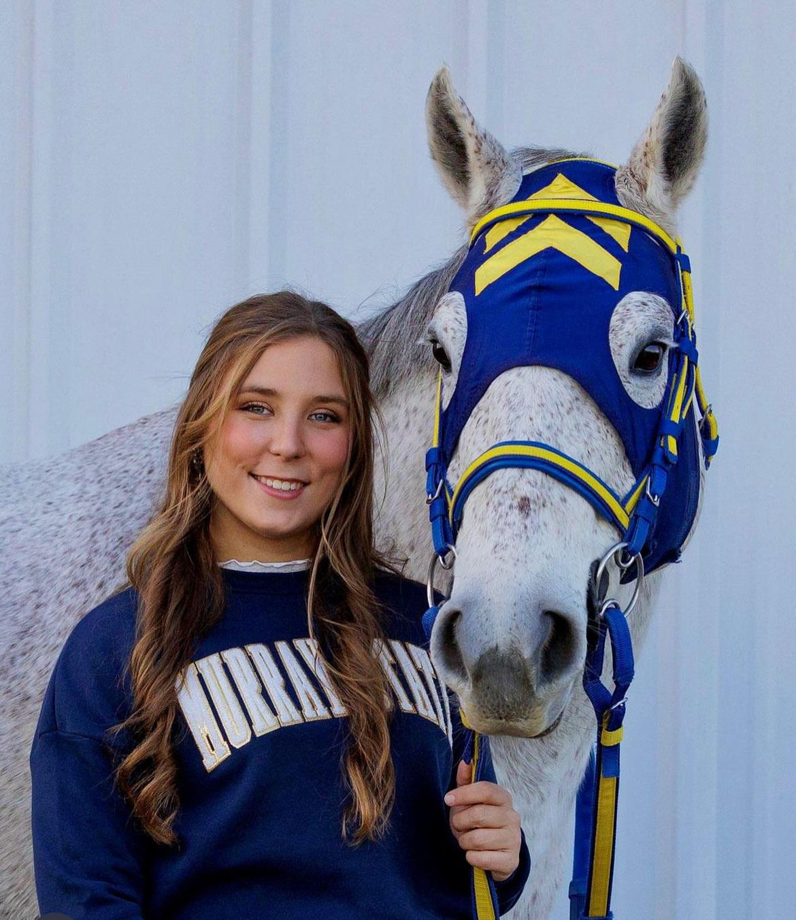
Vision for the Future
  Achieve College Status
  Oakley Applied Science Building Renovations
  Construction of the new Veterinary Sciences Bldg
  School of Veterinary Medicine at MSU

