Slide 1
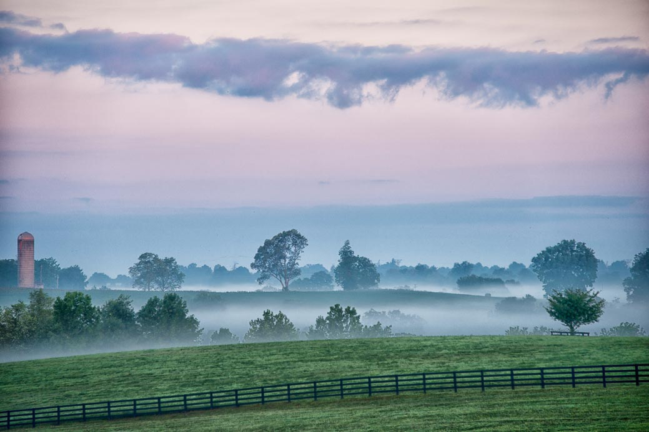

Slide 2
Mission
To protect land in Kentucky’s Bluegrass region through permanent conservation easements.
Vision
A thriving community where land is protected to sustain our identity, economy, and quality of life.
Natural Habitat
Historic
Equine
Cropland/Food
Cattle
Fresh Water
Notes:
Bluegrass Land Conservancy is a non-profit land trust. We work with landowners across the Bluegrass on a voluntary basis to permanently conserve their land for future generations.

Slide 3
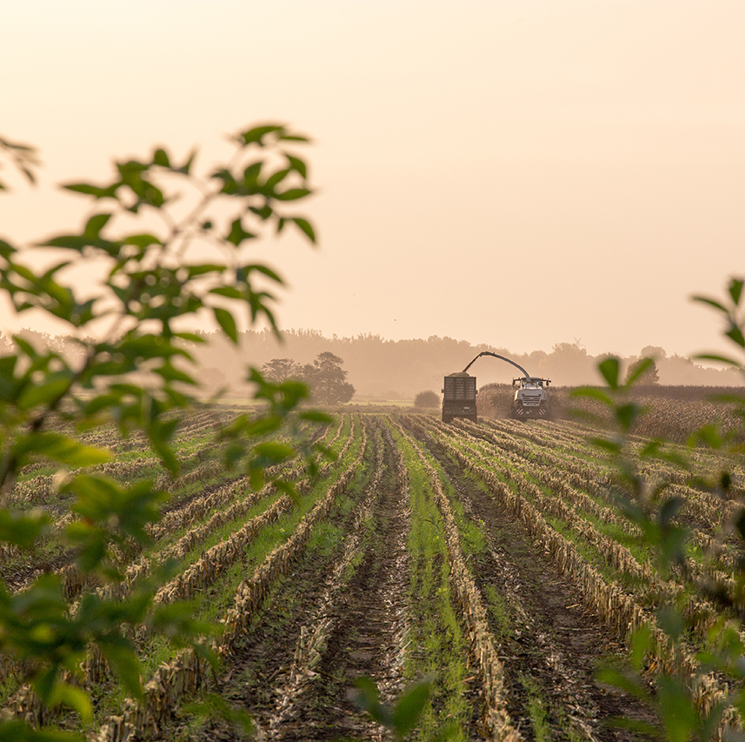
In the last 20 Years, KY has lost
1.4 Million Acres of Farmland
10% of State’s Total
17,000 Farms
20% of State’s Total
12 acres per day of Forest land

Slide 12
BLC USDA Program Status Summary
NRCS Easement Programs
ACEP
$19.5M
Farmland Single Easements
RCPP
$45.7M
Diverse Land Areas
Farm Bill Funded
$7.6M
Palisades
Farm Bill
$22.8M
Louisville
IRA Funded
$22.8M
IRA Funded
$12M
11 Projects, 2,421 Acres
Projects Contracted
Funding Not Frozen
Expect These to Close
10 Projects, 3,000+ Acres
Projects Not Contracted
Funding Frozen
20+ Projects, 10,000+ Acres
Main Contract Complete
Projects Not Contracted
Contracts Now Allowed
Funding Not Frozen
Expect These to Close
40+ Farmers, 10,000+ Acres
Main Contract Complete
Projects Not Contracted
Funding Frozen

Slide 18
