Slide 1
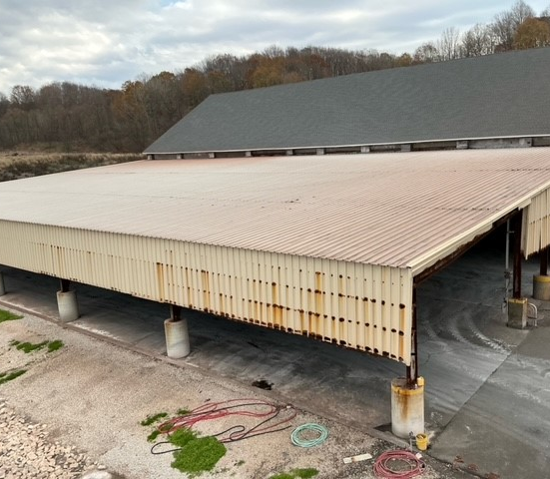
Agri-Port Terminal Project Proposal
Interim Joint Committee on Agriculture
July 10, 2025
Frankfort, KY

Slide 2
History of Agri-Chem, LLC and Agri-Port Terminal
1975
Agri-Chem, Inc. formed
1997
Agri-Port Terminal Opened
1998
Joined with Hopkinsville Elevator, Co. Inc.
2020
Opened state of the art agronomy center at Casky
2012
Hopkinsville Elevator acquired 100% of Agri-Chem, LLC

Slide 3
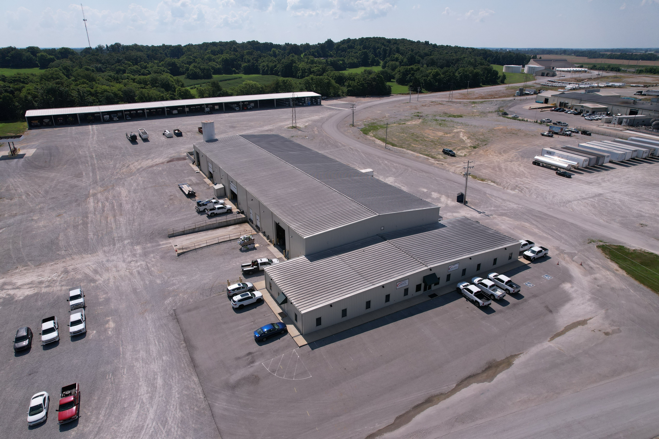

Slide 4
Agri-Port Terminal’s Impact on Kentucky Farming
Agri-Port Terminal in Eddyville, KY supplies 100,000 tons of dry and liquid fertilizer per year to KY farmers.
Those 100,000 tons are applied to 500,000 acres of Kentucky farmland.
Those 500,000 acres produce an average of 200 bushels of corn per acre. When sold at local grain elevators like our parent company, Hopkinsville Elevator Company, those 100,000 tons of fertilizer help create
$500,000,000 in revenue for local farmers.

Slide 5
Current state of the fertilizer building at Agri-Port Terminal

Slide 6
Proposed Building Design
Projected Cost of Project: $1,765,289

Slide 7
Thank you for your time and consideration.

