Slide 1
TRACKSIDE
PRESENTED BY: JOHN EDWARDS
123 Commerce Pkwy,
Campbellsburg, KY, 40011

Slide 2
ABOUT US
Chris Wright, Jason Wright & John Edwards- Co-Owners/Managers
Opened in 2015
01

Slide 3
VISION
In October of 2013 a feasibility study was conducted by Kentucky Center for Agricultural and Rural Development. It revealed a great need for a meat processing facility in our area.
02

Slide 4
CONSTRUCTION
03

Slide 5
PROCESSING
05

Slide 6
PROCESSING
05

Slide 7
CUTTING ROOM
06

Slide 8
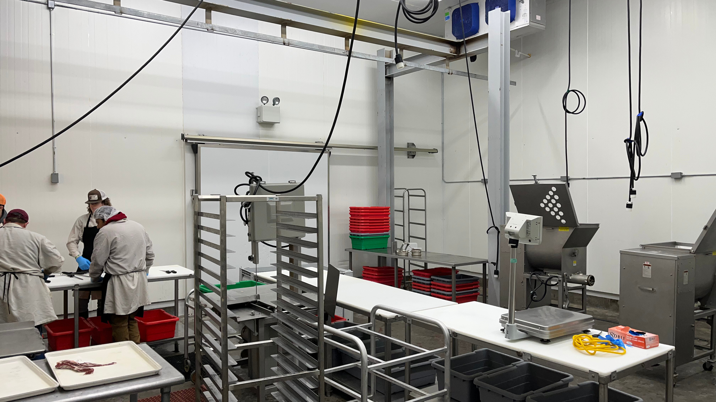
PROCESSING
USDA or Custom Processing options
Cattle
Hog
Lamb and Goat
07

Slide 9
08

Slide 11
CONTACT US
+1 502-532-3015
office@tracksidebutchershoppe.com
123 Commerce Parkway, Campbellsburg, KY 40011

