Slide 1
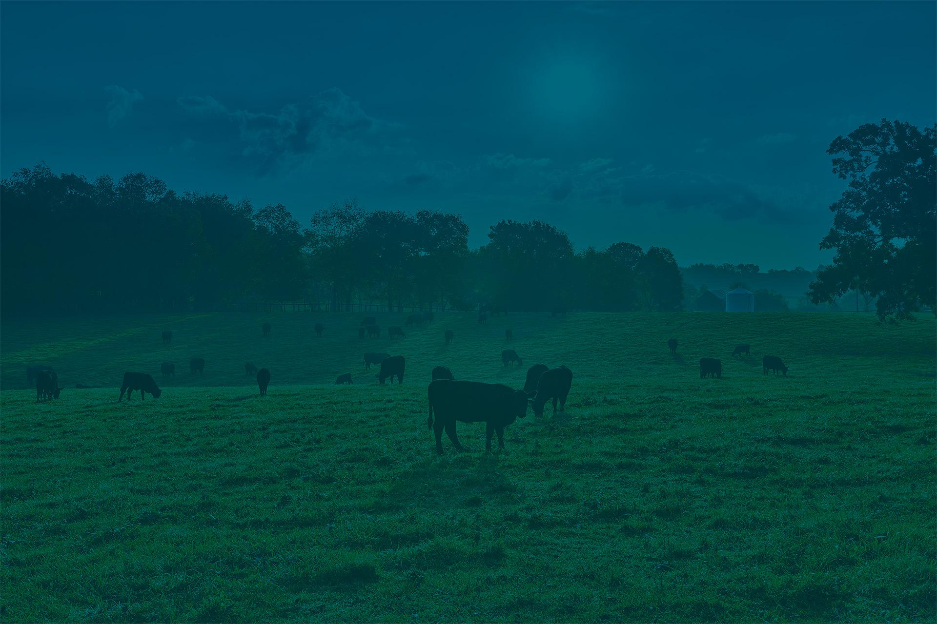

Cultivating agricultural innovation in Kentucky

Slide 2
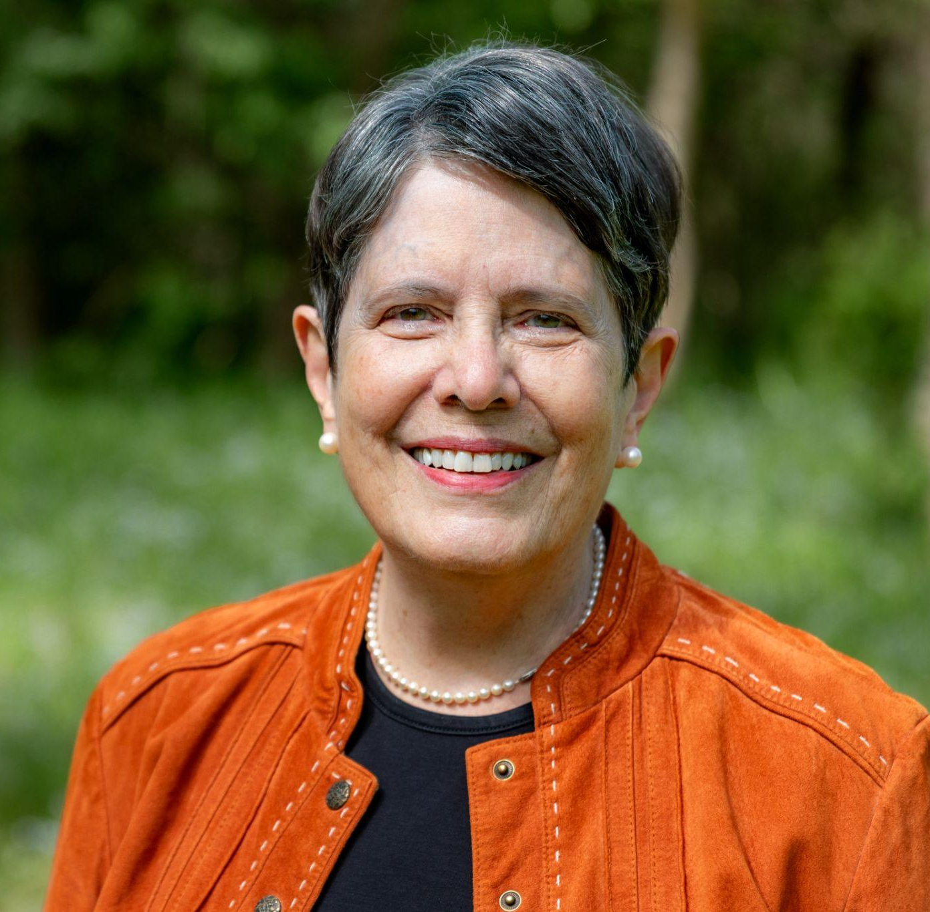
Mayor Linda Gorton
Bluegrass AgTech Development Corp Board Chair
Origin and Partnership Formation

Slide 3






Founding Partners
A portion of the funding for Bluegrass AgTech Development Corp is provided by the Kentucky Agricultural Development Fund.

Slide 4
Jacob Ball
Bluegrass AgTech Development Corp Executive Director
Deep Kentucky roots, raised on a small farm in Nelson County; experienced in program development, workforce engagement, and stakeholder relations
Former agriculture teacher and FFA advisor, recognized with the Milken Educator Award
Appointed July 2025
Leading efforts to grow Kentucky’s agtech ecosystem through grants, partnerships, and farmer engagement

Slide 5
Background

Slide 6
Development Strategy & Formation
Shelman Group Feasibility Study (2020–2022)
40+ stakeholder interviews, national benchmarking, and state-level analysis created a roadmap for a KY agtech ecosystem & development of Challenge Grant Focus Areas
From Strategy to Action
Bluegrass AgTech Development Corp established as the coordinating body
Public-private partnership: KY Dept. of Agriculture, Lexington-Fayette Urban County Government, University of Kentucky, & Alltech
Challenge Grant Program launched with statewide outreach and branding
Vision Forward
Expand farmer innovation networks and agtech showcases
Convene annual summit and develop incubator/cluster space
Position Kentucky as the nation’s agtech hub

Slide 7
Founding Partner Impact on BADC Mission
Lexington-Fayette Urban County Government: provided $1 million to launch grant program and operations; has committed an additional $250,000 for future grants; providing support for innovation and entrepreneurship, positioning Lexington as the home base for Kentucky’s growing agtech ecosystem.
Kentucky Department of Agriculture: through the Kentucky Agricultural Development Fund, added $1 million to award statewide grants; bringing leadership and resources to ensure agtech innovation strengthens farm profitability and rural communities.
University of Kentucky: a key driver of Kentucky’s agtech workforce and innovation, awarding nearly 400 STEM degrees each year with more than 1/3 of graduates entering agriculture and agtech careers. The college is also a hub for new ideas, helping launch 14 companies built on faculty and staff innovations; provides statewide outreach through Cooperative Extension Service.
Alltech: leveraged its global resources and expertise to support the organization’s start-up and strengthen Kentucky’s agtech ecosystem. With its deep network across agriculture, food, and innovation, Alltech helps connect entrepreneurs, farmers, and industry leaders to accelerate growth and collaboration.

Slide 8






The Bluegrass AgTech Development Corp will:
Attract, develop, and support new companies in agri-food and agri-business
Boost Kentucky’s ag and tech economies
Promote more affordable, nutritious and sustainable food for Kentucky and beyond

Slide 9






Similar State AgTech Initiatives
New York
Tennessee
California
Colorado
North Dakota

Slide 10
Outreach & Impact

Slide 11
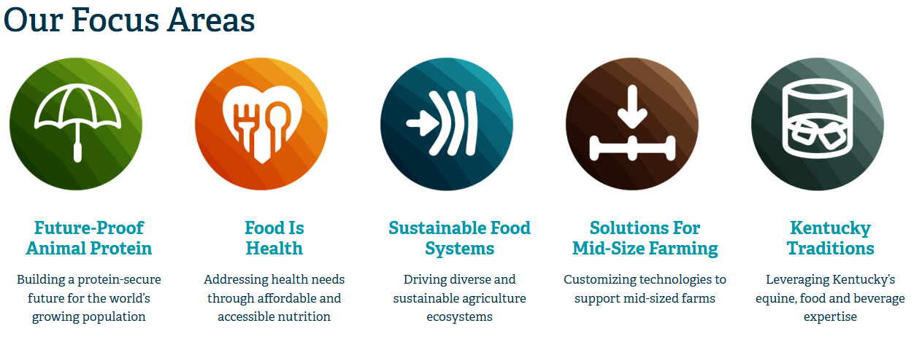

Slide 12
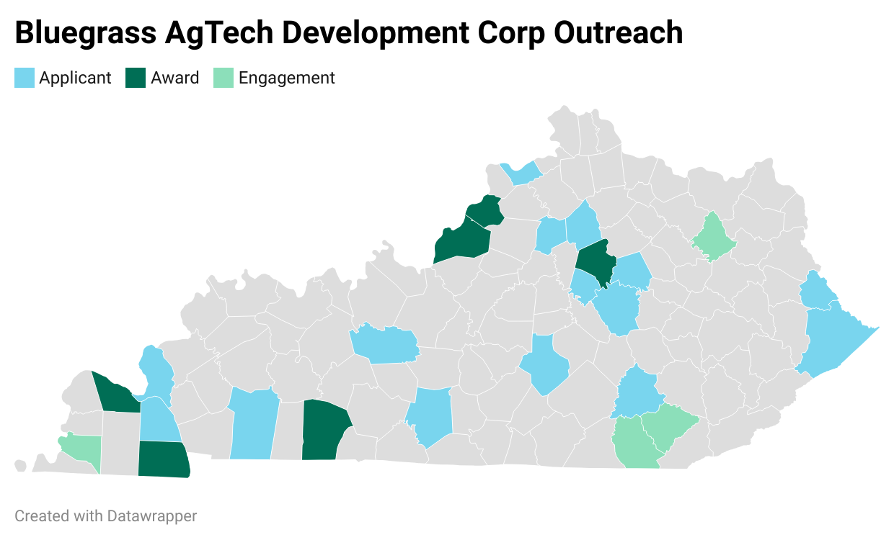

Slide 13

Challenge Grant Program
$925,000 in direct Challenge Grant funding awarded to date
$6.9M+ leveraged in follow-on investment
Round 1 & 2 recipients across: renewable fuels, bio-based products, precision ag, equine innovation

Slide 14
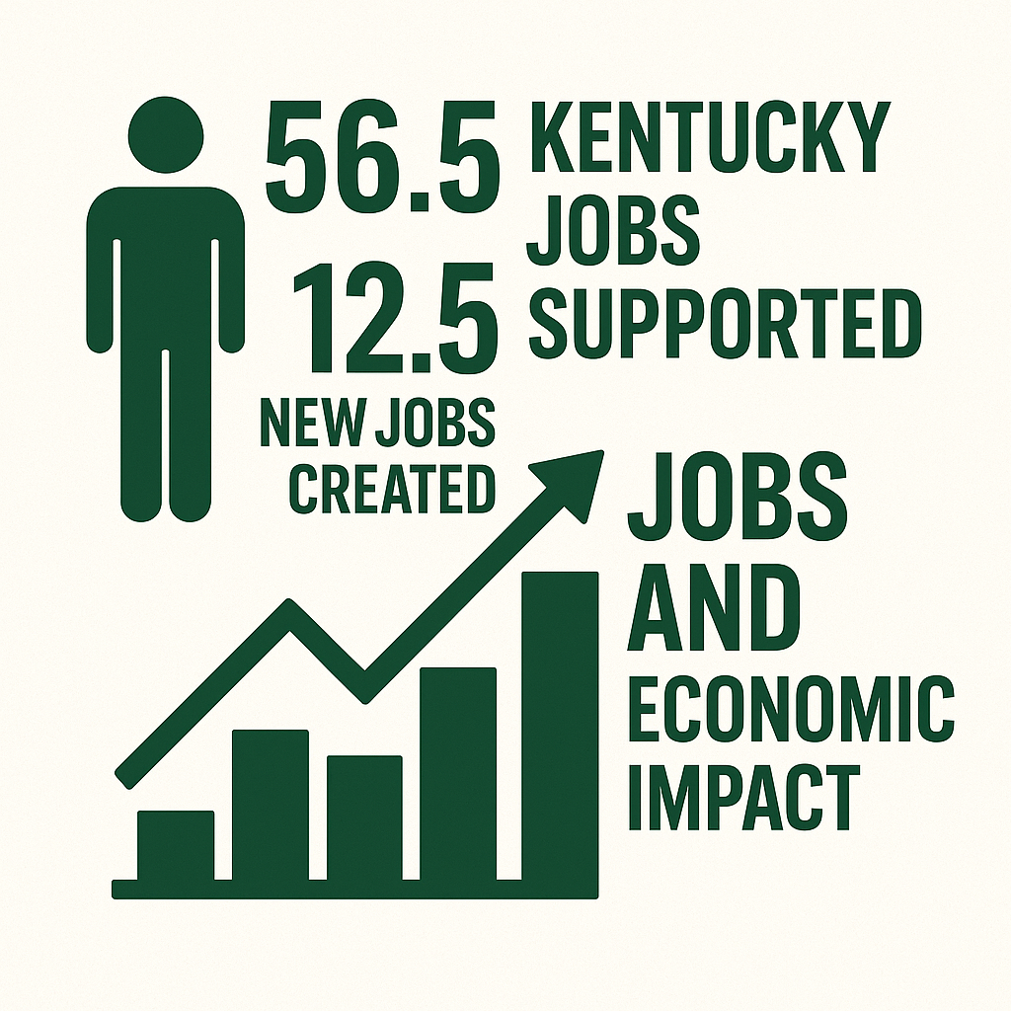
Challenge Grant Program: Economic Impact
56.5 Kentucky jobs supported
12.5 new jobs created
Facility expansions: Hempwood factory, Parasight units, Sunflower Fuels growth
Diversified sectors: renewable materials & fuels, biocontrol, animal health data, plant inputs

Slide 15

Challenge Grant Program: Farmer Impact
Projects led by Challenge Grant Awardees
Engaged 36 Kentucky farms
1,600 acres impacted with new crops (sorghum, hemp, perennial grasses)
$380,000+ direct payments to farmers
Benefits: new income streams, crop diversification, lower livestock costs, access to emerging markets

Slide 16



Announcement of Round 2 Awards
Kanbol, Inc (Auburn, KY) turns leftover corn stalks from Kentucky’s grain farms into compostable food containers, cutting plastic waste and creating extra income for farmers.
ORB Technologies (Lexington, KY) makes eco-friendly building blocks from crops like straw and grasses, giving farmers new income and supporting sustainable construction.
Santerre International (Paducah, KY) turns invasive Asian carp into fertilizer used in organic production, providing farmers with an affordable input while helping waterways and supporting local fishing.

Slide 17
Future Initiatives

Slide 18
What’s Next?
Expand statewide engagement and grow Challenge Grant participation
Build partnerships with innovation hubs, universities, and industry to scale innovation
Establish incubator, host agtech showcases, and launch an annual Kentucky AgTech Summit
Position Kentucky as a national leader in agtech through expanded grants, farmer adoption, and the Farmer Innovation Network
Leverage partnerships within FFA/4-H and Universities to engage youth in agtech and help build talent pipeline in Kentucky
Secure additional funding for expanding operations and the Challenge Grant program through philanthropic foundations, corporate funding, strategic partnerships, and legislative support

Slide 19
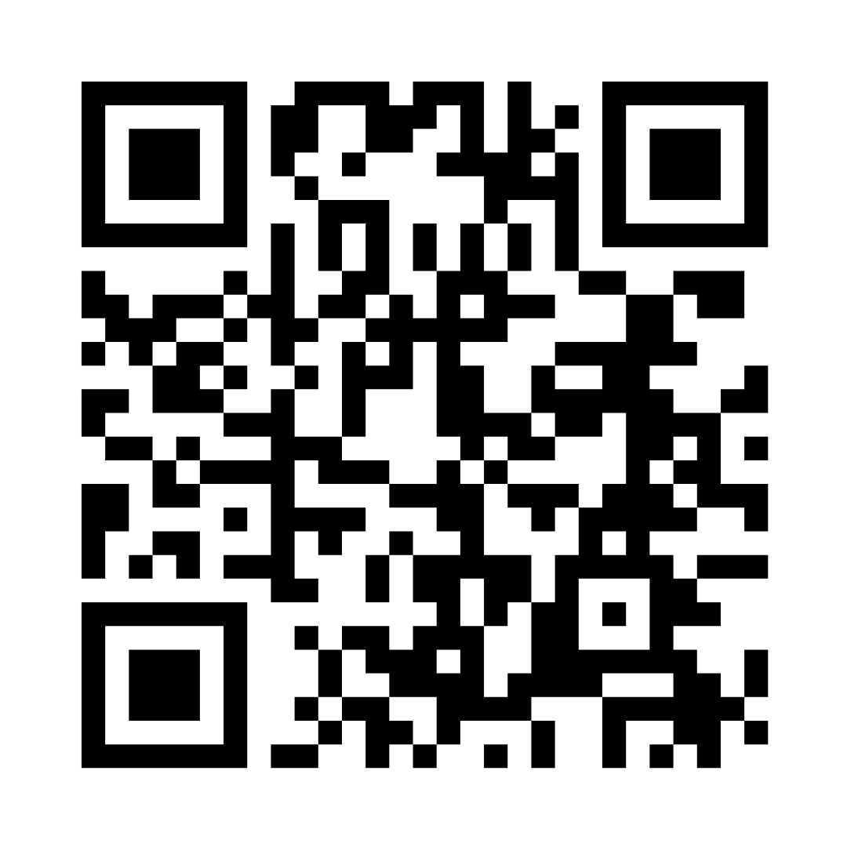
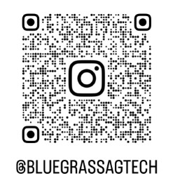
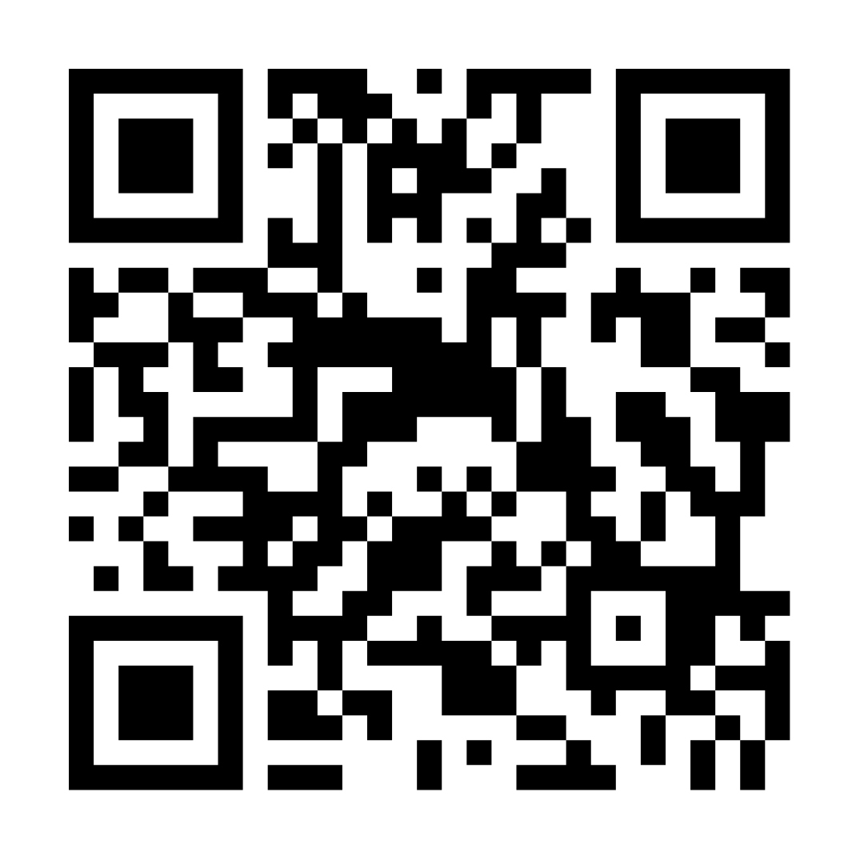
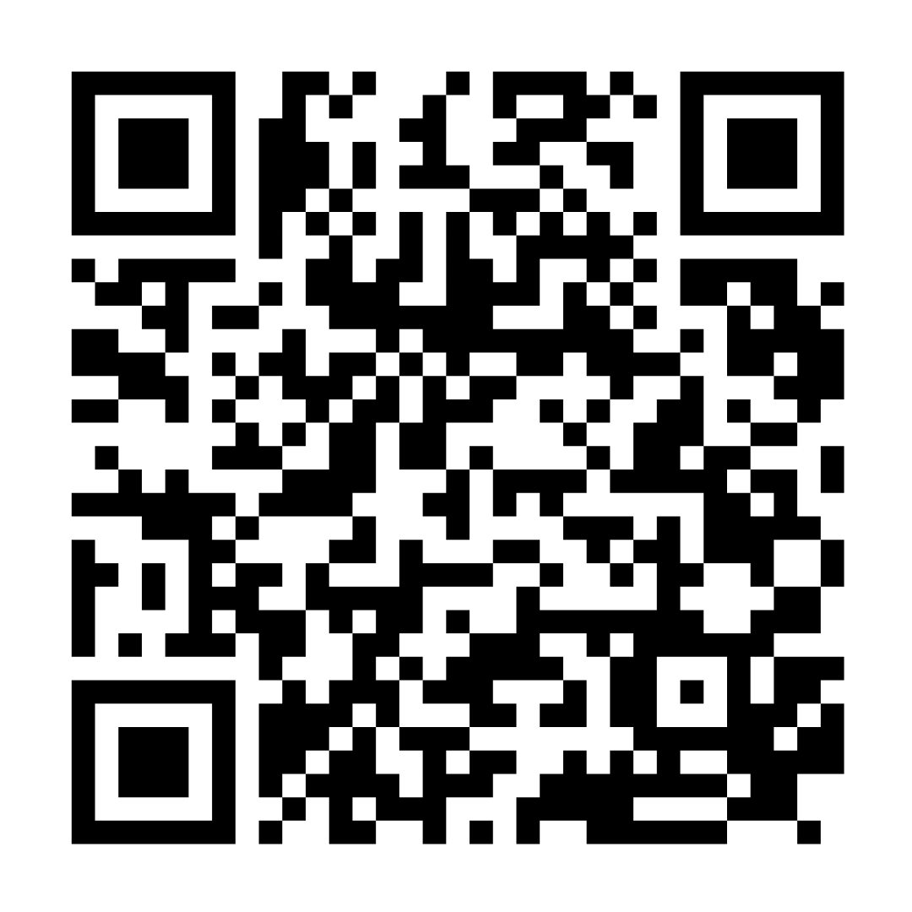
Stay in Touch!
Sign Up for Our
Newsletter!
Follow us on Instagram
Follow us on
Facebook
Follow us on
LinkedIn

