Slide 1


Slide 2
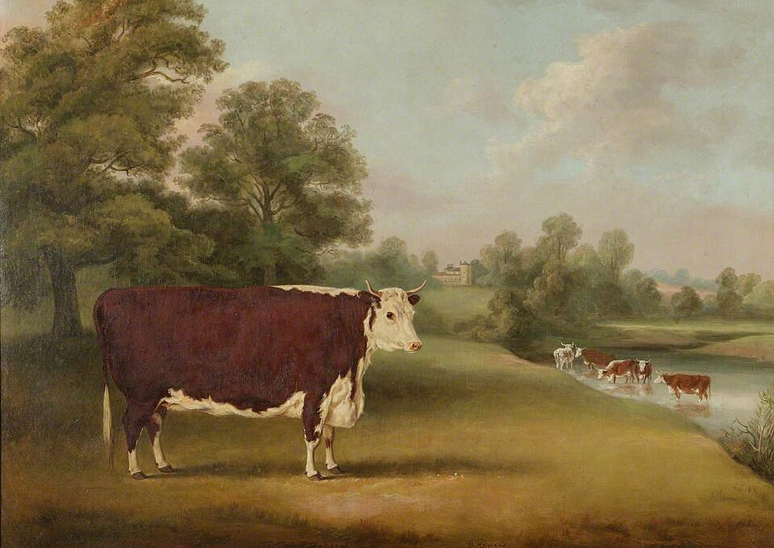
Beef In Kentucky
Kentucky’s connection to the beef industry dates back centuries. From early pioneers to statesman Henry Clay in 1817.
Today, Kentucky is home to over 32,000 beef producers, making it the largest beef-producing state east of the Mississippi River.
The cattle industry contributes more than $1 billion annually to Kentucky’s economy.

Slide 3
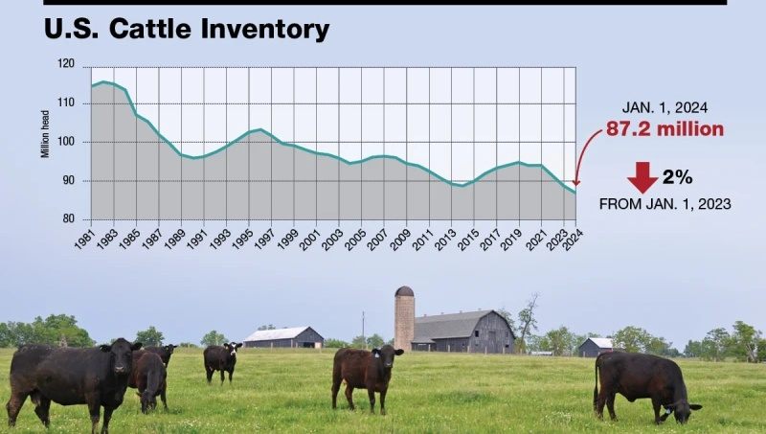
Beef in the News
As of January 1, 2025, the U.S. cattle and calf inventory totaled 86.7 million head.
The smallest total since 1951.

Slide 4
Beef Production
Even though the U.S. is working through the lowest beef cattle inventory since 1951.
Producers are offsetting smaller herd sizes by feeding cattle to heavier weights in the feedlot.
Total U.S. beef production in 2025 is projected at 26.4 billion pounds, compared to 27.1 billion pounds in both 2023 and 2024.
Even with fewer cattle being slaughtered, heavier weights are helping limit production declines.
Fewer cattle today are producing more beef than in 2014 when beef production was 24.3 billion pounds.

Slide 5
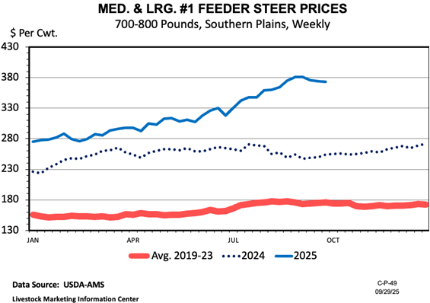
2025 - $2660 2023 - $1260

Slide 6
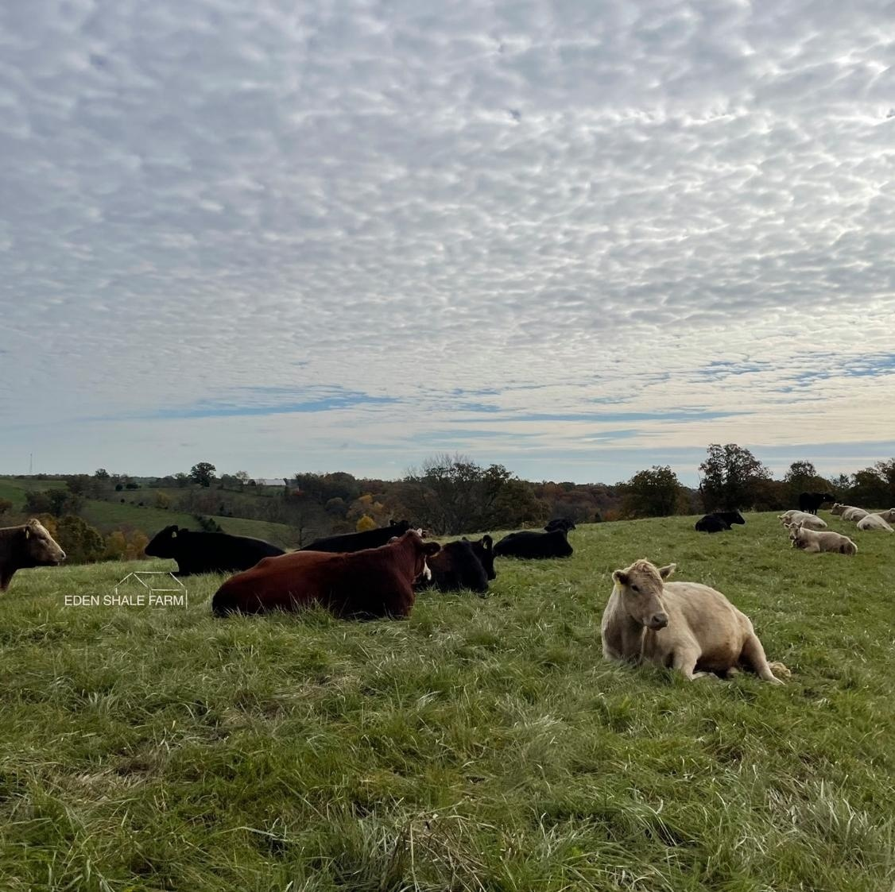
Beef Supply
The industry’s (the cattle farmer) response to rising cattle prices has been unusually slow so far.
Unless heifer retention increases later in 2025, herd expansion in 2027 will likely remain limited.
Cattle prices are expected to stay elevated through much of the decade, with a gradual peak anticipated along the way.
Derrell Peel, Oklahoma State University

Slide 7
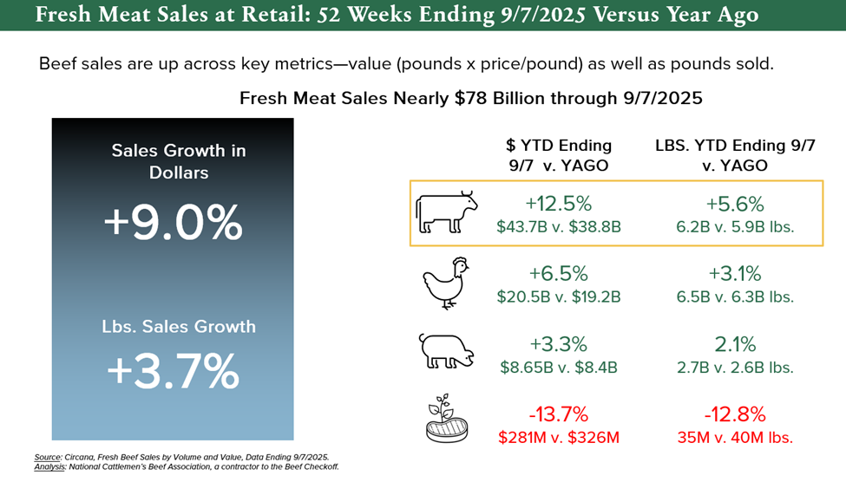

Slide 8
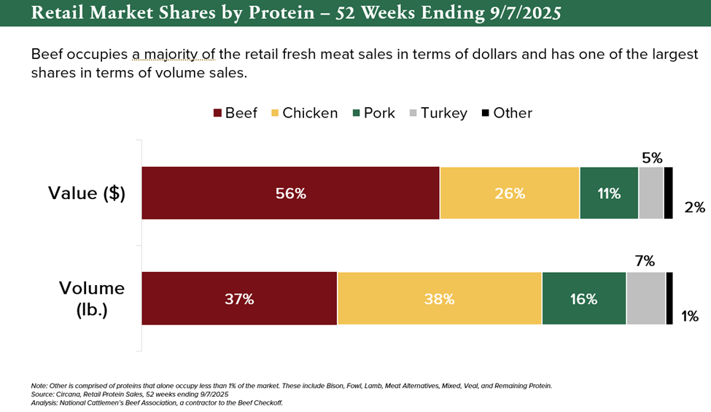

Slide 9
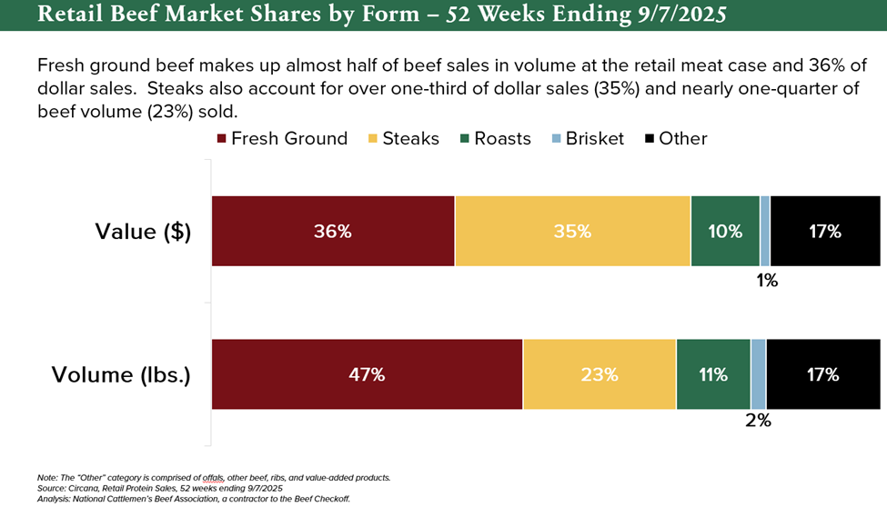

Slide 10
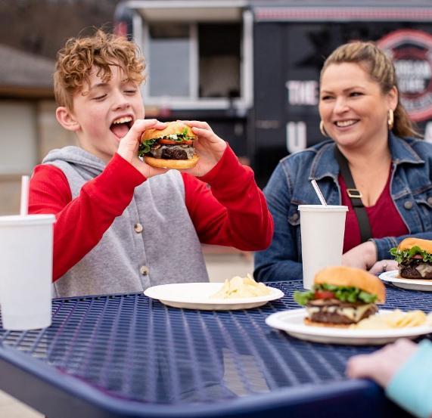
Beef Demand
Beef demand remains strong despite tighter supply and higher prices, supported by consumer consumption trends and retail sales data.
Protein consumption is rising: 61% of consumers report increasing protein intake in 2024 (up from 48% in 2019), and 74% consider meat an important part of their diet.
Affordability and taste drive choices: 40% of consumers view a steak dinner at a restaurant as an indulgent way to enjoy quality food and connect with others.
Beef leads on flavor: Cargill’s 2025 Protein Profile survey found beef ranks as the top protein for taste.
Home cooking on the rise: With budgets in mind, 34% of consumers report eating more meals at home and plan to continue this trend, making dining out a more occasional treat.

Slide 11
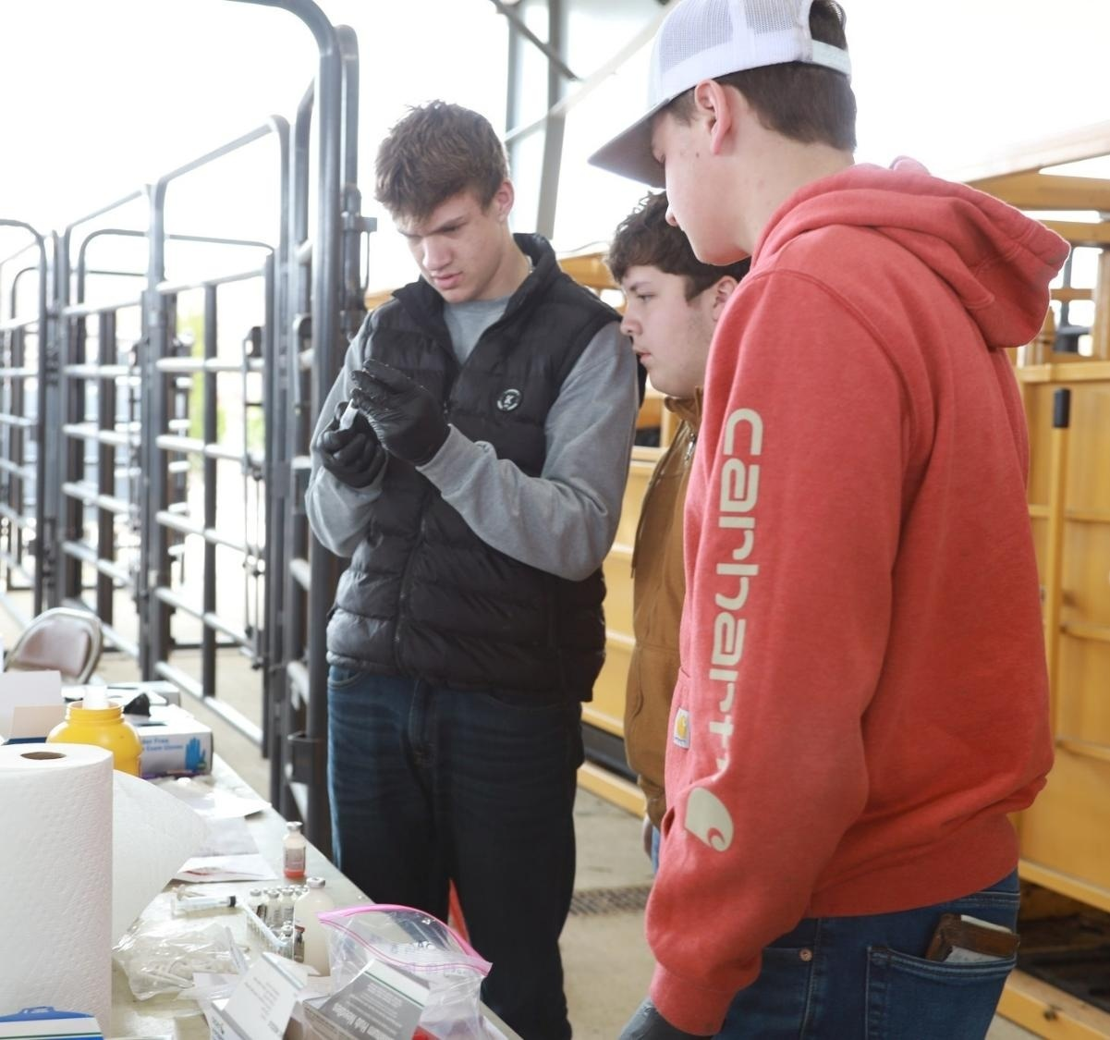
Priorities
Next generation: The future of the beef industry depends on bringing in and supporting our youth and new producers who are ready to carry it forward.
Land use and access: Finding and affording land is getting tougher, making it more important than ever to protect access to quality grazing and production space.
Rebuilding the cow herd: Producers are focused on rebuilding herds to help secure a stable beef supply for the years ahead.

Slide 12



Slide 13
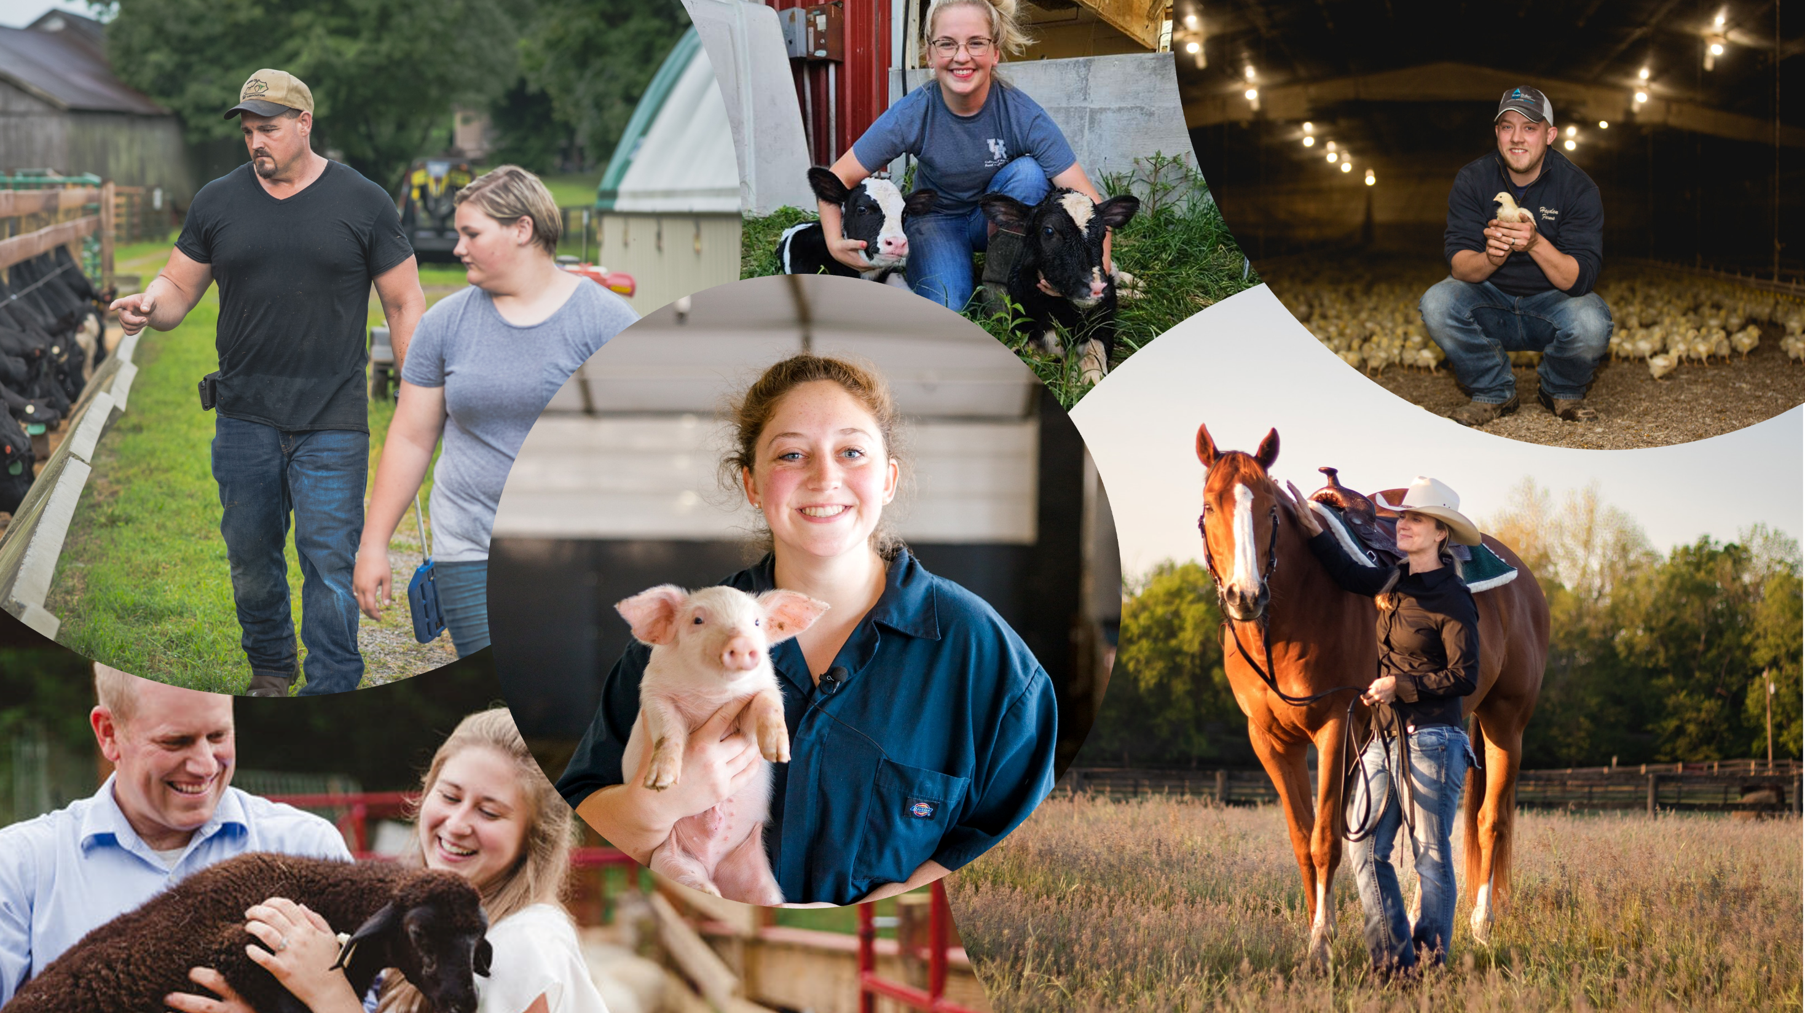
Thank You

Slide 14

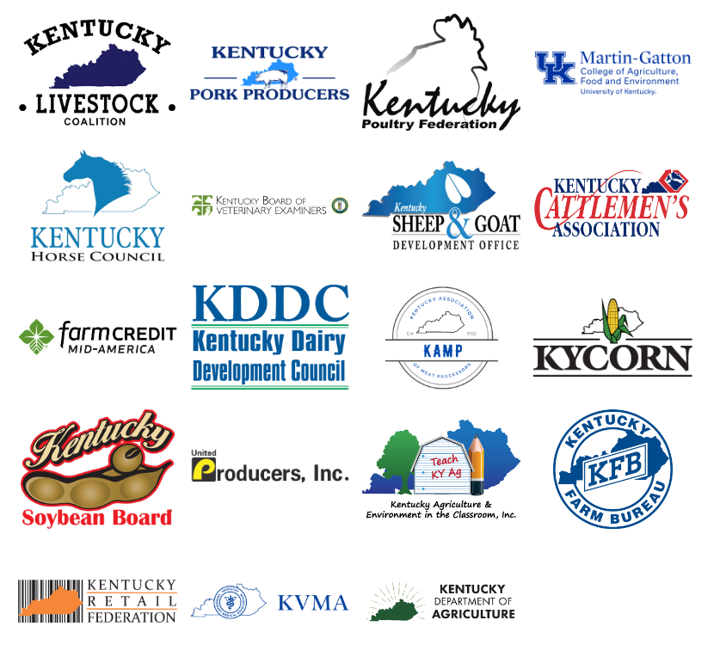
The idea for an innovation center began with a strong statement of need from industry leaders.
Founded in 1993, the Kentucky Cattlemen’s Foundation is a 501(c)(3) nonprofit organization affiliated with the Kentucky Cattlemen's Association.
Members of the Kentucky Livestock Coalition, agriculture groups, and county cattlemen's chapters across the state had several meetings between 2019-2024 to develop a combined effort of support for a Kentucky Livestock Innovation Center.
2019
2024

Slide 15
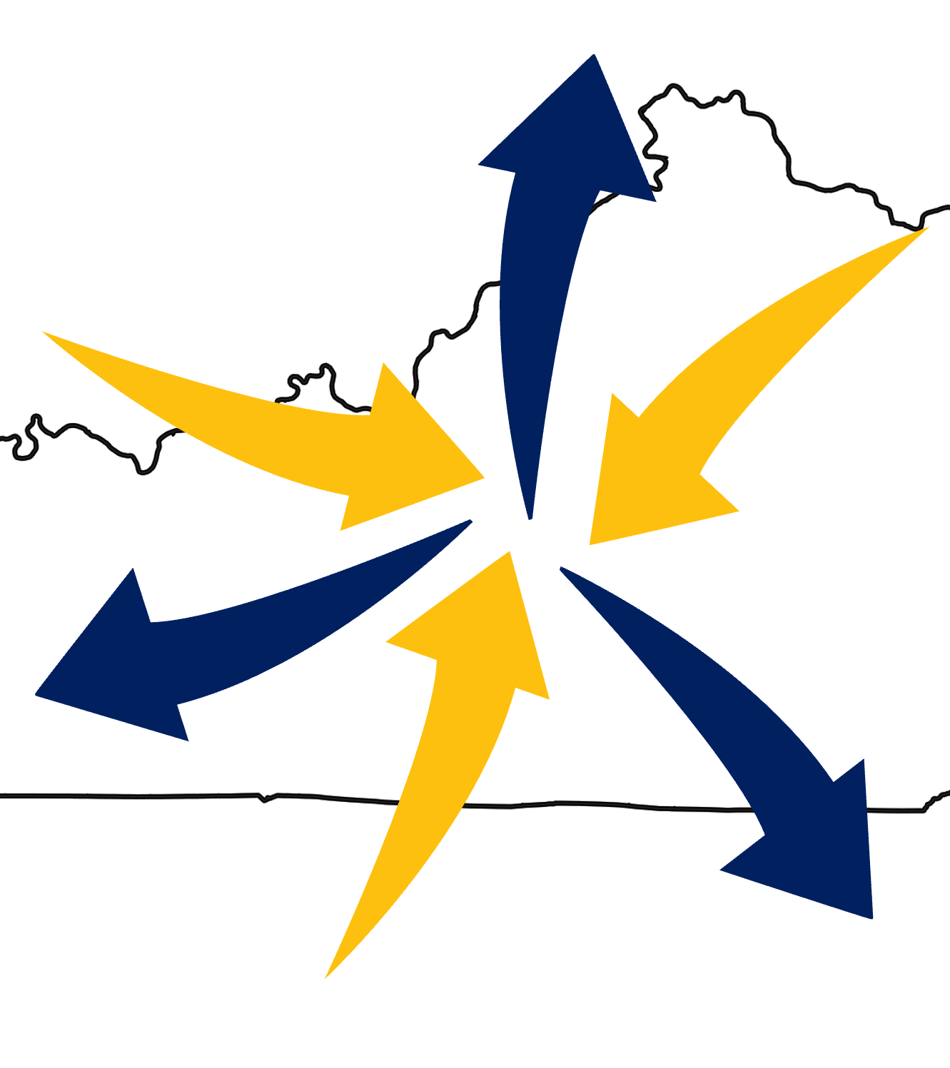
Mission and Purpose
Create a central coordinating location that will directly and indirectly serve as a tool and resource to advance the socioeconomic benefit of agriculture to the Commonwealth of Kentucky.
Direct Impact (Hands-On):
Field Demonstrations
Workshops and Training Sessions
Indirect Impact (Developmental):
Curriculum Development
Industry Collaboration

Slide 16
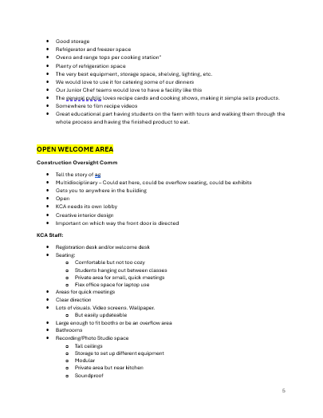
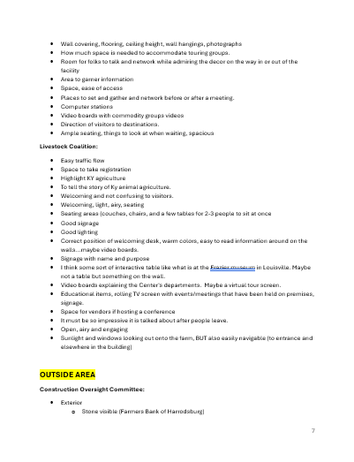
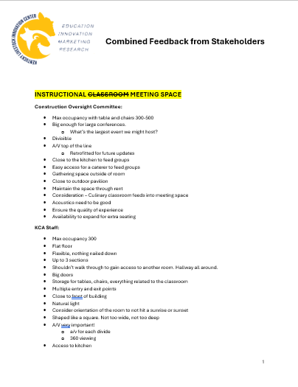
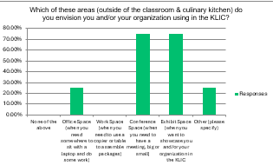
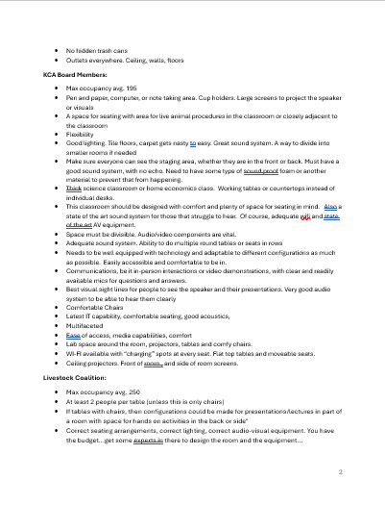
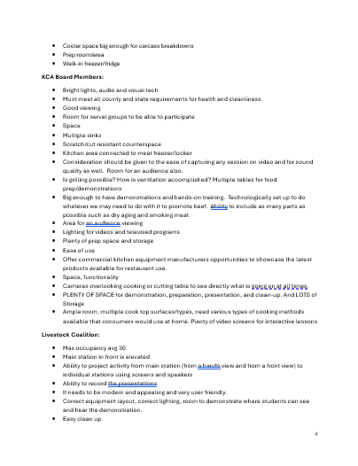
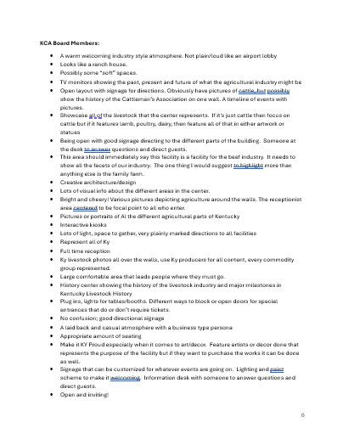
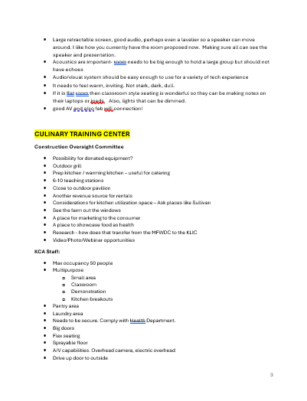
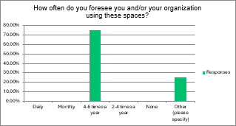
Interactive Design Process

Slide 17
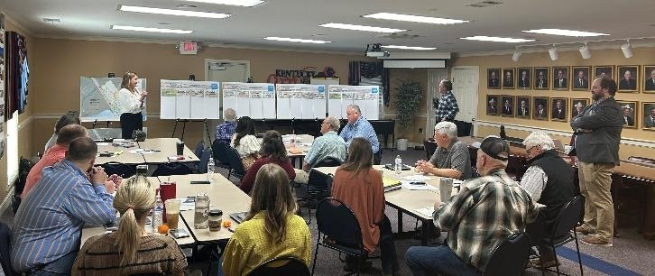
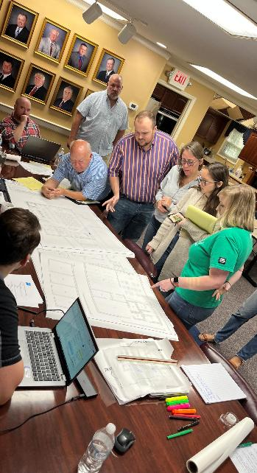
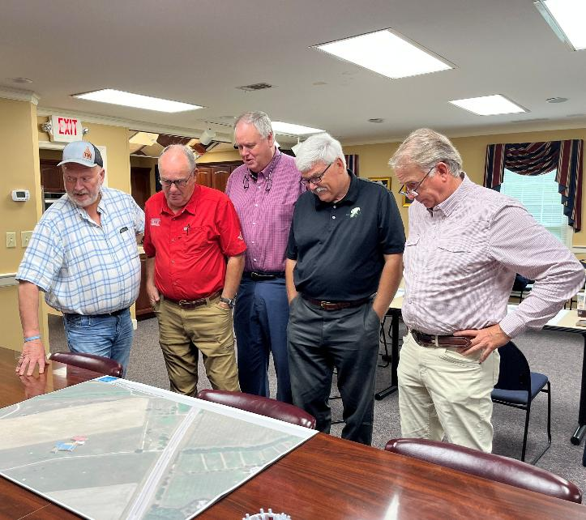
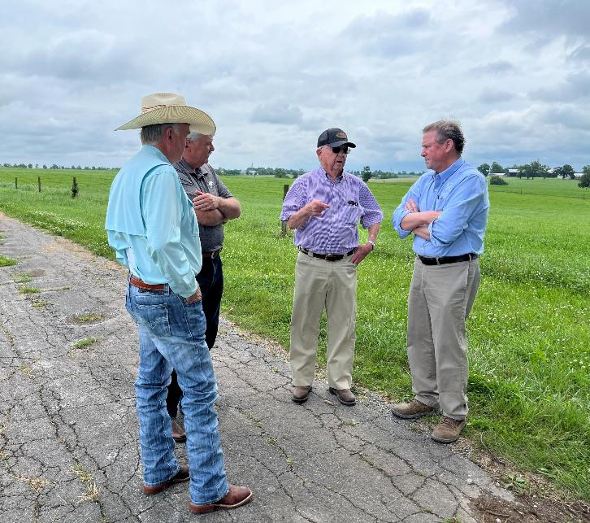
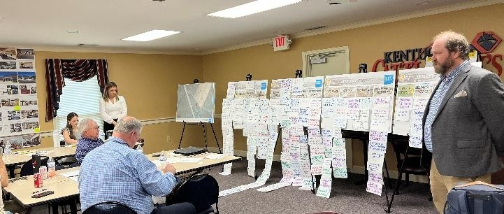
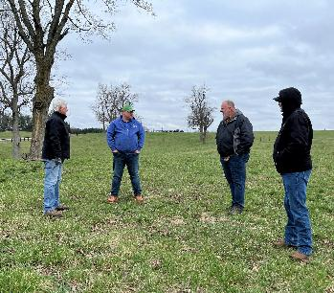

Slide 18
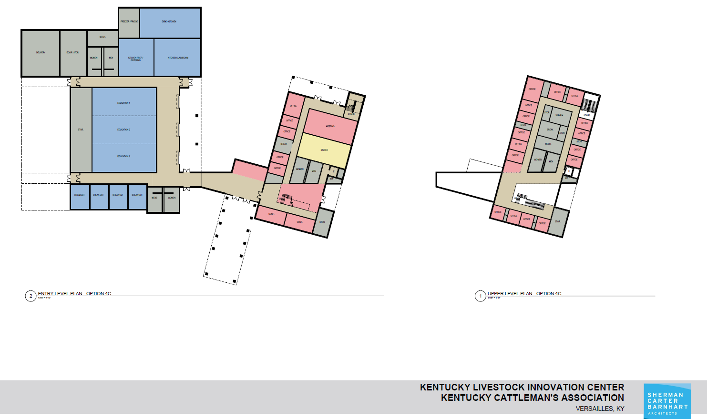
Culinary Training Center
Office Space
Education / Conference Area
Meeting / Business Wing

Slide 19
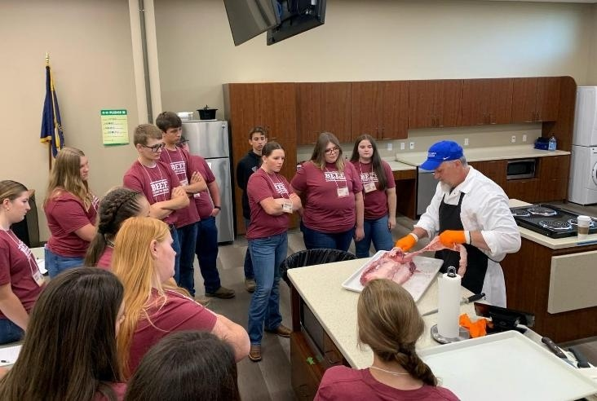
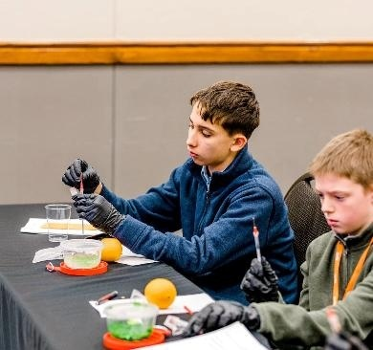
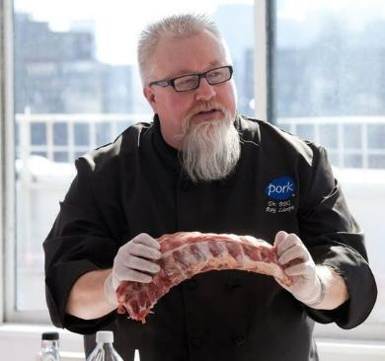
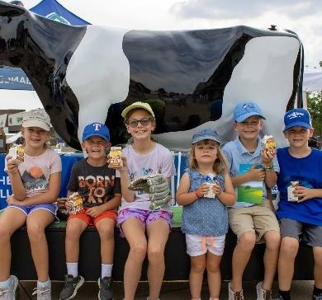
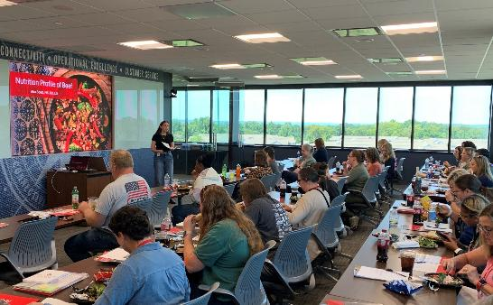
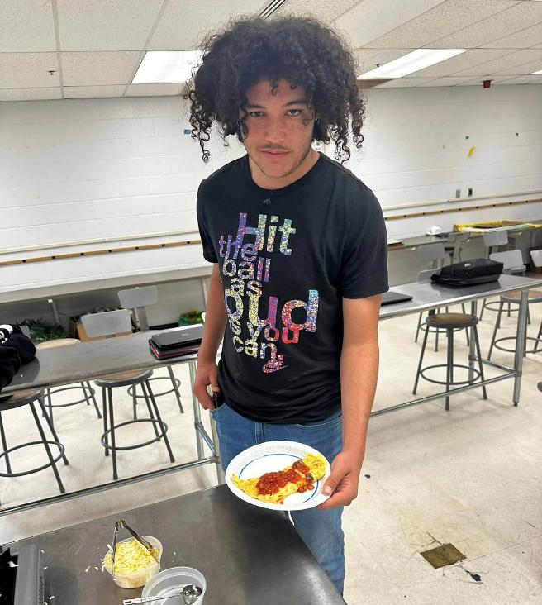
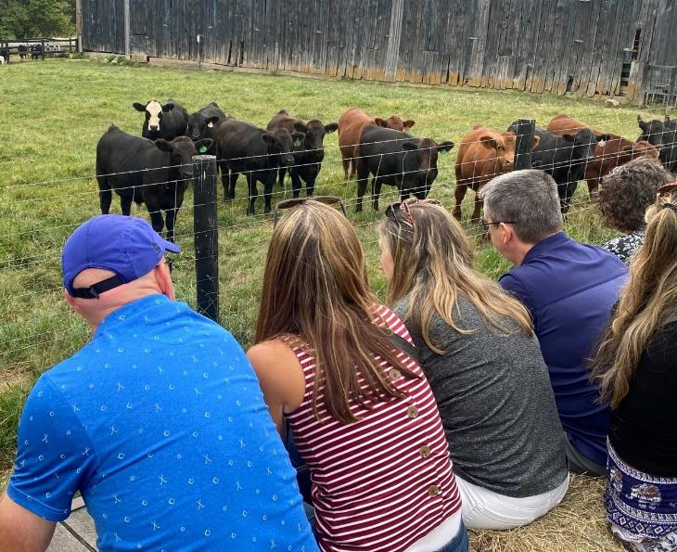
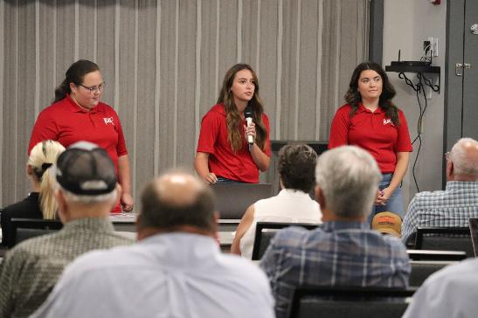

Slide 20

Thank you!
Dave Maples – dmaples@kycattle.org
Nikki Whitaker – nwhitaker@kycattle.org

