Slide 1



PROGRAM UPDATE AND INDUSTRY OVERVIEW
Interim Joint Committee on Agriculture
July 2, 2026

Slide 2


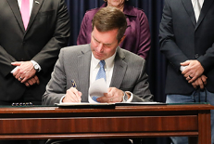
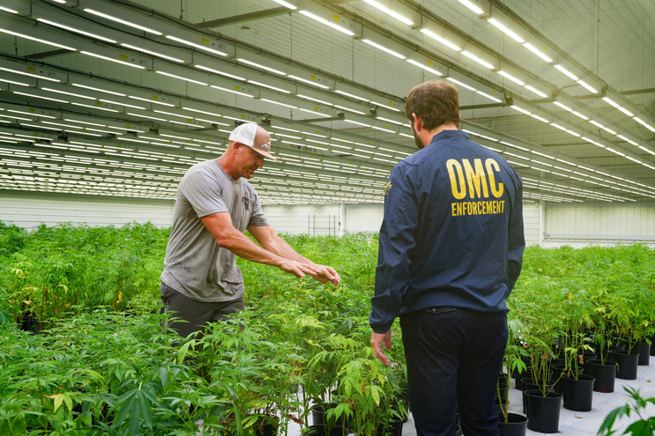
A BRIEF HISTORY OF KENTUCKY’S MEDICAL CANNABIS PROGRAM
March 31
SB 47 is signed legalizing medical cannabis in Kentucky
January 1
First day for Kentucky medical cannabis card applications
June
Over 40% of licensed businesses are operational
2023
2024
2025
2026
Jan-April
Regulations filed for medical cannabis operations
July
Cultivation begins

Slide 3
Overview of obtaining a medical cannabis license
1
2
3
4
5
Application
Application
Application
Application
Application
Application
Review
Lottery
Inspection
Approval
  As required by KRS 218B.140(1)(c)3, OMC promulgated administrative regulations establishing procedures for the issuance of cannabis business licenses. See 915 KAR 1:010 and 915 KAR 1:020.
  The previous initial cannabis busi​ness license period for cultivator, processor, and dispensary application submissions was July 1, 2024 to August 31, 2024.

Slide 4

TOTAL KENTUCKY MEDICAL CANNABIS
LICENSED BUSINESSES
16
CULTIVATORS
6
SAFETY COMPLIANCE
FACILITIES
10
PROCESSORS
48
DISPENSARIES
As of: 6/30/2026

Slide 5


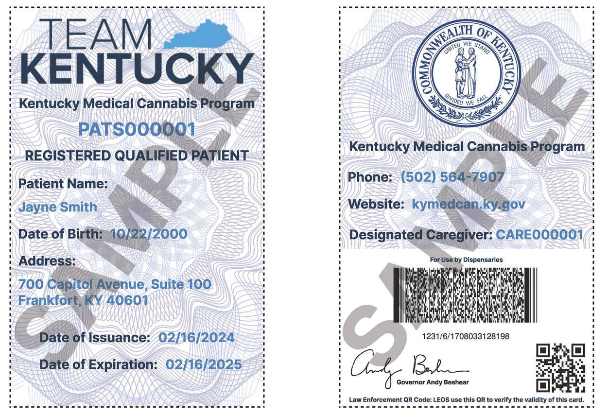

PROGRAM SNAPSHOT
475
ACTIVE REGISTERED PRACTITIONERS
26,000
ACTIVE
CARDHOLDERS
34
OPERATIONAL
BUSINESSES
As of: 6/26/2026

Slide 6
KENTUCKY MEDICAL CANNABIS
OPERATIONAL BUSINESSES
11
CULTIVATORS
2
SAFETY COMPLIANCE
FACILITIES
4
PROCESSORS
17
DISPENSARIES
As of: 6/30/2026

Slide 7


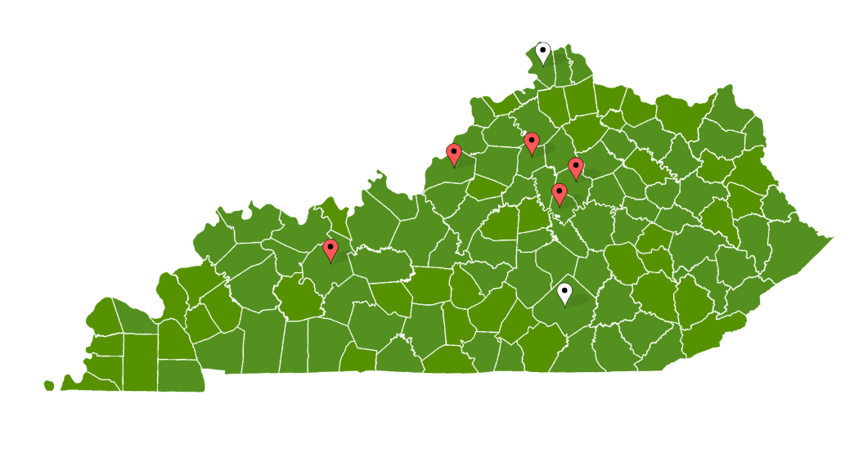
MEDICAL CANNABIS DISPENSARIES
The Post – Ohio
Speakeasy Lexington – Fayette
Blue Sage Nicholasville – Jessamine
NuEra Cannabis – Franklin
Kentucky Alternative Care – Jefferson
Bluegrass Cannacare – Boone
Green Releaf KY – Pulaski
Speakeasy Nortonville – Hopkins
Speakeasy Princeton – Caldwell
Blue Sage Oak Grove – Christian
Blue Sage Georgetown – Scott
High Profile Cannabis Shop London – Laurel
NatureMed Paducah – McCracken
Speakeasy Ashland – Boyd
NatureMed Erlanger – Kenton
Green Releaf – Hardin
Speakeasy Bowling Green – Warren
As of: 6/30/2026

Slide 8
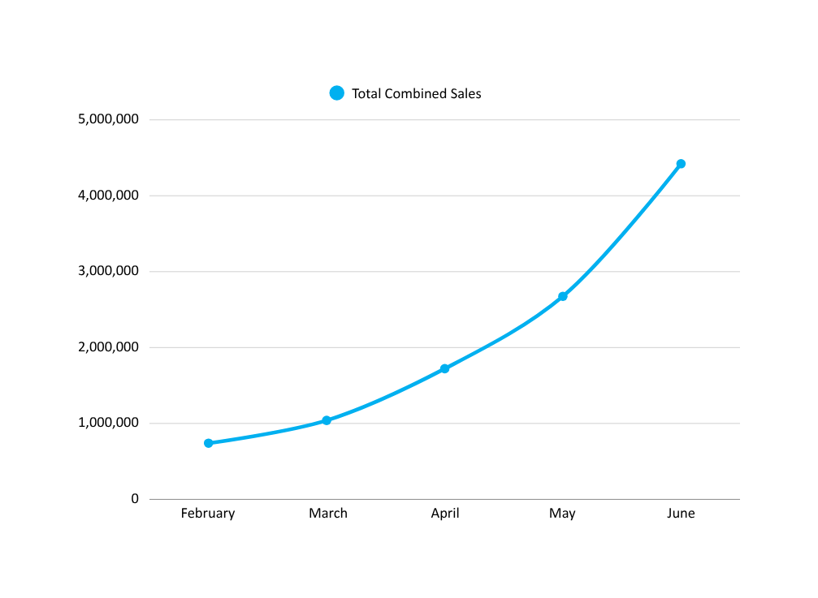
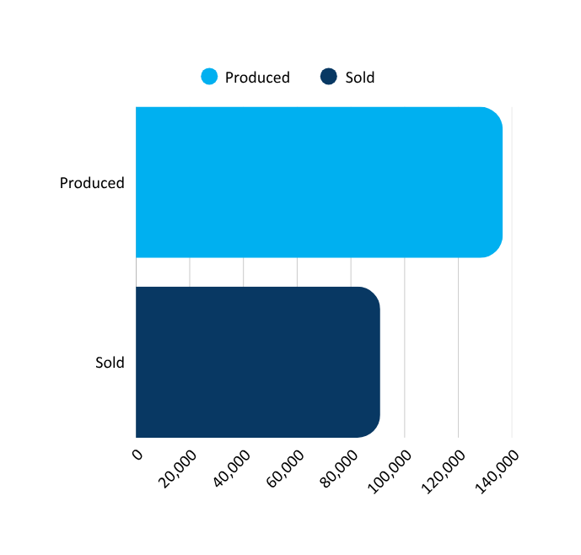
How much medical cannabis has been produced and sold to date?
SALES OVER TIME
UNITS PRODUCED AND SOLD
$4.42M
137K
$1.72M
$1.45M
90K
$1.04M
$740K
Data reflects activity from 12/11/25 - 6/11/26

Slide 9
How many of the producers of medical cannabis are residents of Kentucky?
90%
OF SURVEYED EMPLOYEES ARE
KENTUCKY RESIDENTS
230 of 256 employees
  The Dormant Commerce Clause prevented Kentucky from restricting medical cannabis business participation to state residents.
  Per 915 KAR 1:010, Section 3(5)(a), all cannabis business applicants must be registered and in good standing with the Kentucky Secretary of State.

Slide 10

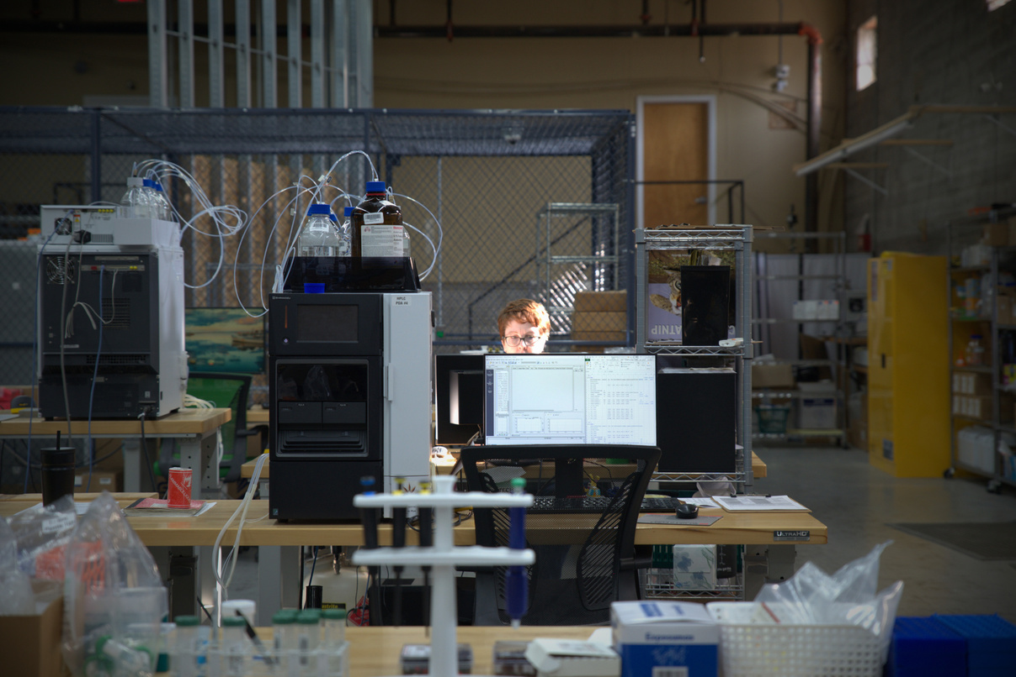
How many medical cannabis businesses had existing hemp licenses dating 5 years or more?
KCA Labs
Aquatic Labs
  OMC identified two (2) safety compliance facilities that previously held Kentucky hemp processor licenses.
  The Kentucky Department of Agriculture maintains records regarding the status and duration of hemp licensure.

Slide 11
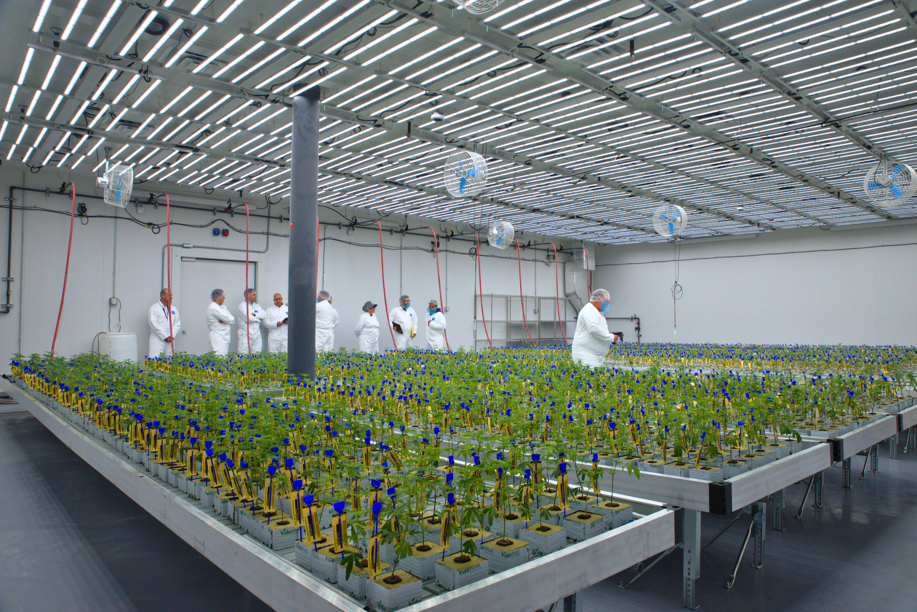
How much does it cost to produce medical cannabis?
  OMC does not cultivate or manufacture cannabis.
  Production costs vary by:
    facility
    scale
    staffing
    technology
    internal operations

Slide 12


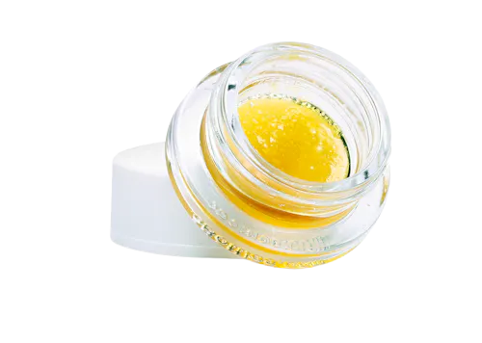
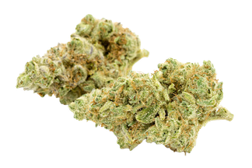
What’s the average wholesale price of medical cannabis?
$17.25
Per Unit of Edibles
$27.64
Per Unit of Raw Plant Material at 3.5g
$38.75
Per Unit of Raw Plant Material at 7g
$28.96
Per Unit of Concentrates
As of: 6/23/2026

Slide 13
What’s the average retail cost of medical cannabis to those with a medical cannabis card?
$40
Per Unit of Edibles
$46
Per Unit of Raw Plant Material at 3.5g
$75
Per Unit of Raw Plant Material at 7g
$55
Per Unit of Concentrates
As of: 6/23/2026

Slide 14
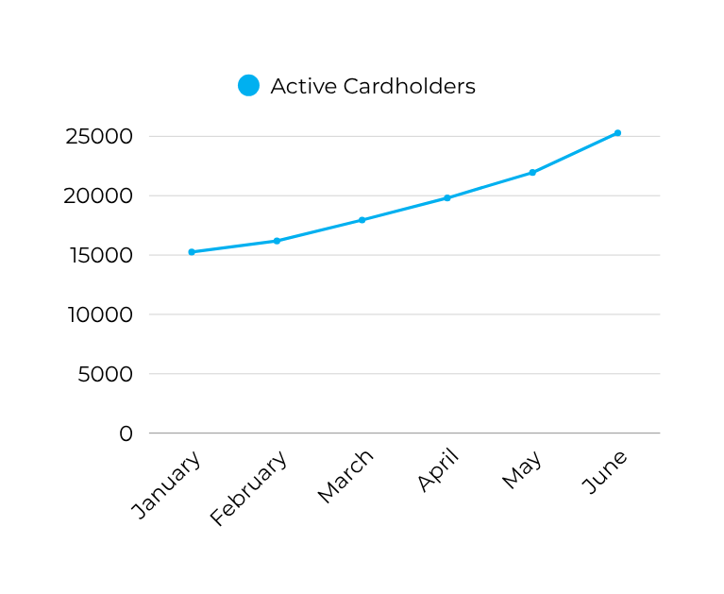
How many currently have a medical cannabis card?
26,000
ACTIVE
CARDHOLDERS
PATIENT GROWTH
25.3K
19.8K
22K
18K
15.2K
16.2K
As of: 6/26/2026

Slide 15
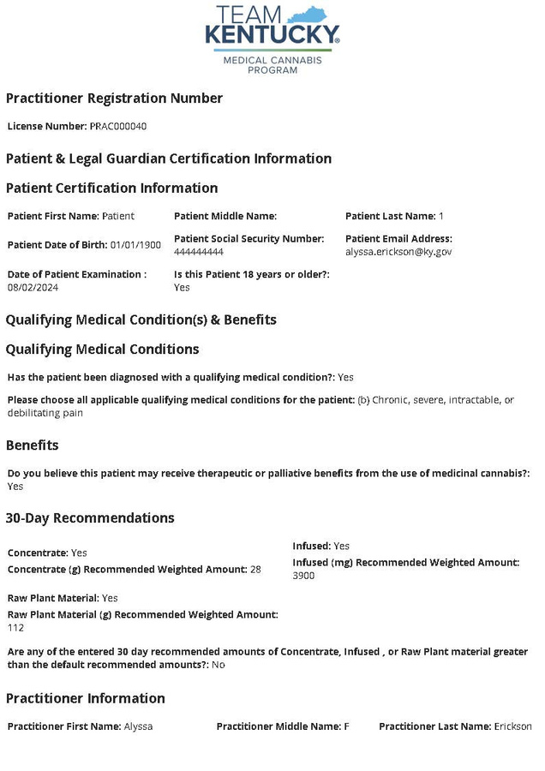
PATIENTS RECEIVE WRITTEN CERTIFICATIONS
Per KRS 218B.010(39), a written certification:
✔ Documents the practitioner's professional opinion that the patient may benefit from medical cannabis
✔ Identifies the patient's qualifying medical condition
✔ Confirms a bona fide practitioner-patient relationship

Slide 16



Who is writing the written certifications for medical cannabis?
Physicians
APRNs
  A medical cannabis practitioner, as defined by KRS 218B.010(17), "means a physician or an advanced practice registered nurse who is authorized to prescribe controlled substances under KRS 314.042, who is authorized by his or her state licensing board to provide written certifications pursuant to KRS 218B.050."​
A physician licensed by the Kentucky Board of Medical Licensure (“KBML”) with the ability to prescribe controlled substances
An advanced practice registered nurse (“APRN”) licensed by the Kentucky Board of Nursing (“KBN”) with the ability to prescribe controlled substances

Slide 17
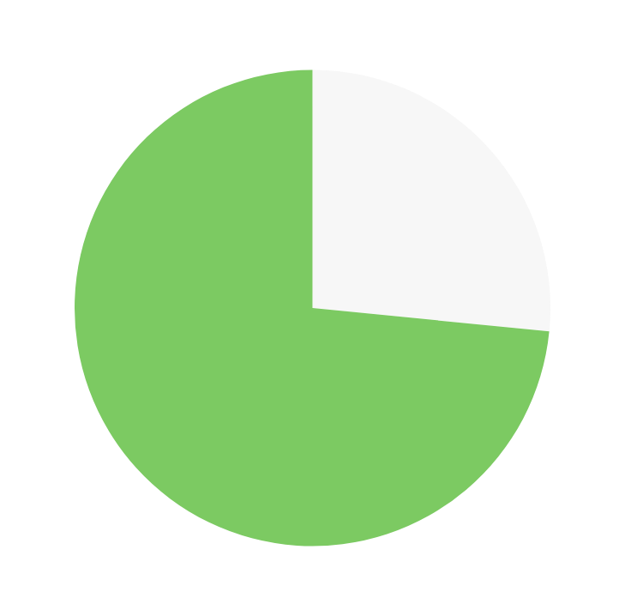
Are the majority of written certifications being issued by physicians or nurse practitioners?
127
Physicians
351
APRNs

Slide 18


Did Kentucky doctors have any input in writing the guidelines for recommending medical cannabis and who were they?
Adopted regulations governing physician participation.
201 KAR 9:067
Adopted regulations governing APRN participation.
See 201 KAR 20:067
  OMC does not maintain a list of individual physicians who participated in drafting those regulations.

Slide 19

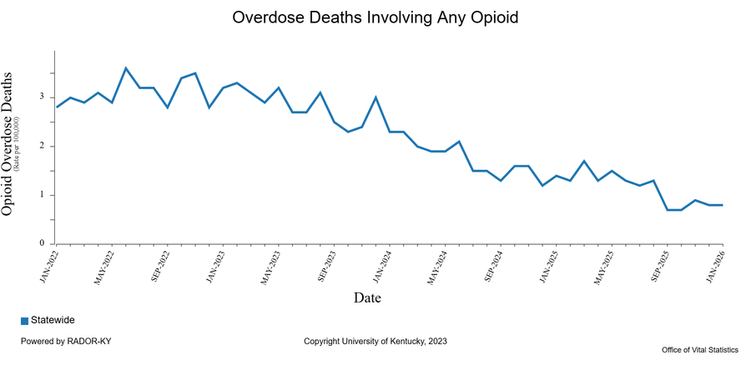
Has opioid use decreased in Kentucky?
22.9%
Decrease in overdose deaths in 2025
15.5%
Reduction in non-fatal opioid poisoning
  Kentucky has seen a decrease in drug overdose deaths for the fourth consecutive year, according to a report released by the Commonwealth’s Justice and Public Safety Cabinet in May 2026.
  A study from the University of Kentucky published in May 2026 “suggests that expanded access to cannabis through medical dispensaries and recreational cannabis laws is associated with lower non-fatal opioid poisoning diagnoses among adults with employer-sponsored insurance” (Hou et al., 2026).
SB 47 takes effect
1st Medical Dispensary Opens

Slide 20
Number of cultivators, producers, processors who operated in Kentucky prior to legalization vs out-of-state operations that moved to Ky in order to “take advantage” of the legalization.
Note: Prior to Senate Bill 47, there were no legal cannabis cultivation or processing operations in the Commonwealth.
  The Dormant Commerce Clause prevented Kentucky from restricting medical cannabis business participation to state residents.
  Per 915 KAR 1:010, Section 3(5)(a), all cannabis business applicants must be registered and in good standing with the Kentucky Secretary of State.

Slide 21
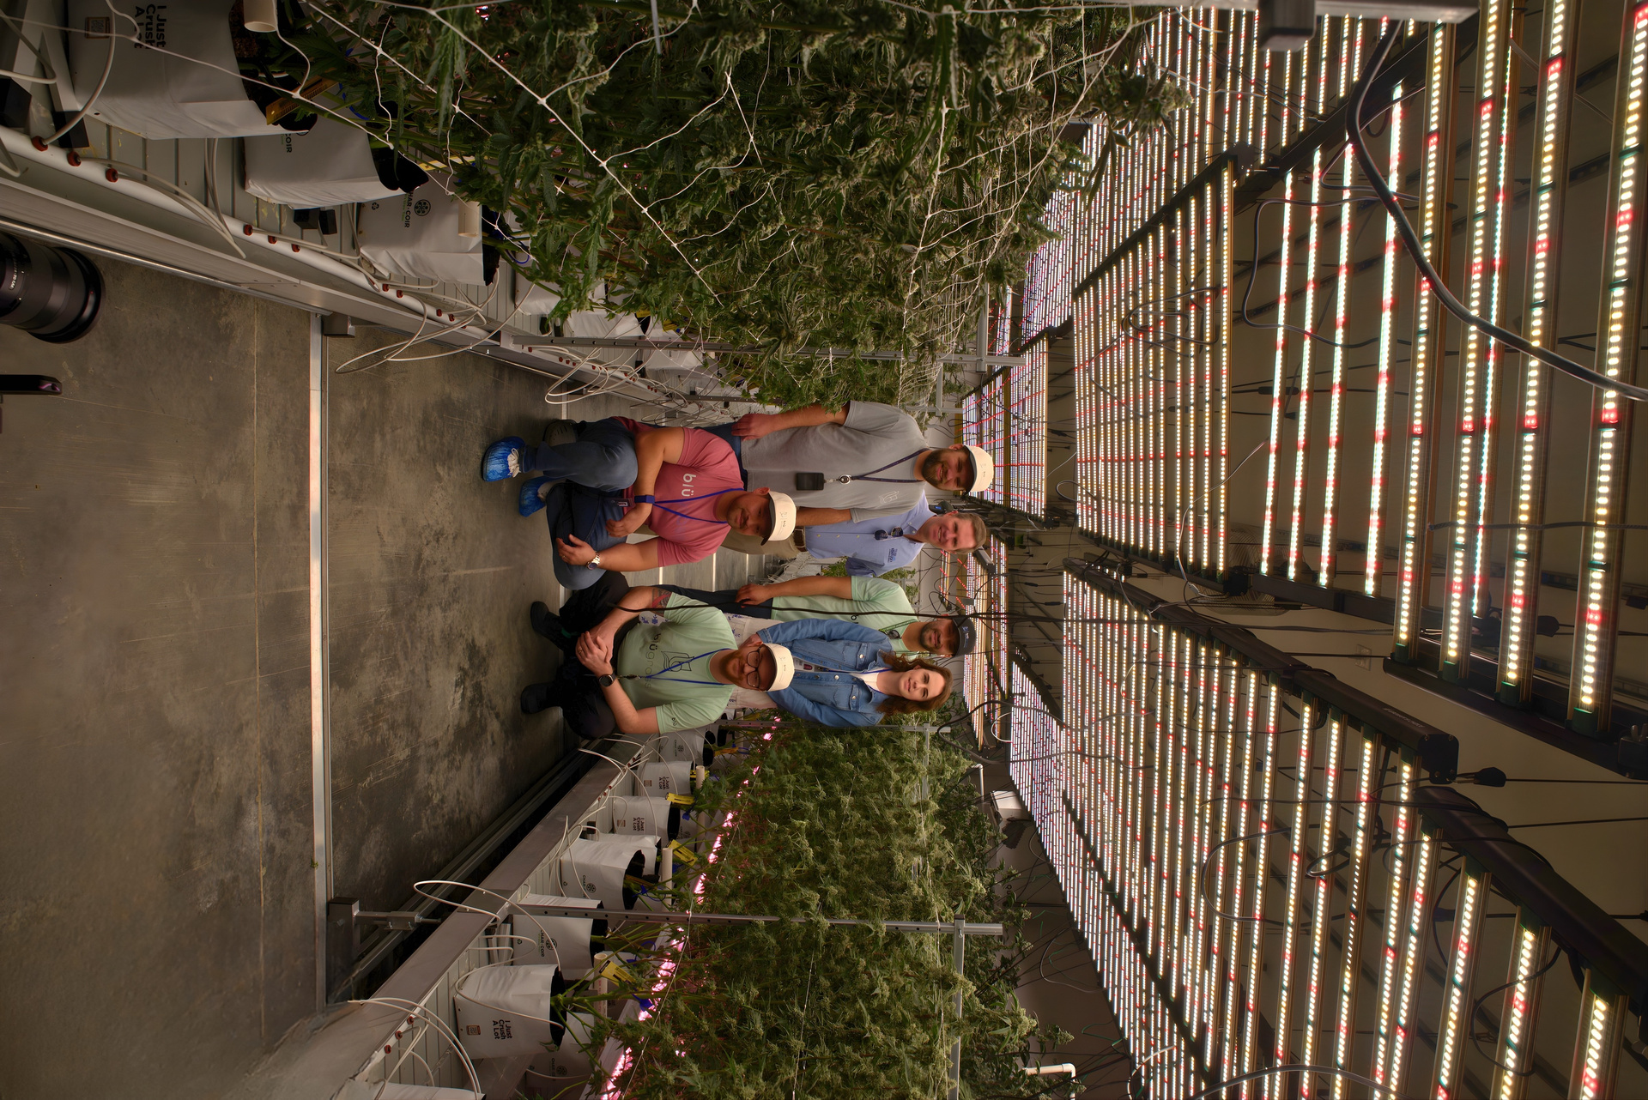
BRINGING KENTUCKIANS BACK HOME
  L&O Legacies Cultivator
  Members of the team previously left Kentucky to work in Colorado's cannabis industry
  Following legalization, they returned to Kentucky

Slide 22

Are any cannabis cultivators or processors previously farmers who diversified to medical cannabis upon the legalization of medical cannabis?
•OMC identified 1 cultivator and 1 processor that previously farmed in different industries.
•KY Cultivation used to work in livestock.
•Limestone Processing did not specify their previous field.

Slide 23
How will Executive Order 2026-318 and 915 KAR 2:050(E) affect supply and demand?

Slide 24
How is pricing determined?
  OMC does not set price.
  Prices are determined by private businesses based on market conditions, including:
    Supply
    Demand
    Competition
  OMC maintains a Dispensary Directory on its website, which links patients to licensed dispensaries and their websites, where current product menus and pricing information can be viewed.

Slide 25
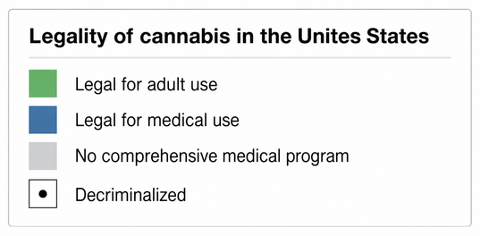
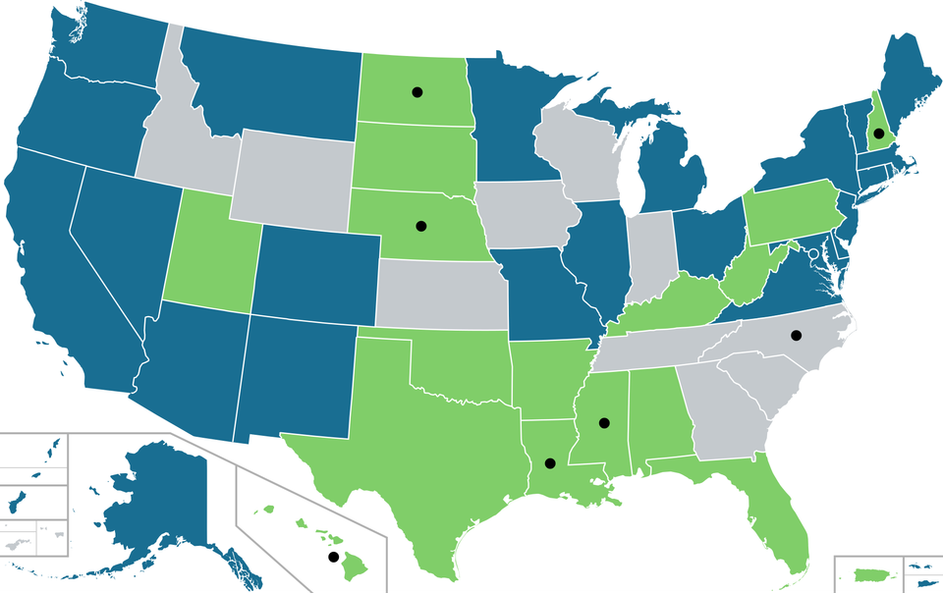
How does the price of medical cannabis compare to surrounding states?
Direct comparisons are difficult because:
  Each state's medical cannabis market operates independently.
  Products cannot be transported across state lines.
  Market maturity, supply and demand, regulations, competition, and taxes vary by state.
As supply and competition expand in Kentucky’s medical cannabis market, prices are expected to moderate consistent with traditional market behavior.

Slide 26
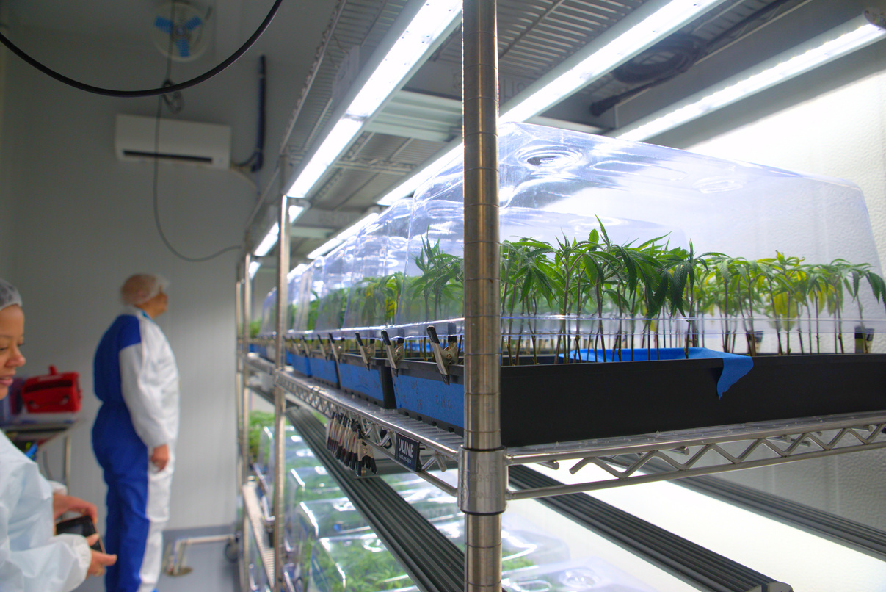
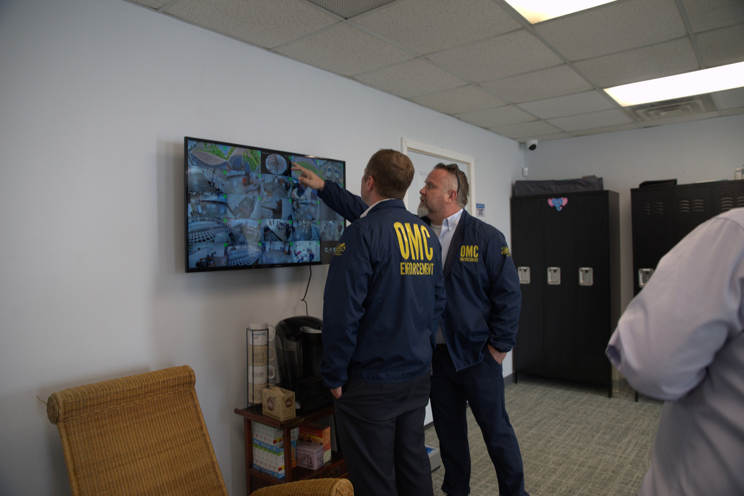
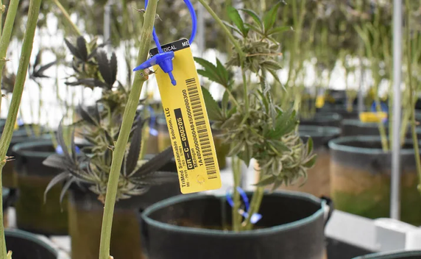
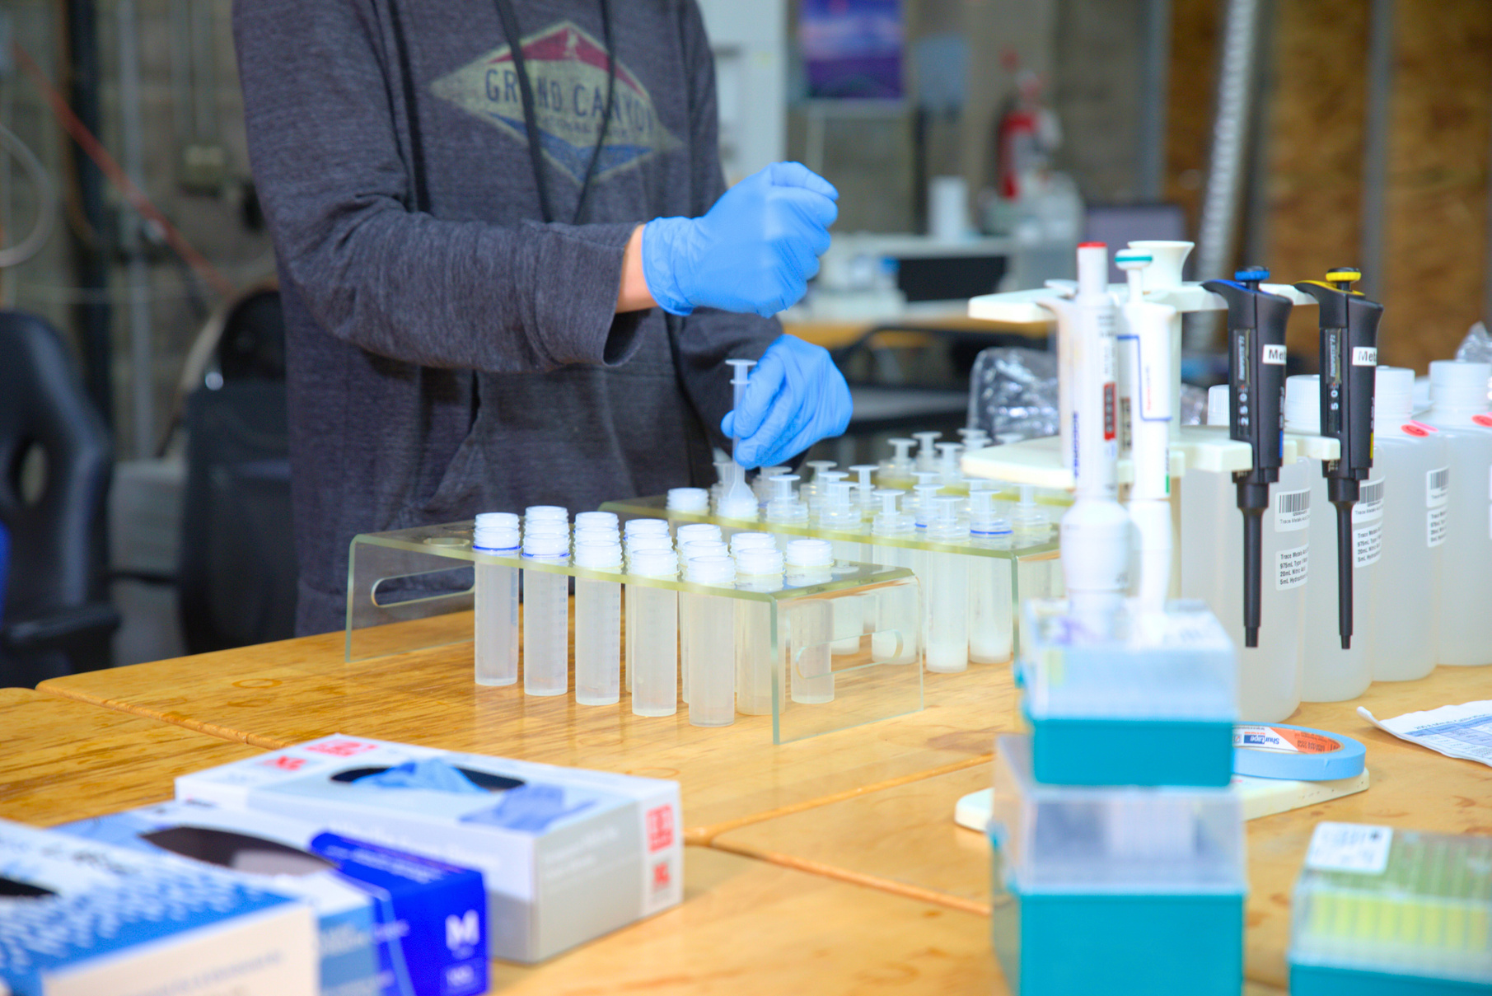
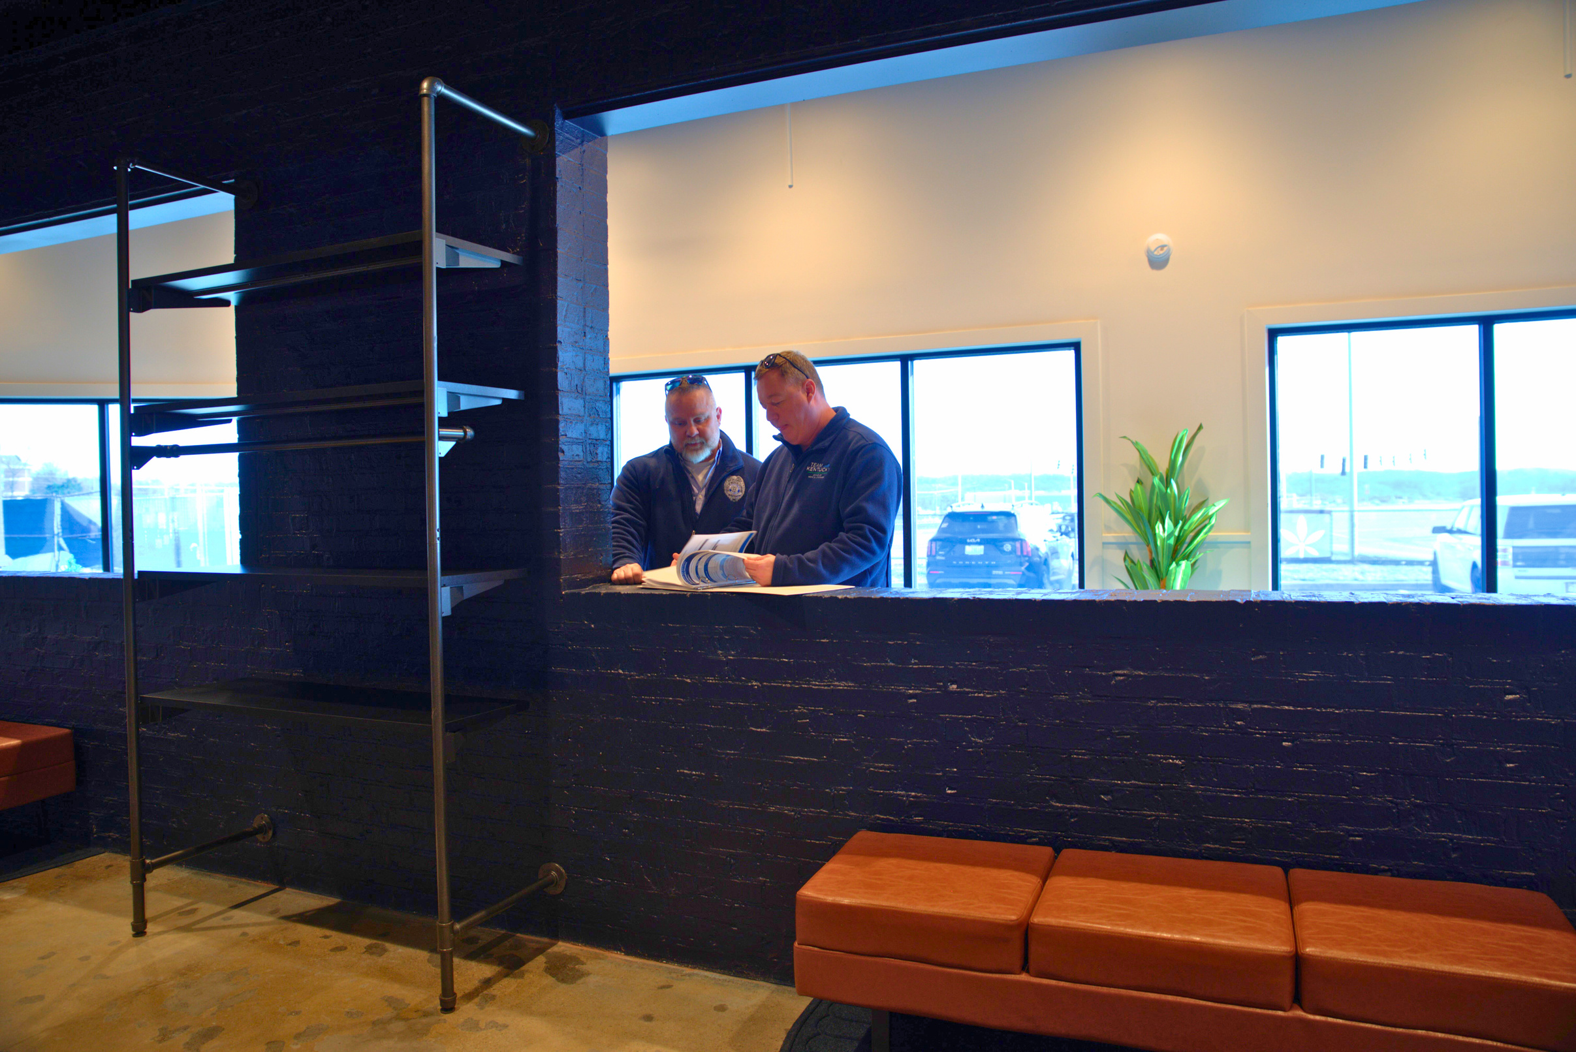
What challenges prevent more Kentucky farmers from participating in medical cannabis production?
Medical cannabis production is subject to specialized statutory and regulatory requirements that differ significantly from traditional farming practices.
Enclosed, Locked Facilities
Security Requirements
Inventory Tracking
Testing Standards
Regulatory Compliance

Slide 27
Overview of obtaining a medical cannabis license
1
2
3
4
5
Application
Application
Application
Application
Application
Application
Review
Lottery
Inspection
Approval
  As required by KRS 218B.140(1)(c)3, OMC promulgated administrative regulations establishing procedures for the issuance of cannabis business licenses. See 915 KAR 1:010 and 915 KAR 1:020.
  The previous initial cannabis busi​ness license period for cultivator, processor, and dispensary application submissions was July 1, 2024 to August 31, 2024.

Slide 28
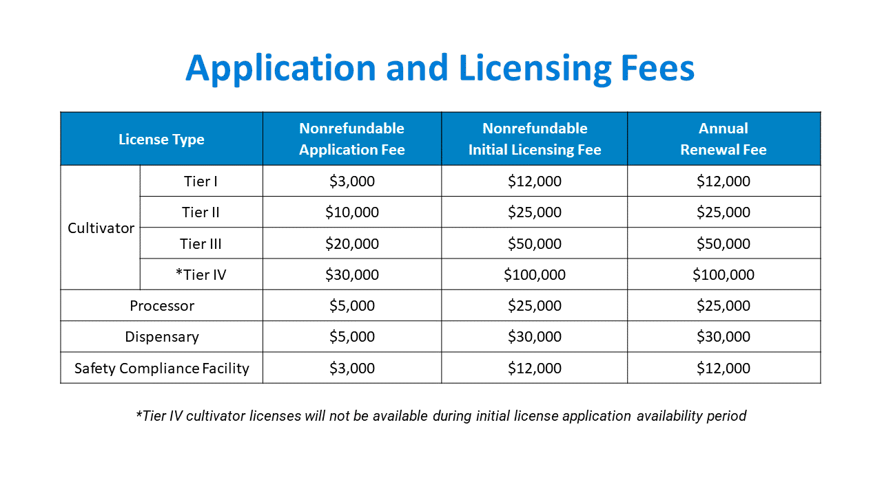
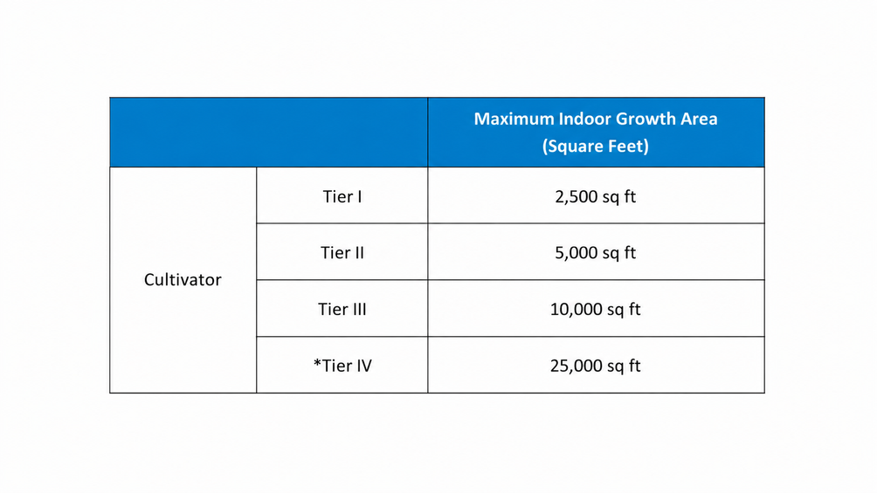
What is the application and license fee for each tier? How many tiers?
Cultivator Tiers Maximum Growth Area

Slide 29
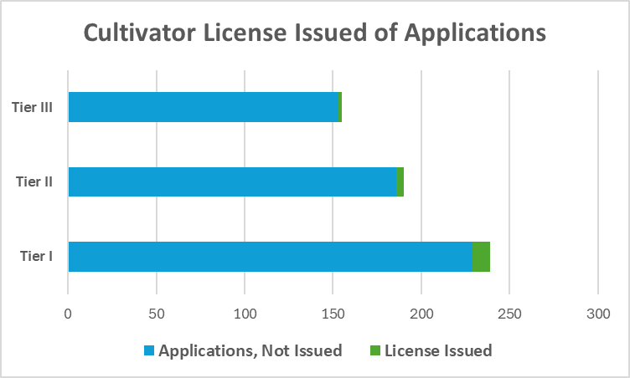
How many applications for a cultivator license were there and how many were issued?
There were 584 applications for 16 available cultivator licenses.
155
2
190
4
239
10

Slide 30
What is the dollar amount in application and license fees collected to date?
$27,789,000
Received from
initial license applications
+
$2,094,000
Received from
initial license fees
+
$2,082,000
Received from
renewal licese fees
(Each license is valid for one year)
=$31,965,000
Received in total from cannabis business application and licensing fees

Slide 31

Of those fees, where did those dollars go?
Per KRS 218B.080(3), “[l]icensure application fees, initial licensing fees, and licensure renewal fees collected by the cabinet pursuant to this section shall be retained by the cabinet for administrative purposes.”

Slide 32
How many licenses have been sold?
28
Approved Sales or Transfers
Please note that per KRS 218B.080(6), the Office “shall approve a [cannabis business] license holder’s sale of a license issued pursuant to this section and KRS 218B.085 and 218B.090 if the purchaser and any new facilities meet the requirements of this chapter.”

Slide 33
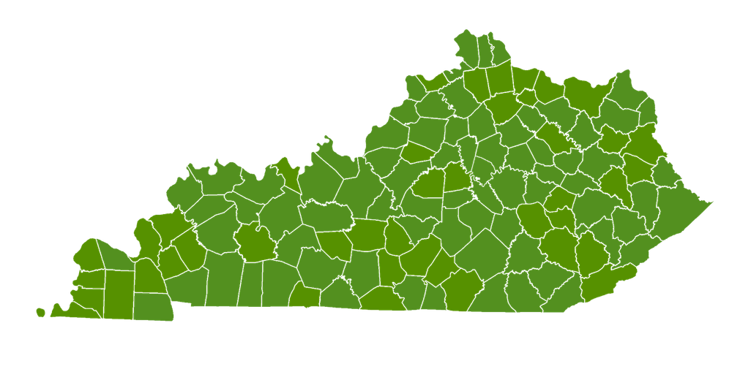

Do any entities have multiple licenses?
OMC identified 3 dispensaries all holding licenses in 2 different dispensary regions:
Reed KY Dispensary LLC
BD Expansion LLC
WPBD Target LLC

Slide 34
QUESTIONS

