Slide 1


Slide 2
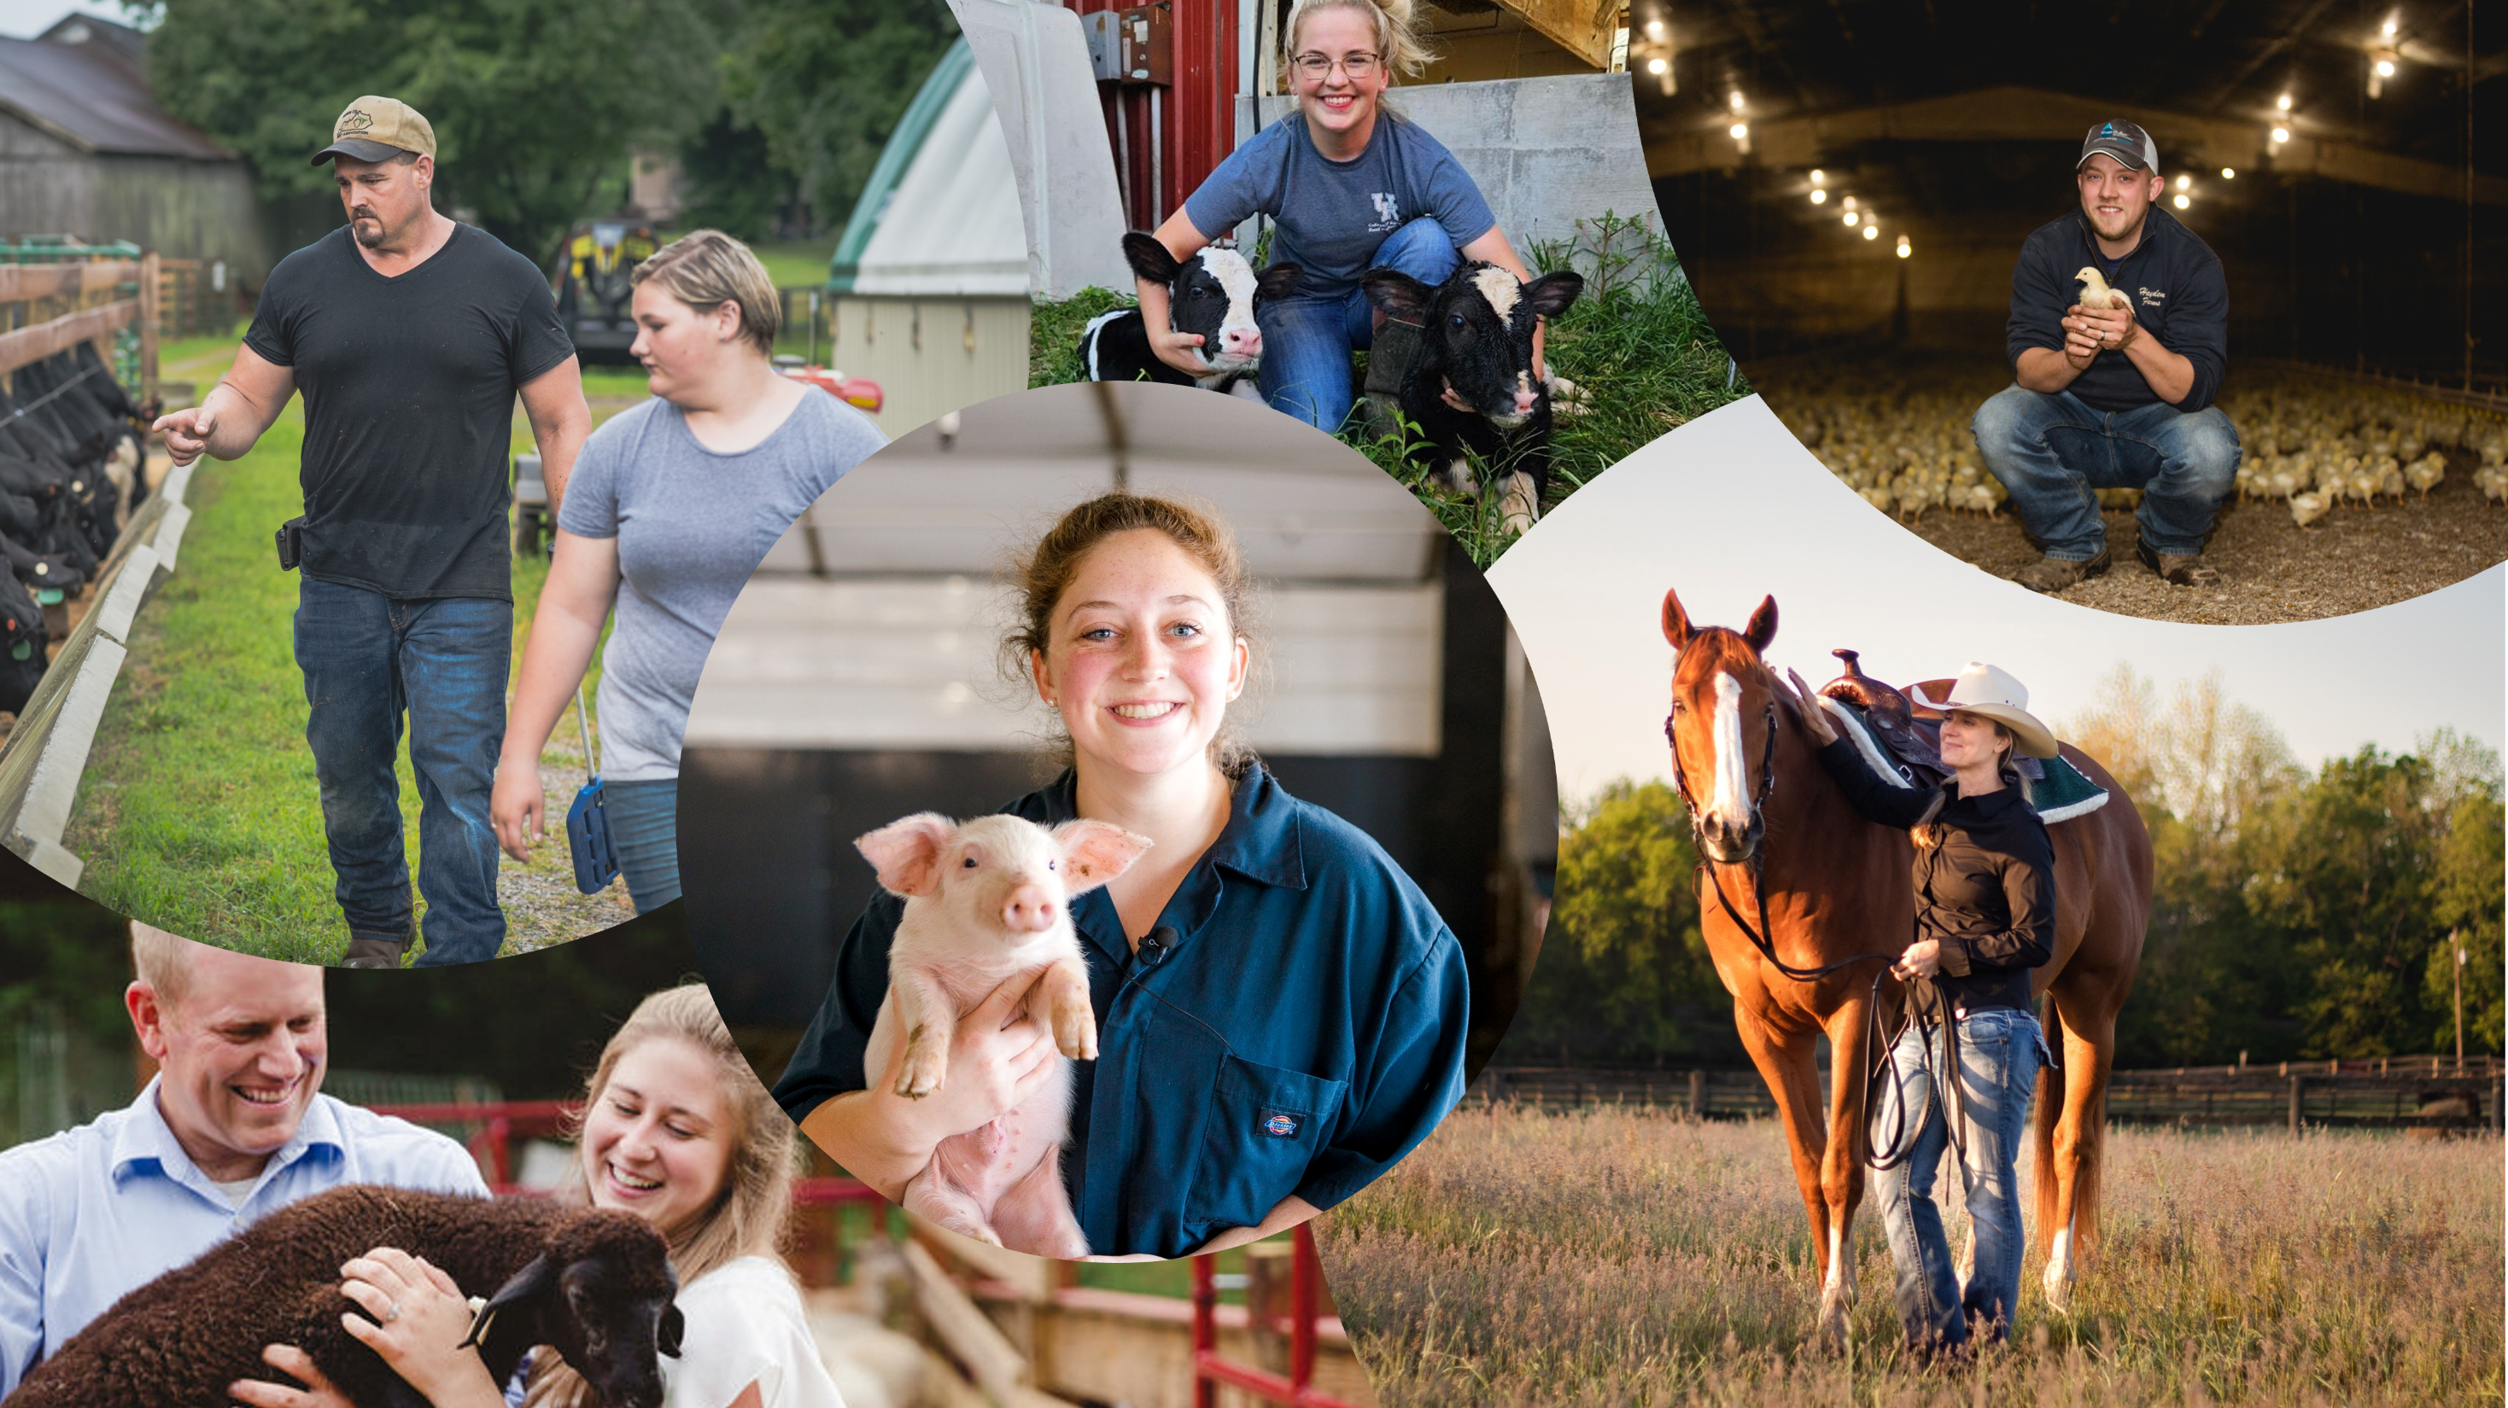
HOUSE BILL 1 THANK YOU

Slide 3


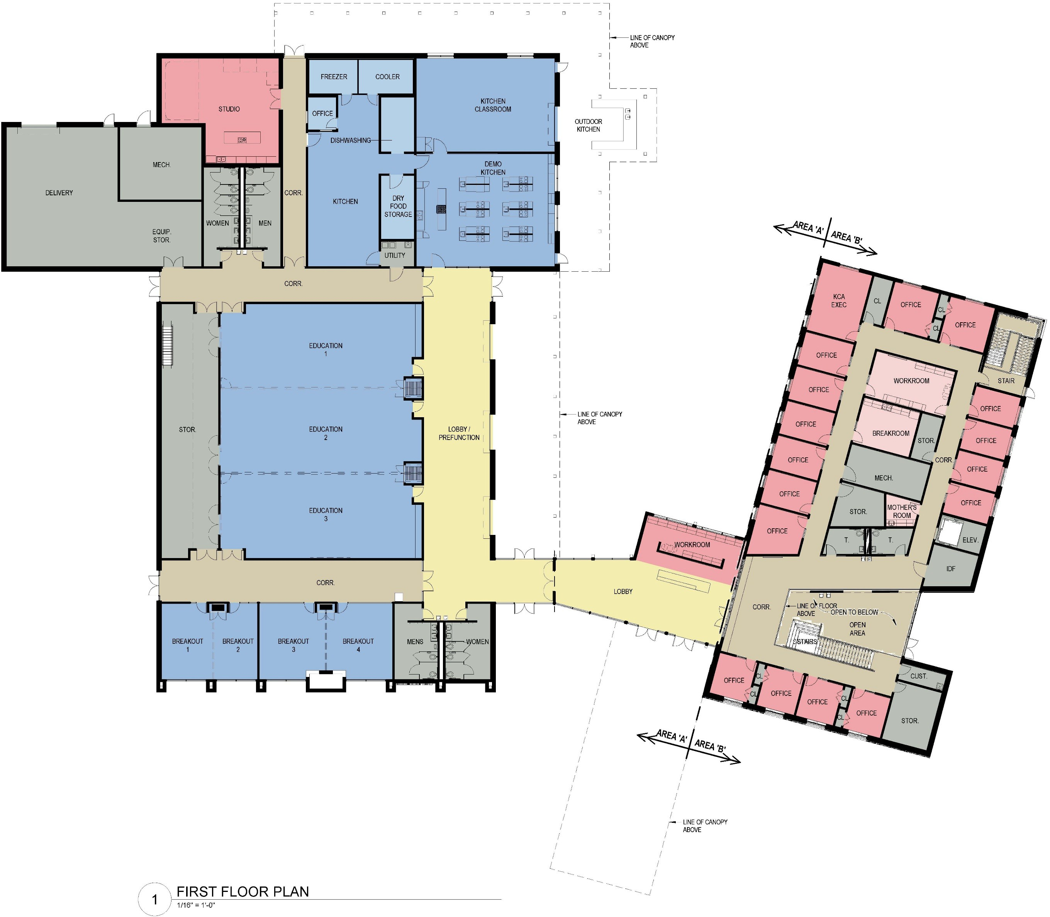


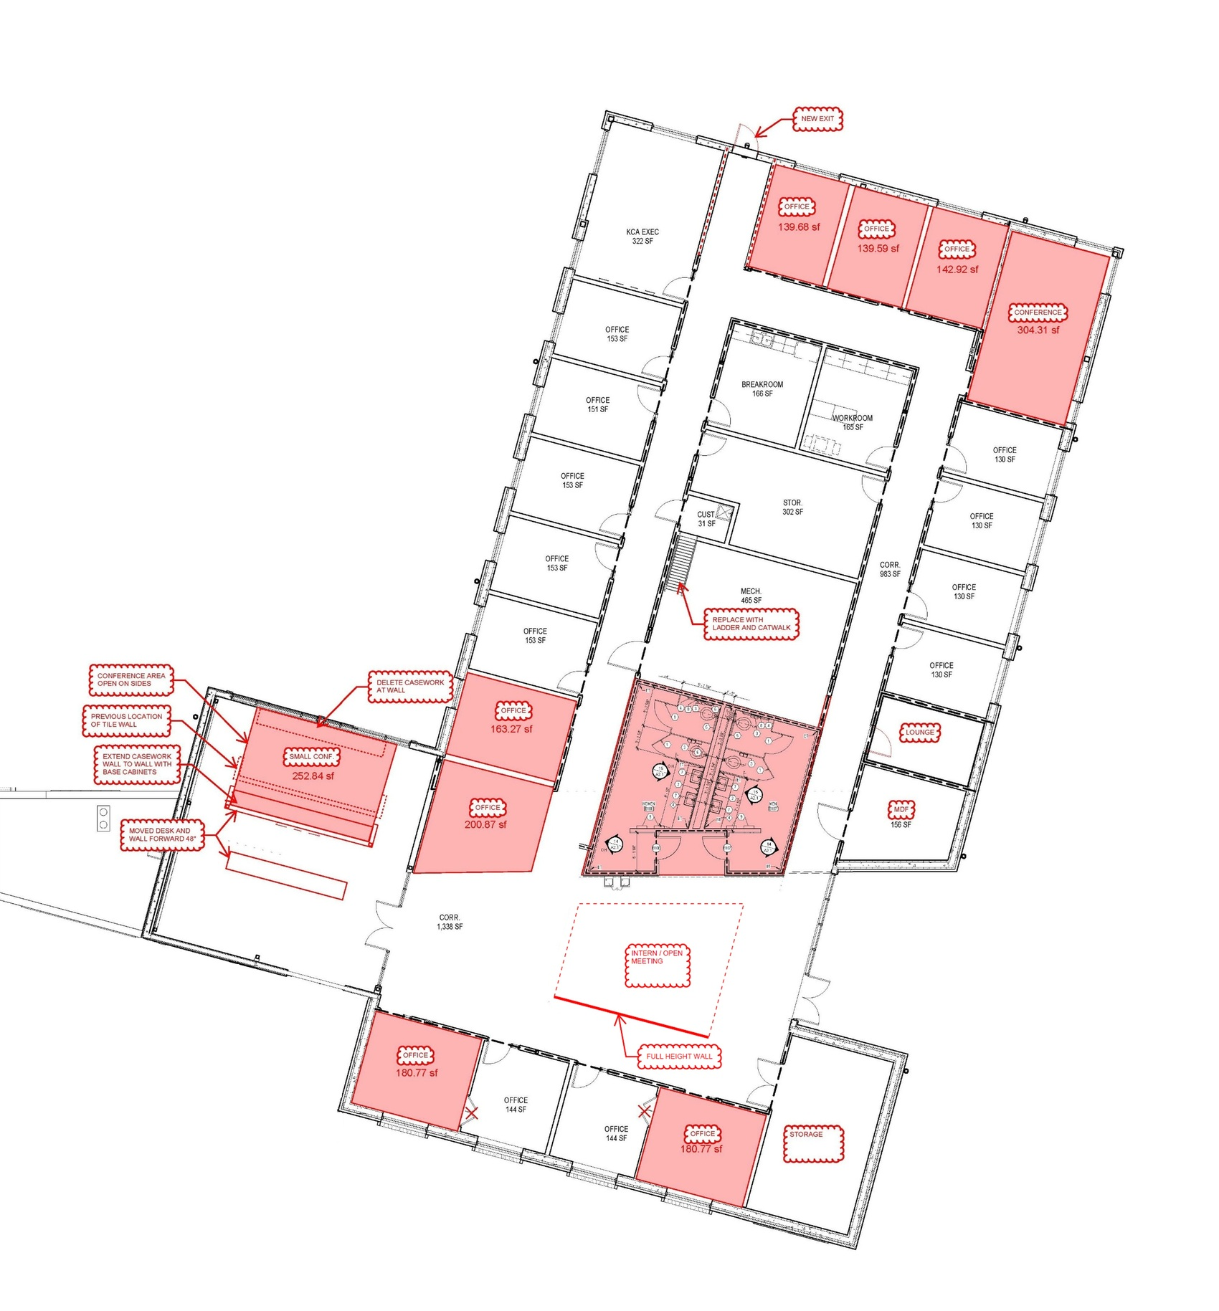




Culinary Training Center
Education / Conference Area
Business Wing / Office Space

Slide 4
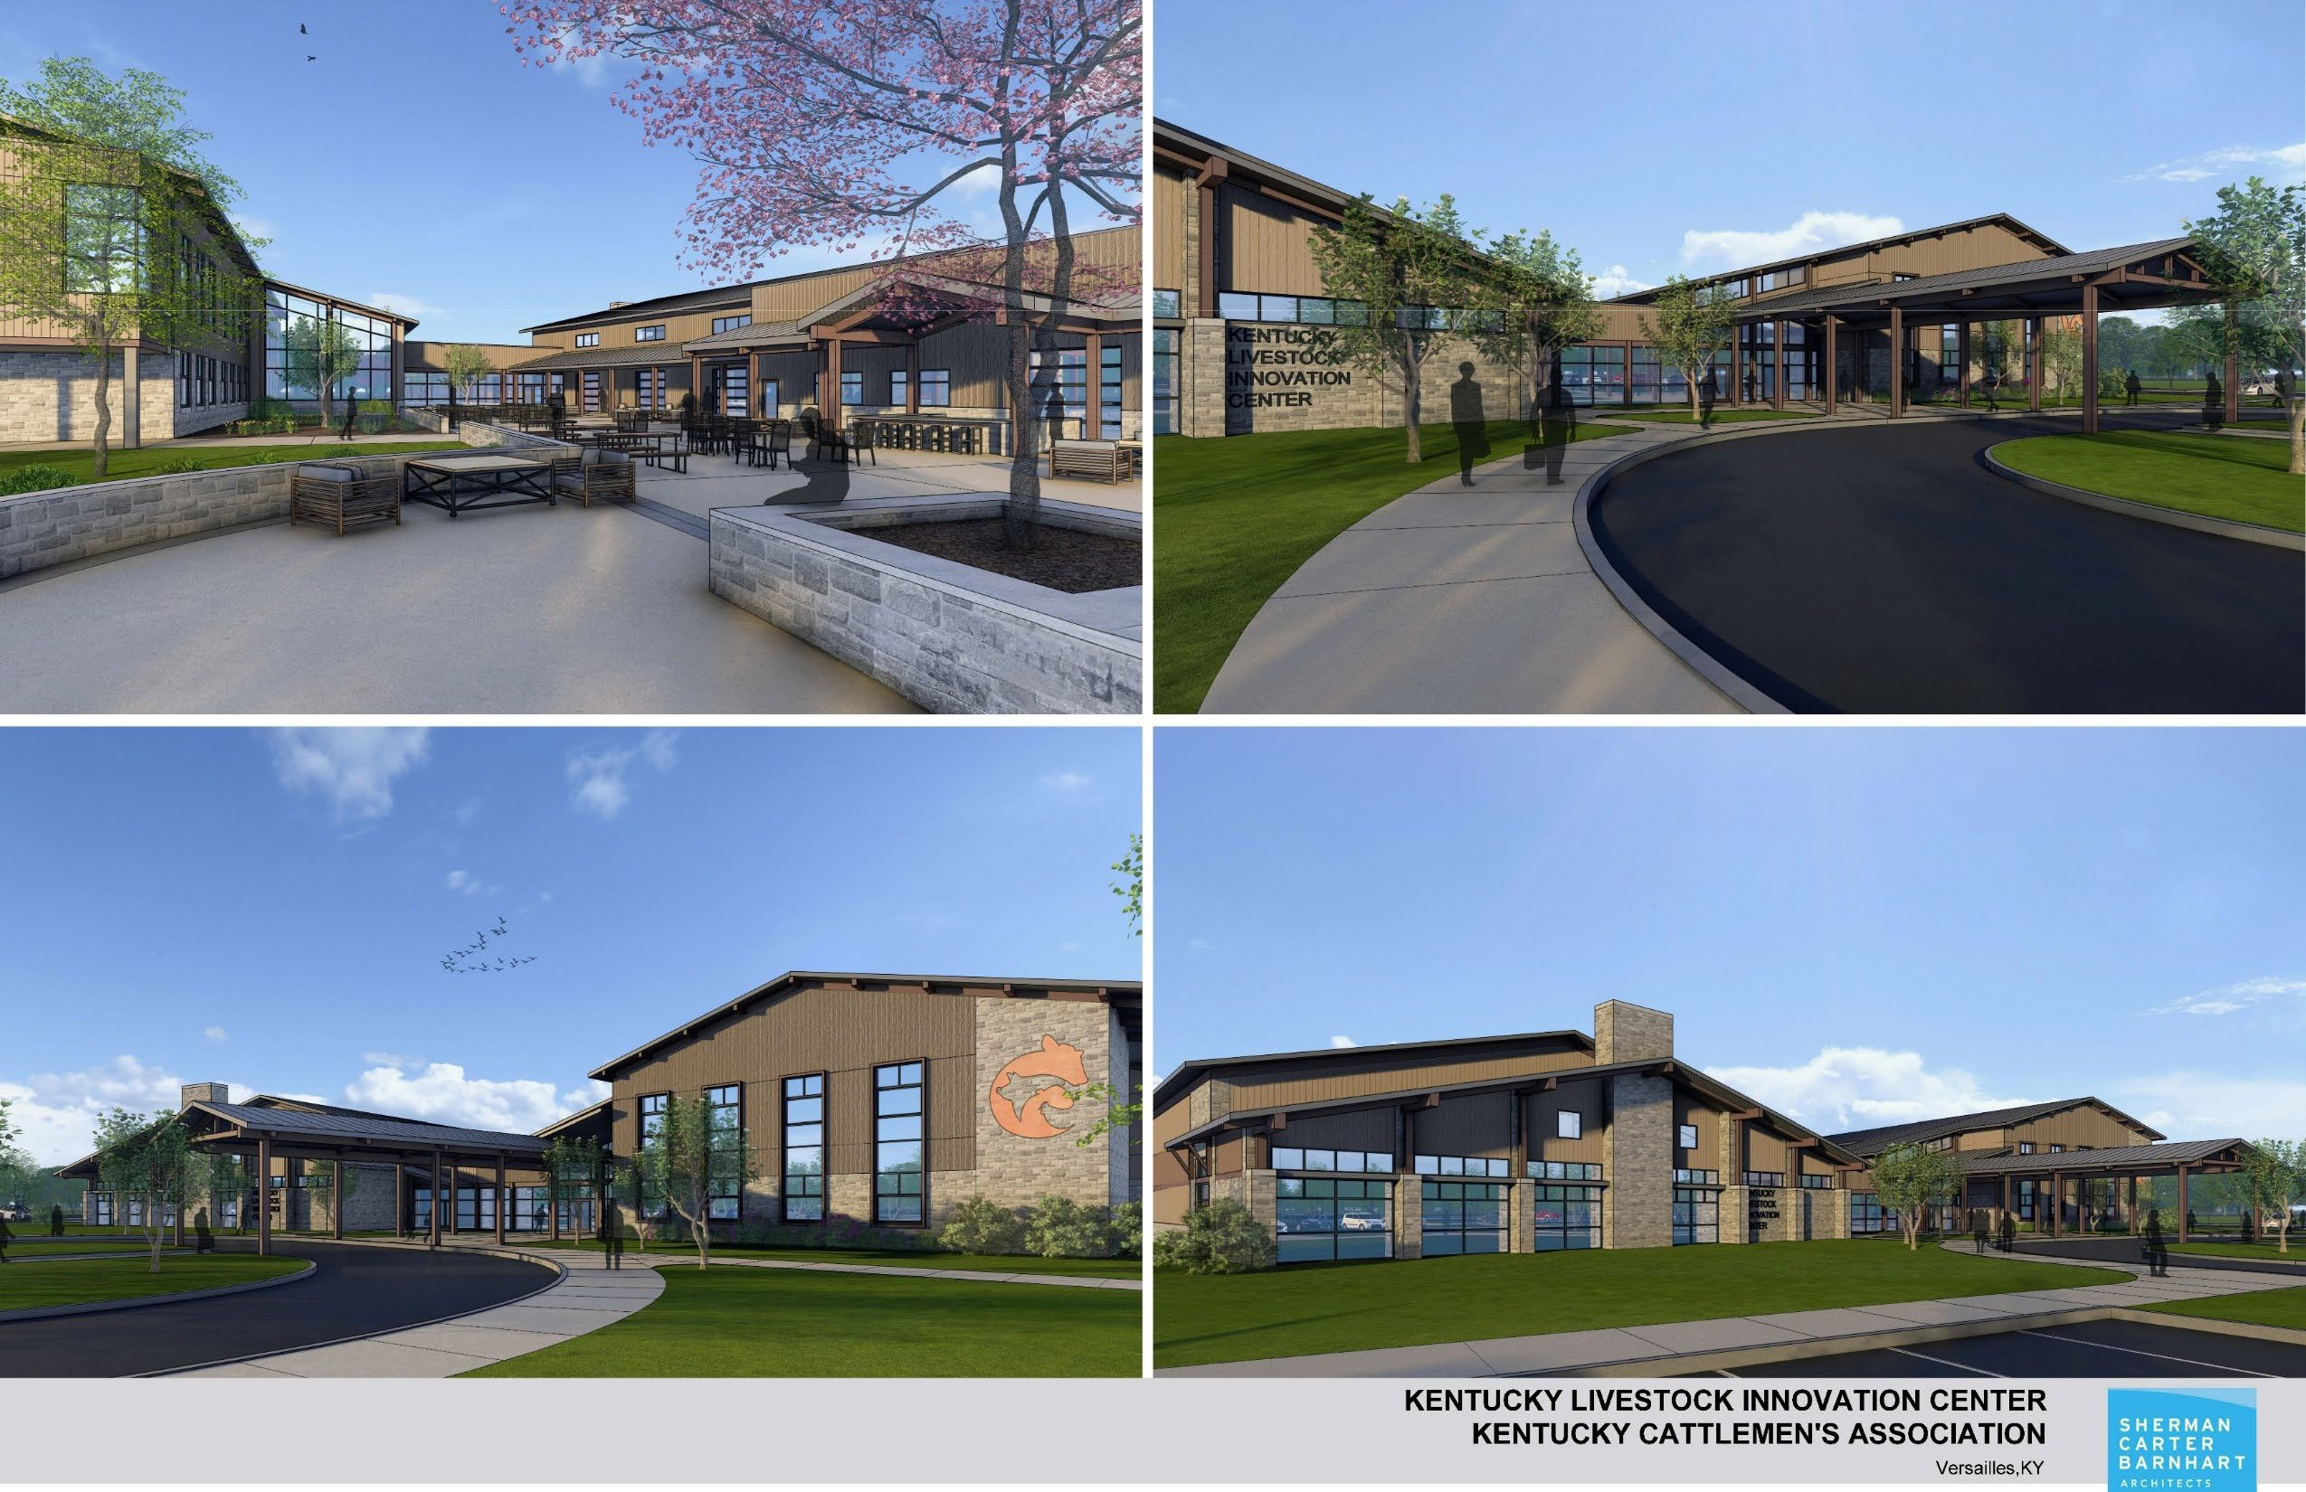

Slide 5
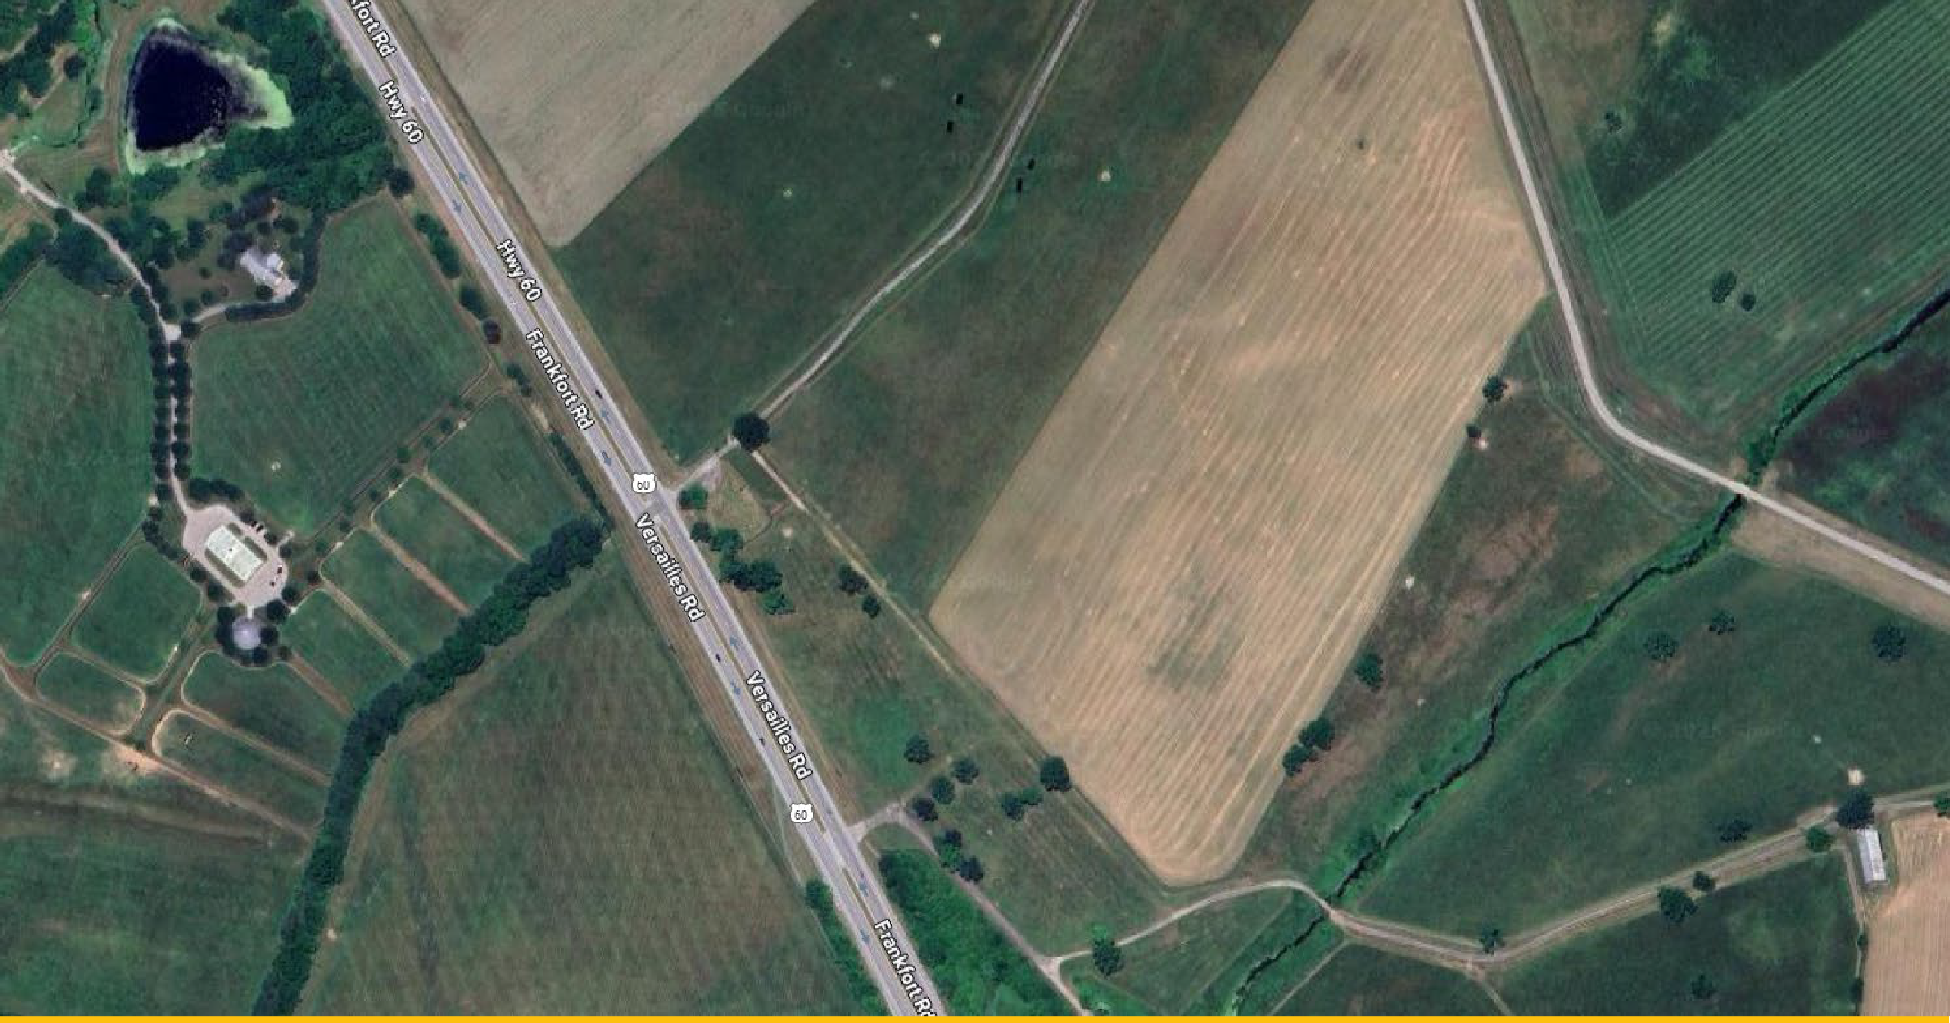
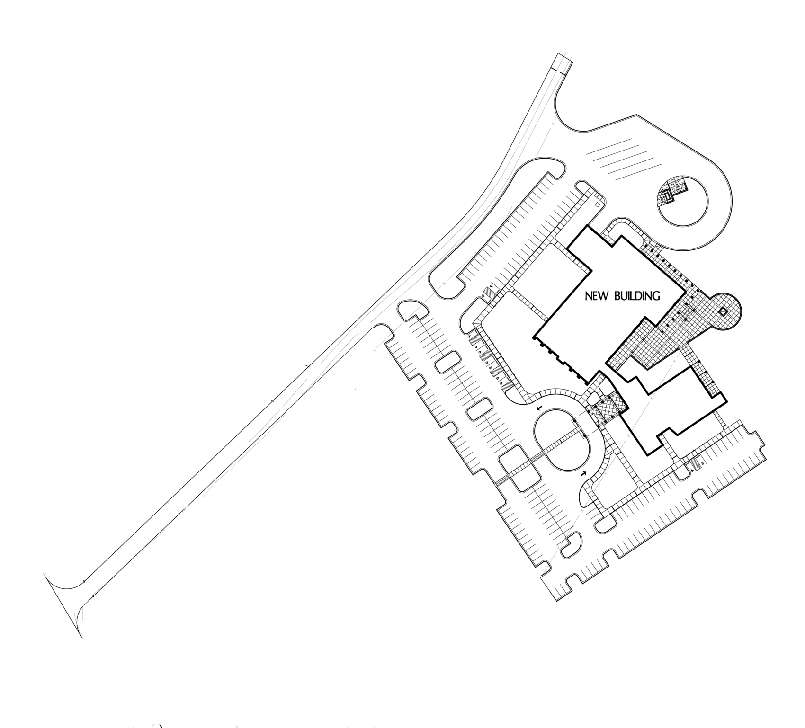
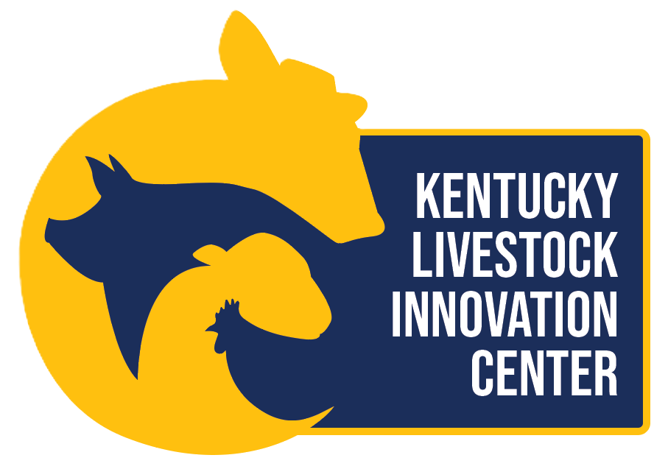

Slide 6
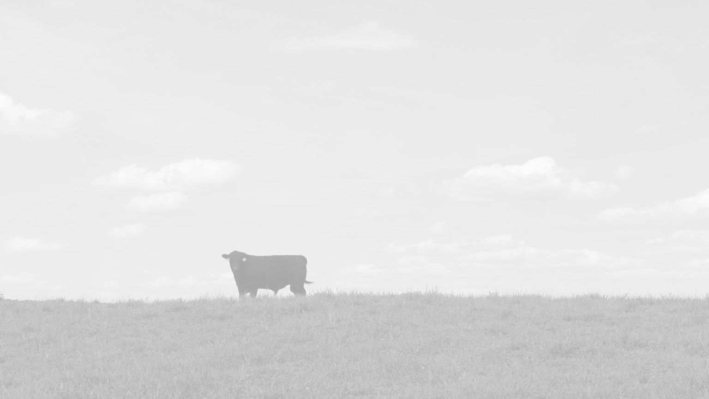

Addressing Challenges in a Changing Cattle Industry

Slide 7
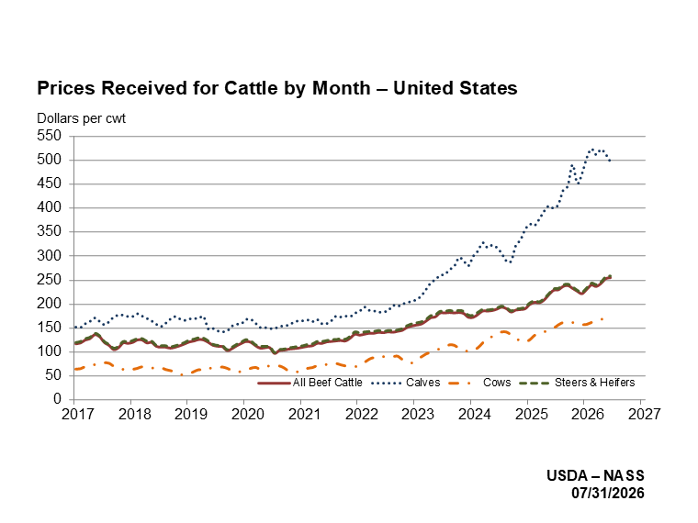

Slide 8
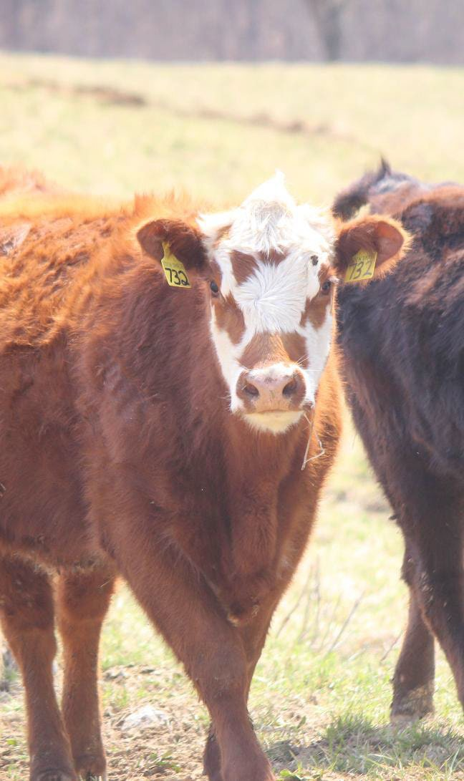
Kentucky Beef Cow Inventory January 1
1,050,000
1,021,000
1,000,000
973,000
965,000
950,000
895,000
907,000
900,000
869,000
862,000
850,000
800,000
750,000
2020
2021
2022
2023
2024
2025
2026
US Beef Cow Inventory January 1
32,000,000
31,300,000
31,200,000
31,000,000
30,100,000
30,000,000
29,000,000
28,900,000
28,200,000
27,900,000
28,000,000
27,600,000
27,000,000
26,000,000
25,000,000
2020
2021
2022
2023
2024
2025
2026

Slide 9
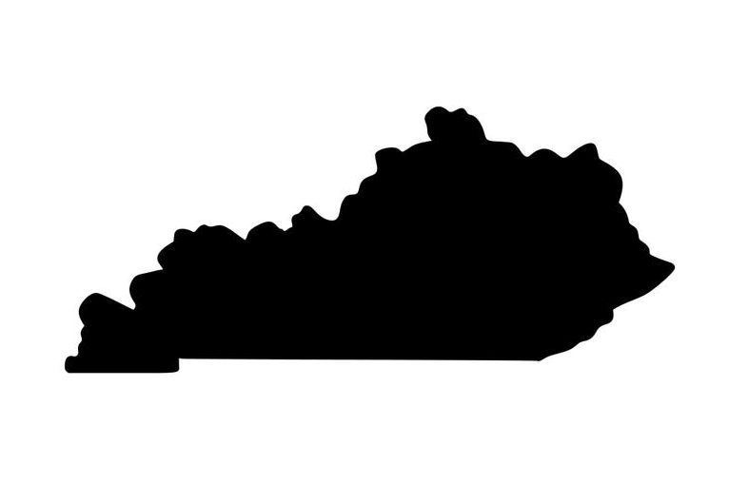
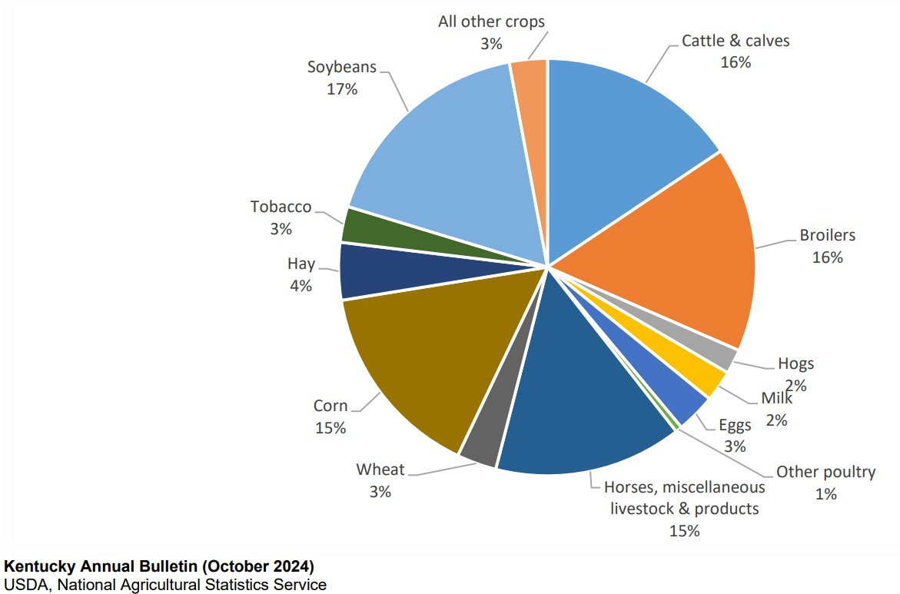
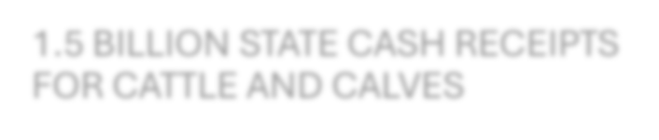
1.5 BILLION STATE CASH RECEIPTS FOR CATTLE AND CALVES

Slide 10
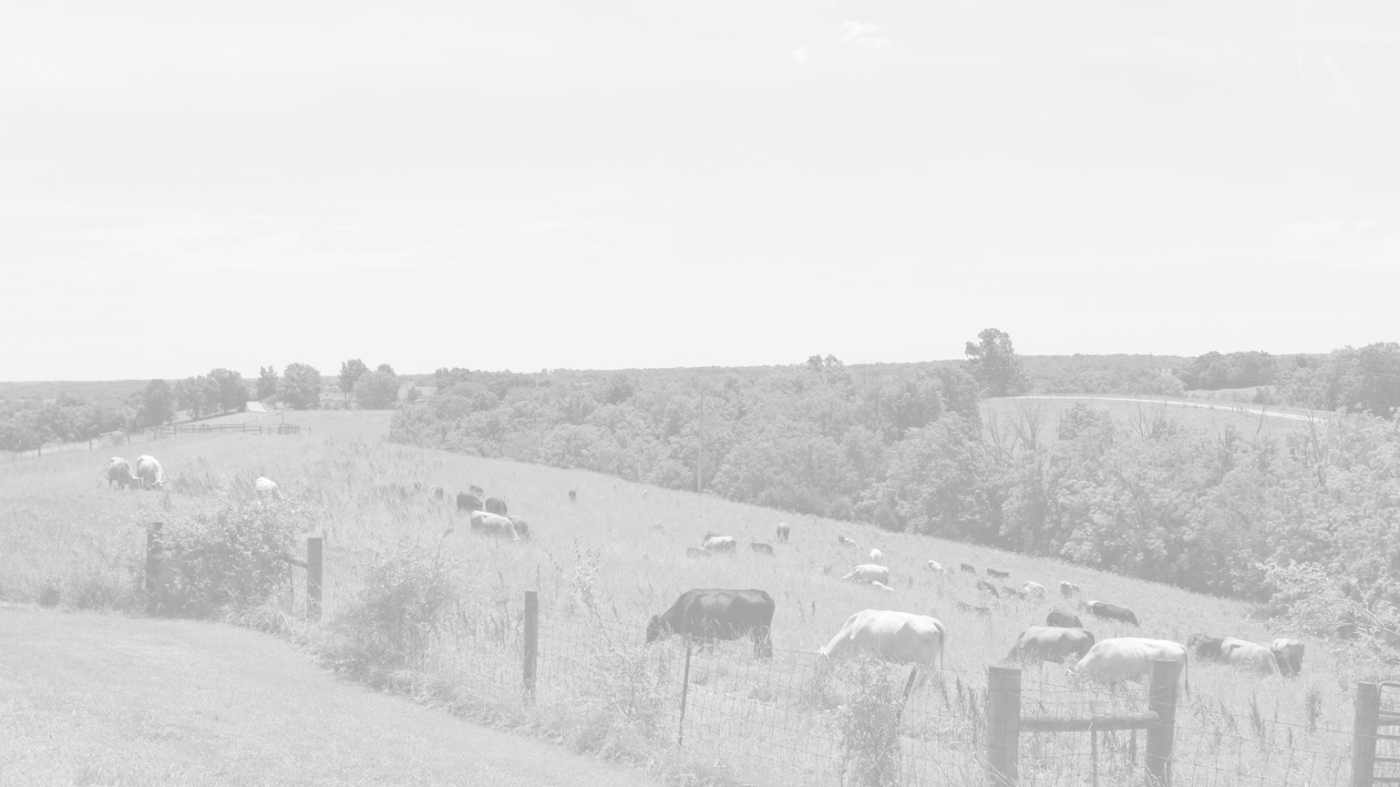
Farm Land by Use - Kentucky
8,000,000
7.32% decrease
7,000,000
6,000,000
5,000,000
29.08% decrease
4,000,000
7.30% decrease
3,000,000
2,000,000
1,000,000
0
Cropland
Pastureland
2007 2012 2017 2022
Woodland

Slide 11

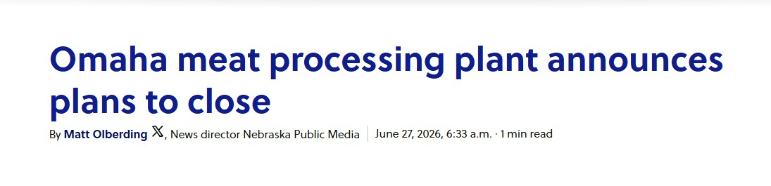

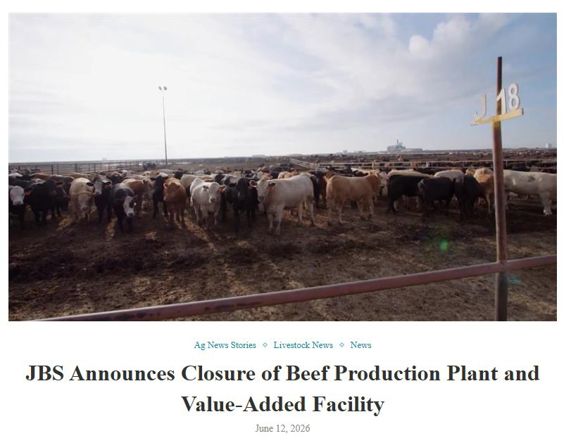

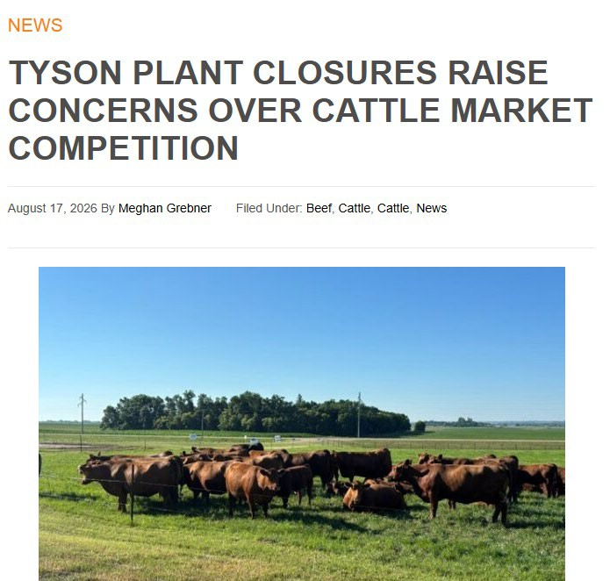

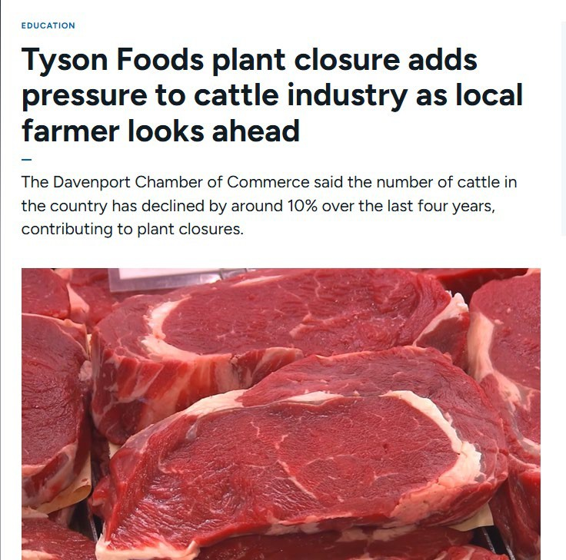

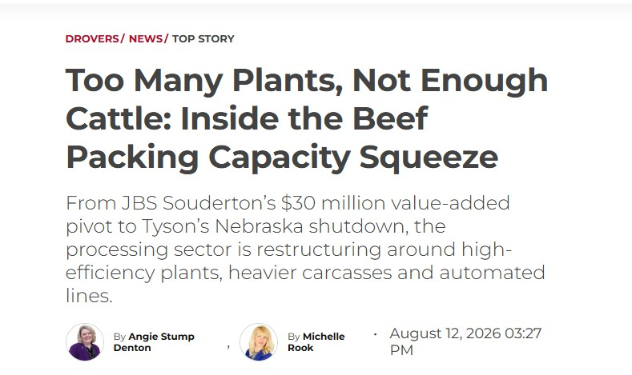

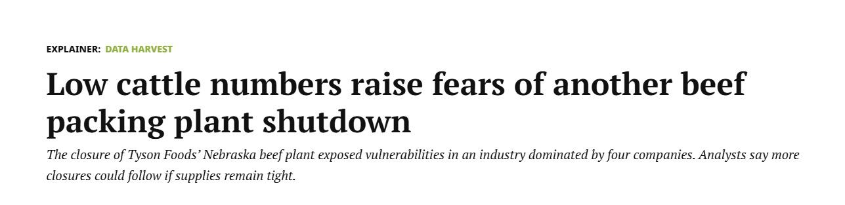

Slide 12
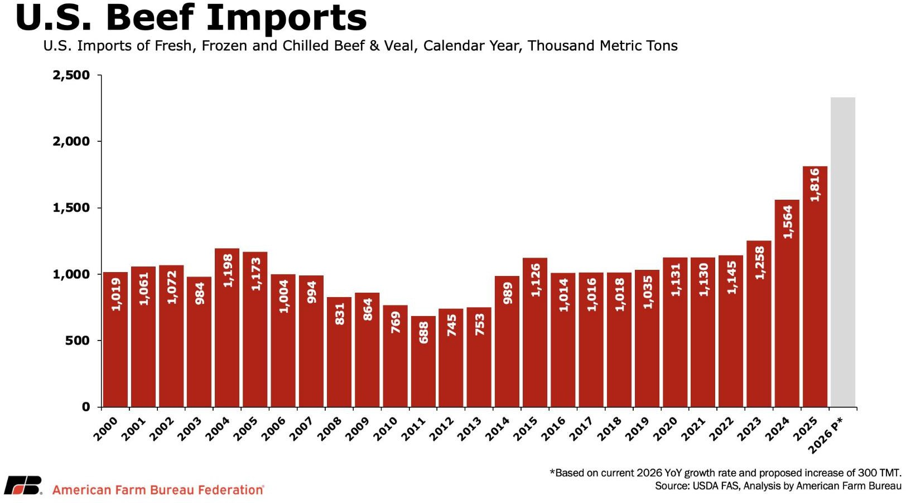

Slide 13
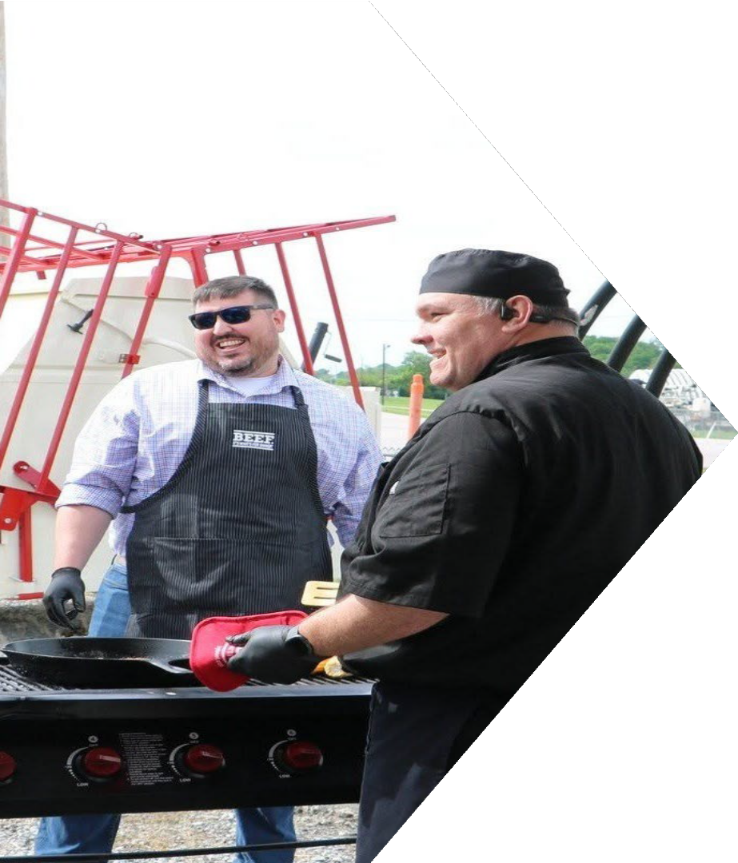
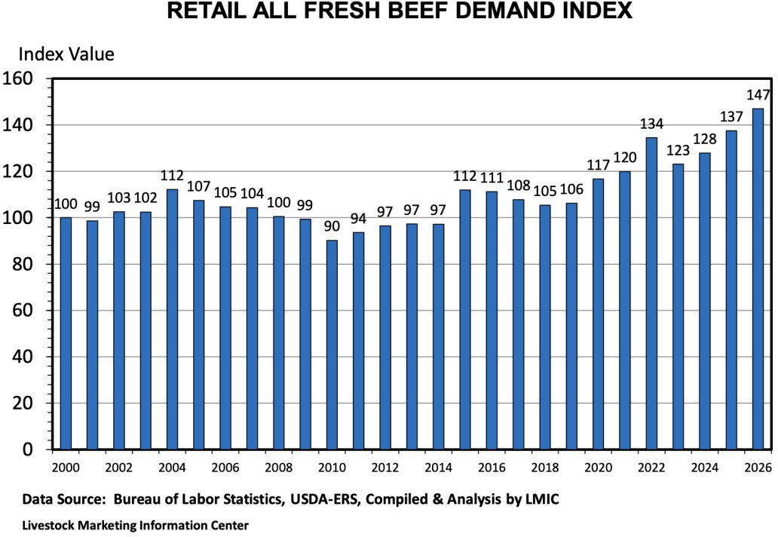

Slide 14
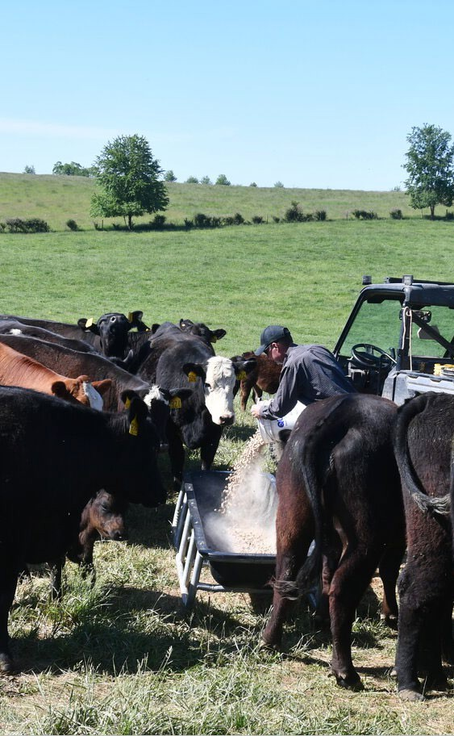
Conclusion:
A pivotal moment for our producers
Producers are making long-term decisions today:
  Rebuild the herd, retain heifers and expand
  Or sell out and leave the industry
Consumers continue to demand high-quality beef - but we recognize that affordability matters when Kentucky families are putting food on the table.
Producers need stability from our government - not policies that create additional uncertainty in an already challenging market.
The Livestock Innovation Center exists to support research, education, and partnerships in the industry.

