Slide 1



Slide 2
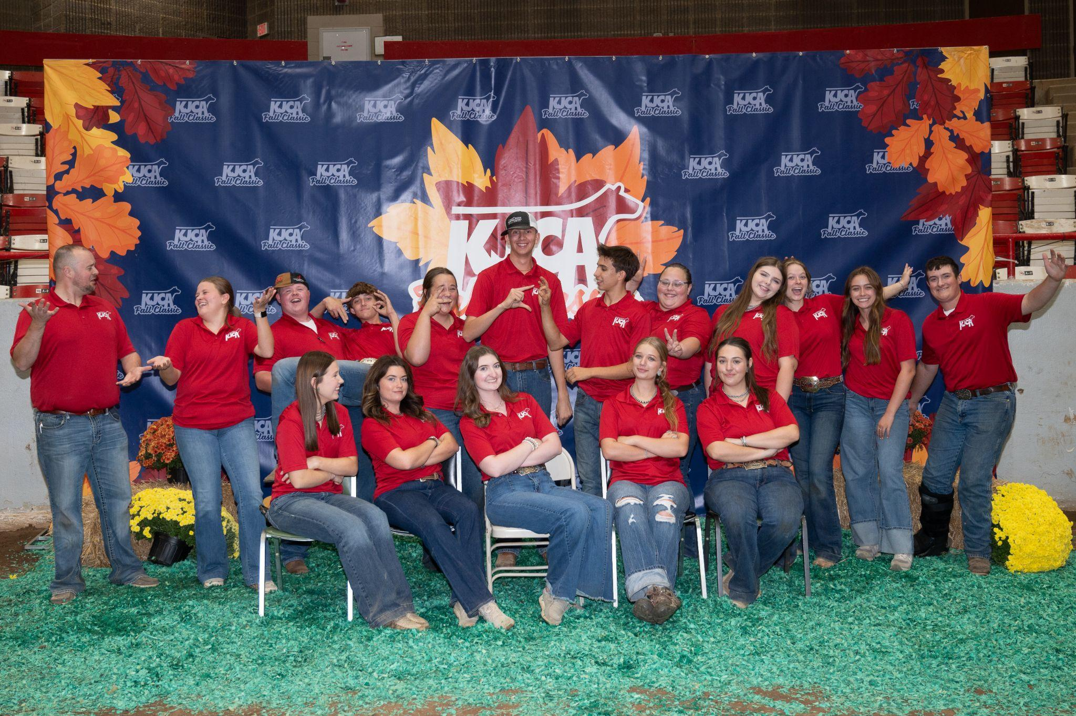
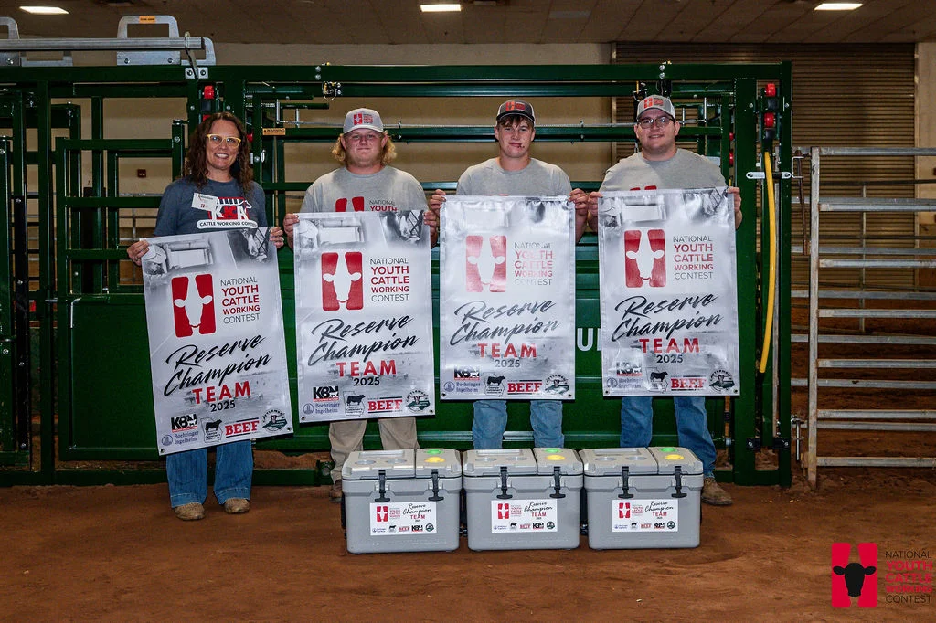
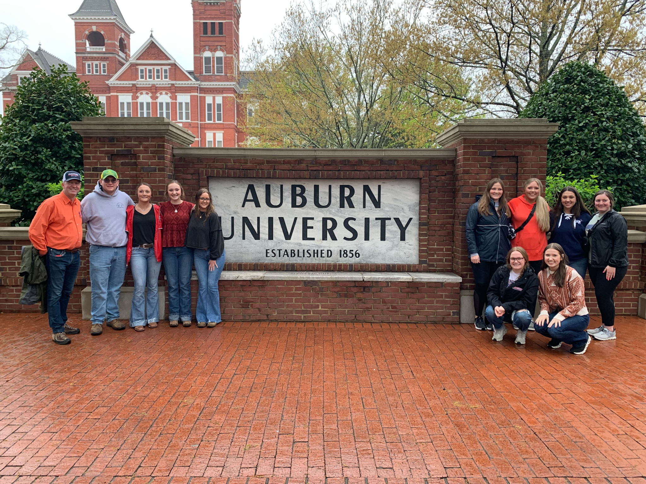


What Is KJCA?
KJCA Fall Classic
KJCA Convention
KJCA Points Program
Kentucky Cattlemen’s Youth Beef Heifer Incentive
KJCA Academy Youth Beef Leadership
Nebraska Youth Beef Leadership Symposium
Cattle Working Contest
Veterinary Mentorship Program
kycattle.org/kjca
Notes:
Run through the different opportunities and talk a little about each. Talk about the ones you have done and what you gained from them.

Slide 3
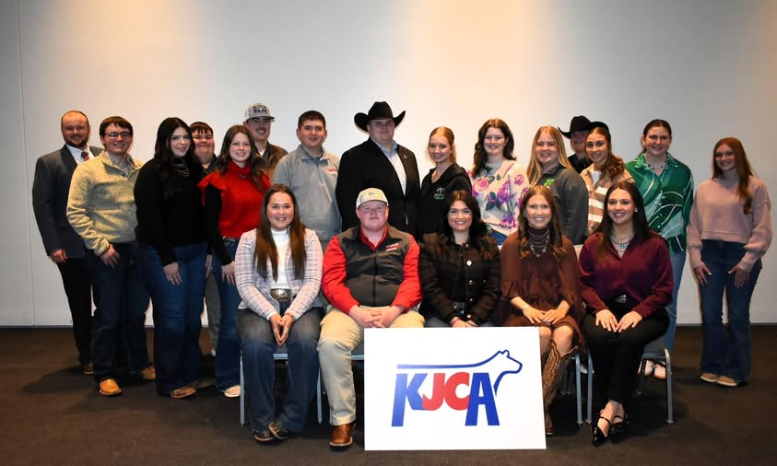
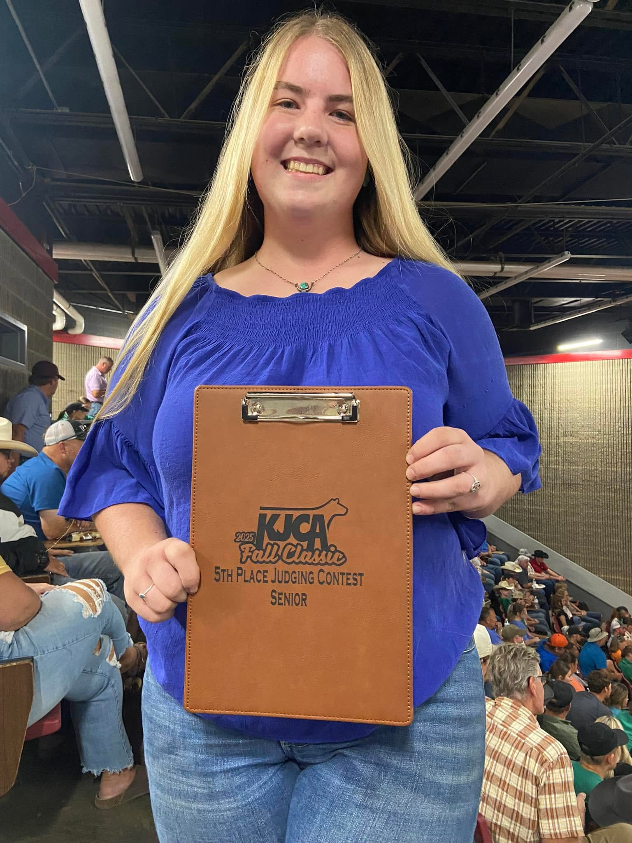
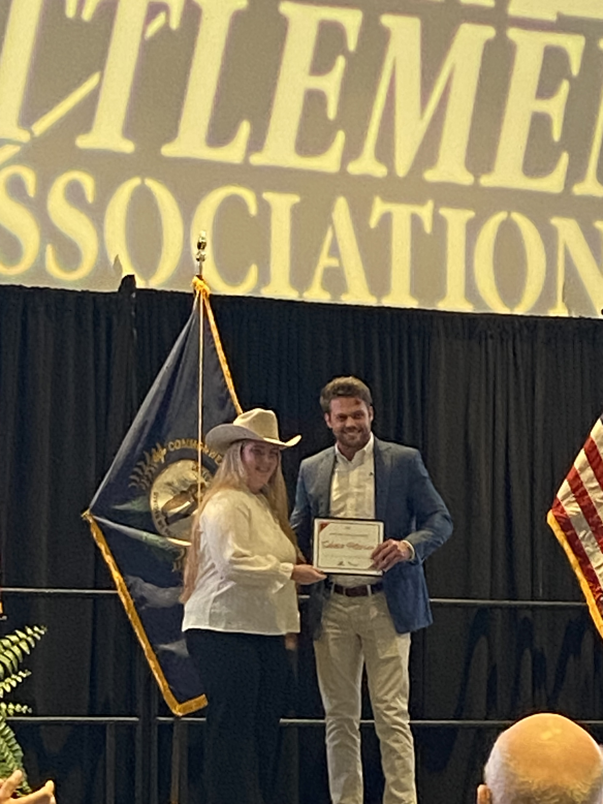
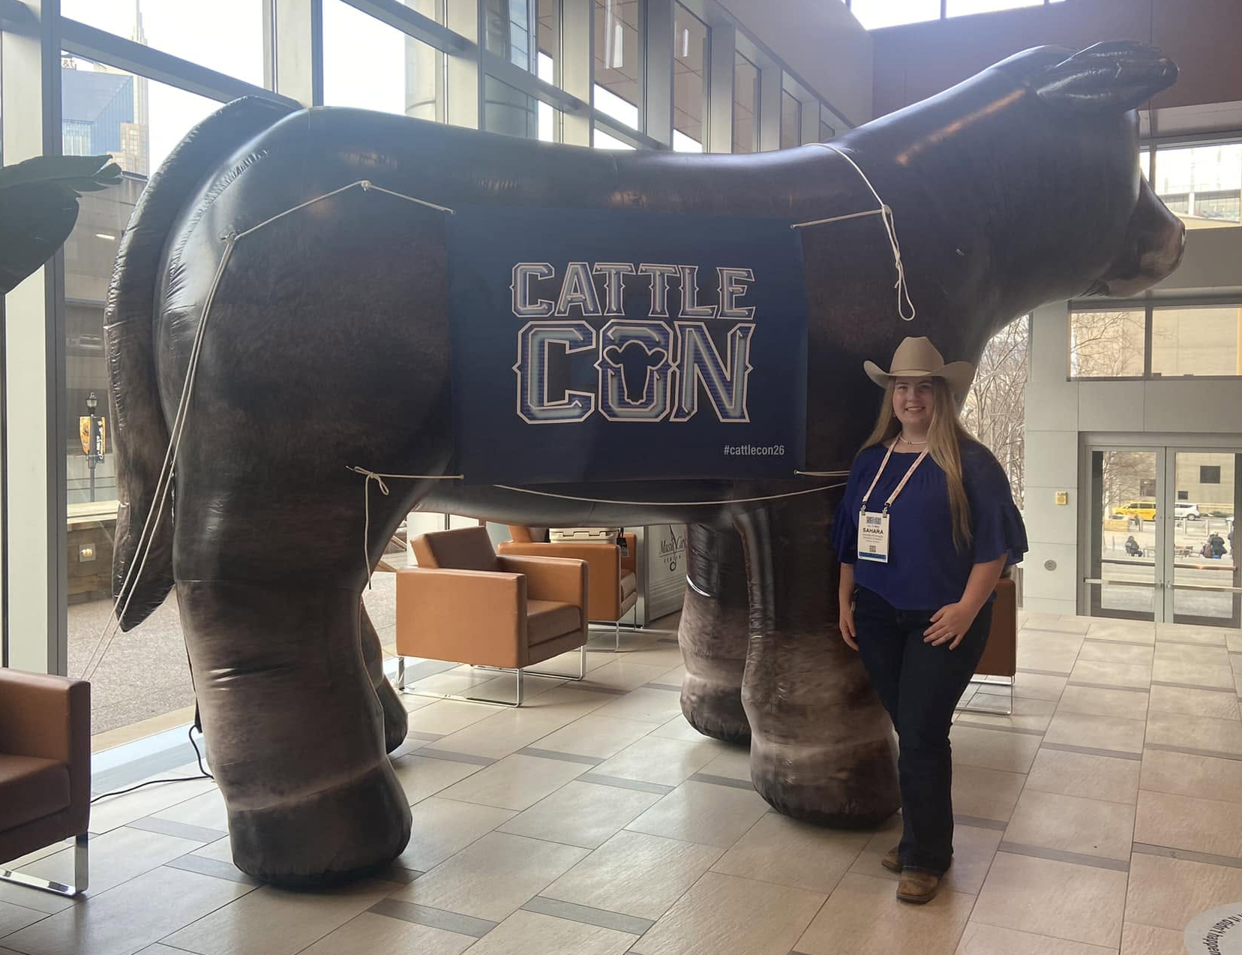
Sahara - Journey with KJCA
Notes:
Why did you get involved, and where has it taken you

Slide 4
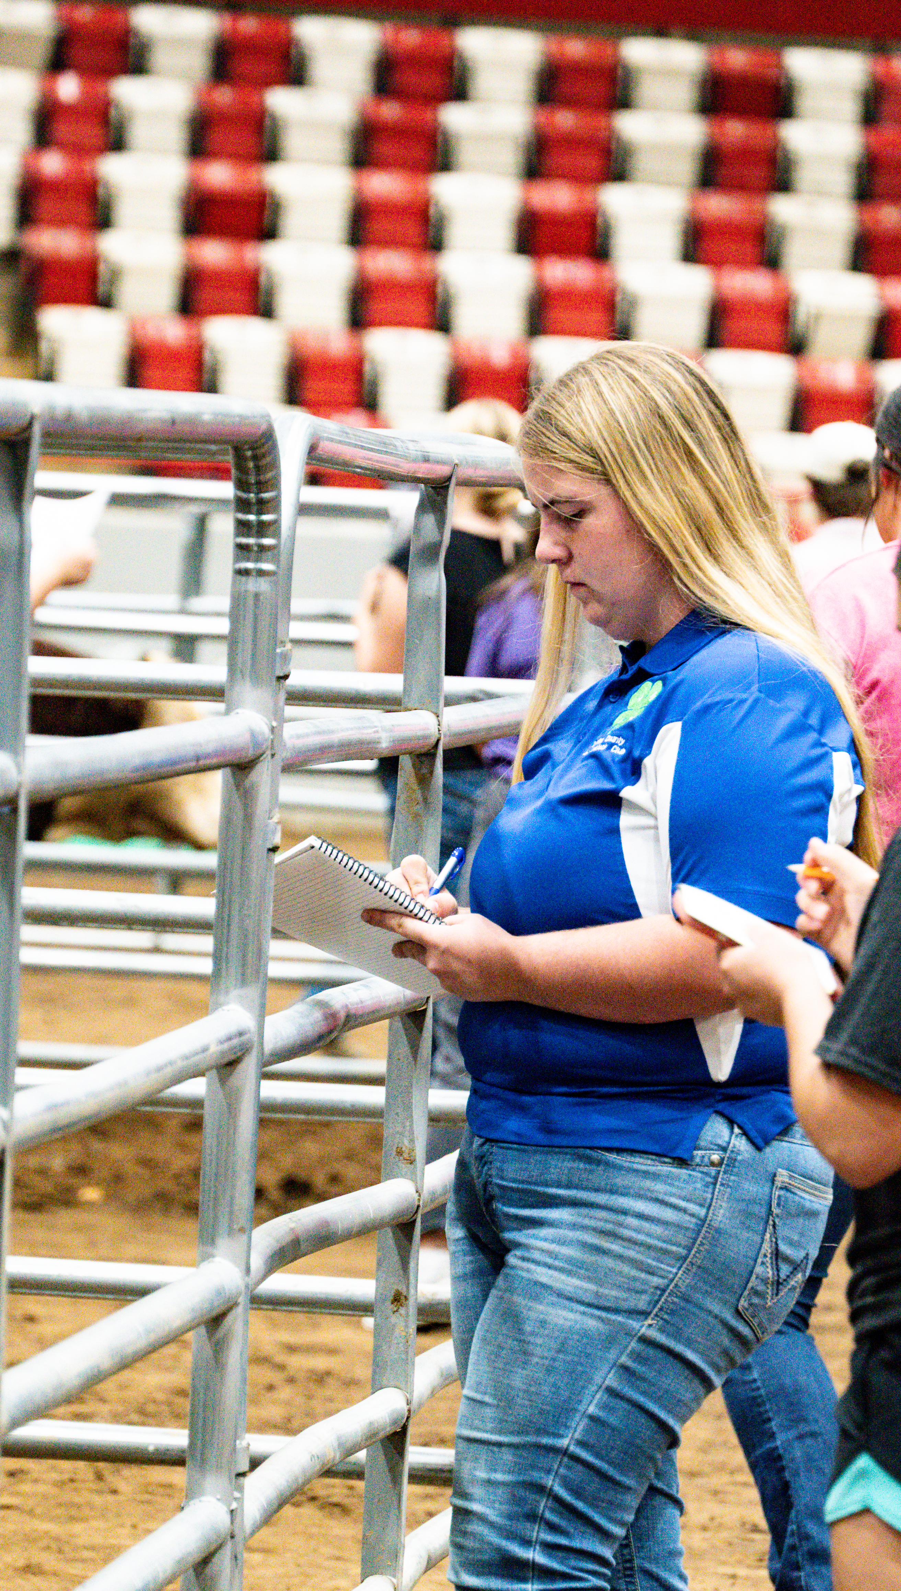
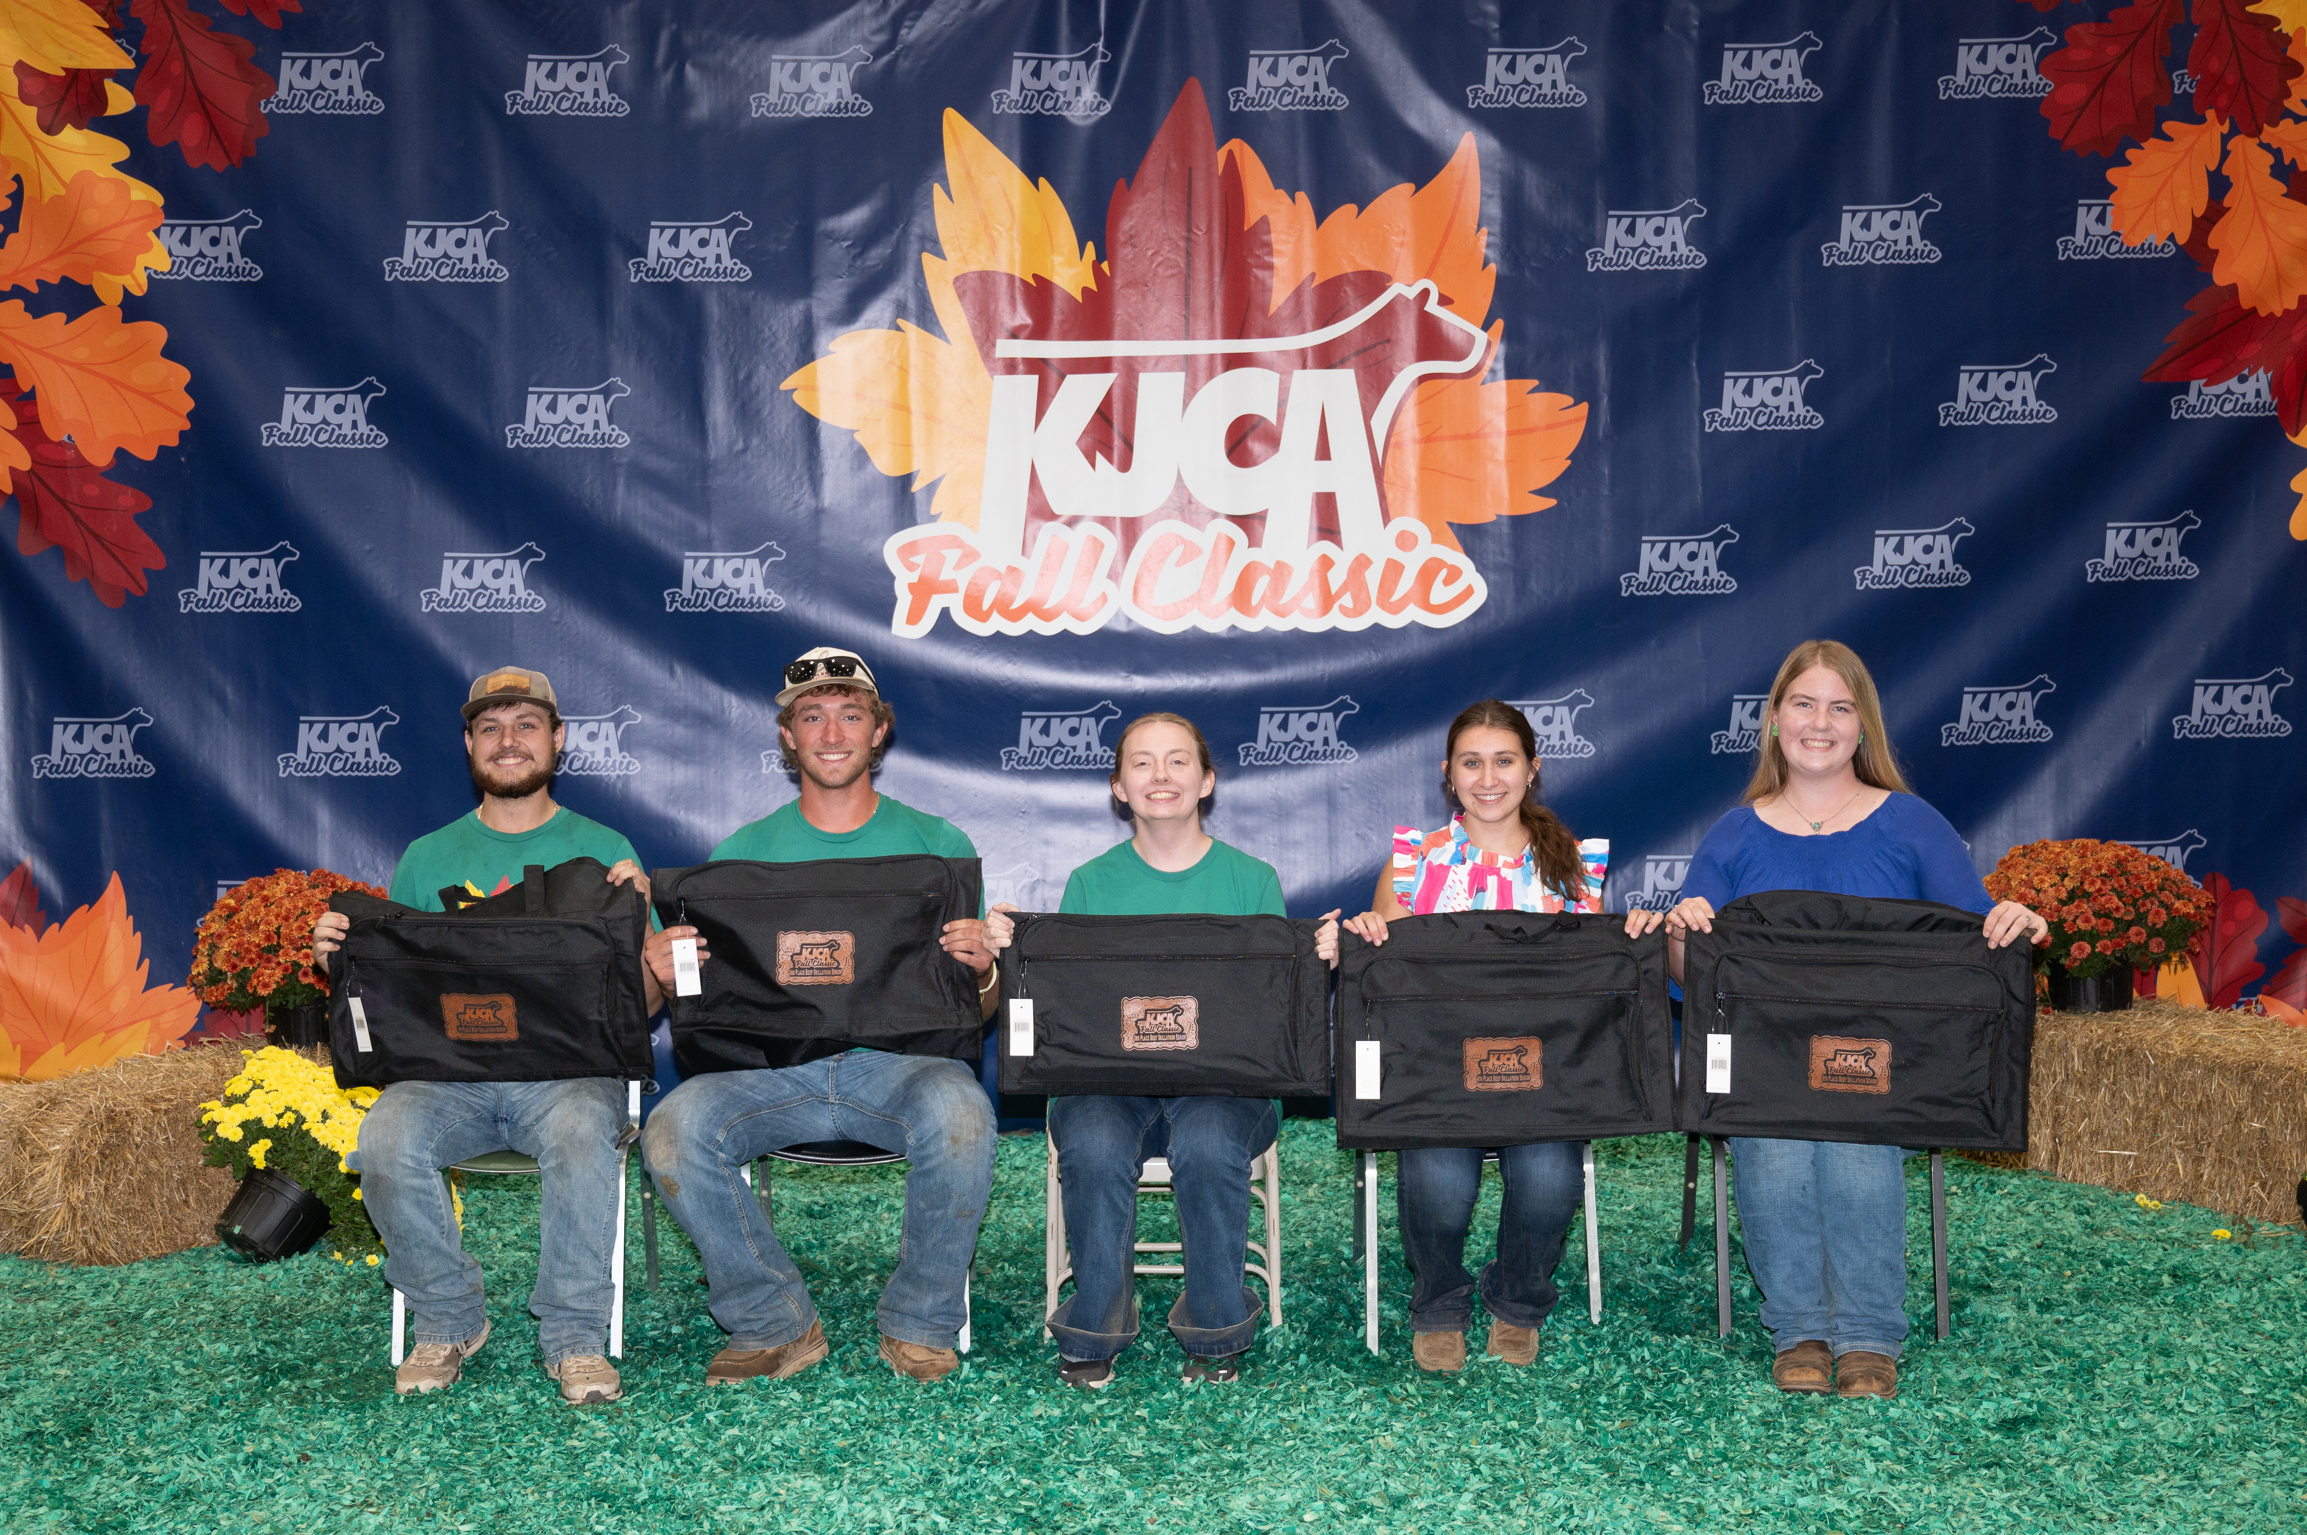
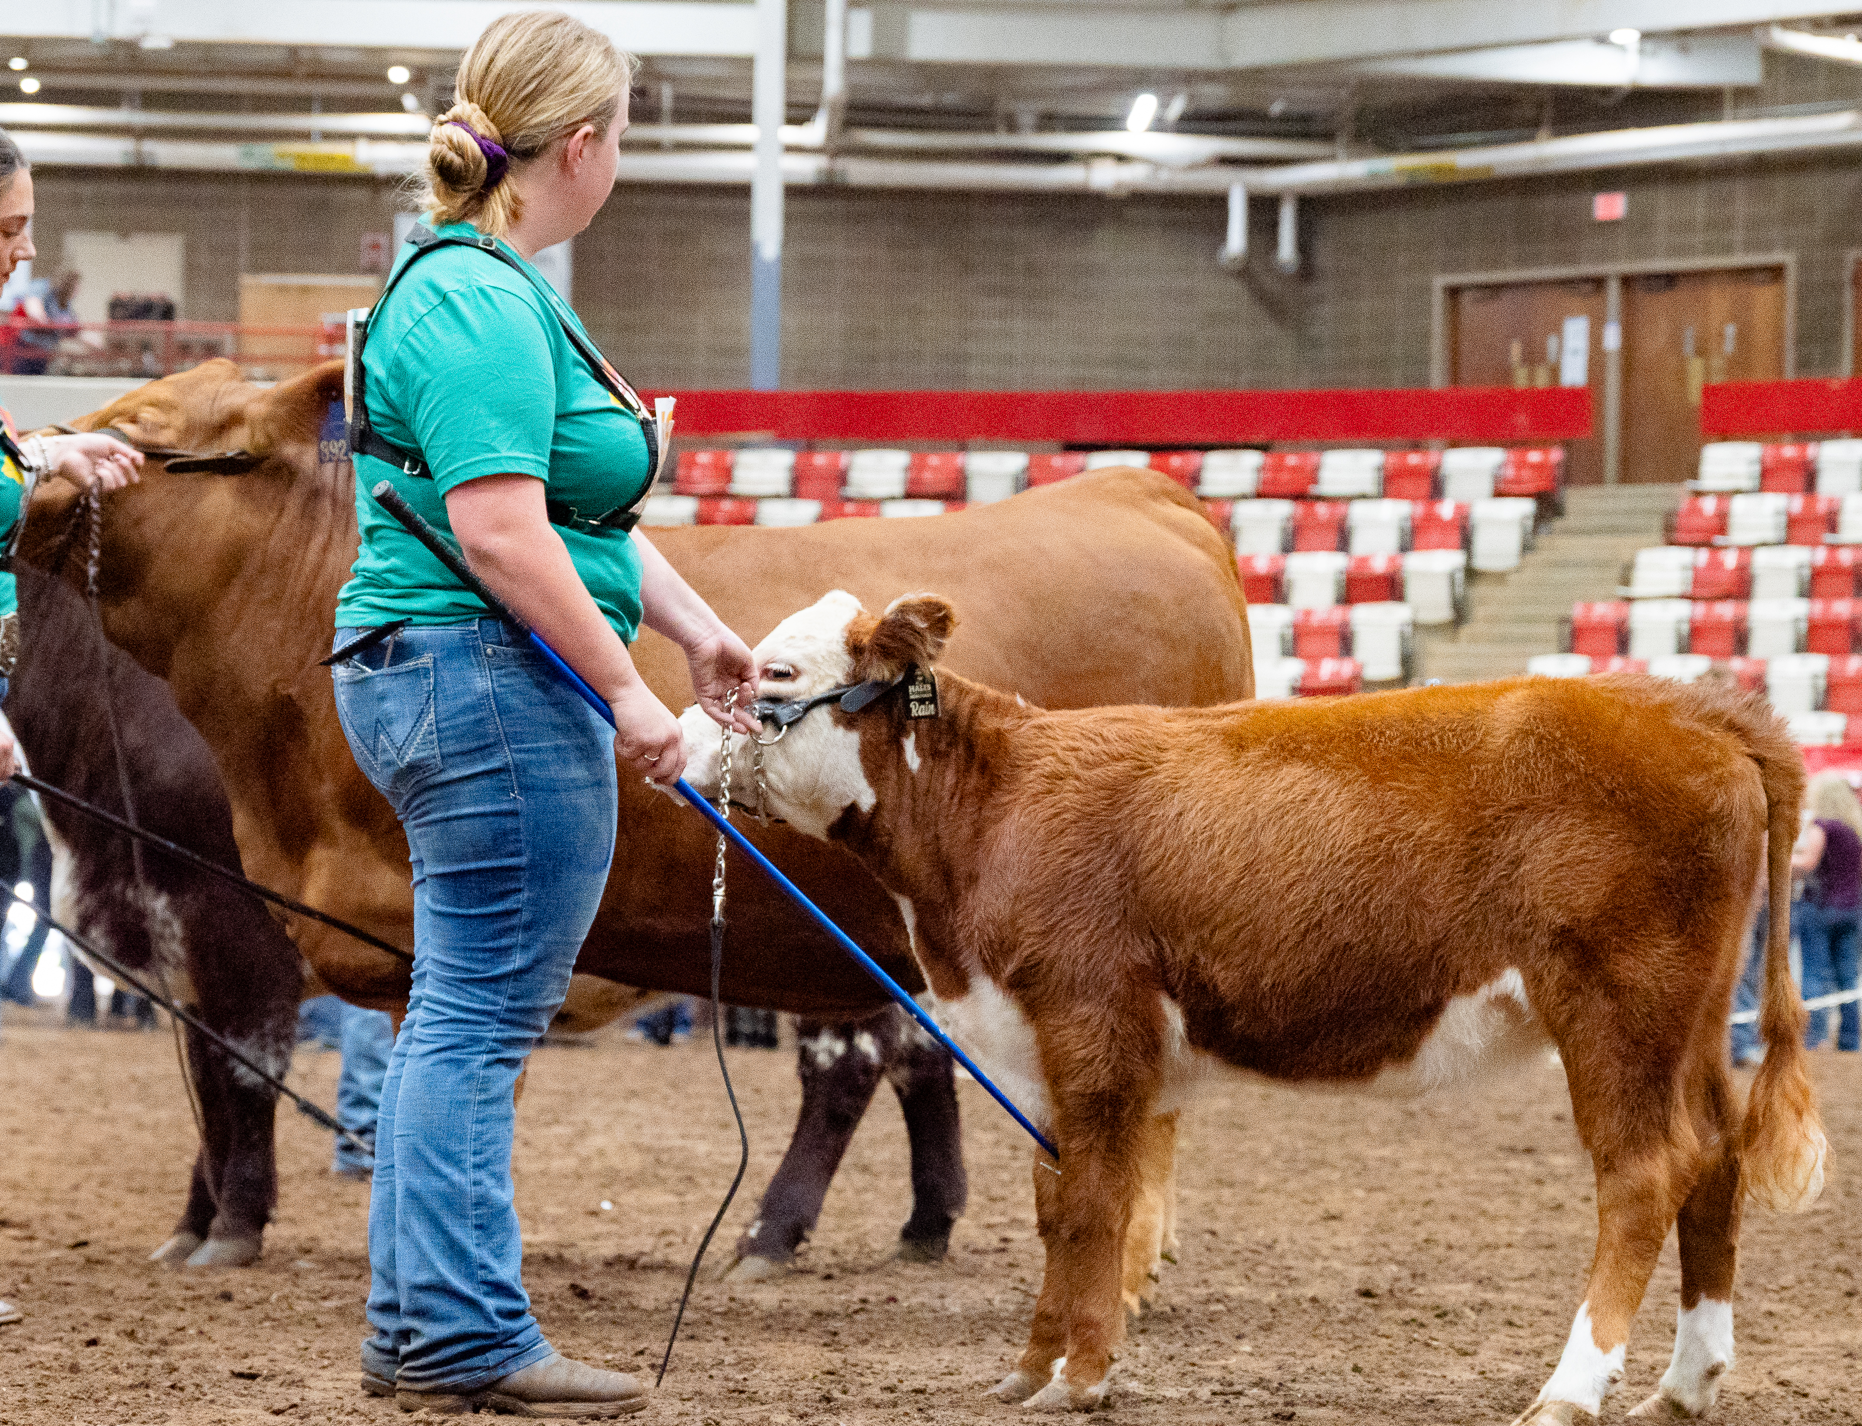

Slide 5
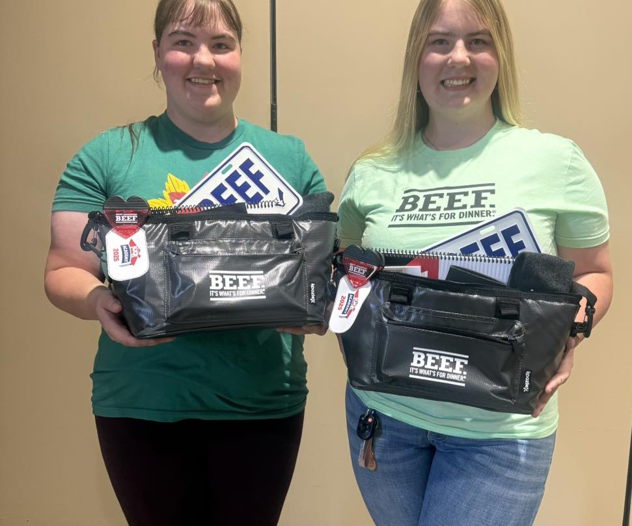
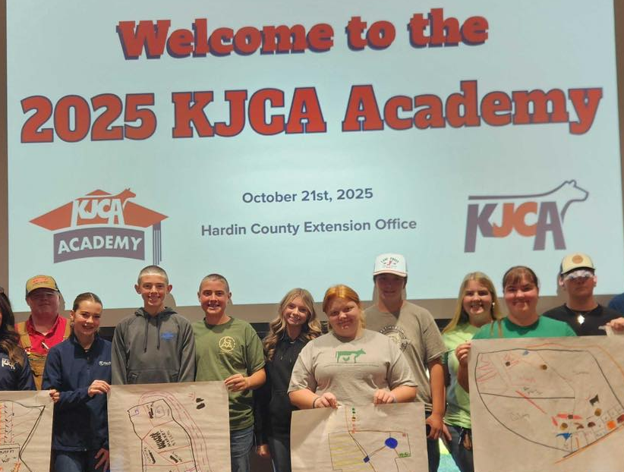
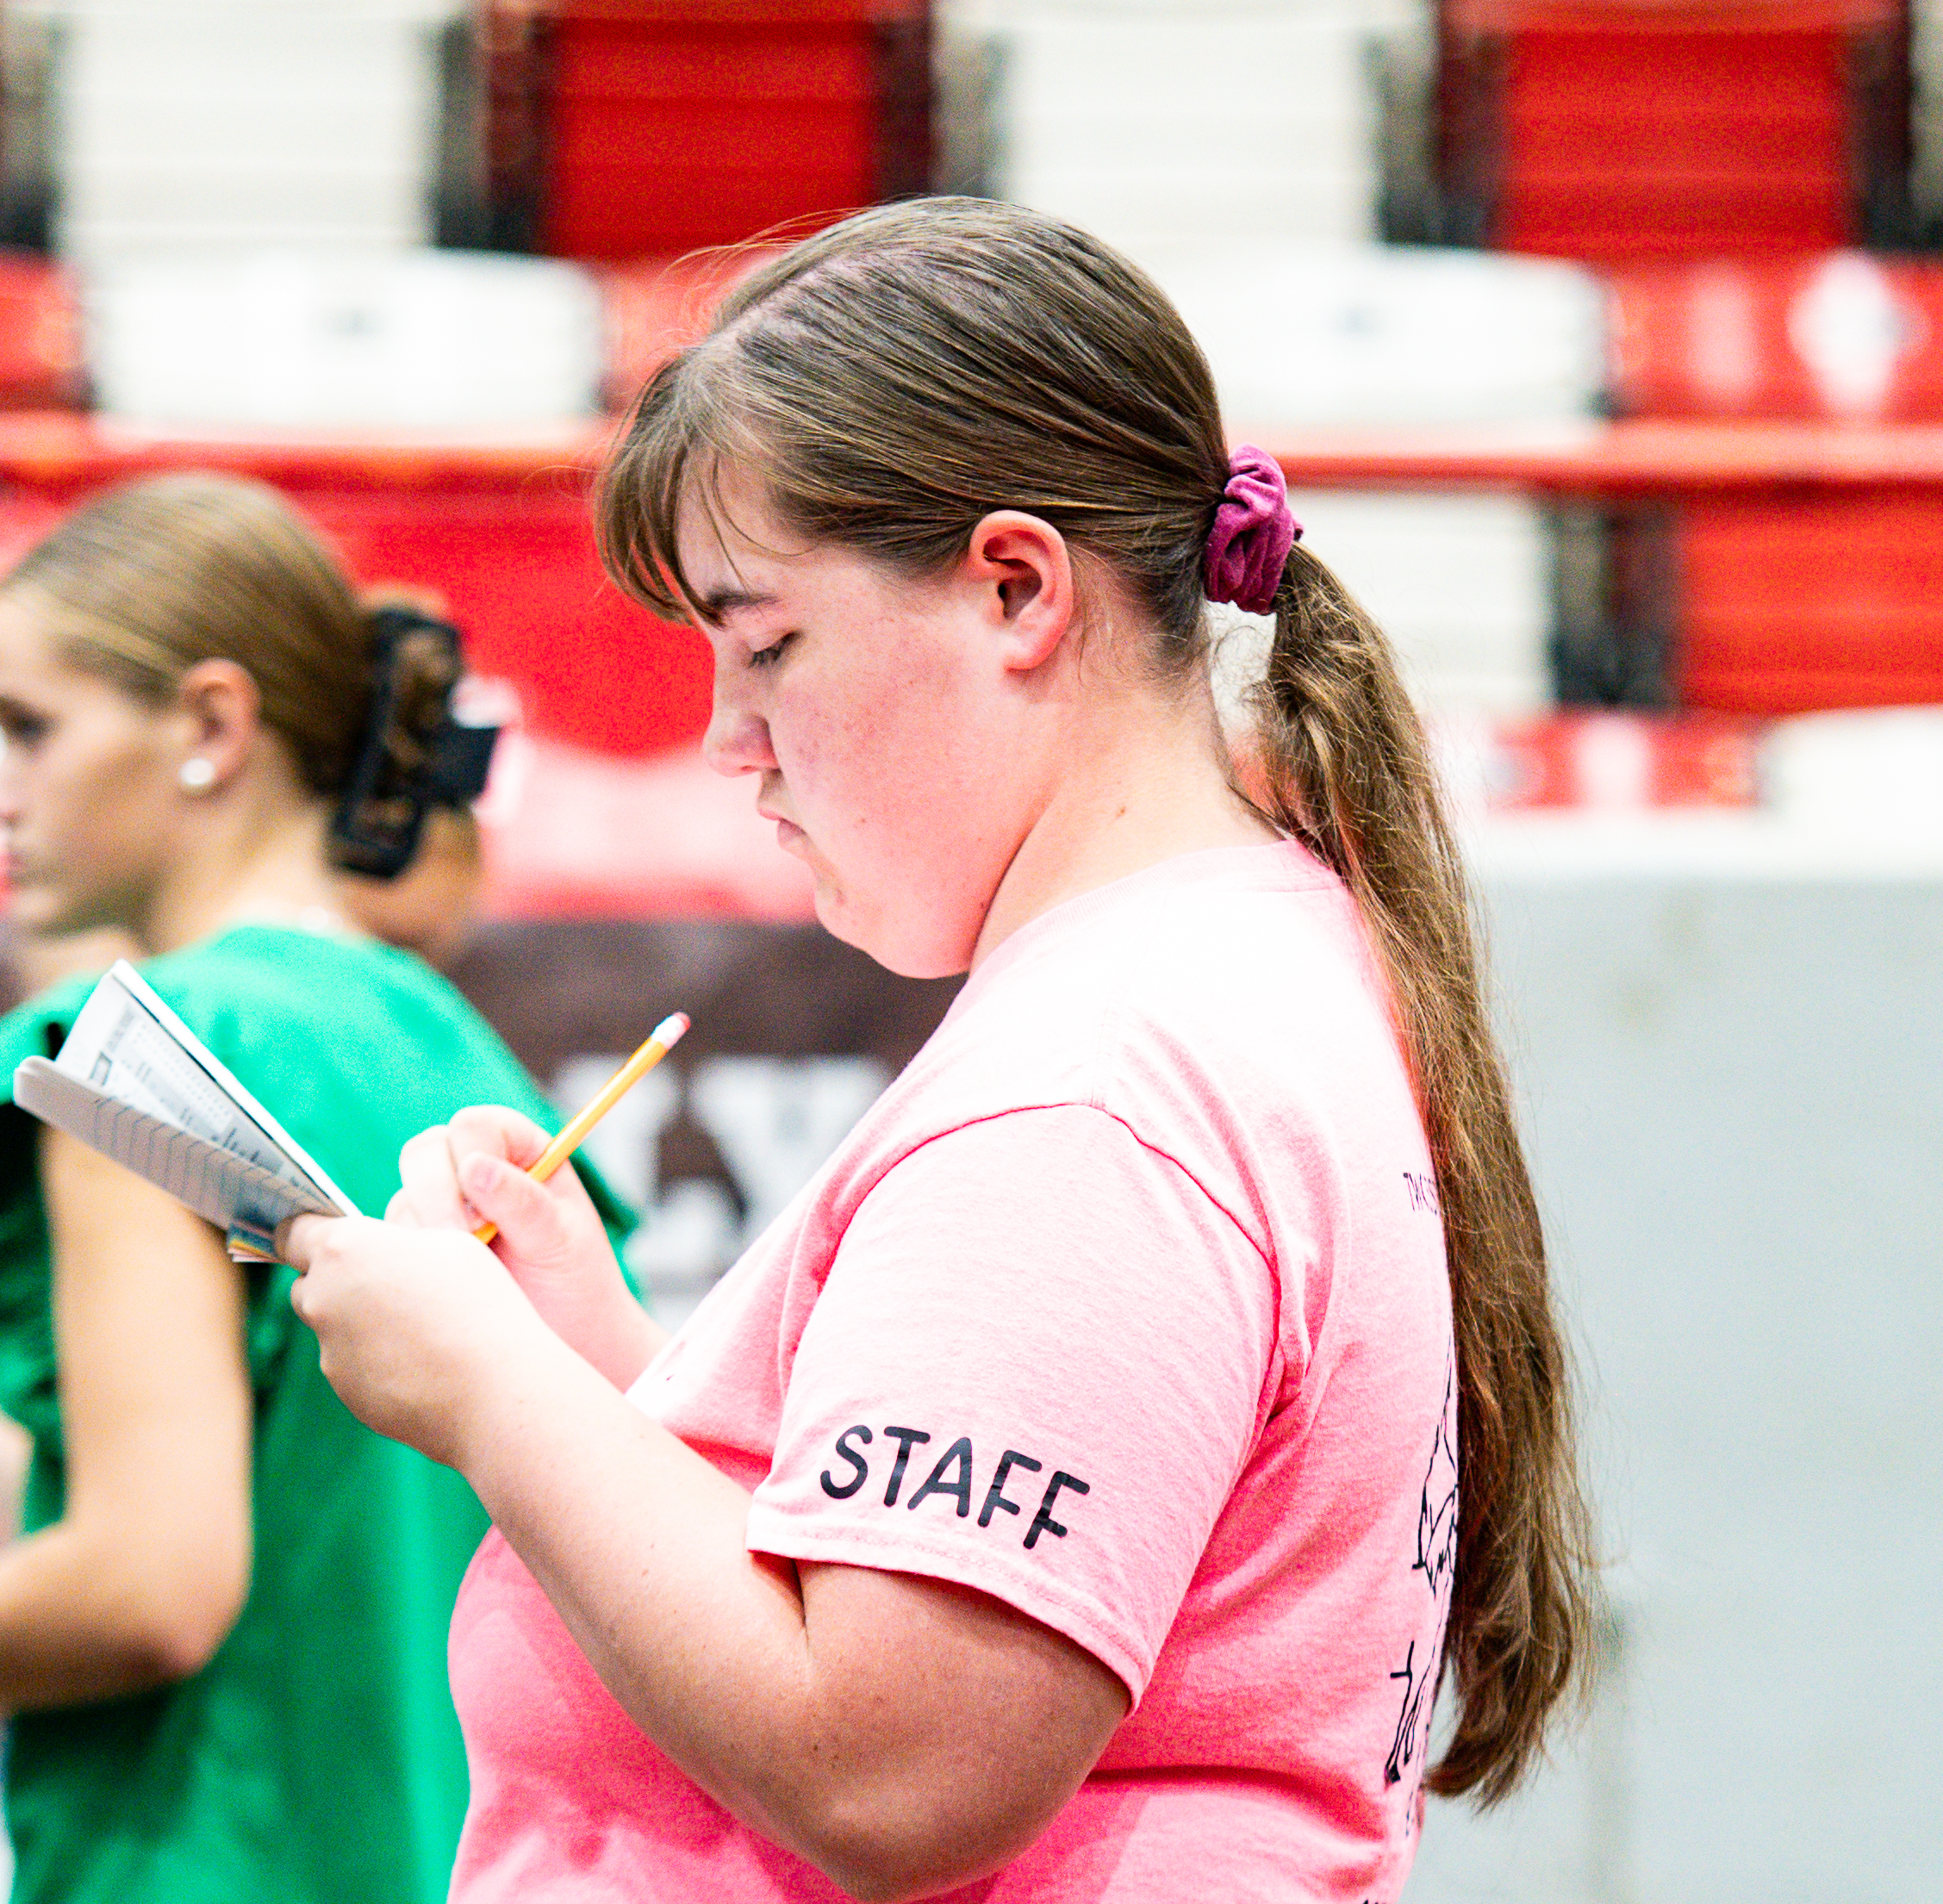
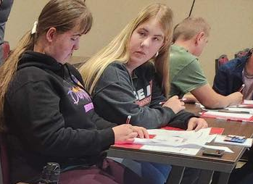
Cheyenne - Journey with KJCA

Slide 6
Why do we need Junior Cattlemen Chapters?
Teaching children where their food comes from
Keeping youth interested in the cattle industry
Teaching youth without family members already involved in cattle
Teaching youth that they can be the first generation
Creating future ag teachers, advocates, and beef producers
Junior Chapters are members of KJCA with opportunities
Notes:
In general, why do these skills matter

Slide 7
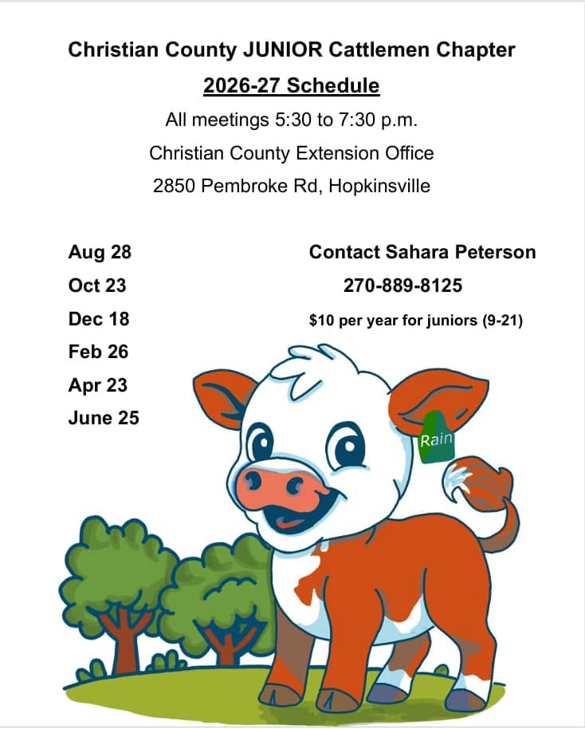
What are we doing in Christian County?
Teaching showing, raising, and caring for cattle
Hands-on classes
Special guests speaking, such as vets and adult cattle farmers
Teaching opportunities available to youth
Meetings every other month
Eligible for KCA and KJCA events
Notes:
Talk about how being on the state board has led to you starting your county chapter

Slide 8
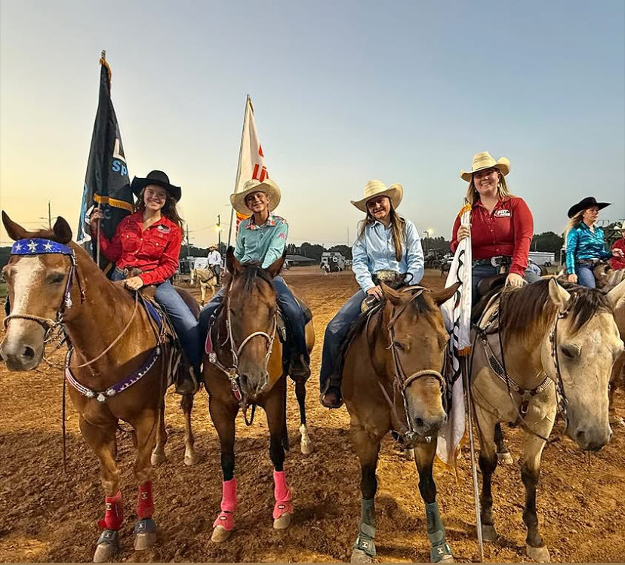
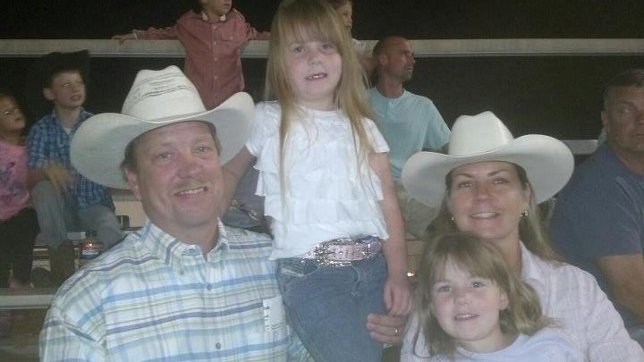
Christian County Cattlemen’s Rodeo
Partner with Lone Star Rodeo Company
Have a Junior Qualifier Day
Junior Cattlemen assisted this year for the first time.

Slide 9
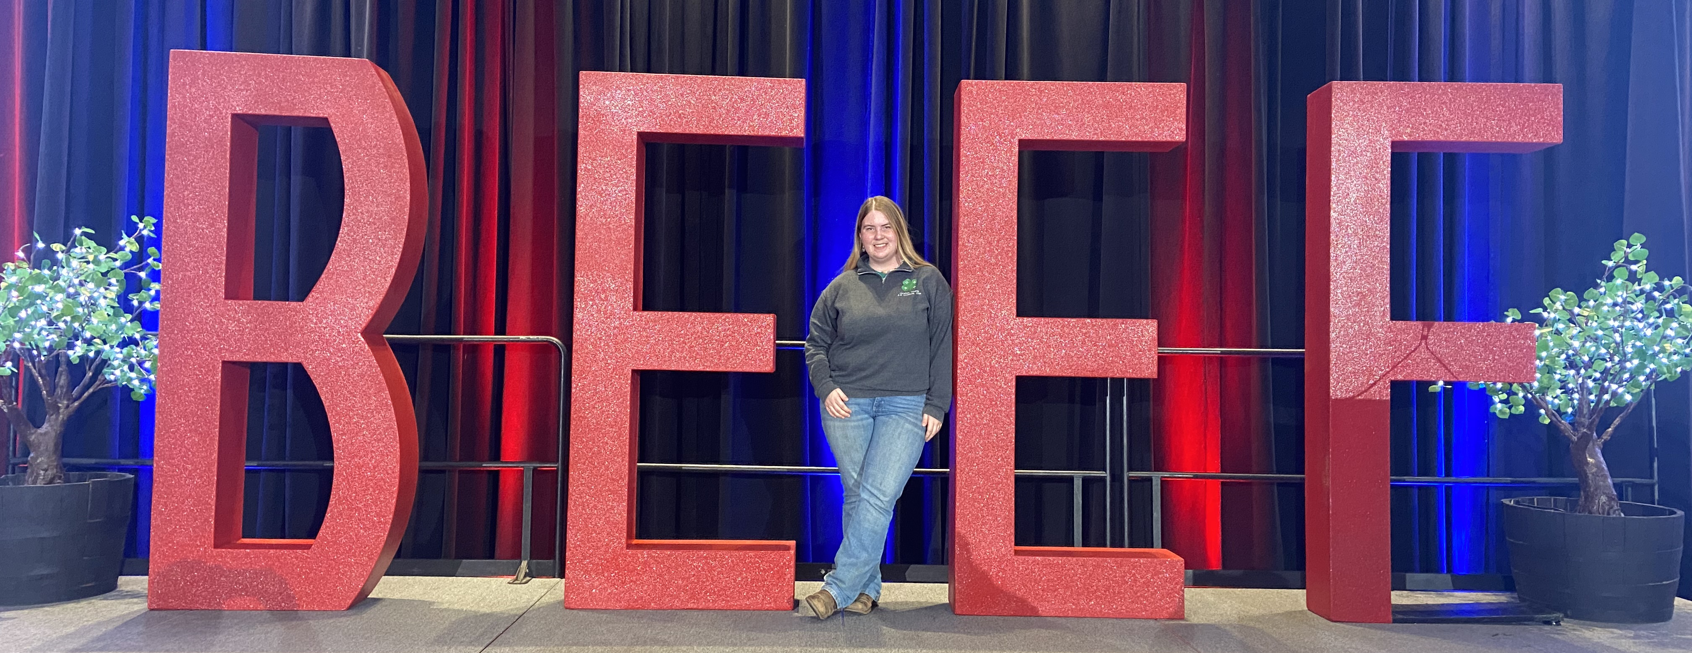
Contact us about how to start a chapter in your county!
Sahara Peterson, Christian Co Cattlemen's Junior Chapter on FB
Kentucky Junior Cattlemen's – kycattle.org
Notes:
Go through what we have already done in the county

