Slide 1

Kentucky Agricultural Economic Update
June 4th, 2026
Dr. Kenny Burdine, Extension Professor Livestock Economics
Jonathan Shepherd, Agricultural Extension Specialist & State Director of UK Income Tax Program
UK Department of Agricultural Economics

Slide 2
What is Agricultural Economics?
Economics of production, marketing, and consumption of agricultural products
Farm management, market analysis, consumer behavior, natural resource economics, and policy​
Why It Matters
Help farmers navigate markets, make decisions, and manage risk.
Inform sound agricultural policy
Supports rural economies, healthcare, and jobs
Guides sustainable resource use

Slide 3
3 Mission areas of Agriculture Economics at UK
Teaching
  Graduate and undergraduate
Research
  Focus on agriculture production, consumer, and economic development
Extension
  Taking the University of Kentucky into the Commonwealth
  In-person programming
  Written Extension outputs
  Less traditional outputs

Slide 4
Kentucky Farm Cash Receipts Exceed $8 Billion
Source: NASS/USDA and UK Estimates for 2025

Slide 5
Distribution of KY Agricultural Cash Receipts
1990s vs 2025
2025 Estimate
$8.3 billion
1990-1999 Average
$3.4 Billion
Livestock Receipts Account for 65% of Total Ag Cash
Source: AEC/UK Estimates (December 2025)
Source: Ky Ag Stats/NASS

Slide 6
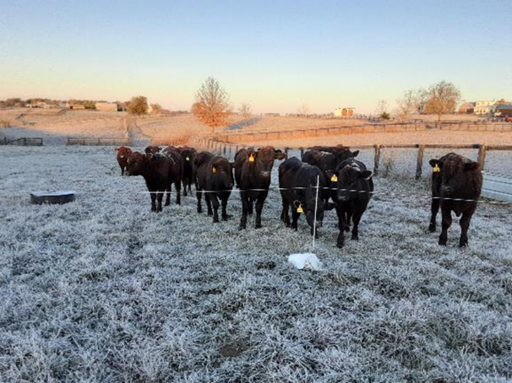
Themes
Divergence between livestock and crop sectors
Land values, interest rates, volatility, etc. = challenges for entry and expansion
Drought impacting much of KY going into last week

Slide 7
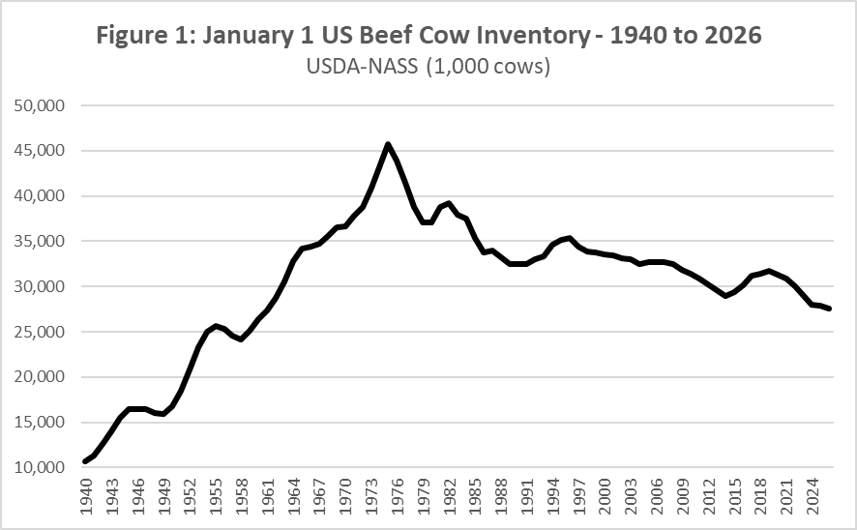
Beef Cattle Values at Record Levels
Extremely strong protein demand
Smallest US cow-herd since the 1960’s
Uncertainty going forward
Calf values and risk = challenge for backgrounders and stockers

Slide 8
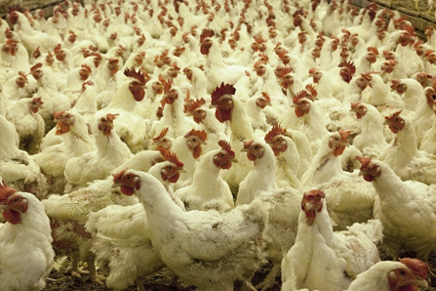
Strength in Most other Animal Sectors
Equine receipts show sharp improvement in 2025
  Keeneland sales, stud fees
Meat demand and moderate feed costs create opportunity for hogs and poultry
Challenges remain for dairy sector
  Tight milk margins partially offset by dairy-beef values
  KY dairy inventory continues to decline

Slide 9
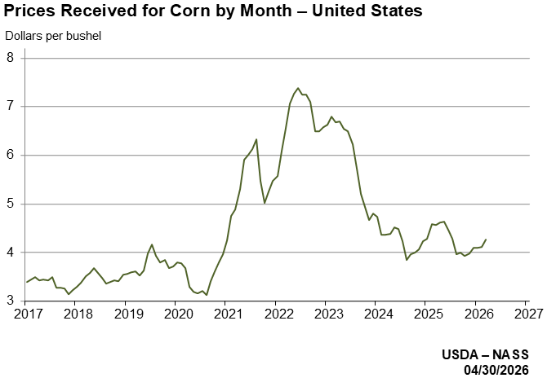
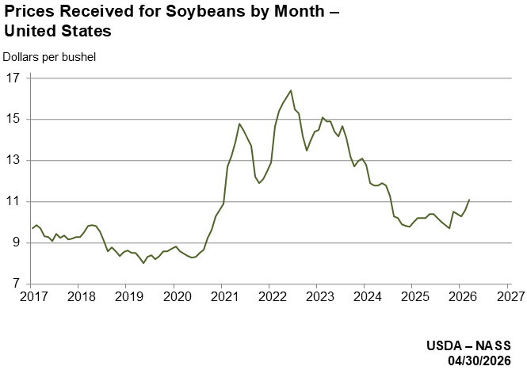
Tight Margins and Large Supplies Impact Crop Sector
Corn, soybean, and wheat prices remain below 2021–2023
Fertilizer and interest costs remain elevated
Export competition from South America remains intense
Working capital is tightening for many operations

Slide 10
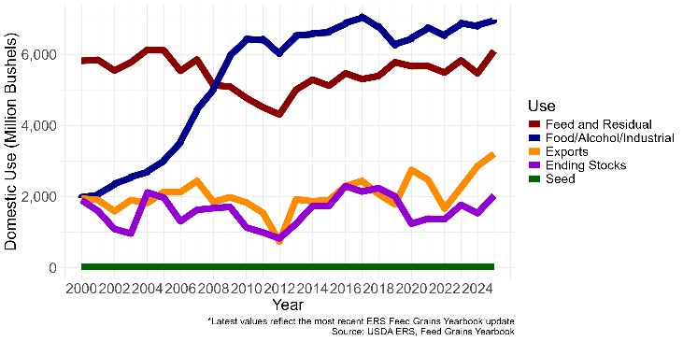
What could improve the outlook?
Improved trade opportunities
Expansion of biofuel demand (SAF, renewable diesel, ethanol)
Weather problems reducing global production
Acreage shifts away from corn
Lower interest rates
Continued policy support

Slide 11
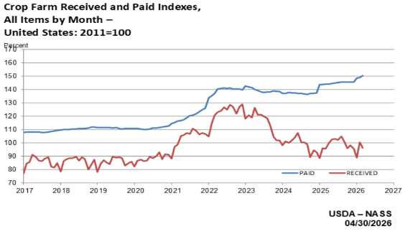
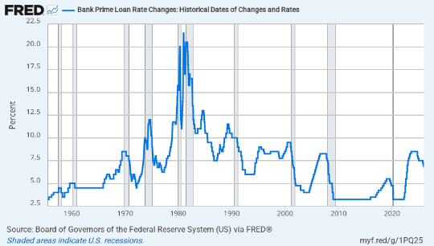
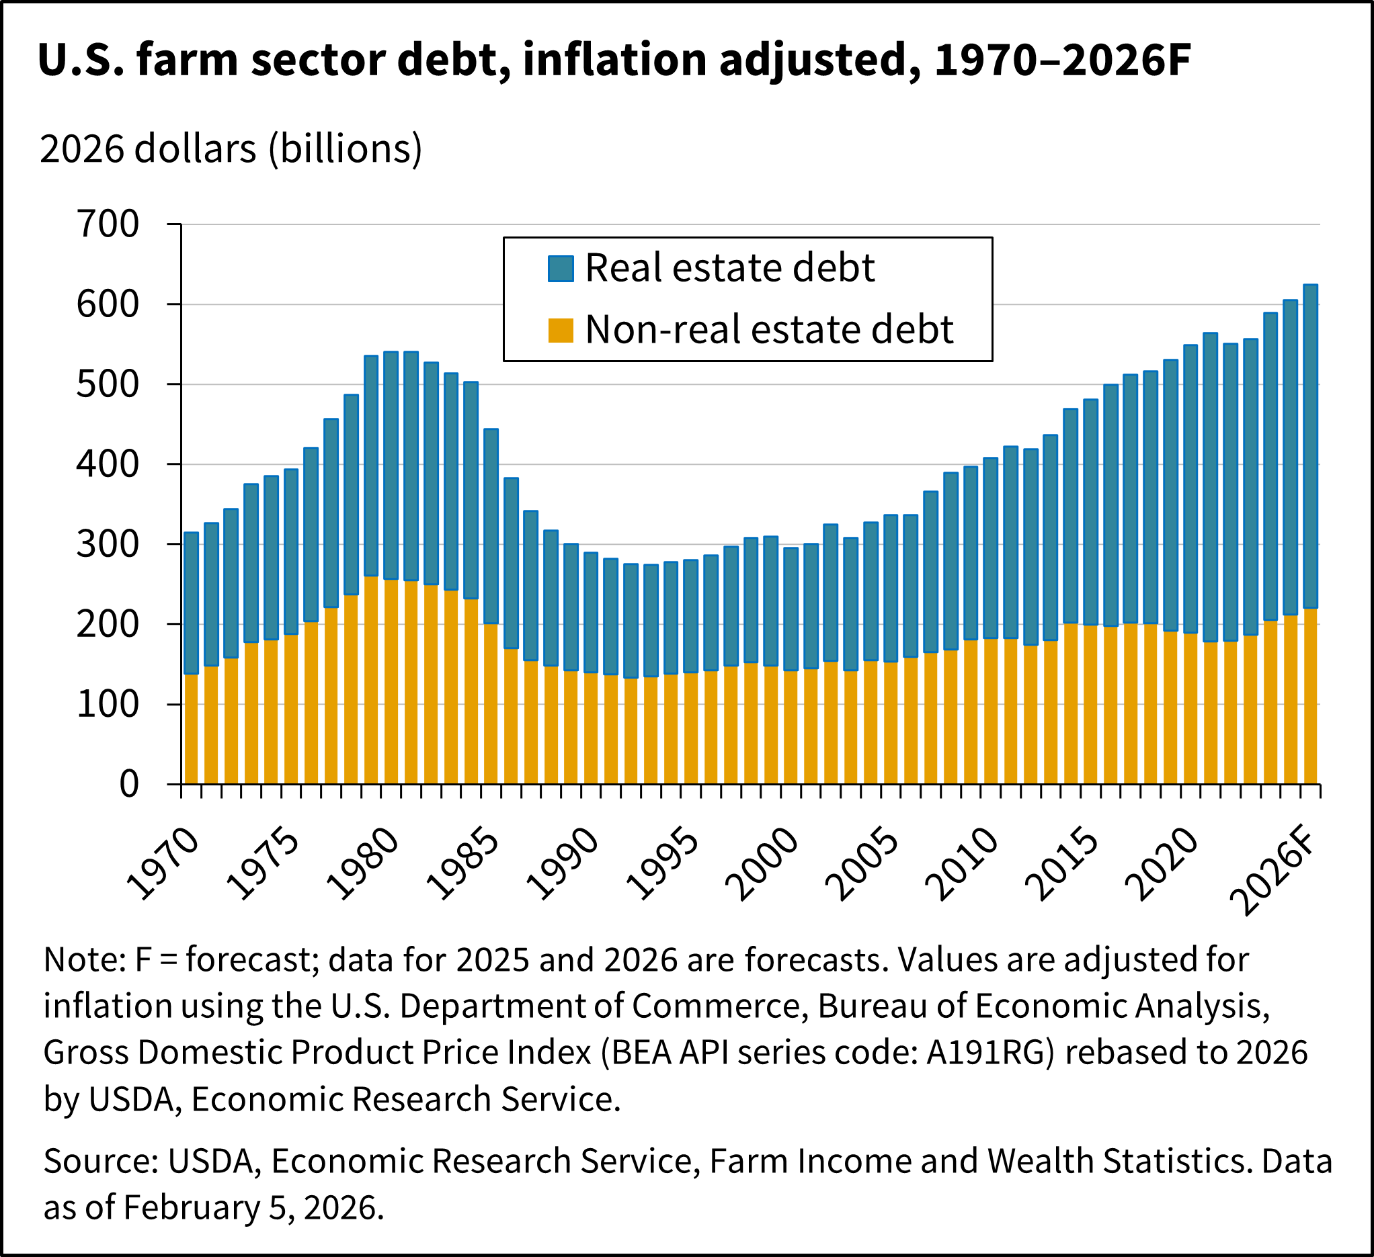
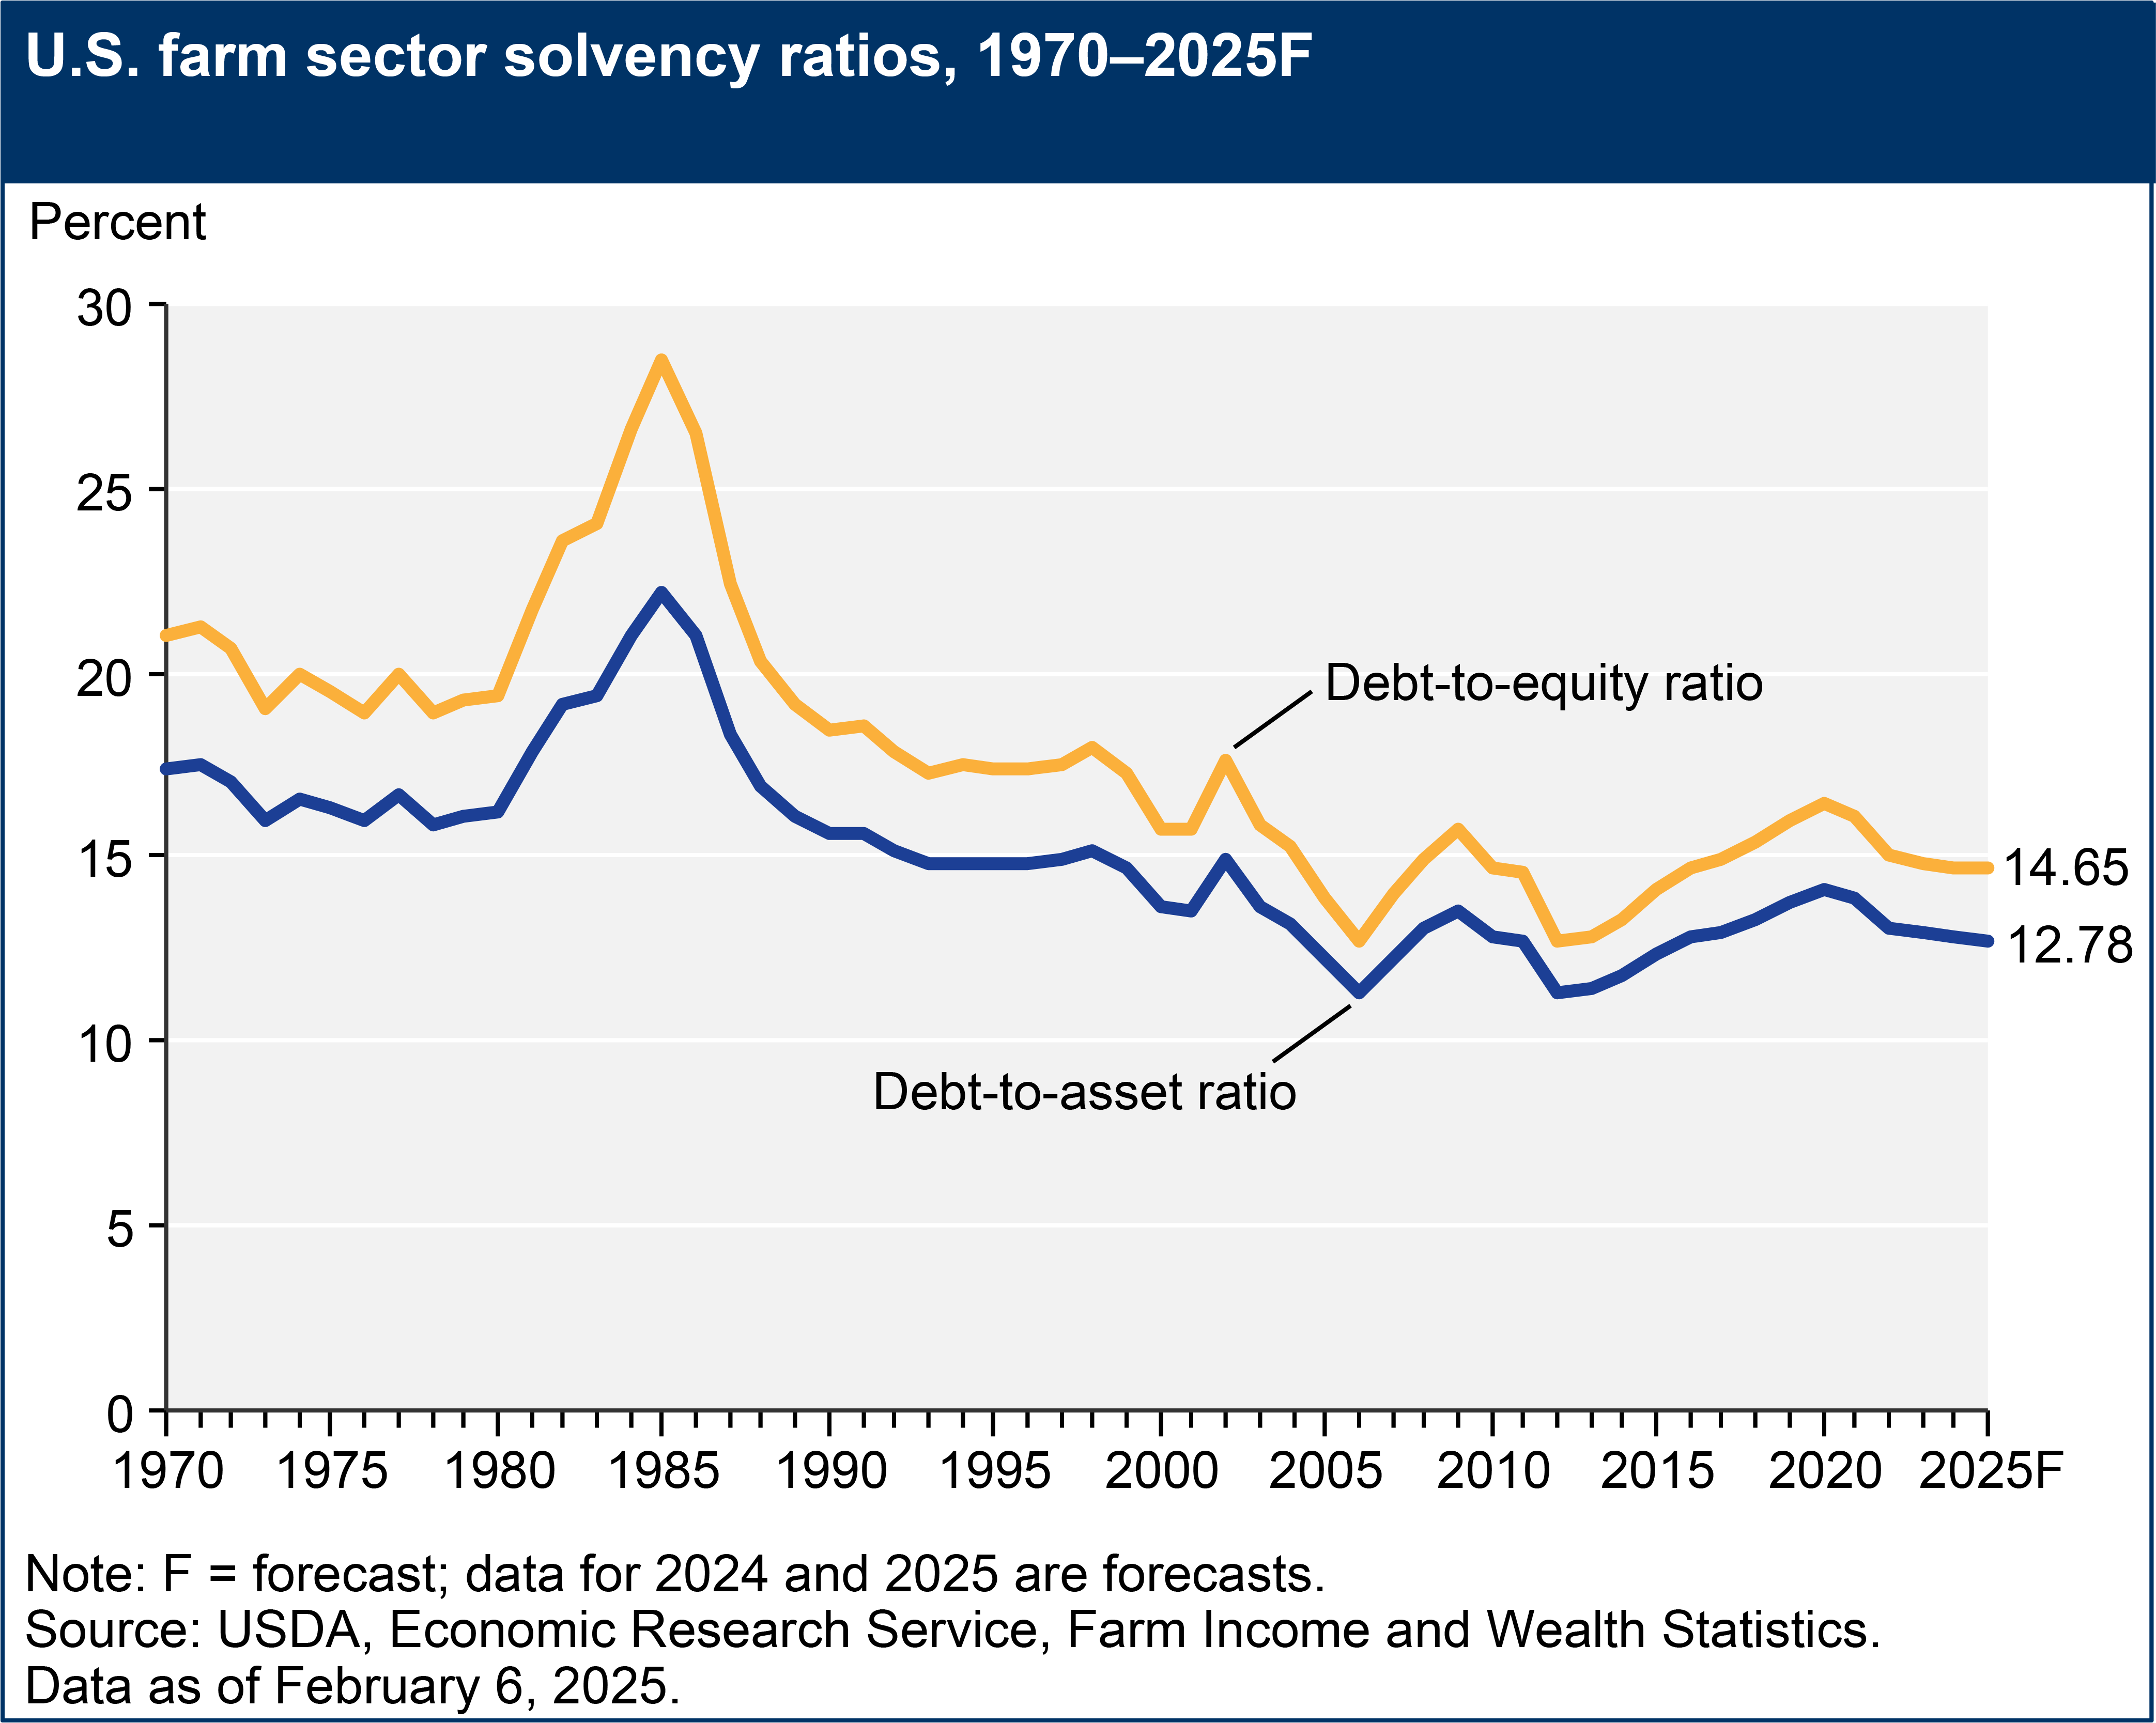
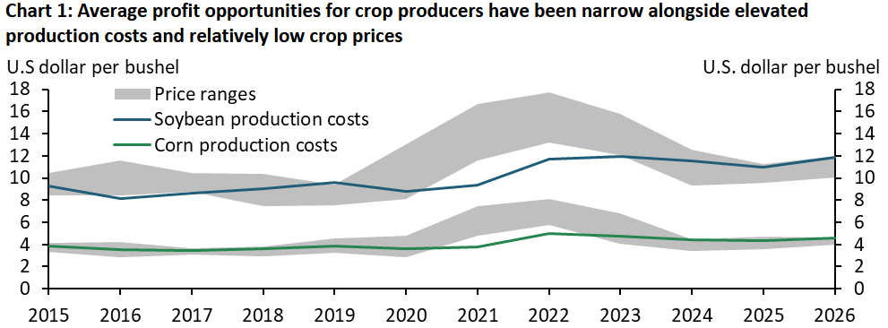
Margin Compression
Interest Rates
Average Financial Health
Average Profit Opportunities
https://www.kansascityfed.org/research/economic-bulletin/resilience-not-crisis-in-the-us-agricultural-economy/

Slide 12
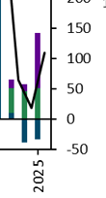
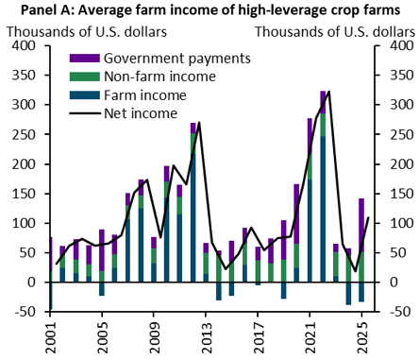
Federal Government Payments Helped in 2025
Source: Deterioration in Farm Financial Conditions Remains Gradual - Federal Reserve Bank of Kansas City

Slide 13
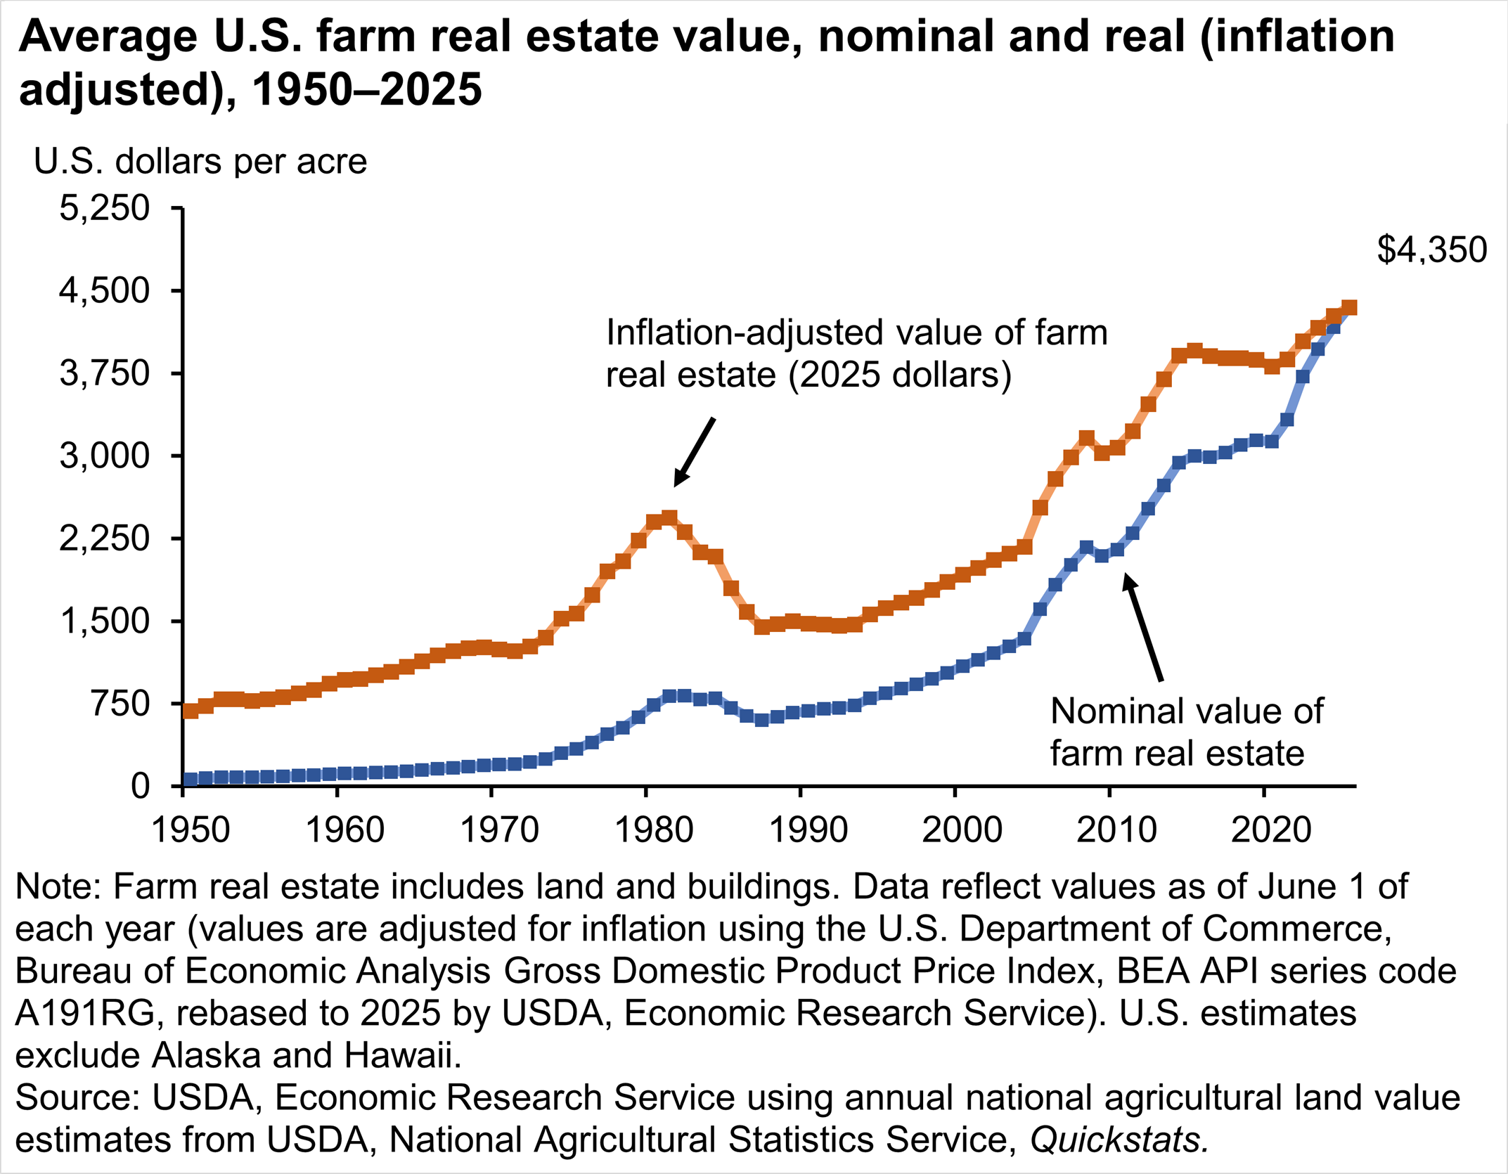
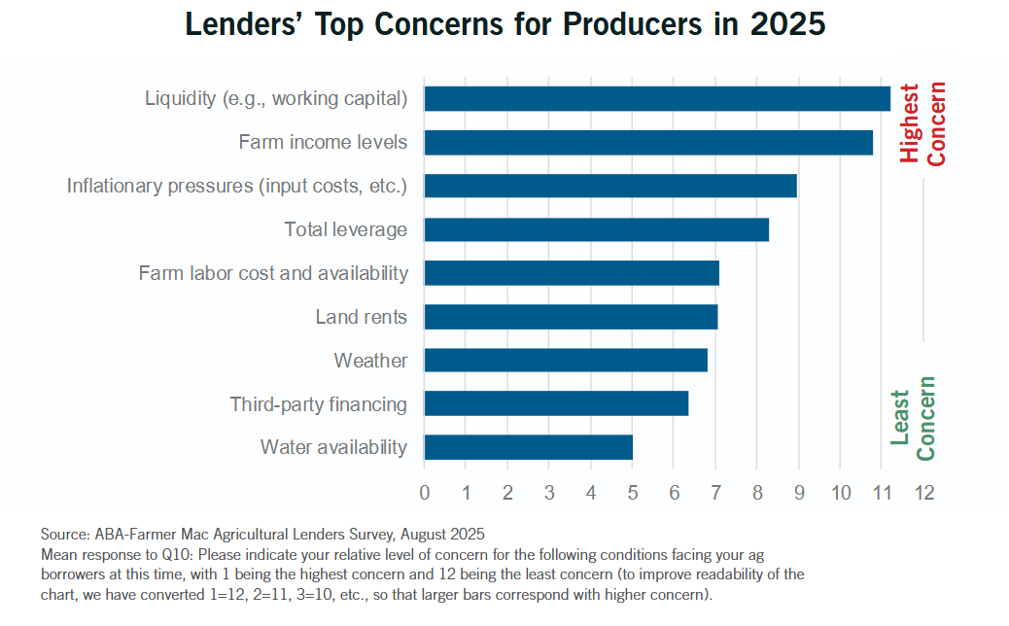

Lender’s Perspective
Land Values

Slide 14
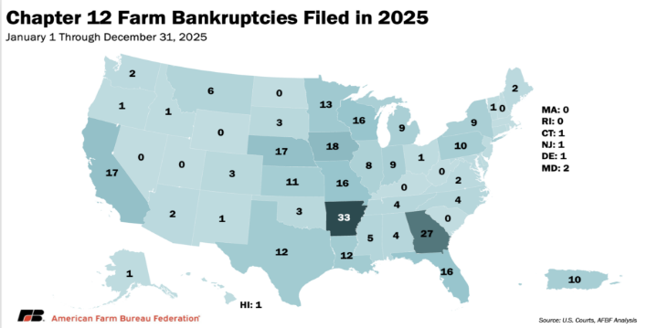
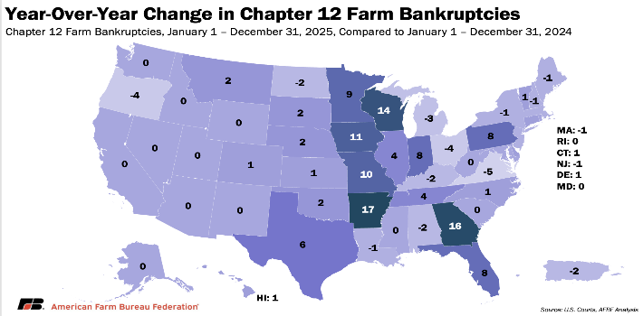
Farm bankruptcies up 46% Nationwide 2024 to 2025
Southeast increased 69%
KY had 0 for 2025

Slide 15
Summary
Strengths
Challenges
Risks
Land and Asset Values
Cattle Prices
Average Farm Balance Sheet Strength
Non-farm income
Agritourism / Value Added
Biofuels
Input prices
Declining working capital
Uncertainty around fuel and fertilizer costs
Weak relative grain prices
Interest rates
Concentration among input suppliers
Entry barriers for young farmers
Margin compression
Liquidity pressures
Continued low profitability can start to weaken financial position
Asset devaluation
China / geopolitical

Slide 16



Contact and Questions
Economic & Policy Update
Dr. Kenny Burdine
Extension Professor of Livestock Economics
kburdine@uky.edu
859-257-7273
Jonathan Shepherd
Agricultural Extension Specialist
State Director of UK Income Tax Program
jdshepherd@uky.edu
859-218-4395

