Slide 1
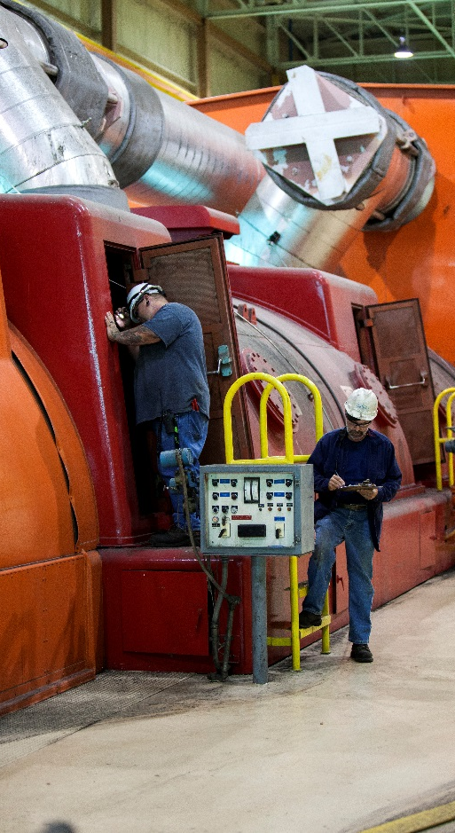
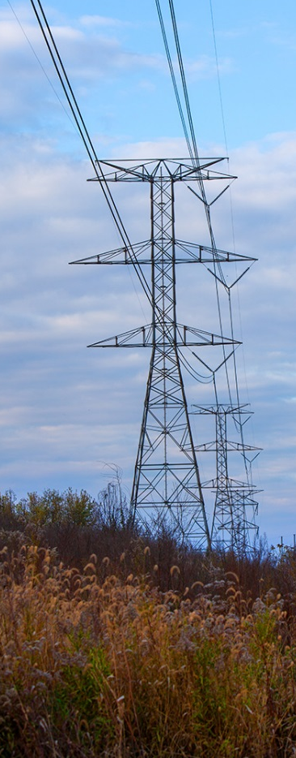
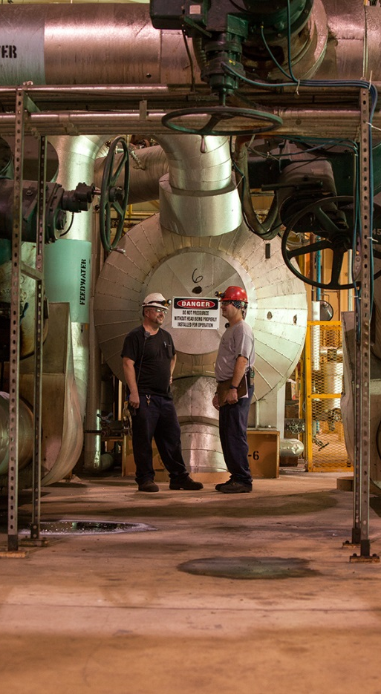
Interim JOINT committee meeting June 7, 2018

Slide 2
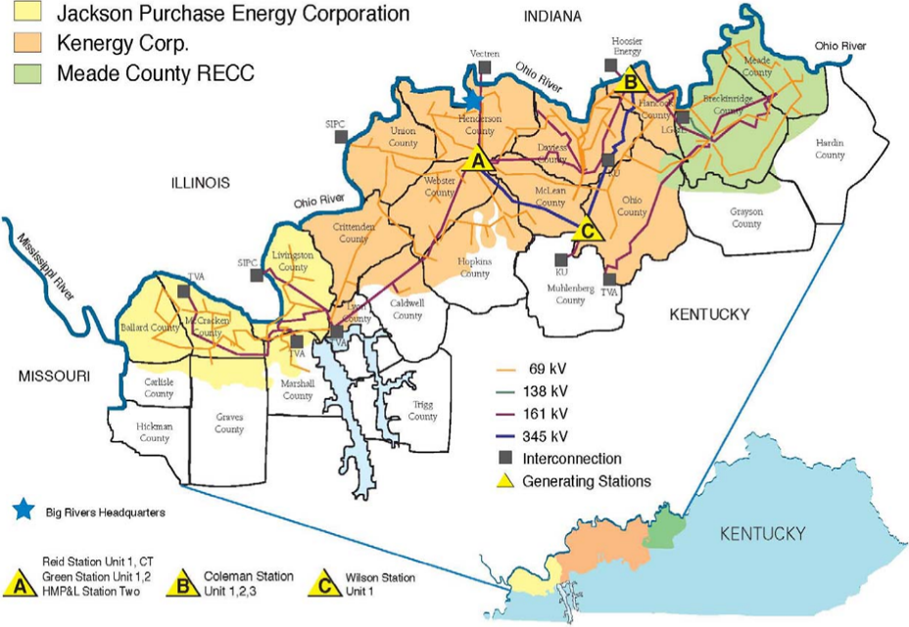
Overview of big rivers
Big Rivers Electric Corporation (Big Rivers) was formed in 1961 and is based in Henderson, Kentucky.
Big Rivers supplies wholesale electric generation and transmission service to three electric distribution cooperatives (Member/Owners).
Member/Owners are local customer-owned cooperatives providing service to approximately 116,000 retail customers on a not-for-profit basis.
Member/Owners serve residential, commercial and industrial customers located in portions of 22 western Kentucky counties.
Big Rivers and our Member/Owners are regulated by the Kentucky Public Service Commission (KPSC).

Slide 3
big rivers Generation and TRANSMISSION ASSETS
Big Rivers provides capacity and energy to our Member/Owners through a combination of eight owned generation units, one leased generation station and purchased power.
Net capacity of owned generation – 1,444 MW
Net capacity of leased generation from Henderson Municipal Power & Light Station Two (HMPL) – 197 MW*
Power purchased from SEPA – 178 MW
~1,300 miles of transmission lines and 22 substations
Midcontinent ISO membership – Dec. 2010
*Contracts have terminated and capacity rights will be zero beginning 6/1/2019

Slide 4
Successfully managing change
After allowing the aluminum smelters access to the wholesale power market in 2012 and 2013 to preserve jobs in Western Kentucky, Big Rivers has continued to work aggressively and successfully to reformat its business model to meet the needs of its member customers and pay its financial obligations.
Big Rivers’ Member/Owner systems, which are financially stable and regionally rate competitive, continue to demonstrate a strong commitment to the customers they serve and maintaining Big Rivers’ financial viability.
Reasonable cash flow coverage and ample liquidity are forecasted to continue, with revenues from new power supply contracts (e.g., Nebraska and Kentucky Municipal Energy Agency) and sales to MISO, helping to lessen financial variability.
Big Rivers’ Management and its Board of Directors remain committed to maintaining healthy financial ratios in an effort to achieve higher credit ratings, ensuring value to its Member/Owners.

