Slide 1
Electricity Generation in Kentucky
KENTUCKY PUBLIC
SERVICE COMMISSION

Slide 2
Overview
Kentucky
Power Plant Retirements
Electricity Cost Changes
Regional Trends
National Trends
Future Generation
Issues to Watch
Policy Academy

Slide 3
Regulated Utilities
Rural Electric Utilities
East Kentucky Power Cooperative (EKPC)-16 cooperatives
Big Rivers Electric Corporation-3 cooperatives
Investor Owned Utilities
Kentucky Power (KY Power)
Duke Energy Kentucky (Duke)
Kentucky Utilities Company (KU)
Louisville Gas and Electric Company (LG&E)
Not regulated by the KY PSC
Tennessee Valley Authority (TVA)
Municipal Utilities
Source: KY PSC & KY Energy Profile

Slide 4
Kentucky Power Plants
2017
Primary Fuel | Unit Count | Nameplate Capacity (MW)
Coal | 41 | 14,193.70
Natural Gas | 53 | 7,326.90
Solar | 1 | 10.00
Hydro | 36 | 1,016.60
Biomass | 26 | 113.40
Petroleum | 7 | 11.50
Total | 164 | 22,672.10
2013
Primary Fuel | Unit Count | Nameplate Capacity (MW)
Coal | 55 | 17,820.00
Natural Gas | 39 | 6,140.60
Solar | - | -
Hydro | 30 | 804.1
Biomass | 24 | 111.80
Petroleum | 8 | 110.30
Total | 156 | 24,986.80
Source: EIA Form 860

Slide 5
Kentucky Plant Retirements (2013-2017)
Unit | Plant | Operator | Capacity (MW) | Initial Year of Operation | Year Retired | Fuel Type | Age
Unit 1 | Big Sandy Plant | American Electric Power (KY Power) | 260 | 1963 | 2016 | Coal* (converted to NG) | 53
Unit 2 | Big Sandy Plant | American Electric Power (KY Power) | 800 | 1969 | 2015 | Coal | 46
Unit 4 | Cane Run Station | LG&E and KU | 155 | 1962 | 2015 | Coal | 53
Unit 5 | Cane Run Station | LG&E and KU | 168 | 1966 | 2015 | Coal | 49
Unit 6 | Cane Run Station | LG&E and KU | 240 | 1969 | 2015 | Coal | 46
Unit 1 | Dale Power Station | East Kentucky Power Co-op | 23 | 1954 | 2014 | Coal | 60
Unit 2 | Dale Power Station | East Kentucky Power Co-op | 23 | 1954 | 2014 | Coal | 60
Unit 3 | Dale Power Station | East Kentucky Power Co-op | 75 | 1957 | 2016 | Coal | 59
Unit 4 | Dale Power Station | East Kentucky Power Co-op | 75 | 1960 | 2016 | Coal | 56
Unit 3 | Green River Generating Station | LG&E and KU | 71 | 1954 | 2015 | Coal | 61
Unit 4 | Green River Generating Station | LG&E and KU | 100 | 1959 | 2015 | Coal | 56
Tyrone 3 | Tyrone Generating Station | LG&E and KU | 73 | 1953 | 2013 | Coal | 60
Haefling 3 | Haefling | LG&E and KU | 14 | 1970 | 2013 | NG | 43
Source: S&P Global

Slide 6
Additional Considerations
Idled Plants (2013-2017)
Unregulated Kentucky Retirements
667 MW
1,419 MW
Unit | Plant | Operator | Capacity (MW) | Initial Year of Operation | Year Idled | Fuel Type | Age
Reid 1 | Robert Reid Power Plant | Big Rivers Electric Corp | 65 | 1966 | 2015 | Coal | 19
Unit 1 | Kenneth C. Coleman Station | Big Rivers Electric Corp | 205 | 1969 | 2014 | Coal | 45
Unit 2 | Kenneth C. Coleman Station | Big Rivers Electric Corp | 205 | 1970 | 2014 | Coal | 44
Unit 3 | Kenneth C. Coleman Station | Big Rivers Electric Corp | 192 | 1971 | 2014 | Coal | 43
Unit | Plant | Operator | Capacity (MW) | Initial Year of Operation | Year Retired | Fuel Type | Age
Shawnee 10 | Shawnee | TVA | 127 | 1956 | 2014 | Coal | 58
Paradise 2 | Paradise | TVA | 633 | 1963 | 2017 | Coal | 54
Paradise 1 | Paradise | TVA | 659 | 1963 | 2017 | Coal | 54
Source: S&P Global

Slide 7
Regulated Retirements Summary
Total Units Retired: 13
Capacity Retired: 2,077 MW
Fuel Source Retired: 12 Coal Plants, 1 Natural Gas Plant
Average Retired Plant Age: 54
Percent Change in Available Nameplate Capacity: -9%
-20% Coal
+19% Natural Gas
+26% Hydro

Slide 8
Planned Kentucky Plant Retirements
Unit | Plant | Operator | Capacity (MW) | Initial Year of Operation | Planned Retire Year | Fuel Type
Unit 1 | E.W. Brown Generating Station | LG&E and KU | 106 | 1957 | 2019 | Coal
Unit 2 | E.W. Brown Generating Station | LG&E and KU | 166 | 1963 | 2019 | Coal
Unregulated Planned Retirements
Unit | Plant | Operator | Capacity (MW) | Initial Year of Operation | Planned Retire Year | Fuel Type
Unit 2 | Elmer Smith | City of Owensboro | 265.6 | 1974 | 2023 | Coal
Unit 1 | Elmer Smith | City of Owensboro | 140.8 | 1964 | 2019 | Coal
Station 2 | Henderson Municipal Power & Light (HMP&L) | HMP&L | 312 | 1972 | 2019 | Coal
Source: EIA

Slide 9
Reasons Stated for Retirements
Low natural gas prices
Age
All plants constructed prior to the Clean Air Act of 1970
Efficiency of plants compared to fleet
Power plant emission rules
Mercury and Air Toxics Standards (MATS)
Declining demand

Slide 10
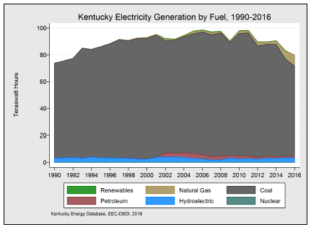
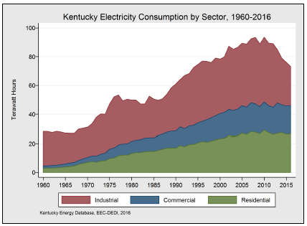
Kentucky Electricity Generation and Consumption
Source: Kentucky Energy Profile

Slide 11
Rate of Electricity Consumption
Steady decrease since 2008
Source: KY Energy Profile

Slide 12
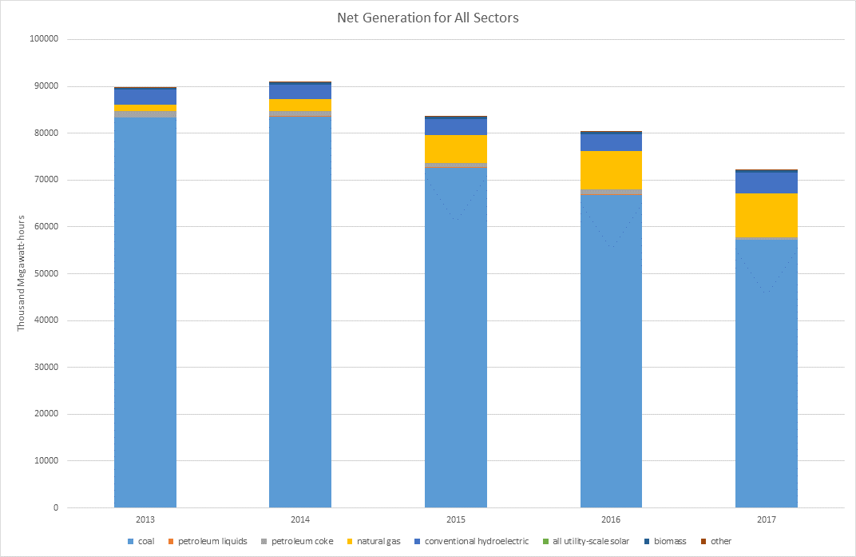
Source: EIA Form 923 & KY PSC

Slide 13
Declining Demand
*calculated for utilities with retired power plants from 2013-2017
Source: EIA Form 861 & Kentucky Energy Profile

Slide 14
2018 Projected Excess Capacity
EKPC: 27%
With PJM requirements: 24% summer excess; -6% winter (deficit)
Participates differently than Kentucky Power and Duke
LG&E/KU: 24.3%
16% planning reserve margin
KY Power: 33.58%
With PJM requirements: 17.7% excess
Duke: 31%
With PJM requirements .93% excess
Big Rivers: 54%
With MISO planning reserve 36.9% excess

Slide 15
Fuel Price
Source: Kentucky Coal Facts

Slide 16
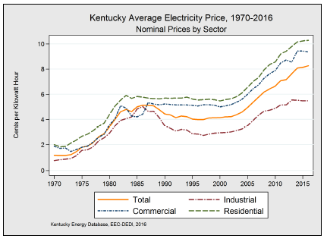
Electricity Cost
2016 Average: 8.26¢*
Residential: 10.29¢
Commercial: 9.37¢
Industrial: 5.49¢
*2017 electricity price per kWh not finalized for every utility
Source: Kentucky Energy Profile

Slide 17
Average Price: Utilities with Recent Retired Plants
*2016 data used for 2017
LGE&KU
2015
2013
KY Power
2016
2015
EKPC
2014
2016
Source: EIA Form 861, monthly data used for 2017

Slide 18
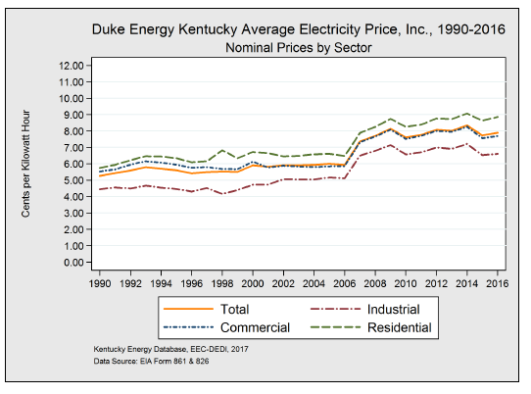
Average Electricity Price: Utilities Without Recent Retired Plants

Slide 19
Upward Pressures on Electricity Prices
Environmental retrofits
Declining load
Fixed costs spread across fewer kWh
Loss of industry pushes more cost to residential class
Increased costs of providing service
Ex: Vegetation management costs
General inflation
Cost related to early closure of power plants
Decommissioning cost
Stranded costs

Slide 20
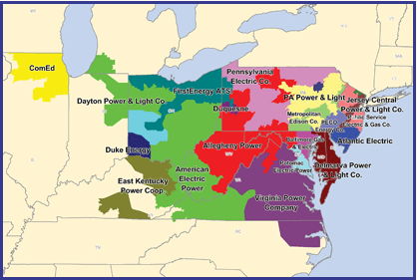
RTO Regions
PJM
MISO
Source: FERC

Slide 21
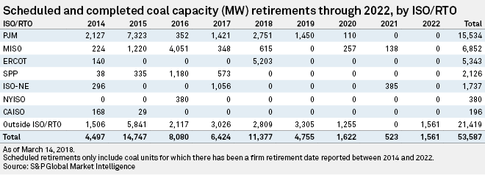
RTO Retirements 2014-2022
PJM: 15,534 MW
MISO: 6,852 MW
Notes:
https://www.snl.com/web/client?auth=inherit#news/article?KeyProductLinkType=2
&id=43987127

Slide 22
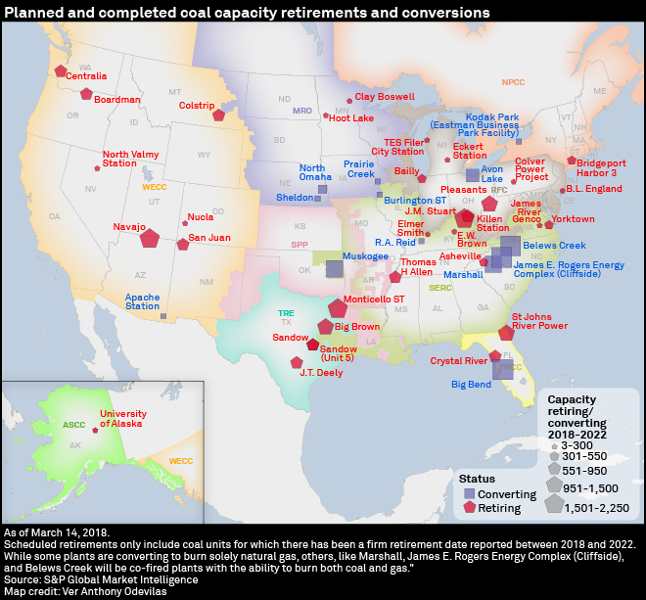
National Retirements

Slide 23
Future Generation
Taken from Integrated Resource Plans (IRPs)
KY Power: 2016
EKPC: 2015
LG&E/KU: 2014
Big Rivers: 2017*
Duke: 2018*

Slide 24
IRPs Summary
All baseload generation proposed is natural gas combined cycle
Least cost calculated using predicted: load, emission cap, capital costs, O&M costs, and fuel costs
Each utility proposed increased renewable generation and demand side management (DSM)
Excess capacity
Each utility forecasted a positive load growth
This assumption has likely changed

Slide 25
Summary of Recent Issues
PJM
Capacity performance
Proposals for capacity re-pricing
Recent capacity auction results
DOE
CPP Repeal

Slide 26
Issues to Watch
Corporate Sustainability Goals
71% of Fortune 100 Companies
Behind the meter generation, utility scale renewable energy, or purchase power agreements
Distributed energy
No forthcoming additional capacity needed to meet demand
Commission is investigating the appropriateness of DSM programs
Adequacy of natural gas infrastructure to serve generators
Future environmental rules concerning hydraulic fracturing
Battery storage
IRS
FERC Order

Slide 27
National Governors Association Policy Academy on Power Sector Modernization
18 month process
DEDI & PSC
How to look long term at the grid in light of the changes occurring with respect to price of renewables, environmental regulations, and corporate sustainability goals
Potential for development of a green tariff
Energy literacy
Technical sessions
No mandates or subsidies
Goal: Keep low prices for our manufacturing economy while providing options for companies that demand particular preferences (CHP, renewables, etc.)

Slide 28
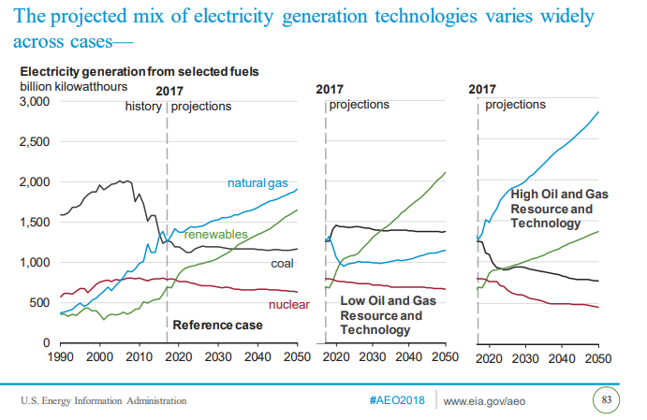
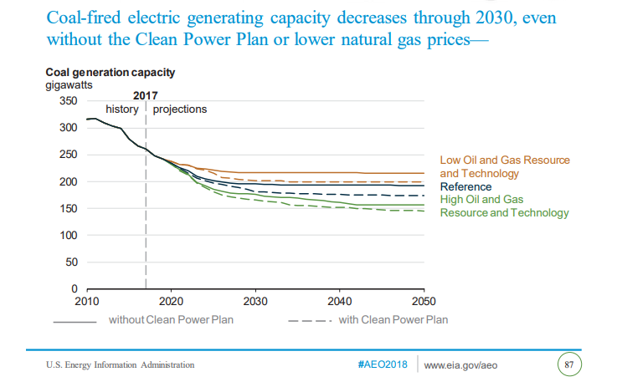
Summary

Slide 29
Questions?
Talina Mathews
Talina.Mathews@ky.gov
502-782-2553

