Slide 1
Reliably Meeting Customers’ Energy Needs at the Lowest Reasonable Cost
David S. Sinclair
Vice President, Energy Supply & Analysis
June 7, 2018

Slide 2
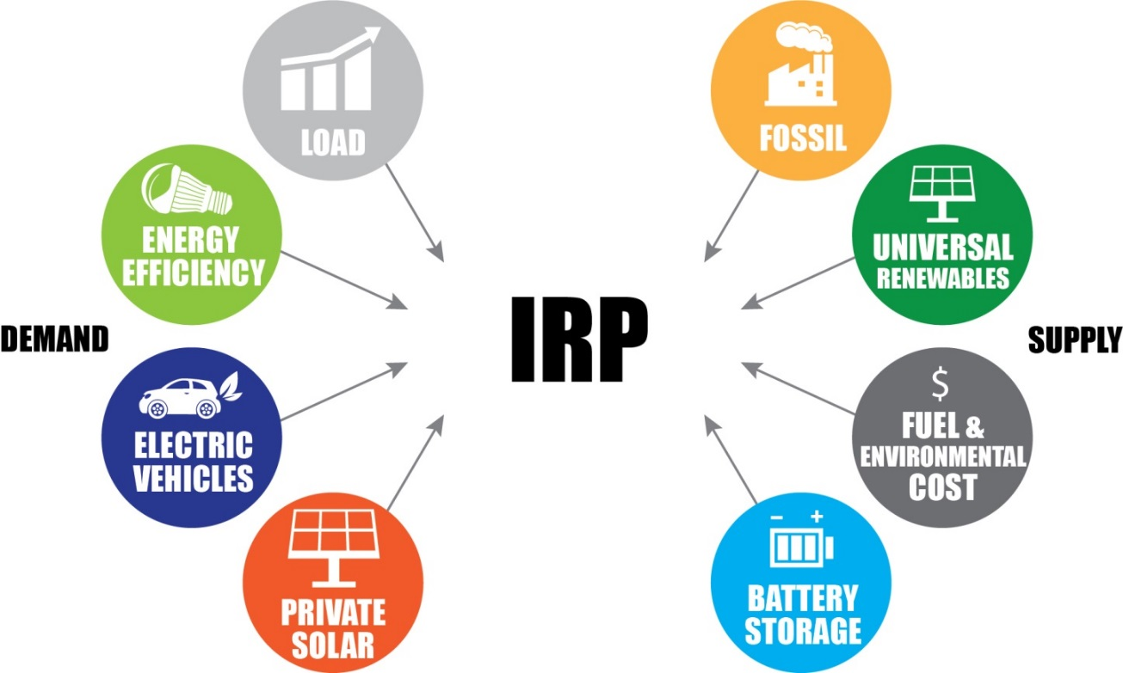
The Integrated Resource Planning (IRP) process has consistently delivered reliability and reasonable cost for our customers
IRP is a holistic approach to understanding customers’ future electricity needs and identifying the best technologies to reliably and economically meet those needs at all times

Slide 3
IRP process drove both coal investments and retirements
Trimble County Unit 2 (732 MW coal unit, commercial ops in 2011)
  Total investment of approximately $1 billion
  Approx. annual savings compared to next-best alternative of $7 million
Environmental investments to comply with MATS
  Enabled approx. 4,300 MW of coal units to continue operation
  Total investment of $2.2 billion
  Approx. annual savings compared to next-best alternatives of $200 million
Retirement of coal units to comply with MATS
  Retired approx. 800 MW of coal units which were 46 to 62 years old in 2015
  Invested $600 million to build state’s first Natural Gas Combined Cycle (662 MW)
  Approx. annual savings compared to next-best alternative of $10 million
Investing $450 million in coal combustion residual (CCR) treatment, transportation & storage and water treatment
Retiring Brown 1 & 2 in spring 2019 (106 MW and 166 MW)
  Units will be 62 and 56 years old
  Reduces investment needed to comply with CCR regulations by about $70 million

Slide 4
Reliably meeting customers’ energy needs every moment of the year requires a diverse mix of resources

Slide 5
Generation reliability must be multi-layered to effectively manage reliability risks
Power Plant Operations
  Load following capability
  Maintenance: planned and unplanned
  Start-up time and minimum up/down times
  Reserves
Fuel Deliverability and Availability
  Coal: barge, rail, truck, on-site storage
  Natural gas: pipeline transportation, scheduling flexibility, pipeline storage
  Oil: truck, on-site storage
  Hydro: river and lake conditions
  Solar: hours of sunlight, angle of sun, cloud conditions
  Wind: wind conditions
Mix of generation assets is required to cost-effectively manage risk of multiple failures

Slide 6
Recent investments and flat load ensures existing fleet likely to be little changed through early 2030s
Based on what we know today, coal units that retire in the future will likely be replaced by a combination of natural gas, renewables, and energy storage

Slide 7
LG&E and KU have assembled a reliable mix of cost-effective generation
IRP process has ensured our customers’ energy needs are reliably and cost-effectively met over both the short and long term
Absent new anti-coal regulations, the existing coal fleet will likely operate into the 2030s and 2040s
Flat load, recent investments, and the current regulatory environment means there will likely be little impetus to change the generation fleet in the next decade

