Slide 1
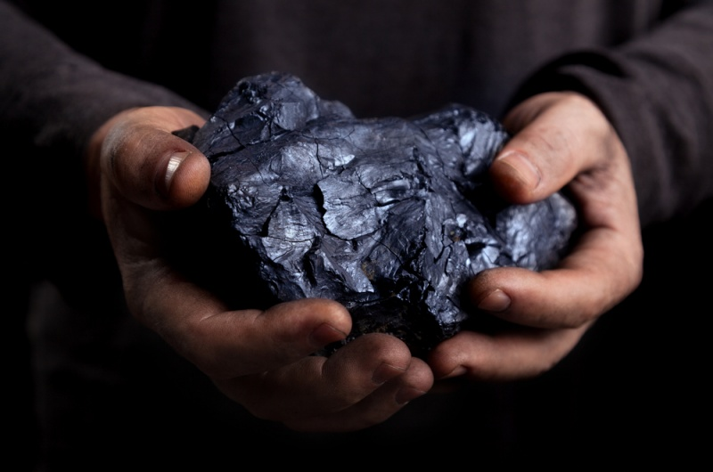
Kentucky Coal & Mineral County Coalition
Webster County Judge/Executive Steve Henry
Union County Judge/Executive Adam O’Nan

Slide 2
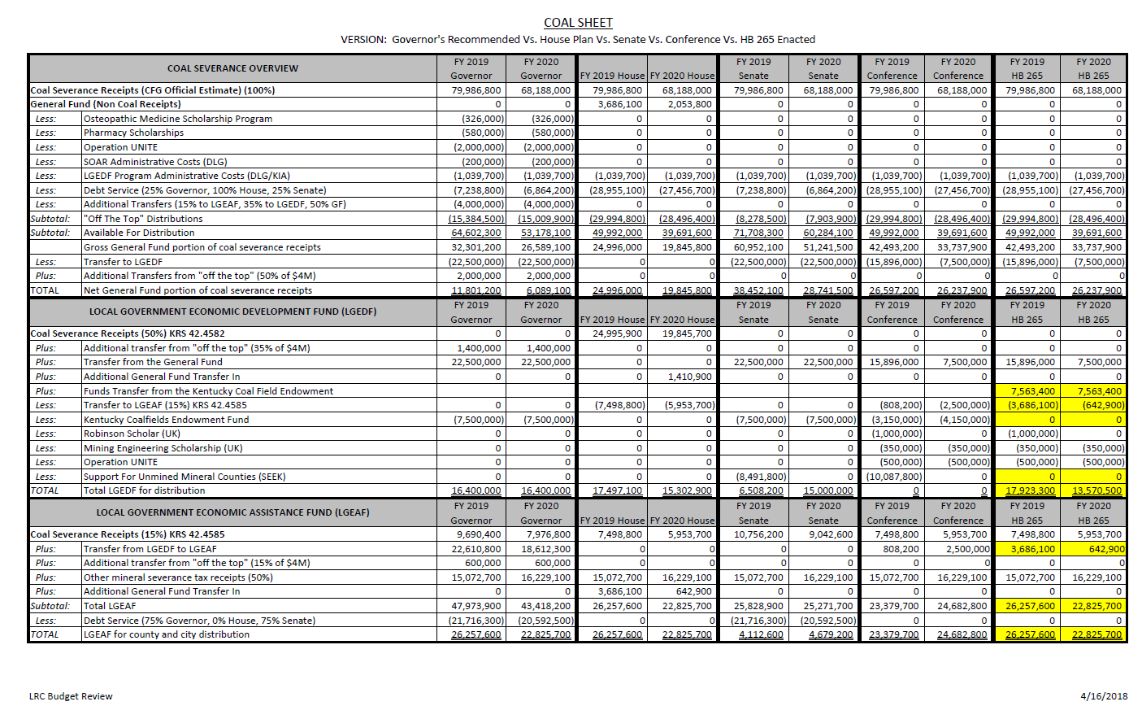
Thank YOu Legislators!!!

Slide 3
Current Statistics
Kentucky is the third largest producer of coal in the US
In FY18, KY severed 43.1 million tons of coal
Union County was the largest coal producer in KY last quarter
In FY12, the coal severance tax yielded $298.3 million in receipts. In FY18, receipts have fallen to $89.6 million
Severed tons have fallen from 109.2 million to 43.1 million short tons
These declines correspond to additional federal government regulations which made it harder a) to open new coal mines; and b) for power plants to burn coal
The recent larger drops correspond to the permanent closure of major coal-fired power plants

Slide 4
Union County
Judge/Executive:
Adam O’Nan

Slide 5
Union County Senior Services Director: Melissa Polites

Slide 6
Items to consider
In the last 6 years, Coal Severance has dropped from 3.2% of the General Fund to 0.8%. Less than 1% may not be a large portion of the state budget, but that percentage is greatly magnified for coal counties. The State has more tools in the toolbox to make up the revenue than County options.
State statues control the county budget process. Counties don’t have the calendar TIME to make up for a drastic change either by budget reductions or increased revenue. Example, in 2018 when the coal sheet was finalized, the county budget process had begun prior to the general assembly adjourning.
County Elected Officials are willing to help legislators regarding Coal & Mineral Severance in anyway possible. Ideally, to proactively devise a plan for 2020 that will help return the severance funding to local communities.

Slide 7
Thank you Legislators!!!

