Slide 1
Interim Joint Committee on Transportation
10-04-2018
Brian Wright – President/CEO
Rod Kuegel – Chairman of the board

Slide 2
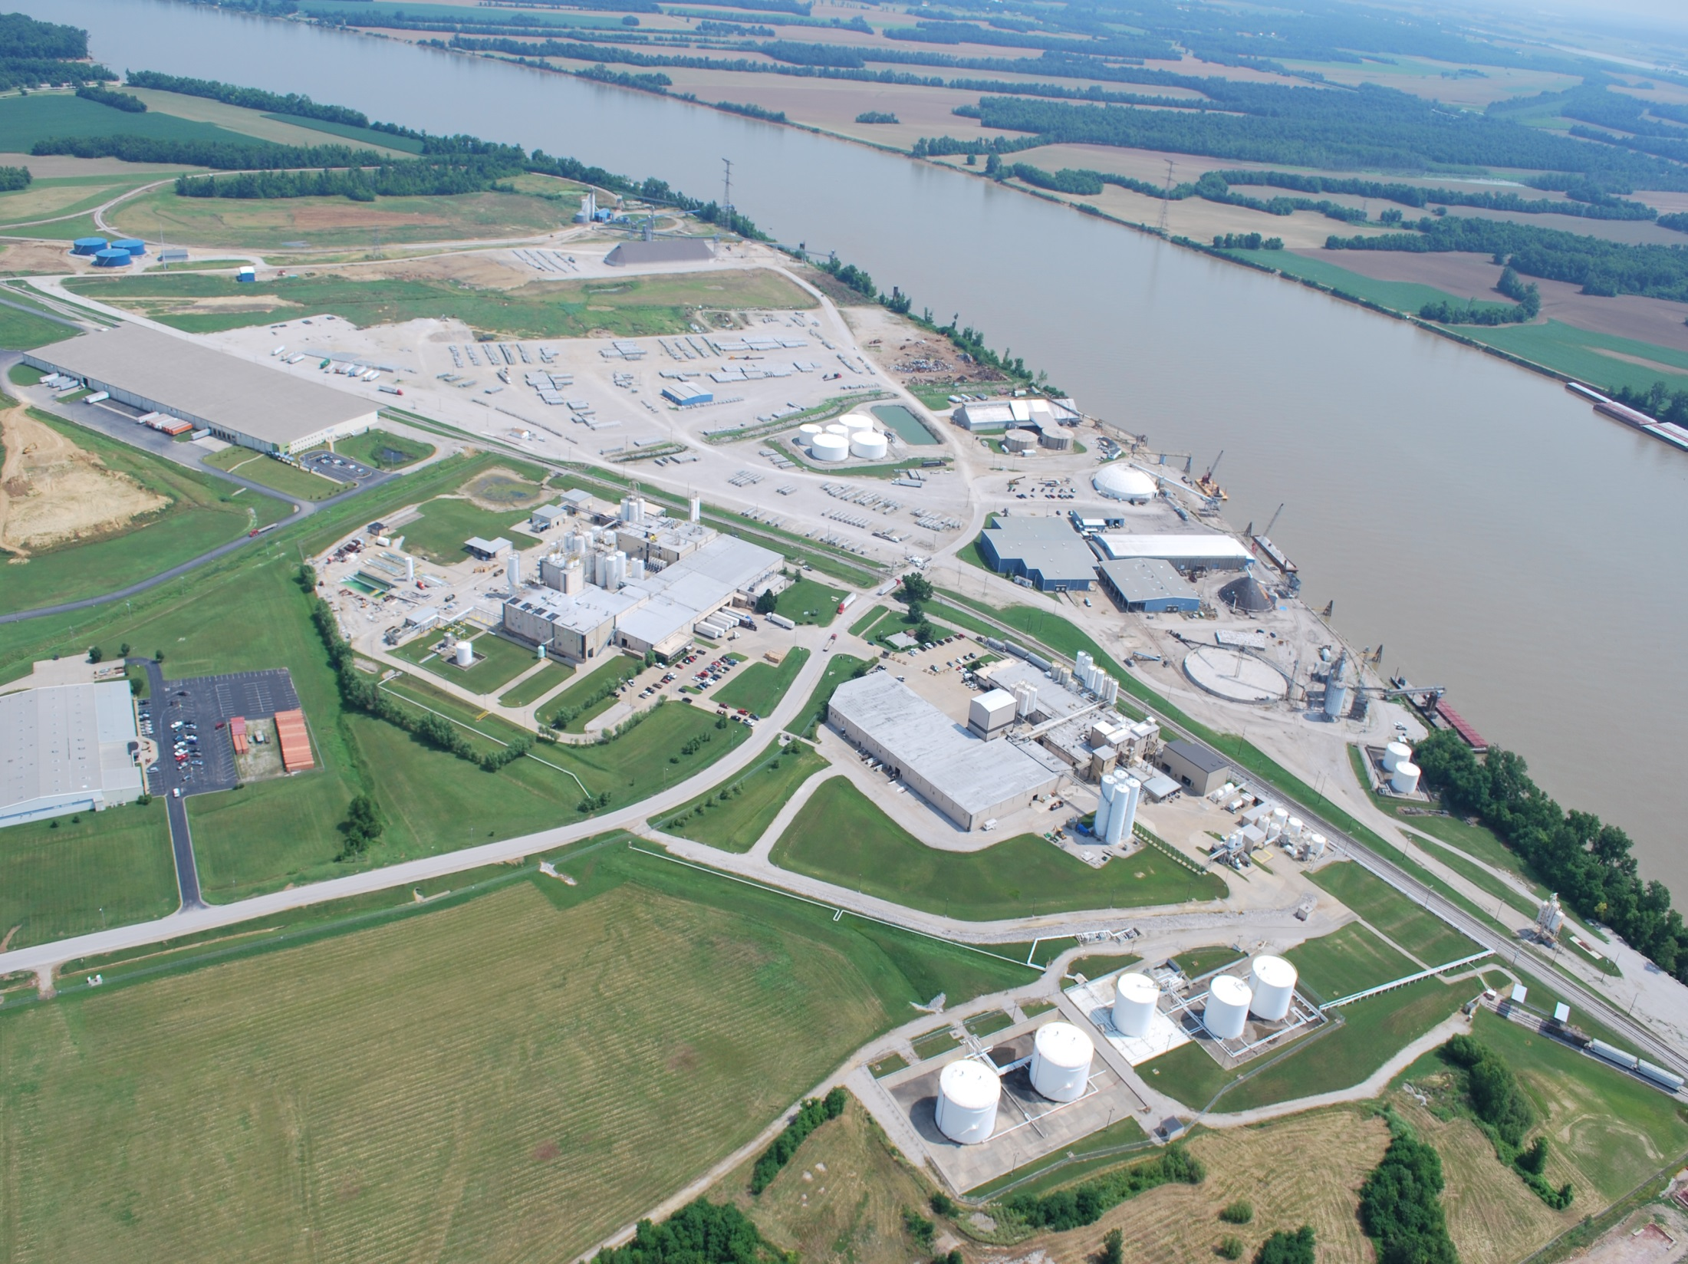
Our mission is to establish the Owensboro Riverport as the premier inland port in the Ohio River Valley by providing a dynamic, efficient, customer oriented, and market focused intermodal facility that contributes to commerce and economic growth for Owensboro and the region.
Chartered 1966 by City of Owensboro
Operational in 1976

Slide 3
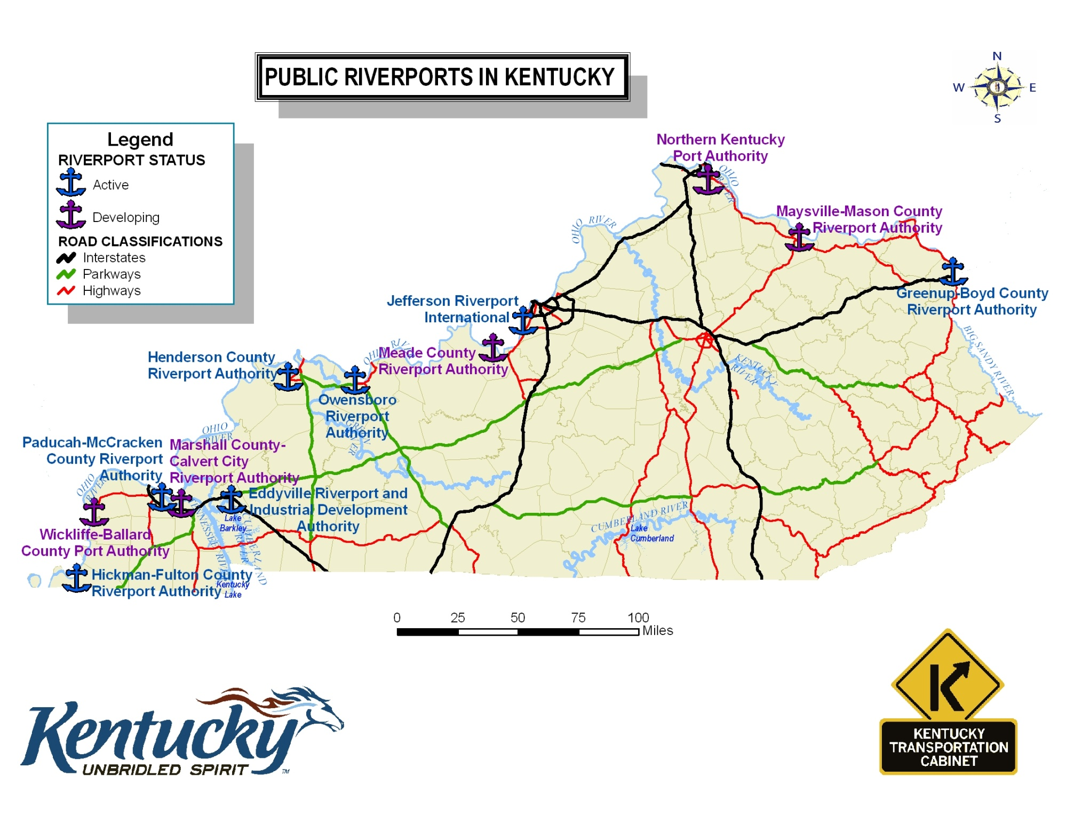

Slide 4
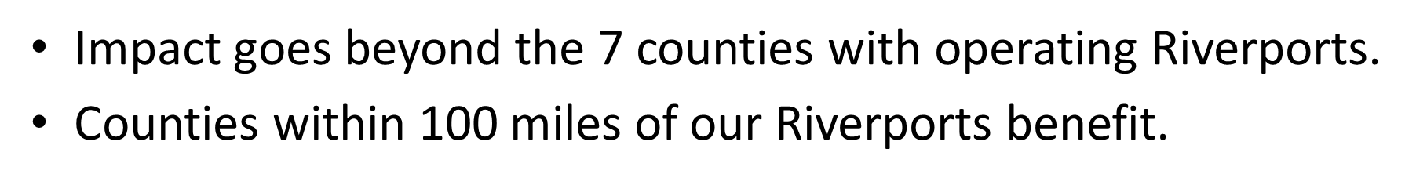
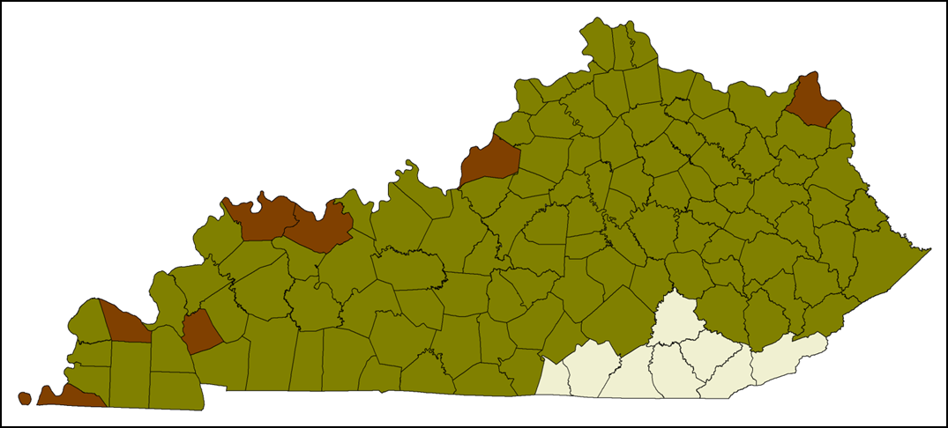
Impact of Public Ports

Slide 5
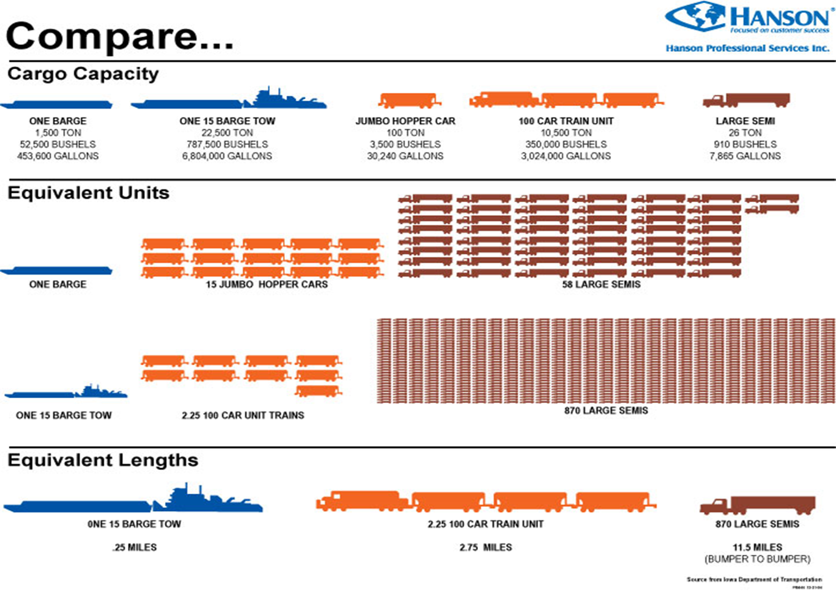

Slide 6
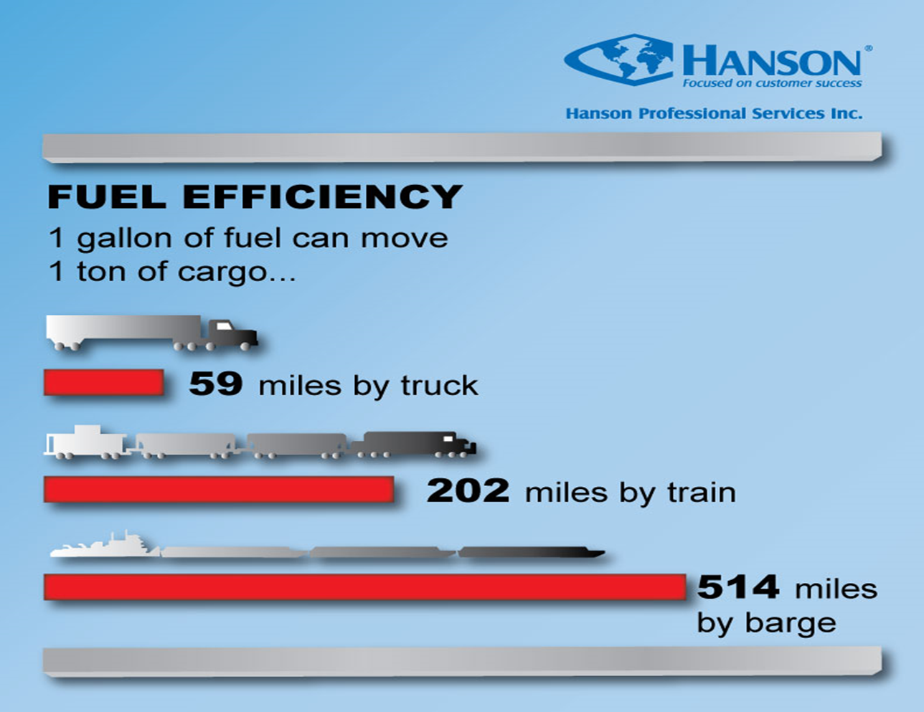

Slide 7
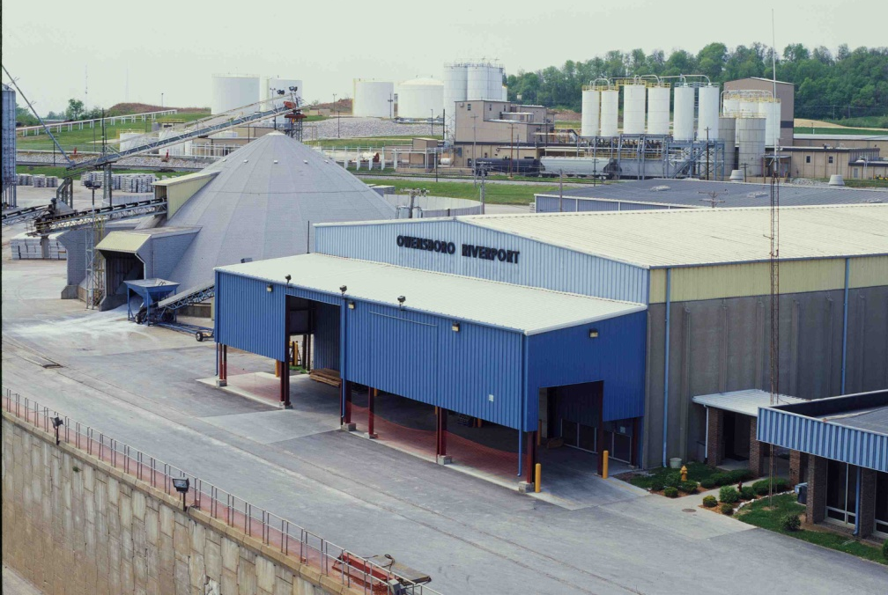
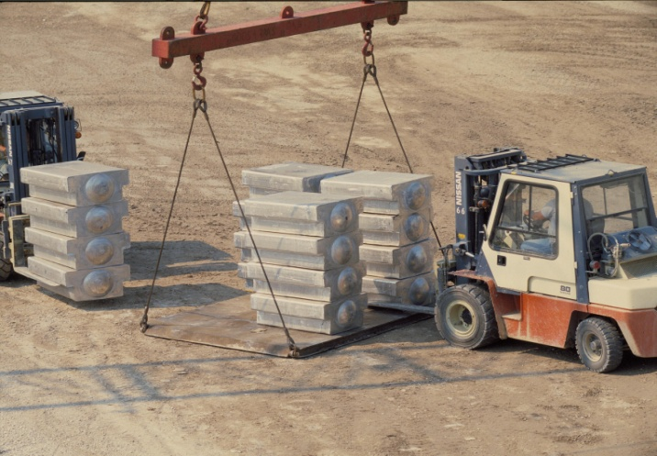
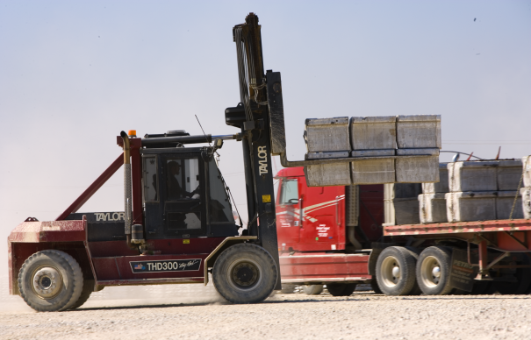
Owensboro Riverport
340 Acre “Working” Terminal
  100 acre rail loop (90 railcars)
  2.5 miles of port owned rail
500,000 sq. ft. of warehousing
New cargo dock in 2014
110-ton Friction Crane
Material Handler (Spud Barge)
40-ton Crane
Lift Truck Fleet (5,000–52,000)
2016 Liebherr LHM 280 w/ 84t capacity
Notes:
We have only purchase 2 pieces of equipment since my tenure as president.
We go to city auction and buy other governmental obsolete equipment and make it work for us. Since my tenure, ORA does not replace equipment every 3, 4, or 5 years as does City, OMU< and RWRA.
ORA load an average of 150 semi-trucks per day

Slide 8


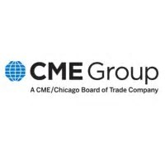

Designations

Slide 9
Volume (Net Tons)

Slide 10
Market Diversification

Slide 11
ORA Revenue

Slide 12
Capital Investments

Slide 13
Economic Impact
Operational Impact – It is estimated that the total economic impact of Owensboro Riverport operations is;
In FY2018, $16.1 million of total output $8.6 million of labor income, and support for 197 jobs annually throughout the region.
Average 2013-2018, $13.8 million of total output, $7.0 million of labor income, and support for 161 jobs annually throughout the region.
Commonwealth Economics: Economic Impact Analysis of Owensboro Riverport September 2018
Notes:
From a Management position we are self sufficient.
We are an Operational Port instead of a Land Lord Port.
All of our processes are done in-house
Purchasing
Accounting

Slide 14
Economic Impact
Capital Investment - The Authority, with support from grant contributions and private sector funding, has invested more than $46.1 million in construction projects at the riverport between 2013 and 2018. The impacts associated with these initial injections into the local economy are estimated to have contributed;
$67.7 million in total economic impact, including total employment for 590 people and $20.3 million in total wages during construction.
Notes:
From a Management position we are self sufficient.
We are an Operational Port instead of a Land Lord Port.
All of our processes are done in-house
Purchasing
Accounting

Slide 15
Economic Impact
Industry Impact - In 2016, out of an estimated $10.7 billion in output, 57,898 jobs, and $2.6 billion in labor income within Daviess County;
$1.6 billion (15.2%) in output, 3,225 (5.6%) jobs, and $155.3 million (5.9%) in income was supported by commodity-driven industries.
In addition, out of an estimated $23.3 billion in output, 114,589 jobs, and $5.3 billion in labor income within the Green River Area Development District (Daviess, Hancock, Ohio, Henderson, McClean, Webster, and Union), $3.5 billion (14.9%) in output, 8,020 (7.0%) jobs, and $385.7 million (7.3%) in income was supported by commodity-driven industries.
Notes:
From a Management position we are self sufficient.
We are an Operational Port instead of a Land Lord Port.
All of our processes are done in-house
Purchasing
Accounting

Slide 16
Looking Forward
Given the projected population growth over the next 25 years, the USDOT has estimated 10 billion additional tons will move domestically throughout the United States.
Centered in the Midwest, Kentucky’s multimodal transportation network is critical to the long-term balance of road, rail, river, and air transportation.
The Owensboro Riverport Authority Master Plan defined in 2016, calls for over $40 Million in capital and infrastructure improvements through 2026 to support this long-term balance.
The Kentucky Association of Riverports along with the Kentucky Infrastructure Coalition supports increased sources of funding to meet the long-term multimodal transportation demands in Kentucky.
Notes:
From a Management position we are self sufficient.
We are an Operational Port instead of a Land Lord Port.
All of our processes are done in-house
Purchasing
Accounting

Slide 17
Our mission is to establish the Owensboro Riverport as the premier inland port in the Ohio River Valley by providing a dynamic, efficient, customer oriented, and market focused intermodal facility that contributes to commerce and economic growth for Owensboro and the region.
Experience
Performance
Excellence

