Slide 1
KENTUCKY COAL Production, Policy & The Future of Coal
Tyler White, President
Kentucky Coal Association
880 Corporate Drive, Suite 101
Lexington, KY 40503
859/233-4743
twhitekentuckycoal.com
www.KentuckyCoal.com

Slide 2
About Kentucky Coal Association
Represents Kentucky’s Coal Production
Member Companies & Associate Member Companies
Provides a “Voice” for Kentucky Coal
Coordinates the Friends of Coal-Kentucky and the Friends of Coal License Plate Program

Slide 3
About Kentucky Coal - 2018
Used Domestically in SE United States
Two Coalfields – Appalachian Coal Basin and Illinois Coal Basin
Primarily Steam Coal
39 million tons of coal production 2018
Compared to -28% reduction in 2016

Slide 4
US Energy Information Administration www.EIA.gov

Slide 5
Production
PRODUCTION E KY W KY
2010 105 MM 68 MM 37 MM
2012 91 MM 49 MM 42 MM
2013 80 MM 39 MM 41 MM
2014 77 MM 37 MM 40 MM
2015 61 MM 28 MM 33 MM
2016 43MM 17MM 26MM
2017 42MM 18MM 23MM

Slide 6
2018 Coal Production

Slide 7
Employment
EMPLOYMENT E KY W KY
2010 17K 13K 4K
2012 16K 11K 5K
2013 13K 8K 4K
2014 12K 7K 4K
2015 9K 6K 4K
2016 6K 3.8K 2.6K
2017 6K 4.1K 2.5K

Slide 8
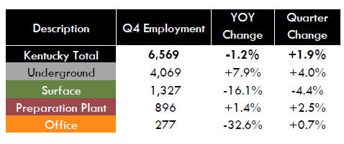
2018 Employment

Slide 10
KY Coal Consumption

Slide 11
Thank You!
House Resolution 144:
A resolution urging the PSC to consider all costs related to the importation of coal for electricity generation.

Slide 12
PSC proposed amendment to 807 KAR 5:056
*Requires the PSC, when evaluating the reasonableness of a utility’s fuel purchase decision, to deduct from the purchase price of the coal the amount of Kentucky severance tax assessed on the coal to be purchased.
Illinois No Severance Tax
Indiana No Severance Tax
West Virginia Reduced Severance Tax in 2019
Kentucky Coal Severance is 4.5%

Slide 13
Next steps?
How can we make KY Coal more competitive?
Cycle of life = more coal = increase demand for load =
lower cost electricity = more jobs =more payroll taxes
Building a New Coal Plant next to the coal source?

Slide 14
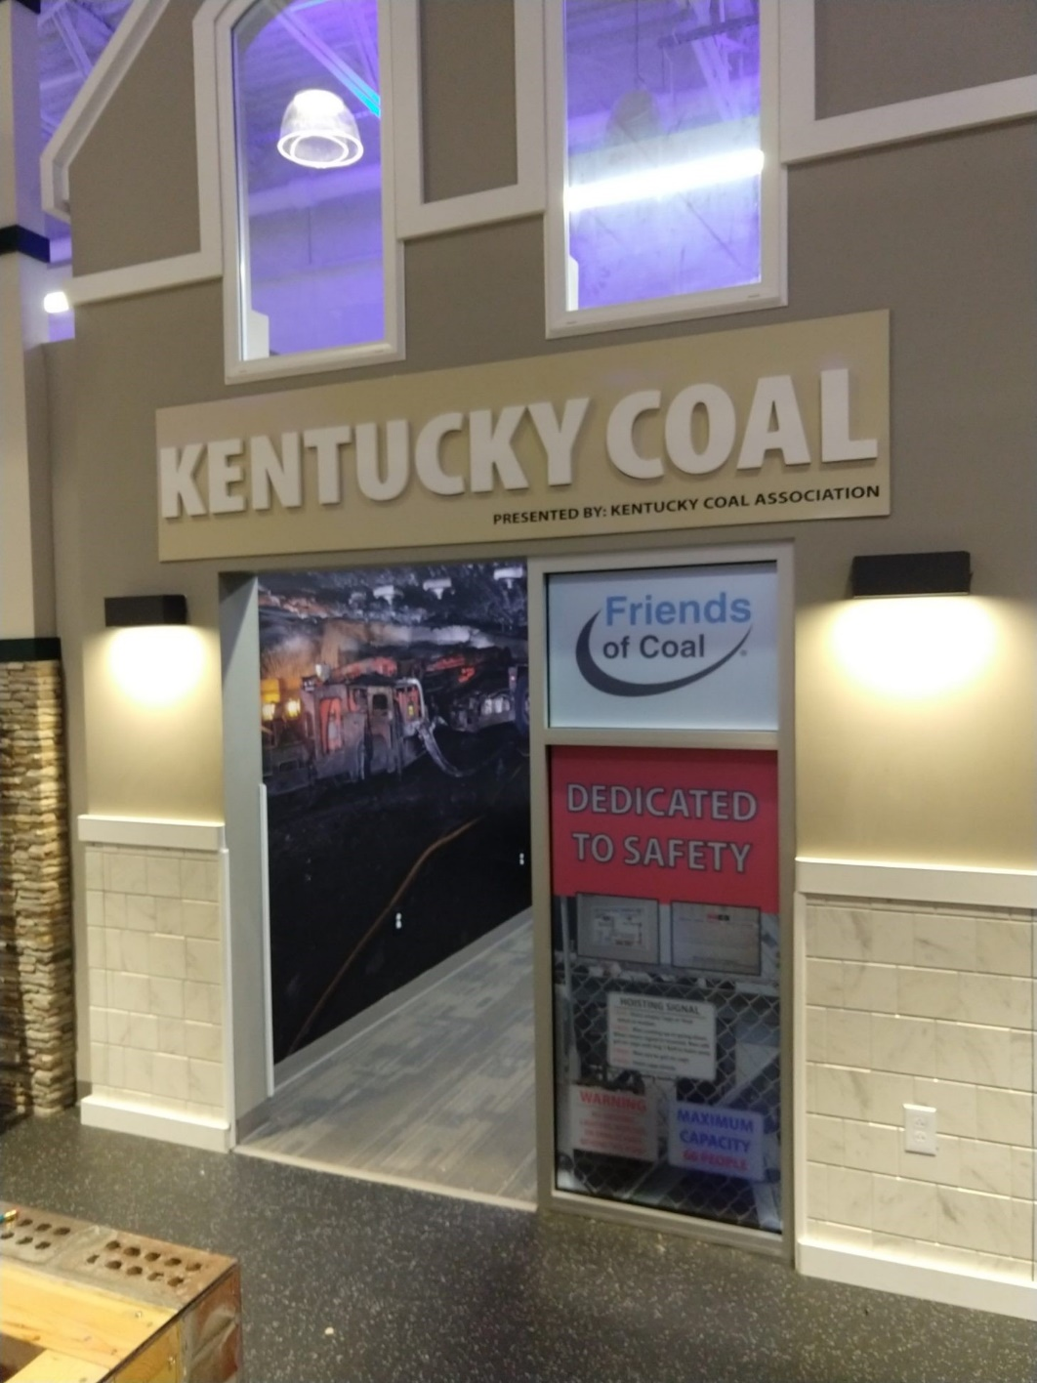
JA Biztown

Slide 17
Safety
Update on HB 384 Mine Safety Modernization
Signed into law 2017

