Slide 1
LIHEAP
Preliminary State Plan Federal Fiscal Year (FFY) 2020
Cabinet for Health and Family Services (CHFS)
Department for Community Based Services (DCBS)
Division of Family Support
and
Community Action Kentucky, Inc. (CAK)
Interim Joint Committee on Natural Resources and Energy
July 9, 2019
Low Income Home Energy Assistance Program (LIHEAP)
Notes:
Introductions

Slide 2
Department for Community Based Services: Eric T. Clark, Commissioner
Division of Service Regions
Division of Administration and Financial Mgmt.
Division of Child Care
Division of Family Support
Division of Program Performance Quality Control
Division of Protection and Permanency
Low Income Home Energy Assistance Program (LIHEAP)

Slide 3
Division of Family Support
Nutrition Assistance Branch
Program Integrity Branch
Policy Development Branch
Family Self Sufficiency Branch
Medical Support and Benefits Branch
Low Income Home Energy Assistance Program (LIHEAP)

Slide 4
HISTORY…
Established in 1982
Safety net focusing on energy conservation and heating and cooling
Meet immediate home energy needs
Households with the lowest incomes that pay a high proportion of income for home energy
Anticipated $57.8M for 2020 Program Year
100% federally funded
Low Income Home Energy Assistance Program (LIHEAP)

Slide 5
LIHEAP HISTORY
HISTORY…
90% used for Kentucky citizens
Less than .2% is retained by DCBS for the Preventive Assistance Program to assist families receiving child protective services with an energy payment
Kentucky Community Action agencies retain up to 5% of their allocation
Up to 15% can be allocated for weatherization
Less than 10% of the award is used for administrative costs
Low Income Home Energy Assistance Program (LIHEAP)

Slide 6
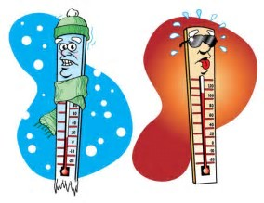
Benefits…
LIHEAP offers the following types of benefits to Kentucky citizens:
Bill payment assistance:
- Subsidy component
- Crisis component
Emergency assistance
Summer cooling (rarely instituted crisis component contingent upon available funding)
Weatherization activities to increase the energy efficiency, health, and safety of eligible low-income individual’s dwellings
Low Income Home Energy Assistance Program (LIHEAP)

Slide 7
Eligibility…
130% of the Federal Poverty Level
Household income must be at or below the following, relative to household size:
Household Size Gross Monthly Income 1 $ 1,353
2 $ 1,832
3 $ 2,311
4 $ 2,790
5 $ 3,268
*Add $479 for each additional family member
The applicant must be responsible for the home heating costs or pay heating costs as a designated portion of rent
Low Income Home Energy Assistance Program (LIHEAP)

Slide 8
Subsidy…
LIHEAP Subsidy Component:
Offsets home heating costs
Has benefit amounts structured by a percentage of the household’s annual heating costs and percentage of poverty met by the household
Application process runs early November through Mid-December
- Early applications occur in October for the elderly, and those with disabilities
- Appointments are available for working individuals
Low Income Home Energy Assistance Program (LIHEAP)

Slide 9
Crisis…
LIHEAP Crisis Component:
Offers assistance for an energy emergency
Includes application processing beginning in January and typically running through March
Requires that all households with incomes above 74% of the Federal Poverty Level to pay a co-payment or a percentage of the crisis component benefit
Low Income Home Energy Assistance Program (LIHEAP)

Slide 10
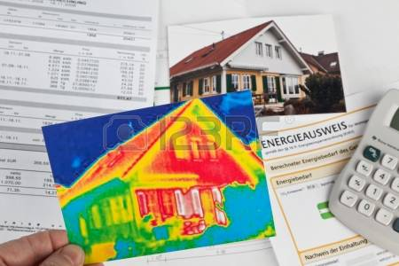
Weatherization Program…
Funds home repairs related to energy efficiency
Serves low-income households whose incomes do not exceed 200% of the Federal Poverty Level
Low Income Home Energy Assistance Program (LIHEAP)

Slide 11
Weatherization Program…
Prioritizes households containing elderly, disabled, or children
Prioritizes eligible households with young children at risk of removal from the home due to substandard conditions
Prioritizes high energy burden households, where the energy costs exceed 15% or more of the household’s income
Low Income Home Energy Assistance Program (LIHEAP)

Slide 12
Weatherization Program…
Weatherization Program includes activities to increase the energy efficiency and reduce heating costs of dwellings:
-Installing insulation
-Refrigerator replacement
-Sealing air infiltration
-Heating system or water heater repair or placement
Low Income Home Energy Assistance Program (LIHEAP)

Slide 13
Weatherization Program…
Improve the health and safety of the dwelling and heating systems:
-Testing for gas leaks, carbon monoxide, and other health and safety issues
-Checking combustible appliances, such as stoves, furnaces, and water heaters
-Installing fire and carbon monoxide detectors
-Energy education prioritizes households containing elderly, disabled, or children
Low Income Home Energy Assistance Program (LIHEAP)

Slide 14
State Fiscal Year 2019…
78,306 households received Subsidy benefits
-Average benefit: $137.78
-$10.8 Million
78,388 households received Crisis benefits
-Average benefit: $327.97
-$41.2 Million
360 dwellings weatherized
-Average benefit: $7,171
-$2.6 Million
Low Income Home Energy Assistance Program (LIHEAP)
Notes:
TT-
Due to enhanced federal funding in 2008, the maximum crisis component benefit amount was increased to $400 and has remained unchanged. The increase in utility benefit was necessary to make certain the federal funds were spent within the fiscal year. Also, the increase in benefits ensured that the LIHEAP crisis component better met the actual heating costs seen by eligible low-income households as a result of recent utility cost increases.
These figures are estimated at this point because we will not know expenditures with certainty until the State Fiscal Year close-out. Some carry-over is expected.
State Administration and Preventative Assistance $104,000
Total $57.8M

Slide 15
Partnerships…
Low Income Home Energy Assistance Program (LIHEAP)
Notes:
RM

Slide 16
Partnerships…
Partnership with Community Action Kentucky, Inc. (CAK) and the Kentucky Housing Corporation (KHC)
23 subcontracting agencies
Kentucky’s Community Action Agencies administer LIHEAP benefits in all Kentucky counties
Low Income Home Energy Assistance Program (LIHEAP)
Notes:
EC
LIHEAP services are provided through a historical and largely federally prescribed contractual arrangement.

Slide 17
LIHEAP
Low Income Home Energy Assistance Program (LIHEAP)
Notes:
RM

Slide 18
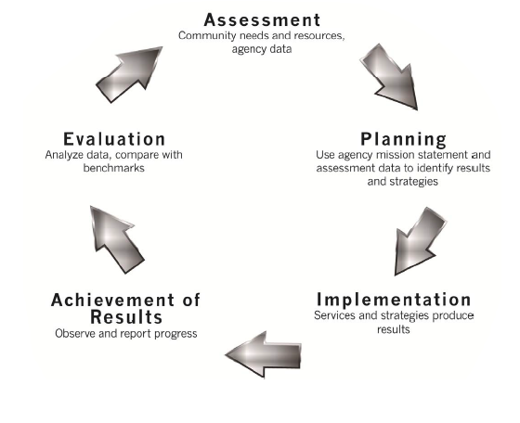
CAK employs continuous quality improvement processes, including:
Change Committee
Manual updates based on technical assistance and monitoring trends for prior year
Data collection and analysis
Training and technical assistance to the Community Action Network
Low Income Home Energy Assistance Program (LIHEAP)
Notes:
RM

Slide 19
Low Income Home Energy Assistance Program (LIHEAP)
Questions?
Notes:
We would like to thank the committee for this opportunity to present. We at the table and representatives from the KY Housing Corporation are available to answer any questions.

