Slide 1
Utility Ratemaking 101 & PSC Update
Presented by Commissioner Talina Mathews, PhD
Kentucky Public Service Commission
To the Interim Joint Committee on Natural Resources and Energy
August 20, 2019
Any views expressed in this presentation are those of the presenter and do not reflect official positions of the PSC.

Slide 2
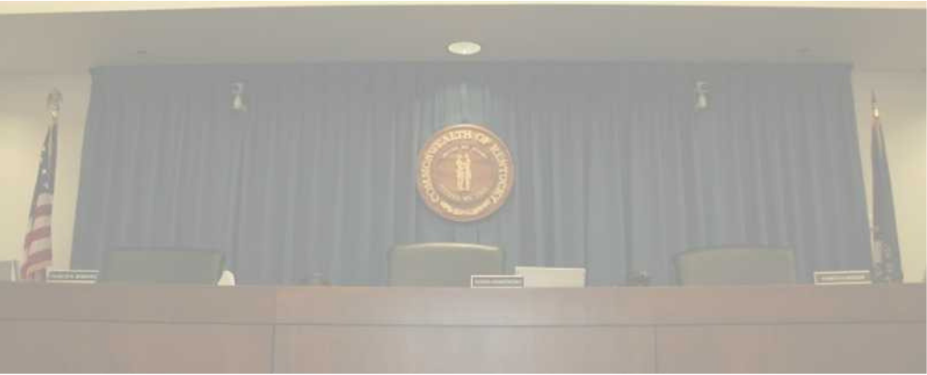
PSC Mission
To ensure that utility rates are fair, just, and reasonable for the provision of safe and reliable services.

Slide 3
PSC Regulated Entities
1,100 jurisdictional utilities:
Water and sewer utilities (small systems comprise the bulk of regulated utilities)
Natural gas distribution systems and intrastate pipelines
Electric utilities (investor-owned and jurisdictional cooperatives)
Telecommunications (small number)
Do not include municipal utilities except for gas pipeline safety.
Do not include cooperatives served by TVA.

Slide 4
PSC Regulatory Responsibility Includes
Rate increase or reduction
Expansion or reduction of utility service boundaries
Construction and operation of utility facilities
Meter accuracy
Operating conditions of a utility
Management audits
Valuation of utility property
Natural gas and coal purchasing practices
Issuance or assumption of securities by a utility
Consumer complaints
Compliance with service and safety regulations

Slide 5
Monopoly Regulation
Natural monopoly, especially the distribution system
In return for their monopoly, in terms of a defined service territory, a utility must serve all customers in that service territory (including those that are geographically challenging to serve), non-discriminatively and with service that is safe and reliable.
Utilities are allowed, through rates, to recover their costs of serving customers, plus the ability to earn a reasonable rate of return on capital investments.

Slide 6
Ratemaking Process

Slide 7
Rate Case: Step One
Utility files for rate increase.
Compute the utility’s revenue requirement
Cost of providing service (disallowance for various items such as lobbying expenses, executive bonuses tied to stock price, advertising, etc.)
Incentives matter
Commission must ensure prudency
Return on Equity (ROE)—must be competitive
Risk profile of the utility
Current capital markets
If a utility is unable to attract capital at a competitive rate, investment may be reduced and service and reliability can suffer. Commission must continue to have benchmarks for service and reliability.

Slide 8
Revenue Requirement Formula
Revenue requirement – base rates
Final revenue requirement = allowable expenses and the opportunity to earn a reasonable rate of return on equity (investor-owned) or to meet TIER requirement (coops)
R = O + (V − D)^{r}
R is the utility's total revenue requirement or rate level. This is the total amount of money a regulator allows a utility to earn.
O is the utility's operating expenses.
V is the gross value of the utility's tangible and intangible property.
D is the utility's accrued depreciation. Combined (V − D) constitute the utility's rate base, also known as its capital investment.
r is the rate of return a utility is allowed to earn on its capital investment or on its rate base.

Slide 9
Outside of Base Rates:
Fuel cost adjustment (above or below base fuel cost)
Commodity cost of natural gas
Environmental compliance cost – separate by state law
Demand-side management surcharge (energy efficiency programs) –separate by state law
Low-income assistance program fee
Franchise fees
Local taxes

Slide 10
Rate Design

Slide 11
Step Two: Rate Design
Allocation of rate (revenue requirement) to each customer class
Usually at least three—residential, commercial, industrial. Some utilities have more depending on the type of customers. Rate allocation among customer classes attempts to reflect the difference in costs to serve.
General principle is not to have one class subsidize others. In general, larger customers have lower cost of service (economies of scale).
In the past, in Kentucky, the industrial class has subsidized the residential class. It costs less to serve 1 MW load than 1,000 1kW loads.
Cost of Service Study (submitted by utility) and billing analysis
Part science, part art—goal is to identify the cost of providing service to each customer rate class.

Slide 12
Rate Design
Allocation between fixed (independent of consumption) and variable costs:
Residential and Commercial typically two-part rates
Customer or meter charge
Volumetric charge
Industrial rates are typically three parts
Customer charge
Demand charge
Volumetric charge
PSC uses cost of service study as a guideline—but rates are not set strictly to reflect costs.
Fixed and variable costs are not allocated on a strictly proportional basis to fixed and variable charges. Variable (consumption based) generally recover a portion of fixed costs; of late, PSC is trying to more closely align fixed/variable costs and rates.

Slide 13
Balancing Act
The bottom line – what is fair, just & reasonable?
Fair to investors.
Sufficient to support safe and reliable service.
Not unduly burdensome on ratepayers.
Ratemaking is prospective—rates set today are to recover future cost of service.
PSC has discretion, but only within the legal limits.
Ratemaking and rate design—states follow principles grounded in decades- long practices and standards—fair, just and reasonable have generally accepted meaning.

Slide 14
Public Comment
Intervention – may come before filing of application
Kentucky Attorney General - statutory representative of ratepayers in general
Full intervenors – must show they represent unique interests and will contribute evidence that otherwise might not be brought before the PSC – testimony, discovery, cross-examination.
Discovery – one or more rounds of data requests to/from parties; from PSC staff
Public meetings – at PSC discretion
Public comment
Evidentiary hearing – not required
Post-hearing filings
Final order based upon the record in the case

Slide 15
Natural Gas
PSC regulates the rates and service of jurisdictional natural gas distribution utilities. By federal law, the wholesale price of natural gas is unregulated and fluctuates with market conditions.
Natural gas distribution companies regulated by the PSC can adjust the amount they charge their customers to pass through the actual cost of the gas—the Purchased Gas Adjustment (KRS 278.040).
PSC approves rates to recover cost of distributing gas to customers (including some pipeline replacement programs designed to accelerate the replacement of primarily cast iron, bare steel, and plastic pipe of a vintage known to cause concern).
PSC reviews PGA and has the authority to review natural gas utility’s purchasing practices and disallow costs that are not deemed to be prudent.

Slide 16
Pipeline Safety
Interstate Pipelines are regulated by the Pipeline and Hazardous Materials Safety Administration (PHMSA), within the U.S. Dep. of Transportation.
Per agreement with PHMSA, Kentucky and most other states assume safety authority over intrastate gas pipelines and hazardous liquid pipelines.
PSC pipeline safety jurisdiction covers more than 200 natural gas distribution systems: LDCs, municipal gas systems, master meter operators, and some universities.
SB 104 (2018 GA) designated PSC statewide authority to enforce and assess penalties for any violation that results in damage to an underground facility used to transport gas or hazardous liquids subject to federal pipeline safety laws…”
To date, ~1,000 reports of excavation-caused damage to natural gas pipelines with more than 400 citations for violations issued.
Education, outreach, and training integral parts of the program to reduce violations and protect public safety. Remember—CALL BEFORE YOU DIG!

Slide 17
Water and Wastewater—Regulated by PSC
Water districts
Water associations
Investor-owned water utilities
Some sewer utilities (not SD1 or MSD)

Slide 18
PSC Updates
July 30, 2019—opened an administrative case (2019-00256) to take comments on implementation of SB 100 (net metering revisions).
PSC will make no decision on net metering rates in this proceeding. Written comments due Sept. 20, and hearing to receive comments on Oct. 1 at 9 a.m.
Comments received will be incorporated into the initial rate proceeding filed by utilities.
SB 100 takes effect Jan. 1, 2020, but new net metered compensation will vary by individual utility.
Completed water loss hearings per case 2019-00041.
Completed investigation of ~1,000 damages to gas pipelines in last 12 months.
Issued ruling on June 14, 2019, on electric vehicle charging states, determining these facilities are not utilities and therefore not subject to PSC regulation.
In last 12 months, conducted 13 major rate cases.
Opened an investigation and adjusted rates downward after the Tax Cuts and Jobs Act to reflect the lower corporate income tax. (Only applicable to investor owned utilities)

Slide 19
Demand Side Management Programs
KRS 278.285—The Commission may determine the reasonableness of DSM plans proposed by a jurisdictional utility. Factors to consider:
Cost-benefit analysis; whether a DSM plan disadvantages any customer class; extent to which a DSM program is affordable and useful to all of a utility’s customers.
PSC has denied continuation of some programs in which benefits do not justify costs or that are no longer affordable or useful to certain customers.
Review criteria on a case-by-case basis. Discontinued Ky Power because customers were paying up to $10/month in a utility service area that has declining load.

Slide 20
Additional Material

Slide 21
Ratemaking
Is governed by statute—KRS 278
Rates must be “fair, just and reasonable
For investor-owned utilities, investors are entitled to an opportunity to earn a return on equity
For non-profit utilities, rates are adequate to meet lender requirements and maintain financial stability.
Rate setting is prospective—rates set today are to recover future cost of service.

Slide 22
278.016 Commonwealth to be divided into geographical service areas.
It is hereby declared to be in the public interest that, in order to encourage the orderly development of retail electric service, to avoid wasteful duplication of distribution facilities, to avoid unnecessary encumbering of the landscape of the Commonwealth of Kentucky, to prevent the waste of materials and natural resources, for the public convenience and necessity and to minimize disputes between retail electric suppliers which may result in inconvenience, diminished efficiency and higher costs in serving the consumer, the state be divided into geographical areas, establishing the areas within which each retail electric supplier is to provide the retail electric service as provided in KRS 278.016 to 278.020 and, except as otherwise provided, no retail electric supplier shall furnish retail electric service in the certified territory of another retail electric supplier.
History: Created 1972 Ky. Acts ch. 83, sec. 2.

Slide 23
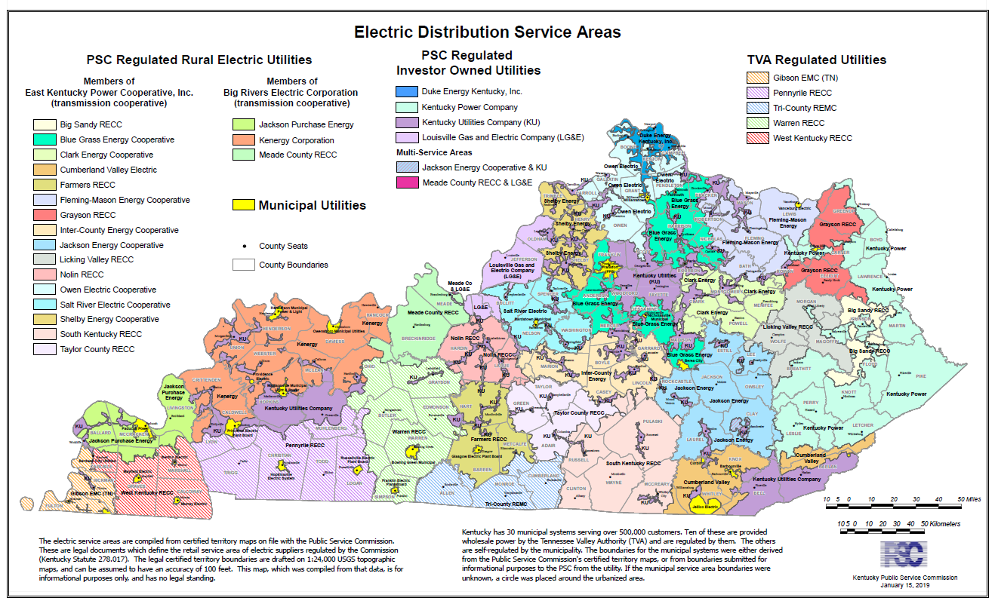
Regulated Electric Utilities—Service Territory
Rural Electric Utilities
East Kentucky Power Cooperative (EKPC)-16 cooperatives
Big Rivers Electric Corporation-3 cooperatives
Investor Owned Electric Utilities
Kentucky Power (KY Power)
Duke Energy Kentucky (Duke)
Kentucky Utilities Company (KU)
Louisville Gas and Electric Company (LG&E)

Slide 24
Cooperatives Served by TVA—Not Regulated by PSC
Hickman-Fulton Counties RECC
Pennyrile RECC
Tri-County REMC
Warren RECC
West Kentucky RECC
These distribution cooperatives serve all or a portion of the following counties: Adair, Allen, Barren, Butler, Caldwell, Calloway, Carlisle, Christian, Clinton, Cumberland, Edmonson, Fulton, Graves, Grayson, Hickman, Livingston, Logan, Lyon, Marshall, Metcalfe, Monroe, Muhlenberg, Ohio, Simpson, Todd, Trigg, Warren and Whitley.

Slide 25
Municipal Electric Utilities—Not Regulated by the PSC
While state Commissions and FERC adhere to similar rate design and rate-making practices and principles, municipalities are governed by city councils or boards and therefore practices vary.
Barbourville
Bardstown Municipal Electric Light &
Bardwell City Utilities
Benham City Utilities
Benton Electric & Gas Systems
Bowling Green Municipal
City of Monticello
Corbin
Falmouth City Utilities
Frankfort Electric and Water Plant
Franklin Electric Plant Board
Fulton Electric & Gas Systems
Glasgow Electric Plant Board
Henderson City Utility Commission
Hickman Electric & Gas Systems
Hopkinsville Electric System
Jellico Electric & Water System
Madisonville Municipal Light & Power
Mayfield Electric & Water Systems
Murray Electric and Natural Gas System
Nicholasville Municipal Electric Sys
Olive Hill Municipal Lighting and Ga
Owensboro Municipal Utilities
Paducah Power System
Paris Combined Utilities
Princeton Electric Plant Board
Providence Electric & Gas Dept.
Russellville Electric Plant Board
Vanceburg Electric & Gas Systems
Williamstown Utility Commission

Slide 27
PSC: Background, Function and Funding
Created by the Kentucky General Assembly in 1934.
Independent Regulatory Agency
Quasi-judicial function
Regulates rates and service provided by jurisdictional utilities.
Operates in accordance with statutes, regulations, and judicial precedent.
Funded by assessment on regulated utilities

Slide 29
About the PSC
Commissioners
Chairman Michael Schmitt
Vice Chairman Robert Cicero
Commissioner Talina Mathews
Executive Director—Gwen Pinson
Professional staff: attorneys, accountants, economists, financial and policy experts, communications and IT, etc.
Contact: ky.psc.org
502.564.3940
Karenl.Wilson@ky.gov (legislative liaison)

Slide 30
Energy Snapshot

Slide 31
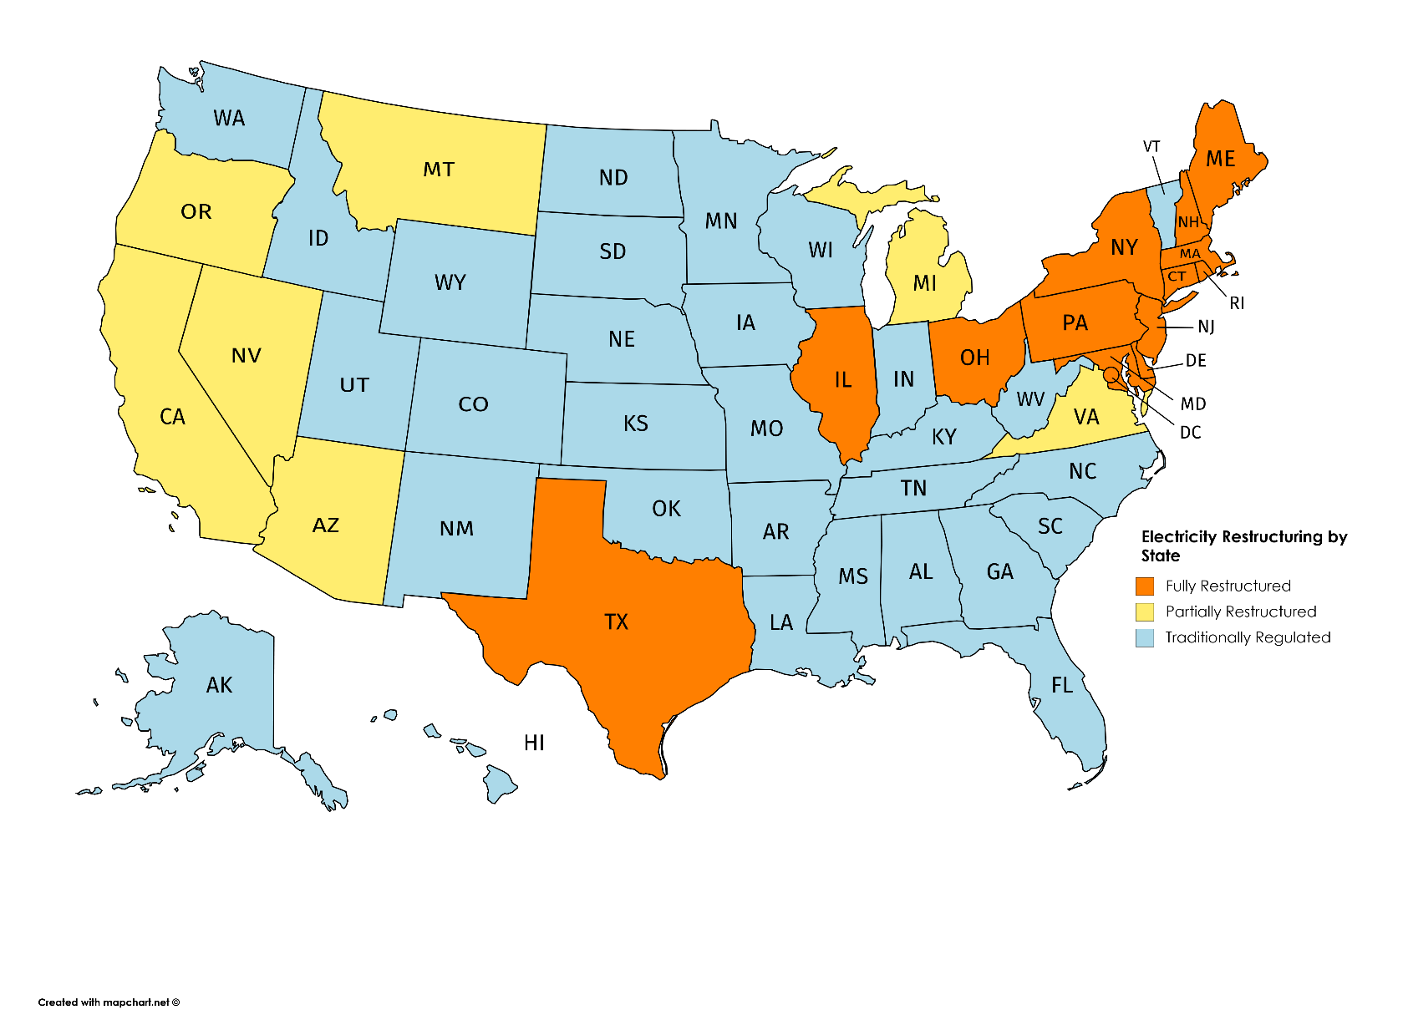
Restructured Versus Traditionally Regulated Markets
“Restructuring drove no relative improvement in 2018 versus 2000 electric prices” S&P Global, August 7, 2019.
Some restructured or deregulated states taking steps to prevent uneconomic units from closing.

Slide 32
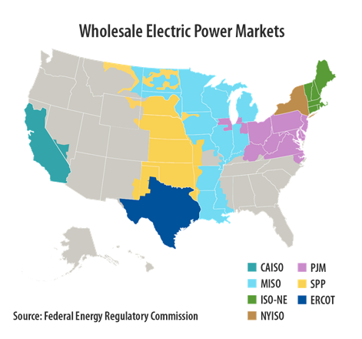
Several states, including Kentucky, have different utilities participating in different markets.
Kentucky’s utilities participating in PJM:
Kentucky Power
Duke Energy
East Kentucky Power
Midcontinent Independent System Operator (MISO)
Big Rivers Electric Cooperative

Slide 33
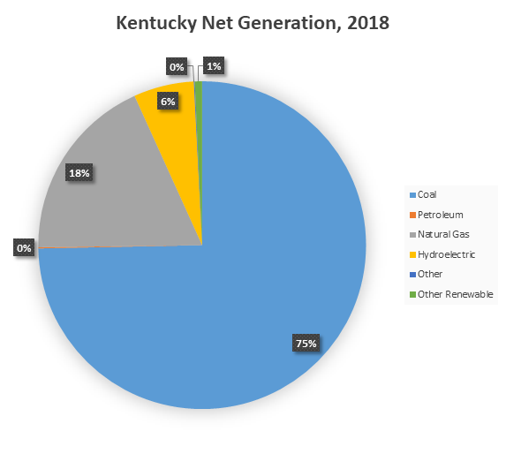
Kentucky Net Electricity Generation, 2018

Slide 34
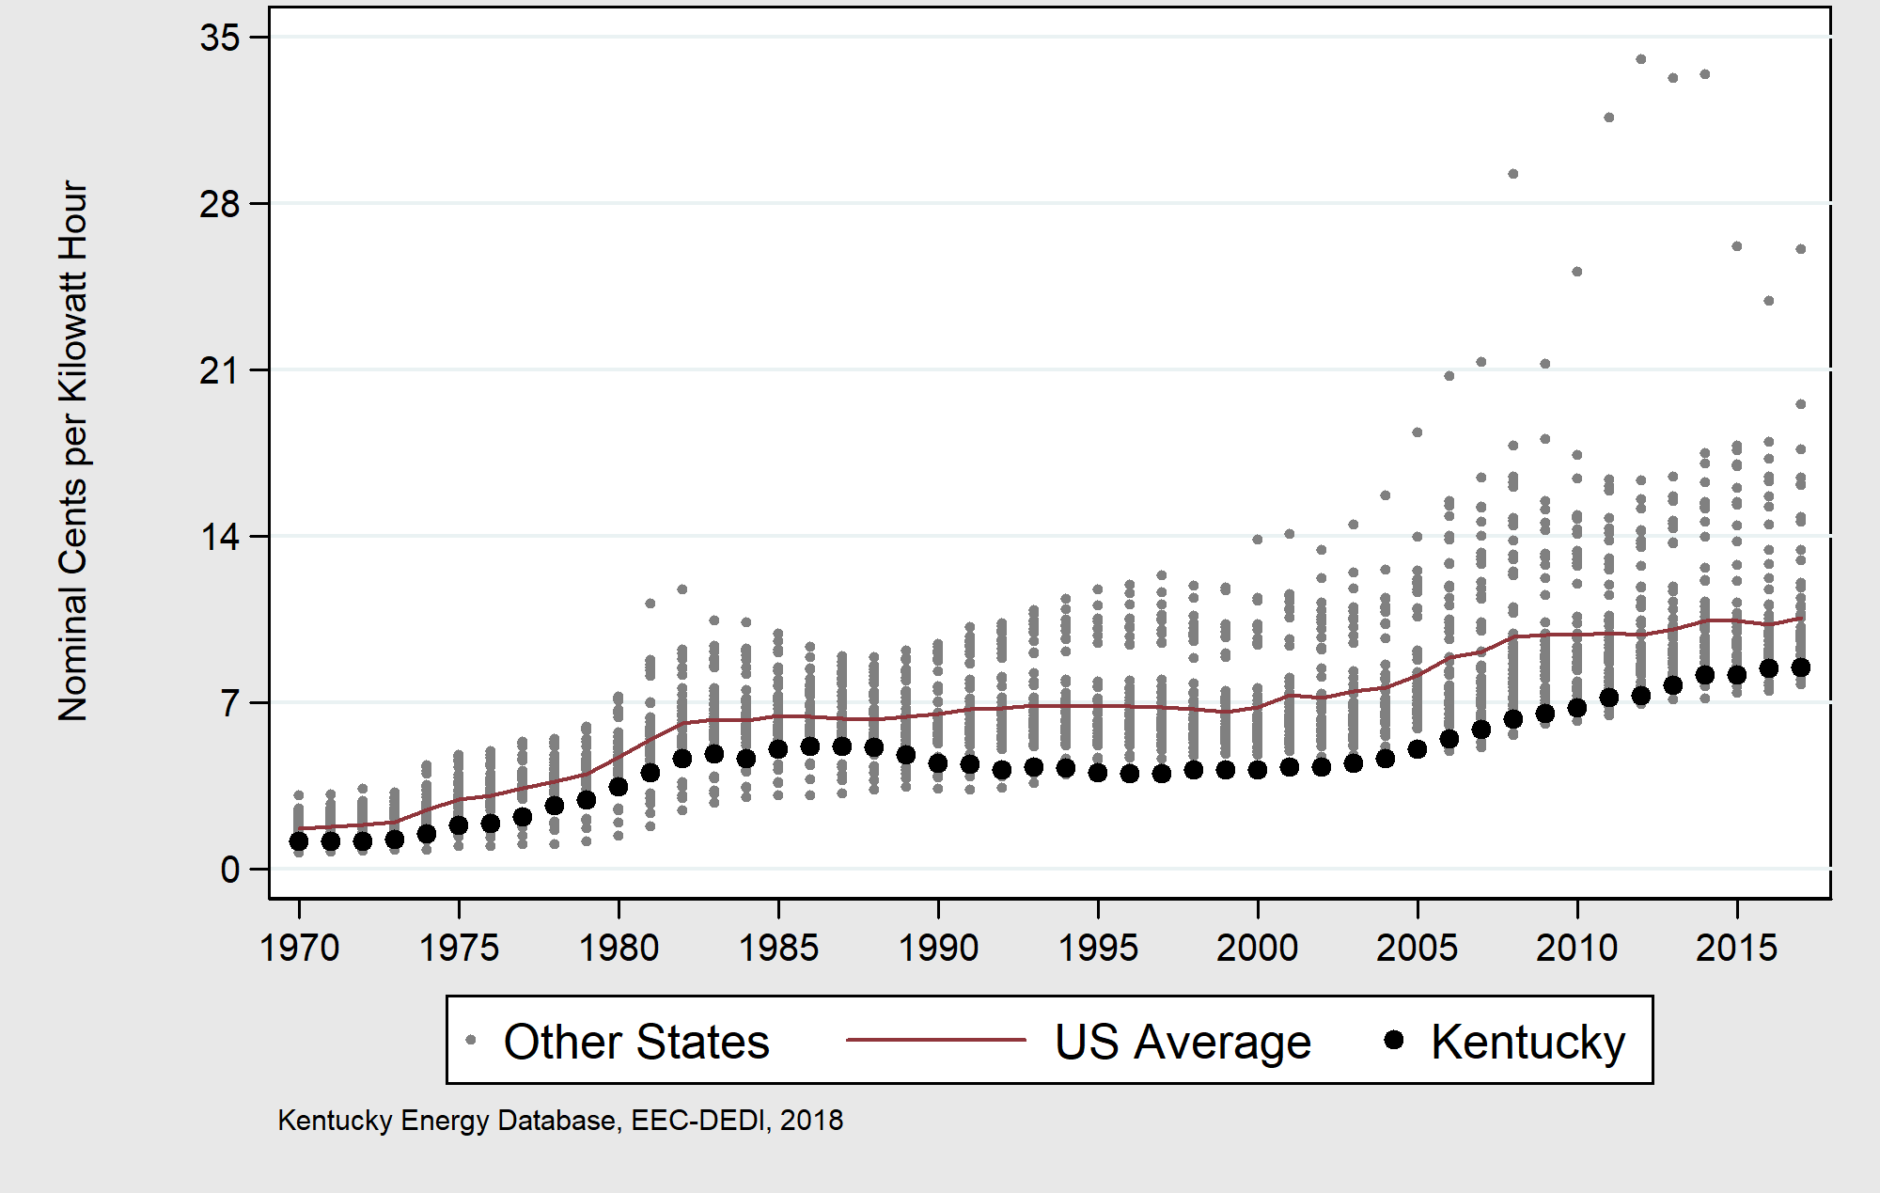
Kentucky Average Electricity Price, 1970-2017
Compared to Other States

