Slide 1
2019 HB 199 – Kentucky Oil & Gas Abandoned Storage Tank and Orphan Well (KASTOW) cleanup program - Update on Implementation - Interim Joint Committee on Natural Resources and Energy October 1, 2019
Charles Snavely, Secretary, Energy & Environment Cabinet
Dennis Hatfield, Director, Division of Oil & Gas

Slide 2
Kentucky Abandoned Storage Tank and Orphan Well Reclamation Program (KASTOW)
SB 186: Effective 6-24-2015
KRS 353.561-564
Defined abandoned tank facilities, need for remediation, and established fund.
Process to notice abandonment to last known operators.
Established right of entry authority to inspect, assess and respond.
Specified reclamation scope of work,
Criteria set for clean-up process.
No funding mechanism provided.
HB-199: Effective 6-27-2019
Revisions to KRS 353.562-564
Created KASTOW Program, adding orphan wells to scope.
Defined complete site reclamation process, tanks, flow lines, and orphan wells.
Allow 3rd party service contracts.
Provided for emergency response.
Waiver to state of abandoned tank and infrastructure ownership.
Requires funding via the biennial budget process.

Slide 4
Orphaned Oil & Gas Wells across Kentucky - Estimated Plugging Cost -
ESTIMATED ABANDONED WELL PLUGGING LIABILITY ($$)
District | Average P&A Costs/Well | Total
Pikeville (1626) | $7,500 | $12,195,000
Barbourville (3032) | $5,800 | $17,585,600
Glasgow (5759) | $2,500 | $14,397,500
Madisonville (3322) | 1,881-$9,400-Int. Ill. Basin 1,441-$6,800-Other areas | $17,681,400 $9,798,800
Frankfort (97) | $2,500 | $242,500
TOTAL-POTENTIAL LIABILITY TO STATE OF KY |  | $71,900,400

Slide 5
KASTOW – Financial Need
The Division of Oil and Gas (DOG) operates a well plugging program for orphaned wells that are prioritized based on environmental and/or safety impact.
There are approximately 14,000 known orphaned oil and gas wells in KY.
The estimated financial liability for plugging of orphan well is approximately $72M.
The estimated financial liability to remove and provide cleanup of abandoned oil tank battery operations is unknown.
KASTOW as established in KRS 353.562 - requires funding to be provided in the biennial budget for site cleanup and administrative costs. Need a minimum of $1.5M/year.

Slide 6
Impacts of Abandoned Storage Tank Problem
Degradation of abandoned storage tanks results in leaks of crude oil, bottom sludge, and produced brine from the tank site; this becomes more pronounced over time.
Contamination of soil adjacent and downslope of tank site.
Contamination of surface waters of the Commonwealth.
Older tank structures present safety hazards to nearby residents.
Abandoned facilities reduce property values, limit use of the land, impact agriculture, impair tourism efforts, and create a negative view of the industry and area.

Slide 7
Basic Approach to the KASTOW Program
Phase 1 – cleaning up 10 pilot project sites across the State:
To develop site scope templates for varying tank facility layouts,
To gain experience in actual cleanup procedures and proper oversight,
To identify a solid contractor base and scales of equipment required,
To confirm best procedures for contaminated soil removal and disposal,
To establish work protocols, and documentation requirements.
Subsequent Phases of cleanup would be grouped by regions and/or counties, to gain benefit of mobilization and scale of project.
Planned cleanups would be to target clusters of 15 to 20 tank sites to benefit impact and economics.

Slide 8
KASTOW Tank Reclamation Process
 | 1. INITIAL FIELD INSPECTION
 | 2. RETURN FOR DETAIL SITE ASSESSMENT/SCOPE
 | 3. DESIGN REMEDIATION PLAN
 | 4. SOLICITATION AND AWARD OF BIDS
 | 5. CONTRACTOR SITE CLEANUP AND RECLAMATION
 | 6. SITE CLOSURE

Slide 9
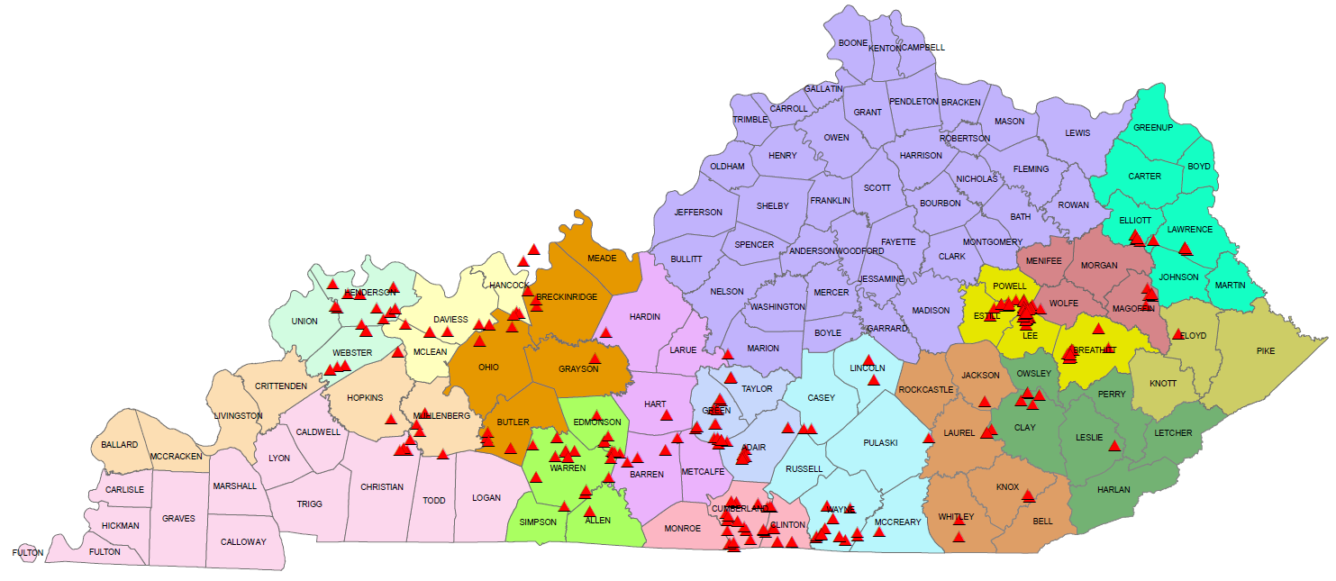
KASTOW Tanks
Inspected Tanks
325 total Sites
09/25/2019

Slide 10
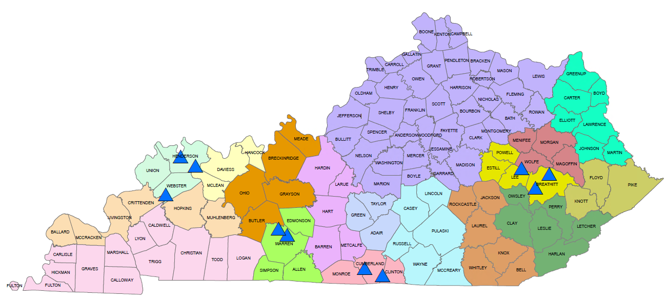
KASTOW Tanks Phase 1
Bid Package
Ten Initial Sites Out in July 2019

Slide 11
Process of Tank Site Reclamation
Removal of tanks, flow lines, and other surface equipment.
Recovery of liquid using vacuum trucks, assure proper disposal.
Soil assessment at spill locations to determine extent for clean-up excavation.
Contractor excavates oil contamination areas (to a visible standard).
Temporary stockpiling of contaminated material (soil, absorbent pads) on impermeable plastic.
Transport and disposal of contaminated materials to an approved site.
Grade, reclaim, and revegetate.

Slide 12
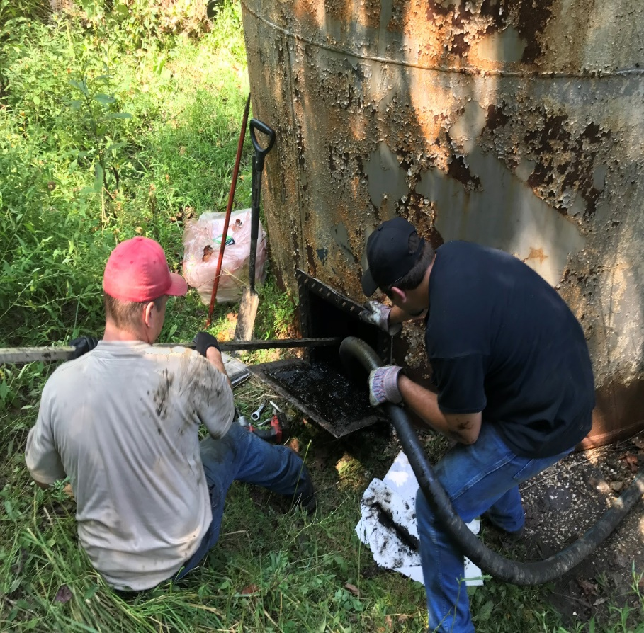
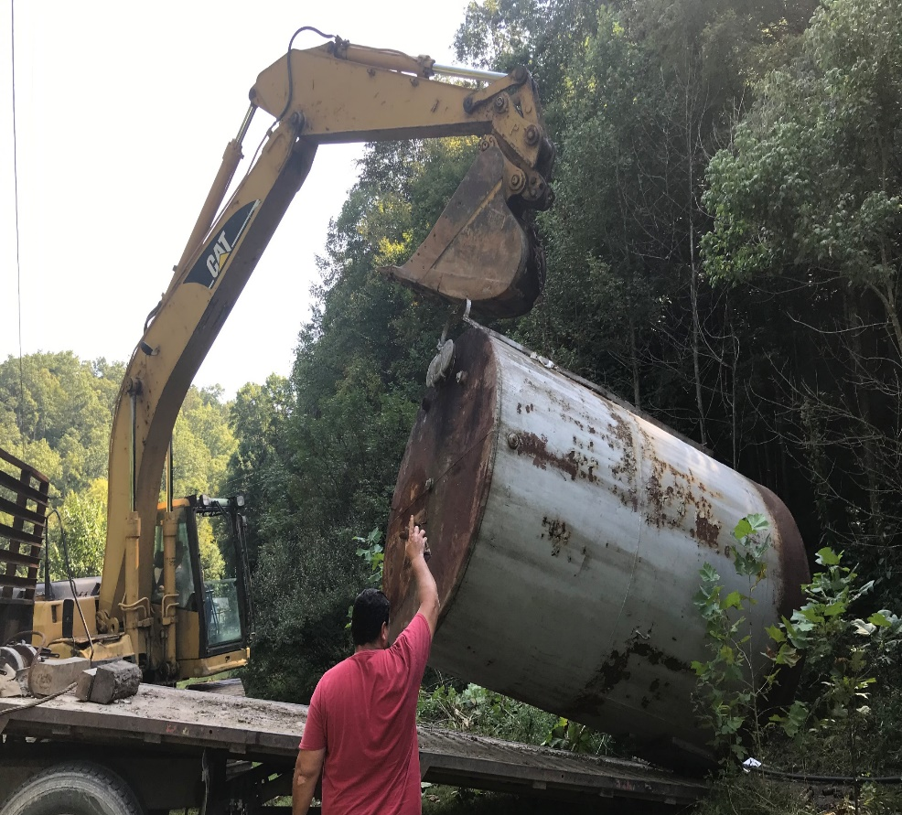
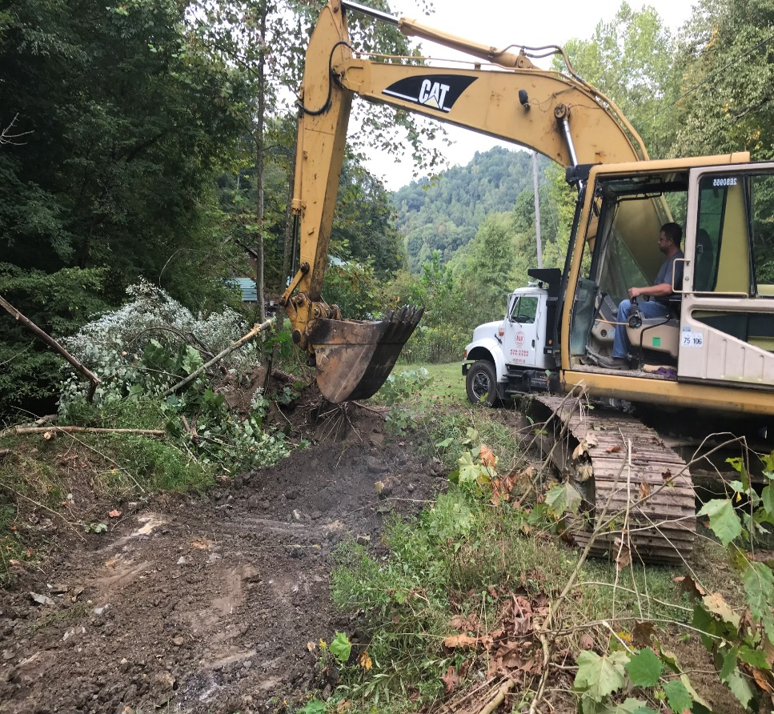
Tank Remediation Procedure
Remove waste from tank
Remove Tank From Site
Dispose of Visible Surface Contamination
Restore and Seed

Slide 13
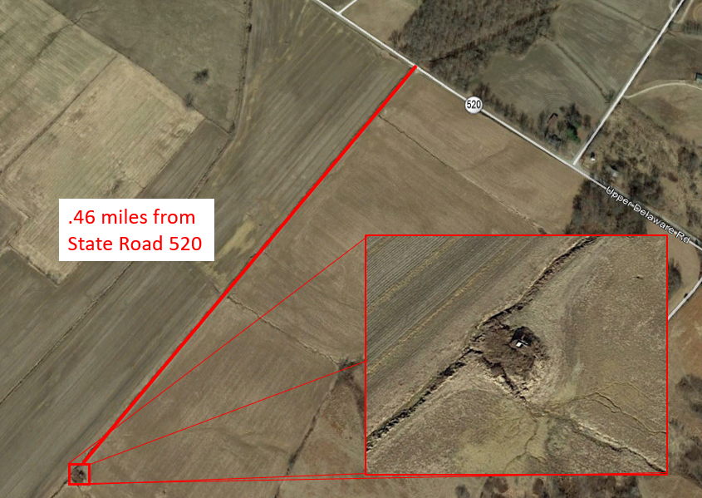
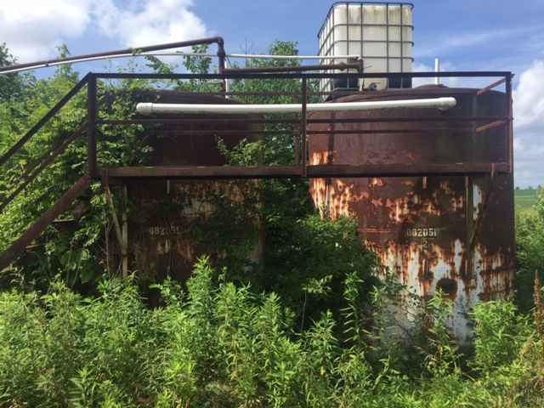
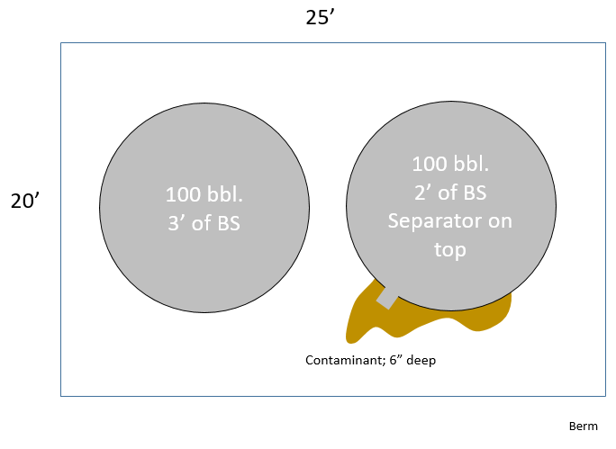
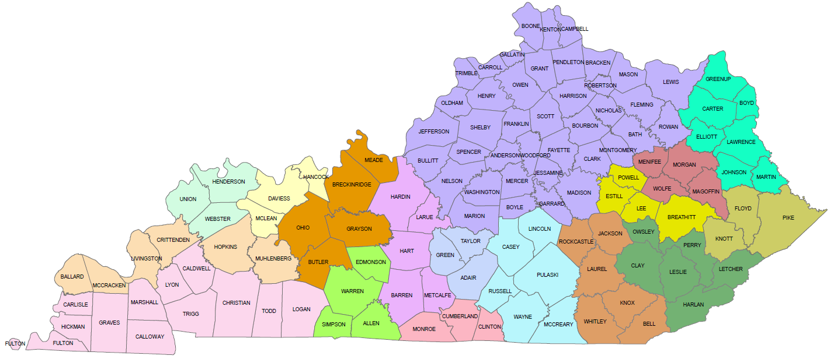
Buchanan Lease, Webster Co., Tank T000527
Lat: 37.71110; Long: -87.45160
Tank Type: Steel
Tank Size: 2x100 bbl. tanks
Residual Fluid in tanks: Yes; 2-3’ in each tank
Lines: Yes, Buried.
Separator: Yes; Mounted atop tank
Contamination: Limited to oil around valve: 3-6” deep.
Estimated Soil Removal: Less than 4.5 tons

Slide 14
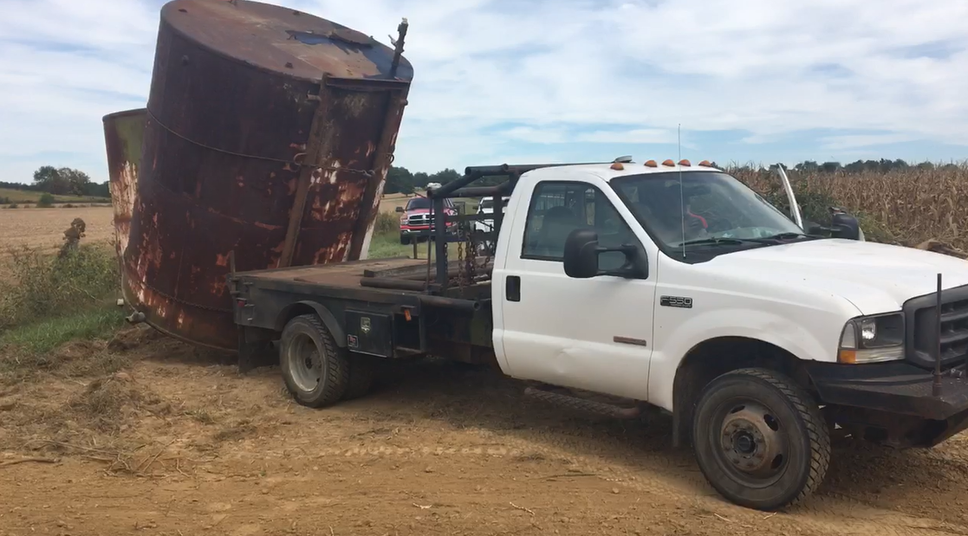
Tank T000527 – Henderson Co.
Before
Loading

Slide 15
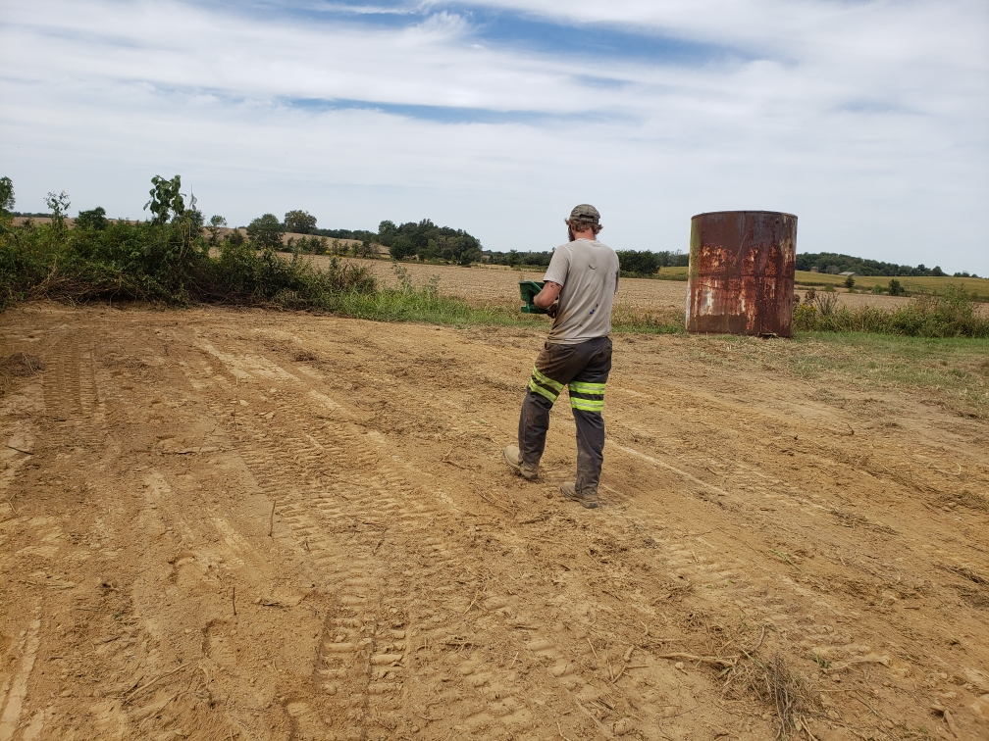
Tank T000527 – Henderson Co.
Seeding
Restored

Slide 16
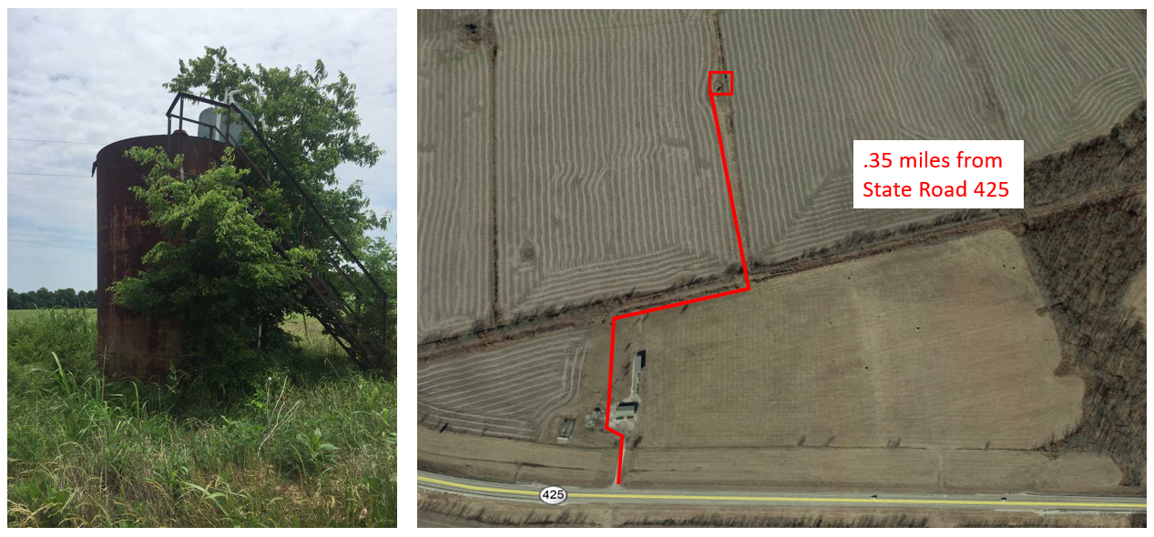
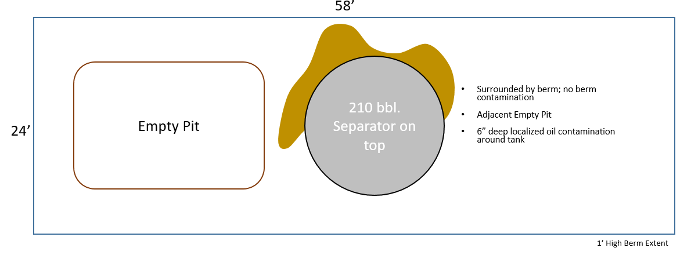
Pritchett Lease, Henderson Co., Tank T000611
Lat: 37.79320; Long: -87.63060
Tank Type: Steel
Tank Size: 1x210 bbl. tank
Residual Fluid in tanks: Empty tank
Lines: None Found
Separator: Yes
Contamination: Some Light surface contamination around base; 2” deep
Estimated Soil Removal: Less than 4 tons

Slide 17
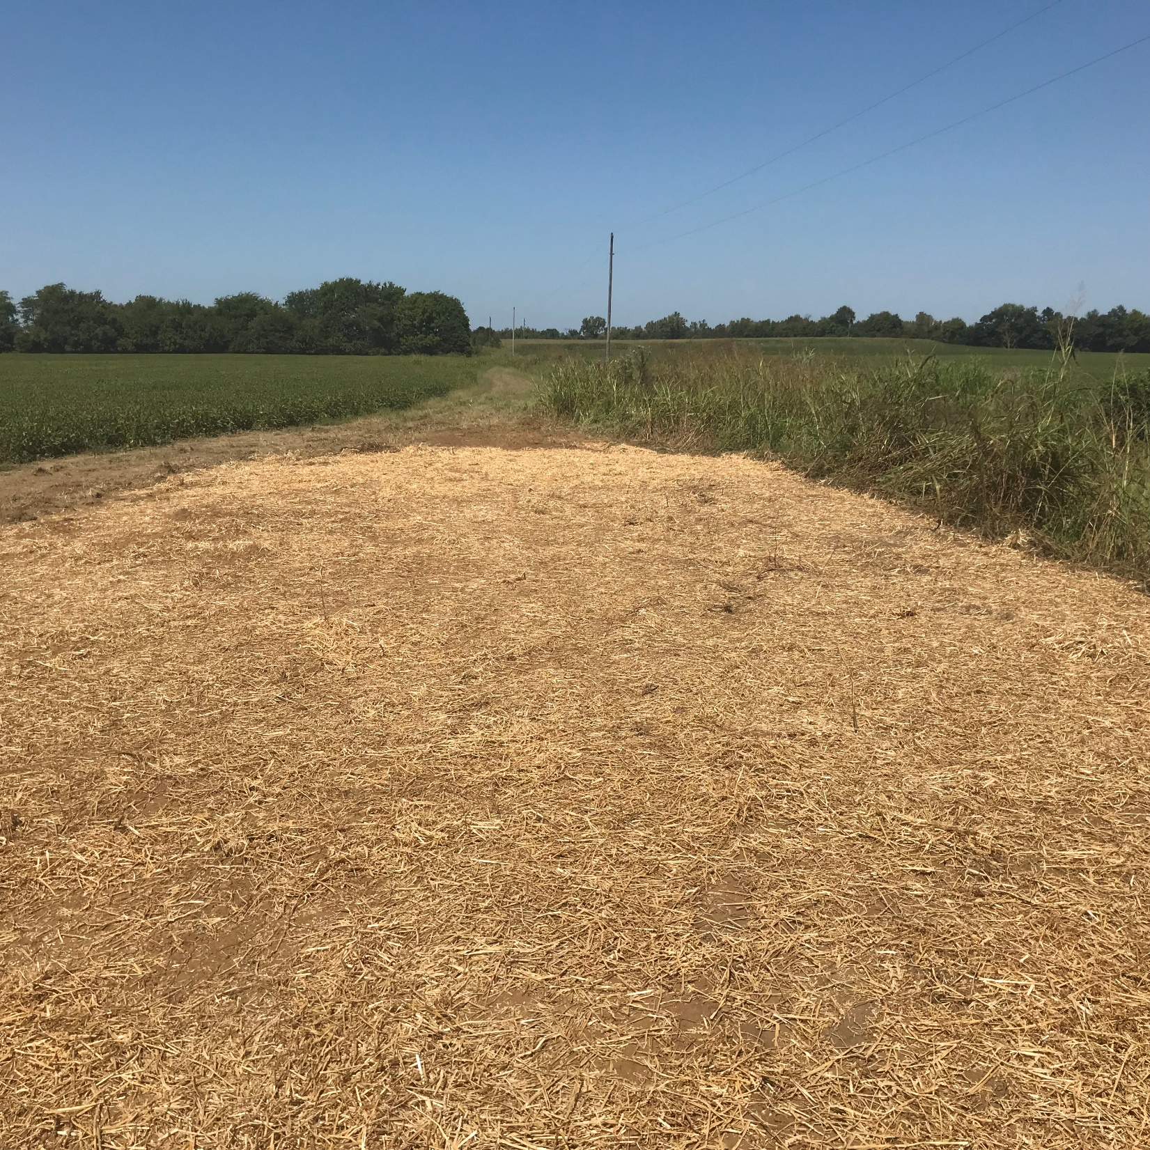
Tank T000611 – Henderson Co.

Slide 18
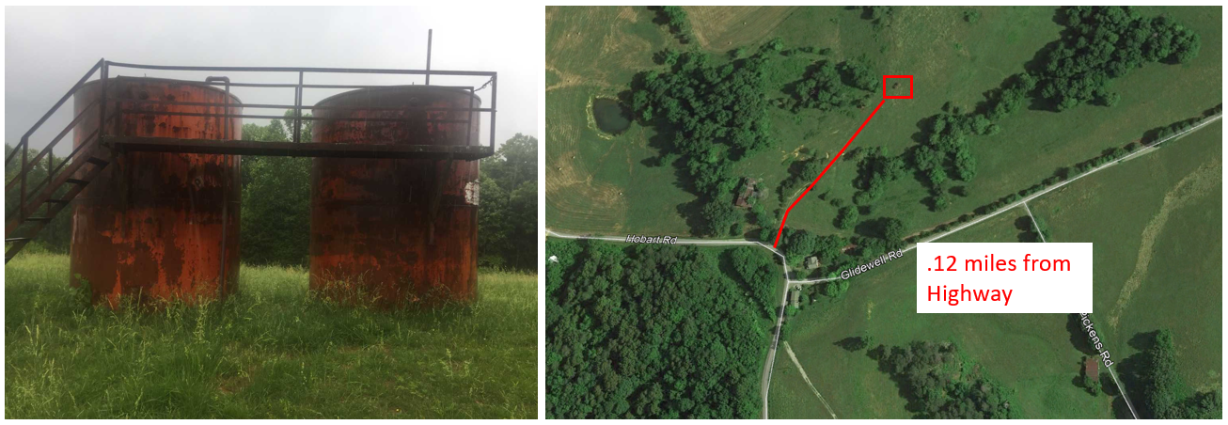
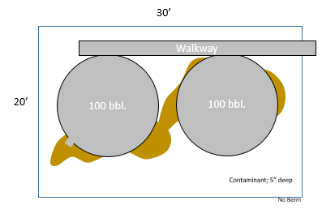
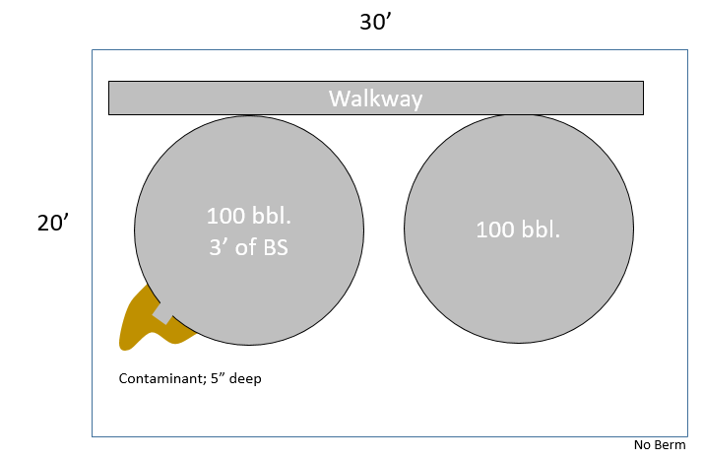
Crawley Lease, Clinton Co., Tank T000540
Lat: 36.69816; Long: -85.25996
Tank Type: Steel
Tank Size: Two Tank Batteries: 4x100 bbl. Tanks total.
Residual Fluid in tanks: ~3’ B.S.
No Berm
Lines: None observed
Separator: No
Contamination: Some Light surface contamination around base; 2-6” deep
Estimated Soil Removal: Less than 13 tons

Slide 19
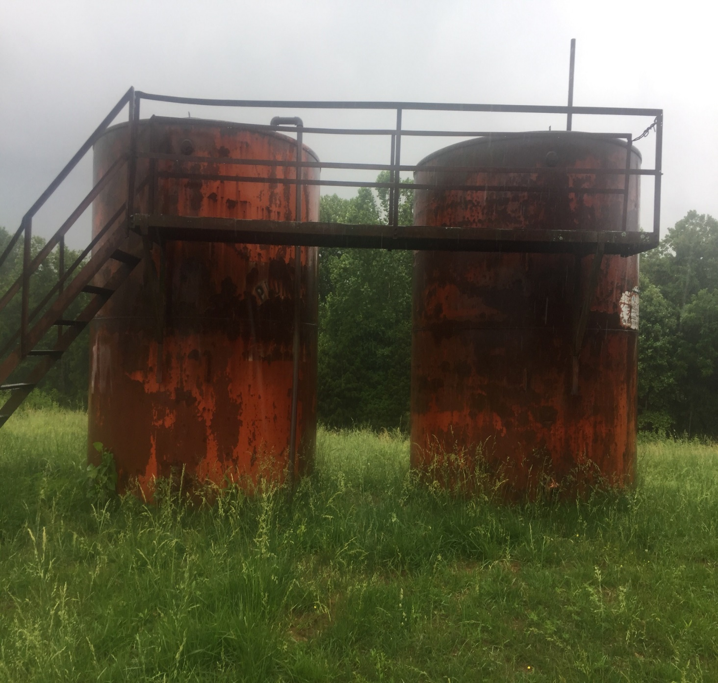
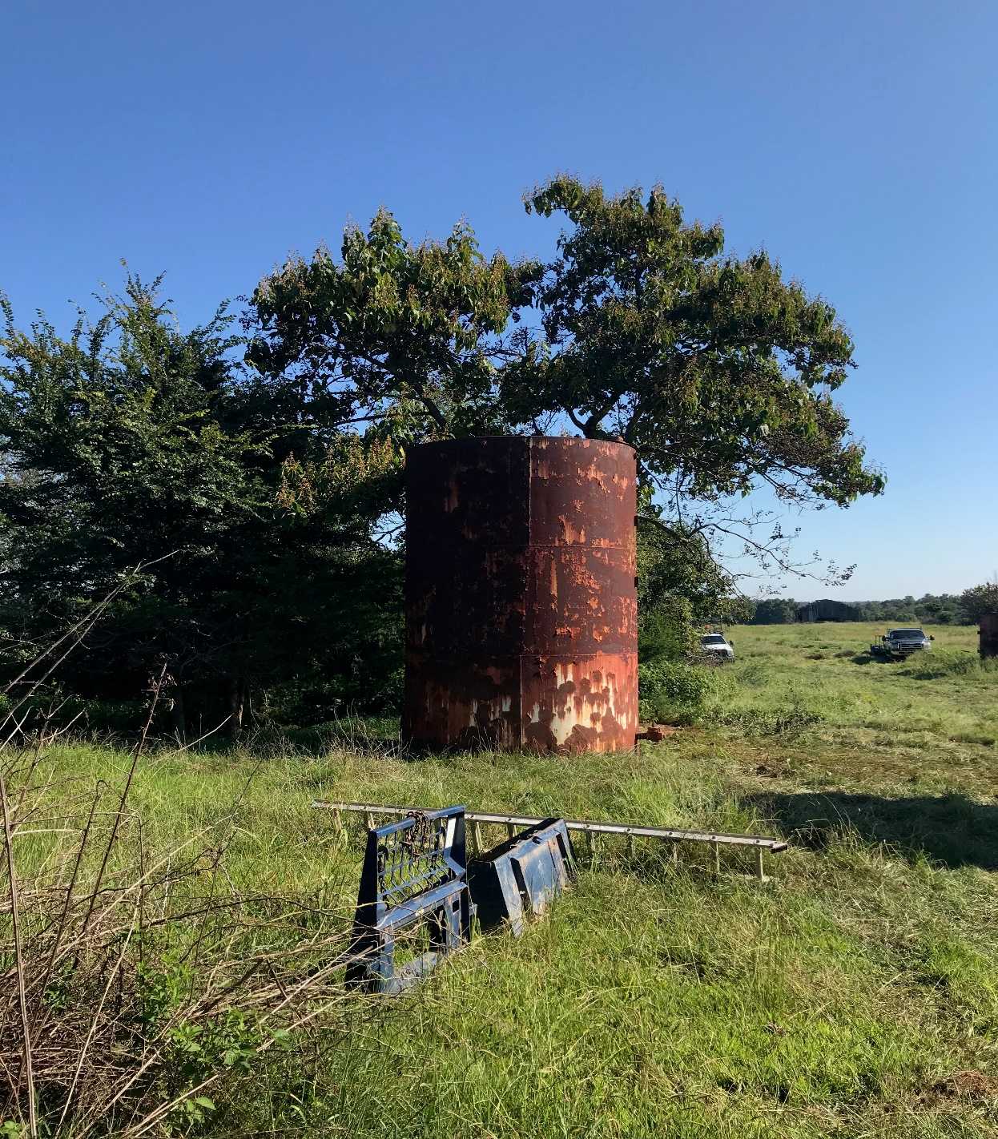
Tank Site T000540 – Clinton Co.
Before Restoration

Slide 20
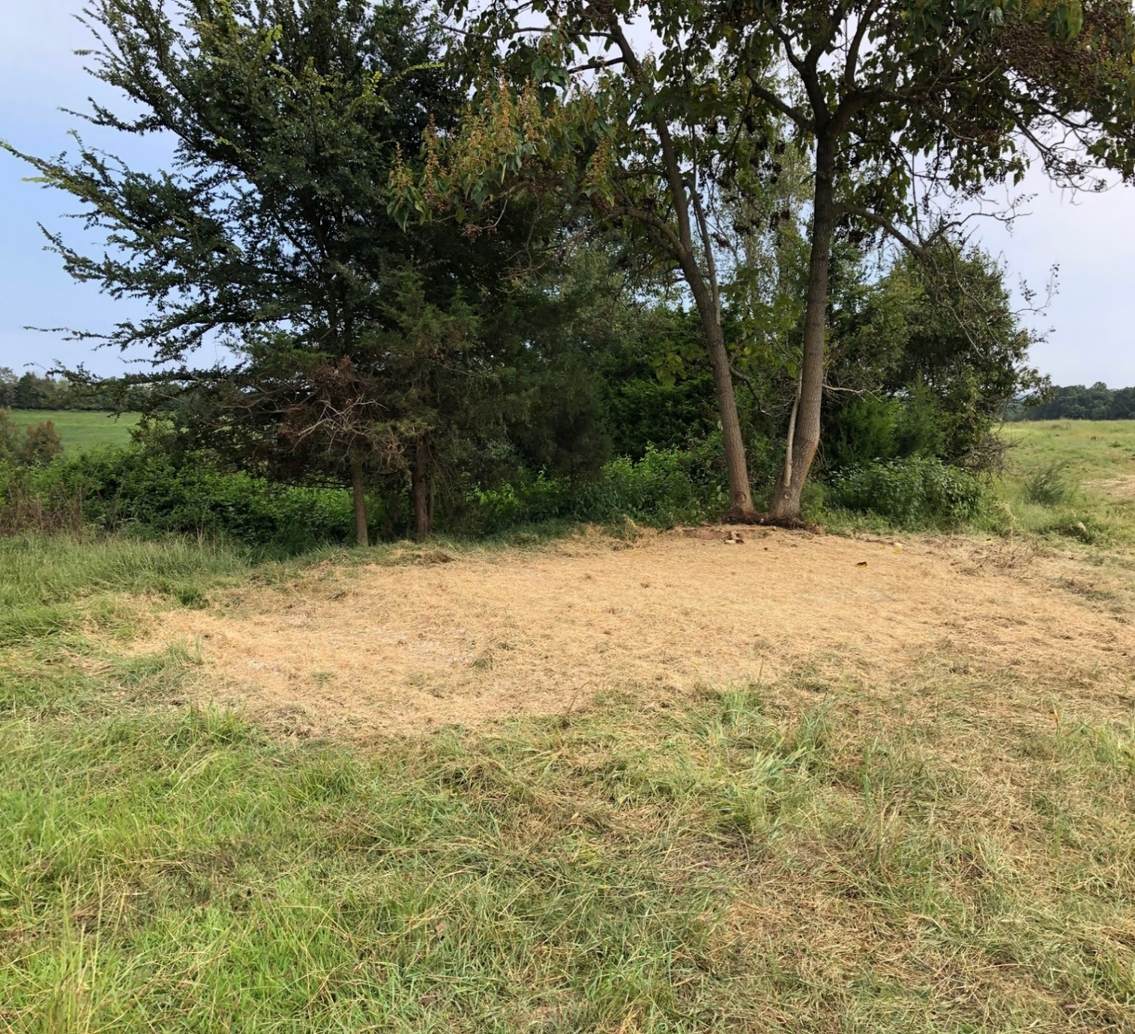
Tank T000540 – Clinton Co.
After Restoration

Slide 21
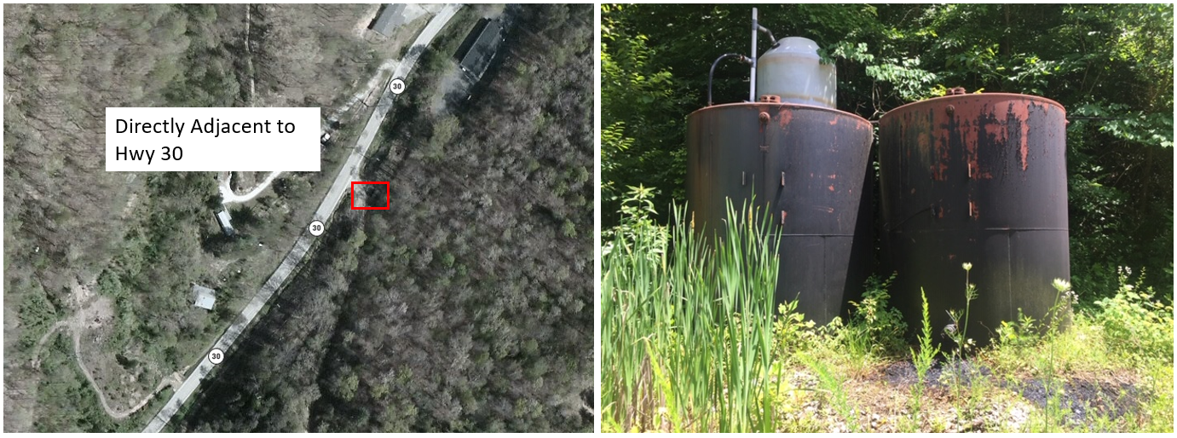
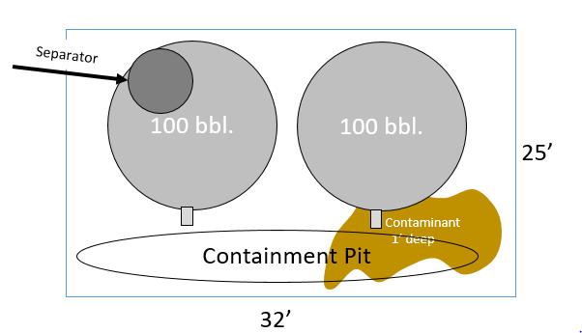
Charles Trimble Lease; Breathitt Co., Tank T000804
Lat: 37.49335; Long: -83.487199
Tank Type: Steel
Tank Size: 2x100 bbl. tank
Residual Fluid in tanks: Yes, Unknown amount
Lines: None Found
Separator: Tank-Mounted
Contamination: Heavy surface contamination around base; >1’ deep
Estimated Soil Removal: Less than 25 tons

Slide 22
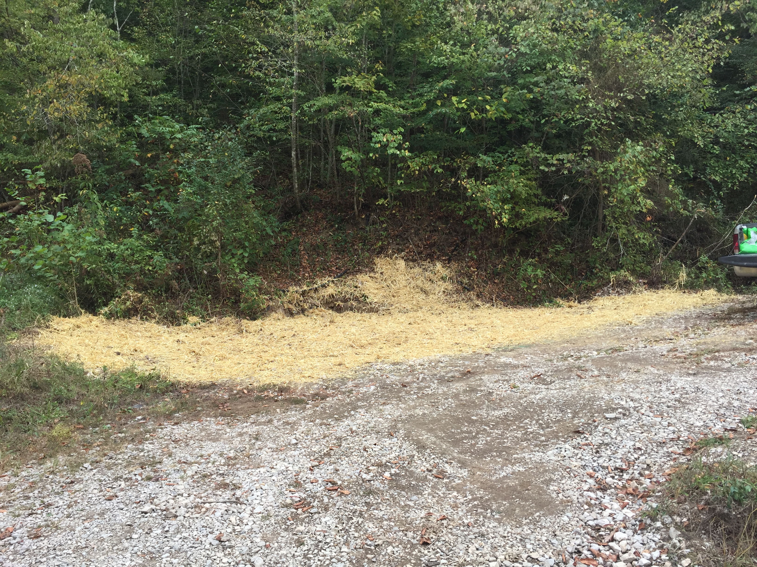
Tank T000804 – Breathitt Co.

Slide 23
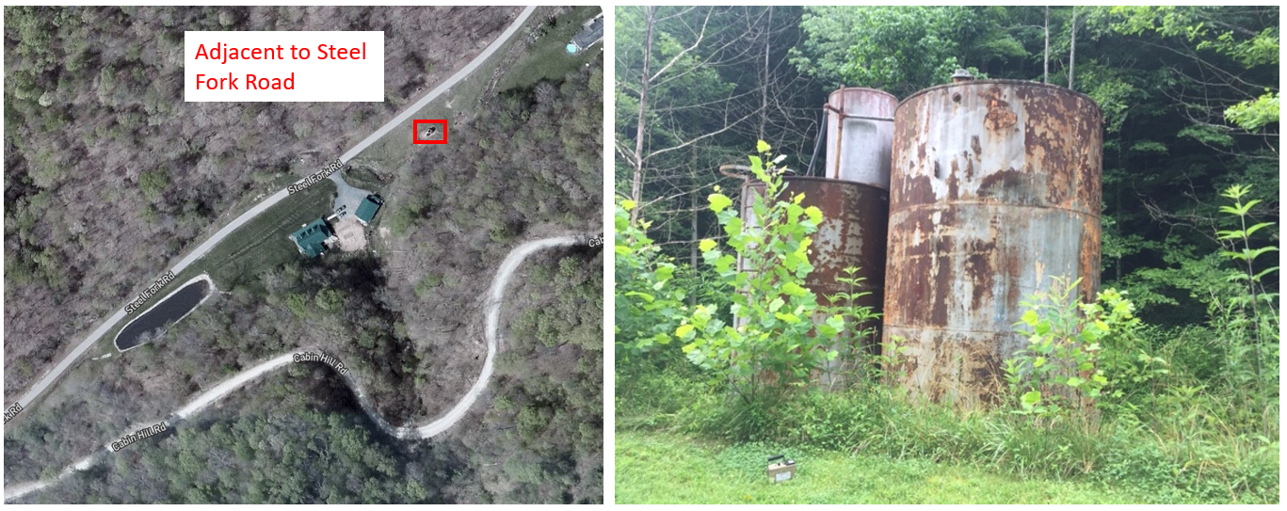
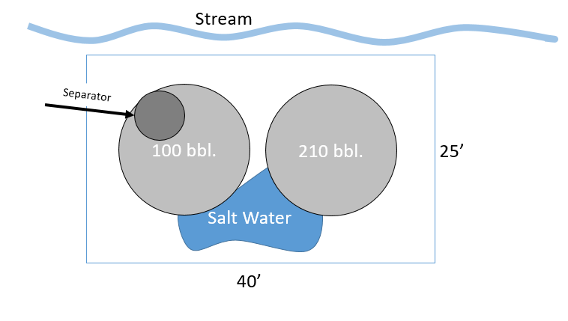
Hollan Lease; Breathitt Co., Tank T000545
Lat: 36.69816; Long: -85.25996
Tank Type: Steel
Tank Size: 1x100 bbl. Tank; 1x210 bbl. tank
Residual Fluid in tanks: 1-2’ B.S.
Lines: None Found
Separator: Yes
Contamination: Some Light surface contamination around base; 2-6” deep
Estimated Soil Removal: Less than 6 tons

Slide 24
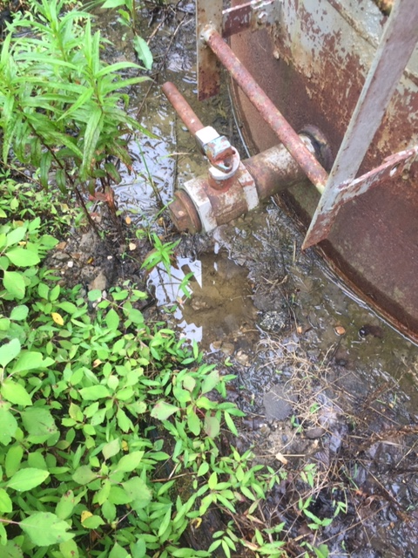
Tank T000545 – Breathitt Co.

Slide 25
Tank T000545 – Breathitt Co.

Slide 26
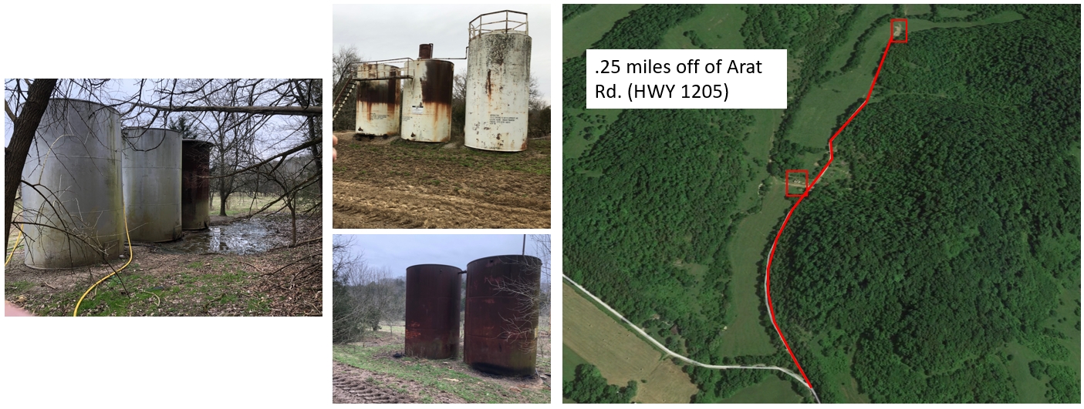
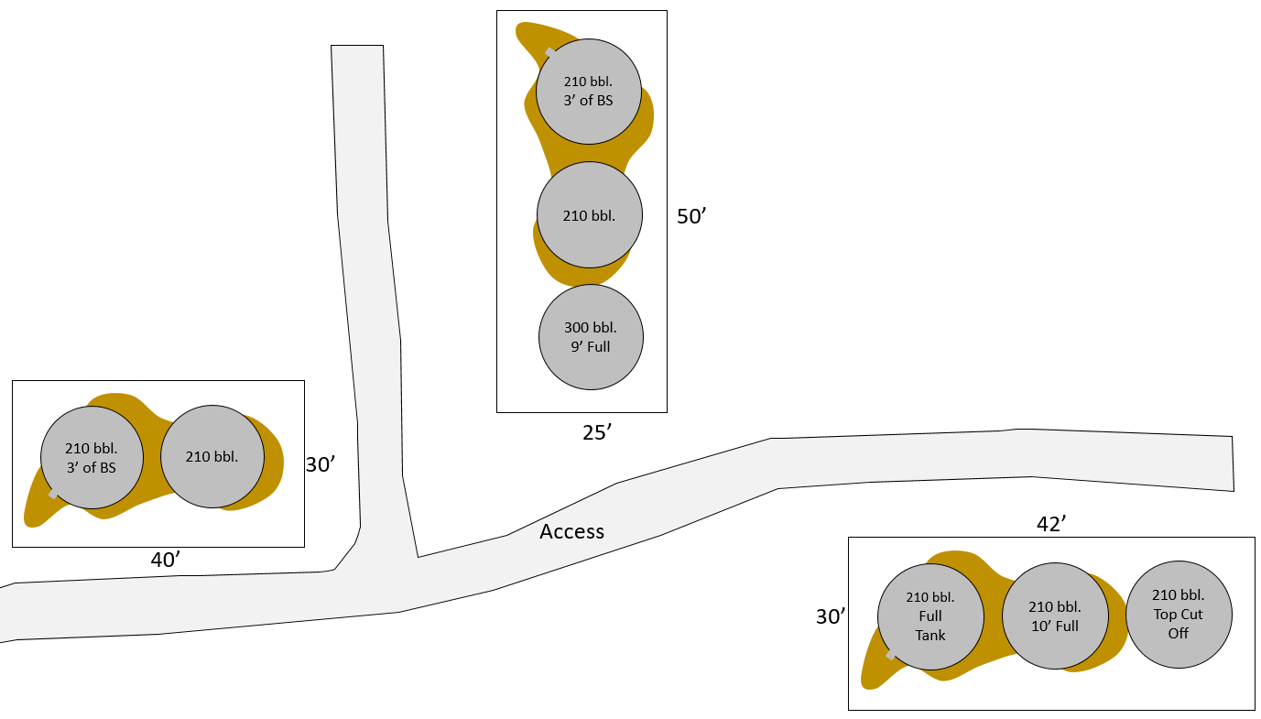
John Parrish Lease; Cumberland Co., Tank T000538
Lat: 36.765556; Long: -85.469444
Tank Type: Steel
Tank Size: 3 Tank Batteries: 7x210 bbl. Tanks; 1x300 bbl. Tank.
Residual Fluid in tanks: 3’ to 10’.
Lines: Yes, Buried
Separator: No
Contamination: Observed surface contamination around base of tanks; 2-6” deep, up to 5’ lateral dispersion.
Estimated Soil Removal: Less than 30 tons

Slide 27
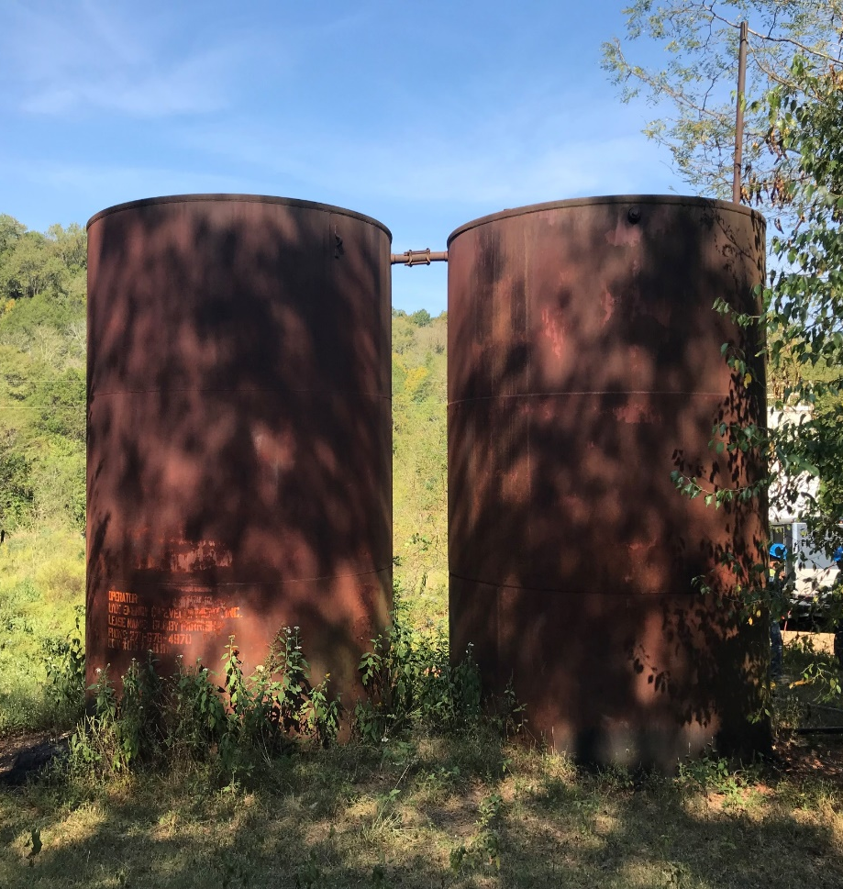
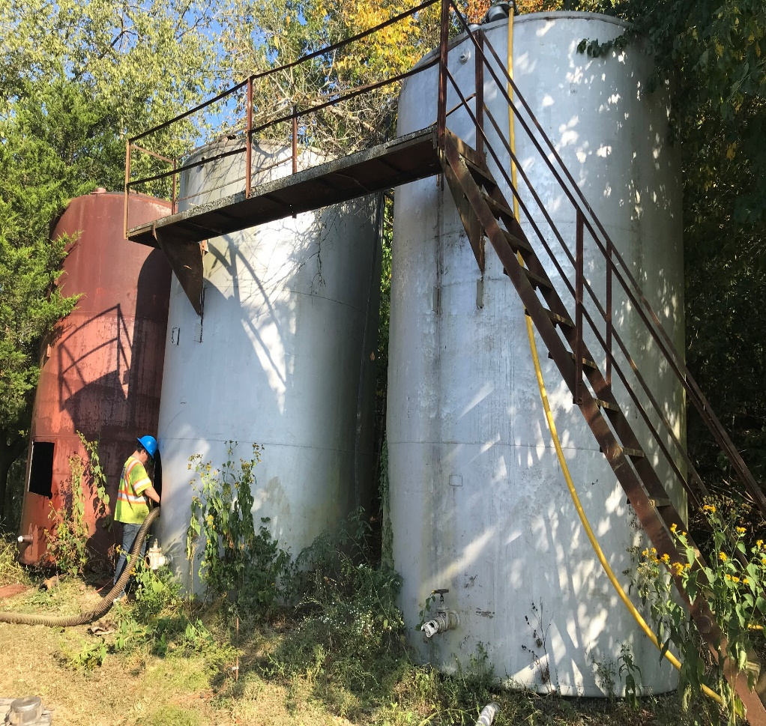
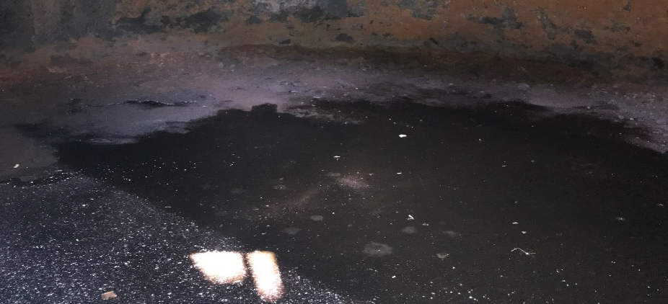
Tank T000538 – Cumberland Co.
Sludge Inside tanks
Active Leakage
Uncapped Lines

Slide 28
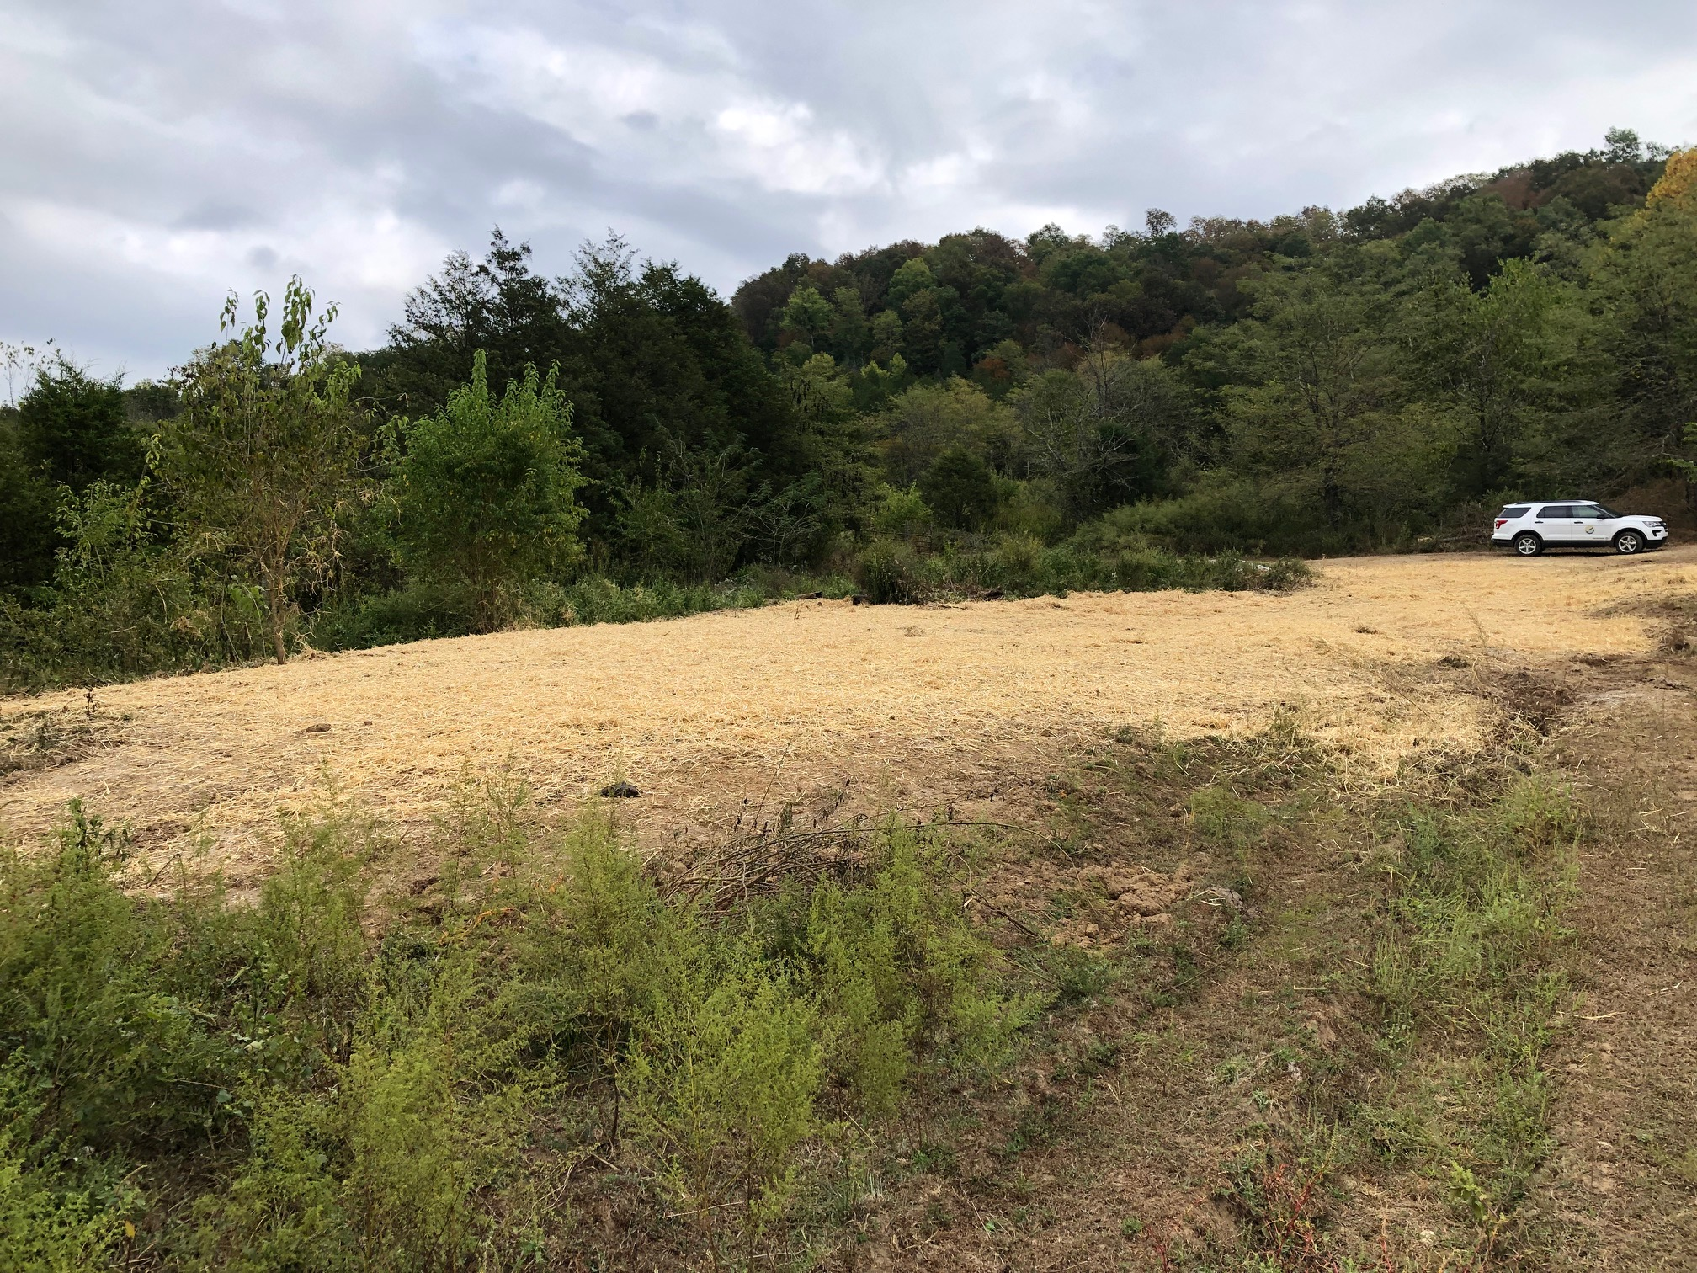
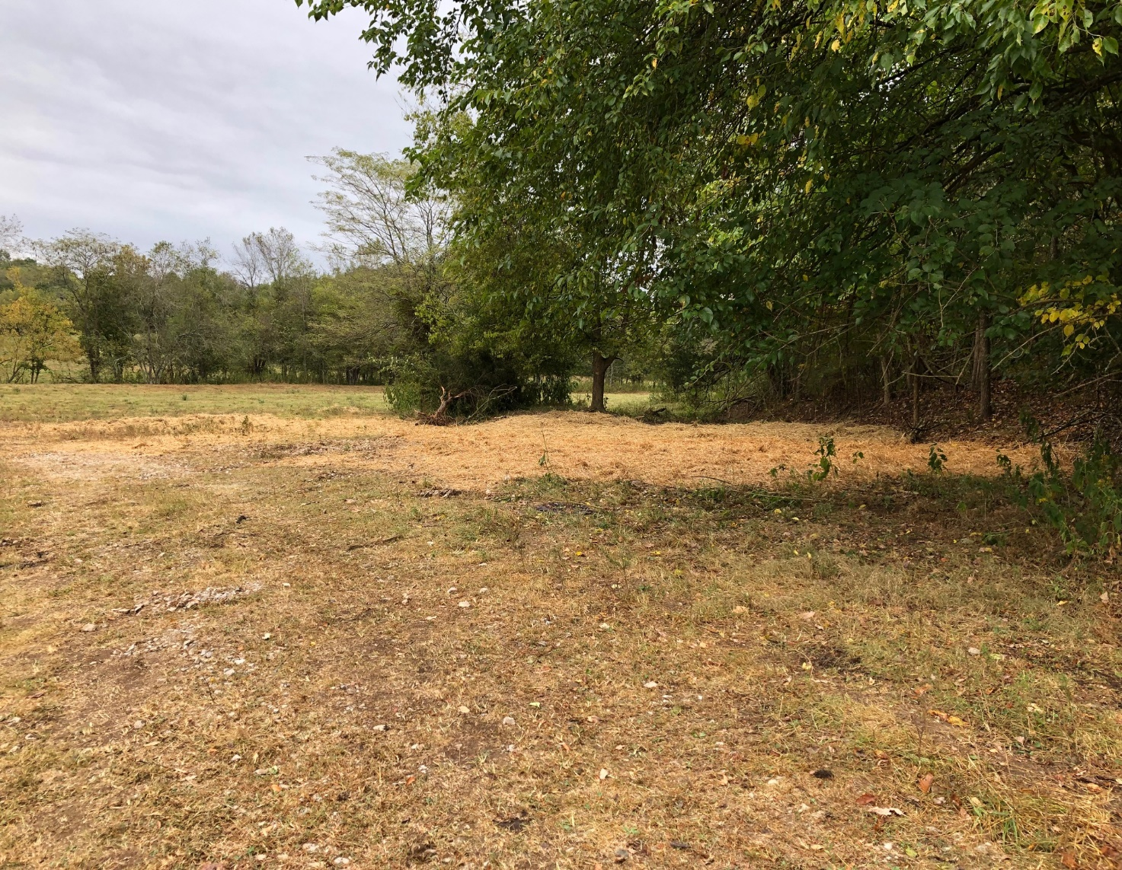
Tank T000538 – Cumberland Co.

Slide 29
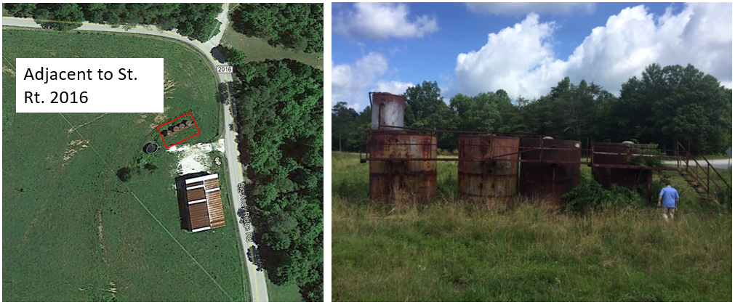
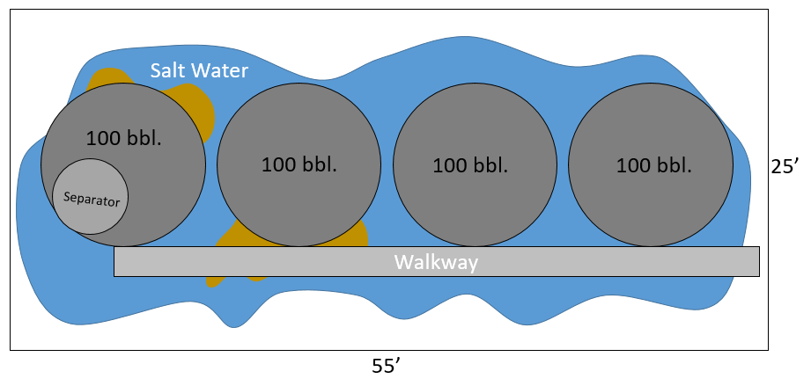
Russell Parsons Lease; Lee County, Tank T000808
Lat: 37.68023; Long: -83.62774
Tank Type: Steel
Berm: Yes, 1’
Tank Size: 4x100 bbl. tanks
Residual Fluid in tanks: Unknown Amount
Lines: None Found
Separator: Yes, Tank Mounted
Contamination: Heavy Salt water Leakage; 1’ deep
Estimated Soil Removal: Less than 38 tons

Slide 30
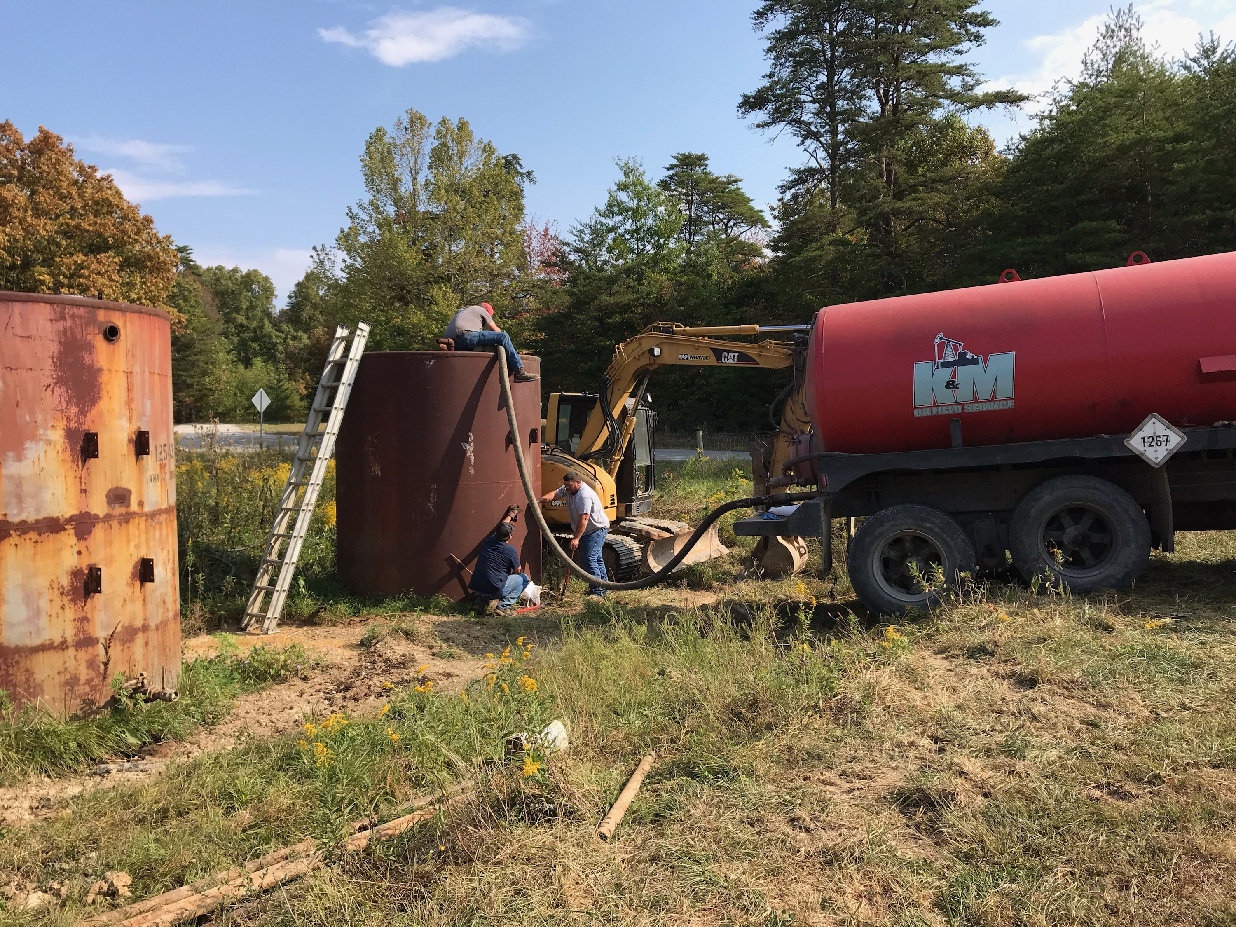

Slide 31
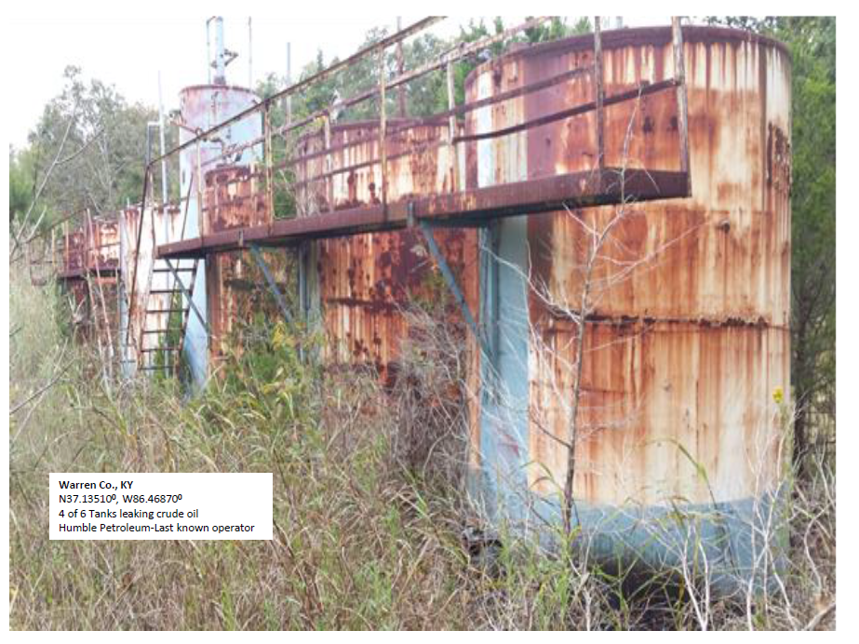
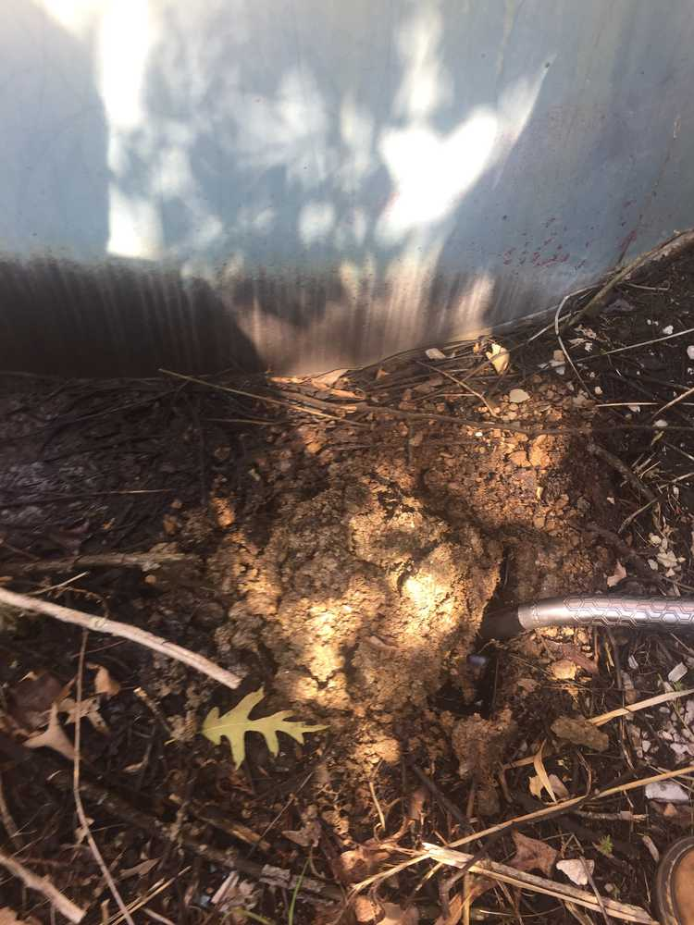
Devore Lease, Warren Co., Tank T000661

Slide 32
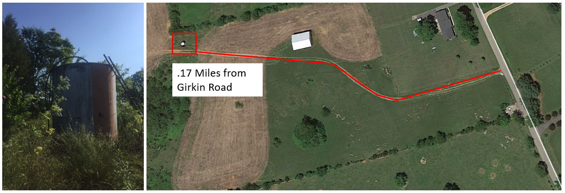
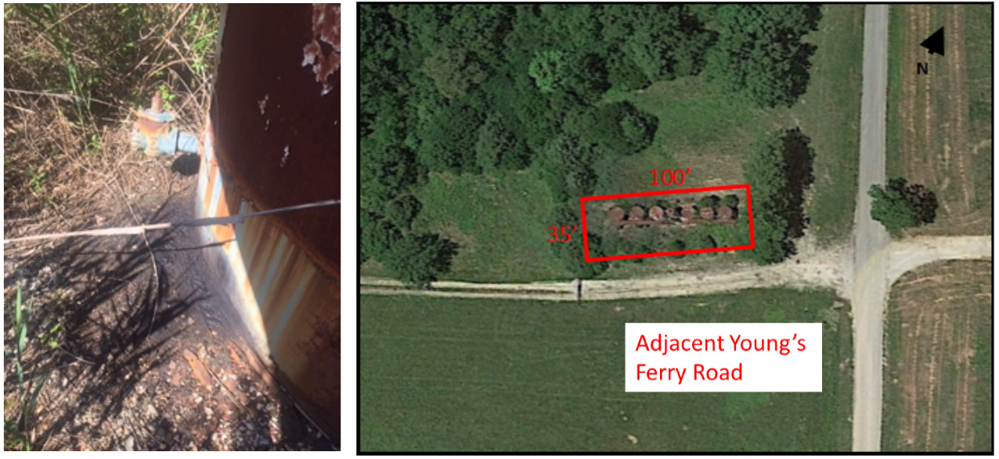
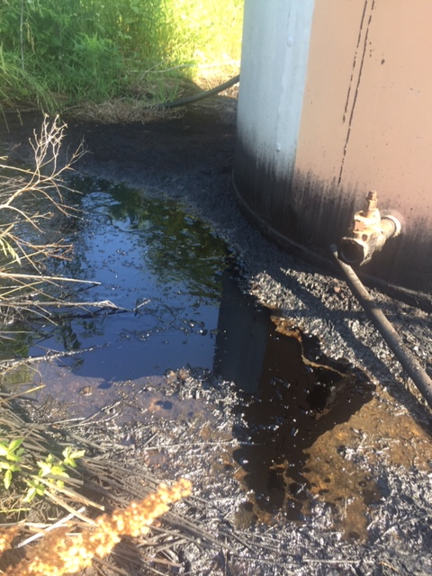
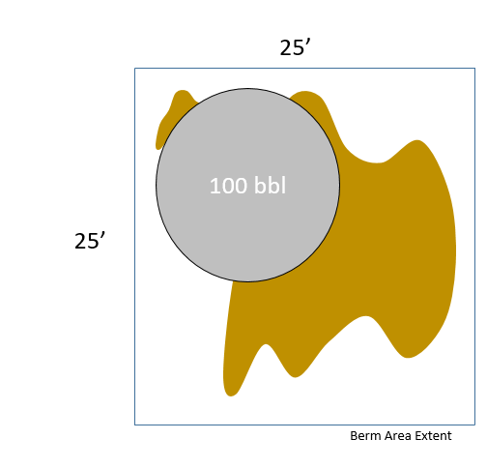
Wilson Lease #1, Warren Co., Tank T000801
Lat: 37.07608; Long: -86.36722
Tank Type: Steel
Tank Size: 1x100 bbl. tank
Residual Fluid in tanks: 2-3” B.S.
Lines: Yes, Buried
Separator: No
Contamination: Some heavy pooling contamination around base; 1’ deep
Estimated Soil Removal: Less than 22 tons

Slide 33
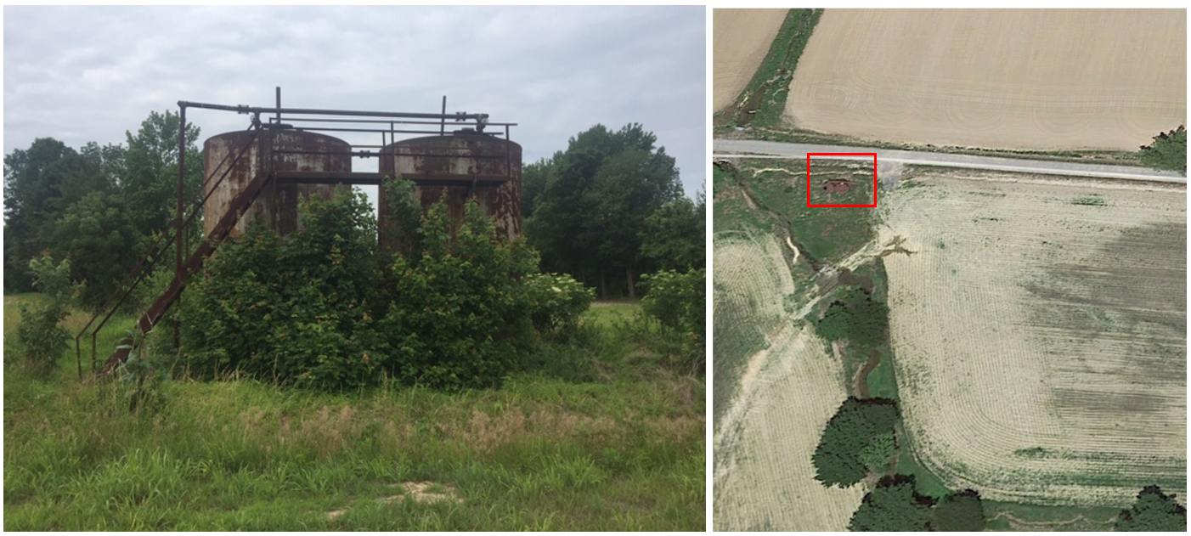
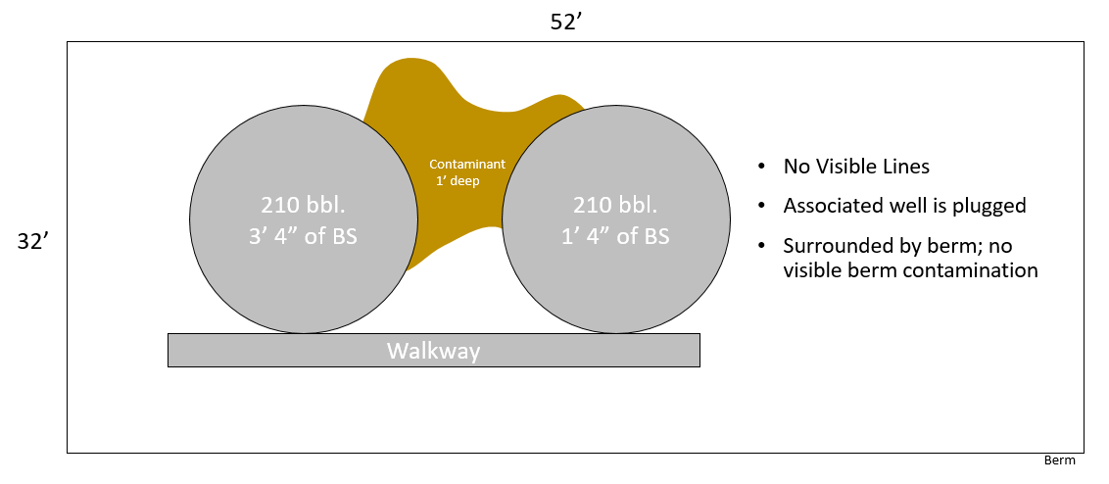
Ira Johnson Lease; Webster Co., Tank T000613
Lat: 37.79320; Long: -87.63060
Tank Type: Steel
Tank Size: 2x210 bbl. tank
Residual Fluid in tanks: Empty tank
Lines: None Found
Separator: Yes
Contamination: Some Light surface contamination around base; 2” deep
Estimated Soil Removal: Less than 10 tons

Slide 34
Phase I Bids: Summary and Status

Slide 35
KASTOW Progress and Path Forward
Phase 1 will have all ten tank sites (containing 36 tanks) completed by October 8.
Bids went out July 22.
Single site contracts awarded on August 22.
First field work began on August 30.
Seven sites reclaimed as of October 1.
Phase 2 Bid Package A with 16 sites (37 tanks) in West Kentucky (Henderson, Webster, Union County’s) is now being processed by the Finance Cabinet for RFP’s to go out soon.
Phase 2 Package B with a single site (18 tanks, 3 lagoons) in Daviess County is ready for bid via Finance Cabinet this week.
Phase 2 Package C in now in assembly by KDOG with 15 tank sites (57 tanks) in East Kentucky (Wolfe, Lee, Elliott Counties). Should be ready for bid via Finance Cabinet in mid-October.
Initial experience would indicate year one (FY2020) could see 100 sites reclaimed, containing over 300 abandoned storage tanks.
The key focus of first year will be tanks, plan to expand orphan well effort in Year Two (FY2021) provided funding ($1.5M/Year) is provided in the biennial budget.

Slide 36
Questions?

Slide 37
Additional examples of Abandoned Crude Oil-Brine Storage Tanks in Kentucky

Slide 38
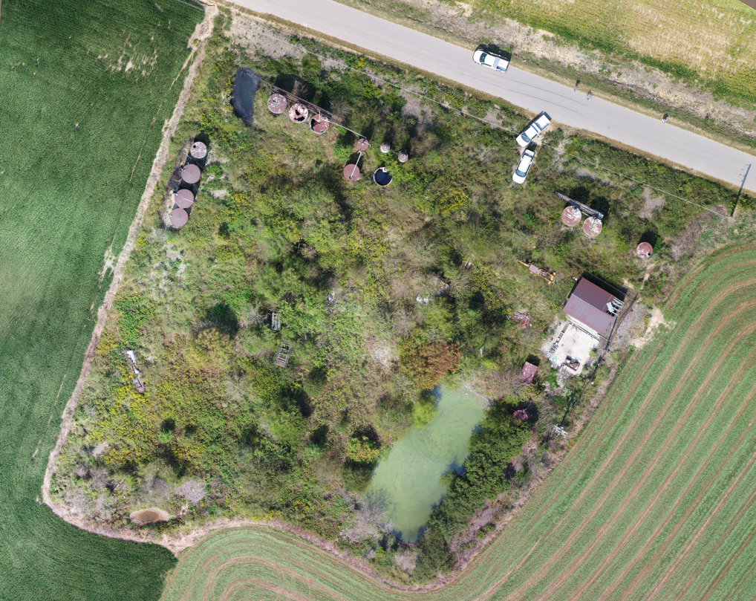
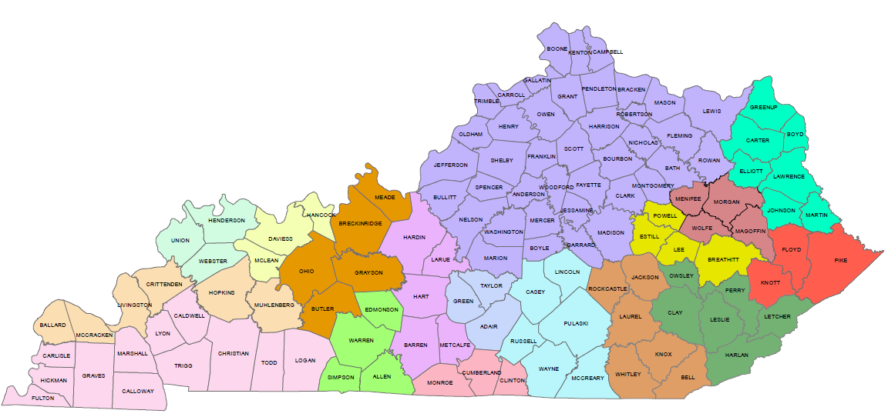
Site includes 18 total tanks, Lagoons, and additional facility equipment.

Slide 39
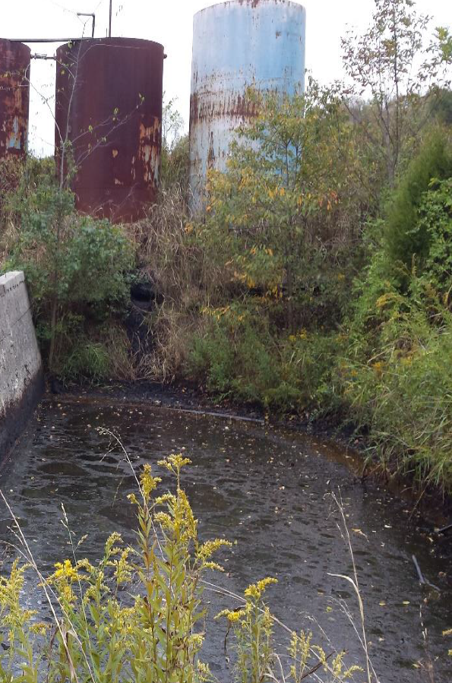
Hopkins Co., KY
1 -100 bbl tank leaking
1 - wooden tank, soil saturated
Fluids discharged
Warren Co., KY
4 of 6 tanks leaking crude oil

Slide 40
Henderson Co., KY
2 - 100 bbl tanks leaking
1 - 100 bbl tank partially crushed
Fluids discharged

Slide 41
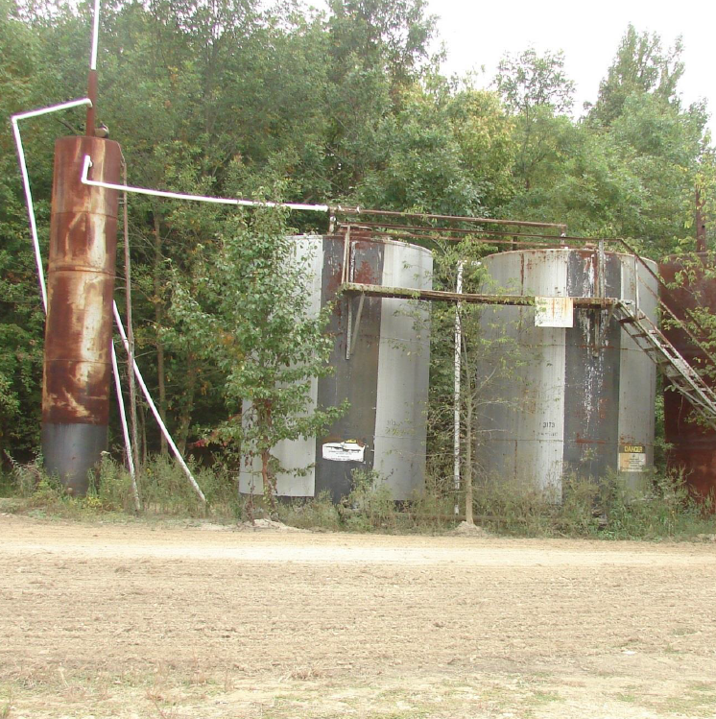
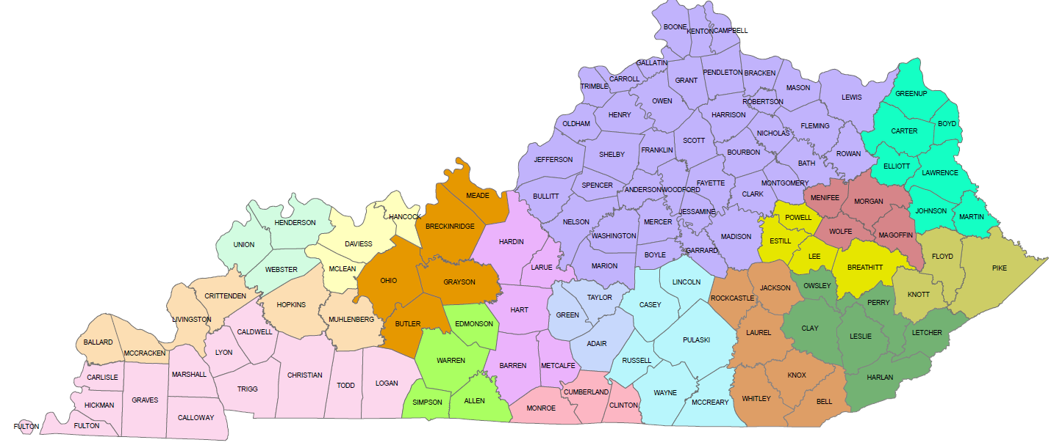
Muhlenburg Co., KY
1 - 100 bbl tank leaking
210 bbl cut open
Henderson Co., KY
2 - 210 bbl tank leaking
Impacts large Farm

Slide 42
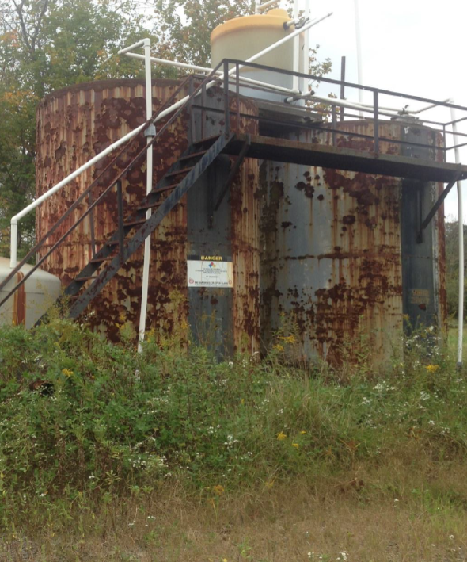
Wolfe Co., KY
2 - 210 bbl tank leaking
Daviess Co., KY
2 - 210 bbl tank leaking
1 - 50 bbl tank leaking
Flowline leaking

Slide 43
Lee Co., KY
7 Tanks in Heavily Recreated Area; Significant Leakage

Slide 44
Lee Co., KY
4 Tanks in Heavily Recreated Area; Significant Leakage

Slide 45
Elliott Co., KY
2 100 bbl. tanks; Significant Leakage Upstream of Residence

