Slide 1
COVID – 19 Regulatory Flexibility Policy Update Interim Joint Committee Meeting on Natural Resources & Energy June 4, 2020
Rebecca Goodman, Secretary
Gordon Slone, Commissioner DNR
John Lyons, Deputy Commissioner DEP

Slide 2
COVID-19 Implications for EPA’s Enforcement and Compliance Assurance Program
EPA Memorandum Overview:
Issued March 26, 2020 - Retroactive to March 13, 2020
Temporary policy regarding enforcement of environmental obligations where noncompliance occurs due to the COVID-19 pandemic.
Allows authorized states (Kentucky is a designated authority) to take different approach.
General conditions for entities seeking temporary relief of environmental compliance obligations.
Regulatory Obligation Examples:
Settlement & consent decree milestones;
Facility management & staffing levels;
Air, drinking water & wastewater limits;
Reporting & testing obligations; and
Hazardous waste management.

Slide 3
EEC COVID-19 Regulatory Flexibility Response & Process
May 15, 2020, memo issued by Secretary Goodman outlines process for regulated entities impacted by pandemic to request enforcement discretion for environmental obligations.
Used EPA’s March 26 memo as guidance for policy development.
EEC policy has been extended to June 30, 2020.
Conditions:
1. Regulated entities remain obligated to
ensure compliance with requirements;
2. When compliance is not possible, notification should be made to the
appropriate regulatory program; and
Documentation of noncompliance and actions to return to
compliance must be submitted to agency and maintained onsite.

Slide 4
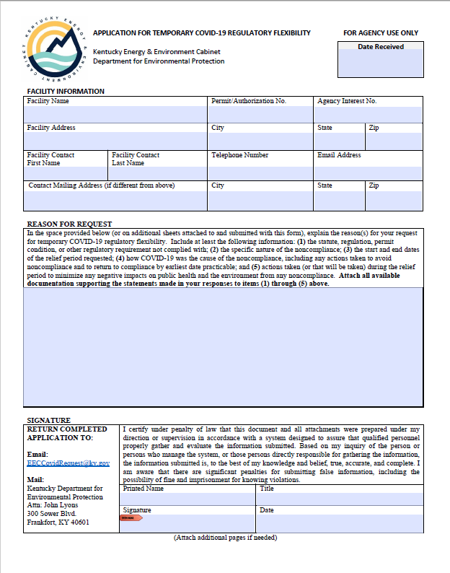
Documentation:
The specific regulatory or permit requirement not complied with;
A concise statement describing how the COVID emergency prevents compliance;
The duration of time that the noncompliance has persisted or will persist; and
The measures take to mitigate any negative impacts on public health and the environment from any noncompliance.

Slide 5
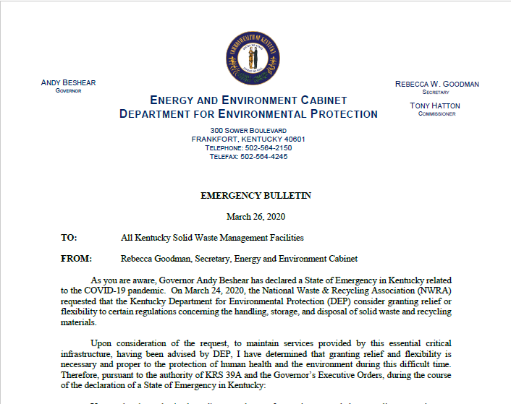
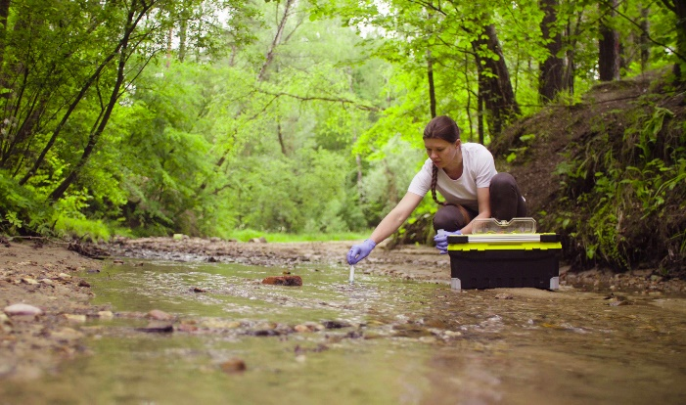
EEC COVID-19 Requests for Temporary Regulatory Flexibility
COVID-19 Regulatory Flexibility Committee
Program Waivers/Extensions: 7
Regulatory Flexibility Requests:
61
Inspections & Investigations
Pending Legal Actions

Slide 6
EEC COVID-19 Request Resources
EEC Covid-19 webpage:
https://eec.ky.gov/newsroom/Pages/Kentucky-EEC-COVID19.aspx
EEC Covid-19 Regulatory Flexibility Request Application: https://eec.ky.gov/Environmental-Protection/Documents/KY%20DEP%20Covid-19_Request_Form.pdf
Guidance Policy:
https://eec.ky.gov/Environmental-Protection/Documents/DEP%20Covid%20Statement.pdf
Requests Submitted To:
EECCovidRequest@ky.gov

Slide 7
Kentucky Coal Mines and COVID – 19
COVID – 19 has contributed to the uncertain conditions in Kentucky’s coal mining industry.
Permitting - Slight decrease in permitting actions.
The mining and mineral extraction industry was deemed a life-sustaining business.

Slide 8
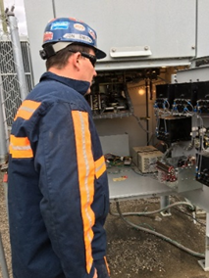
Division of Mine Safety
Miner certification expirations were extended for 120 days.
- Surface and underground annual
trainings.
- Mine Emergency Technicians.
COVID-19 requirements for the mining industry and the division response.
- Executive Order No. 2020-257 allowed life-
sustaining business to remain open.
- These industries must follow social distancing
and hygiene guidance from the CDC and the
Kentucky Department of Public Health.
- Healthy at Work

Slide 9
Division of Mine Permits
Coal Market Deferments
- 405 KAR 16:020 Section 5 allows
permittees granted coal market
deferment to defer the time criteria
for coal removal and contemporaneous
reclamation.
- The Division of Mine Permits has seen
an increase in the requests for coal
market deferments.
- The division has committed to
providing expedited review of
deferment requests.

Slide 10
Questions ???
THANKS
REBECCA GOODMAN SECRETARY ENERGY & ENVIRONMENT CABINET REBECCA.GOODMAN@KY.GOV 502-782-7075 | GORDON SLONE COMMISSIONER DEPARTMENT OF NATURAL RESOURCES GORDON.SLONE@KY.GOV 502-782-6773 | JOHN LYONS DEPUTY COMMISSIONER DEPARTMENT FOR ENVIRONMENTAL PROTECTION JOHN.LYONS@KY.GOV 502-782-2592

