Slide 1
Low Income Home Energy Assistance Program (LIHEAP) Preliminary State Plan Federal Fiscal Year (FFY) 2021
Cabinet for Health and Family Services (CHFS)
Department for Community Based Services (DCBS)
Division of Family Support
and
Community Action Kentucky, Inc. (CAK)
July 9, 2020

Slide 2
DCBS: Marta Miranda-Straub, Commissioner
Division of Service Regions
Division of Administration and Financial Mgmt.
Division of Child Care
Division of Family Support
Division of Protection and Permanency
Low Income Home Energy Assistance Program (LIHEAP)

Slide 3
HISTORY…
LIHEAP
Federal program established in 1981
Safety net focusing on heating and cooling assistance and energy conservation
Meets immediate home energy needs
DCBS partners with CAK to provide assistance in all 120 Kentucky counties
Anticipated $70.2M for 2021 program year
100% federally funded
Low Income Home Energy Assistance Program (LIHEAP)
Notes:
2021 projection-2nd and 3rd allotment (supplement) received in FFY 20 and CARES money plus the 21 LIHEAP Award. (minus 25% for Heating subsidy start up)

Slide 4
LIHEAP
HISTORY…
90% of funds are used to assist Kentucky residents
$400,000 is retained by DCBS for the Preventive Assistance Program to assist families receiving child protective services with energy payments
Up to 15% can be allocated for weatherization
Up to 10% is used for administrative costs
Low Income Home Energy Assistance Program (LIHEAP)

Slide 5
COVID Response
In order to maintain social distancing, community action agencies (CAAs) can utilize various means to complete applications including:
electronically;
by mail;
over the phone; or
office drop box
Some CAAs offer online scheduling for clients
Low Income Home Energy Assistance Program (LIHEAP)

Slide 6
CARES Funds
$900M was distributed nationwide in supplemental funding for LIHEAP FFY 2020
Of that $900M, Kentucky was awarded $13,745,001
This funding was provided to “prevent, prepare for, or respond to” home energy needs related to the national emergency created by COVID-19
Low Income Home Energy Assistance Program (LIHEAP)

Slide 7
CARES Funds, Cont.
CARES LIHEAP funding is being used to fund a new cooling program for Kentucky
The new program essentially creates year-round utility assistance for residents of the Commonwealth
Low Income Home Energy Assistance Program (LIHEAP)

Slide 8
LIHEAP
Benefits…
LIHEAP provides the following types of assistance to Kentucky residents:
Bill payment assistance year-round for heating and cooling:
- Subsidy component
- Crisis component
Emergency assistance
Weatherization activities to increase the energy efficiency, health, and safety of eligible low-income individual’s dwellings
Low Income Home Energy Assistance Program (LIHEAP)
Notes:
The five components of LIHEAP are (1) Heating Subsidy, (2) Heating Crisis, (3) Spring Subsidy, (4) Summer Cooling Crisis and (5) Summer Cooling Subsidy.

Slide 9
60% SMI in Kentucky
Eligibility:
SMI for 1 Person Household | SMI for 2 Person Household | SMI for 3 Person Household | SMI for 4 Person Household | SMI for 5 Person Household
$24,242 | $31,702 | $39,161 | $46,620 | $54,079
SMI is the state median income
The applicant must be responsible for the home heating/cooling costs or pay heating/cooling costs as a designated portion of rent

Slide 10
LIHEAP
LIHEAP Heating Subsidy Component:
Offsets home heating costs
Assistance amounts are structured according to percentage of poverty met by the household
Application period is open from early November through Mid-December
- Early applications occur in October for the elderly and those with disabilities
- Appointments are available for working individuals
Low Income Home Energy Assistance Program (LIHEAP)

Slide 11
LIHEAP
LIHEAP Heating Crisis Component:
Offers assistance for an energy emergency
Application period is open from January through April
Assistance is limited to the amount necessary to relieve the crisis with the maximum amount not to exceed community action agency’s local cost for a deliverable supply of household’s primary heating fuel or $600 for gas or electric
Low Income Home Energy Assistance Program (LIHEAP)

Slide 12
LIHEAP
LIHEAP Cooling Subsidy:
Offers assistance for summer cooling costs
Assistance amounts are structured according to percentage of poverty met by the household
Application period is open May through June
Low Income Home Energy Assistance Program (LIHEAP)
Notes:
Non-Subsidized Housing 0-100% $200 101-150% $150
Subsidized Housing 1-100% $50 101-150% $100

Slide 13
LIHEAP
LIHEAP Cooling Subsidy/Crisis:
Funds made available for emergency cooling assistance
Recipients may apply more than once up to the maximum amount of $600
Application period is open July through October
Low Income Home Energy Assistance Program (LIHEAP)
Notes:
Applicants may apply 1 X for subsidy July – Oct and up to the maximum amount of $600 for Crisis July-Oct.

Slide 14
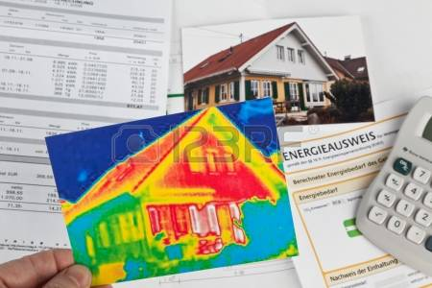
Weatherization Program…
LIHEAP
Funds home repairs related to energy efficiency
Serves low-income households whose incomes do not exceed 200% of the Federal Poverty Level
Low Income Home Energy Assistance Program (LIHEAP)

Slide 15
Weatherization Program…
LIHEAP
Prioritizes:
Households containing elderly, disabled, or children
Households with young children at risk of removal from the home due to substandard conditions
High energy burden households, where the energy costs exceeds 15% of the household’s income
Low Income Home Energy Assistance Program (LIHEAP)

Slide 16
Weatherization Program…
LIHEAP
Weatherization Program includes activities to increase the energy efficiency and reduce heating costs of dwellings:
-Installing insulation
-Refrigerator replacement
-Sealing air infiltration
-Heating system or water heater repair or replacement
Low Income Home Energy Assistance Program (LIHEAP)

Slide 17
LIHEAP
Weatherization Program…
Improves the health and safety of the dwelling and heating systems:
-Testing for gas leaks, carbon monoxide, and other health and safety issues
-Checking combustible appliances, such as stoves, furnaces, and water heaters
-Installing smoke and carbon monoxide detectors
-Energy education
Low Income Home Energy Assistance Program (LIHEAP)

Slide 18
State Fiscal Year 2020…
LIHEAP
75,291 households received subsidy benefits
-Average benefit: $137.68
-Total of $ 10.3 Million
122,417 households received crisis benefits
-Average benefit: $193.78
-Total of $23.7 Million
360 dwellings were weatherized
-Average benefit: $7,171
-Total of $2.6 Million
Low Income Home Energy Assistance Program (LIHEAP)
Notes:
TT-
The total benefit amount has increased to $600 due to COVID 19. The increase in utility benefit was necessary to make certain the federal funds were spent within the fiscal year. Also, the increase in benefits ensured that the LIHEAP crisis component better met the actual heating costs seen by eligible low-income households as a result of recent utility cost increases.
These figures are estimated at this point because we will not know expenditures with certainty until the State Fiscal Year close-out. Some carry-over is expected.

Slide 19
LIHEAP
Partnerships…
Low Income Home Energy Assistance Program (LIHEAP)
Notes:
RM

Slide 20
Partnerships…
LIHEAP
Partnership with CAK and the Kentucky Housing Corporation (KHC)
23 subcontracting agencies
Kentucky’s community action agencies administer LIHEAP in all Kentucky counties
Low Income Home Energy Assistance Program (LIHEAP)
Notes:
EC
LIHEAP services are provided through a historical and largely federally prescribed contractual arrangement.

Slide 22
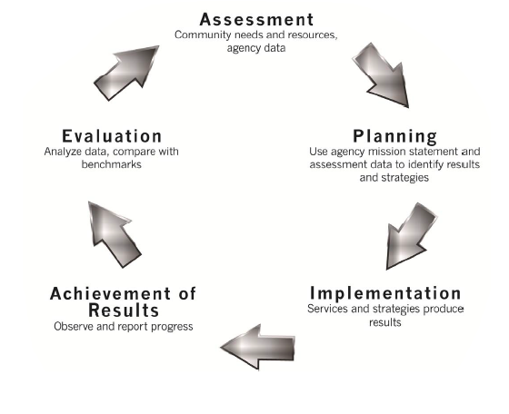
Community Action Kentucky, Inc.
CAK employs continuous quality improvement processes, including:
Change Committee
Manual updates based on technical assistance and monitoring trends for prior year
Data collection and analysis
Training and technical assistance to the Community Action Network
Low Income Home Energy Assistance Program (LIHEAP)
Notes:
RM

Slide 23
Low Income Home Energy Assistance Program (LIHEAP)
Questions?
Notes:
We would like to thank the committee for this opportunity to present. We at the table and representatives from the KY Housing Corporation are available to answer any questions.

