Slide 1
Interim Joint Committee on Natural Resources and Energy
November 18, 2020
Tyler Campbell
Executive Director

Slide 2
Kentucky Telecom Association Concerns with New Dig Law Proposal
New definition of “untonable/unlocatable facilities” serves to increase locate request times beyond all of Kentucky’s surrounding states.
All of Kentucky’s surrounding states and most states throughout the U.S. require locate requests to be completed within 2-3 working days.

Slide 3
Kentucky Telecom Association Concerns with New Dig Law Proposal
Normal locate requests deemed “untonable/unlocatable” would increase from current 2 working days to 5 working days.
Large project requests deemed “untonable/unlocatable” would increase from current 5 working days to 8 working days.
*(Based on last year’s version of the 811 bill draft. KTA has not seen the version for 2021 GA at time of preparing presentation.)*

Slide 4
Examples of Locate Request Times from Neighboring States

Slide 5
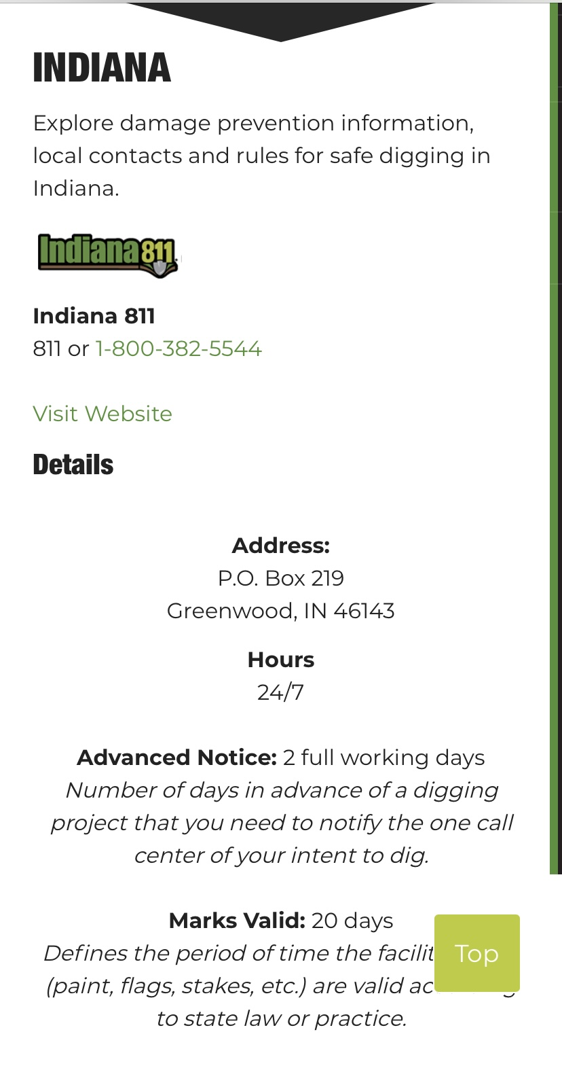

Slide 6
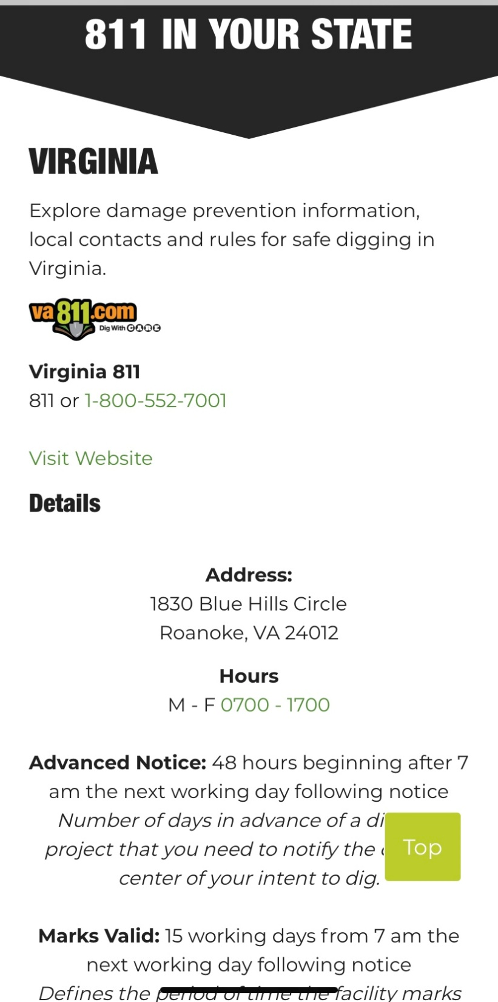

Slide 7
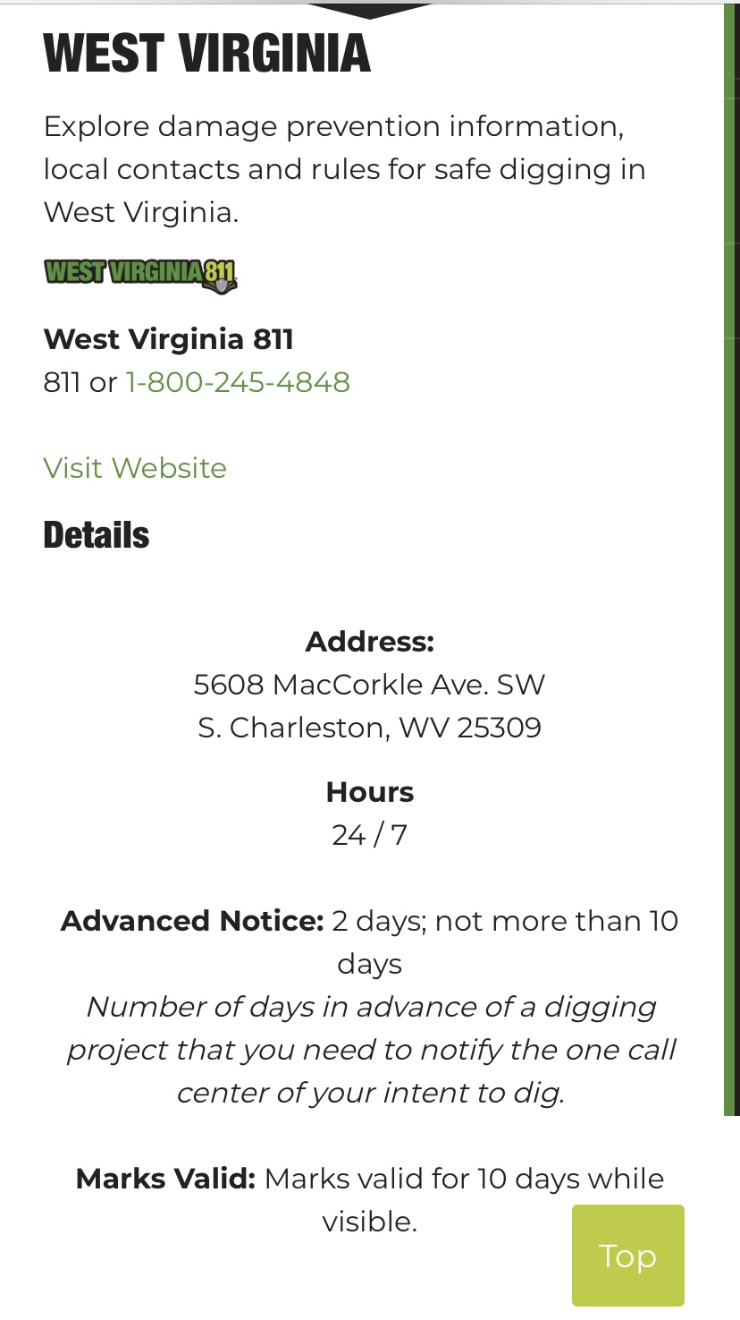

Slide 8
Kentucky Telecom Association Concerns with New Dig Law Proposal
There is no accuracy requirement associated with the new dig law proposal. Accuracy is already a problem for nonmetallic facilities.
Current law states nonmetallic facilities without metallic tracer wire must be located as accurately as possible based on field location records. This results in a wide interpretation of the current law and current practices to locate these facilities.
Without any type of accuracy requirement in the new dig law proposal, operators will have longer than any of KY’s surrounding states to try and locate their underground facilities, and many will still not be able to locate these facilities any more accurately than today. This does not improve on the problems with KY’s existing dig law.

Slide 9
Kentucky Telecom Association Concerns with New Dig Law Proposal
The demand for broadband deployment has never been higher and Kentucky’s rural broadband providers continually work to expand broadband deployment in their rural communities.
Additional delays in locate request times in rural areas will result in delays to future fiber construction projects and will serve to drive up the cost of broadband deployment.

Slide 10
QUESTIONS?
Tyler Campbell
Executive Director
Kentucky Telecom Association
305 Ann Street, Ste 202
Frankfort, KY 40601
502.699.2206

